Slide 1
Teaching on Shift in Emergency Medicine
Module 4: Teaching Techniques
Notes:
Hello, welcome to module 4. Here we wanted to discuss some miscellaneous teaching techniques that can be used for learners of all types of levels. These are evidence-based methods that have been shown to improve learning while on shift.

Slide 2
Objectives
Examine four general teaching techniques aimed at ALL learners
Understand the key tips to make these work as well as pearls and pitfalls for each technique
Notes:
Here are out objectives
We will be sharing four teaching techniques that can be used during a shift on any type of learner
Each of these techniques requires practice to get right, so we will help you out with some pearls and pitfalls you need to know for each of them

Slide 3
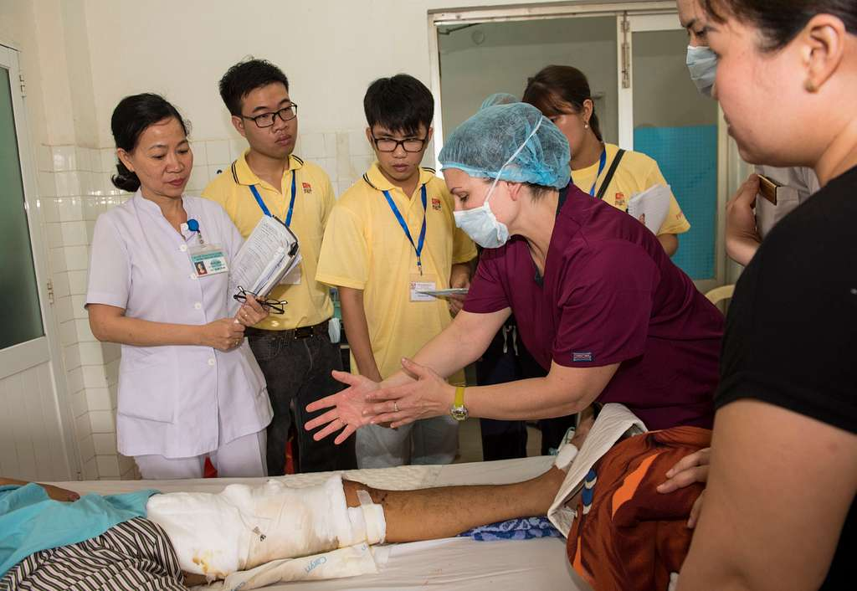
Skill 1: Bedside Presentations
Notes:
Lets start with our first technique. This technique is your traditional presentation at the bedside of the patient. The learner gives their presentation, including history of present illness, past medical history, exam, and plan in front of the patient.
Team members are introduced to the patient and patient oriented to goal of teaching rounds.
Benefits of this are that it is a familiar setting and technique.
Reference: Natesan S, Bailitz J, King A, Krzyzaniak SM, Kennedy SK, Kim AJ, Byyny R, Gottlieb M. Clinical Teaching: An Evidence-based Guide to Best Practices from the Council of Emergency Medicine Residency Directors. West J Emerg Med. 2020 Jul 3;21(4):985-998. doi: 10.5811/westjem.2020.4.46060. PMID: 32726274;

Slide 4
Skill 1: Bedside Presentations
TIPS
Set the stage
Ask patient and family for clarifications after presentation
Assign team members to other tasks during the presentation
PEARLS & PITFALLS
Round with the entire team when possible
Set expectations
Avoid using medical jargon and hypothetical scenarios
Notes:
Tips to make this work include: setting the stage beforehand, including asking the patient and family to listen to the presentation without interruption with time for clarification after. It may be helpful to prep the presenter beforehand, have them practice with a member of the team if this is their first time presenting in front of a patient. Another tip is to assign roles to team members, including jotting down feedback for learner, entering orders, writing notes.
It is important to utilize patient-centered communication to ensure understanding and respect.
This technique works best when the entire team is available to round; and it is important to set expectations of the learner and avoid using medical jargon or having hypothetical discussions in front of the patient
Reference: Natesan S, Bailitz J, King A, Krzyzaniak SM, Kennedy SK, Kim AJ, Byyny R, Gottlieb M. Clinical Teaching: An Evidence-based Guide to Best Practices from the Council of Emergency Medicine Residency Directors. West J Emerg Med. 2020 Jul 3;21(4):985-998. doi: 10.5811/westjem.2020.4.46060. PMID: 32726274;

Slide 5
Skill 2: ED STAT
E
Expectations​
D
Diagnose the Learner​
S
Set-Up​
T
Teach​
A
Assess and Give Feedback​
T
Teacher Always (Role Model)
Notes:
Moving on, our next technique is an aptly named method called ED STAT, because we work in the ED and all our teaching needs to be STAT! ED STAT stands for:
Emergency Department Strategies for Teaching Any Time.
This technique outlines the format of a learner encounter using the mnemonic ED STAT
The first two steps occur at the beginning of the rotation or time period spent with the learner.
The educator should begin by setting expectations for shifts and orienting them to their clinical setting and how they would prefer the learner pick cases or present them.
The educator should then try to understand the level of of the learner. The educator can ask questions about what types of cases the learner finds challenging or what the learner would like feedback on or what skills they are developing. This will provide information about the learner’s current skill level.
Next, using a specific patient case, pose a question to the learner that will set-up be the teaching moment. For example: to focus on clinical reasoning, a preceptor could ask “if this patient has low back pain, what are the red flags you should ask about in taking a history?” If the focus is on management, the question could be related to admission or discharge of a patient with pneumonia.
Provide high yield, concise teachings to the learner and refer them to resources to further develop their knowledge.
Then provide constructive feedback to the learner, ensuring they are involved in the process by asking for self-reflection.
Make sure to role model professional behavior during the interaction. Be aware of body language and nonverbal communication, as well as including information about whether statements made are opinions or facts.
Reference: Chinai SA, Guth T, Lovell E, Epter M. Taking Advantage of the Teachable Moment: A Review of Learner-Centered Clinical Teaching Models. West J Emerg Med. 2018 Jan;19(1):28-34. doi: 10.5811/westjem.2017.8.35277. Epub 2017 Dec 5. PMID: 29383053; PMCID: PMC5785198.

Slide 6
Skill 2: ED STAT
TIPS
Make sure to understand the level of the learner at the onset
PEARLS & PITFALLS
Designed for ED setting
Educator may require some type of instruction in this method prior to use
Notes:
This technique works best when you make an effort to understand the level of the learner at the onset.
Once the expectations have been set and your learner has been assessed, the “STAT” portion of this model can be repeated over the course of a shift working together with every sequential patient
This is intended for the ED environment, but it may require a little more information prior to adapting this model. Remember there are steps for the beginning of the shift or rotation to make this technique optimal
Reference: Chinai SA, Guth T, Lovell E, Epter M. Taking Advantage of the Teachable Moment: A Review of Learner-Centered Clinical Teaching Models. West J Emerg Med. 2018 Jan;19(1):28-34. doi: 10.5811/westjem.2017.8.35277. Epub 2017 Dec 5. PMID: 29383053; PMCID: PMC5785198.

Slide 7
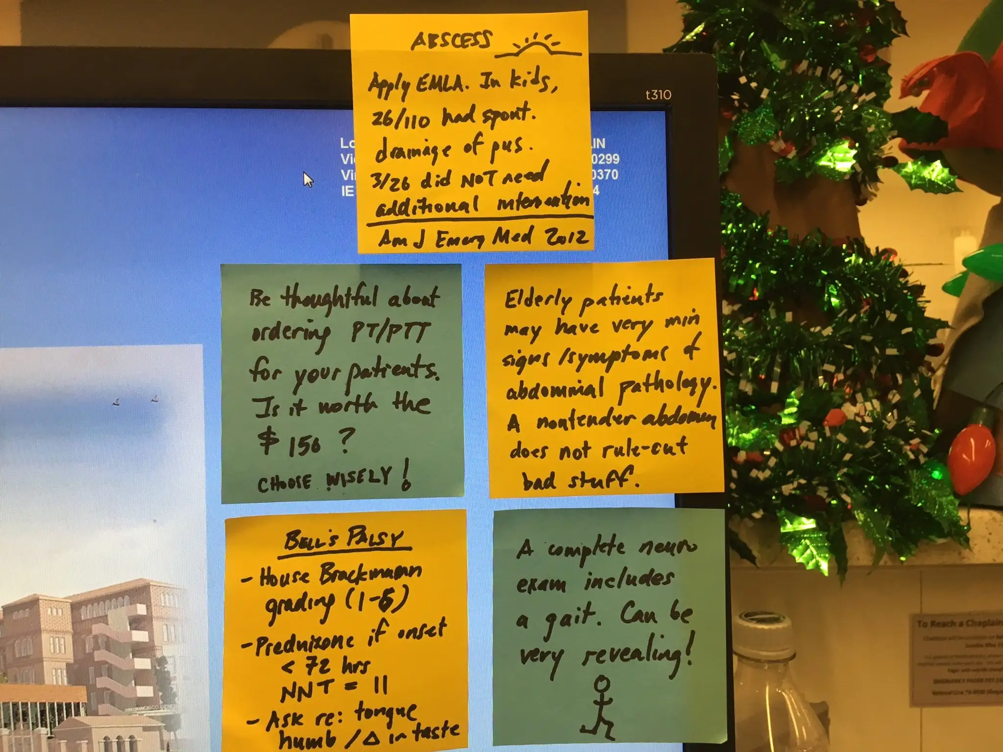
Skill 3: Post-it Pearls
Image source: https://www.aliem.com/post-it-pearls-bedside-teaching/
Notes:
Now lets discuss a very colorful and highly regarded technique called post-it pearls!
This technique involves writing key learning points as you go during a clinical shift onto a post-it note or white board displayed for all learners, then reviewing the topic at the end of the shift.
This is a great visual representation of the teaching occurring during a shift. Learners can also photograph this for review after the shift.
Make it fun! Some faculty compete with other faculty in other areas of the ED to see how many teaching post-its can be made during a shift!
Reference: Lin M. New Year’s Resolution | Post-It Pearls - Back to basics with bedside teaching. 2017 Jan. https://www.aliem.com/post-it-pearls-bedside-teaching/.

Slide 8
Skill 3: Post-it Pearls
TIPS
Have some teaching pearls prepared for high frequency cases
PEARLS & PITFALLS
Flexibility and ease of use
Succinct
Educational content can be unpredictable
Notes:
To maximize this technique, you ideally have a few teaching pearls prepared for high frequency cases or issues. This type of skills is one that builds on itself the more you use it, as you start to develop high yield pearls that you can use for various situations
A benefit of this technique is that it can be used in the midst of a busy shift. By coming back to the topic at the end, you have the flexibility to continue patient management without interruptions while also teaching pertinent information.
By placing on a post-it, learning points must be succinct and brief, allowing for focused education. This prevents you from accidentally going too far into the weeds and teaching for too long, hence losing learner attention.
Learners can also benefit by photographing the note for review after the shift.
A downside to this technique is that educational content can be unpredictable, so it can be difficult to prepare for topics which may arise. Fortunately, as ED docs, we are the jack of all trades and tend to have comfort with navigating through the unknown!
Reference: Lin M. New Year’s Resolution | Post-It Pearls - Back to basics with bedside teaching. 2017 Jan. https://www.aliem.com/post-it-pearls-bedside-teaching/.

Slide 9
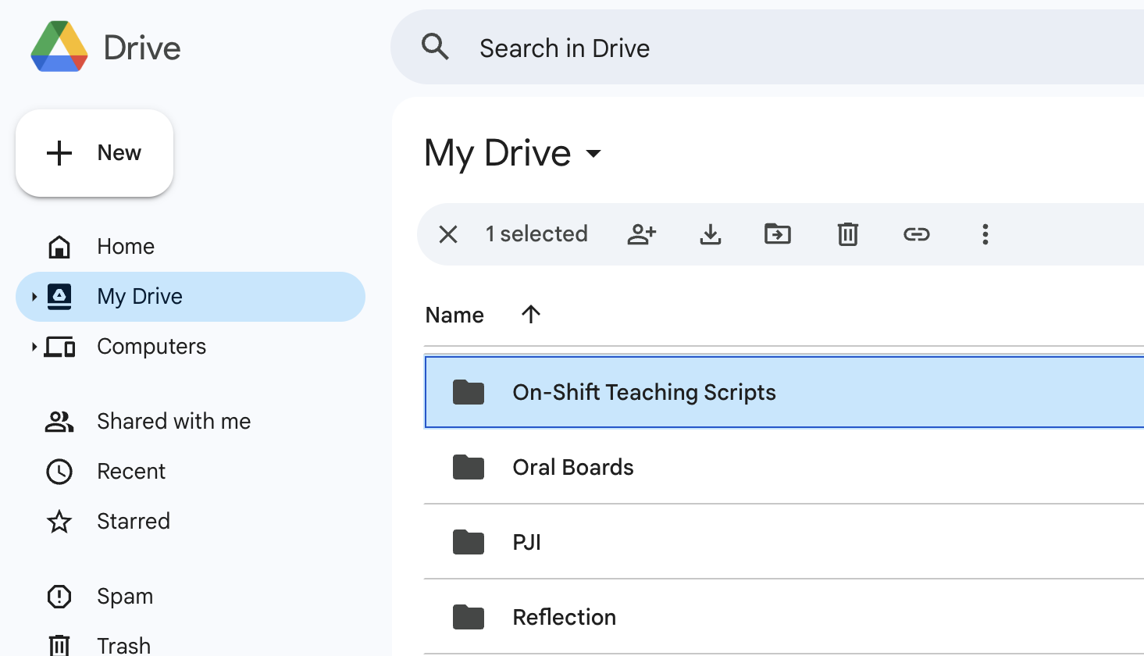
Skill 4: Teaching Scripts
Notes:
Teaching Scripts are prepared mini-lectures targeting a specific concept that the instructor has previously memorized.
These can come with accessory media or figures kept in a flash drive or online storage (such as google drive or dropbox), or even a physical folder for old-school educators!
Sample topics may include management of a common critical situation (such as hyperkalemia or DKA), red flag signs and symptoms for a chief complaint (such as for back pain or headache), or interpretation of lab findings (such as AG acidosis or evaluation of anemia).

Slide 10
Skill 4: Teaching Scripts
TIPS
Avoid too much content
PEARLS & PITFALLS
Consider "what if" scenarios
Need some preparation ahead of time
Ideally occur during lulls in patient care
Notes:
It is important to avoid too much content in these mini-lectures and focus on 2-3 teaching points for each topic.
Remember, in a lecture hall a learner has maximum 7 minutes of attention. And that is when they have no clinical responsibilities. in the clinical setting your learner will have closer to 2 minutes of attention. These lectures must be brief and to the point.
It is helpful to develop a full teaching script and then edit down into smaller mini-scripts
These are also useful for “What if” scenarios – for example, what if this patient with back pain had a fever, what if they used IVDU. This can easily turn into a teaching script for the red flags of back pain.
These do require a little preparation ahead of time and ideally occur during lulls in patient care, which can be a rare occurrence in some EDs!
Start saving up your teaching scripts during shifts for future use.
BONUS TIP- Take photos of your post-it pearls and you can use these as teaching scripts for the future!
References:
Green GM, Chen EH. Top 10 ideas to improve your bedside teaching in a busy emergency department. Emerg Med J. 2015 Jan;32(1):76-7. doi: 10.1136/emermed-2014-204211.
Natesan S, Bailitz J, King A, Krzyzaniak SM, Kennedy SK, Kim AJ, Byyny R, Gottlieb M. Clinical Teaching: An Evidence-based Guide to Best Practices from the Council of Emergency Medicine Residency Directors. West J Emerg Med. 2020 Jul 3;21(4):985-998. doi: 10.5811/westjem.2020.4.46060. PMID: 32726274;

Slide 11
Take-home points
Knowing a few techniques you can use with any learner will make teaching on shift easier
Bedside presentations can be used to assess the learner’s history-taking skills
ED-STAT is a general way to approach a new learner
Post-it pearls and teaching scripts are great tools to have prepared for anytime teaching
Notes:
Now before you go, lets review some important points from this topic
It is good to practice and become proficient at a few different teaching techniques that you can use in different situations!
Bedside teaching is a tried and true method, and if perfected, can be a very useful teaching tool for certain situations
ED STAT is a longitudinal method that can help, especially if you know the learner and have more time with them.
Finally, if you are going to be teaching learners in the long run, it is good to start developing post-it pearls and teaching scripts to make it easier for you in the future

Slide 12
Notes:
It is time for our post-curriculum activity. Use the Activity Printout accompaniment for this module to assist with the exercise questions

Slide 13
Practice
For the following 3 patient chief complaints, use a post-it or blank paper to write down teaching points to discuss with a learner:
30 yo presenting in DKA
60 yo with sudden onset headache
70 yo suspected esophageal foreign body
25 yo with acute SOB and clear lungs

Slide 14
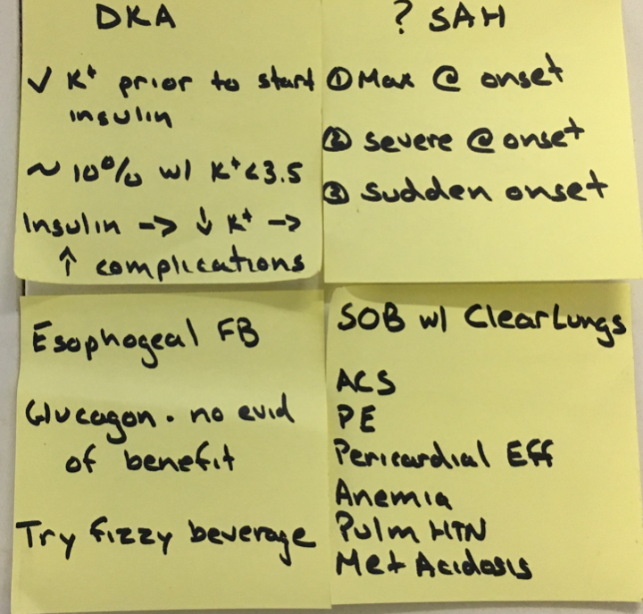
Practice
Notes:
Here are some examples (answers) of post-it pearls that you can use for those cases.

Slide 15
Questions?
Comments?
Concerns?
Opinions?
Anecdotes?
Monologues?
Diatribes?
Riddles?

