Slide 1
Teaching on Shift in Emergency Medicine
Module 2: The Novice Learner
Notes:
One of the most common type of learner that we often will experience would be the novice learner. Whether this learner is still a student, an early resident, an APP or a part of the support staff, it is our duties to learn how to properly teach them while on shift.

Slide 2
Objectives
Define the "novice learner" in the Emergency Department setting
Describe the following teaching techniques for novice learners:
Two-minute observation
Aunt Minnie
SPIT
Activated demonstrations
Discuss and reflect on application of
techniques
Notes:
During this session we plan to:
Identify and define the novice learner, discuss their baseline skills
We will cover four teaching techniques for this group including: two minute observation, aunt minnie, SPIT, and activated demonstrations
We will then have time to allow the group to practice one of these techniques
In addition, throughout our presentation and at the end, we will list additional resources for those interested in getting to know more about these topics

Slide 3
Who is the novice learner?
Not based on level of training
Is defined by skill, experience & background
Notes:
So let’s start with who is the “novice learner and what does this mean?”
First off, it is not based on time in training; when we define this we are not going to use terms based on post grad year or year in medical school.
This is defined by skill, experience, and background

Slide 4
Who is the novice learner?
REPORTER
R
INTERPRETER
I
MANAGER
M
EDUCATOR
E
Notes:
Generally, these learners should be thought of as being on the reporter and interpreter role of the RIME framework (as a reminder that stands for reporter, interpreter, manager and educator)
Let's take a look at the abilities of the reporter/interpreter level learners on the next slide
Reference: Pangaro L. A new vocabulary and other innovations for improving descriptive in-training evaluations. Acad Med. 1999;74:1203–1207.

Slide 5
Skills of a novice learner
Ask
Develop
Prioritize
Notes:
The novice learner should be able to:
Ask ask the right questions to collect data from patients (most of the time)
Develop a preliminary list of differential diagnoses based on the data collected
Prioritize a list of most likely to least likely diagnoses with guidance

Slide 6
Goals of the novice learner
Apply knowledge from classroom and textbook
Learn practical skills from experts in the field
Build pattern recognition and inventory of experiences
Notes:
The novice learner has their own goals – they want to:
Apply knowledge from the classroom and textbook
Learn practical knowledge from experts in the field
Build pattern recognition and inventory of experiences

Slide 7
Teaching Techniques
Two-minute observation
Aunt Minnie
SPIT
Activated demonstrations
Notes:
The techniques reviewed in this presentation are geared toward the novice learner. Here we have:
Two-minute observation
Aunt Minnie
SPIT
Activated demonstrations

Slide 8
Skill 1: Two Minute Observation
Goals:
Review fundamentals of history taking
Real time observation of patient interactions
Pearls:
Explain the process to the learner and the patient
Avoid jumping in to allow learner independence
Pitfalls:
Not the best technique if time is limited for debriefing
Notes:
Let's start with the two-minute observation is just that.
The clinician observes the student-patient interaction for 2 minutes only, slipping out of the room after this time period. This is ideally the first 2 minutes of the interaction, so that the history is observed.
The educator should make sure to explain the process to both the learner and the patient and should avoid interrupting the interaction.
In a private setting following the observation, you will then debrief what you observed during the encounter. During this debrief, it is good to do the following:
Ask you learner for reflections on the encounter
Give feedback to learner, utilizing their self-reflection as a guide
References:
Green GM, Chen EH. Top 10 ideas to improve your bedside teaching in a busy emergency department. Emerg Med J. 2015 Jan;32(1):76-7. doi: 10.1136/emermed-2014-204211.
Irby DM, Wilkerson L. Teaching when time is limited. BMJ. 2008;336(7640):384-387. doi:10.1136/bmj.39456.727199.

Slide 9
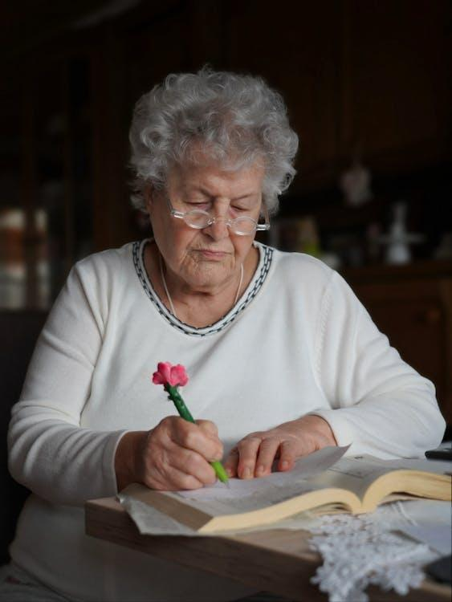
Skill 2: Aunt Minnie
Benefit:
Good for low volume days
Promotes rapid pattern recognition.
Be sure to:
Explain process to learner
Strategically select patients
Avoid:
Rare or complex presentations
Notes:
Aunt Minnie is a technique to build pattern recognition with a learner. This is a good tool to use with junior learners when the day might otherwise be relatively routine and without any unique or interesting patients.
It’s important to explain to the learner ahead of time what you plan to do and pick the patient that this technique will be used on strategically.
Presentations that are more bread and butter or more classic are the best choice for the use of this teaching skill.
Rare, complex cases are not appropriate as the learner likely will not be able to utilize or build rapid pattern recognition in these scenarios.
Reference: Irby DM, Wilkerson L. Teaching when time is limited. BMJ. 2008;336(7640):384-387. doi:10.1136/bmj.39456.727199.AD

Slide 10
Skill 2: Aunt Minnie
Learner sees patient, does H&P
Learner presents only the chief complaint and presumed diagnosis
Preceptor sees patient
Preceptor discusses patient with learner
Notes:
This technique is based on the idea that you can easily recognize your Aunt Minnie from a mile away based on her special unique characteristics (whether it is how she dresses, the sound of her heels when she walks, her perfume, her voice or demeanor…etc), even if you can't see her face.
In medicine, this is attune to the old adage- “If you hear hooves, think horses not zebras” i.e. use pattern recognition to identify common presentations of common diagnoses. ​
How to do it:
The learner sees the patient, presents the chief complaint and their presumed diagnosis. While they are writing the note, you go and see the patient, considering their presumed diagnosis. You then discuss the case, focusing on questioning the learner as to why they came to the presumed diagnosis.
For example, the student sees someone with RLQ abdominal pain. They then present a chief complaint of RLQ pain and a diagnosis of appendicitis. The preceptor then sees the patient. If the patient indeed has classic findings of appendicitis (mcburney’s point tenderness, fever, anorexia), then the preceptor positively reinforces this as a correct answer. However, if the case seems more like a kidney stone (sudden right flank pain, vomiting, hematuria), then the preceptor can discuss what elements led the learner to a diagnosis of appendicitis and why the preceptor instead thinks ureterolithiasis is more likely.

Slide 11
Skill 3: SPIT
Serious
Probable
Interesting
Treatable
Notes:
Some learners struggle to think of ways to create a broad and powerful list of differential diagnoses for patients in the Emergency Department.
The SPIT technique can be used to help expand a learner’s thought on what the diagnosis could be.
This is especially helpful for learners who often present a narrow differential.
How it works- You can advice your learners that when they are writing down their list of differential diagnosis, they should:
First think about the serious (life threatening) things this could be
Next what is the most probable thing this could be
Since “the eyes don't see what the mind doesn't know”, it is always good to consider some interesting or rare diagnoses that might fit with the presentation.
Finally, you should look at the patient and consider any aspects of their presentation that are treatable (smoking, unmanaged hypertension, obesity, inability to pay for prescriptions, social issues…etc)
You can further expand this to ask what history, exam or diagnostic testing findings would make each of these diagnoses more likely.
For example, a learner sees a patient with RLQ pain. A selection of differentials includes:
Serious: malignancy such as colon cancer
Probable: appendicitis
Interesting: Yersinia enterocolitis
Treatable: groin strain, constipation, poor conditioning
Reference: Chinai SA, Guth T, Lovell E, Epter M. Taking Advantage of the Teachable Moment: A Review of Learner-Centered Clinical Teaching Models. West J Emerg Med. 2018 Jan;19(1):28-34. doi: 10.5811/westjem.2017.8.35277. Epub 2017 Dec 5.

Slide 12
Skill 4: Activated Demonstrations
Educator introduces a skill to be observed
Example: “Watch how I take a psychiatric history.”
Frame
Learner observes educator perform the skill
Observe
Educator facilitates reflection by the learner and helps them set future goals
Reflect
Notes:
Finally, let’s discuss Activated Demonstrations, which is a type of apprenticeship model. In this technique, the educator frames the interaction by introducing a skill to be observed.
This could be a clinical skill such as a history, exam or could be a procedure such as placing a central line or leading a code.
The learner then observes the educator perform the skill.
Following this, the educator facilitates reflection by the learner and sets some follow up goals in terms of next steps for the learner
References:
Green GM, Chen EH. Top 10 ideas to improve your bedside teaching in a busy emergency department. Emerg Med J. 2015 Jan;32(1):76-7.
Irby DM, Wilkerson L. Teaching when time is limited. BMJ. 2008;336(7640):384-387. doi:10.1136/bmj.39456.727199.AD

Slide 13
Skill 4: Activated Demonstrations
Benefit:
Allows learner to gain experience by observation of an expert
Can be utilized when time is limited
Can be used for procedural and non- procedural skills
Be sure to:
Create time for reflection and discussion following the observation
Notes:
The benefits to this type of apprenticeship model is that the learner can learn a skill directly from an expert, especially during times when the ED is very busy.
However, the final part, “reflection” is key, as this is the part where the learner can imagine how they will apply this skills in the future

Slide 14
Take-Home Points
When working with a novice learner:
help them ask the right questions
develop a preliminary list of differential diagnoses
prioritize their differential based on most and least likely
Understand the goals of a novice learner:
apply the knowledge they have from the classroom
learn practical skills that will help them in the future
build their pattern recognition
Notes:
In conclusion,
The novice learner should be able to:
Ask the right questions to collect data from patients (most of the time)
Develop a preliminary list of differential diagnoses based on the data collected
Prioritize a list of most likely to least likely diagnoses with guidance
The novice learner wants to:
Apply knowledge from the classroom and textbook
Learn practical knowledge from experts in the field
Build pattern recognition and inventory of experiences
The following skills can be helpful when guiding the novice learner:
Two-minute Observation
Aunt Minnie
SPIT
Activated Demonstrations

Slide 15
Take-Home Points
There are various techniques that can be helpful when guiding the novice learner. Remember:
Two-minute Observation
Aunt Minnie
SPIT
Activated Demonstrations
Notes:
In conclusion,
The novice learner should be able to:
Ask the right questions to collect data from patients (most of the time)
Develop a preliminary list of differential diagnoses based on the data collected
Prioritize a list of most likely to least likely diagnoses with guidance
The novice learner wants to:
Apply knowledge from the classroom and textbook
Learn practical knowledge from experts in the field
Build pattern recognition and inventory of experiences
The following skills can be helpful when guiding the novice learner:
Two-minute Observation
Aunt Minnie
SPIT
Activated Demonstrations

Slide 16
Notes:
It is time for our post-curriculum activity. Use the Activity Printout accompaniment for this module to assist with the exercise questions

Slide 17
Activity
Think- Pair-Share
Of the skills we reviewed, can you think of an opportunity you may have had on your past few shifts to use one of these?
Two minute observation
Aunt Minnie
SPIT
Activated Demonstrations
Pair up with your neighbor and Share how you have used one of these
Notes:
Think pair share or we could ask them, how do some of these techniques improve any challenges you may see working with a novice learner?

Slide 18
Questions?

