Slide 1
Case Studies in Overcoming Barriers to Building EM Research Programs
Andra Blomkalns, MD, MBA
Nathan Kuppermann, MD, MPH
Robert W. Neumar, MD, PhD
Peter E. Sokolove, MD

Slide 2
MINIONS
Creating a Research Associate Program
Andra L. Blomkalns, MD, MBA
(Allyson C Sage, MD & Daniel Nishijima,, MD)
Redlich Family Endowed Professor
Stanford Emergency Medicine
AACEM/AAAEM Retreat 2024
Notes:
So far who has research associate program (nomenclature)? Undergrads? Medical students?
UC David since 2000
Why - Clinical research workforce, great monitoring opportunity, attract people to EMED (pathways)
Who – Gen Z
How - Formal student course
Why Not? – Turnover, training,
Chief EMRAP, which is the
only paid position (Student Assistant IV)
the Vice Chief; Head Trainer; Senior Trainers
Public Relations lead; Education and Development Lead; and 10-15 students who have passed exams and are designated as trainers. The number of active students varies between
60-80 per quarter; right now we have 72 active students on our roster.

Slide 3
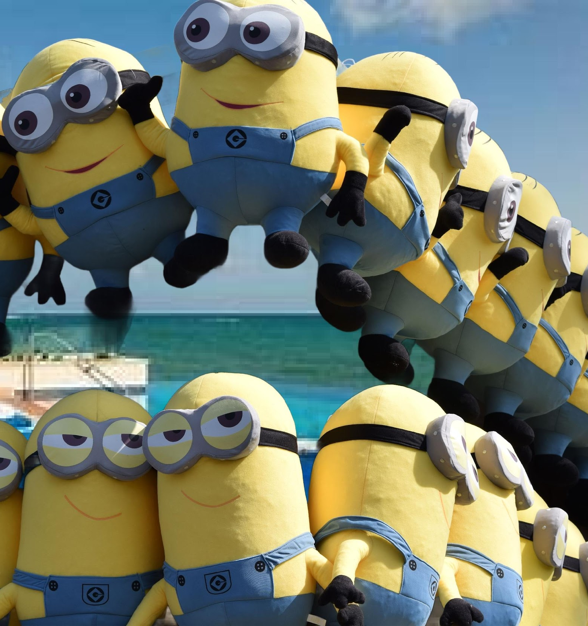
WHO
Undergraduate students
Medical student
Paid model

Slide 4
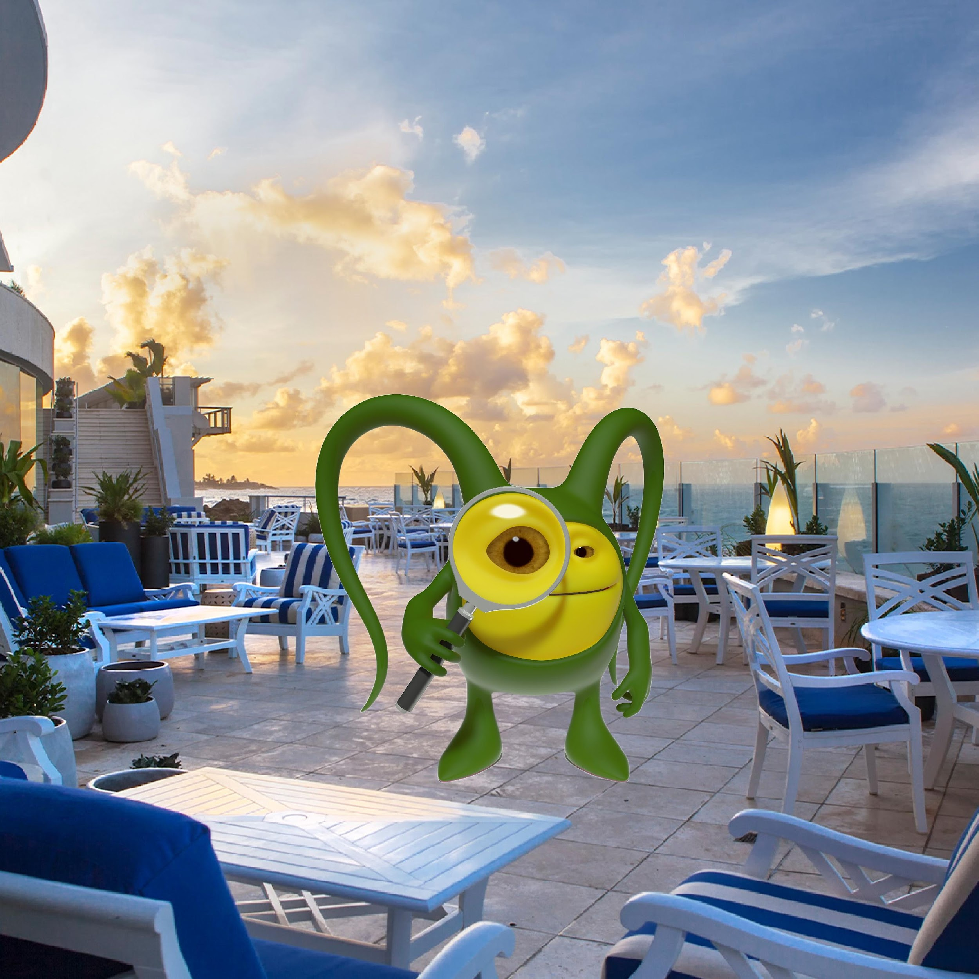
WHY
Research productivity
Financial/ready- made workforce
Mentoring next generation

Slide 5
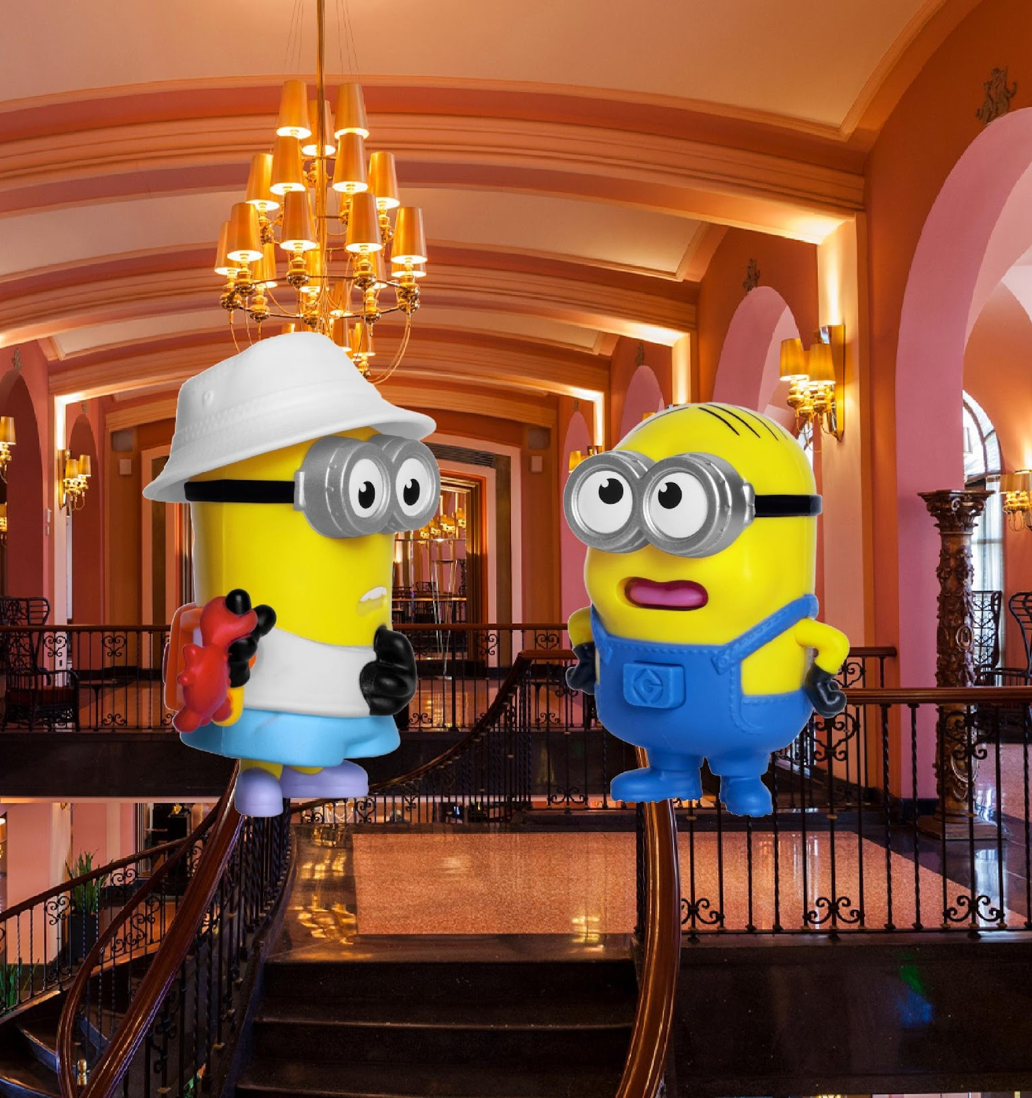
Infrastructure
Administration
Leadership
Staffing

Slide 6
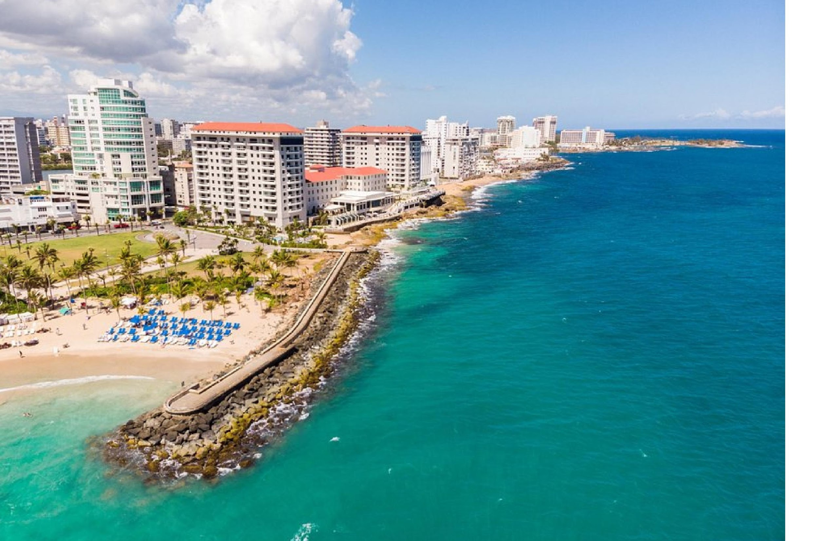
Discussion
Novel models
Pitfalls
Sharing resources

Slide 7
Building an Emergency Medicine Research Program:
Thinking creatively outside of the doc-box
Nathan Kuppermann, M.D., M.P.H.
March 19th, 2024

Slide 8
First steps
Faculty with research interests
Develop faculty researchers and leaders
T-awards, K-awards
Examine existing funding and infrastructure
Current or pending grants to support research
Clinical trial contracts with industry
Support from the health system
Nurture/hire Staff interested in clinical research
Notes:
Identify faculty with an interest in conducting research. Clinical faculty can also be productive
What grants or contracts are available that can support clinical research personnel?
Recruit staff with research experience and build around them

Slide 9
Develop the staff infrastructure
Dedicated space for staff and research files
Training and education
Basic lab equipment
Micropipettes, refrigerator, centrifuge, ultralow freezer
Notes:
If possible, identify administrative space for your team but it’s also important to have space in the ED
Utilize institutional training in research from your CTSA, etc. Encourage staff to attend training or obtain certification in clinical research
Invest in basic equipment which increases the chance for site selection for industry studies and trials

Slide 10
Build on different funding sources
In Vitro Diagnostic Studies
Phase II or Phase III clinical trials
Short-term studies work best
Can partner with other Departments
Federal funding including:
NIH, PCORI, AHRQ, CDC, HRSA, others
Try to become part of a network:
SIREN, PECARN, others
Notes:
In Vitro diagnostic studies (collecting blood to test new diagnostics) are generally easy to do in the ED setting
Phase II or Phase III drug studies can be done but you may want to avoid trials with a lot of demands on clinical staff or that require long-term follow-up
If you partner with inpatient Depts the ED staff can recruit/enroll and then pass longer term study procedures to other Dept

Slide 11
Create flexible staffing models
Build upon experienced research personnel
Positions should have different levels, different terms
Spread staffing across different shifts
Ensure career ladder opportunities
Develop a student intern program
Placement for staff needing temporary accommodations
Notes:
Start with your core experienced research staff and build around them
Staffing hours should mirror when patients are present, especially evening hours and weekends if possible
As you build staff, create different staffing levels such as Associate, Senior, Supervisory levels
Personnel costs are the biggest expense – create opportunities for undergraduate or medical student volunteers to participate and enhance your program
Sometimes nurses need temporary accommodations due to an injury – they can be quickly trained in research to help your program, and their salary is paid by their home unit

Slide 12
Important members of a novel team
Vice Chair for Research
Departmental research manager(s)
Regulatory specialist
(Part-time) statistician
Multiple research coordinators
Communications /dissemination specialist
Grant writer
PhD investigator(s)
Involve residents, RNS, APPS
Build a culture of research, innovation, creativity - everyone participates!
Be prepared to pay from your departmental funds as grants come in!

Slide 13
Spread the Word
Highlight research infrastructure with faculty candidates
Spotlight research projects at faculty meetings
Encourage visibility of research team in the institution
Notes:
Make sure your faculty candidates meet with your research manager to learn about the research infrastructure
Highlight new or ongoing research projects at your faculty meetings
Encourage the research team to participate in presentations and get the word out about the great research work you are doing

Slide 14
If you build it…
Funding
Staffing
Infrastructure
Visibility

Slide 15
… your research program investment will pay off

Slide 16
… your research program investment will pay off

Slide 17
Questions?

Slide 18
PhDs in EM Research Programs
Robert W. Neumar, MD, PhD
Department of Emergency Medicine
University of Michigan

Slide 19
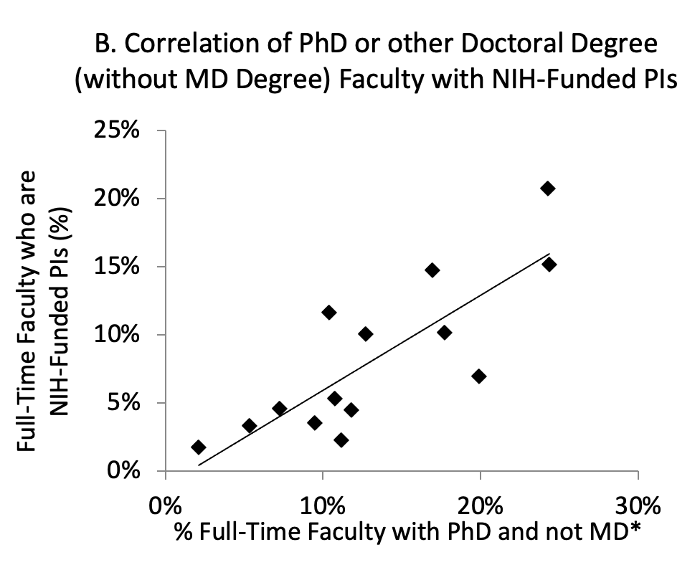
PhDs Correlates with NIH-Funded PIs
R²=0.62
https://www.aamc.org/data-reports/faculty-institutions/interactive-data/2019-us-medical-school-faculty
http://www.brimr.org/NIH_Awards/NIH_Awards.htm
Neumar Acad Emerg Med 2022

Slide 20
U.S. Medical School Clinical Department PhD Faculty
EM PhD Faculty
N=146
https://www.aamc.org/data-reports/faculty-institutions/report/faculty-roster-us-medical-school-faculty

Slide 21
PhD Investigator Pipeline
Students
Dissertation Committees
Graduate Research Assistants
Post-Docs
Primary mentor
Co-mentor
Shared projects
Faculty
Research or tenure track
Joint appointments
Synergy with faculty physician-scientists
Funding expectations

