Slide 1
Maintaining Clinical Skills I’ve Still Got it, Right?
Leigh A. Patterson MD, MAED
ECU Emergency Medicine
Notes:
Thank yous to Jennifer Muir, Richard Stair, Jennifer Bennett and Tim Reeder

Slide 2
Question
Have you supervised a resident performing a Lumbar Puncture in the last 18 months?
Have you performed an LP in the last 18 months?
How many and how often must you perform a procedure to maintain your competence?
Notes:
Clinical Skills Attrition
Intubation, CVC,

Slide 3
Case 1
Mid-career EM faculty
Mid range performance
Dayshifts – Conference coverage
Colleague concerns
2 Peer Review Cases in a year
Notes:
MD note for 6-1 shift

Slide 4
Case 1
Mid-career EM faculty
Mid range performance
Dayshifts – Conference coverage
Colleague concerns
2 Peer Review Cases
Debriefing meeting
Parity in scheduling
It’s fine when the residents are there
Most procedures are fine

Slide 5
Case 1
Secondary Peer Review at Community Site
FPPE with Chief of Staff, CMO
RoundTable Analytics
2 Year Matched Colleague Comparison
Patients Triaged to Resusc Rooms
Room-to-Doc
Procedural Data Review

Slide 6
Case 1
CME Education
Reflection
Separation

Slide 7
Case 2
Mid-career PEM faculty
Learner feedback
Nursing feedback
RT Case for Peer Review
3 Areas – Intubations, Resuscitation Direction, CVC/LP
Notes:
Periodic gentle feedback/nudging to in house Sim Center

Slide 8
Case 2
Mid-career PEM faculty
Learner feedback
Nursing feedback
RT Case for Peer Review
3 Areas – Intubations, Resuscitation Direction, CVC/LP
Meeting for Reflection
Notes:
Periodic gentle feedback/nudging to in house Sim Center

Slide 9
Case 2 - Simulation
10 cases in 3 Key areas
US CVC mannequin, 4 Intubations, Infant LP
Trauma, SVT, Respiratory Distress
4 Experienced Faculty Assessors
Audio +Video Recording
Performance Checklists
Chair Beta Tested
Faculty Informed

Slide 10
Case 2
Simulation Outcome
Reflection
Options
Decision

Slide 11
Case 3 (X2)
Clinical Re-entry Plans
>6 months
Phase 1 – Simulation Assessment
Phase 2 – Patient Care with Supervision
Phase 3 – Independent Supervised Care
2 PPH, Chart Reviews

Slide 12
In Common
Intent to Practice
Hesitancy to Disclose
Simulation Performance Anxiety
Perspective of Learners

Slide 13
Self-Assessment
“A number of studies found the worst accuracy in self-assessment among physicians who were the least skilled and those who were the most confident.”
“Age or experience did not correlate with the clinician’s ability to judge performance in joint injections.”
Davis DA, Mazmanian PE, Fordis M, Van Harrison R, Thorpe KE, Perrier L. Accuracy of physician self-assessment compared with observed measures of competence: a systematic review. JAMA. 2006 Sep 6;296(9):1094-102. doi: 10.1001/jama.296.9.1094. PMID: 16954489.

Slide 14
Ongoing Practice In EM
2018, 18 EDs, 3 AHCs 16-65 K
2805 procs – 1582 Performed
182 FTE
50% no CVC, LP; 75% no CT; 25% no Intubation
33% Performed by Docs <5 years Practice
Volume - Learners
Simon EL, Smalley CM, Meldon SW, Borden BL, Briskin I, Muir MR, Suchan A, Delgado F, Fertel BS. Procedural frequency: Results from 18 academic, community and freestanding emergency departments. J Am Coll Emerg Physicians Open. 2020 Sep 26;1(6):1669-1675. doi: 10.1002/emp2.12238. PMID: 33392575; PMCID: PMC7771730.
Notes:
Didn’t look at mixed practice – AHC +FSED/Community

Slide 15
Outside EM
50% bedside procs performed by GIM + SS
11% hospitalists perform core procs
Transparent Dialog
Protocols – supervision, Procedure Team
Retraining Opportunities
Vaisman A, Cram P. Procedural Competence Among Faculty in Academic Health Centers: Challenges and Future Directions. Acad Med. 2017 Jan;92(1):31-34. doi: 10.1097/ACM.0000000000001327. PMID: 27465227; PMCID: PMC5191975.

Slide 16
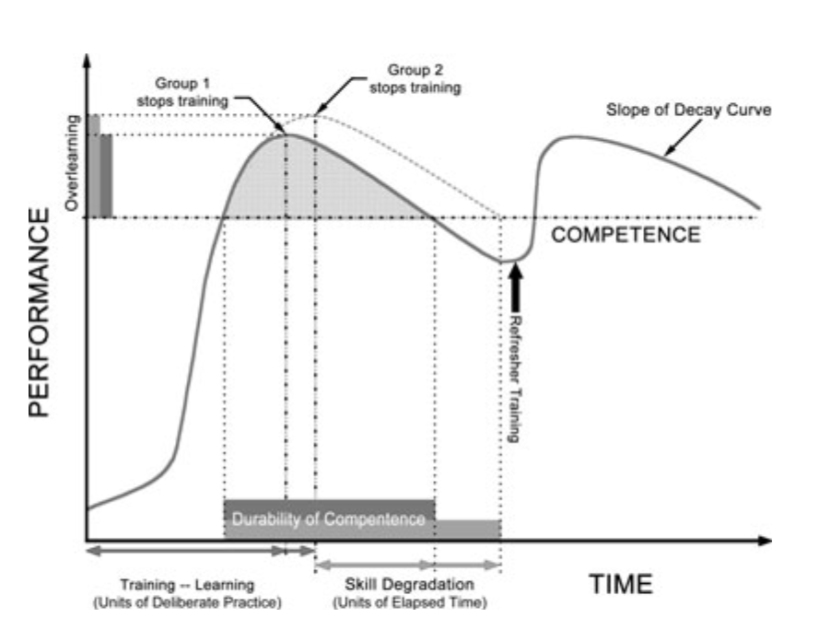
Experience Curves
Pusic MV, Kessler D, Szyld D, Kalet A, Pecaric M, Boutis K. Experience curves as an organizing framework for deliberate practice in emergency medicine learning. Acad Emerg Med. 2012 Dec;19(12):1476-80. doi: 10.1111/acem.12043. Epub 2012 Dec 11. PMID: 23230958.
Notes:
Skill Durability
Mixed practice >> Blocked
Distributed practice >> Massed practice

Slide 17
Answers and Questions
Faculty Simulation
How many?
How Often?
Who and how do we monitor?
What is my obligation as chair?
Is there opportunity for EM?

Slide 18
Department Interventions
Annual Eval Performance Review
Faculty Simulation Sessions
Procedure Team
System Analysis and Quarterly Monitor

Slide 19
Thank you
Richard Stair – stairr@ecu.edu - Simulation
Jennifer Muir – muirj@ecu.edu

