Slide 1
Rejuvenating Medical Student Interest in EM
Laura R. Hopson, MD, MEd
Associate Chair, Education
University of Michigan
President-Elect CORD
Tiffany Murano, MD
Vice Chair, Education
Columbia University
Notes:
Tell a brief story about my love for jigsaw puzzles. Then… let's approach our task of reigniting medical students' interest in emergency medicine as if we're solving a complex jigsaw puzzle. Just as each piece in a puzzle plays a crucial role in revealing the bigger picture, let's explore how each of our unique perspectives and ideas can contribute to the solution. Just as solving a puzzle requires patience, creativity, and a willingness to try different approaches, let's bring these qualities to our quest for innovative strategies. Together, let's piece together the puzzle of inspiring the next generation of emergency physicians, creating a vibrant future for our field.

Slide 2
No financial disclosures
Content reflects presenters’ opinions and not organizational endorsement
All images used under license from Canva
Notes:
No financial disclosures
This work represents the presenters’ personal opinions and does not reflect organizational endorsement.
All graphics licensed through Canva/Pixabay

Slide 3
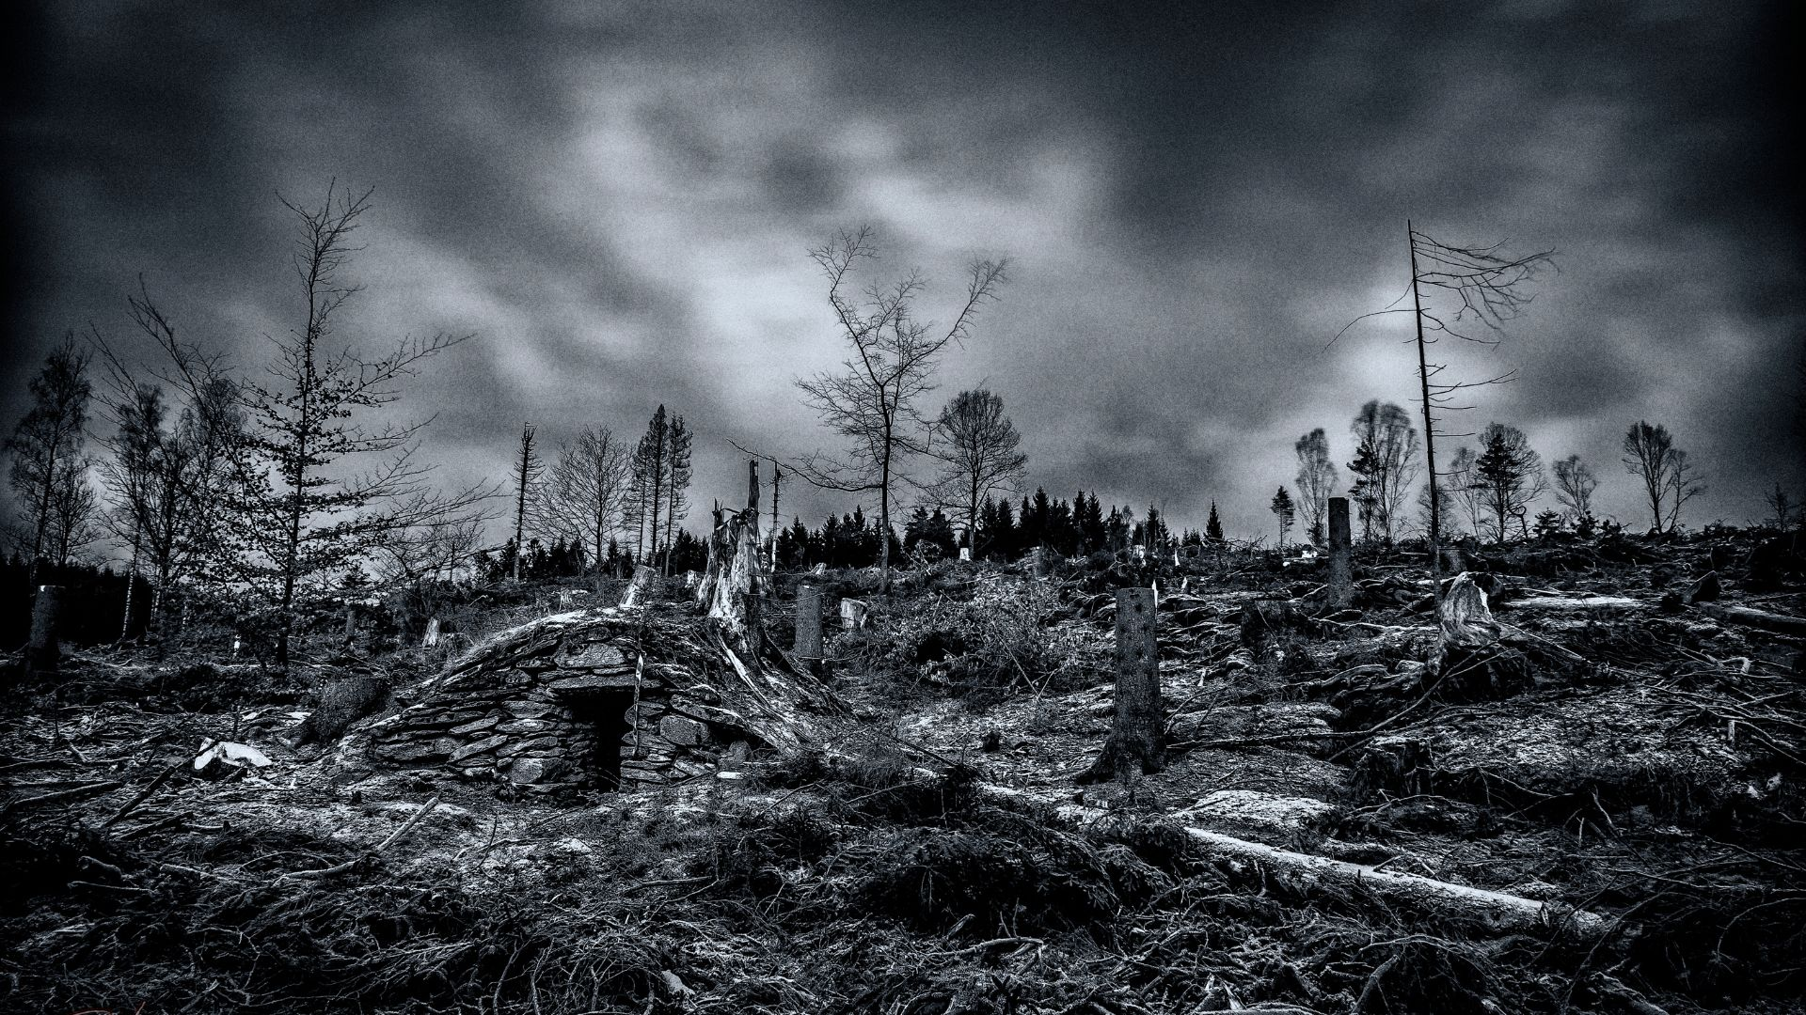
Notes:
We all know where we are
How did we get here? – we are not going to spend a lot of time on this but we want to spend a few minutes anchoring everyone in the data to inform the critical discussion which is:
Where do we go from here? – this is where we want to focus

Slide 5
Notes:
In 2023 we dropped below a 1:1 ratio for applicants and positions
But look at 2024!
So, this is good right? Problem solved
Not so fast.

Slide 6
Notes:
MDs applicants are flat at about 1500
Growth in EM application numbers is almost entirely in osteopathic grads and IMGs
Parity among applicant types

Slide 7
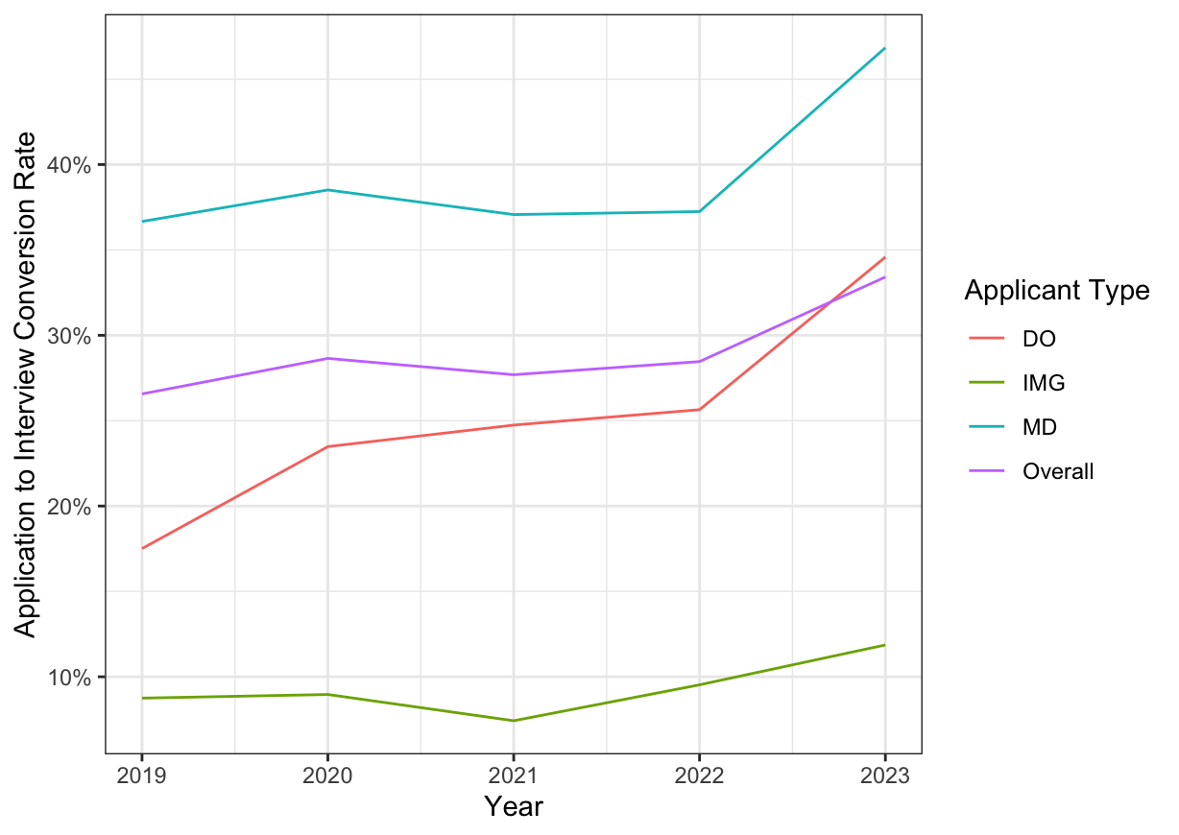
Figure 4. Emergency Medicine Application to Interview Conversion Rate by Applicant Type: This represents the proportion of interviews obtained by an applicant per program applied.
Legend: DO=osteopathic, IMG=international medical graduate, MD=allopathic
Cracking the Code on the Emergency Medicine Match: It’s About Supply, Not Interviews Pelletier-Bui et al. In Press AEM Education & Training. Accepted January 21, 2024
Notes:
Cracking the Code on the Emergency Medicine Match: It’s About Supply, Not Interviews Pelletier-Bui et al. In Press AEM Education & Training. Accepted January 21, 2024
We also see that US MD applicants are the ones most likely to receive interviews in our current interviewing practices. IMGs are the least likely.
We are not going to spend time talking about the why’s during this session to avoid bogging down the discussion
A manuscript in press with AEM educ and training shows that we have a pretty consistent differential in all applicant groups between those applying and those submitting ROLs in EM of about 10%
Let’s dive into the applicant situation further.
A manuscript in press with AEM educ and training shows that we have a pretty consistent differential in all applicant groups between those applying and those submitting ROLs in EM of about 10%
IMGs are challenging not necessarily because of their training but other barriers to entrance – Visa requirements, institutional credentialing, English proficiency concerns etc.
DO’s likely face bias in the allopathic world with perceptions of osteopathic training (right or wrong) as well as navigating barriers such as a different set of board exams (e.g. COMLEX v. USMLE)
Cracking the Code on the Emergency Medicine Match: It’s About Supply, Not Interviews Pelletier-Bui et al. In Press AEM Education & Training. Accepted January 21, 2024

Slide 8
Notes:
To be a healthy specialty, we can’t ignore a major applicant pool and their engagement with our field

Slide 9
Notes:
So to understand where we are losing people,

Slide 10
Notes:
We need to spend a bit of time talking about what the data tells us about potential points of intervention

Slide 11
Putting the pieces together…
"Cold Feet": A qualitative study of medical students who seriously considered emergency medicine but chose another specialty
Notes:
We have several sources of data which reinforce these conclusions.
First is a 2020 analysis by Burkhardt et al looking at where EM loses potential student interest.
There are two qualitative studies from 2024 both in AEM education and training which also provide insights. While these two studies had different focuses and timelines, their conclusions reinforce each other.
REFERENCES
Diaz R, Balgord S, Klekowski N, et al. Understanding clerkship experiences in emergency medicine and their potential influence on specialty selection: A qualitative study. AEM Educ Train. 2024;8(1):e10932. Published 2024 Feb 9. doi:10.1002/aet2.10932e Akhaven paper which grew out of a CDEM initiative is particularly notable since they managed to identify and recruit the elusive participant of the student who considered but did not pursue EM.
Akhaven, “Cold Feet” AEM Educ Train, In press
Burkhardt J, DesJardins S, Gruppen L. Diversity in emergency med­icine: are we supporting a career interest in emergency medicine for everyone? Ann Emerg Med. 2019;74(6):742-750.
Burkhardt J, DesJardins S, Gruppen L. Identifying barriers to a di­ verse emergency physician workforce: identifying when and how leaks occur in the pipeline. Ann Emerg Med. 2020;76(1):113-115.

Slide 12
Five Domains of Concern
ED Environment
Jobs
Engagement of diverse populations
Mentorship and exposure
Career longevity
Notes:
These challenges really drop into 5 broad categories
We are going to touch briefly on the issues and the data that supports them as concerns.
We have a scant 30 minutes to tackle a huge issue
We want to spend the conclusion of this session discussing as a group what the potential interventions may be.

Slide 13
ED
environment
Notes:
These challenges really drop into 5 broad categories
We are going to touch briefly on the issues and the data that supports them as concerns.
We have a scant 30 minutes to tackle a huge issue
We want to spend the conclusion of this session discussing as a group what the potential interventions may be.

Slide 14
“A nurse got bit by a patient, and I remember asking an attending, ‘What are we going to do about this?’…The answers were correct, but none of them made it seem like anything was going to change.”
-Student quoted in Akhaven
Notes:
Coming from multiple sources is the importance of some of the challenging and too-often violent interactions we have with patients, families, other physicians and members of the healthcare team.
While we think of the big interactions, the students also see us struggling with consultants, admitting physicians etc.
This leaves an impression…
“…they took a swing at me. But I dodged it.”
From Diaz, 2024

Slide 15
"One thing that did intimidate me about EM was having to go up against the questioning of your clinical calls and pushback from everyone else in the hospital.“
-Student quoted in Akhaven
Notes:
While we think of the big interactions, the students also see us struggling with consultants, admitting physicians etc.
This leaves an impression…

Slide 16
Engagement of a diverse population of students

Slide 17
Notes:
We need to think about students’ perceptions of inclusivity and belonging within our specialty
Women have persisted at about 35% of applicants and entering EM residents for a number of years (citation below). Women are now making up at least if not slightly more than half of medical students by AAMC numbers.
We know from Burkhardt’s work that women who do not enter medical school with a strong interest in EM from prior exposure are much less likely than men to convert to the specialty.
Why is this?
We have some evidence from the Diaz paper that there is perception that the specialty creates vibes of exclusion.

Slide 18
“I have done four shifts now, and I've not worked with a single female resident or attending yet.”
-Student quoted in Diaz
“... men, and this could be attendings and residents [in EM], ... seem to have this really, "bro-y collegiality," that's not always access­ible to other people.”
-Student quoted in Diaz
Notes:
Engagement of Women in the specialty.
Women have persisted at about 35-40% of applicants and entering EM residents for a number of years (citation below). Women are now making up at least if not slightly more than half of medical students by AAMC numbers.
We know from Burkhardt’s work that women who do not enter medical school with a strong interest in EM from prior exposure are much less likely than men to convert to the specialty.
Why is this?
We have some evidence from the Diaz paper that there is perception that the specialty creates vibes of exclusion. Some of this is overt and some more covert.
Bowe SN, Wang X, Whipple ME, Bly RA. Evidence of specialty-specific gender disparities in resident recruitment and selection. J Grad Med Educ. 2021;13(6):841-847.
Burkhardt J, DesJardins S, Gruppen L. Diversity in emergency med­icine: are we supporting a career interest in emergency medicine for everyone? Ann Emerg Med. 2019;74(6):742-750.
Burkhardt J, DesJardins S, Gruppen L. Identifying barriers to a di­ verse emergency physician workforce: identifying when and how leaks occur in the pipeline. Ann Emerg Med. 2020;76(1):113-115.
"You know, I think socially we ... condition women to be less vocal and self-advocating for themselves in a professional environment, at least in the way that is beneficial in the ED…I'd imagine that's probably playing a pretty significant role in disincentivizing from people from either wanting to go into it or conversely being evaluated well in it."
-Student quoted in Diaz, 2024

Slide 19
DIVERSITY
Notes:
We would like to think of our specialty like this:
https://www.acgme.org/globalassets/pfassets/publicationsbooks/2022-2023_acgme_databook_document.pdf
Percentages in the female box are out of the total 8946.
Looking at diversity beyond gender identification:
Active EM Residents: 8,946
Black: 520 (5.8%)
Hispanic,Latino: 925 (10%)
Multi-racial: 449 (5%)
EM Female Residents: 3906 (43.6%)
Black: 261 (2.9%)
Hispanic/Latino: 392 (4.3%)
Multi-racial: 205 (2.3%)

Slide 20
Notes:
Looking at diversity beyond gender identification:
Active EM Residents: 8,946
Black: 520 (5.8%)
Hispanic,Latino: 925 (10%)
Multi-racial: 449 (5%)
EM Female Residents: 3906 (43.6%)
Black: 261 (2.9%)
Hispanic/Latino: 392 (4.3%)
Multi-racial: 205 (2.3%)

Slide 21
Notes:
Looking at diversity beyond gender identification:
Active EM Residents: 8,946
Black: 520 (5.8%)
Hispanic,Latino: 925 (10%)
Multi-racial: 449 (5%)
EM Female Residents: 3906 (43.6%)
Black: 261 (2.9%)
Hispanic/Latino: 392 (4.3%)
Multi-racial: 205 (2.3%)

Slide 22
Notes:
We ideally want to recruit residents and faculty who come from diverse backgrounds

Slide 23
Jobs

Slide 24
Notes:
Reality versus Fear
In 2021, the EM workforce study landed and dramatically changed the entire discussion around the specialty.
If you have 7+ years invested beyond college and potentially hundreds of thousands of dollars in debt, the prospect of not having a job is terrifying.
This parallels the collapse of anesthesia in the 1990’s. In my discussion with Michigan’s chair emeritus his synopsis was “The students will come back when they BELIEVE there are jobs” (Tremper)
***Do we want to mention anything here about mission creep/APP threats and that chatter?

Slide 25
"There were a lot of people who wrote long things [on the internet] saying, 'If you're a medical student considering EM, really consider all your other options because things are looking bleak. ‘”
-Student quoted in Akhaven
Notes:
Akhavan In press
Whether or not the reality matches the Fear
If you have 7+ years invested beyond college and potentially hundreds of thousands of dollars in debt, the prospect of not having a job [or having a job in a location that is undesirable] is terrifying.
This parallels the collapse of anesthesia in the 1990’s. In my discussion with Michigan’s chair emeritus his synopsis was “The students will come back when they BELIEVE there are jobs” (Tremper)

Slide 26
Mentorship & Exposure

Slide 27
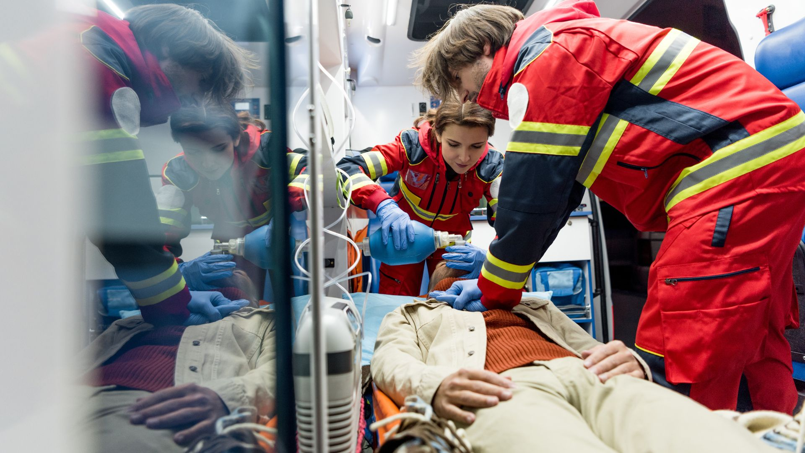
“I think that my school doesn't let us do EM until fourth-year made things a little tricky. It was hard to start the application process before even having the rotation.”
-Student quoted in Diaz 2024
“...I did have some opportunity to see some really strong women in emergency medicine. And I think if I hadn't seen that and I just had the experience of my residents, for example, who are mostly men, I don't know if I would have wanted to do it.”
-Student quoted in Diaz 2024
Notes:
In both the Diaz and Akhavan papers we see themes of students needing and wanting earlier engagement with the specialty in order to facilitate their career selection process. This also reinforces the conclusions from the Burkhardt paper particularly with regard to women.
Students also need role models and mentors in which they see themselves.

Slide 28
Notes:
793/1372 (58%) responded. Over half had EM experience prior to medical school. When
students selected EM varied: 13.9% prior to, 50.4% during, and 35.7% after their M3 year.
Early exposure, presence of an EM residency program, previous employment in the ED,
experience as a pre-hospital provider, and completion of an M3 EM clerkship were associated
with earlier selection. Delayed exposure to EM was associated with later selection of
EM.
PLOS
Burkhardt also identified in his 2019 work that women in particular are difficult to pull into the specialty unless they arrive at medical school with some experience or interest in EM.

Slide 29
Career Longevity

Slide 30
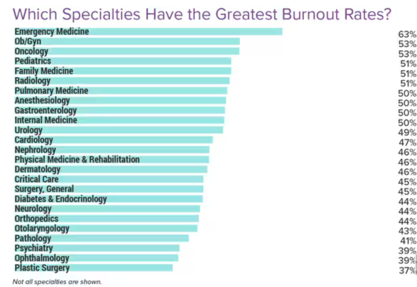
"I could tell people were tired, and a lot of them were talking about their exit strategy, and I didn't want that to be me. “
-Student quoted in Akhaven
Medscape Physician Burnout and Depression Report 2024
Notes:
Medscape burn out data 2024 https://www.medscape.com/slideshow/2024-lifestyle-burnout-6016865
Finally, we see students highlighting concerns in Akhaven about burnout and career longevity
EM is certainly not unique in its struggles but students highlight this as a concern.

Slide 31
Notes:
So we have just talked about problems
Let’s talk about solutions to meaningfully intervene in what is happening.

Slide 32
Five Domains of Concern
ED Environment
Jobs
Engagement of diverse populations
Mentorship and exposure
Career longevity
Notes:
These challenges really drop into 5 broad categories
We are going to touch briefly on the issues and the data that supports them as concerns.
We have a scant 30 minutes to tackle a huge issue
We want to spend the conclusion of this session discussing as a group what the potential interventions may be.

Slide 33
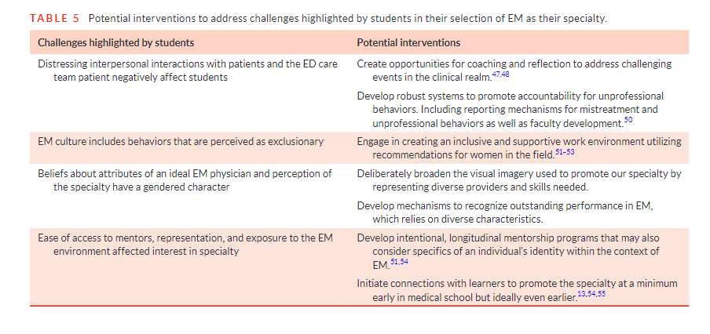
Notes:
From Diaz 2024
Diaz et al proposed several interventions in their paper.
What do we think of these?
Are there other points of intervention?

Slide 34
Notes:
We also have recommendations from an AWAEM taskforce many of which deal with environmental and systems issues

Slide 35
ED Environment
Notes:
What are some ways that we can create a safe, welcome, and professional environment? Does anyone want to share what they do at their institution?
Create a more welcoming, safe, and professional environment for students, nurses, trainees.
It’s a stressful environment, try to have moments to debrief after events occur—and events will occur.
Check in with the students during their experiences to ensure that there is psychologic and physical safety.

Slide 36
Engage Diverse
Students
Notes:
What are some of the ways that you can not only recruit diverse residents and faculty but also support them?
Just like patients feel better when they are treated by people who look like them and have had similar experiences, this is also true of medical students and residents. If students do not have these connections then they will be less inclined to seek out the specialty or individuals within the specialty for guidance.

Slide 37
Jobs
Notes:
Students for sure have an ear to the ground. They are members of our student and resident organizations and whatever is said in those circles is what is heard and what circulates/filters down to the students. It did not help that we have heard that Deans of medical school were talking some students out of EM because of the potential workforce issue.
Potential solutions:
Be transparent
Meet with medical school leadership and be proactive about student/career advising
Spread a positive message

Slide 38
Exposure &
Mentorship
Notes:
Solutions:
Faculty teach in the pre-clinical years
Faculty interview for the medical school
Have faculty in leadership positions within the medical school
Shadowing
Research opportunities
Community outreach/undergrad engagement
Informal first responder training – Narcan, epipens, scene citizenship

Slide 39
Career Longevity
Notes:
Improve the work environment
Shift modification
Faculty development and diverse career pathways
Faculty recognition

Slide 40
Thank you! Questions? Thoughts? Ideas?

