Slide 1

Academy of Administrators in Academic Emergency Medicine
Operations and Research
Fiscal Year 2023
James Scheulen
Steve Maxwell
On behalf of the
AAAEM Benchmark Committee
March, 2024

Slide 2


16 years ago
Fiscal Year 2007
N = 30

Slide 3

Benchmark Data Collection FY 11
51 Academic Medical Center hospitals
  Primary Academic Hospitals: 39
  Academic Affiliated Hospitals: 12
  Community Hospitals: 4
Database
  Over 15,000 data points
  94% Report Level 1 Trauma Center
  45% Report separate Pediatric ED operations
    15 reported separate data

Slide 4
Data Set: Demographics
Fiscal Year | 2019 | 2020 | 2021 | 2022 | 2023
Academic Hospital | 74 | 72 | 70 | 73 | 76
Academic Affiliated | 17 | 18 | 18 | 20 | 20
Academic/Affiliated | 91 | 90 | 88 | 93 | 96
Community | 34 | 28 | 34 | 40 | 42
Freestanding ED | 5 | 7 | 6 | 8 | 8
Adult Departments | 130 | 125 | 127 | 141 | 142
Pediatric ED | 24 | 18 | 20 | 20 | 19
Total ED Reports | 154 | 143 | 127 | 161 | 165

Slide 5
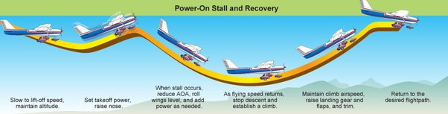
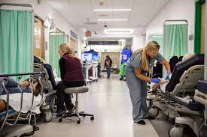
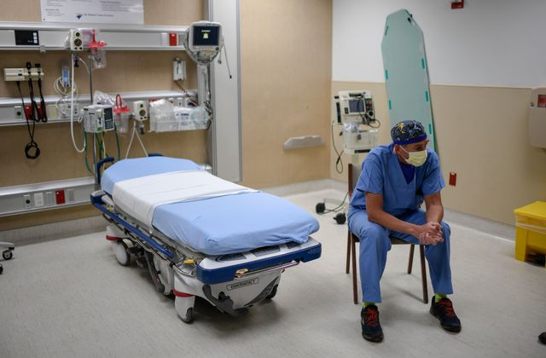
Survey Timeline
July
Aug
Sept
Oct
Nov
Dec
Jan
Feb
Mar
Apr
May
June
FY 2019
Normal
FY 2020
COVID
July
Aug
Sept
Oct
Nov
Dec
Jan
Feb
Mar
Apr
May
June
July
Aug
Sept
Oct
Nov
Dec
Jan
Feb
Mar
Apr
May
June
FY 2021
Recovery
July
Aug
Sept
Oct
Nov
Dec
Jan
Feb
Mar
Apr
May
June
FY 2022
New Normal
July
Aug
Sept
Oct
Nov
Dec
Jan
Feb
Mar
Apr
May
June
FY 2023
Normal

Slide 6
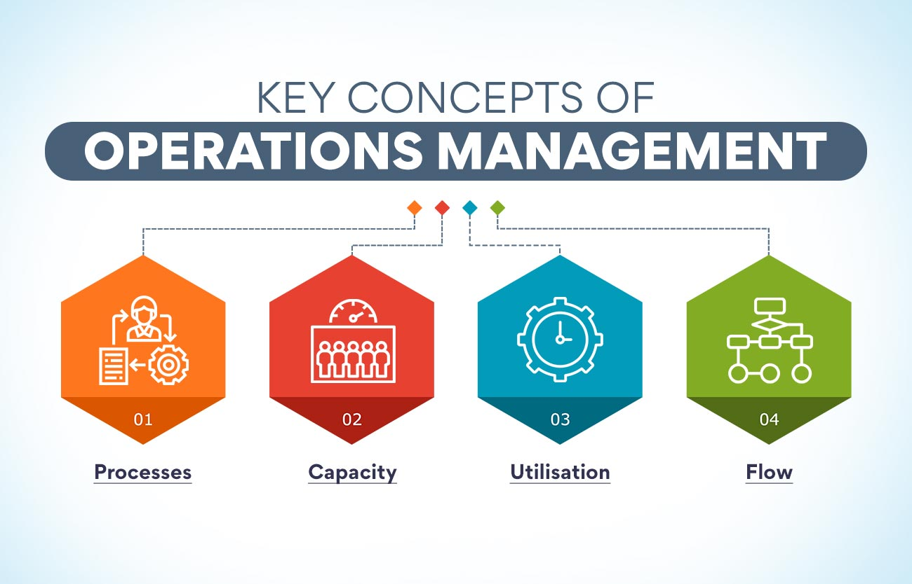



Increasing
Process
time
Limited
Capacity/High
Occupancy
Bed Hour
Utilization
Non-Emergent
Internal Flow
and
Decision Making

Slide 7

Benchmark Committee
Gregory M. Archual, MBA (Co-Chair) James J. Scheulen, PA, MBA (Co-Chair)
Kathleen M. Acevedo, MBA Louis E. Burton, MHSM, FACHE
David Christiansen, MBA Gai Cole, DrPH, MBA, MHA
Theodore Corbin, MD Robert Eisenstein, MD
Sara Engle, MBA Amy Jameson, MPhil, MA, MBA
Kenny Lopiano, PhD Steve Maxwell, MSM
Becky McGowan, MBA Ashlee Melendez, MSPH, BSN
Jennifer Patton Muir, EdD, MBA Ryan Pauline, MBA, FACHE
Steven Petrovic, MBA Brendan Russell, MBA
Kain C. Robbins Travis W. Schmitz, PhD, MBA
Benjamin Sun, MD Alyssa Tyransky, MTDA
Gregory Volturo, MD

Slide 8


New questions
Occupancy data:
  Hospital MN Occupancy
  DOM MN Occupancy
  DOM 7am Occupancy
Telemedicine in the ED
Provider in triage/intake
Throughput data:
  Arrival to triage and Arrival to room
Professional fee billing data
  Impact of January 2023 changes
Residency questions
  Off service rotators in ED
Faculty data
  Clarification of clinical hours
  Research funding

Slide 9
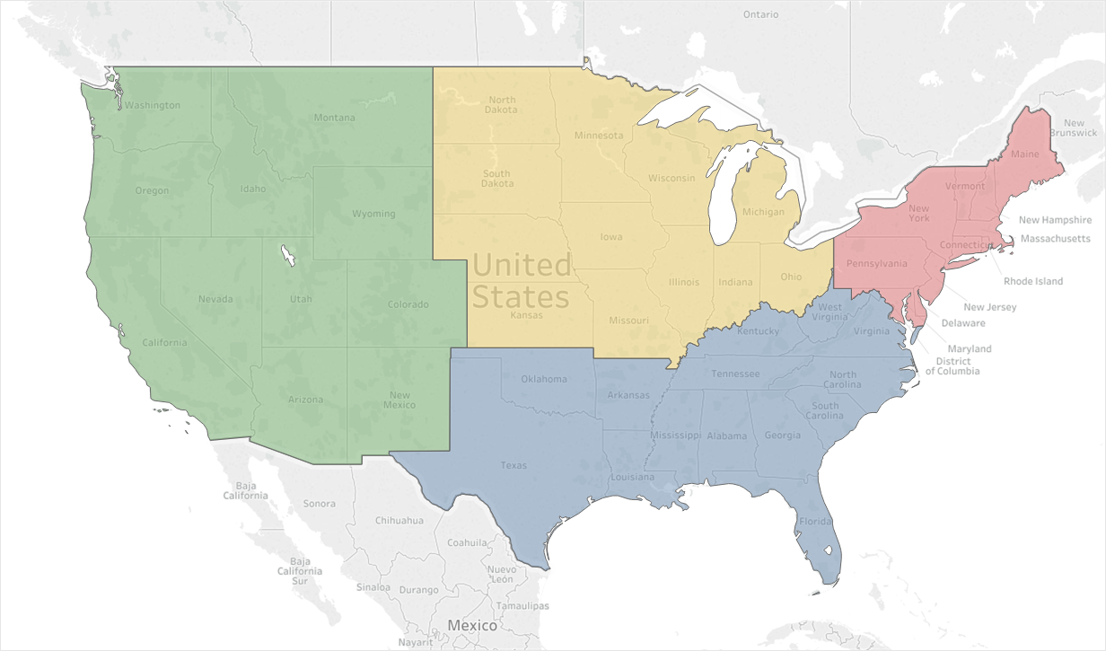
Data Set
Adult Academic and Affiliate Responses: 92
20
18
37
17
5,814,990 Emergency Visits
1,523,165 Hospitalizations
$757,032,693 Collected Revenue

Slide 10

Hospital Operations
Staffed (612) vs Licensed (664) beds: 92% (Mean)
Inpatients from ED: 55% (Academic)
Inpatients from ED: 80% (Community)
Academic Mean Turnover = 53 patients/bed
Estimated inpatient LOS = 6.9 days
Community Mean Turnover – 75 patients/bed
Estimated inpatient LOS = 4.9 days

Slide 11







18%
27%
Patient Transfers
Scheduled Admissions
EMTALA
Not Elective
They are
sick too
Predictable
Emergency Department
Space
Urgent Admissions from
Clinics/Offices
Space
41%
13%
Sources of Patients: Points of Control

Slide 12

The Academic ED
Fiscal Year 2023 | Median
Hospital Beds | 604
Licensed ED Beds | 57
Total Bed Hours | 536,560
% Bed Hours to MAIN | 69%
ED Treat & D/C | 38,248
ED Admissions | 14,803
Hospital Observation | 2,854
Total Visits | 63,591
Hospitalized Rate (Calc) | 27.8%
Unique visits | 66.4%
63,591 Visits
Range: 28,011 – 144,710
40,878 Unique visits

Slide 13
The Academic ED
 | 2019 Median | 2020 Median | 2021 Median | 2022 Median | 2023 Median
Hospital Beds | 632 | 664 | 656 | 655 | 604
Licensed ED Beds | 52 | 59 | 58 | 58 | 57
Total Bed Hours | 495,670 | 520,689 | 534,360 | 525,600 | 536,560
% Bed Hours to MAIN | 70% | 67% | 68% | 70% | 69%
ED Treat & D/C | 42,244 | 38,875 | 35,748 | 35,842 | 38,248
ED Admissions | 14,702 | 14,258 | 14,831 | 15,118 | 14,803
Hospital Observation | 3,262 | 3,215 | 2,868 | 2,867 | 2,854
Hospitalized Patients | 17,964 | 17,473 | 17,699 | 17,985 | 17,657
Total Visits | 64,326 | 59,417 | 56,235 | 62,483 | 63,591
Hospitalized Rate | 27.9% | 29.4% | 31.5% | 28.8% | 27.8%
Unique Visits (65%) | 65% | 65% | 66.4% | 66.8% | 66.4%

Slide 14
Patient Populations
 | 2019 Median | 2020 Median | 2021 Median | 2022 Median | 2023 Median
Total | 64,326 | 59,417 | 56,235 | 62.483 | 63,591
EMS Arrivals | 18,005 | 15,876 | 16,515 | 18,333 | 18,451
EMS Percent | 26.2% | 25.9% | 28.1% | 27.6% | 27.9%
EMS Admit Rate | 42.9% | 42.6% | 45% | 41.3% | 40.9%
Behavioral Health | 5.5% | 4.9% | 5.0% | 5.0% | 4.9%
Patients > 65 Years | 20.7% | 21.0% | 21.5% | 21.6% | 22.2%
Pediatric Visits | 2.1% | 1.7% | 0.8% | 1.2% | 1.8%
Dedicated Pediatrics | 24,921 | 22,160 | 19,766 | 26,929 | 31,661

Slide 15
Patient Volume Trend: Median
Patient Volume Trend—All Responders FY 23

Slide 16
Hospitalization Data
55% of hospitalizations
are from the ED
45% of ED hospitalizations
Arrive by EMS

Slide 17
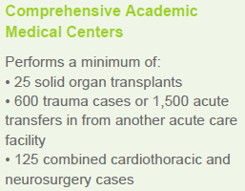
Hospitalization Data
Source: Vizient Clinical Database (CDB)
Notes: Outliers included; Normal newborns excluded; ‘CAMC’ cohort is pre-defined each year by Vizient and comprises 109 CAMCs

Slide 18
Hospitalization Data
Inpatient Volume + LOS = 94% Occupancy (DOM) at 7 am

Slide 19


Inpatient Occupancy
All beds
Academic = 89%
DOM beds
Academic = 91%
DOM beds
Academic = 94%
Approximately 80% of all patients in DOM come from the ED
Approximately 67% of all ED hospitalizations go to DOM

Slide 20
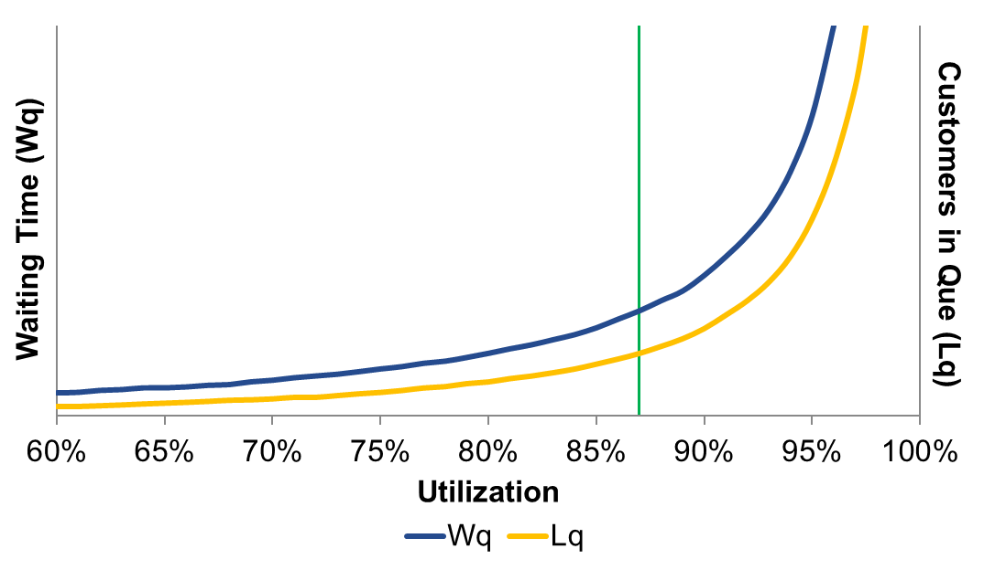
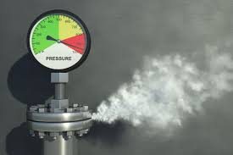

Drivers of Operations
DOM
7 AM
+.66
days
DOM
MN
MN
20

Slide 21
Left Before Treatment Complete
High occupancy/utilization = Abandon the queue
Mean Percentage of Arrivals
Mean

Slide 22
Left Before Treatment Complete
Operating at high occupancy and utilization
Mean Percentage of Arrivals
Mean

Slide 23
Left Before Treatment Complete
Operating at high occupancy and utilization
Mean Percentage of Arrivals
Mean

Slide 24
Left Before Treatment Complete
Mean Percentage of Arrivals
5,467
Patients
Mean

Slide 25
LOS Trend: Median LOS
Median Emergency Department Length of Stay
Hours
Median times represented here
Mean times are longer
Distribution with a long right tail

Slide 26
LOS Trend: Median LOS
Median Emergency Department Length of Stay
Hours
Fast Track
Total LOS
Median times represented here
Mean times are longer
Distribution with a long right tail

Slide 27
LOS Trend: Median vs Mean LOS
Total ED LOS: Mean vs Median
Hours
Mean times represent what staff and patients experience
Data distribution has a long right tail

Slide 28
LOS Trend: Median vs Mean LOS
Discharged Patient Length of Stay
Hours
Mean times represent what staff and patients experience
Data distribution has a long right tail

Slide 29
LOS Trend: Median vs Mean LOS
Hospitalized Patient Length of Stay
Hours
Mean times represent what staff and patients experience
Data distribution has a long right tail

Slide 30
LOS Trend: Bed to Decision Time
Median “Main” Bed to Decision Time: Admit vs D/C
Mean
5 Hours
Hours
Mean
4 Hours

Slide 31
Boarding Time
Mean and Median Boarding Time
Hours
The Boarding “Tail” continues to grow

Slide 32
Boarding Time
Total Boarding Hours
14.4 beds fully
dedicated to
Inpatient care
14.5 beds fully
dedicated to
Inpatient care
Hours
13 beds fully
dedicated to
Inpatient care
Slightly fewer
patients with
slightly longer
boarding per
patient
10 beds fully
dedicated to
Inpatient care
9 beds fully
dedicated to
Inpatient care

Slide 33
Boarding Distribution
FY 2015 vs FY 2023
Percent of Patients
Boarding Hours

Slide 34
Value Added Time
Bed to Decision Time
vs
Total LOS
Bed to Decision Time
vs
Total LOS

Slide 35

Sub-cycle Time
DISCHARGED PATIENTS
ADMITTED PATIENTS
Arrival to Provider: 1.0 hr
Provider to Decision: 3.9 hr
Decision to Depart: 1.0 hr
Arrival to Provider: 1.0 hr
Provider to Decision: 5.5 hr
Decision to Depart: 8.0 hr

Slide 36
Ancillary Resource Utilization
Resource | FY 19 | FY 20 | FY 21 | FY 22 | FY 23
CT Utilization | 25.5% | 28.3% | 31.3% | 30% | 31.5%
MRI Utilization | 2.7% | 2.8% | 2.8% | 2.9% | 3.2%
Plain Film (% visits) | 40.2% | 43.0% | 44% | 42% | 40.3%
Laboratory (% visits) | 69.6% | 70.5% | 72.2% | 72% | 69.7%
EKG (% visits) | 33% | 36% | 40% | 38% | 38.5%
U/S (Radiology) | 7.9% | 6.9% | 7.6% | 7.8% | 7.8%
Consult & D/C | 7.0% | 7.5% | 8.5% | 9.4% | 8.8%
MRI Turnaround | 4.0 hr | 4.3 hr | 5.1 hr | 5.3 hr | 5.5 hr
Mean = 2.3 hours vs 2.8 hours
Mean CT Process time has increased by 39%
Mean MR process time has increased by 169%
CT and MR Utilization account for 65,000 hours of process time
If patients are in beds, we now dedicate AN ADDITIONAL 2 beds entirely to CT/MR wait: 7 beds entirely dedicated to process wait time
Mean = 5.0 hours vs 11.3 hrs

Slide 37
LOS Behavioral Health
Behavioral Health Patients = 5.7% of Arrivals or 3500 patients

Slide 38
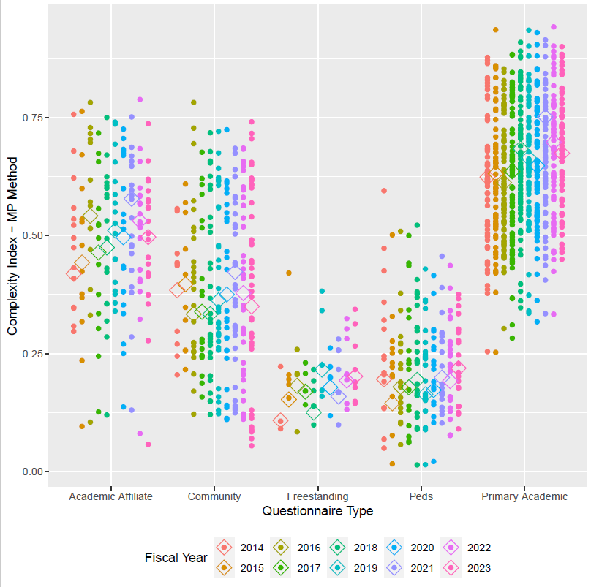
Operations Based Complexity Index
Hospitalization rate
  Flat to lower
EMS Arrivals
  Flat
EMS Admissions
  Flat
High Acuity Codes
  Flat
Acuity 1&2
  Flat
.679
.490
.396
.148
.238
Notes:
There are 2 options we can pursue.
Looking at acuity as a stand-alone concept for our patient population where we seek to quantify and contrast how sick our patients are. High acuity patients are more likely than low acuity patients to die, require surgery, or be medically admitted. Question: is your average behavioral health patient high or low acuity?
The other option is to expand this concept and incorporate additional factors that serve as indicators of how complex it is to clinically and operationally manage these patients. This option isn’t just about how sick the patients are but how resource intensive they are and how much pressure the place on the internal system of the ED.

Slide 39
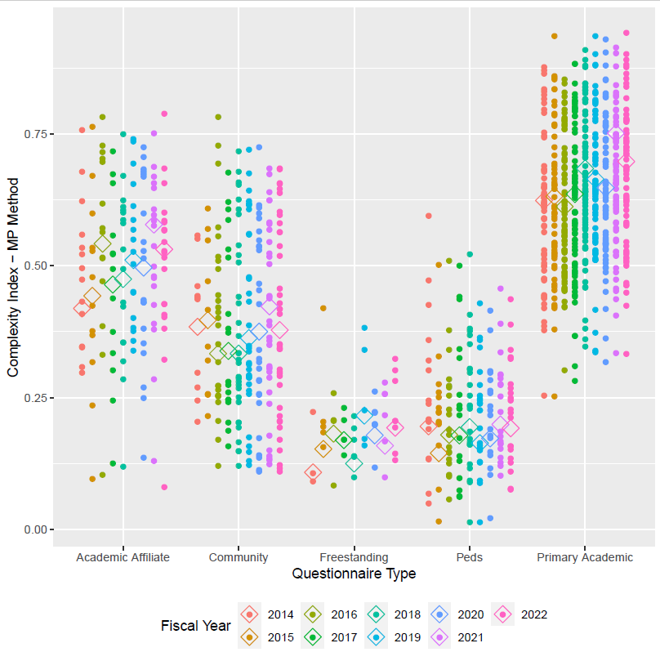
Operations Based Complexity Index
Fiscal Year 2022
Fiscal Year 2023
.697
.679
.531
.490
.378
.396
.193
.192
.148
.238
Notes:
There are 2 options we can pursue.
Looking at acuity as a stand-alone concept for our patient population where we seek to quantify and contrast how sick our patients are. High acuity patients are more likely than low acuity patients to die, require surgery, or be medically admitted. Question: is your average behavioral health patient high or low acuity?
The other option is to expand this concept and incorporate additional factors that serve as indicators of how complex it is to clinically and operationally manage these patients. This option isn’t just about how sick the patients are but how resource intensive they are and how much pressure the place on the internal system of the ED.

Slide 40
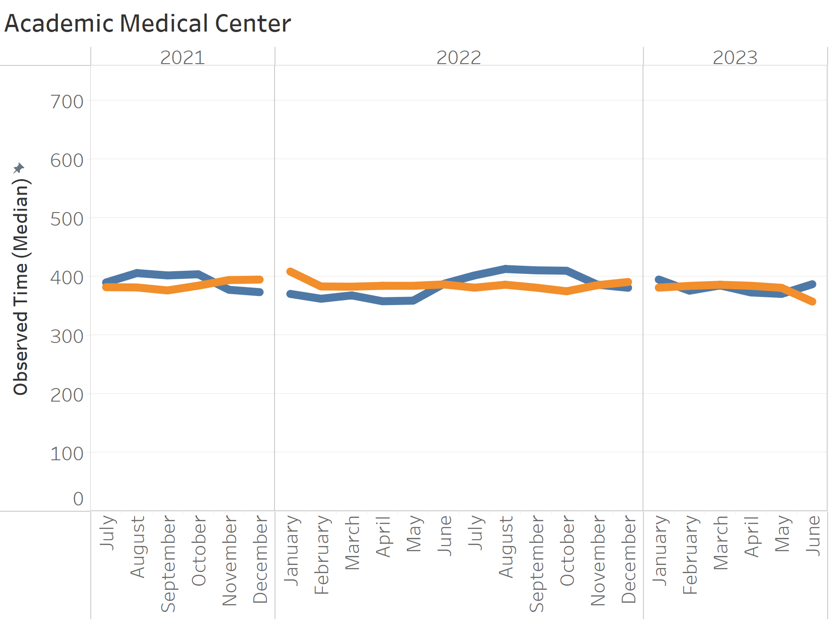
Patient Based Complexity Index
Variables provide a good fit
(r² = 0.71)
More patients
More patients with chronic ETOH
More patients with psychosis
More elderly and/or with comorbidities
More patients with oncology Dx
Patients from neighborhoods with high social needs/PCP desert
Reduced time = more patients with:
  Current drug or alcohol overdose
  History of 7-day returns to the ED
  Severe trauma
Notes:
There are 2 options we can pursue.
Looking at acuity as a stand-alone concept for our patient population where we seek to quantify and contrast how sick our patients are. High acuity patients are more likely than low acuity patients to die, require surgery, or be medically admitted. Question: is your average behavioral health patient high or low acuity?
The other option is to expand this concept and incorporate additional factors that serve as indicators of how complex it is to clinically and operationally manage these patients. This option isn’t just about how sick the patients are but how resource intensive they are and how much pressure the place on the internal system of the ED.

Slide 41
Operations Based Complexity Index
Fiscal Year 2023 Complexity Index
Notes:
There are 2 options we can pursue.
Looking at acuity as a stand-alone concept for our patient population where we seek to quantify and contrast how sick our patients are. High acuity patients are more likely than low acuity patients to die, require surgery, or be medically admitted. Question: is your average behavioral health patient high or low acuity?
The other option is to expand this concept and incorporate additional factors that serve as indicators of how complex it is to clinically and operationally manage these patients. This option isn’t just about how sick the patients are but how resource intensive they are and how much pressure the place on the internal system of the ED.

Slide 42
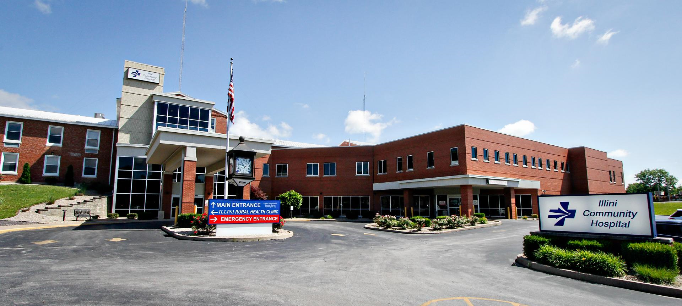
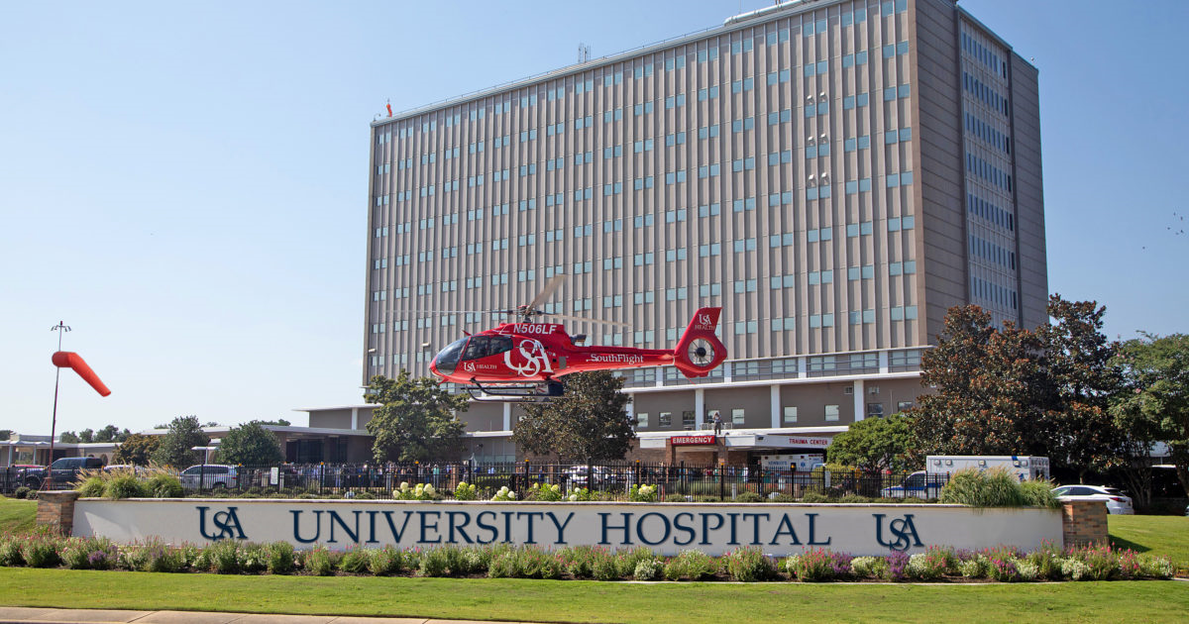
Academic vs Others
 | Arrivals | Unique Visits | Value Time D/C | Value Time Admit | Hospitalized Rate | ED Index
Academic | 62,483 | 67.1% | 64% | 36% | 28.8% | .679
Community | 29,239 | 69.5% | 71% | 49% | 16.1% | .396
Freestanding | 28,578 | 69.6% | 62% | 30% | 10.2% | .148
Pediatrics | 26,929 | 70.2% | 66% | 43% | 13.9% | .238

Slide 43
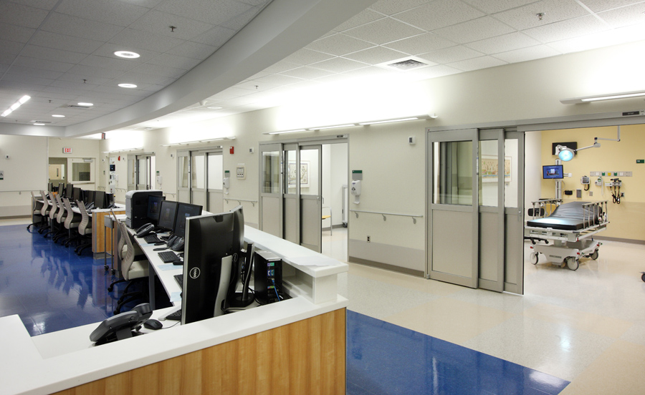



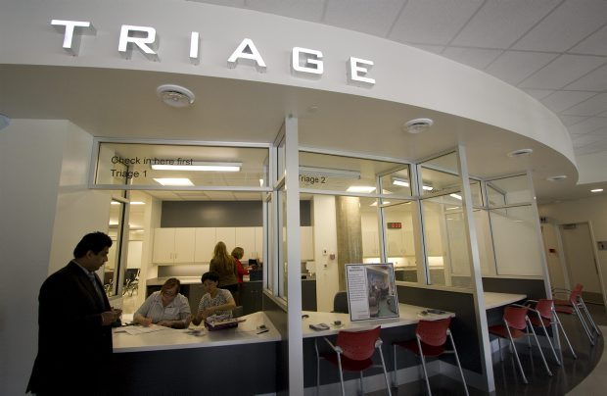
Nursing and Support Hours
50% report working MORE hours than budget
 | Percent Worked Hours
Nursing | 98.6%
Support | 121.1%
 | % Yes | Weekday | Weekend
Case Management | 85% | 16 | 16
Social Work | 91% | 24 | 24
Pharmacist | 92% | 16 | 16

Slide 44
Observation Benchmarks
Emergency Department Observation
 | Obs Unit | % in Obs | Bed Turn | % D/C | To Order | To Decide | Total LOS
FY 23 | 46% | 6% | 1.1 | 74% | 6.0 | 13.5 | 22.5
FY 22 | 50% | 5% | 0.9 | 73% | 5.4 | 14.8 | 22.1
FY 21 | 47% | 5% | 1.0 | 70% | 5.6 | 14.0 | 21.0
FY 20 | 46% | 5% | 0.8 | 75% | 5.1 | 14.8 | 20.4
FY 19 | 47% | 6% | 0.9 | 69% | 4.6 | 14.0 | 19.0
Consistent performance but increasing time

Slide 45

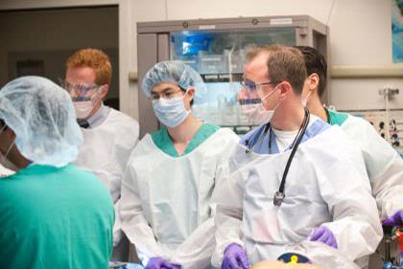
Education: Residency
69% of programs are 3 years
13 residents per year
21% with departmental funded residents
57% report a required EM Clerkship

Slide 46
Off Service Residents
50% of provider staffing = residents
37,595 annual hours
30% of resident hours are off service (5.4 FTE)
43% reported a decrease in off service hours
 | ACCM | Family | IM | GYN/OB | Ortho | Surgery | Other
% Yes | 7% | 13% | 56% | 15% | 25% | 0% | 14%
Reduction in physician staffing?
Increase in other physician staffing?
Increase in APP staffing?

Slide 47
New questions
Occupancy data:
  Hospital MN Occupancy
  DOM MN Occupancy
  DOM 7am Occupancy
Telemedicine in the ED
Provider in triage/intake
Throughput data:
  Arrival to triage and Arrival to room
Professional fee billing data
  Impact of January 2023 changes
Residency questions
  Off service rotators in ED
Faculty data
  Clarification of clinical hours
  Research funding

Slide 48


General Operations
Do you utilize telemedicine in your ED?
  37% of reporting departments utilize telemedicine

Slide 49
General Operations
Do you have a provider at “intake”
 | All responders (90) | Positive Responders
Do not have a provider | 42%
Attending and APP | 21% | 37%
Attending MD only | 18% | 31%
APP only | 10% | 17%
Resident and APP | 3% | 6%
Resident and Attending | 3% | 6%
Resident, Attending, APP | 2% | 4%
Virtual provider | 0% | 0%
Total | 100% | 100%

Slide 50
Inpatient Occupancy
All beds
Academic = 89%
Community = 80%
DOM beds
Academic = 91%
Community = 80%
DOM beds
Academic = 94%
Community = 80%

Slide 51


Inpatient Occupancy
Academic Centers
Occupancy: 94%
Boarding: 8.0 hours
Community Hospitals
Occupancy: 80%
Boarding: 4.1 hours

Slide 52
Academic Emergency Medicine
Tripartite Mission
Research
Teaching
Patient Care

Slide 53


Research – Where have we been
Emergency Medicine Grant Activity FY 23
  Institutions reporting Active Grants: 41
  Institutions reporting Active NIH Grants: 34
Notes:
Number of institutions have trend in decline over five years from 55 to 49 to 42 to 48 to 45 to 40 to 39
NIH decline follows similar 44 to 43 to 37 to 41 to 37 then reduced to the 32

Slide 54
Submissions and Awards
Reported Grant Submissions and Awards
 | FY 14 | FY 15 | FY 16 | FY 17 | FY 18 | FY19 | FY20 | FY21 | FY22 | FY23
Number Submitted | 784 | 733 | 1,026 | 915 | 782 | 938 | 1,158 | 892 | 758 | 861
Awarded from Submissions | 336 | 342 | 507 | 373 | 334 | 350 | 356 | 283 | 296 | 248
Conversion Rate | 42.9% | 46.7% | 49.4% | 40.7% | 47.6% | 37.4% | 44.3% | 38.4% | 39.1% | 37.9%
Awarded from submissions is a calculation based upon a subset of institutions that reported conversion rate and
number of the grants submitted.
Notes:
Awarded from submissions is calculation based on submitted grants and the conversion rate for those that reported conversions

Slide 55
Grant Spending
Notes:
NIH of $107M is about 77% of the blue ridge total of $137M in awards
Of note – CDC 1 for $15M (UCLA) and industry 1 for $6.6M
Other federal seems trending towards pre covid base line

Slide 56
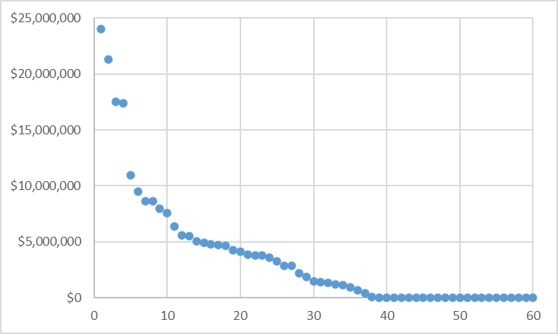
Total spending by institution
Total Grant Spending
Reporting Institutions
Notes:
Continued trend upwards of spending

Slide 57
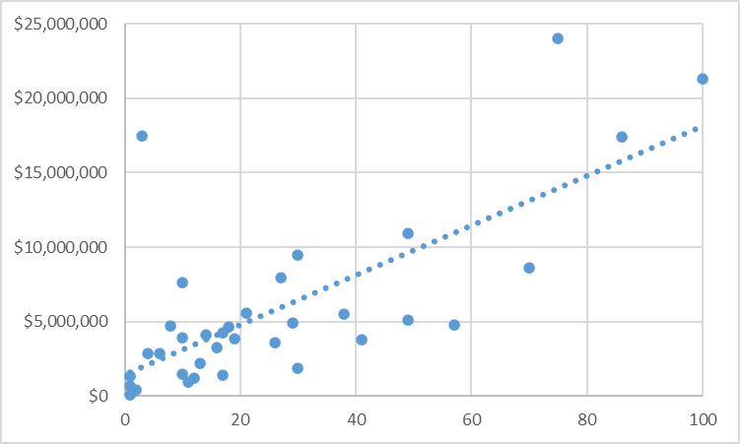
Grants submitted to total spending
Total Grant Spending
Number of Grants Submitted
Notes:
Correlation between the number of grants submitted and the total spending. Could be more spending leads to submitting more grants or submitting more grants leads to more research spending.
Number of submissions going up – increase from 4 to 6 to 7 instutitutions with >40 grants submitted.

Slide 58
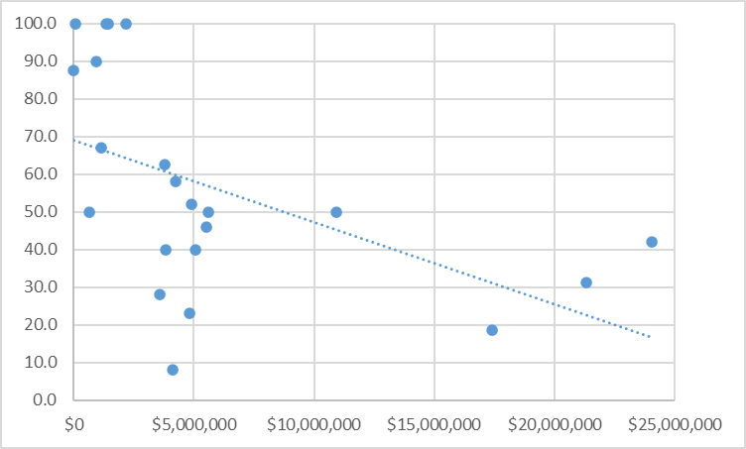
Grant success rate to total spending
Grant Success Rate
Total Grant Spending
Notes:
We looked at grant success rate by rank, by size of spending, number of grants submitted, all the data seems to indicate an approximate success rate of about 40% and does not appear to be dependent on any variable, ie the institutions with high submisssions and by rank all seem to have approximately the same success rate, this is consistent over a couple years.

Slide 59
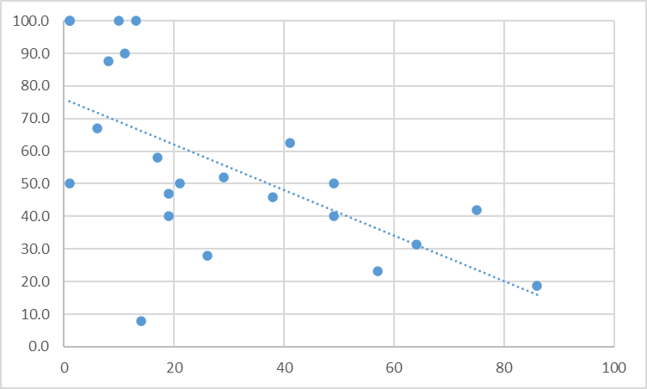
Grant success rate to grants submitted
Grant Success Rate
Number of Grants Submitted
Notes:
Success rate was typically around 40% for all, will be interesting to see if the two higher sites go back up

Slide 60
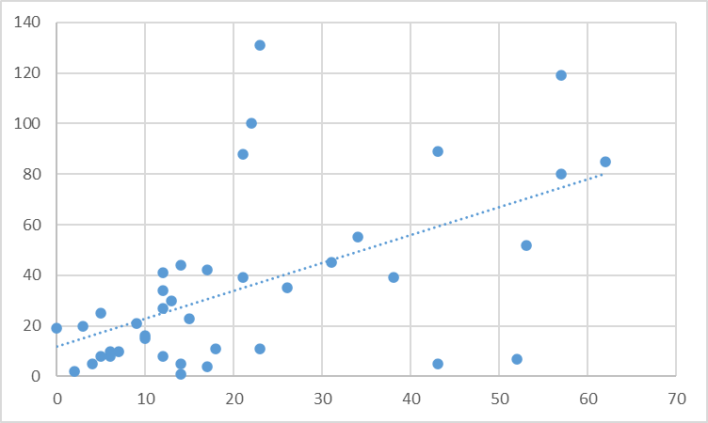
Grants compared to PI’s
Number of faculty doing research
Number of Active Grants
Notes:
Same sloped line when doing tenured faculty vs any faculty but smaller sample size

Slide 61
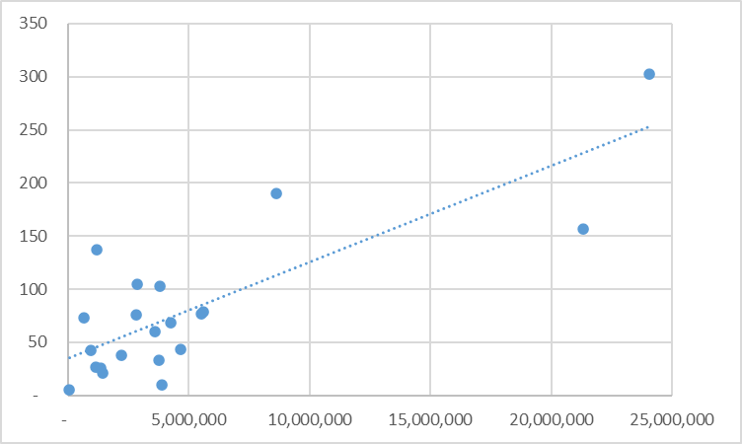
Peer Reviewed publications and annual research grants and spending
Total Publications
Total Publications
Number of Active Grants
Total Grant Spending
Notes:
Amount of the grants does not seem to impact the number of publications – more grants is same slope as funding

Slide 62
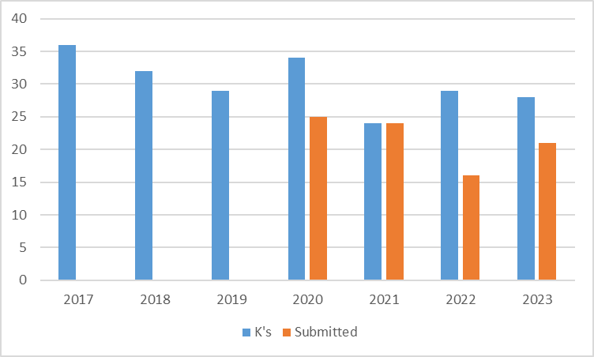
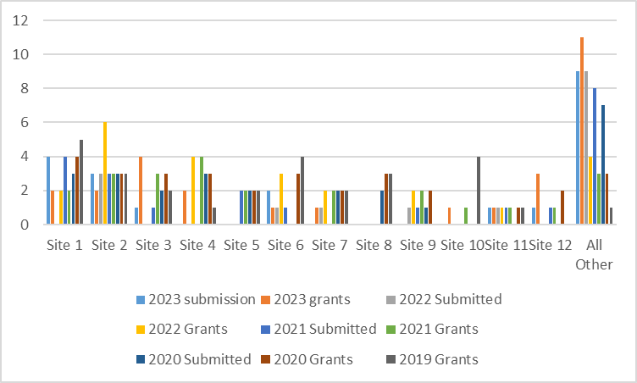
Use of Funds to support K awards
Institutions reporting K’s slightly increasing over prior three years. (16,14,15,20)
Institutions submitting new K’s consistent over past four years.
4 institutions without active K’s submitted new K’s
Number of K awards
Other sites have trend of increasing K award applications.
Number of K awards
Notes:
The graphs show institutions that had active K awards or submitted K awards this year. There are 7 institutions that currently do not have K awards and of those 16 institutions that do have K’s, 10 submitted new awards.

Slide 63
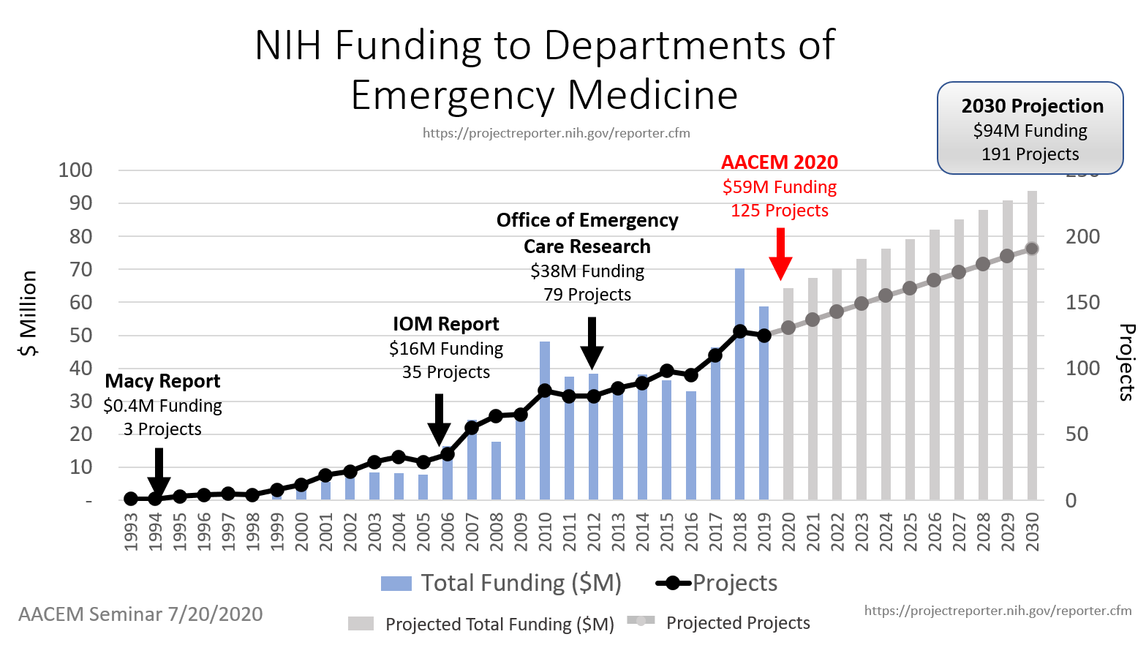
AACEM Chair Research Goals
Notes:
2023 projection from the chairs had $73M and 145 projects on way to $100M and 191 projects
$137M total NIH funding: 2030 goal = $100M
206 NIH-funded projects: 2020 goal = 200
147 NIH-funded EM PIs (22 K awardees): 2030 goal = 150
45 departments with NIH-funded PIs: 2030 goal = 50
2.2% of Med School EM faculty are NIH-Funded PIs: 2030 goal 3%

Slide 64
Progress to 2030 Goals
$137M total NIH funding: 2030 goal = $100M
206 NIH-funded projects: 2020 goal = 200
147 NIH-funded EM PIs (22 K awardees): 2030 goal = 150
45 departments with NIH-funded PIs: 2030 goal = 50
2.2% of Med School EM faculty are NIH-Funded PIs: 2030 goal 3%
Notes:
2023 projection from the chairs had $73M and 145 projects on way to $100M and 191 projects
$137M total NIH funding: 2030 goal = $100M
206 NIH-funded projects: 2020 goal = 200
147 NIH-funded EM PIs (22 K awardees): 2030 goal = 150
45 departments with NIH-funded PIs: 2030 goal = 50
2.2% of Med School EM faculty are NIH-Funded PIs: 2030 goal 3%

Slide 65
Thank You

Slide 66
Academy of Administrators in Academic Emergency Medicine
Annual Meeting 2012
Benchmark Data Summary
Fiscal Year 2011
April 3, 2012
J. Scheulen
Department of Emergency Medicine
Johns Hopkins Medicine

