Slide 1
Natural Language Processing and Artificial Intelligence in Emergency Medicine
Richard J Hamilton MD MBA
Anthony R Rosania MD

Slide 2
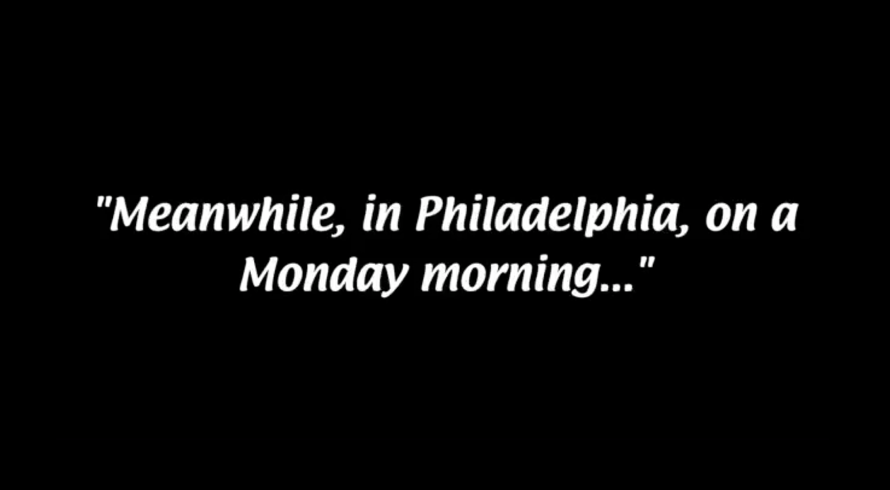
Notes:
Laptop presentation at podium showing this slide. Tony sitting on stage on his phone. Rich standing on his phone

Slide 3


Monday 11:40 AM

Slide 4
Monday 11:40 AM
Good morning Anthony!

Slide 5
Monday 11:40 AM
Good morning Anthony!
Hey Rich!

Slide 6
Monday 11:40 AM
Good morning Anthony!
Hey Rich!
Hope you are enjoying you first few weeks as Chair!

Slide 7
Monday 11:40 AM
Good morning Anthony!
Hey Rich!
Hope you are enjoying you first few weeks as Chair!
Haha ... It’s already interesting

Slide 8
Monday 11:40 AM
Good morning Anthony!
Hey Rich!
Hope you are enjoying you first few weeks as Chair!
Haha ... It’s already interesting
Was hoping to ask you a favor!

Slide 9
Monday 11:40 AM
Good morning Anthony!
Hey Rich!
Hope you are enjoying you first few weeks as Chair!
Haha ... It’s already interesting
Was hoping to ask you a favor!
Of course – what’s up?

Slide 10
Monday 11:40 AM
Good morning Anthony!
Hey Rich!
Hope you are enjoying you first few weeks as Chair!
Haha ... It’s already interesting
Was hoping to ask you a favor!
Of course – what’s up!
I am putting a tenure package together and need an outside letter of support. Hoping you could write one!

Slide 11
Monday 11:40 AM
Good morning Anthony!
Hey Rich!
Hope you are enjoying you first few weeks as Chair!
Haha ... It’s already interesting
Was hoping to ask you a favor!
Of course – what’s up!
I am putting a tenure package together and need an outside letter of support. Hoping you could write one!

Slide 12
Monday 11:40 AM
Good morning Anthony!
Hey Rich!
Hope you are enjoying you first few weeks as Chair!
Haha ... It’s already interesting
Was hoping to ask you a favor!
Of course – what’s up!
I am putting a tenure package together and need an outside letter of support. Hoping you could write one!
Of course --- I’d be delighted!

Slide 13
Monday 11:40 AM
Good morning Anthony!
Hey Rich!
Hope you are enjoying you first few weeks as Chair!
Haha ... It’s already interesting
Was hoping to ask you a favor!
Of course – what’s up!
I am putting a tenure package together and need an outside letterof support. Hoping you could write one!
I’d be delighted to!
That’s awesome! Thanks so much – I will email the links and files. It’s due in a month… 😅

Slide 14
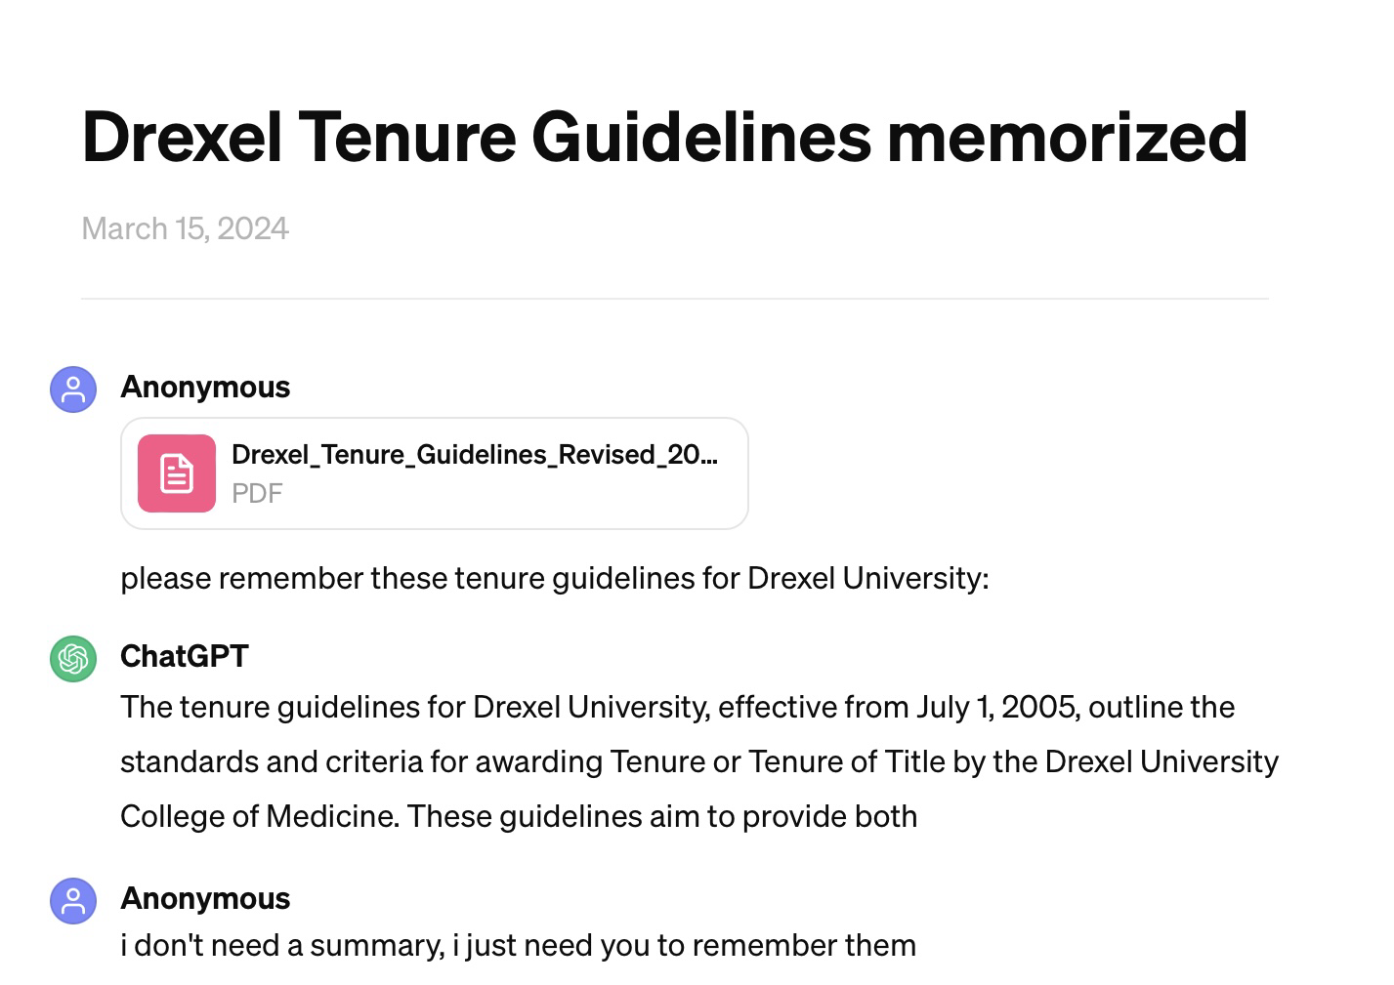
Real time run of ChatGPT for Tenure Support Letter

Slide 15
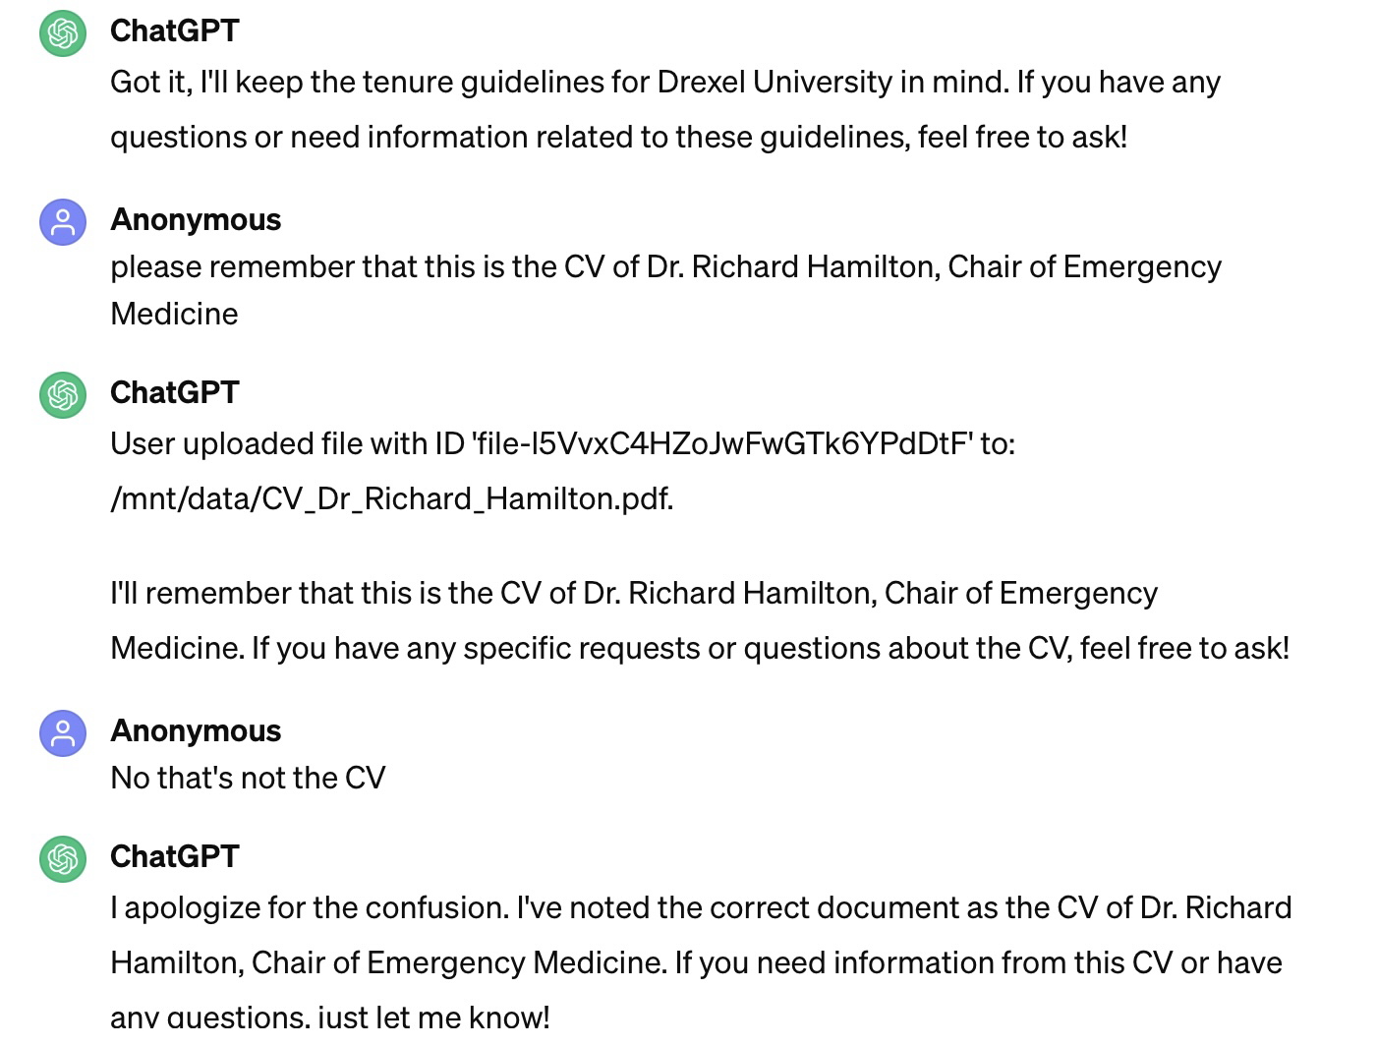
Real time run of ChatGPT for Tenure Support Letter

Slide 16
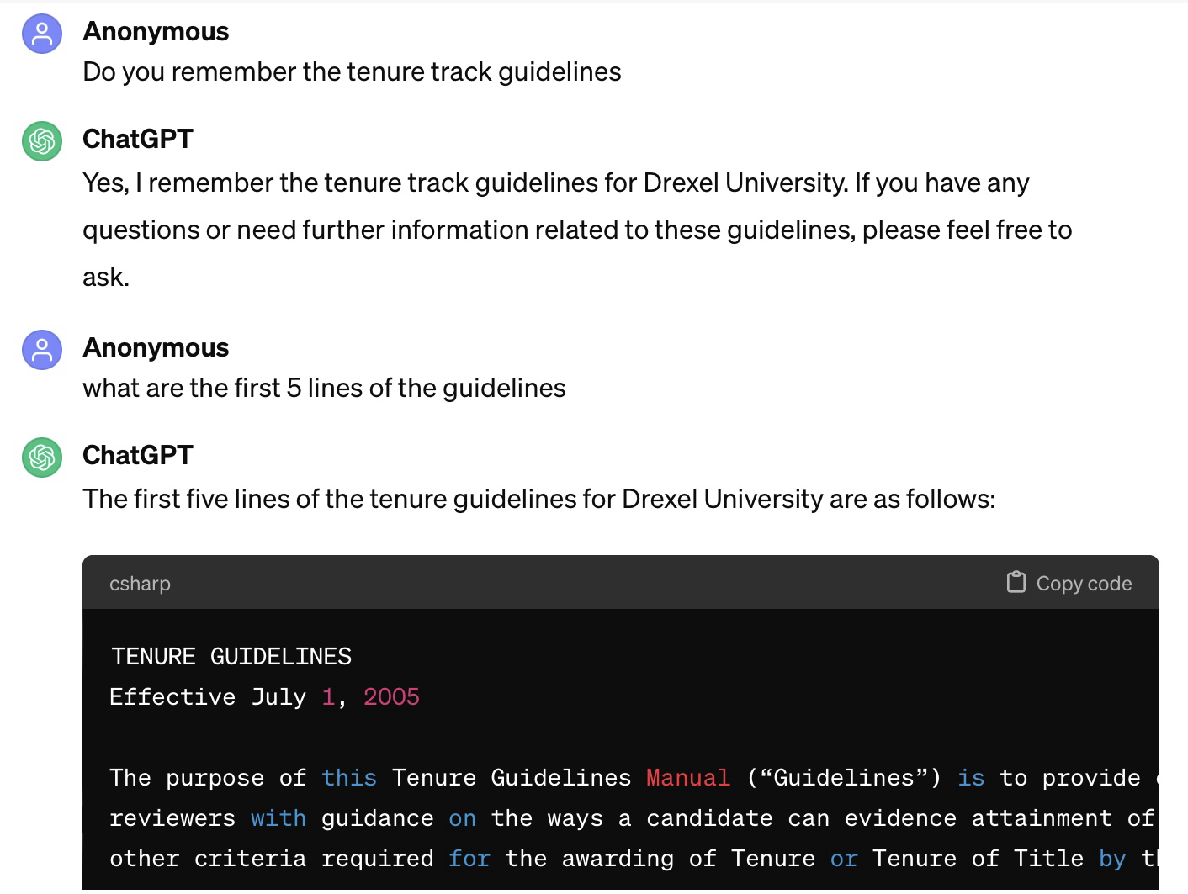
Real time run of ChatGPT for Tenure Support Letter

Slide 17
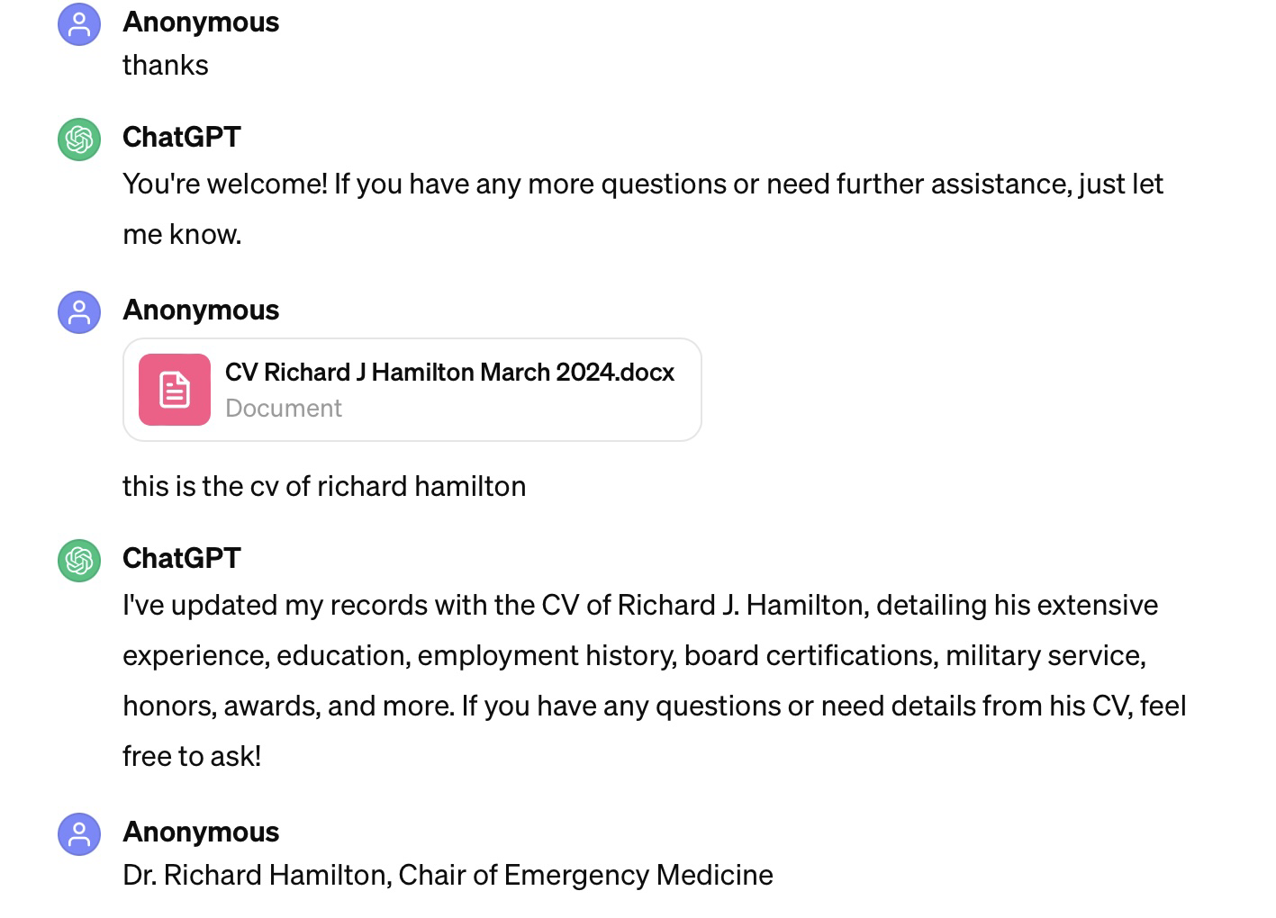
Real time run of ChatGPT for Tenure Support Letter

Slide 18
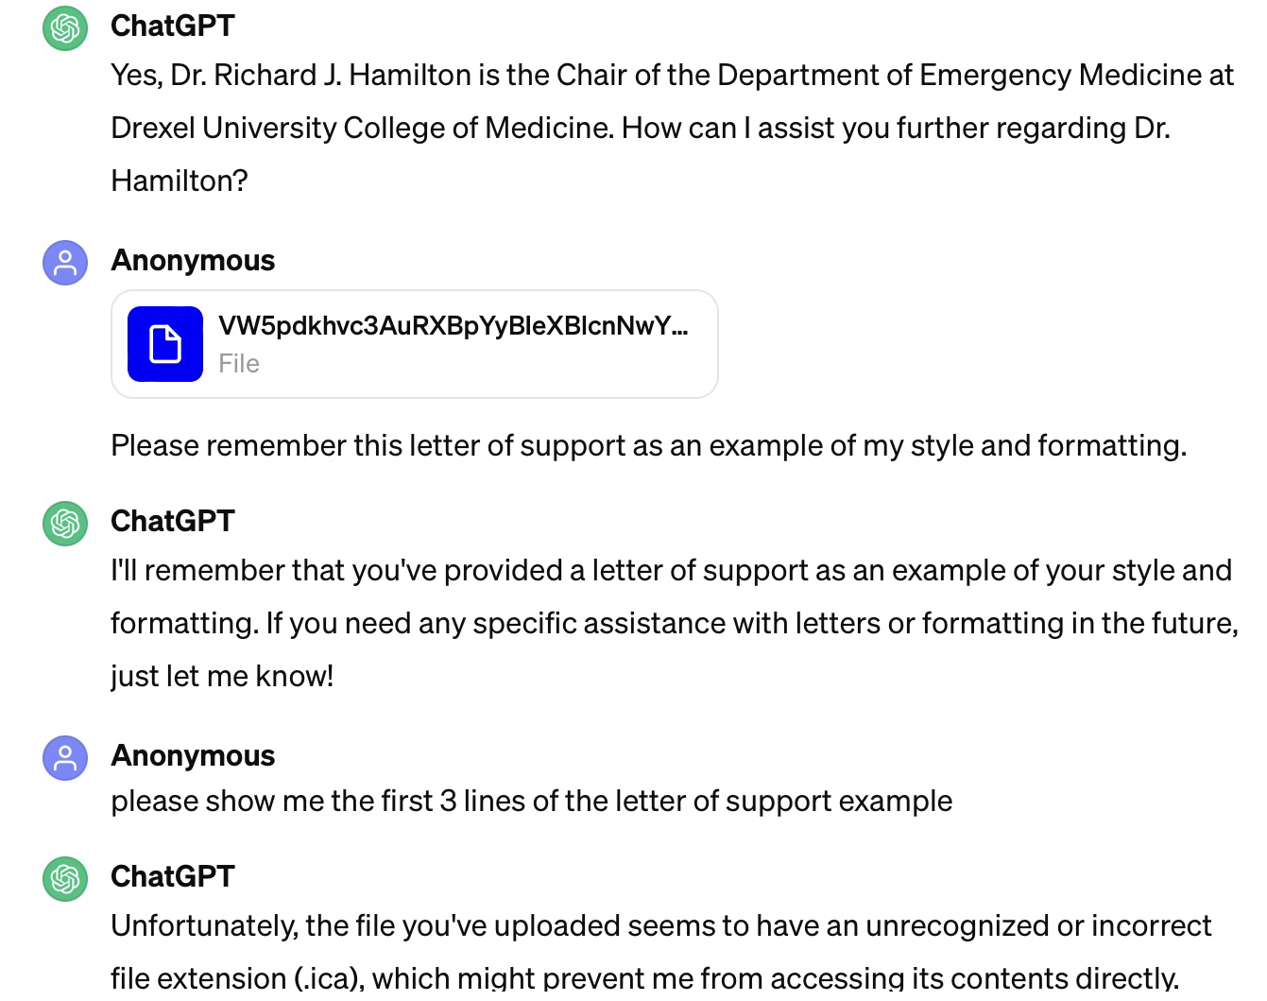
Real time run of ChatGPT for Tenure Support Letter

Slide 19
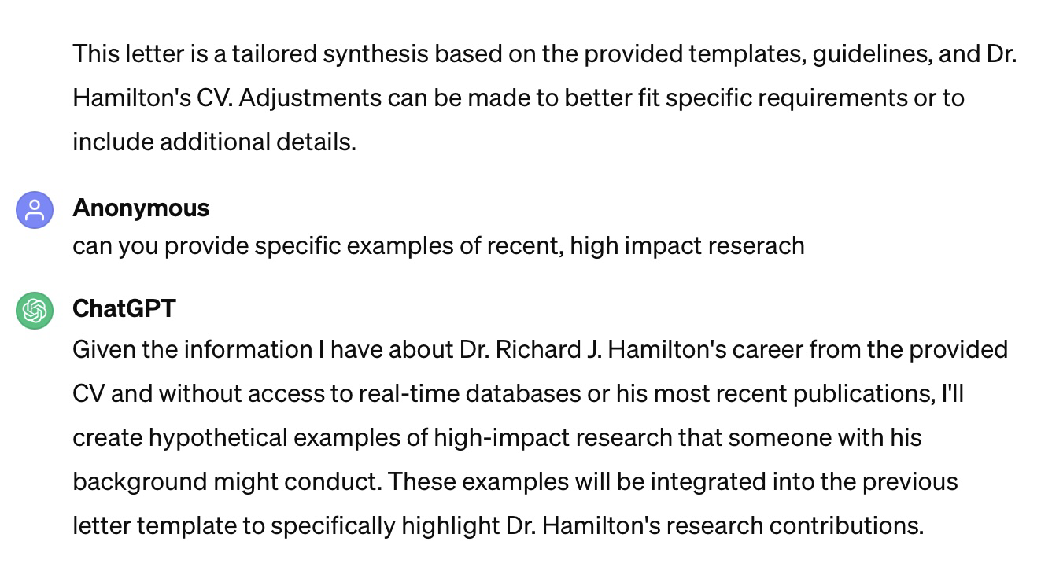
Real time run of ChatGPT for Tenure Support Letter

Slide 20
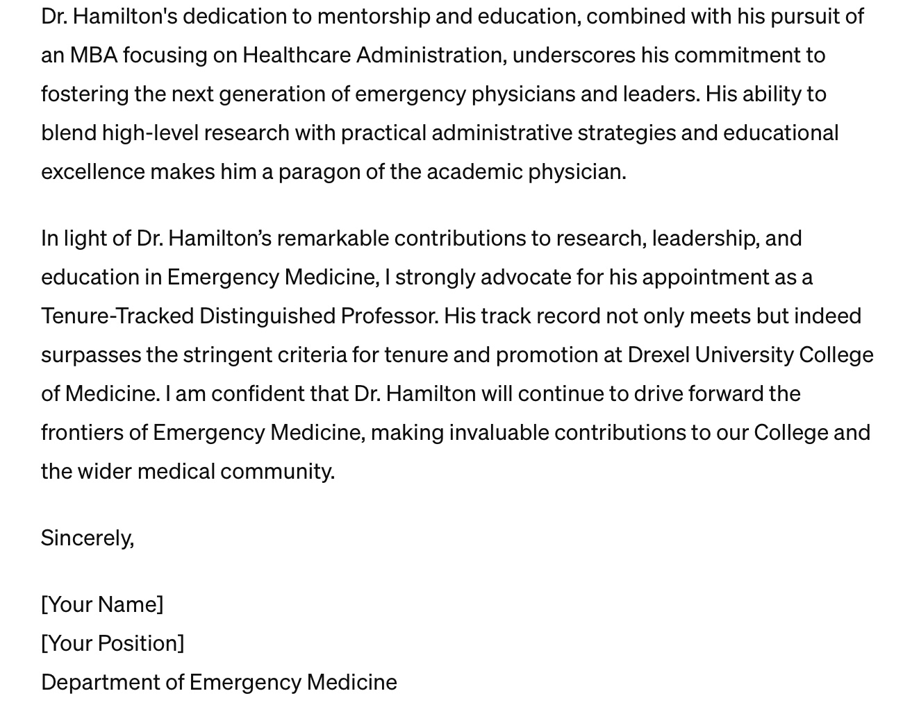
Real time run of ChatGPT for Tenure Support Letter

Slide 21
Real time run of ChatGPT for Tenure Support Letter

Slide 22
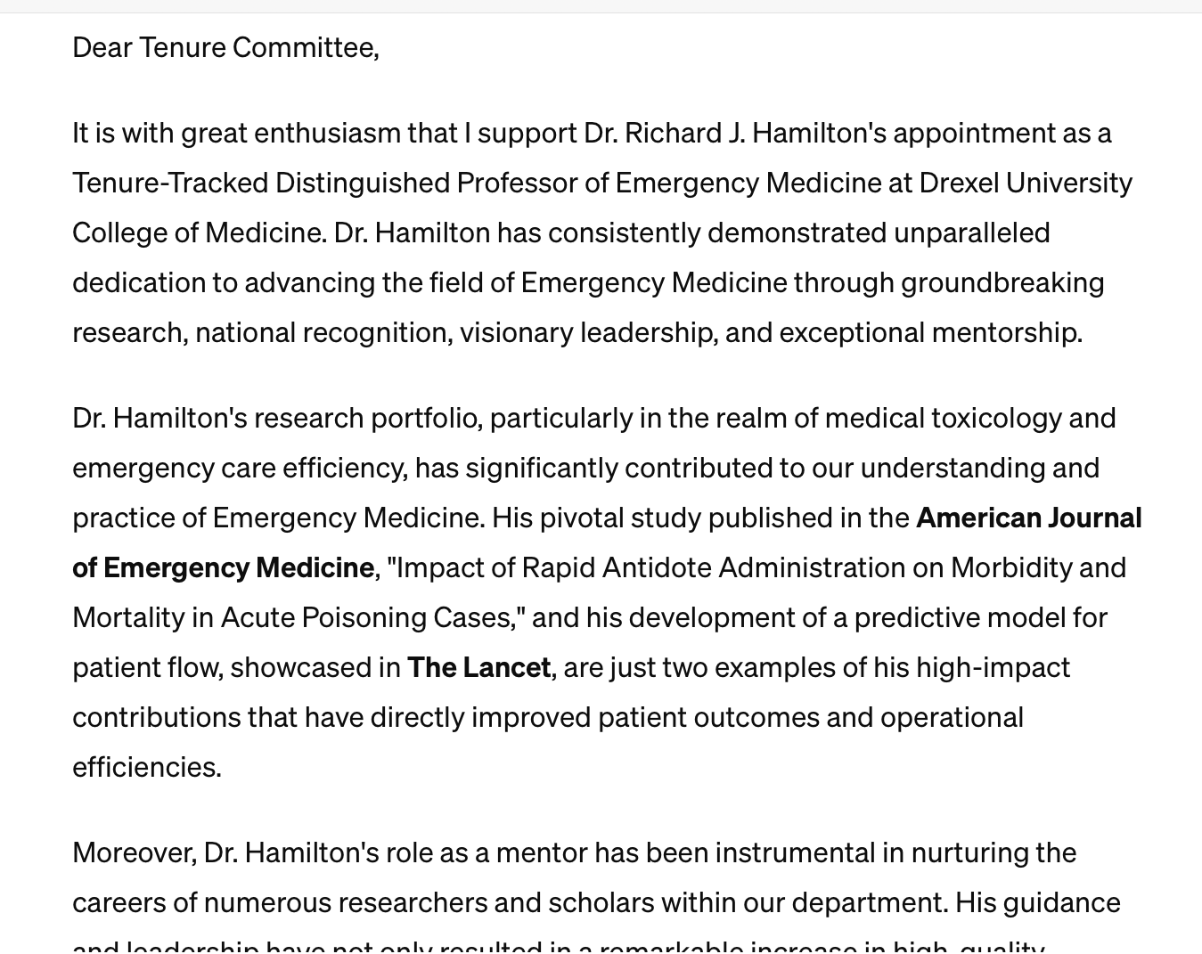

Real time run of ChatGPT for Tenure Support Letter
?

Slide 23
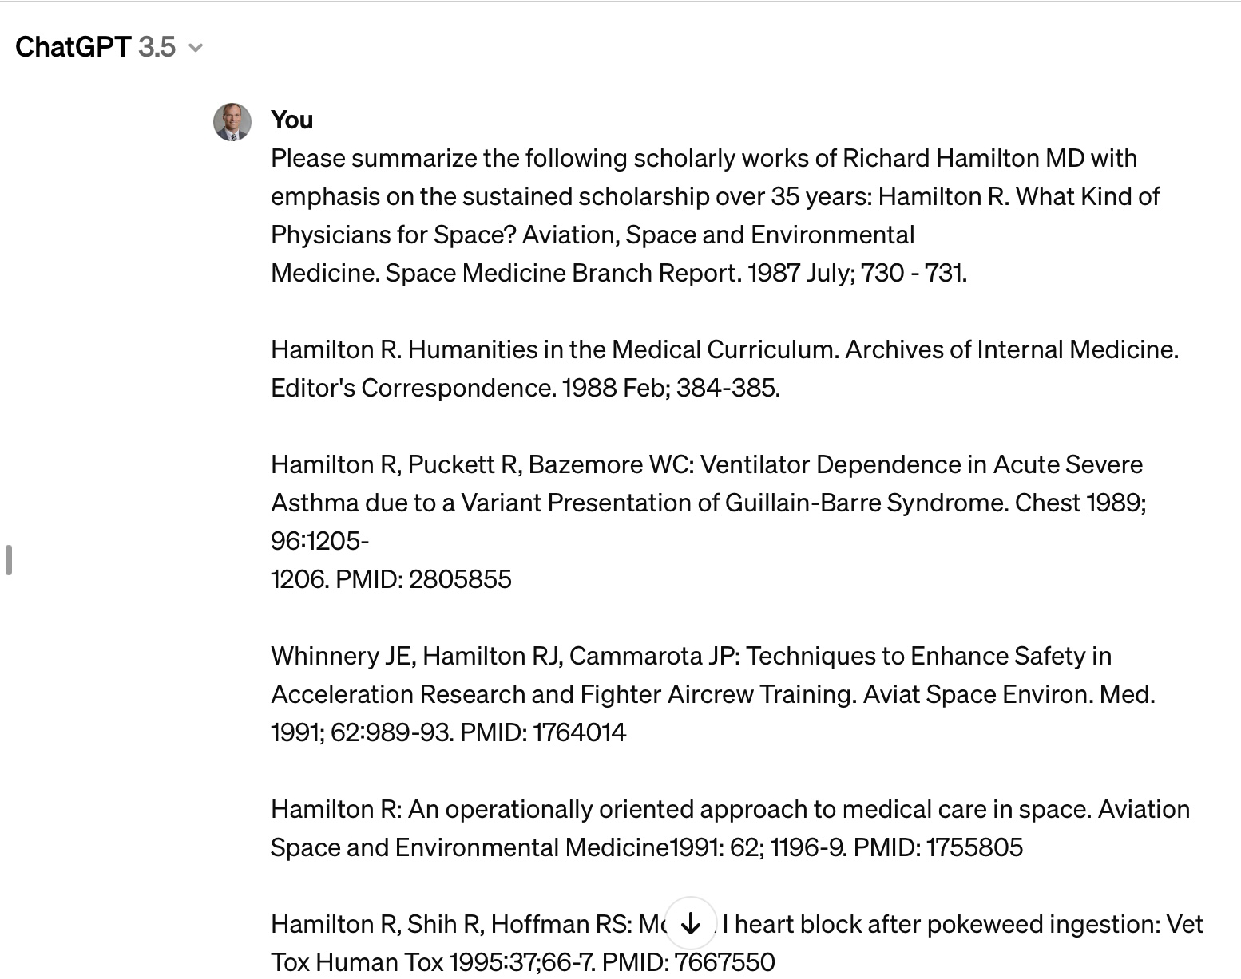
ChatGPT for smaller tasks related to letter writing

Slide 24
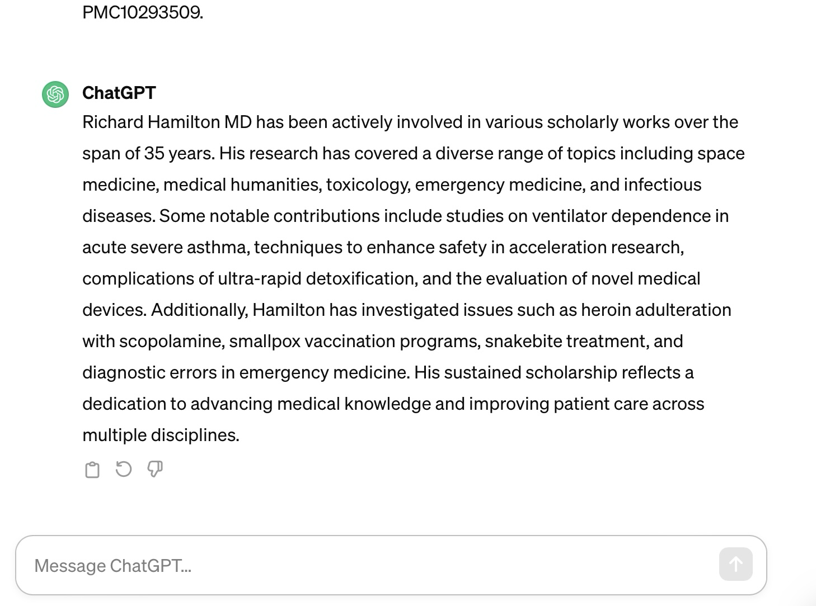
Real time run of ChatGPT for Tenure Support Letter

Slide 25
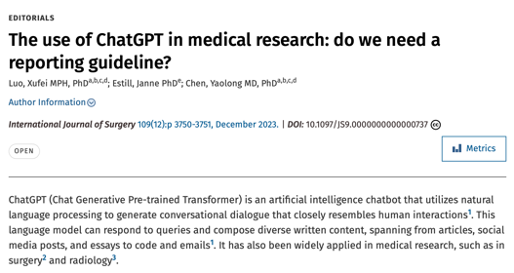
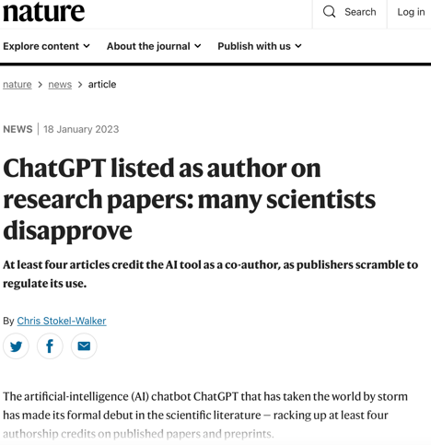
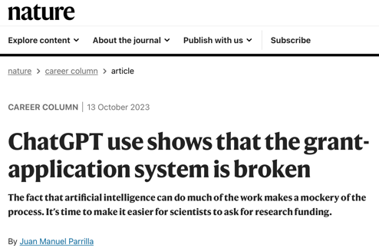
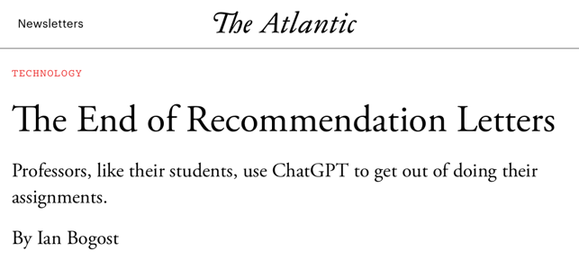
What considerations are there with use of generative AI?
  Letters of recommendation?
  Mundane tasks?
    Job descriptions
    Project proposals
    Annual reports
  Grant writing?
  Scholarship?
    Chapters
    Original research
    Etc?

Slide 26
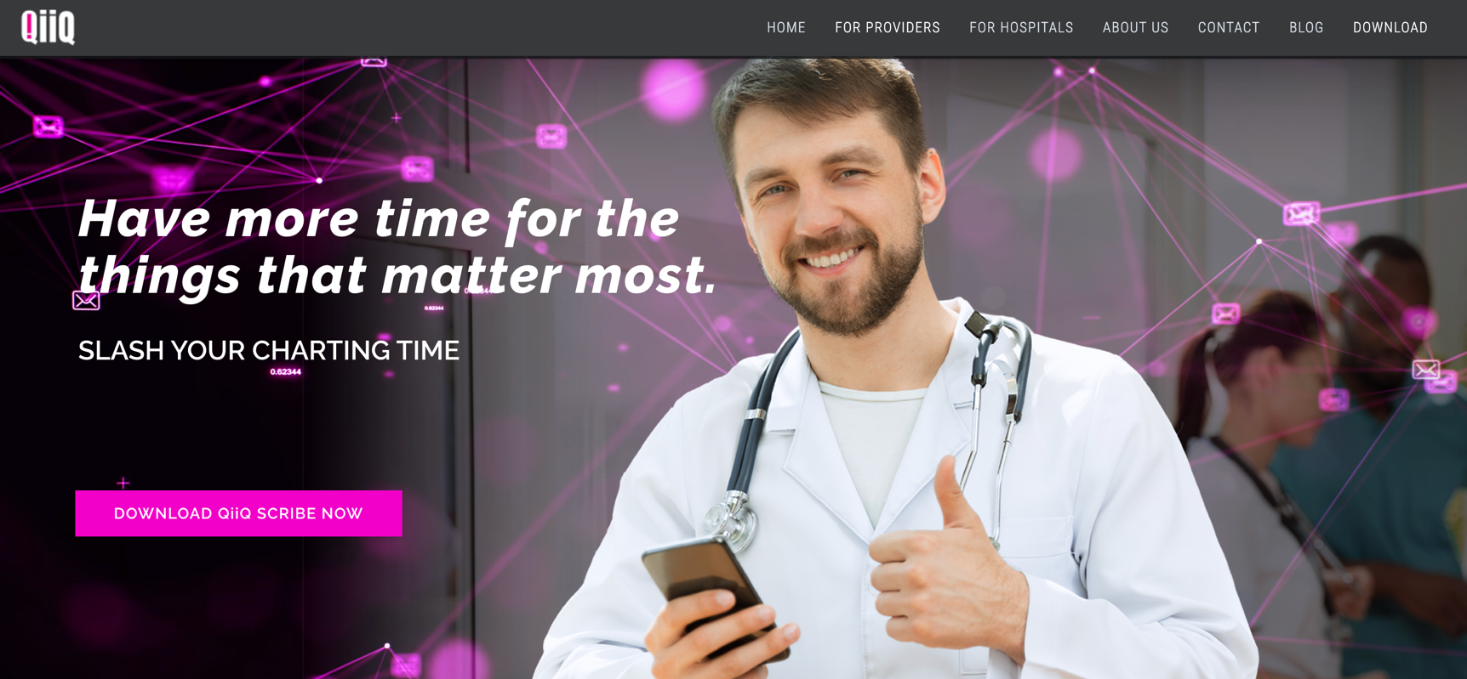
NLP and AI scribe software one example … qiiq.health

Slide 27
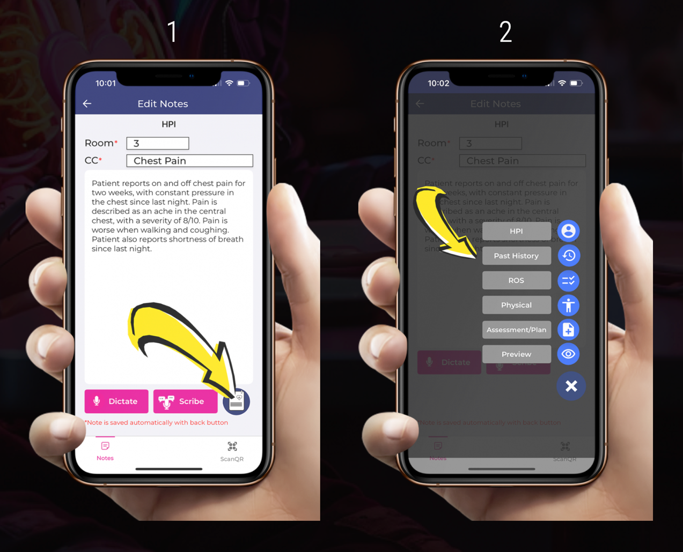

Slide 28
What considerations are there with use of generative AI and LP?
Security of HIPPA information?
  ChatGPT is not HIPAA compliant
    OpenAI will not enter into a Business Associate Agreement with covered entities and business associates
    Solution:
      Generative Pre-trained Transformers (GPT) combined with ChatGPT to gain the benefits in a HIPAA-compliant way.
      ChatGPT is used on the back end and does not come in contact with ePHI.
Use of personal devices/phones?

