Slide 1
AAAEM Executive and Committee Reports
San Juan, Puerto Rico
March 2024
David Christiansen

Slide 2
Executive Committee
President – David Christiansen, University of Florida College of Medicine, Jacksonville
Past President – Amy Jameson, University of New Mexico
President Elect – Becky McGowan, University of Colorado Denver School of Medicine
Treasurer – Jennifer Patton Muir, The Brody School of Medicine at East Carolina University
Secretary – Steve Maxwell, University of Michigan
Member at Large – Diane C. Lee, Jefferson Einstein Hospital
Member at Large – Brendan Russell, Mass General Brigham
SAEM Board Liaison – Erin Campo
SAEM Staff Liaison – Ali Raja, MD MBA
Member at Large AACEM Liaison - Open

Slide 3
Incoming EC Members/Committee Openings
Secretary: Brendan Russell, Mass General Brigham
Member at Large: Diane C. Lee, Jefferson Einstein Hospital
Member at Large: Kashwayne Williams, Washington University St. Louis
Strategic Planning – Chair or Co-Chair needed
Membership – Co-Chair needed

Slide 4
AAAEM 2023-2024 Committee Chairs
Benchmark - Greg Archual, MBA and Jim Schuelen, PA MBA
Communications – Cali Myers, MHA
Inclusiveness, Diversity, Equity and Anti-Racism (IDEA) - Louis Burton, MHSM
Education & Professional Development Committee – Frank Jurkiewicz, III, MBA
Membership Committee - Steve Petrovic, MBA
Strategic Planning – Ambroysa Amlong
Nominating Committee – Amy Jameson, MBA MPhil
Wellness Workgroup – Katy Oksuita, MS

Slide 5
AAAEM Treasurer's Report
March 2024
Jennifer Muir
AAAEM Treasurer

Slide 6
Finance Committee Members 2023
Amy Jameson, University of New Mexico
Becky McGowan, University of Colorado Anschutz Medical Campus
Brendan Russell, Harvard University
Dave Christiansen, University of Florida – Jacksonville
Diane Lee, Jefferson Einstein
Jennifer Muir, East Carolina University
Steve Maxwell, University of Michigan
Travis Schmitz, Northwestern University

Slide 7
Finance Committee Activities 2023
*Reviewed Monthly Revenue & Expenses for AAAEM and CAEMA
•Reviewed Member Assistance Program applications
•Developed 2024 Budget

Slide 8
2023 Year End Statement (Unaudited)

Slide 9
2024 Budget (January –December)
CY 24 Budget Considerations
Retreat Cost
Budget entry for AAAEM Committees
Reducing Costs/Increasing Revenue for Sustainability

Slide 10
Benchmark Committee
March 2024
Jim Scheulen/Greg Archual

Slide 11
Benchmark Committee Members
Gregory M. Archual, MBA (Co-Chair) James J. Scheulen, PA MBA (Co-Chair)
Kathleen M. Acevedo, MBA Louis E. Burton, MHSM FACHE
David Christiansen, MBA Gai Cole, DrPH MBA MHA
Theodore Corbin, MD Robert Eisenstein, MD
Sara Engle, MBA Amy Jameson, MPhil MA MBA
Kenny Lopiano, PhD Steve Maxwell, MSM
Becky McGowan, MBA Ashlee Melendez, MSPH BSN
Jennifer Patton Muir, EdD MBA Ryan Pauline, MBA FACHE
Steven Petrovic, MBA Brendan Russell, MBA
Kain C. Robbins Travis W. Schmitz, PhD MBA
Benjamin Sun, MD Alyssa Tyransky, MTDA
Gregory Volturo, MD

Slide 12
Benchmark Committee Purpose Statement
The Benchmark Committee is responsible for development and distribution of the annual benchmarking Emergency Medicine operations and salary surveys. Members of the committee will also gather, collate, and present survey results. The surveys are data gathering instruments designed to capture each site’s unique information that can be used to compare across all sites. The benchmark data is used by Department Administrators and Chairs as a basis for strategic and operational decision making within their institutions for needed resources equal to our counterparts in other like emergency departments.

Slide 13
Benchmark Committee Activities
Annual in-person meeting occurred in June to discuss changes to the surveys
Committee had monthly calls to discuss progress and refine questions
Performed annual Benchmark survey
  92 academic/affiliated responses
Performed Faculty & APP Salary Surveys
Salary survey

Slide 14
Benchmark Committee Membership
2 Co-Chairs, Data Manager, Roundtable representative, & AACEM members are not included in numbers below
15 AAAEM members (must have completed surveys for the past 2 years)
  5-year terms, 3 members per term, can be renewed once
  Accepting applications for 3 new members for a 5-year term
    Co-Chairs will select new members
    Diversity (e.g race, ethnicity, geographic, size of institution, private v state owned, etc) of committee will be considered when selecting new members
    Applicants must email their CV & letter of intent to the Data Manager (Alyssa.Tyransky@osumc.edu) by April 12th

Slide 15
AAAEM Publications
Ulintz A, Tyransky A, Archual GM, Kadish CB, Panchal AR. “Clinical Duties and Compensation for US Emergency Medicine Fellows at Academic Centers: a Descriptive, Cross-Sectional Survey”. Academic Emergency Medicine: Education & Training. Accepted 1/23/2024.
Kilaru AS, Scheulen JJ, Harbertson CA, Gonzales R, Mondal A, Agarwal AK. Boarding in US Academic Emergency Departments During the COVID-19 Pandemic. Ann Emerg Med. 2023 Jan 19:S0196-0644(22)01328-2. doi: 10.1016/j.annemergmed.2022.12.004. Epub ahead of print. PMID: 36681622; PMCID: PMC9851166.
Van Heukelom et.al. Inpatient Boarding Definitions and Mitigation Strategies: A Cross-Sectional Survey of US Academic Emergency Departments. American Journal of Emergency Medicine. Accepted awaiting publication.
Rathlev NK, Holt NM, Harbertson CA, Hettler J, Reznek MA, Tsai SL, Lopiano KK, Bohrmann T, Scheulen JJ. 2017 AAAEM Benchmarking Survey: Comparing Pediatric and Adult Academic Emergency Departments. Pediatr Emerg Care. 2021 Dec 1;37(12):e1278-e1284. doi: 10.1097/PEC.0000000000002002. PMID: 31977768.
Reznek MA, Scheulen JJ, Harbertson CA, Kotkowski KA, Kelen GD, Volturo GA. Contributions of Academic Emergency Medicine Programs to U.S. Health Care: Summary of the AAAEM-AACEM Benchmarking Data. Acad Emerg Med. 2018 Apr;25(4):444-452. doi: 10.1111/acem.13337. Epub 2017 Nov 13. PMID: 29071804.
Wiler JL, Rounds K, McGowan B, Baird J. Continuation of Gender Disparities in Pay Among Academic Emergency Medicine Physicians. Acad Emerg Med. 2019 Mar;26(3):286-292. doi: 10.1111/acem.13694. Epub 2019 Feb 19. PMID: 30664286.
Archual GM, Panchal AR, Angelos MG, Way DP. The Impact of Selecting Specific Cohorts for Benchmarking and Interpretation of Emergency Department Patient Satisfaction Scores. Acad Emerg Med. 2020 May;27(5):388-393. doi: 10.1111/acem.13895. Epub 2019 Dec 23. PMID: 31778272.
Reznek MA, Larkin CM, Scheulen JJ, Harbertson CA, Michael SS. Operational factors associated with emergency department patient satisfaction: Analysis of the Academy of Administrators of Emergency Medicine/Association of Academic Chairs of Emergency Medicine national survey. Acad Emerg Med. 2021 Jul;28(7):753-760. doi: 10.1111/acem.14278. Epub 2021 Jul 8. PMID: 33977605.
Yiadom MY, Scheulen J, McWade CM, Augustine JJ. Implementing Data Definition Consistency for Emergency Department Operations Benchmarking and Research. Acad Emerg Med. 2016 Jul;23(7):796-802. doi: 10.1111/acem.12988. Epub 2016 Jul 1. PMID: 27121149; PMCID: PMC6805130.
Reznek MA, Michael SS, Harbertson CA, Scheulen JJ, Augustine JJ. Clinical operations of academic versus non-academic emergency departments: a descriptive comparison of two large emergency department operations surveys. BMC Emerg Med. 2019 Nov 21;19(1):72. doi: 10.1186/s12873-019-0285-7. PMID: 31752708; PMCID: PMC6868754.
Madsen TE, Heron S, Lall MD, Blomkalns A, Arbelaez C, Lopez B, Lin M, Rounds K, Sethuraman KN, Safdar B. Institutional solutions addressing disparities in compensation and advancement of emergency medicine physicians: A critical appraisal of gaps and associated recommendations. Acad Emerg Med. 2022 Jun;29(6):710-718. doi: 10.1111/acem.14452. Epub 2022 Feb 23. PMID: 35064998.
Peterson SM, Harbertson CA, Scheulen JJ, Kelen GD. Trends and Characterization of Academic Emergency Department Patient Visits: A Five-year Review. Acad Emerg Med. 2019 Apr;26(4):410-419. doi: 10.1111/acem.13550. Epub 2018 Sep 24. PMID: 30102817.
Madsen TE, Linden JA, Rounds K, Hsieh YH, Lopez BL, Boatright D, Garg N, Heron SL, Jameson A, Kass D, Lall MD, Melendez AM, Scheulen JJ, Sethuraman KN, Westafer LM, Safdar B. Current Status of Gender and Racial/Ethnic Disparities Among Academic Emergency Medicine Physicians. Acad Emerg Med. 2017 Oct;24(10):1182-1192. doi: 10.1111/acem.13269. Epub 2017 Sep 21. PMID: 28779488.

Slide 16
Communications Committee
March 2024
Cali Myers
Committee Chair
University of Alabama at Birmingham

Slide 17
Communications Committee Update
Newsletter
  Published: September, February
    New item: retiree spotlights
  To be published: April
    Highlight on retreat happenings
  Focus on a format which aligns with AAAEM/SAEM branding and clearness/consistency
  Struggle to get news about members

Slide 18
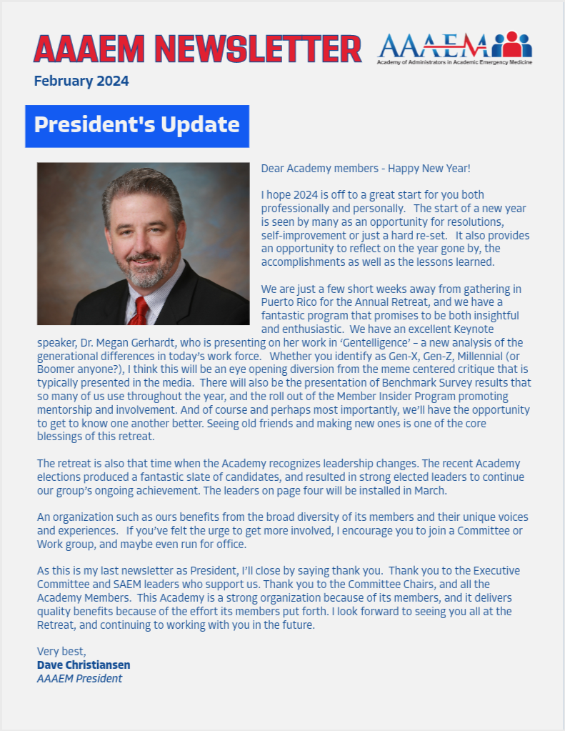
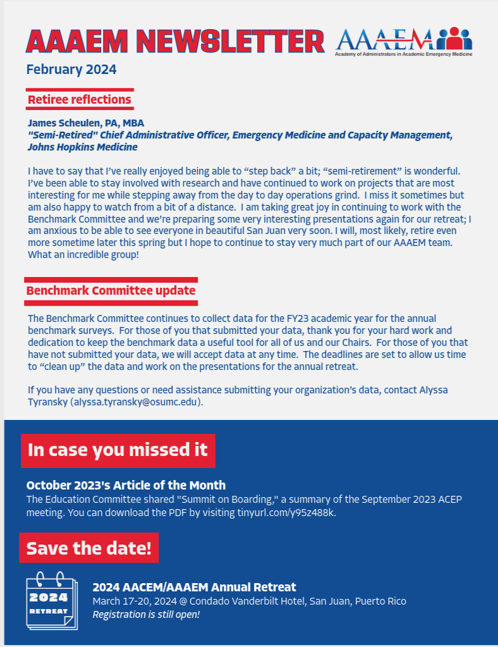
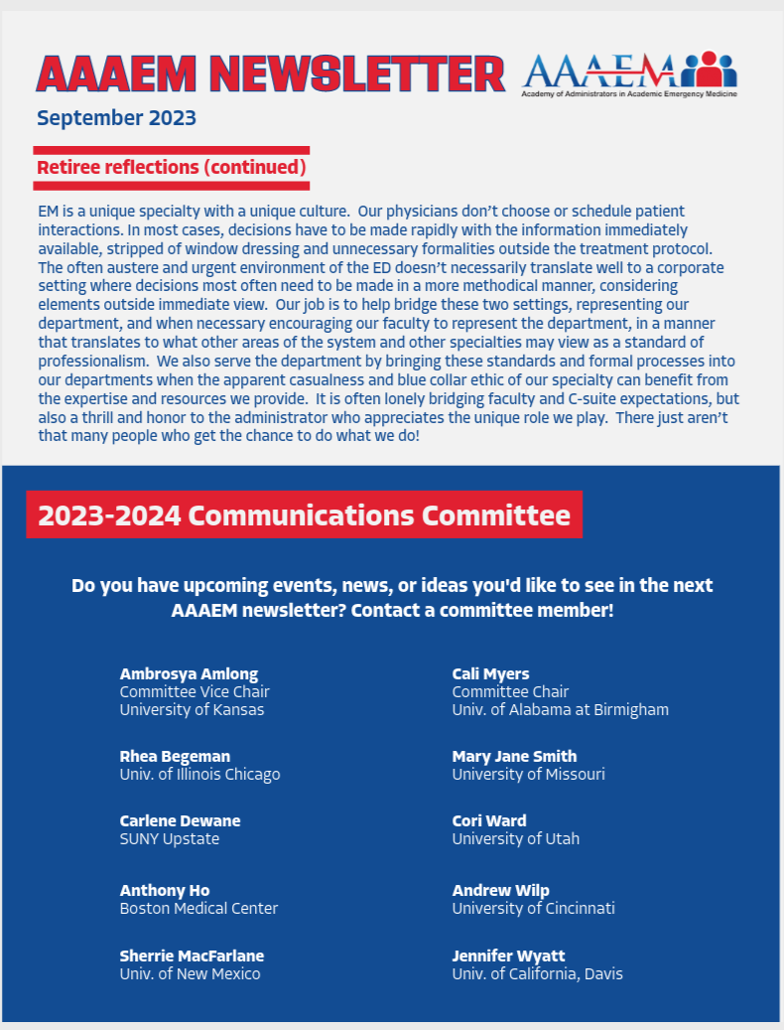
Communications Committee Update

Slide 19
Communications Committee Update
Thank you to our membership!
  Cori Ward, University of Utah
  Carlene Dewane, SUNY Upstate
  Sherrie Cornett, University of New Mexico
  Anthony Ho, Boston Medical Center
  Andrew Wilp, University of Cincinnati
  Jennifer Wyatt, University of California Davis
  Rhea Begeman, University of Illinois Chicago
  Mary Jane Smith, University of Missouri
  Ambrosya Amlong, University of Kansas (Vice Chair)

Slide 20
Inclusiveness, Diversity, Equity and Anti-Racism (IDEA) Committee Report
March 2024
Louis Burton

Slide 21
IDEA Committee Members
Rhea Begeman, University of Illinois at Chicago
Louis Burton, UT Health, San Antonio, TX
Bonnie Cheung, University of California—Los Angeles
Christine Hendricks, Stanford University, California
Katy Oksuita, University of Wisconsin-Madison
Diane Lee, Einstein Healthcare Network, Philadelphia, PA
Adrian Lopez, UT Health, San Antonio, TX
Justine Murphey, Stanford University, California
Laura Robinson, University of Nebraska Medical Center
Andrew Wilp, University of Cincinnati, Ohio

Slide 22
IDEA Goals and Activities 2024
Two Goals
  Increase Diversity of AAAEM Group
  Conduct Diversity Training/Education
  Increase Diversity of AAAEM Group
    Joint venture with AACEM DEI Committee
      Marketing of CAEMA Graduates – place on website – done
      Chairs letting AAAEM know of DA vacancies

Slide 23
IDEA Goals and Activities 2024
Diversity Training
  Conducted Journal Club – Book “How to be an Inclusive Leader”
  Submitted articles to AAAEM Quarterly Newsletter
Miscellaneous
  Requested funding AAAEM Executive Committee to establish CAEMA Diversity Scholarship – paid travel for 2 recipients
  Participation on AACEM Diversity Panel, Joint Retreat, PR

Slide 24
Education and Professional Development Committee
March 2024
Frank Jurkiewicz, MBA

Slide 25
Education and Professional Development Committee
2023-2024 Membership
  Ashlee Melendez, University of Louisville
  Becky McGowan, University of Denver School of Medicine
  Frank Jurkiewicz – Chair, University of Florida, Gainesville
  Adrian Lopez, University of Texas School of Medicine at San Antonio
  Brendan Russell – Vice Chair, Brigham and Women's Hospital
  Travis Schmitz, Northwestern Medicine
  Kenneth Taylor, Denver Health Hospital Authority
  Mary Jane Smith, University of Missouri
  Lauren Tanzer, Penn Medicine
  Sara Engel, Medical College of Wisconsin
  Cali Myers, University of Alabama at Birmingham
  Kashwayne Williams, Washington University St. Louis SOM
  Cori Ward, University of Utah
  Bonnie Cheung, University of California Los Angeles
  Cody Ching, University of Iowa Hospitals and Clinics

Slide 26
Education and Professional Development Committee
2023-2024 Accomplishments
  Committee hosted several education sessions
  Brendan Russell launched EM article of the month
  Updated committee name and charter

Slide 27
Education and Professional Development Committee
Committee Name Change:
  Reflecting on Past Accomplishments
  Extending Focus to Professional Development
  Aim for Clarity in Group Focus
  Supporting Member Education Through Professional Development

Slide 28
Education and Professional Development Committee
CAEMA Integration:
  Understanding Program Curriculum
  Potential Integration of Committee Members
  Leveraging Expertise Within Membership
  Valuable Opportunity for Collaboration

Slide 29
Education and Professional Development Committee
SAEM Didactic Coordination:
  Increasing Exposure at National Level
  Complexity of Current Submission Process
  Lack of Consistent Presence
  Need for Streamlined Process
  Enhancing Visibility and Impact Through Coordination

Slide 30
Membership Committee Report
Steven T Petrovic, MBA ​
Chief of Administrative Officer​
University of Cincinnati Physicians​
University of Cincinnati – College of Medicine

Slide 31
Membership Committee Members
Kathleen Acevedo, University of Virginia
Adrian Lopez, University of Texas – San Antonio
Becky McGowan, University of Colorado
Ryan Pauline, Thomas Jefferson
Steve Petrovic, University of Cincinnati
Kain Robbins, Penn State University
Lowell Tyler, Duke University
Kashwayne Williams, Washington University (St. Louis)

Slide 32
Membership Committee
Annual Goals:
Align AAAEM membership with the AACEM
13 New Members
Improve new membership onboarding
      AAAEM Mentorship Program
Increase membership with Associate & Emeritus Status
Maintained Largest Membership Panel in our history - 126
91 Administrator
33 Associate
2 Emeritus

Slide 33
Membership Committee

Slide 34
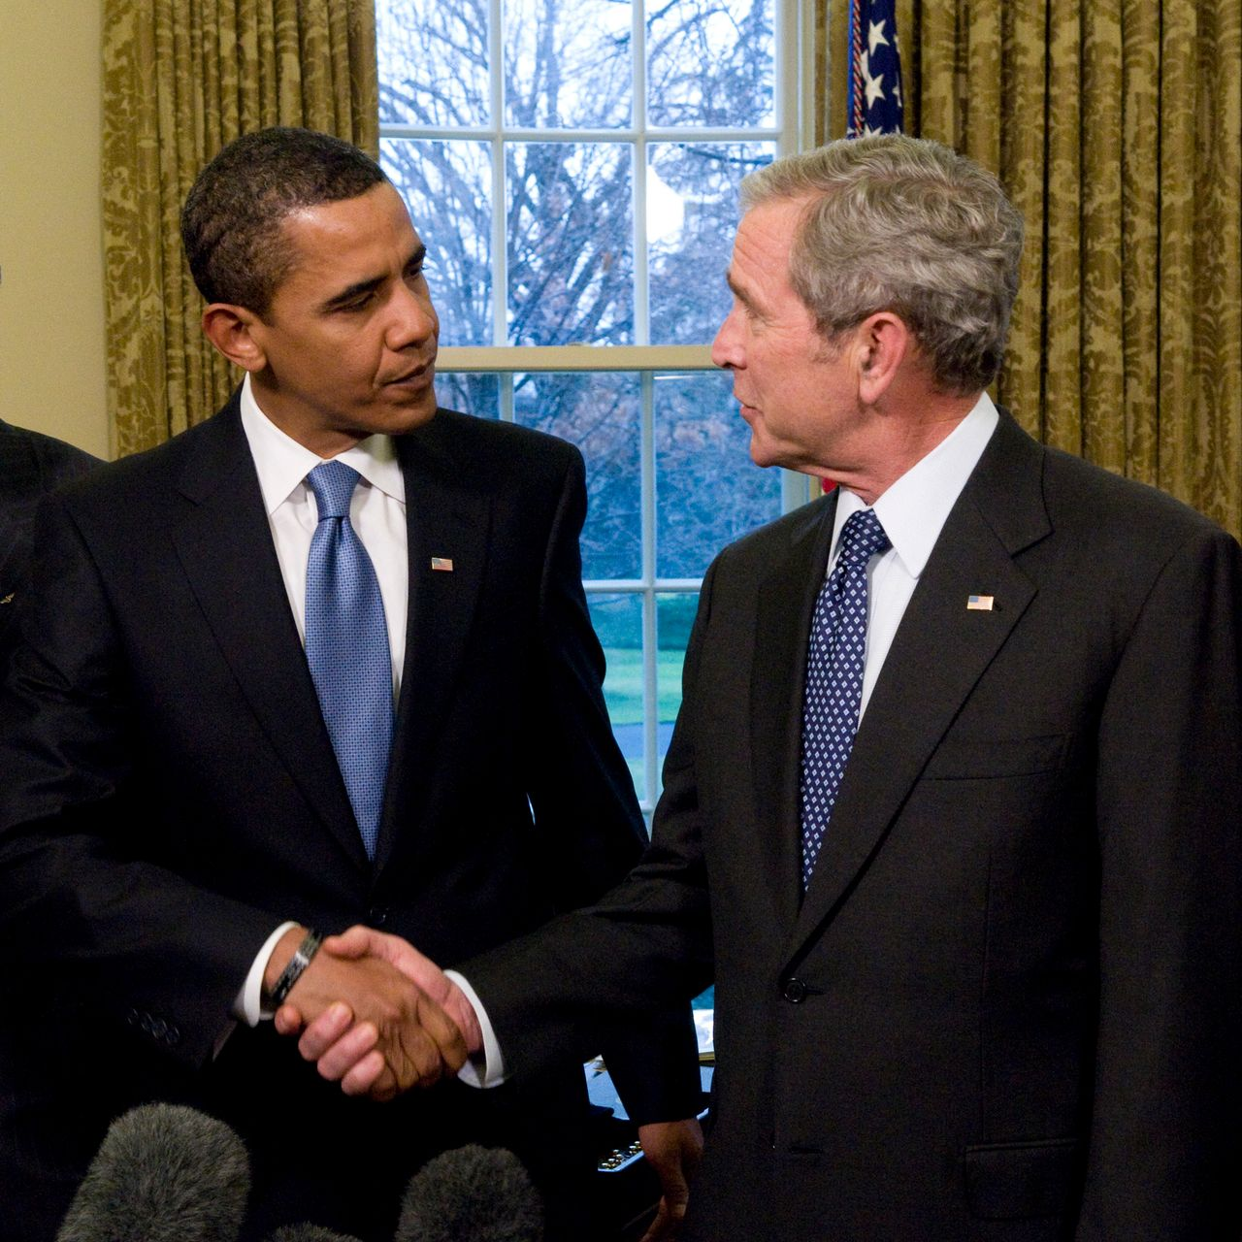
Membership Committee

Slide 35
Strategic Planning Committee
Annual Report
2023/2024
Ambrosya Amlong
Former Sr. Administrator
University of Kansas

Slide 36
AAAEM Strategic Planning Committee
2022/2023
Ambrosya Amlong, Chair – U of Kansas
Gai Cole, Vice Chair – Johns Hopkins
Kathleen Acevedo – U. of Virginia Health
Rhea Begeman – U of Illinois Chicago
Steve Maxwell – University of Michigan
Kashwayne Williams – Washington Univ
Anthony Ho – Boston Medical Center
Katie Oksuita – U of Wisconsin
Carlene Dewane – Upstate Med Univ
Mary Jane Smith – U of Missouri
Special thanks to Aimee Kalandras (Johns Hopkins) for meeting minutes.

Slide 37
2022/2023 Key Accomplishments
Updated & Reorganized Strategic Plan
  Member Engagement top priority
  Member Development secondary
  Inclusion of formal mentorship program under Member Development
Members Survey Modification
  Will not complete survey annually
  Will determine annually needs for survey
Charter
  Completed strategic planning charter

Slide 38
Strategic Planning Committee
Proposed Goals for 2023/2024
Continue to have a strong committee of highly engaged members
Maintain communication and interaction with all AAAEM committees
Transition to a new Committee Chair

Slide 39
Wellness Task Force
March 2024
Katy Oksuita

Slide 40
Wellness
Designated a Task Force at the 2023 Retreat
Less structured than a standing Committee
Has a Chairperson - works with President and President Elect to develop objectives
Conducts activities for the benefit of Members
Immediate Goal: Hosting an event at the Retreat!

Slide 41
Wellness
Events during Retreat
MONDAY – 3/18 at 7:00 a.m
  Meet in the lobby for a group walk to Playita del Condado, San Juan.
  Point person is Cali Myers
TUESDAY – 3/19 at 4:00 p.m.
  Meet in in the lobby for a walk to Escambron Beach, San Juan
  Point Person is Amy Jameson
  The group will return at 6 p.m. and host a Happy Hour and conversation

Slide 42
Nominating Committee
March 2024
Amy Jameson
Chair & Immediate Past President

Slide 43
Nominating Committee Members
Louis Burton
Ashlee Melendez
Kain Robins
Travis Schmitz
Becky McGowan
Amy Jameson

Slide 44
2023-2024 Activities
Developed and submitted the Nomination Committee Charter to the Executive Committee for approval;
Recruited and vetted members for the annual elections;
Reviewed and submitted award winner names to the Executive Committee for approval

Slide 45
AAAEM Award Descriptions and Guidelines
James J. Scheulen Lifetime Achievement Award in Academic Emergency Medicine Administration
The AAAEM Lifetime Achievement Award in Academic Emergency Medicine Administration is the highest recognition the Academy gives an individual. It recognizes an academic emergency medicine administrator who has demonstrated noteworthy achievement, exceptional leadership, and management proficiency. One who has enhanced the strategic and operational effectiveness of academic emergency departments, emergency medicine education or emergency medicine research in his or her institution, and/or the broader academic emergency medicine community.
Minimum requirement: Must be AAAEM member for greater than 5 consecutive years and work a minimum of 10 years in academic emergency medicine. Member should demonstrate the following:
Advances interprofessional education, be involved in professional growth, and educational programs within the Academy
Commitment to the organization through AAAEM leadership
Provides leadership and service within our profession
Evidence of research and/or creative scholarship activities related to academic emergency medicine
Creates and cultivates sharing of ideas and best practices amongst AAAEM members
Significant Contributions to Academic Emergency Medicine Administration Annual Award
The AAAEM Annual Academy Award recognizes an academic emergency medicine administrator who has demonstrated exceptional leadership within the past three years.
Minimum requirement: AAAEM member with demonstration of the following:
Exhibits exemplary leadership qualities (i.e. Sharing best practices, Mentoring, Advocacy of the profession, Participation in AAAEM activities)
Shows outstanding dedication, competence, and exceptional performance
Shows strategic and operational effectiveness
Contributes to emergency medicine education and/or research via presentations or other
Noteworthy contribution/s to the growth and success of AAAEM
The Rising Star Academy of Administrators in Academic Emergency Medicine Award
This recognizes an academic emergency medicine administrator affiliated with AAAEM who has demonstrated significant participation and/or leadership within the academy during their first five years of membership.
Minimum requirement: AAAEM member for 5 years or less with a demonstration of the following:
Significant participation in AAAEM activities (e.g. projects) and/or committees
Demonstrated leadership skills
Positive peer to peer interactions
Works effectively with AAAEM leadership (either at committee or organizational level or both)
Demonstrated initiative to further AAAEM goals and outcomes

Slide 46
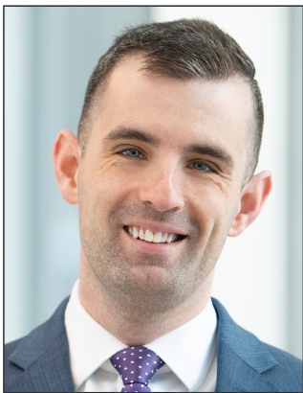
Award Winner
James J. Scheulen Lifetime Achievement Award in Academic Emergency Medicine Administration
Travis W. Schmitz, PHD, MBA
Department Administrator
Northwestern Memorial HealthCare and
Northwestern University’s Feinberg School of Medicine

Slide 47
End of Committee Reports
BREAK
Committee Sign Up
  Please reach out to Committee Chairs to explore opportunities to get involved!

