Slide 1
Hitting the Ground Running: Key 2024 Reimbursement Changes
AACEM/AAAEM Annual Retreat
San Juan, Puerto Rico
Jason Adler, MD, CEDC, FAAEM
Notes:
Director of Compliance and Reimbursement
University of Maryland School of Medicine

Slide 2
No Relevant Financial Disclosures
LogixHealth
Vice President, Coding

Slide 3
Objectives
Highlight lessons learned from 2023 Documentation Guidelines
Review the 2024 conversion factor (CF) and reimbursement impact for EM
Discuss split shared visit updates to 2024

Slide 4
New Documentation Guidelines Lessons Learned
Notes:
Just CPT!

Slide 5
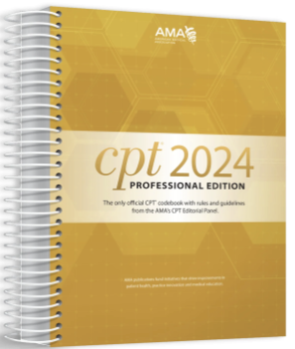
Generational Change: Documentation Guidelines
28 years in the making!
Value the cognitive work performed when documented
Early returns are positive
Notes:
Muscle memory.

Slide 6
Generational Change: Lessons Learned
Levels 1 and 2 are uncommon
Shift from 99283 to 99284
Potential of slight decrease in 99285
The intent of the guidelines was not to decrease the RVU/patient
Notes:
Group education, template modifications, data tracking

Slide 7
A Timeline of Note Bloat

Slide 9
Length and Redundancy of Outpatient Progress Notes
Note length increased by 60.1% (99% CI, 46.7—75.2%)
Redundancy increased by 10.9%
Clinicians spending 25-50% more time at the EHR
Notes:
Oregon health and science university. 2 704 800 notes written by 6228 primary authors . MORE TIME AT THE EHR THAN BEDISDE.

Slide 10
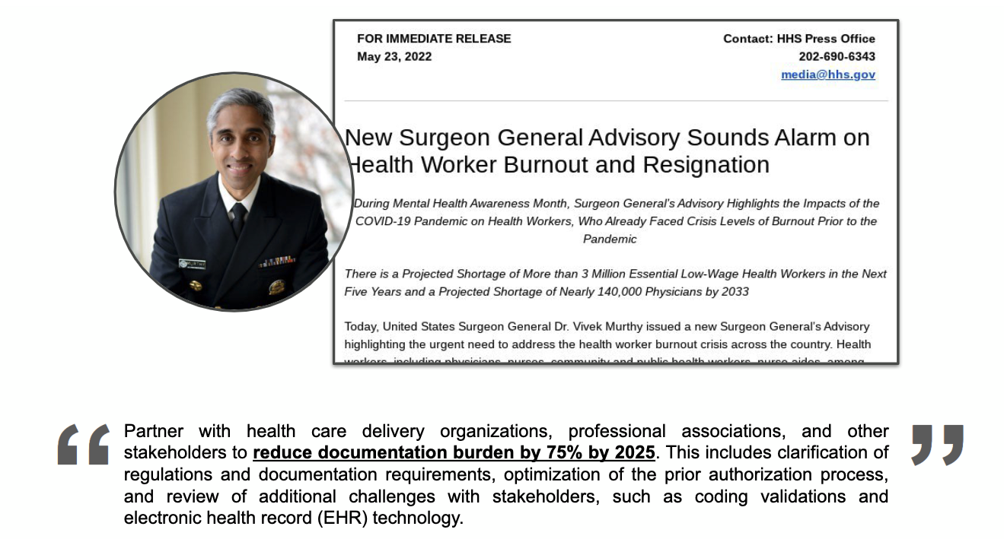
Patients Over Paperwork
Notes:
CMS. Documentation burden has been defined as the “stress imposed by the excessive work required to generate clinical records,” and previous studies have described this burden using various concepts and constructs
Docs don’t want to live in the EMR, coders don’t want to sort through hundreds of pages of notes, administrators don’t want to burnt employees

Slide 11
Electronic Health Record and Burnout
Notes:
Journal of American medical informatics association, July 2023. you only need a keyboard and wiifi to search EMR and burnout

Slide 12
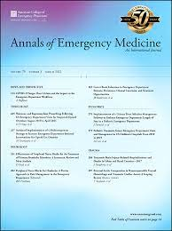
Note Length and Documentation Time
Notes:
Evolve, adapt, and innovate.
Study design
February 2018 through June 2023
1,679,762 notes
Primary outcome
Note length
Documentation time

Slide 13
Note Length and Documentation Time

Slide 14
Note Length
2023 DG Conversion
Notes:
There will be a time when we no longer see normocephalic head or no proptosis ….

Slide 15
Reimbursement Updates 2024

Slide 16
Reimbursement Updates 2024
Changes to conversion factor
Budget neutrality and the add-on complexity code
Delay of updated Medicare Economic Index (MEI) weights

Slide 17
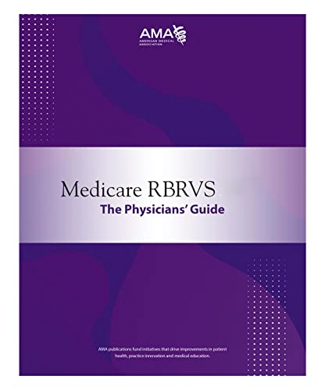
RBRVS Equation
Work RVUs
Practice Expense RVUs
Liability Expense RVUs
Total RVUs for a given code
RVU_{Total} X Conversion Factor (CF) = Medicare Payment
Notes:
Resource based relative value scale. EM has the highest % of work to total RVUs due to limited practice expense. 7% professional liability insurance, 16% PE, 77% wRVU. Medicare geographic practice cost index. ~50% wRVU for entire house of medicine (45% PE).
MGPCI – updated every few years by CMS. All 3 components involved. Liability expense. Then MIPS adjustment.

Slide 18
2024 wRVUs: Unchanged from 2023
Code | 2022 wRVU | 2023 wRVU | 2024 wRVU *
99283 | 1.6 | 1.6 | 1.6
99284 | 2.74 | 2.74 | 2.74
99285 | 4.0 | 4.0 | 4.0
* Addendum B RVU and related information CY 2024 CMS 1784-P
Notes:
2023 2.74→ 2.6. PLI no change, PE .35→.34. 30-40M

Slide 19
Budget Neutrality
2024 CMS Physician Final Rule, pg 1947/2709
Notes:
Reason for increased expenditures: office codes increased in 2021, estimated utilization of the add-on complexity code G2211 (full adoption, 1/3% of O/O codes). 90% of 2.17% cut. 1.8 Billion of increased expenditures directly tied to G2211. → 2% of 2.17.
RVUs for office visits went up, new code, must decrease CF

Slide 20
2024 Medicare Conversion Factor
CY 2023 Conversion Factor
Conversion Factor without the CAA, 2023
CY 2024 RVU Budget Neutrality Adjustment [Complexity Code]
CY 2024 1.25% Increase Provided by the CAA, 2023
2024 Conversion Factor
33.8872
33.0607 2.5%
0.9783 2.20%
1.0125 1.25%
32.7375 (3.39%)
2024 CMS Physician Final Rule Table 116
Notes:
90% of the budget neutrality adjustment is for complexity code. Consolidated appropriations act 2023 (expected 2.5% cut, CAA resolved that over 2 years). Multiple cuts that congress has paid for. CAA as law. Inconsistent math: 32.7442 (-3.37%).
Too Complex for CMS
Preamble Language:
CF $32.7442
-3.37%

Slide 21
2024 RVUs Per E/M Level

Slide 22
Medicare Physician Payment Is Not Keeping Up with Inflation
Notes:
RVU 1998: $35, 2024 $33. Hospital: 1998 $35, 2024 $70. MEI includes cost for supplies/ PE, not included in part B.
Adjusted for inflation in practice costs, Medicare physician payment declined 30% from 2001 to 2023. adjust for inflation GAS 2000 $1.51/gallon, now $4.9/gallon
Medicare physician pay has increased just 11 percent over the last two decades, or 0.5 percent per year on average. And roughly one-third of that increase is the temporary 3.75 percent update for 2021 that will expire in 2022. In comparison: • Medicare hospital updates totaled roughly 60 percent between 2001 and 2021, with average annual increases of 2.4 percent for both inpatient and outpatient services. • Medicare skilled nursing facility (SNF) updates totaled more than 60 percent between 2001 and 2021, or 2.5 percent per year. • The cost of running a medical practice increased 39 percent between 2001 and 2021, or 1.6 percent per year. Inflation in the cost of running a medical practice, including increases in physician office rent, employee wages, and professional liability insurance premiums, is measured by the Medicare Economic Index or MEI. • Economy-wide inflation, as measured by the Consumer Price Index, increased 51 percent over this period (or 2.1 percent per year).

Slide 23
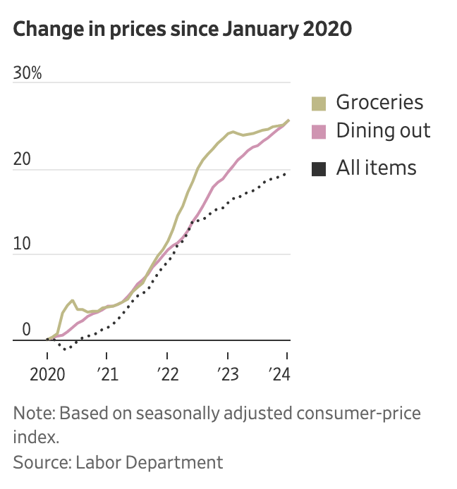

Slide 24
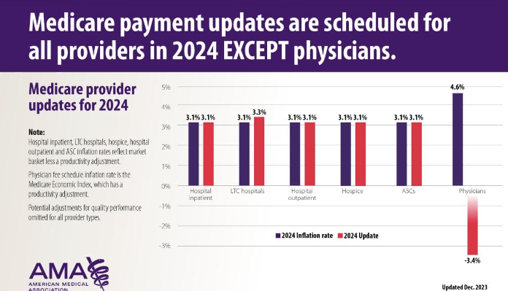
Medicare Physician Payment Is Not Keeping Up with Inflation
Notes:
Inflationary factor – market basket inflationary factor 80% increase over 20 years. We’d be at 70$/RVU if linked to inflation
That cut comes on the heels of the 2% payment reduction in 2023, when the Medicare Economic Index (MEI) was 3.8% last year and 4.6% this year, the highest level this century.

Slide 26
Congress Is Watching: Strengthening Medicare for Patients and Providers Act
Links conversion factor to Medicare Economic Index (MEI)
Includes physician practice costs
Sponsored by:
Larry Bucshon, R- Indiana
Ami Bera, D-California
Raul Ruiz, D-California
Mariannnette Miller-Meeks, R-Iowa
Notes:
Another bill focusing on budget neutrality. All MDs. Bipartison. 56 cosponsors – 30 democrats, 26 republicans. Maybe a 1% patch.

Slide 27
H.R. 6683
To amend title XVIII of the Social Security Act to increase support for physicians and other practitioners in adjusting to Medicare payment changes
H.R. 6683 Sponsor
Gregory Murphy (R-NC)
H.R. 6545 Sponsor:
Mariannette Miller-Meeks (R-Ia)
“These cuts threaten healthcare access for seniors as well as the viability of physician practices, including many in rural and underserved areas. Canceling the cut is a good new year's resolution.”
AMA President Dr. Jesse M. Ehrenfeld
Notes:
Proposed to eliminate the full 3.37 cut

Slide 28
Some Relief is Coming!
New 2024 Conversion Factor (CF)
$33.2875
1.69% Reduction compared to 2023
Effective March 10, 2024
Notes:
https://www.fiercehealthcare.com/providers/congress-reaches-spending-deal-doc-pay-bump-delayed-dsh-cuts-and-more
33.2875

Slide 29
2024 Time-Only Split/Shared Services Delayed!

Slide 30
Defining Substantive Portion
E/M visit performed by physician and non-physician provider
Physician can bill for services if they perform a substantive portion of the encounter
Substantive portion defined in 2022
History, or exam, or MDM
More than half of total time
2023 proposal included time only
Notes:
Initial reg. we advocated!!! Last year

Slide 31
2024 Delayed Implementation of Time-Only Definition
“After much consideration, we are proposing to delay the implementation of our definition of the "substantive portion" as more than half of the total time through at least December 31, 2024….
We are proposing to maintain the current definition of substantive portion for CY 2024 that allows for use of either one of the three key components (history, exam, or MDM) or more than half of the total time spent to determine who bills the visit.”
2024 CMS Physician Proposed Rule, pg 256/1920
Notes:
We advocated

Slide 32
2024 Final Rule Aligns with CPT Shared Visit Definition
“After reviewing the revisions made by the AMA CPT Editorial Panel that were included in the 2024 CPT codebook publication, specifically the Evaluation and Management (E/M) Services Guidelines language surrounding “substantive portion” for split (or shared) services, and in light of public comments on our policies, we agree that we should align our definition of substantive portion with the CPT E/M guidelines for this service.”
2024 CMS Physician Final Rule, pg 475/2709

Slide 33
2024 CPT Shared Visit Language
“For the purpose of reporting E/M services within the context of team-based care, performance of a substantive part of the MDM requires that the physician(s) or other QHP(s) made or approved the management plan….and takes responsibility for that plan with its inherent risk…”
2024 AMA CPT, pg 6
Number and complexity of problems addressed at the encounter
Risk of complications and/or morbidity of mortality of patient management

Slide 34
2024 CPT Shared Visit Language
Amount and complexity of data
Category 1 – Does NOT have to be personally performed by the physician​
Assessing the independent historians narrative​
Reviewing external records​
Ordering/reviewing tests, images, tracings​
Category 2 and 3– Must be personally performed by the physician IF used for code assignment ​
Independent interpretation of images, tracings, tests​
Discussion of management plan or test interpretation

Slide 35
2024 Shared Visit Attestation
“I personally made/approved the management plan and take responsibility for the patient management.”
Additional options when performed to support medical decision making
“I independently interpreted the following study(s) [eg, EKG, CXR], which showed [interpretation].”
“I discussed with [insert physician name, specialty], who recommends [insert recommendation].”
“I personally made/approved the management plan and take responsibility for the patient management. I independently interpreted the EKG, which shows NSR, nl ST segments."

Slide 36
ACEP Shared Service FAQs
Does the ED physician have to document the Medical Decision Making, or can they attest to their participation in the encounter and refer to the PA/NP documentation to support reporting a Split/Shared Visit?
In the Federal Register for CY 2020, CMS established a general principle to allow the physician/QHP who furnishes and bills for professional services to review and verify, rather than re-document, information included in the medical record by physicians, residents, nurses, students or other members of the medical team.
In accordance with this existing principle, it is not required for the ED physician to document the MDM. Instead, they may review and approve the PA/NP documentation and attest to their performance of the substantive portion of the MDM.

Slide 37
Substantive Portion Face-To-Face
For all split (or shared) visits, one of the practitioners must have face-to-face (in-person) contact with the patient, it does not have to the physician, nor the practitioner who performs the substantive portion and bills for the visit. The substantive portion can be entirely with or without direct patient contact
Pub 100-04 Ch 12 30.6.18B
Notes:
Medicare claims processing manual

Slide 38
CMS Shared Visit Documentation Standard
Notes:
Documentation standard, BUT, we could do better.

Slide 39
Appropriate Use Criteria

Slide 40
Appropriate Use Criteria
Established in the Protecting Access to Medicare Act (PAMA), 2014
Qualified clinical decision support mechanism prior to ordering advanced diagnostic imaging
Goal of cost reduction
Planned implementation in 2017
Multiple delays

Slide 41
Appropriate Use Criteria – Gone!
“As a result, we propose to pause implementation of the AUC program for reevaluation, and rescind the current AUC program regulations from § 414.94. We expect this to be a hard pause to facilitate thorough program reevaluation and, as such, we are not proposing a time frame within which implementation efforts may recommence.”
2024 CMS Physician Proposed Rule, pg 735/1920

Slide 42
Key MDM Drivers – Documentation Guidelines

Slide 43
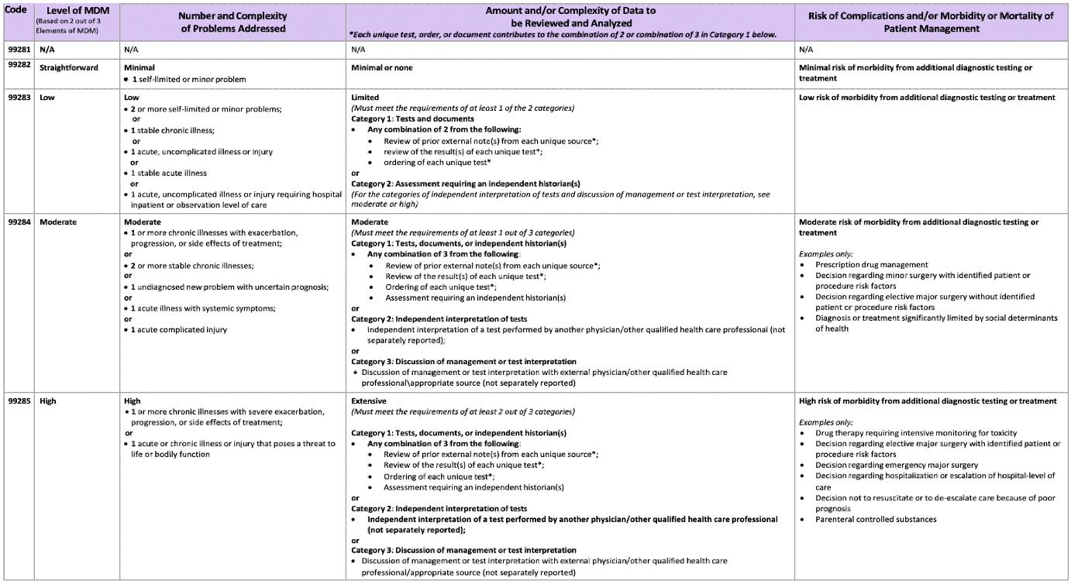
Key Documentation Elements
Notes:
Will focus on the clinically meaningful elements to capture the work we do

Slide 44
Key Documentation Elements - Clinical
Differential diagnosis demonstrate complexity of care
Pertinent comorbidities that may affect care
Discussions and record review
History obtained from an independent historian (family/EMS)
Review of external records (inpatient notes, office records, PDMP)
Discussions of management with other clinicians (hospitalist, consultants, pharmacy, social work)
Independent interpretations of studies (EKG, X-ray, ultrasound)
Diagnostic tests and prescription medication appropriately considered (X-ray, CT, antibiotics)
Appropriate consideration of hospitalization or de-escalation of care
Care significantly impacted by social determinants of health

Slide 45
Take Home Points
Emergency Medicine has adapted well to the current documentation guidelines with some reduction in note bloat
The reduced conversion factor is triggered by budget neutrality and the lack of an inflation index
Split shared visits have new definitions

Slide 46
Questions & Contact Jason Adler, MD, CEDC, FACEP jadler@logixhealth.com 202.438.6983

