Slide 2
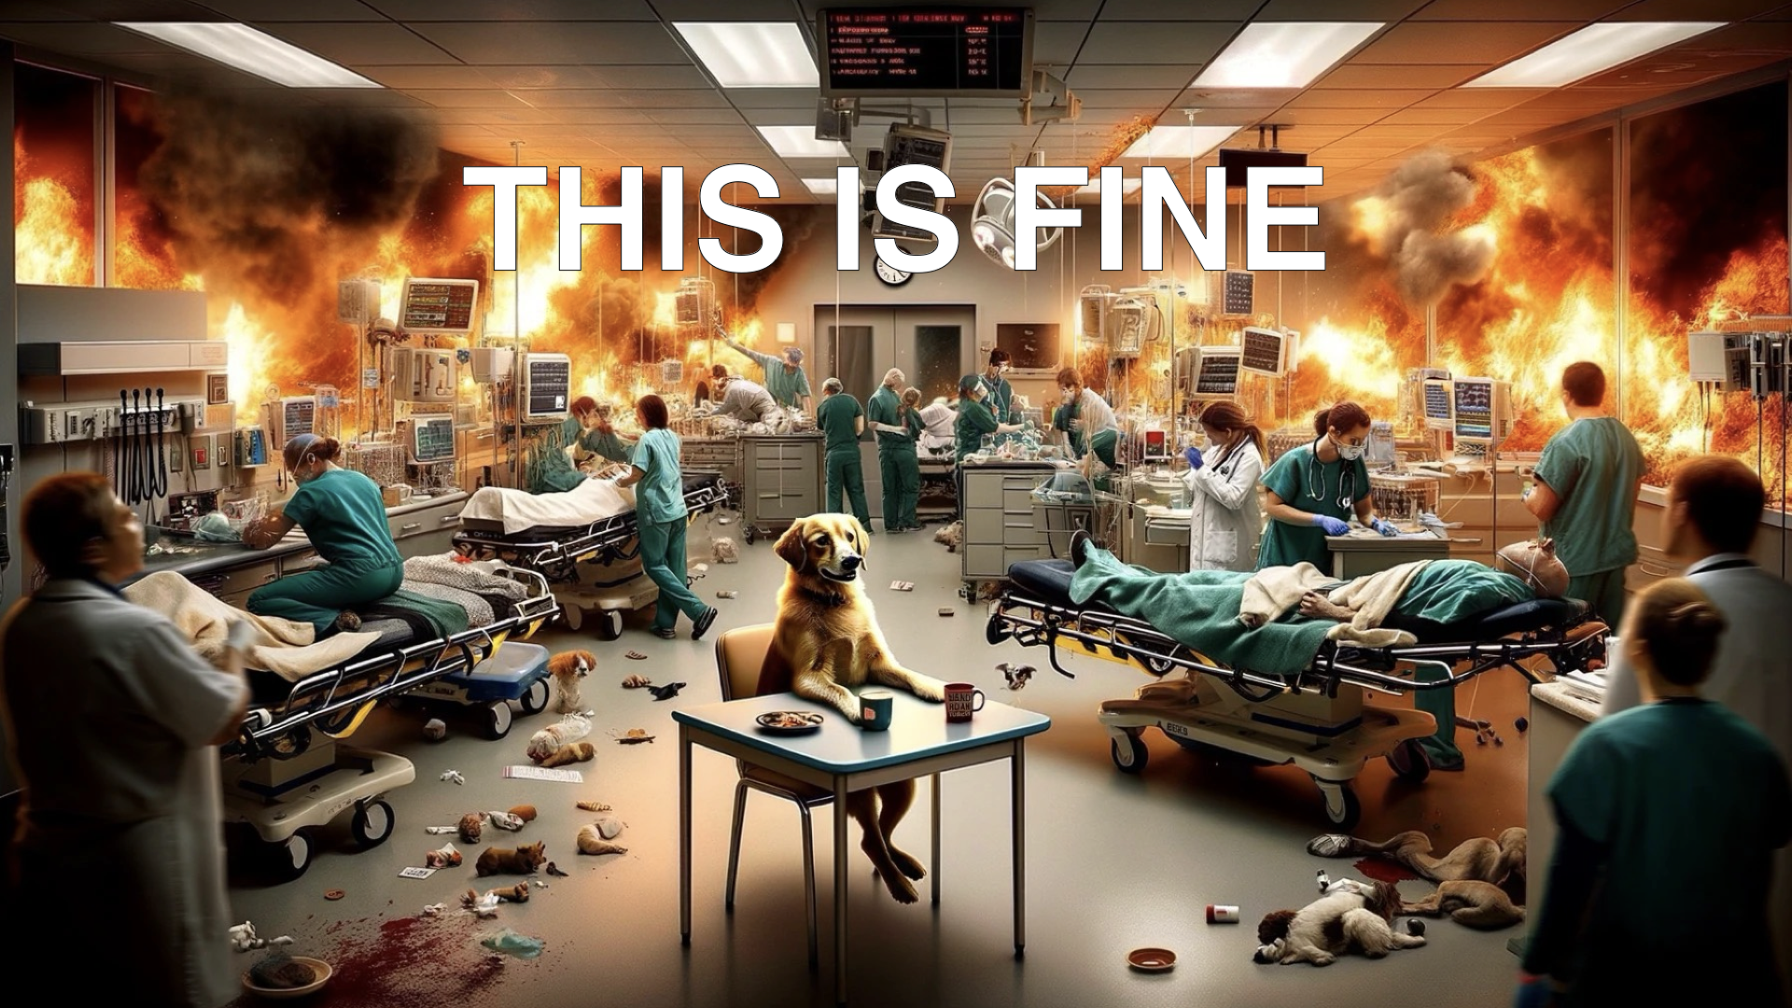
Notes:
Common agreement #1 boarding/overcrowding is going to be a problem going forward in EM
Common agreement #2 there will be operational adaptations to deal with overcrowding for the foreseeable future
When seeking to understanding the teaching environment of overcrowded and boarded Eds, there is a lot of opinion and not a ton of evidence.

Slide 3
Notes:
Putting my cards on the table, so you know where I am coming from, I believe that critical levels of boarding and overcrowding negatively impacts the educational environment of the ED.
I also believe we have an incomplete understanding when that negative impact starts and how it manifests.
And I believe that operational changes we make to counteract board may negatively impact the educational environment of the ED

Slide 4
Notes:
We are currently facing a challenge: how do we teach the next generation of Emergency docs?
In a world with decreased patient volumes, increased boarding, how do we train our residents to multi-task, see enough volumes of patients, get adequate procedural volume.
And in a world where ED operations shifts to push patients through the system faster and in new ways, how do we train our residents to work in new models of patient care like PIT, how do we ensure the educational experience of residents in systems that may skim minor care volume off the top and shift patient care out of the typical patient care space of the ED bed or hallway.

Slide 5
Notes:
Before we get to some ways that I believe that we can address those challenges, let’s take a bit of time and dig into the literature that addresses

Slide 15
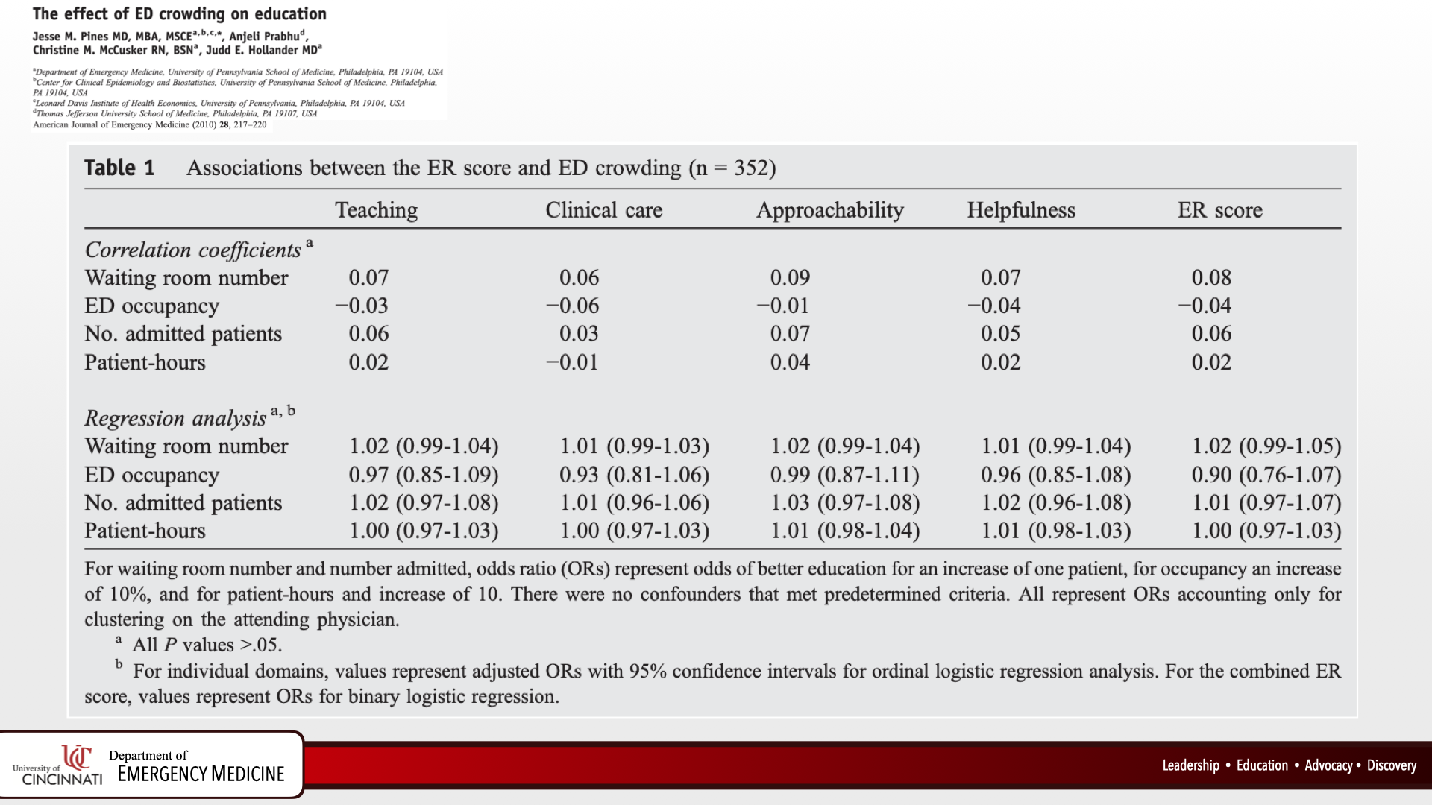

Slide 24
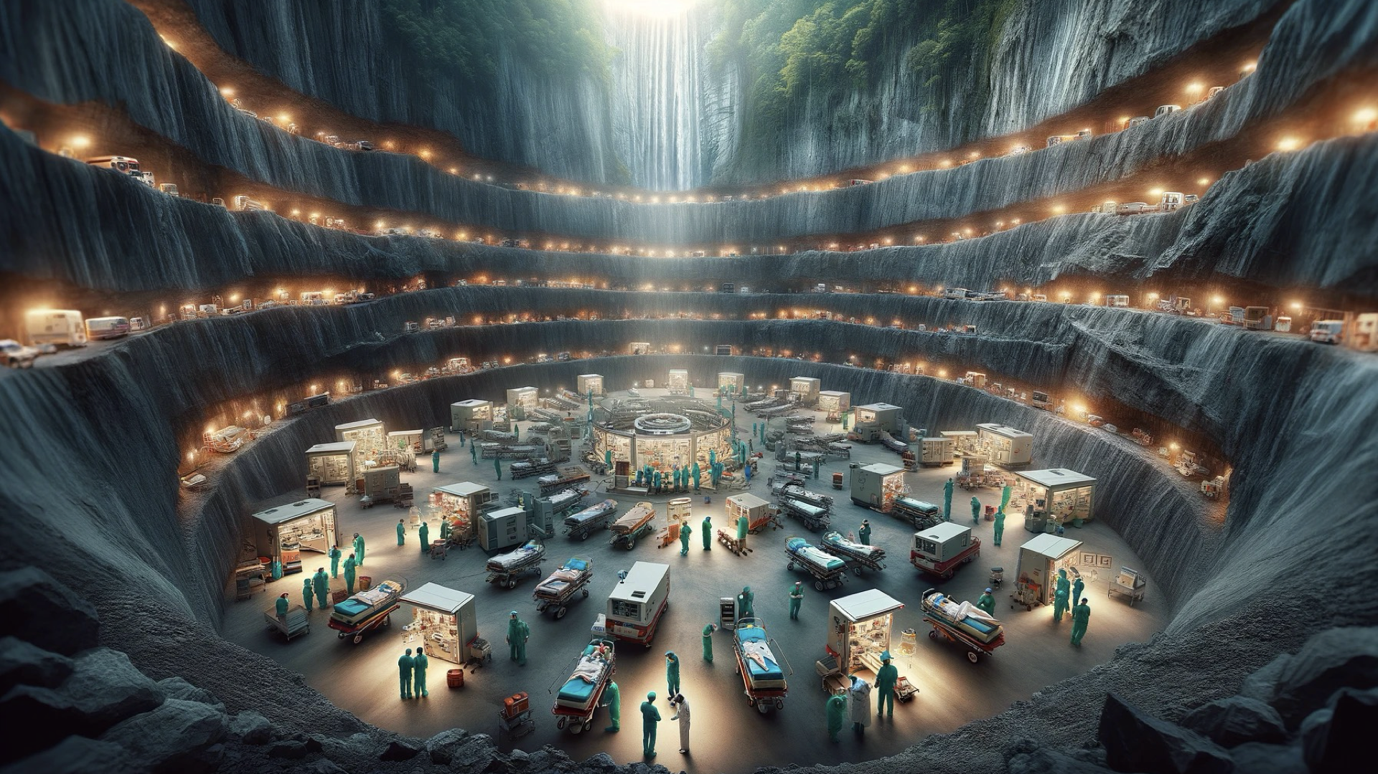

Slide 30
Notes:
End conclusion, placing a physician in triage did not negatively impact the perceived resident educational experience. However, while residents didn’t perceive the PIT process negatively impacting their educational involvement with attendings, both groups perceived differential diagnosis development was negatively impacted. Attendings also felt diagnostic test selection and medical decision making may be negatively impacted. For academic centers looking to implement a PIT process, ensuring appropriate educational reinforcement of these areas of concern may be helpful.

Slide 31
Notes:
So that is pretty much it. Most of the literature that is out there is single center studies. The chosen metrics for overcrowding vary from paper to paper and most of the outcome data is based on perception of the teaching climate. And, all of this data is pre-pandemic

Slide 32
Notes:
So we are still left with this challenge - how do we teach the next generation of Emergency docs right now, in the complicated messy world we work in?

Slide 33
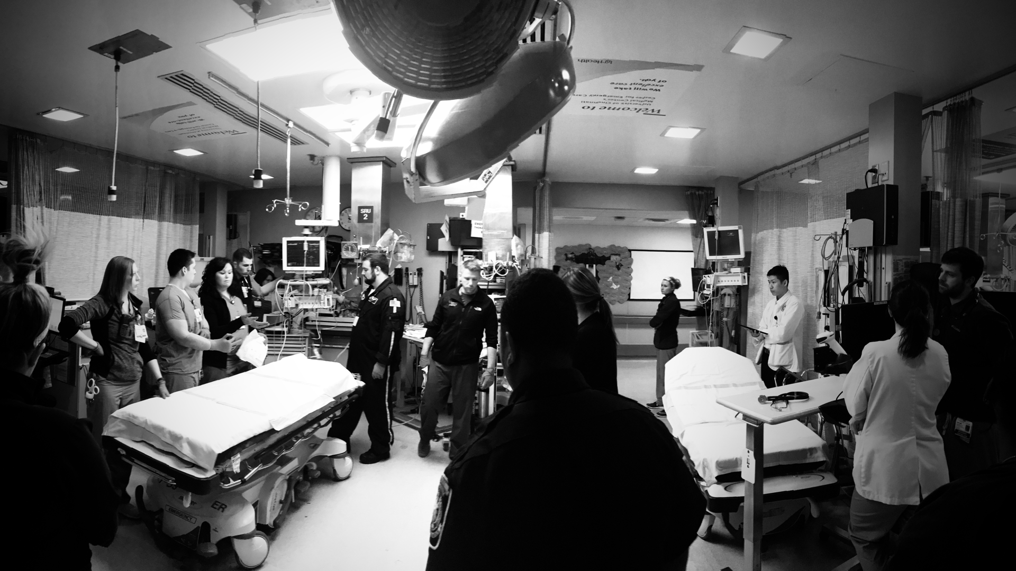
Notes:
We have to think carefully about picking educational opportunities that will support not just the cognitive growth of our students and residents but also supporting their affective and psychomotor growth.
Being an ER doc is not just about knowing the book presentation of a disease process or interacting in an oral boards format, it’s about sifting through complex histories and physicals in a time limited environment, sniffing out life threatening disease quickly, stabilizing patients, switching from one patient to another quickly, remaining calm under extreme pressures, all while delivering compassionate and empathetic care to patients who are potentially having the worst days of their lives. To provide aide and comfort to anyone, at anytime, for anything that may show up in our department.

Slide 38
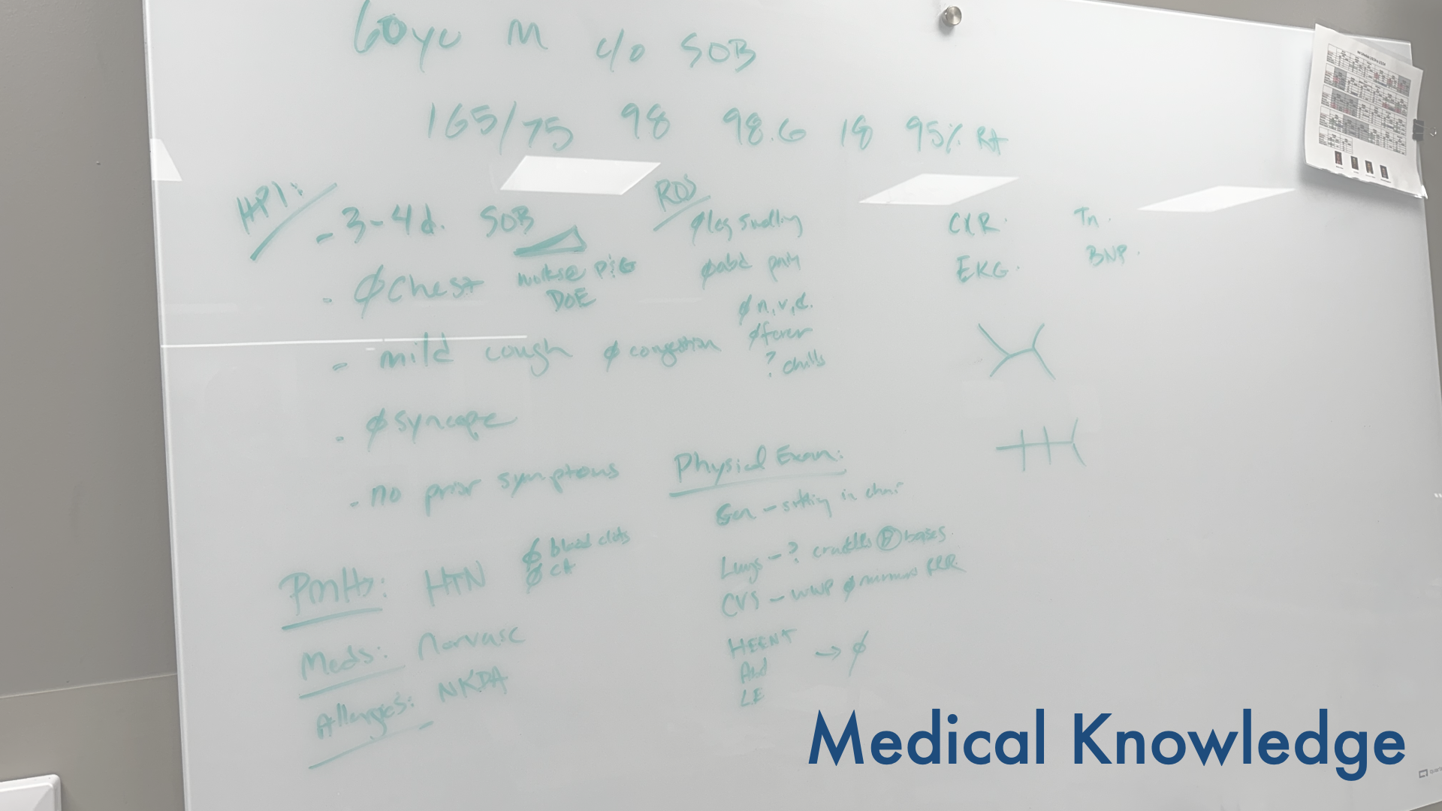
Notes:
Whiteboard teaching - cash for cases, stop, drop, resuscitate

Slide 39
Notes:
Whiteboard teaching - cash for cases, stop, drop, resuscitate

Slide 41
Notes:
Concept of practice - small improvements to specific actions that improve overall efficiency.

Slide 46
Notes:
PICOT questions, EBCP - finding literature about specific patients you have. Can find primary literature or show how to find resources on shift

Slide 47
Notes:
What is the take away from this. Let’s remember that Emergency Medicine is a specialty that was created when we took a forgotten and neglected corner of the hospital, where patients suffered from inconsistent care and inadequate training of the providers that worked there. We are innovators and pioneers in the house of medicine. We have been challenged from day 0 to carve out the scope of our specialty. We continue to be challenged today to train the next generation of EM physicians. Physicians who can deliver compassionate, intelligent, efficient care to whomever presents to them regardless of who they are, when they show up, or what they have wrong with them.
To train them in our current environment requires a bit of ingenuity and to figure out how best to train them necessitates an understanding of how the operational environment of the ED and operational changes effect their education. The big take away is that we can’t have a passive relationship with this problem. We need to embrace this challenge to train the next generation of EM physicians.

