Slide 1

Academy of Administrators in Academic Emergency Medicine
Salary and Staffing Survey
Fiscal Year 2023
James Scheulen, PA, MBA
On behalf of the
AAAEM Benchmark Committee
March, 2024

Slide 2

Academic Faculty Life
Faculty Compensation
Faculty Benchmarks
Provider Coverage Hours
Professional Billing
James Scheulen
On behalf of the AAAEM Benchmark Committee
March, 2023

Slide 3
Physician Staffing
Arrivals per
faculty hour:
2.3
Arrivals per
faculty hour:
2.4
Arrivals per
faculty hour:
2.1
Arrivals per
faculty hour:
2.1
Arrivals per
faculty hour:
2.3
Notes:
The mean increase was 2075 hours across the board, but hard to make year to year comparisons because of the varying participation among sites and data entry. But it does appear that we have been adding more clinical hours over the past few years

Slide 4
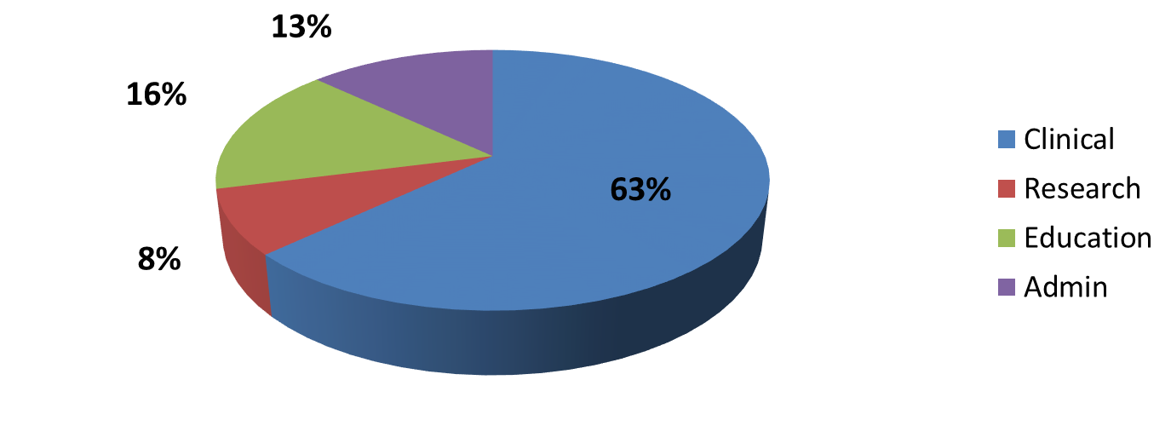
Faculty Effort
Percent Faculty Effort: Multiple Missions
Increasing clinical effort
FY 2015
FY 2023
Academic Centers

Slide 5
Daily Provider Coverage
Hours per Day
56%
52%
52%
Attending
Hours
33%
54%
Attending
Hours
31%
Resident
Hours
43%
Resident
Hours
56%
APP
Hours
11%
APP
Hours
26%
Notes:
Medians :184 hours in main ED 2016 ; 2017 186 hours as was 186 in 2012, essentially resident coverage has remained flat we have added attending hours to compensate for increase volume On average 50 %f the daily ED coverage hours are provided by residents for EDs> 40 K
From 2012 through 2017 the percent resident coverage 55%, 55%,56%,54%, 52%, 52%

Slide 6


Faculty Benchmarks
RVU Productivity
  Per hour
  Total
Publications
  First vs any author
External Funding
  What percentage of your effort is externally funded research grants and research contracts including all sponsors (federal, non-federal, foundations and industry) and subcontracts from other institutions?
Notes:
2016 =160356 total median COLLECTION $44.44, PER MD HOUR 6.54; PER PATIENT BILLED 2.88; RVU PER CLINICAL fte 10613
2017= 173902 total median; Collection $45.76; PER MD HOUR 6.73; PER PATIENT BILL 2.86, PER FTE 10127
Work RVU per MD hour up slightly from last yeas as is collection per RVU.
RVU collection range 93.63-9.92
25th percentile = 39.08
75th percentile 51.77

Slide 7
Faculty Benchmarks
Clinical Productivity
 | Mean | Median
Annual Physician Hrs | 28540 | 27375
PPH Staffed | 2.3 | 2.3
PPH Billed | 2.09 | 1.96
WRVU/CFTE | 13751 | 9751
WRVU per MD Hour | 6.8 | 6.5
Note: CFTE based upon the FTE reported as clinically based FTE

Slide 8


Faculty Benchmarks
Authorship
  538 faculty reported having a publication this year (20%)
  685 publications reported this year
    30% First Author
    20% Senior Author
    50% Other Authorship position
External Funding
  9.8% of faculty reported having “external funding”
  Of those reporting:
    23% of effort is supported
    Range: 1 to 95%

Slide 9
Charge and Productivity Data
 | FY 19 Median | FY 20 Median | FY 21 Median | FY 22 Median | FY 23 Median
Work RVU/Hour | 7.2 | 6.8 | 6.0 | 6.1 | 6.5
Work RVU/Patient | 3.0 | 3.0 | 3.2 | 3.2 | 3.2
Collection/Work RVU | $47.19 | $47.05 | $46.95 | $46.35 | $47.23
Collections ($) | $8,480,310 | $8,174,995 | $7,737,646 | $8,473,792 | $8,464,630
Collections/Visit | $128.27 | $136.30 | $140.61 | $138.83 | $144.91

Slide 10
Payer Mix
Mean Payer Mix Distribution

Slide 11
Professional Fee Billing
E & M Codes
Percent
84% Levels 4, 5 and CC
92% of charges from E&M Codes

Slide 12
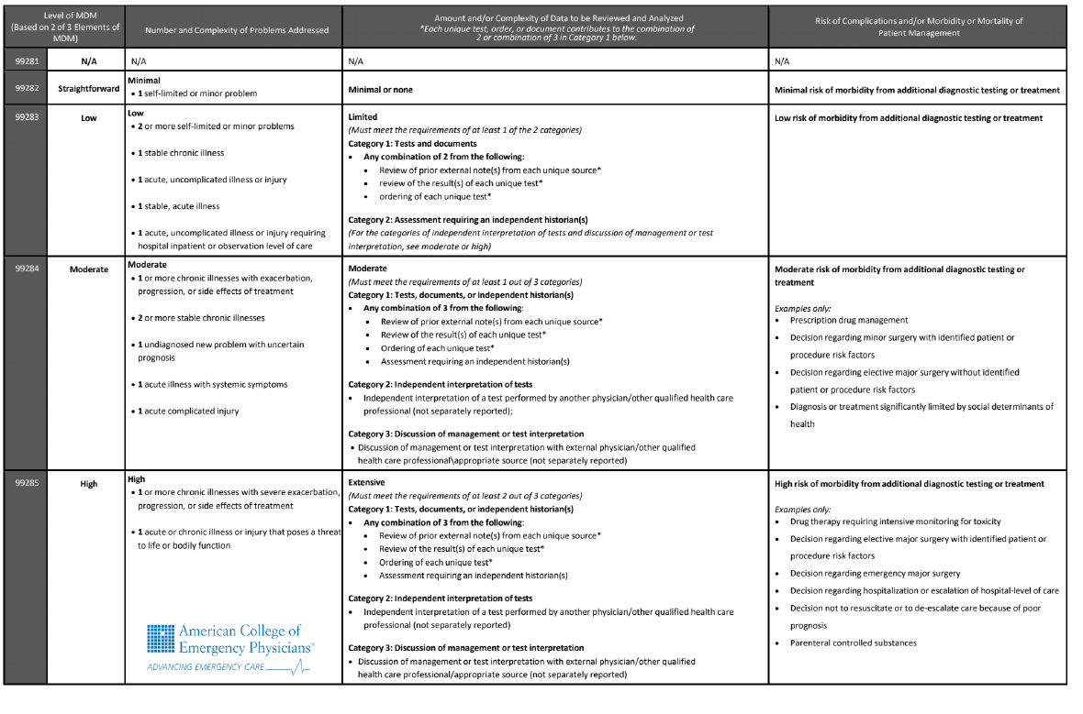
Coding Changes
January 2023 Coding Changes
Focus on MDM and Risk
Did we see an impact—first 6 months

Slide 13
Professional Fee Coding Changes
Pre-coding rule change: July—December = 1,977,357 Total
99281 | 99282 | 99283 | 99284 | 99285 | 99291 | 99292
10,136 | 71,652 | 281,186 | 773,816 | 713,028 | 118,893 | 8,646
1% | 4% | 14% | 39% | 36% | 6% | 0%
Post-coding rule change: January—June = 1,984,222 Total
99281 | 99282 | 99283 | 99284 | 99285 | 99291 | 99292
1,567 | 42,445 | 255,763 | 825,700 | 724.074 | 126,950 | 7,723
0% | 2% | 13% | 42% | 36% | 6% | 0%

Slide 14
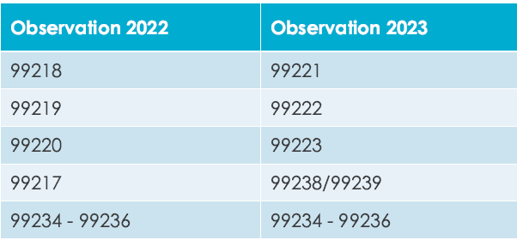
Observation Coding Changes
Jan 2023 coding change
Some shift of code use
  CPT now in line with CMS interpretation
Some change in RVU value
Initial Impression:
Despite the change in codes—the RVU impact is near zero

Slide 15
Faculty Salary
APP Salary

Slide 16
Faculty Demographics
2022 Salary Survey Demographics
 | FY 19 | FY 20 | FY 21 | FY 22 | FY 23
# Faculty | 2468 | 2530 | 2560 | 2454 | 2677
Experience
Years at Current EM | 8.2 | 8.8 | 8.5 | 8.9 | 8.9
Years post Residency | 11.5 | 11.6 | 10.8 | 11.0 | 10.9
Degree
MD/Master/PhD | 98% | 96% | 95% | 95% | 94%
DO | 2% | 4% | 5% | 5% | 6%
Notes:
Slide 3

Slide 17
Faculty Demographics
Years as EM Faculty
54.4% < 10 years
30.0% = 10 to 20 years
15.7% > 20 years

Slide 18
Faculty Demographics
Faculty Rank
In EM: 3.7
In EM: 6.5
In EM: 13.0
In EM: 21.6

Slide 19
Faculty Demographics

Slide 20
Faculty Demographics

Slide 21
Faculty Demographics
Note: 3% Do not disclose

Slide 22
Clinical Hours: Rank & Site
Do you require a minimum number
of clinical hours?
71% = Yes
Median = 400
Do shifts recognize sign in & out?
34% = Yes
Assumed work week hours?
40 hours
Assumed weeks per year
48 weeks

Slide 23
Base Clinical Hours
“This is the normal starting point for the number of clinical hours worked (do not include scheduled post shift charting time, CME and vacation) by a 1.0 FTE clinical faculty member with no other funded responsibilities that would reduce their clinical commitment. Please only include direct patient care hours.”
1440

Slide 24
Salary Trends: All Faculty
Mean Total Salary = $346,598 (+3.1%)
$343,175
No Chairs and Chiefs
Chairs and Chiefs included

Slide 25
Salary Trends: All Faculty
2023 Base = 85% of total
Chairs and Chiefs included

Slide 26
Salary Trends: No Chair & Chief
Mean Total Salary = $343,175 (+4.1%)
16% over 5 years
Chairs and Chiefs and Pure Pediatrics excluded

Slide 27
Salary Trends
Mean Total Salary = $343,175 (+4.1%)
Mean Base Salary = $288,941 (+5.1%)
2023 Base = 84% of total
Chairs and Chiefs and Pure Pediatrics excluded

Slide 28
Salary Trends
First Year Faculty
Mean Total Salary = $294,088 (+0.17%)

Slide 29
Salary by Rank
10%
10%
Chairs, Chiefs, pure Peds EM excluded
Notes:
Cathi’s Note: for 2018 instructors, I excluded affiliate sites since those are the main outliers in that group. All others include all sites.

Slide 30
Salary Trends: Regions

Slide 31
Salary Trends: Regions

Slide 32
Salary Trends: Regions

Slide 33
Salary Trends: Regions
9%

Slide 34
Compensation Plans

Slide 35

How do we pay our faculty?
Faculty Compensation Plans
Single component: 2.7%
Salary only
Three component: 51.5%
Base + Extra + Stipend
Base + Extra + Bonus = 87%
Base + Stipend + Bonus
Two component: 26.2%
Base + Extra hours
Base + Stipend
Base + Bonus = 73%
Four component: 19.5%
Base + Extra+ Stipend + Bonus

Slide 36
Salary Components
100%
Base
93%
Base
84%
Base
74%
Base
Chairs, Chiefs, pure Peds EM faculty excluded

Slide 37
Salary Components

Slide 38
APP Salary Survey
Fiscal Year 2022 Data

Slide 39


PA and NP Demographics
773 Advanced Practice Providers
  8.8 years post training
  69% Physician Assistant
  31% Nurse Practitioner
  64% Female
  30% Male
  6% Do not disclose

Slide 40

PA and NP Demographics
ED area worked
More than one area | 74%
Main ED only | 16%
Observation only | 8%
FT/Arrival/Triage | 3%
1,631 Total hours
$141,138 Total salary
Minimal difference PA/NP
300 hour reduction for lead or administration
$18,000 difference between administrative role and none

Slide 41
PA and NP Salary
5.5%

Slide 42
PA and NP Salary
No significant change in total hours worked
Pay rate changes with years of service

Slide 43
PA and NP Salary
Salary by Region
 | Total Salary | Total Hours | % PA
West | $158,599 | 1431 | 57%
Midwest | $146,438 | 1696 | 75%
Northeast | $143,218 | 1582 | 78%
South | $132,254 | 1808 | 63%
Highest APP
Concentration
Shift from NP
To PA

Slide 44
10 Tidbits
Revenue flat and expenses increasing
Faculty with “Administrative duties”= +10% salary
Nocturnists = +6.5% salary
Faculty in community settings = +3.4% salary
DO = -3% salary and +3% in hours
Top 5 “Job Duty Hours Allocation”
  Department Chair
  Executive Vice-chair
  Residency Director
  Vice-chair Research
  Vice-chair and Director Clinical Operations
No change in clinical productivity based upon EM years
No change in clinical productivity based upon EM rank
Since 2015 we’ve seen a shift from Assistant to Associate
With some variability—Specialty Boards = Mean salary of all faculty

Slide 45
Thanks
Let’s talk…

Slide 46
Faculty Level Benchmarks
RVU Productivity
  Per hour
  Total
Publications
  First vs any author
  Journal quality
  Type of publication
Grants submitted/Awarded
  Submission or award
  NIH or all
  PI or other
Needed? Wanted? Useful?
Notes:
2016 =160356 total median COLLECTION $44.44, PER MD HOUR 6.54; PER PATIENT BILLED 2.88; RVU PER CLINICAL fte 10613
2017= 173902 total median; Collection $45.76; PER MD HOUR 6.73; PER PATIENT BILL 2.86, PER FTE 10127
Work RVU per MD hour up slightly from last yeas as is collection per RVU.
RVU collection range 93.63-9.92
25th percentile = 39.08
75th percentile 51.77

Slide 47
Physician Hour Coverage
1 added patient = 22 additional provider minutes
+ 1000 patients = 366 additional provider hours
+10000 patients = 3667 additional provider hours
Notes:
Medians :184 hours in main ED 2016 ; 2017 186 hours as was 186 in 2012, essentially resident coverage has remained flat we have added attending hours to compensate for increase volume On average 50 %f the daily ED coverage hours are provided by residents for EDs> 40 K
From 2012 through 2017 the percent resident coverage 55%, 55%,56%,54%, 52%, 52%

Slide 48
Daily Provider Coverage
Hours per Day
56%
52%
52%
Attending
Hours
34%
54%
APP
Hours
33%
Resident
Hours
54%
APP
Hours
11%
Attending
Hours
67%
Common for APP coverage in fast track areas in community
Notes:
Medians :184 hours in main ED 2016 ; 2017 186 hours as was 186 in 2012, essentially resident coverage has remained flat we have added attending hours to compensate for increase volume On average 50 %f the daily ED coverage hours are provided by residents for EDs> 40 K
From 2012 through 2017 the percent resident coverage 55%, 55%,56%,54%, 52%, 52%

Slide 49
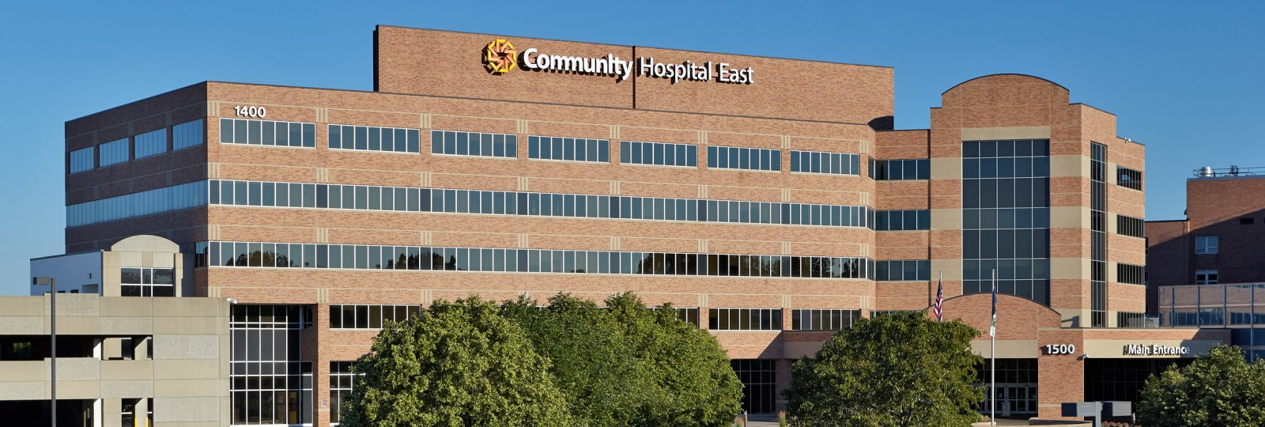
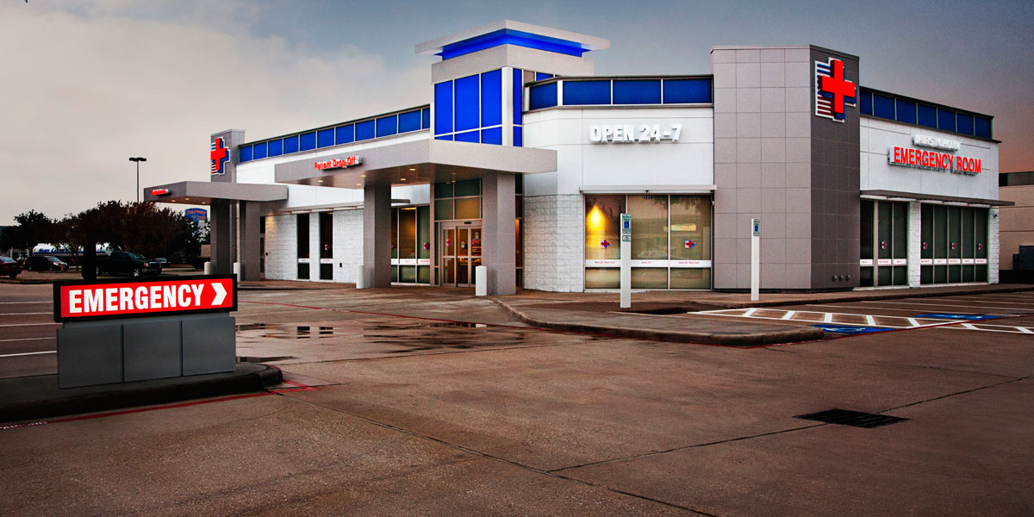
Faculty Salary
Practice setting
 | Clinical Hours | Total Salary
Academic | 969 | $330,650
Academic Affiliate | 1,144 | $339,409
Community | 1,314 | $332,667
Freestanding | 1,484 | $337,597

Slide 50
Professional Fee Billing
Percent
Academic & Affiliate:
95% of RVUs Attributed to faculty

Slide 51
Payer Mix
Mean Payer Mix Distribution

Slide 52
Faculty Salary Survey
Faculty Demographics

Slide 53
PA and NP Salary
Salary by Region
 | Total Salary | Total Hours | % PA
Midwest | $146,438 | 1696 | 75%
Northeast | $143,218 | 1582 | 78%
South | $132,254 | 1808 | 63%
West | $158,599 | 1431 | 57%
Highest
Concentration
APPs
Shift from NP
To PA
47% to 63%

