Slide 1
Diversity, Equity, & Inclusion Workgroup Survey Updates March 20th 2023 AACEM Dana Point, CA

Slide 2
Survey Background
Importance/history
Listserv recruitment Fall 2022
Data per each Department
Proposed every other year survey
Document progress
Share data individually and as group
Notes:
DEI critical for successful departments and for specialty
Serve our patients better when we represent our pt population

Slide 3
Survey Questions
Department demographics
Diversity metrics
Gender, Race, Ethnicity
Faculty
Professor, Associate, Assistant, Instructors (non-fellows)
Tenure track, tenured, endowed professorships
Fellows, residents
Leadership positions
VC, Division/Section Chief, Medical Director, PD, APD, Clerkship and Fellowship Director, other directors
Notes:
Dept demographics – 7 geographic regions, total faculty/resident numbers
Faculty, Instructors (non-fellows),
Fellows not included above as Instructors, both ACGME and non-ACGME

Slide 4
Results
43 of 150 (29%) departments participated
Data on 5180 total individuals
Individual dashboards being created
Will distribute late Spring
Webinar to discuss

Slide 5
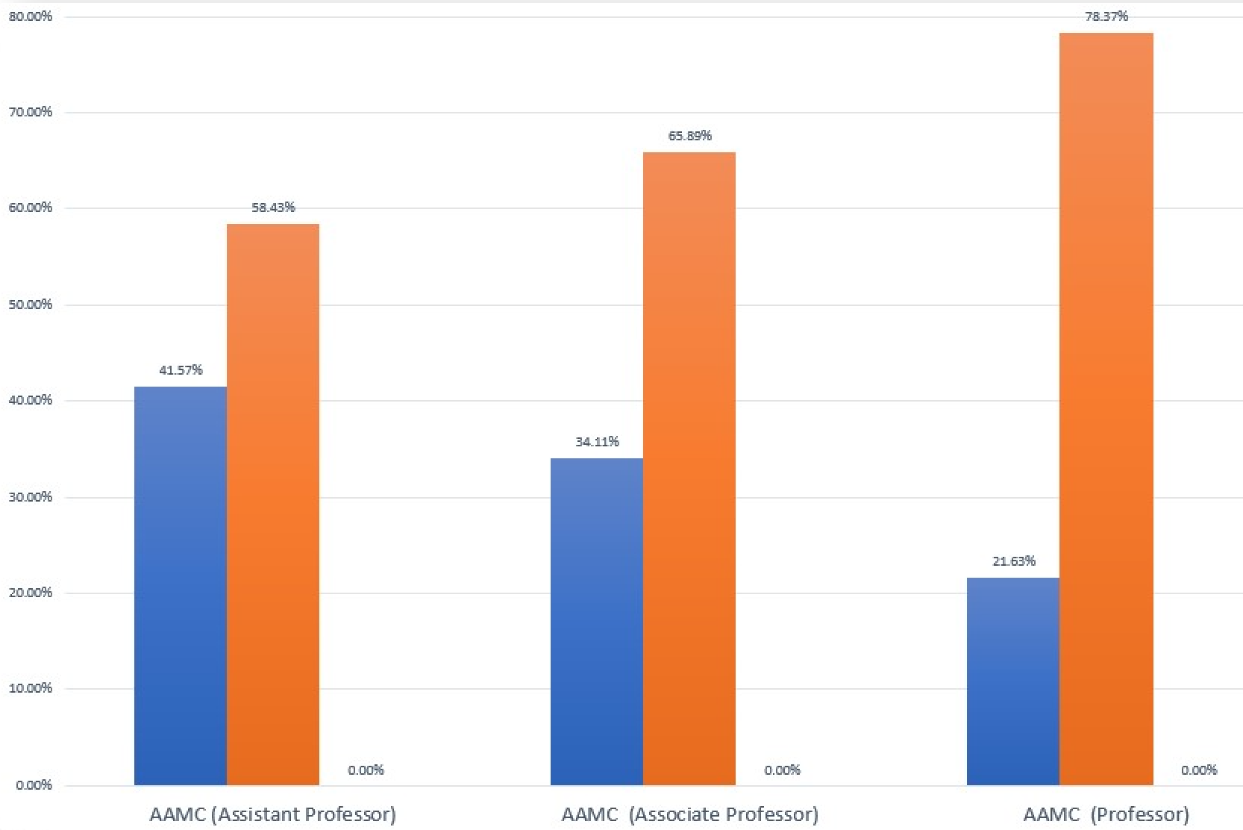
AAMC Data- Gender by Rank
78%
Assistant
Associate
Professor
66%
58%
42%
42% all AAMC
34%
28% all AAMC
22%

Slide 6
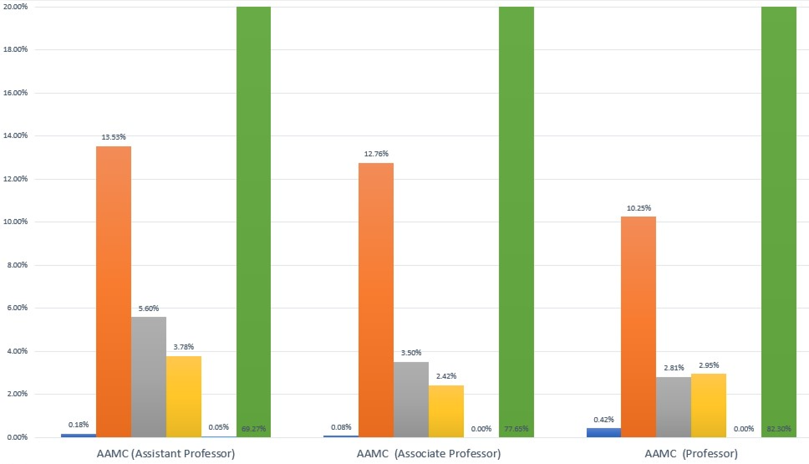
AAMC Data- Race/Ethnicity by Rank
77.7%
69%
Associate
Professor
Assistant
82.3%
13.5%
9% EM vs 12% AAMC
12.8%
7% EM vs 9% AAMC
10.25%
5.6%
3.8%
3.5%
2.8%
2.4%
2.9%
0.18%
0.05%
0.08%
0%
0.4%
0%
Notes:
Note they do not include multiracial

Slide 7
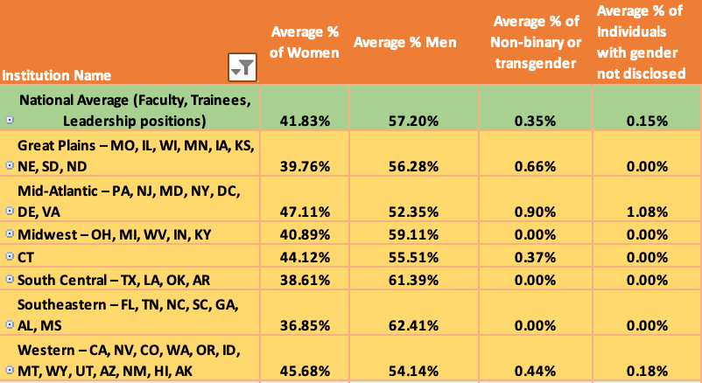
AACEM Data- Gender by Region
Notes:
Compiled gender and race/ethnicity by region

Slide 8
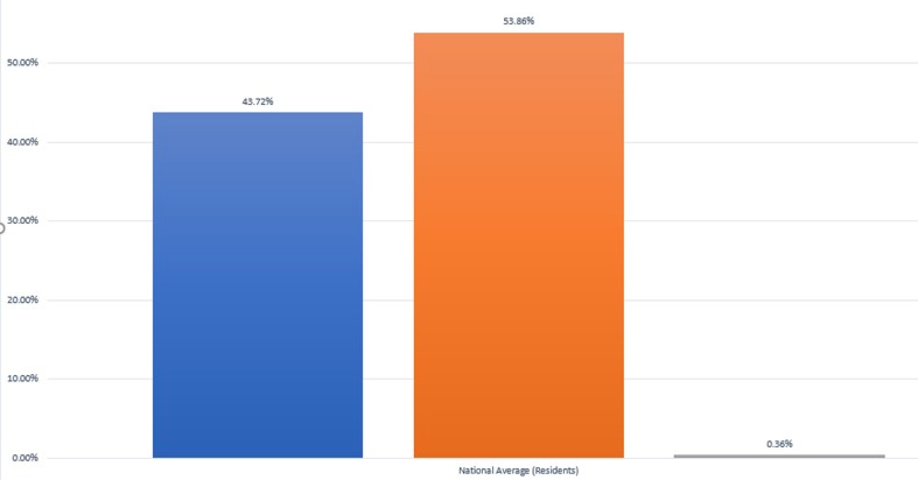
AACEM Data- Gender Residents
53.8%
43.7%
0.36%

Slide 9
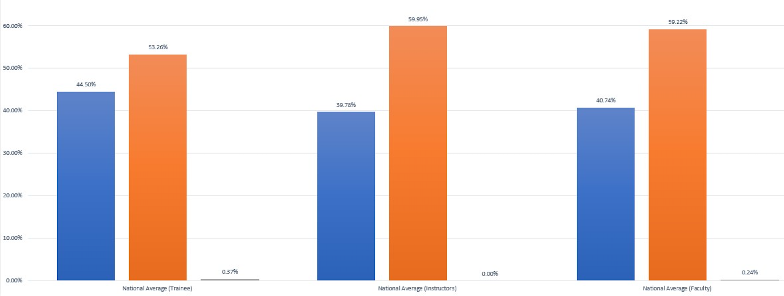
AACEM Data- Gender by Role
Trainees
Instructors
Faculty
60%
60%
53.3%
44.5%
40%
41%
0.4%
0%
0.25%

Slide 10
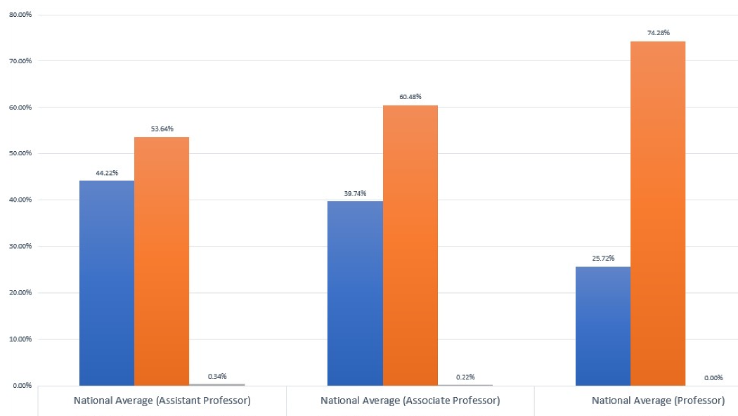
AACEM Data- Gender by Rank
Women Men Non binary
Assistant
Associate Professor
Professor
AAMC: 42% women 58% men
AAMC: 34% women 66% men
AAMC: 22% women 78% men
60%
74.3%
54%
44.2%
39.7%
25.7%
Women
Men
Non binary
0.34%
0.22%
0%

Slide 11
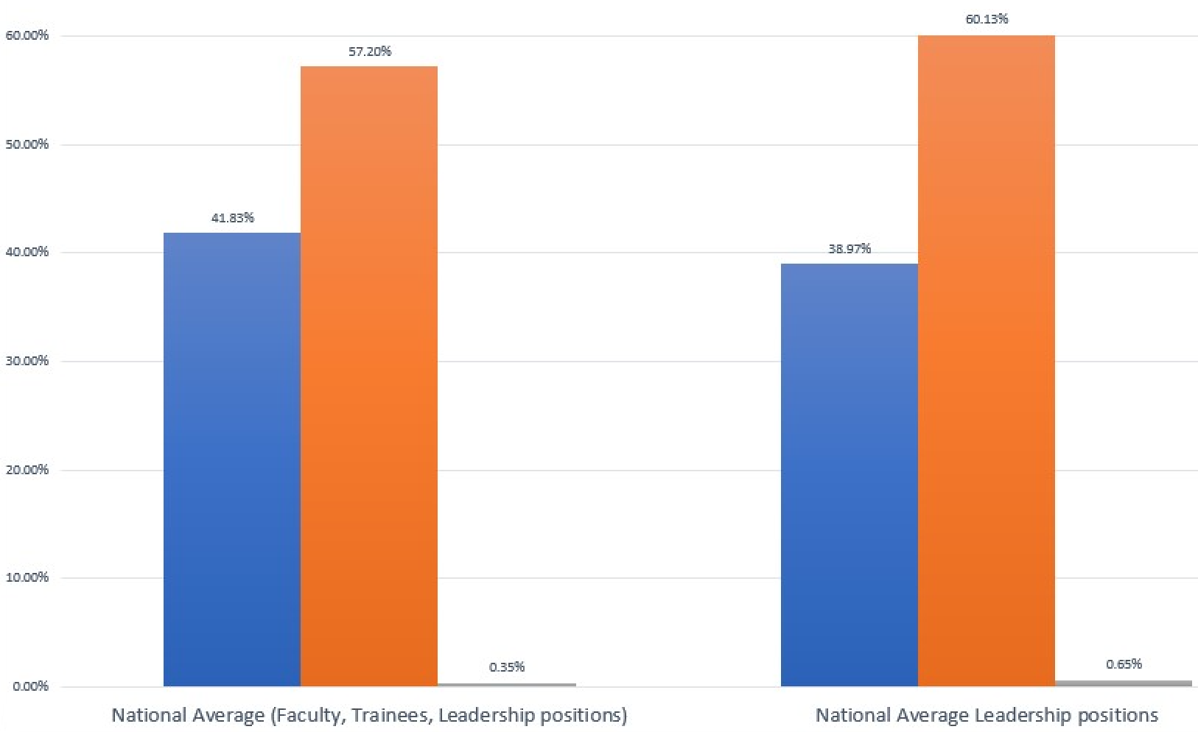
AACEM Data- Gender, Leadership
All (faculty/trainees)
Leadership
60%
57.2%
42%
39%
0.35%
0.65%

Slide 12
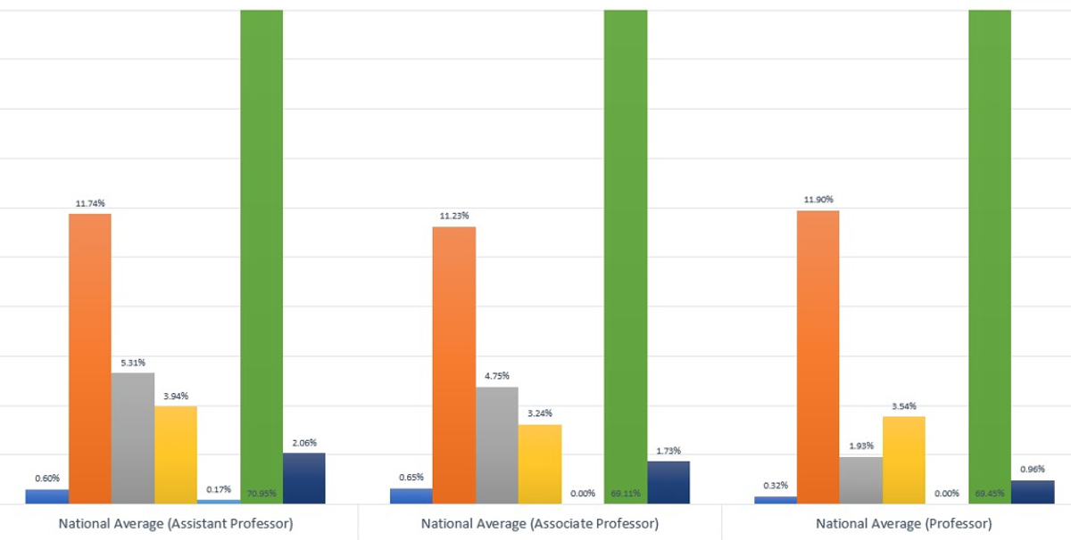
AACEM Data- Race/Ethnicity by Rank
Assistant
Associate
Professor
71%
69%
69.5%
11.7%
11%
12%
5.3%
4%
4.8%
3.5%
3.2%
1.9%
2%
0.2%
1.7%
1%
0.6%
0.7%
0%
0.3%
0%

Slide 13
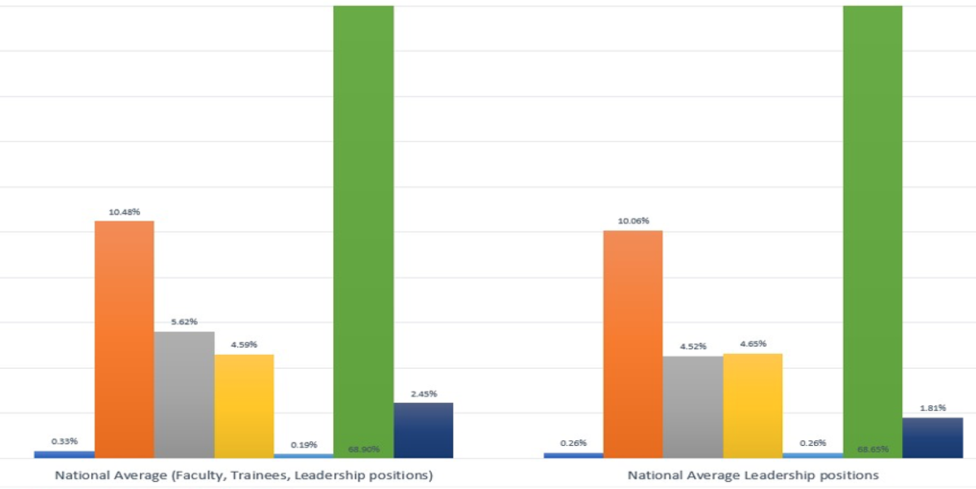
AACEM Data- All, Leadership Race/Ethnicity
69%
69%
All
Leadership
10.5%
10%
5.6%
4.6%
4.5%
4.7%
2.5%
0.26%
1.8%
0.33%
0.2%
0.26%
Notes:
Scale the graph

Slide 14
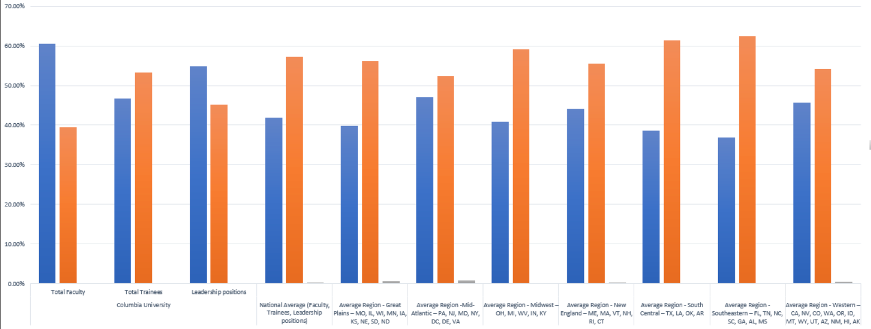
Columbia Data- Gender
Columbia
US Regions
All
Faculty
Leadership
Trainees

Slide 15
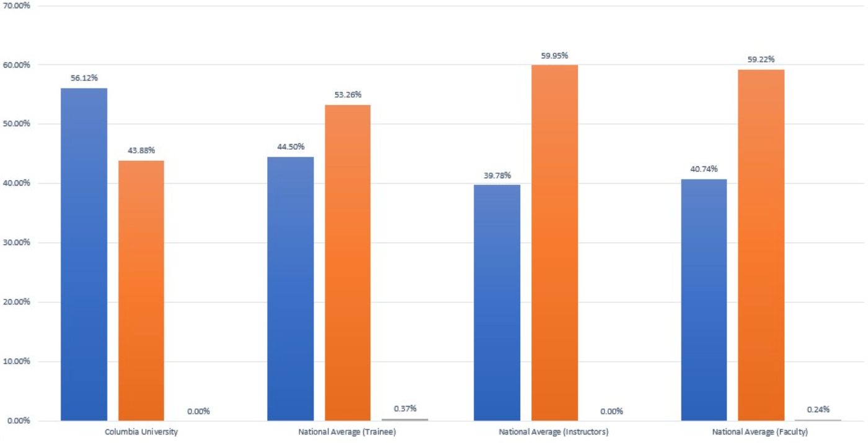
Columbia Data- Gender by Role
Columbia
Trainee
Instructor
Faculty

Slide 16
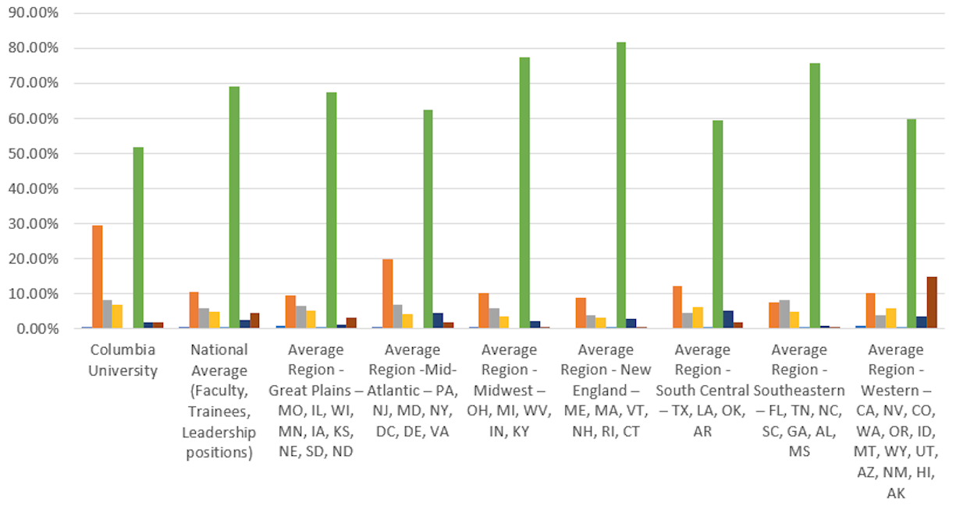
Columbia Data- Race/Ethnicity
Did not Disclose
Columbia
All

Slide 17
Where do we go from here
Proposed every other year survey
Document progress
Will discuss results at Spring DEI webinar
Please attend!
Use to facilitate recruitment of diverse faculty and trainees
Benchmarking
Notes:
DEI critical for successful departments and for specialty
Serve our patients better when we represent our pt population

