Slide 1
Welcome to the 2023 AACEM/AAAEM Annual Retreat

Slide 2
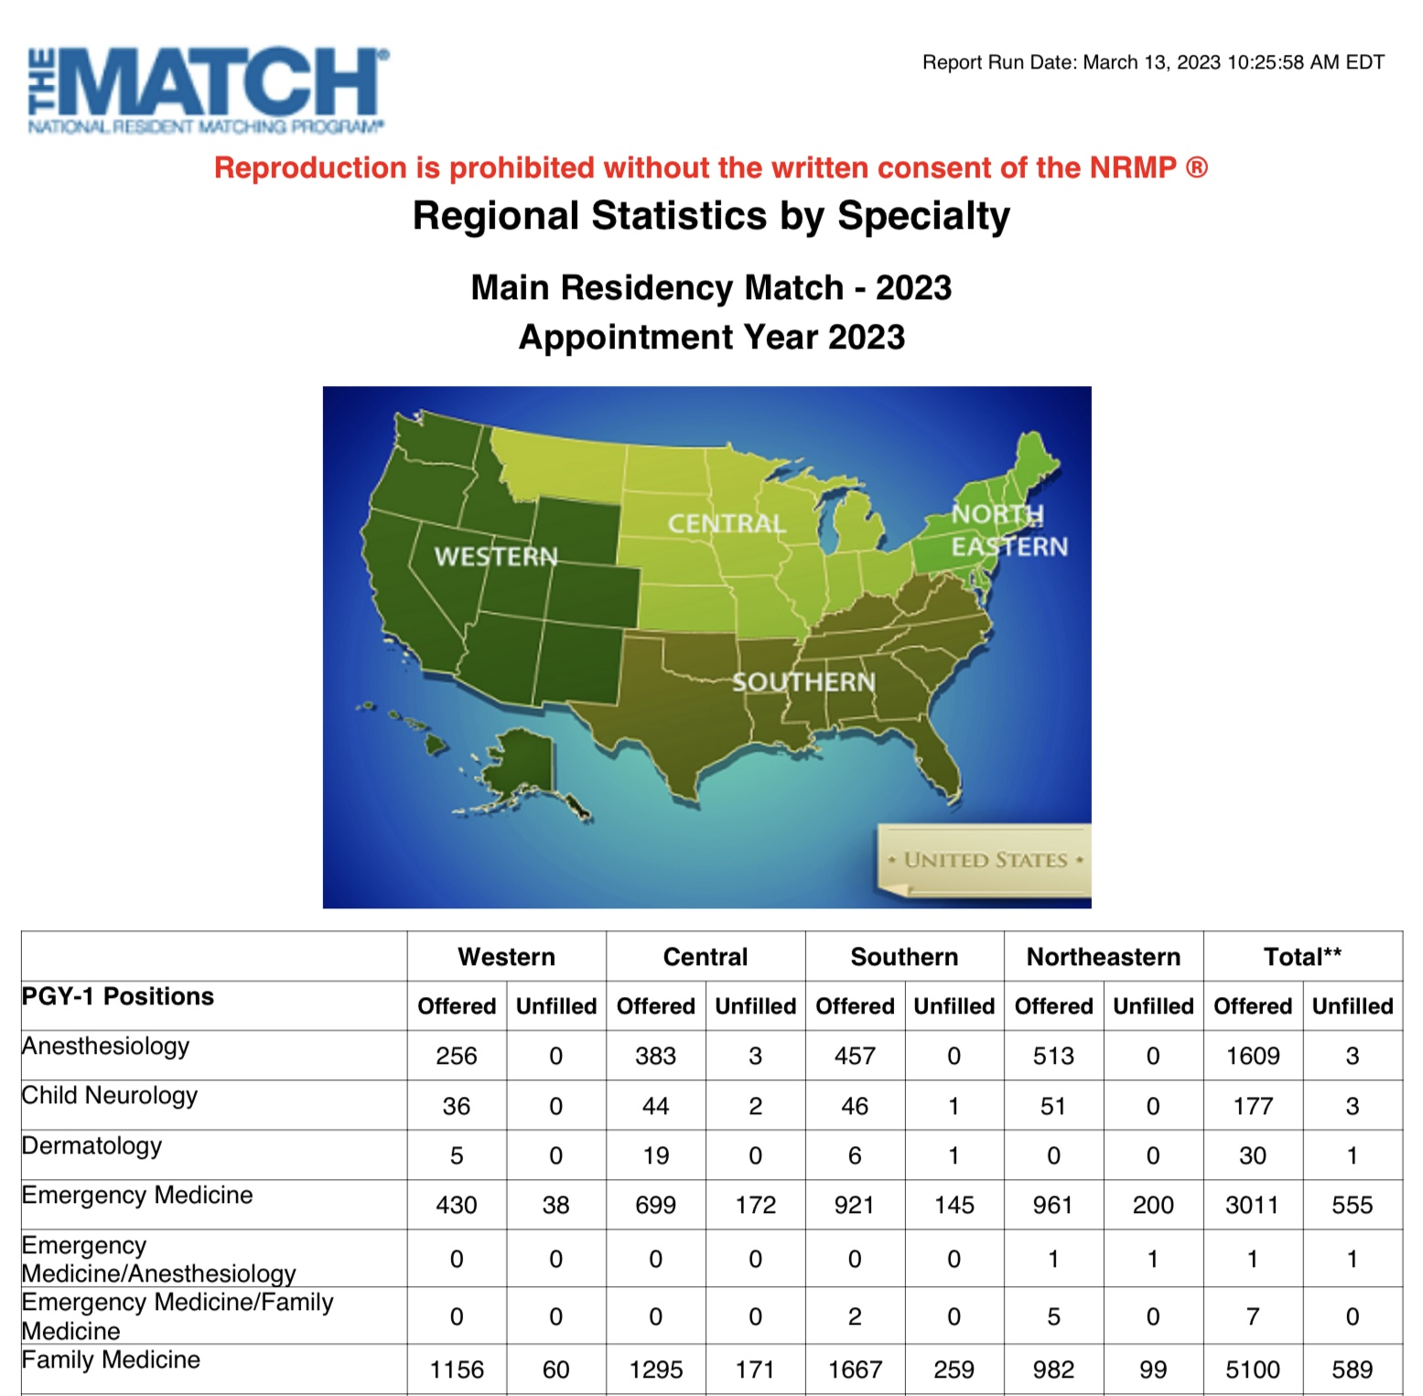
Notes:
Chairs turn vision into strategy, strategy into tactics, tactics into messaging, and messaging has to spark meaningful action and bring purpose to each team members effort.
Monday of last week, we found out that last year’s bad match statistics was not a fluke, it was the beginning of a trend that has worsened.

Slide 3
Framing the DEI discussion
Notes:
And so in case you need to frame our keynote into actionable objectives, here is one way to look at our match results. Now, I am not saying this is the issue in its entirety – far from up – but it does appear that our DEI vision and our DEI outcomes are not in alignment. Our plan is to have a Keynote Workshop… it will be interactive and will require you to break up into small groups and interact and problem solve.

Slide 4
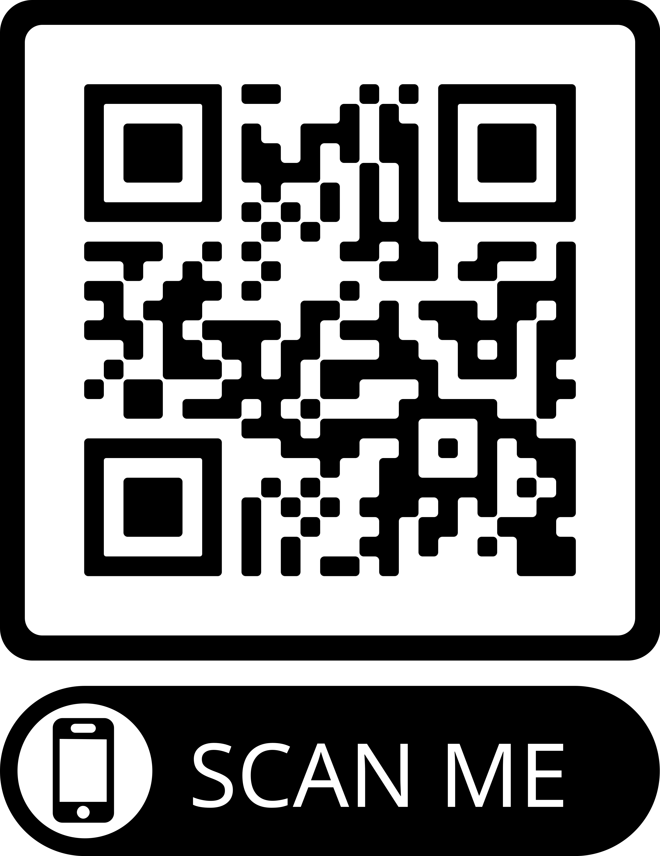
Chair’s Pledge
https://www.surveymonkey.com/r/VKCZLHG

Slide 5
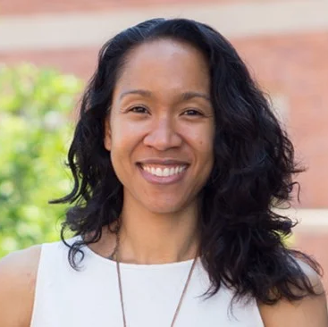
Heather Maiirhe Caruso PhD
Associate Dean, Equity, Diversity, and Inclusion
Adjunct Associate Professor of Management and Organizations
Adjunct Associate Professor of Behavioral Decision Making UCLA Anderson School of Management
Chair, UCLA Council of Equity Advisors
Co-founder, Second Science Project
Notes:
HEH-thur MY-ee-ray kah-ROO-soh '
Heather Maiirhe Caruso is a faculty member and associate dean at the UCLA Anderson School of Management, as well as Chair of the UCLA Council of Equity Advisors. Her career began as an engineer and executive in a multinational Silicon Valley startup, and has since become a Stanford- and Harvard- trained academic determined to help diverse workforces grow, communicate, and work effectively together. Dr. Caruso came to UCLA Anderson after over a decade co-directing a center at Chicago Booth with 2017 Nobel Laureate in Economics Richard Thaler. As partners, Caruso and Thaler co-directed the world’s oldest center devoted to judgment and decision making—the Chicago Booth Center for Decision Research (now the PIMCO Center for Decision Research). Their work helped to bring insights from the global bestseller Nudge to the world, and now supplements her work as dean with consulting and teaching on the practice of inclusive leadership, communication, and collaboration.

