Slide 1
AAAEM Executive and Committee Reports Dana Point, CA
March 2023
Amy Jameson

Slide 2
Executive Committee
President – Amy Jameson, University of New Mexico
Past President – Kain Robbins, Penn State University, Milton S. Hershey Medical Center
President Elect – David Christiansen, University of Florida College of Medicine, Jacksonville
Treasurer – Becky McGowan, University of Colorado Denver School of Medicine
Secretary – Jennifer Muir, The Brody School of Medicine at West Carolina University
Member at Large – Travis W. Schmitz, Northwestern University, Feinberg School of Medicine – McGaw
Member at Large – Steve Maxwell, University of Michigan
SAEM Board Liaison – Erin Campo
SAEM Staff Liaison – Pooja Agrawal, MD, MPH
Member at Large AACEM Liaison - Open

Slide 3
Incoming EC Members
Steve Maxwell – Secretary, University of Michigan
Diane C. Lee, Einstein Healthcare Network
Brendan Russell, Mass General Brigham

Slide 4
AAAEM 2022-2023 Committee Chairs
Benchmark - Greg Archual, MBA and Jim Schuelen, PA, MBA
Communications - Shannon Hughen-Giger, MHA,
Cali Sanford is stepping in as Chair
Inclusiveness, Diversity, Equity and Anti-Racism (IDEA) - Louis Burton, MHSM
Education Committee – Frank Jurkiewicz, III, MBA
Membership Committee - Steve Petrovic, MBA
Strategic Planning - Andrew Kennedy, MBA
Ambrosya Amlong is stepping in as Chair
Wellness Committee - Tim Sullivan, MHA, FACHE
TBA, based upon conversation on Tuesday
Nominating Committee - Kain Robbins

Slide 5
AAAEM Treasurer's Report
March 2023
Becky McGowan
AAAEM Treasurer

Slide 6
Finance Committee Members 2022
Becky McGowan, University of Colorado Anschutz Medical Campus
Amy Jameson, University of New Mexico
Dave Christiansen, University of Florida -Jacksonville
Jennifer Muir, East Carolina University
Kain Robbins, Penn State University
Steve Maxwell, University of Michigan
Travis Schmitz, Northwestern University

Slide 7
Finance Committee Activities 2022
*Reviewed Monthly Revenue & Expenses for AAAEM and CAEMA
•Reviewed Member Assistance Program applications
•Developed 2023 Budget
*Revised Definition Matrix for Individual Budget Categories

Slide 8
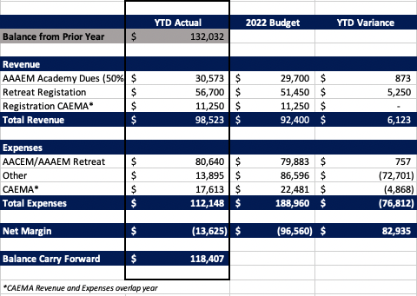
2022 Year End Statement (Unaudited)

Slide 9
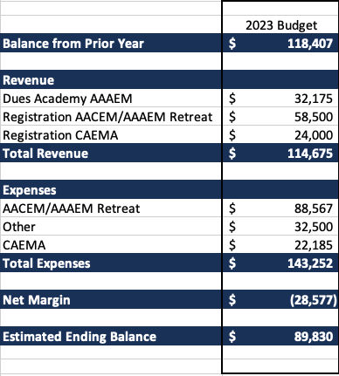
2023 Budget (January –December)
CY 23 Budget Considerations
Expanded Member Assistance Program
Retreat Cost
Budget entry for AAAEM Committees

Slide 10
Benchmark Committee
March 2023
Jim Scheulen/Greg Archual

Slide 11
Benchmark Committee
Committee returned to annual in-person meeting in August to discuss changes to the surveys
Committee had monthly calls to discuss progress and refine questions
Continued data collection/analysis on COVID specific survey
Monthly data collected covers January 2019 – December 2022
Performed annual Benchmark survey
94 academic/affiliated responses
Performed Faculty, APP, & Fellow (new) Salary Surveys
Alyssa Tyransky, Benchmark Surveys & Data Analytics Manager, replacing Cathi Harbertson

Slide 12
Benchmark Committee Membership
AAAEM Executive Committee approved Benchmark Committee membership structure
2 Co-Chairs, Data Manager, Roundtable representative, & AACEM members are not included in numbers below
15 AAAEM members (must have completed surveys for the past 2 years)
5-year terms, 3 members per term, can be renewed once
Accepting applications for 3 new members for a 5-year term
Co-Chairs will select new members
Diversity (e.g race, ethnicity, geographic, size of institution, private v state owned, etc) of committee will be considered when selecting new members
Applicants must email their CV & letter of intent to the Data Manager (Alyssa.Tyransky@osumc.edu) by April 14th

Slide 13
AAAEM Publications
Kilaru AS, Scheulen JJ, Harbertson CA, Gonzales R, Mondal A, Agarwal AK. Boarding in US Academic Emergency Departments During the COVID-19 Pandemic. Ann Emerg Med. 2023 Jan 19:S0196-0644(22)01328-2. doi: 10.1016/j.annemergmed.2022.12.004. Epub ahead of print. PMID: 36681622; PMCID: PMC9851166.
Van Heukelom et.al. Inpatient Boarding Definitions and Mitigation Strategies: A Cross-Sectional Survey of US Academic Emergency Departments. American Journal of Emergency Medicine. Accepted awaiting publication.
Rathlev NK, Holt NM, Harbertson CA, Hettler J, Reznek MA, Tsai SL, Lopiano KK, Bohrmann T, Scheulen JJ. 2017 AAAEM Benchmarking Survey: Comparing Pediatric and Adult Academic Emergency Departments. Pediatr Emerg Care. 2021 Dec 1;37(12):e1278-e1284. doi: 10.1097/PEC.0000000000002002. PMID: 31977768.
Reznek MA, Scheulen JJ, Harbertson CA, Kotkowski KA, Kelen GD, Volturo GA. Contributions of Academic Emergency Medicine Programs to U.S. Health Care: Summary of the AAAEM-AACEM Benchmarking Data. Acad Emerg Med. 2018 Apr;25(4):444-452. doi: 10.1111/acem.13337. Epub 2017 Nov 13. PMID: 29071804.
Wiler JL, Rounds K, McGowan B, Baird J. Continuation of Gender Disparities in Pay Among Academic Emergency Medicine Physicians. Acad Emerg Med. 2019 Mar;26(3):286-292. doi: 10.1111/acem.13694. Epub 2019 Feb 19. PMID: 30664286.
Archual GM, Panchal AR, Angelos MG, Way DP. The Impact of Selecting Specific Cohorts for Benchmarking and Interpretation of Emergency Department Patient Satisfaction Scores. Acad Emerg Med. 2020 May;27(5):388-393. doi: 10.1111/acem.13895. Epub 2019 Dec 23. PMID: 31778272.
Reznek MA, Larkin CM, Scheulen JJ, Harbertson CA, Michael SS. Operational factors associated with emergency department patient satisfaction: Analysis of the Academy of Administrators of Emergency Medicine/Association of Academic Chairs of Emergency Medicine national survey. Acad Emerg Med. 2021 Jul;28(7):753-760. doi: 10.1111/acem.14278. Epub 2021 Jul 8. PMID: 33977605.
Yiadom MY, Scheulen J, McWade CM, Augustine JJ. Implementing Data Definition Consistency for Emergency Department Operations Benchmarking and Research. Acad Emerg Med. 2016 Jul;23(7):796-802. doi: 10.1111/acem.12988. Epub 2016 Jul 1. PMID: 27121149; PMCID: PMC6805130.
Reznek MA, Michael SS, Harbertson CA, Scheulen JJ, Augustine JJ. Clinical operations of academic versus non-academic emergency departments: a descriptive comparison of two large emergency department operations surveys. BMC Emerg Med. 2019 Nov 21;19(1):72. doi: 10.1186/s12873-019-0285-7. PMID: 31752708; PMCID: PMC6868754.
Madsen TE, Heron S, Lall MD, Blomkalns A, Arbelaez C, Lopez B, Lin M, Rounds K, Sethuraman KN, Safdar B. Institutional solutions addressing disparities in compensation and advancement of emergency medicine physicians: A critical appraisal of gaps and associated recommendations. Acad Emerg Med. 2022 Jun;29(6):710-718. doi: 10.1111/acem.14452. Epub 2022 Feb 23. PMID: 35064998.
Peterson SM, Harbertson CA, Scheulen JJ, Kelen GD. Trends and Characterization of Academic Emergency Department Patient Visits: A Five-year Review. Acad Emerg Med. 2019 Apr;26(4):410-419. doi: 10.1111/acem.13550. Epub 2018 Sep 24. PMID: 30102817.
Madsen TE, Linden JA, Rounds K, Hsieh YH, Lopez BL, Boatright D, Garg N, Heron SL, Jameson A, Kass D, Lall MD, Melendez AM, Scheulen JJ, Sethuraman KN, Westafer LM, Safdar B. Current Status of Gender and Racial/Ethnic Disparities Among Academic Emergency Medicine Physicians. Acad Emerg Med. 2017 Oct;24(10):1182-1192. doi: 10.1111/acem.13269. Epub 2017 Sep 21. PMID: 28779488.

Slide 14
Communications Committee
March 2023
Shannon Giger

Slide 15
Communications Committee Update
Newsletter
Membership Profiles
Website Improvements
This year the communication committed produced 3 newsletters (summer, fall and winter) some notable additions we added were:
Committee reports
New member profiles (highlighted 5 this year)
SAEM directors listing with direct links
Important Announcements
Leadership Testimonials
Highlights of our members
We identified over 70 members (almost half) that didn’t currently have their member pictures. We have the listing so hopefully we will be able to grab some who attend our retreat while taking the group photo. We also created a membership google doc that provides more of an expansive listing or “areas of expertise”.
Special thanks to Ryan Pauline for pulling the listing together!
We made website improvements this year that included these things below:
CAEMA grads listings
Created a website analysis spreadsheet
w/the goal to review content on committee pages and look for ways to drive more traffic while keeping content up to date and appealing to membership. This still a work in progress but we made great strides in parsing this out.
Special thanks to Jennifer Muir for pulling the analysis together and parsing it out!

Slide 16
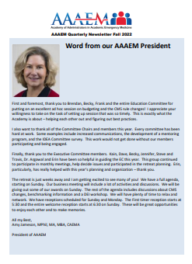
Communications Committee Update

Slide 17
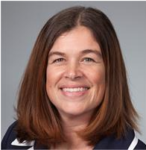
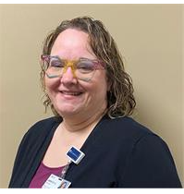
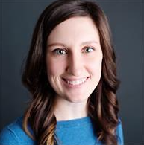
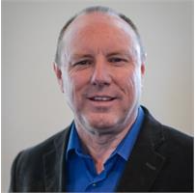
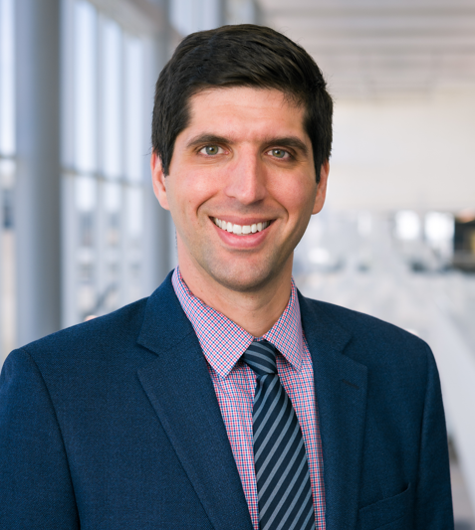
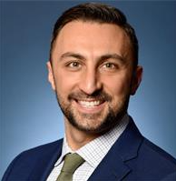
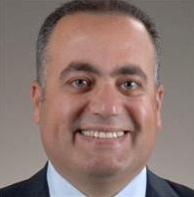
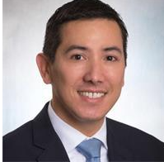
Thank You to the Communication Committee Members
Ambrosya Amlong, Vice Chair
Cali Sanford
David Calder
JC Busworld
Ryan Pauline
Hesham Youssef
Anthony Ho
Shannon Giger, Chair

Slide 18
Inclusiveness, Diversity, Equity and Anti-Racism (IDEA) Committee Report
March 2023
Louis Burton

Slide 19
IDEA Committee Members
Rhea Begeman, University of Illinois at Chicago
Louis Burton, UT Health, San Antonio
Dave Calder, Loma Linda University
Katy Oksuita, University of Wisconsin-Madison
Andrew Kennedy, University of Alabama at Birmingham
Diane Lee, Einstein Healthcare Network
Justine Murphey, Stanford University
Chelsea Pentecost, UT Health, Houston
Laura Robinson, University of Nebraska Medical Center
Tim Sullivan, Thomas Jefferson University and Hospitals

Slide 20
IDEA Goals and Activities 2022
Three Goals
Increase Diversity of AAAEM Group
Create Guideline/Protocol Reporting
Conduct Diversity Training/Education
Increase Diversity of AAAEM Group
Make recommendation – membership Committee – Outreach
Make recommendation – Education Committee – Tool Kit for Succession Planning
Host ACHE Fellowship Diversity Interns – mini job board? Stipend?

Slide 21
IDEA Goals and Activities 2022
Create Guideline/Protocol Reporting
AAAEM
Code of Professional Conduct
Members have an ethical obligation to professionally act in a manner that upholds the purposes, values, and objectives of AAAEM
Members shall conduct themselves in a professional manner while attending or participating in AAAEM sponsored events and in all communications with SAEM Staff
While alcohol is served at many AAAEM events, members shall not use any substance to an excess that negatively impacts the member’s ability to act in a professional manner
Members shall be honest, fair, and act respectfully and with integrity
Members shall endorse Diversity, Equity, and Inclusion and shall not discriminate against members or AAAEM staff regarding religion, race, ethnicity, color, national origin, sex, sexual orientation, or disability
Conduct unbecoming of an AAAEM Member should be reported to the AAAEM President and SAEM CEO. The AAAEM Executive Committee, including but not limited to the SAEM Ethics Committee, will investigate any reported breaches of professional conduct and reserves the right to enforce the AAAEM Code of Professional Conduct up to and including removal of AAAEM Membership

Slide 22
IDEA Goals and Activities 2022
Diversity Training
Conducted Journal Club on 11/16 – Disarming Racial Microaggressions: Microintervention Strategies for Targets, While Allies and Bystanders
Submitted Quarterly IDEA related topics to AAAEM Newsletter
Hosting Panel Discussion – Best Practices – IDEA

Slide 23
Education Committee
March 2023
Frank Jurkiewicz

Slide 24
Education Committee
2022-2023 Membership
Ashlee Melendez, University of Louisville
Becky McGowan, University of Denver School of Medicine
Jennifer Muir, The Brody School of Medicine at East Carolina University
Shannon Giger, University of Arkansas for Medical Sciences
Tim Sullivan, Thomas Jefferson University
Frank Jurkiewicz – Chair, University of Florida, Gainesville
Adrian Lopez, University of Texas School of Medicine at San Antonio
Hesham M. Youssef, University of Toledo
Ryan Pauline, Thomas Jefferson University
Brendan Russell – Vice Chair, Brigham and Women's Hospital
Travis Schmitz, Northwestern Medicine
Kenneth Taylor, Denver Health Hospital Authority

Slide 25
Education Committee
2022-2023 Accomplishments
Committee established quarterly education sessions
December 2022 – Mike Granovsky, MD, LogixHealth
February 223 – CMS Changes and Budgeting Practices
June 2023
October 2023
Nominated inaugural Vice Chair of Education Committee
VC of committee monitored AAAEM listserve and solicited follow-up from sender
Committee partnered with CAEMA leadership to review curriculum and assist with identification of subject experts
Repository of Professional development books

Slide 26
Education Committee
2022-2023 Future Initiatives
Development of on-boarding resources for new administrators
New administrator exposure to benchmark survey portal – Roundtable Analytics
Must read ED articles and helpful web links
Hot Topic development

Slide 27
Membership Committee Report
Steven T Petrovic, MBA ​
Chief of Administrative Officer​
University of Cincinnati Physicians​
University of Cincinnati – College of Medicine

Slide 28
Membership Committee Members
Kathleen Acevedo, University of Virginia
Adrian Lopez, University of Texas – San Antonio
Becky McGowan, University of Colorado
Ryan Pauline, Thomas Jefferson
Steve Petrovic, University of Cincinnati
Kain Robbins, Penn State University
Lowell Tyler, Duke University
Kashwayne Williams, Washington University (St. Louis)

Slide 29
Membership Committee
Annual Goals:
Align AAAEM membership with the AACEM
15 New Members
Improve new membership onboarding
AAAEM Mentorship Program
Increase membership with Associate & Emeritus Status
Largest Membership Panel in our history - 126
91 Administrator
33 Associate
2 Emeritus

Slide 30
Membership Committee

Slide 31
Strategic Planning Committee
Annual Report
2022/2023
Andrew D. Kennedy, M.B.A.
Executive Administrator
University of Alabama at Birmingham (UAB)
Committee Chair

Slide 32
AAAEM Strategic Planning Committee 2022/2023
Drew Kennedy, Chair – UAB
Gai Cole, Vice Chair – Johns Hopkins
Kathleen Acevedo – U. of Virginia Health
Ambrosya Amlong – University of Kansas
Bob Balboni – Brown University
Jeannie Castellane - Rutgers
Melinda Kaye Franks - Vanderbilt
Frank Jurkiewicz – University of Florida
Steve Maxwell – University of Michigan
Anne McDonald – University of Mississippi
Jennifer Muir – East Carolina University
Tim Sullivan – Thomas Jefferson University
Kashwayne Williams – Washington University
Hesham M. Youssef – University of Toledo
Special thanks to Aimee Kalandras (Johns Hopkins) for monthly meeting minutes.
Special thanks to Shelley Osenroth (Michigan) for assistance with the membership survey.

Slide 33
2022/2023 Key Accomplishments
Distributed strategic plan membership survey to AAAEM membership in February 2023
New timing for distribution
New questions: Experience, Demographics
Customary but disappointing response rate
Shared results with Executive Committee and committee chairs, along with comparison of results from previous years
Workgroup:
Steve Maxwell – University of Michigan
Kathleen Acevedo – University of Virginia Health
Jeannie Castellane - Rutgers
Melinda Kaye Franks - Vanderbilt

Slide 34
Strategic Membership Survey Results

Slide 35
2022/2023 Key Accomplishments
II. Reviewed, discussed, and edited the Strategic Plan:
Proposed edits shared with the Executive Committee
Wordsmithing, clarifying Core Principles (Best Practices)
Identified areas for further discussion, potential removal (Greater Integration in SAEM)
Workgroup:
Gai Cole – Johns Hopkins
Frank Jurkiewicz – University of Florida
Jennifer Muir – East Carolina University
Kashwayne Williams – Washington University

Slide 36
2022/2023 Key Accomplishments
III. Developed SWOT Analysis session for 2023 annual retreat
Sunday, March 19, 2023
Incorporate feedback from 2022 survey
Incorporate prior SWOT Analysis items
Gather consensus perceptions from members at the retreat
Generate discussion and create engagement among AAAEM members
Workgroup:
Ambrosya Amlong – University of Kansas
Bob Balboni – Brown University
Anne McDonald – University of Mississippi
Tim Sullivan – Thomas Jefferson University
Hesham M. Youssef – University of Toledo

Slide 37
Strategic Planning Committee Proposed Goals for 2023/2024
Continue to have a strong committee of highly engaged members
Maintain communication and interaction with all AAAEM committees
Transition to a new Committee Chair

Slide 38
Wellness Committee
March 2023
Tim Sullivan

Slide 39
Wellness
2022 members
Full Name | Institution Name
Anthony A.E. Ho | Boston Medical Center Emergency Medicine Department
Chelsea Pentecost, MBA | The University of Texas Health Science Center McGovern Medical School-Houston
Janet L. (Sherry) Baker | The University of Texas Health Science Center McGovern Medical School-Houston
Crystal A. Sparks | University of Arkansas for Medical Sciences College of Medicine
Cali Sanford, MHA | University of Alabama at Birmingham
Andrew J. Wilp, MBA | University of Cincinnati College of Medicine
Kathleen M. Acevedo, MBA | University of Virginia Health

Slide 40
Nominating Committee
March 2023
Kain Robbins

Slide 41
Nominating Committee Members
Rhea Begeman
Antoinette Brooke
Louis Burton
Ashlee Melendez
Kain Robins

Slide 42
AAAEM Award Descriptions and Guidelines
James J. Scheulen Lifetime Achievement Award in Academic Emergency Medicine Administration
The AAAEM Lifetime Achievement Award in Academic Emergency Medicine Administration is the highest recognition the Academy gives an individual. It recognizes an academic emergency medicine administrator who has demonstrated noteworthy achievement, exceptional leadership, and management proficiency. One who has enhanced the strategic and operational effectiveness of academic emergency departments, emergency medicine education or emergency medicine research in his or her institution, and/or the broader academic emergency medicine community.
Minimum requirement: Must be AAAEM member for greater than 5 consecutive years and work a minimum of 10 years in academic emergency medicine. Member should demonstrate the following:
Advances interprofessional education, be involved in professional growth, and educational programs within the Academy
Commitment to the organization through AAAEM leadership
Provides leadership and service within our profession
Evidence of research and/or creative scholarship activities related to academic emergency medicine
Creates and cultivates sharing of ideas and best practices amongst AAAEM members
Significant Contributions to Academic Emergency Medicine Administration Annual Award
The AAAEM Annual Academy Award recognizes an academic emergency medicine administrator who has demonstrated exceptional leadership within the past three years.
Minimum requirement: AAAEM member with demonstration of the following:
Exhibits exemplary leadership qualities (i.e. Sharing best practices, Mentoring, Advocacy of the profession, Participation in AAAEM activities)
Shows outstanding dedication, competence, and exceptional performance
Shows strategic and operational effectiveness
Contributes to emergency medicine education and/or research via presentations or other
Noteworthy contribution/s to the growth and success of AAAEM
The Rising Star Academy of Administrators in Academic Emergency Medicine Award
This recognizes an academic emergency medicine administrator affiliated with AAAEM who has demonstrated significant participation and/or leadership within the academy during their first five years of membership.
Minimum requirement: AAAEM member for 5 years or less with a demonstration of the following:
Significant participation in AAAEM activities (e.g. projects) and/or committees
Demonstrated leadership skills
Positive peer to peer interactions
Works effectively with AAAEM leadership (either at committee or organizational level or both)
Demonstrated initiative to further AAAEM goals and outcomes

Slide 43
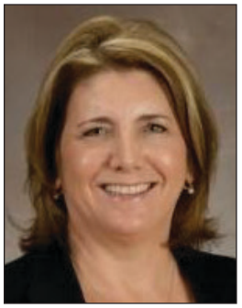
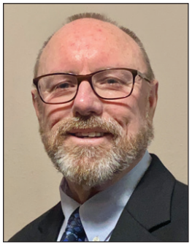
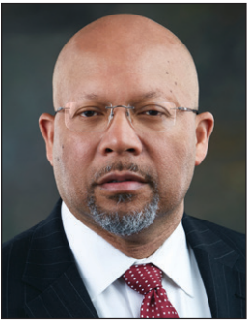
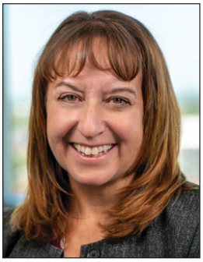
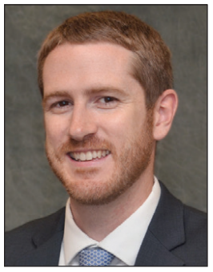
Award Winners
James J. Scheulen Lifetime Achievement Award in Academic Emergency Medicine Administration
Significant Contributions to Academic Emergency Medicine Administration Annual Award
The Rising Star Academy of Administrators in Academic Emergency Medicine Award

Slide 44
Recognition and thank you…
Thank you to Erin Campo, SAEM Director of Governance!
Thank you to the Executive Leadership Team and all of the Committee Chairs!
Looking forward to Dave’s leadership!

