Slide 1
How to Handle Generational Differences and Prevent Quiet Quitting
Stephanie Kayden, MD, MPH
Deputy Chair, Brigham and Women’s Hospital, Harvard University
James Miner, MD
Chair, Hennepin County Medical Center, University of Minnesota
AACEM/AAAEM Retreat - March 22, 2023

Slide 2
Boomers (1946-1964)
Background
Job Expectations
Didn’t grow up with computers
Collectively engaged in social movements
Started jobs when workplaces had fewer women, less diversity
Long-term job security was common
“Work is life”
Dedicated, loyal, hard-working
Expect to ‘pay their dues’
Value structure, security
Prefer face-to-face interaction
Want respect

Slide 3
Gen X (1965-1980)
Background
Job Expectations
Grew up with rapid change:
Technology growth
Many women entering the workforce
Increased acceptance of social differences
‘Latchkey kids’
Independent, self-sufficient
Used to working solo or in small teams
Value work-life balance, autonomy, flexibility
Pragmatic realists
Want to be trusted and have autonomy over their work

Slide 4
Millennials (1981-1996)
Background
Job Expectations
First adopters of social media, instant messaging
Started college/work during Great Recession
Women > men in educational achievement
Economically stunted young adulthood
“Work hard, play hard”
Desire immediate feedback
Expect to be judged by results, not time spent
Value meaningful work and social life
Want purpose and to feel connected to the organization’s mission

Slide 5
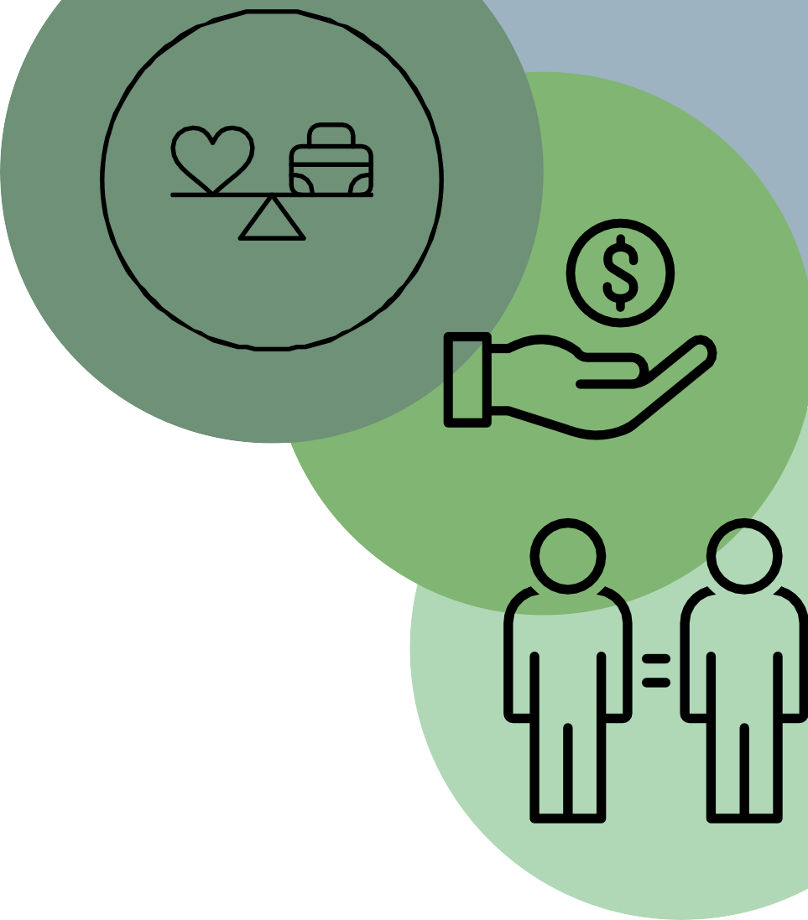
Gen Z (1997-2012)
Background
Job Expectations
Raised as ‘digital natives’
Schooled in collaborative efforts
Half are racial/ethnic minorities
Grew up during Great Recession
Most educated generation
Expect new technology and formal training
Prioritize salary over benefits
Value authenticity, diversity, creativity
Prefer millennial managers
Want empathy, engagement

Slide 6
Quiet Quitting
Defined as not taking on any more responsibilities that your job requires
Boomers and Gen X gave us the Great Resignation
Millennials and Gen Z developed Quiet Quitting, with the term surfacing on Tik Tok last summer
Developed from the pandemic’s disruption of traditional office culture

Slide 7
Why? - Feeling Taken Advantage of - Finding more passion in activities outside of the workplace
Signs
Cynical all the time
Disengaged
Don’t finish projects or complete work with consistently poor quality
Causes
Unclear expectations
Lack of communication
Overworked
Being micromanaged

Slide 8
Preventing Quiet Quitting
In general
Allow autonomy
Create a sense of purpose
Foster engagement
Listen, learn, and implement
Specific Ideas
Communicate early, often and transparently
Democratize decision making
Help them find projects that fit their skill set
Invest in professional development
Coaching
Continuous learning
Team based training
On demand micro-learning
Adapt training to the diverse needs of your physicians

