Slide 1
Work Force
Richard J Hamilton MD MBA
Rawle A Seupaul MD

Slide 2
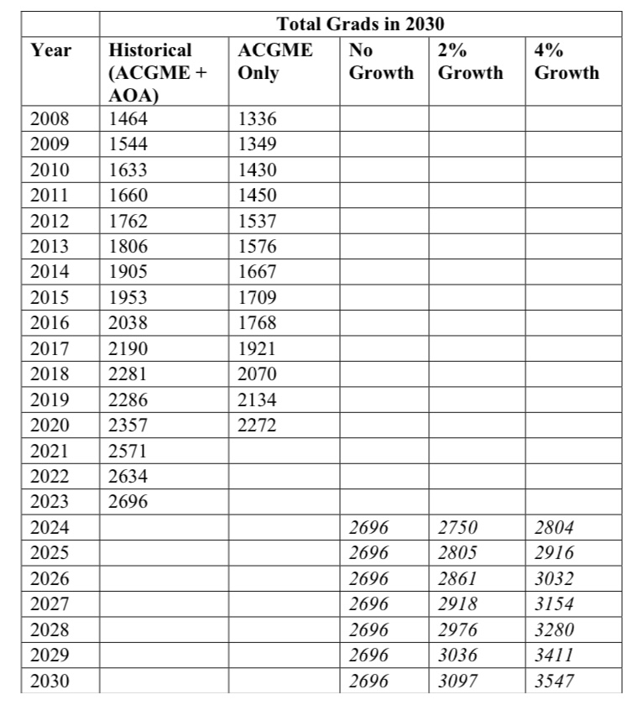
Workforce study in 2023
2023 Match will be the class of 2026
2961 filled positions (Main + SOAP)
Class of 2026 = 2961
2-4% growth
Notes:
The pause in hiring around Covid seems to have ended…
The workforce oversupply is still 7 years away…

Slide 3
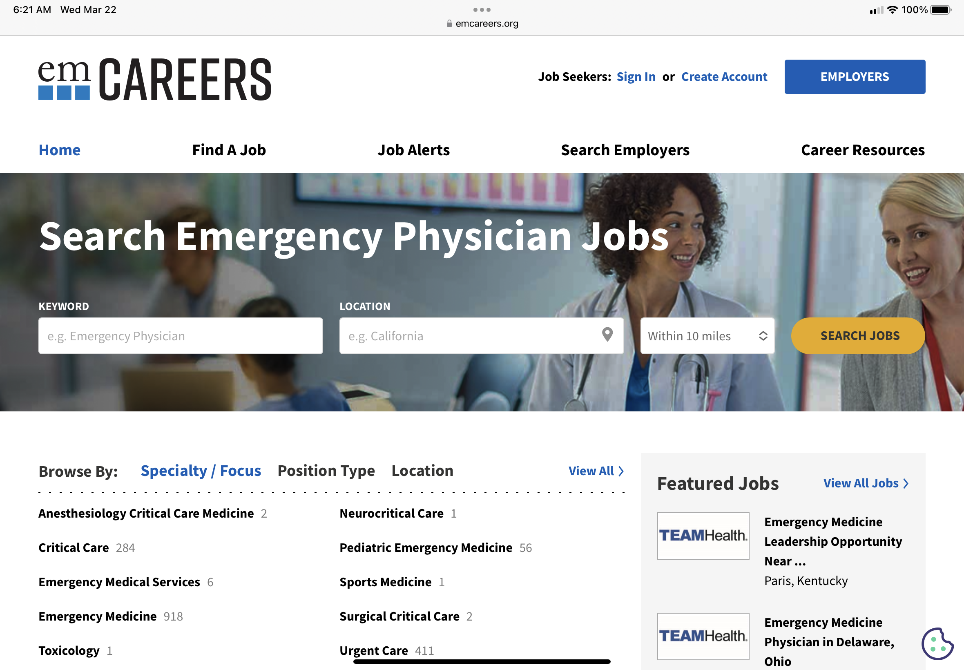
The jobs are back…
Notes:
Especially in the EP deserts!!!!

Slide 4
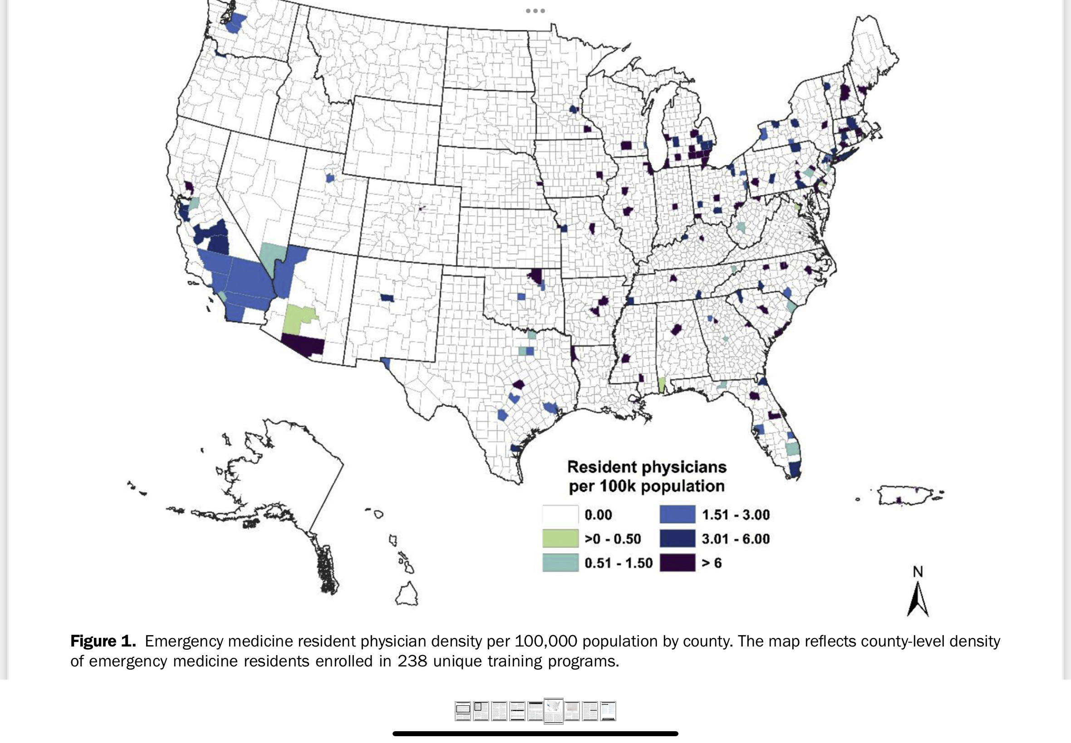
Emergency Physician Deserts
The number of emergency medicine residency programs has increased;
most new programs were added to the states that already had emergency medicine residency programs.
There is an emergency physician “desert” in the rural United States, lacking both residents and residency training programs. [Ann Emerg Med. 2022;80:3-11.]

Slide 5
EM work life balance reconsidered
Notes:
Autonomy, mastery and purpose
Move to the positive
EM as a calling, a vocation
Programs to develop skills
A dream job?

Slide 6
A new model…
How many of you have this position
Reduced FTE
Clinical Rate ($/hr) same
Full Time benefits
Ability to pick up additional shifts

Slide 7
A new model to discuss
Staffing the old way
130 hrs/month x 12 months (no vaca)
24 hr single coverage ED needs 6.0 FTEs (including a medical director etc)
Staffing with reduced FTEs
100 hrs/month (.77 FTE) x 12 months (no vaca)
Same ED now requires 8.0 FTEs
We just added 2 jobs!!!!
Bigger labor pool for callouts/FMLA/Holidays
Leverage salary with additional shifts
Wellness benefits etc

