Slide 1
No Easy Answers – Strategies for Leading
in Chaotic Times
AACEM Leadership Development Working Group
With Guest Presenter Michael J. Stamos, MD
Dean, UCI School of Medicine

Slide 2
AACEM Leadership Development Working Group
Stephen J. Wolf, MD (Chair)
Christian Arbelaez, MD, MPH
Jane H. Brice, MD, MPH
Yvette Calderon, MD, MS
Charles Louis Emerman, MD
Chris Fox, MD
Azita G. Hamedani, MD, MPH, MBA
Katherine L. Heilpern, MD
Stephanie Kayden, MD, MPH
Brent King, MD, MMM
Ian B.K. Martin, MD, MBA
Robert F. McCormack, MD
Becky McGowan, MBA
Becky McGowan, MBA
Peter S. Pang, MD
Mary D. Patterson, MD
Susan B. Promes, MD, MBA
Ralph J. Riviello, MD, MS
Rahul Sharma, MD, MBA
Susan A. Stern, MD
Jeffrey Stowell, MD
Benjamin C. Sun, MD, MPP
Elizabeth Lea Walters, MD
Brian J. Zink, MD
Erin K. Campo (Staff Liaison)

Slide 3
Strategies for Leading in Chaotic Times
Agenda
Objective: Learn and share strategies for leading in chaotic times
Leading in Crisis Introduction (10 min)
Moderated Breakouts with Scenario Discussions (20 min)
Report out (10 min)
Follow-up Email Summary

Slide 4
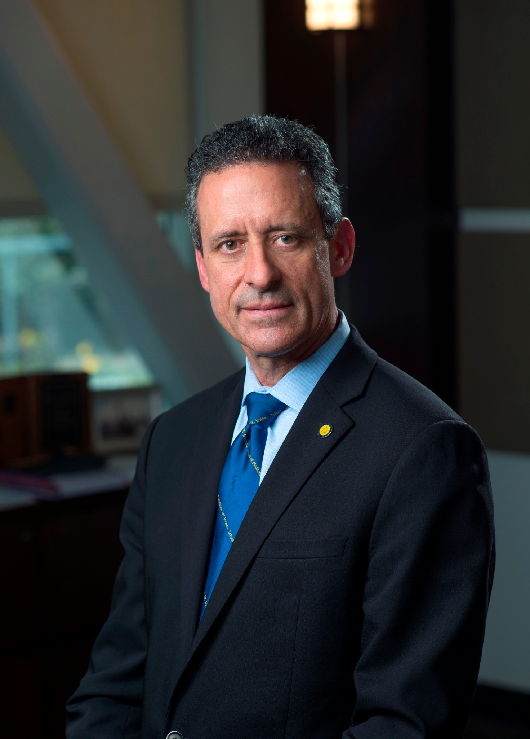
Leading in Chaotic Times: Michael J. Stamos, MD
Michael J. Stamos, MD, joined UCI in 2002 and is currently dean of the School of Medicine, a position he has held since early 2016. During his tenure, the School has steadily climbed in national research stature and has received the highest accreditation possible from the Association of American Medical Colleges/American Medical Association Liaison Committee on Medical Education. In addition, he has led the School’s effort to engage its diverse population in its commitment to inclusive excellence in medical education and sustainable change. Today, more than 50 percent of the school’s executive leadership team are women and the number of students identifying as underrepresented minorities is at a nation-leading 17 percent. As a clinician, Dr. Stamos is an internationally recognized expert in the treatment of colorectal cancer and inflammatory bowel disease using minimally invasive surgery and sphincter-preserving techniques. He is a past president of the American Society of Colon and Rectal Surgeons (ASCRS), the American Board of Colon and Rectal Surgery (ABCRS), and past president of the Research Foundation of ASCRS. Dr. Stamos is regularly listed among America's Top Doctors, Best Doctors in America, and "Physicians of Excellence".

Slide 5
Breakout Session Instructions
Please count off at your table (# 1-5)
Starting again if there are more than 5 at your table.
Find your Breakout by your number
Group 1 – Front Stage Left
Group 2 – Front Stage Right
Group 3 – Room Center
Group 4 – Back Stage Left
Group 5 – Back Stage Right
Choose a group recorder who will report out your strategies at the end.
Discuss the scenario and work through these questions:
What are the key issues to consider in your scenario?
What are the greatest risks as a leader for your scenario?
What are the 2-3 key strategies your group recommends when navigating this contentious topic?

Slide 6
No Easy Answers –
Strategies for Leading in Chaotic Times
Breakout Session - Report Out

Slide 7
Thank You!
AACEM/AAAEM Annual Retreat
3/21/2023
AACEM Leadership Development Working Group

