Slide 1
AACEM Executive Committee Update

Slide 2
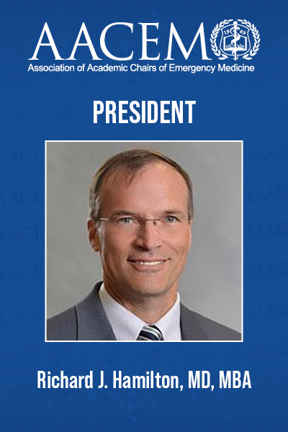
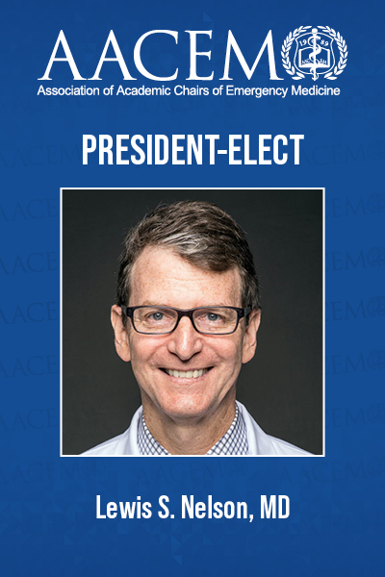
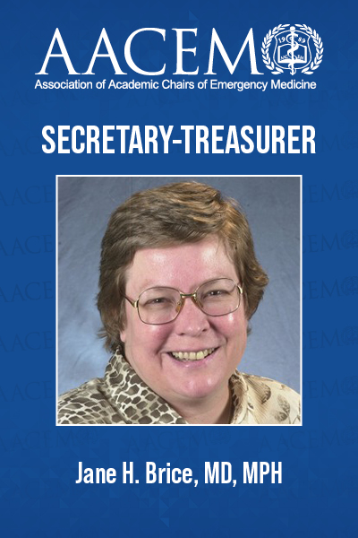
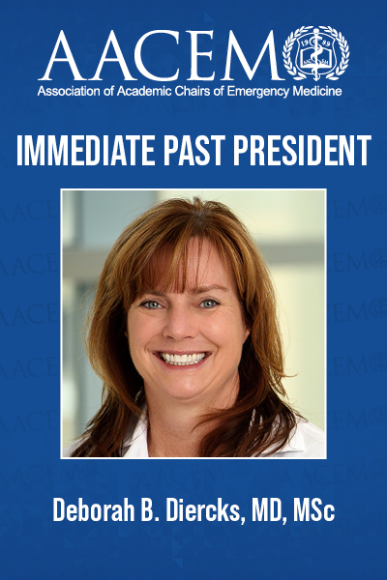
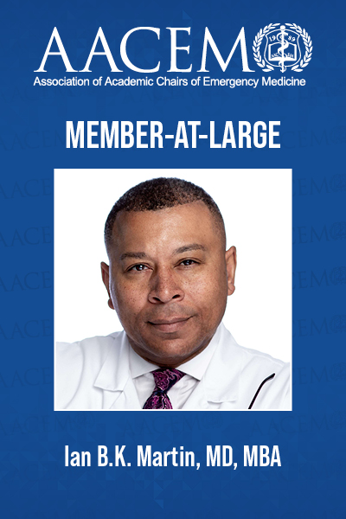
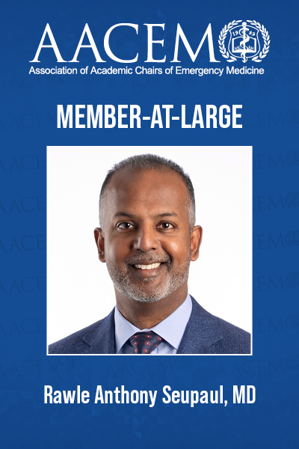
Welcome from Your Executive Committee
And congratulations to Dr. Mary Tanski, joining the AACEM Executive Committee at SAEM23!

Slide 3
Mission and Membership
Our Vision: To be the essential resource for the successful academic chair of emergency medicine
Representing: Over 150 Chairs

Slide 4
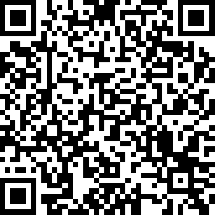
Call for Workgroups/Committee
Sign up for an AACEM workgroup/committee appointment now for 2023-2024!
Boarding
Chairs Support and Resources (new)
DEI
Leader Development
Membership
Research

Slide 5
Chair Mentorship Program
PURPOSE:
Provide a resource for newly appointed chairs of academic departments of emergency medicine
Provide an opportunity for established chairs to share their knowledge, insights, and experiences with developing chairs
Enhance networking among new and established members of the Association
Facilitate an on-site visit of either ($1,500 travel stipend provided by AACEM)
The mentor to the new chair's program, or
The new chair to the mentor's program
4 Chairs currently enrolled as mentees!
Mentee Eligibility: Any AACEM active/full or associate member in good standing who is within 6 to 18 months of assuming a chair position may apply to be a mentee. Email aacem@saem.org for more information!

Slide 6
AACEM Funding
AACEM has grown to be $1,000,000 strong
Much is invested and protects the organization for a rainy day
$20,000 annually set for AACEM project proposals.
Project proposal submission form will be released in fall 2023 for 2024 funding.
Additional funding provided by AACEM for Scholarships (CDP, eLead).

Slide 7
AACEM Collaborations
AACEM Regularly collaborates with SAEM, AAEM, ABEM, ACEP, ACOEP, CORD, EMRA and SAEM-RAMS
ACEP-led All EM Workforce Taskforce
SAEM-led All EM DEI Taskforce
Accreditation Council for Graduate Medical Education (ACGME)
Association of American Medical Colleges (CFAS)
Emergency Medicine Policy Institute (EMPI)

Slide 8
Recent AACEM Position Statements
March 2023: Multi-Organizational Statement on the Emergency Medicine 2023 Match Results
December 2022: All EM DEI Vision Statement
December 2022: Multi-Organizational Letter Regarding AHRQ Report on Diagnostic Errors in the Emergency Department
November 2022: Letter to the White House regarding the Emergency Department Board Crisis
November 2022: CFAS Sign-on Letter Encouraging Appropriators to Finalize FY23 NIH Funding Increase
November 2022: Letter to House and Senate Appropriations Committee to finalize FY23 NIH funding increase
October 2022: ACEP Letter on Boarding Summit
June 2022: EM Organizations Communicate Opposition to Doximity "Reviews" of EM Residency Training Programs
May 2022: Statement on Firearms Injury

Slide 9
NEW AACEM Chair Support and Resources Workgroup Update
Nicole S McCoin, MD, FAAEM, FACEP Chad M. Cannon, MD
John P. Marshall, MD

Slide 10
NEW AACEM Chair Support and Resources Workgroup Update
Combined the Community & Member Advocacy Workgroups
NEW Chair Support and Resources Workgroup:
Responsible for unifying Academic Emergency Medicine Chairs by developing and promoting best practices for engagement and resource sharing among the AACEM membership.
The workgroup will:
Determine the needs and priorities of the AACEM members
Develop strategies for member resource and data sharing
Evaluate efficient online methods to objectively answer member questions (i.e. embedded survey tool in the AACEM listserv)
Enhance engagement for all members
Enhance role in unifying EM organizations

Slide 11
NEW AACEM Chair Support and Resources Workgroup Update
First Mission of the Workgroup:
Review the existing community site to determine how best to improve navigability, search, and retrieval of previous surveys and materials
Add keywords and tags and to existing and new content
Encourage increased sharing of materials to save time/effort and improve everyone’s success
Protocols, Policies, Algorithms
Program, Division or Fellowship development Proposals
Lectures, Curriculums, etc.

Slide 12
AACEM DEI Workgroup Update
Angela M. Mills, MD
Nathan Kuppermann, MD, MPH

Slide 13
AACEM DEI Webinars
Recent Webinars:
September 2022: Black Men in White Coats Documentary Discussion
January 2023: SAEM DEI Curriculum (recorded)
Call for webinar participation! Bring a friend!
DEI Workgroup meets monthly, established the DEI Survey discussed yesterday, and is planning a webinar to discuss the DEI survey results in detail.

Slide 14
AACEM Research Workgroup Update
Robert W. Neumar, MD, PhD Andra L. Blomkalns, MD, MBA

Slide 15
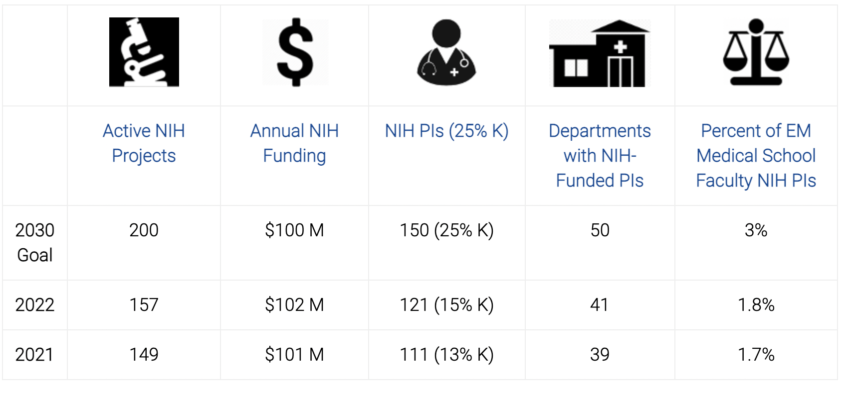
Strategic Goals for Emergency Medicine NIH Funding
https://www.saem.org/research/strategic-goals-for-emergency-medicine-nih-funding

Slide 16
Celebrating Scientists
Recognized by name in:
Pulse
SAEM Weekly
SAEM Social Media
Included on signage via QR code at SAEM23:
on the Awards signage
on the walk-in slides
with “Federally Funded Investigator” badge ribbons
Listed on saem.org

Slide 17
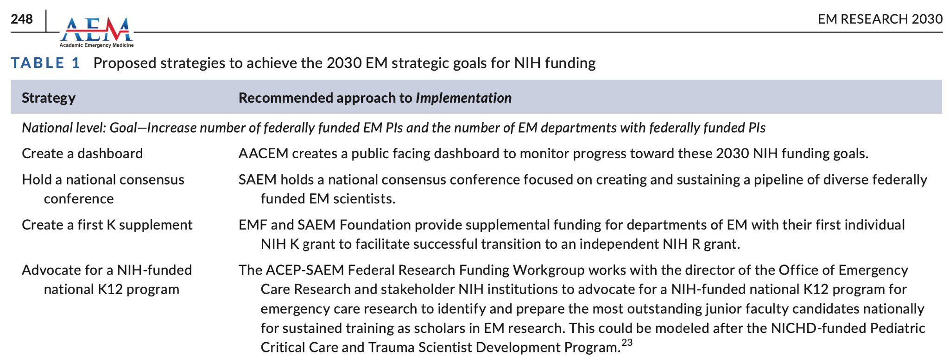
National K12 Program
Neumar et al AEM 2021

Slide 18
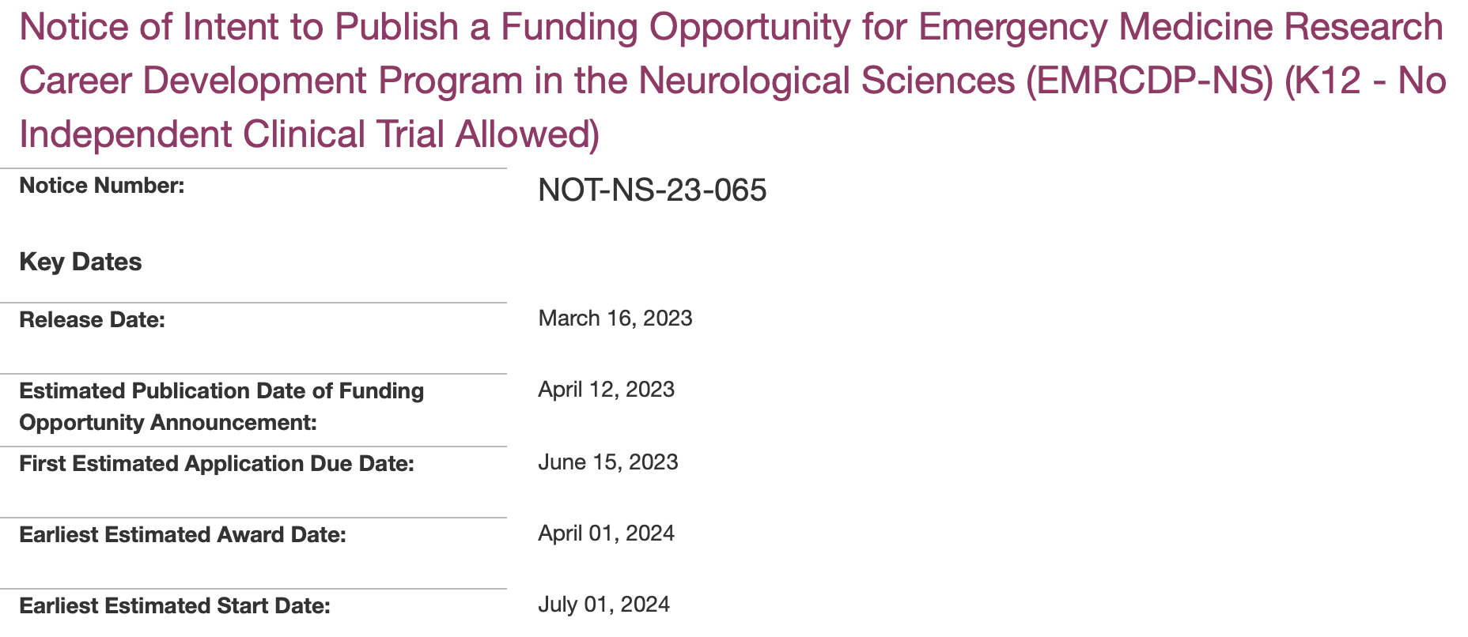
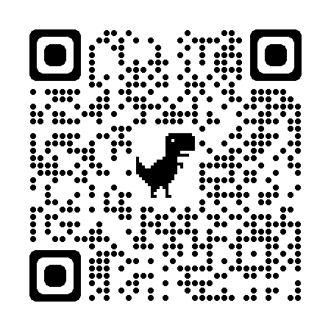
National K12 Program
Council discussion and approval
https://videocast.nih.gov/watch=48629
(at time stamp 4:25:42)
https://grants.nih.gov/grants/guide/notice-files/NOT-NS-23-065.html

Slide 19
Research Program Consult Service
As a key strategy to achieving the 2030 research strategic goals, the AACEM Research Workgroup is developing a Research Program Consult Service.
Target: Academic departments striving to create and increase federally-funded research programs at all levels of development, including the very early stages.

Slide 20
National EM Scholars Program
To nurture a diverse pipeline of future EM scientists, the AACEM working group is developing proposal to establish a National Emergency Medicine Scholars Program, which will provide one-year awards to support the training of medical students under the supervision of federally-funded EM Research mentors.

