Slide 1
Academy of Diversity and Inclusion in Emergency Medicine
Law, Ethics, and Truth:
Caring for LGBT Patients in the ED
Introduction to and Module from the new ADIEM
LGBT Residency Curriculum
SES116
Joel Moll MD
Paul Krieger MD
Notes:
Available at: http://www.algbtical.org/family1.jpg. Accessed March 15, 2015. (Picture posted is no longer up online here is updated one)
Available at: http://divadynastymagazine.com/wp-content/uploads/2013/07/black-lesbian-wedding-dc.jpg. Accessed March 15, 2015.
Available at: http://assets.nydailynews.com/polopoly_fs/1.1389393!/img/httpImage/image.jpg_gen/derivatives/landscape_635/74656318.jpg. Accessed March 15, 2015.

Slide 2
Financial Disclosures
None

Slide 3
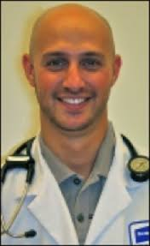

Session Faculty
 | Paul Krieger Icahn School of Medicine at Mount Sinai | Joel Moll Virginia Commonwealth University

Slide 4
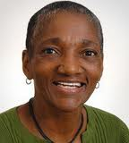

Acknowledgment
Thea James
Boston University
Ellen Slaven
Louisiana State University

Slide 5
Additional Disclosure
We went to medical school, not law school
In real life situations please consult your hospital for actual legal advice
Notes:
Available at: http://www.urrepublic.com/wp-content/uploads/2015/01/blind-race2-5e1143ea4e122a1c8d62e64ce27da36f9ed0299d.jpg. Accessed March 15, 2015.

Slide 6
Today’s Session
Section | Leader
Introductions | Joel Moll
Purpose of Session | Paul Krieger
ADIEM LGBT Curriculum | Joel Moll
Small Group Cases | All Faculty
Module PowerPoint | Paul Krieger
Post Test & Review | Joel Moll
Summary and Sharing | Joel Moll

Slide 7
Questions
Who are you?
  Faculty
  Residents
  Students
  Other

Slide 8
Questions
Does your state allow visitation by same-sex partners?
  Yes
  No
  Don’t Know

Slide 9
Questions
Does your program offer SSDP Benefits?
  Yes
  No
  Don’t Know

Slide 10
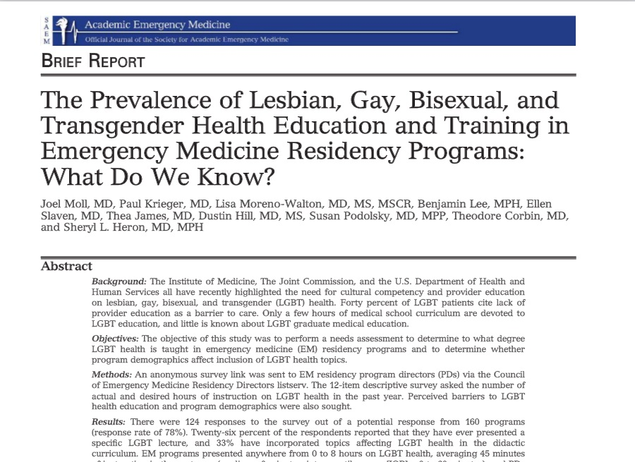
Purpose
Notes:
PAUL
Moll J, Krieger P, Moreno-walton L, et al. The prevalence of lesbian, gay, bisexual, and transgender health education and training in emergency medicine residency programs: what do we know?. Acad Emerg Med. 2014;21(5):608-11.

Slide 11
Are Emergency Medicine Residents Comfortable Caring for Lesbian, Gay, Bisexual and Transgender Patients? What Do We Know?
Krieger P, Moll J, Heron SL, Lee B, Johnson G, Podolsky S, Hill D, Moreno-Walton L

Slide 12
Overall, how comfortable are you addressing the needs of your lesbian, gay, bisexual, and transgender (LGBT) patients?
55% reported being comfortable

Slide 13
History Taking
Only 36% routinely ask
Only 18.3%
routinely ask

Slide 14
Transgender Patients

Slide 15
Transgender Patients
22% found it
more challenging

Slide 16
I have observed discriminatory or inappropriate comments about LGBT patients or staff?
22.5%
17.2 %

Slide 17
Additional Findings
94% thought LGBT patients deserved the same medical care as other patients
94.7% felt comfortable working with LGBT physicians
Males are 2.3 times more likely to observe discrimination
PGY 3 and 4 were more likely to observe discriminatory statements (approaches 80%)

Slide 18
ADIEM Curriculum Modules
Introduction to LGBT Health in EM
  Healthcare disparities of gay men, lesbians and transgender patients
  Communication
Ethics and Legal Considerations
Transgender Health
Special LGBT Populations
Notes:
JOEL

Slide 19
Module Contents
Learning Objectives
Cases for discussion
Short PowerPoint Presentation
Post Test
Resources for further learning

Slide 20
ADIEM Curriculum Modules
Introduction to LGBT Health in EM
  Healthcare disparities of gay men, lesbians and transgender patients
  Communication
Ethics and Legal Considerations
Transgender Health
Special LGBT Populations
Notes:
JOEL

Slide 21
Module 2 Objectives
Give examples how current law affects healthcare for LGBT patients and may have a negative impact on their health
Know current federal law for visitation and advanced directives and apply them to LGBT individuals
Discuss ethical issues surrounding the
interface of LGBT patients and the law

Slide 22
Case Discussions
Small Groups

Slide 23
Academy of Diversity and Inclusion in Emergency Medicine
Lesbian, Gay, Bisexual , Transgender Curriculum
Module 2
Government, Law, and LGBT Health
Notes:
PAUL

Slide 24
Module 2:
Government, Law and LGBT Health
Notes:
Paul

Slide 25
OBJECTIVES
Give examples how current law affects healthcare for LGBT patients and may have a negative impact on their health
Know current federal law for visitation and advanced directives and apply them to LGBT individuals
Discuss ethical issues surrounding the
interface of LGBT patients and the law

Slide 26
What Is LGBT Health?
Health Care Disparities
- Youth
- Elderly
Lack of Provider Education
Barriers to Care
Unique / Specific Health Care Needs
Same Health Needs as Others
LGBT
Health
Notes:
The Health of LGBT individuals is comprised of multiple components displayed in wheel above. In addition to needing the same health care as others they also have specific health care needs. LGBT individuals experience health care disparities as discussed in detail in the Institute of Medicines report “The Health of Lesbian, Gay, Bisexual and Transgender People” (1). LGBT people face unique barriers to care secondary to current discriminatory laws in the United states. This first Module will the relationship between discriminatory laws on employment and marriage and how they create barriers to care, inequality, and challenges in the health care system for LGBT people.
National Research Council. The Health of Lesbian, Gay, Bisexual, and Transgender People: Building a Foundation for Better Understanding. Washington, DC: The National Academies Press, 2011.

Slide 27
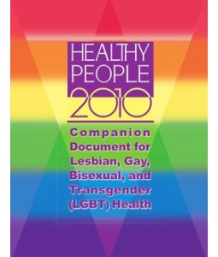
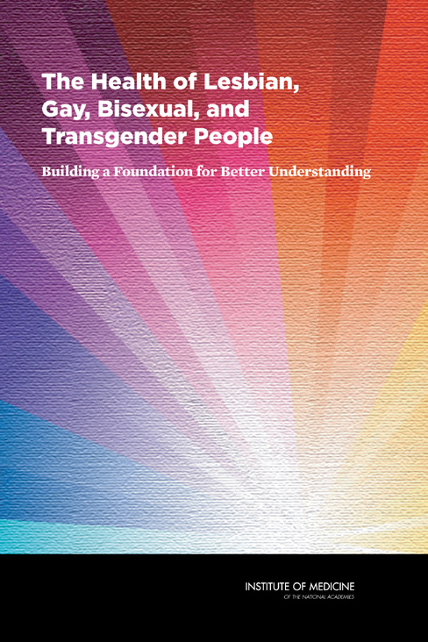
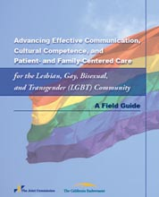



Notes:
Since 2010 key federal agency in Health care have acknowledged LGBT health care disparities, the paucity of research, and lack of provider education.
Please see Handout 1: LGBT Health Resource Guide for further discussion on these organizations and resources
Gay and Lesbian Medical Association and LGBT health experts. Healthy People 2010 Companion Document for Lesbian, Gay, Bisexual, and Transgender (LGBT) Health. San Francisco, CA: Gay and Lesbian Medical Association, 2001.
National Research Council. The Health of Lesbian, Gay, Bisexual, and Transgender People: Building a Foundation for Better Understanding. Washington, DC: The National Academies Press, 2011.
The Joint Commission: Advancing Effective Communication, Cultural Competence, and Patient- and FamilyCentered Care for the Lesbian, Gay, Bisexual, and Transgender (LGBT) Community: A Field Guide. Oak Brook, IL, Oct. 2011. LGBTFieldGuide.pdf
Available at: http://www.nih.gov/. Accessed February 11, 2015.
Available at: http://www.hhs.gov/web/policies/webpolicies/logo-policies.html. Accessed February 11, 2015.
Available at: https://www.healthypeople.gov/. Accessed February 11, 2015.

Slide 28
Laws and LGBT Health
ENDA
Marriage
Hate Crimes
Student Discrimination
Laws impacting transgender patients
Bullying
Notes:
Marriage inequality and ENDA (employment nondiscrimination act), which has not passed congress for over 10 years, have direct effects on access to care, and health care and finacial resources for LGBT individuals.
Available at: http://saem.org/saem-community/academies/academy-for-diversity-and-inclusion-in-emergency-medicine-(adiem). Accessed February 11, 2015.

Slide 29
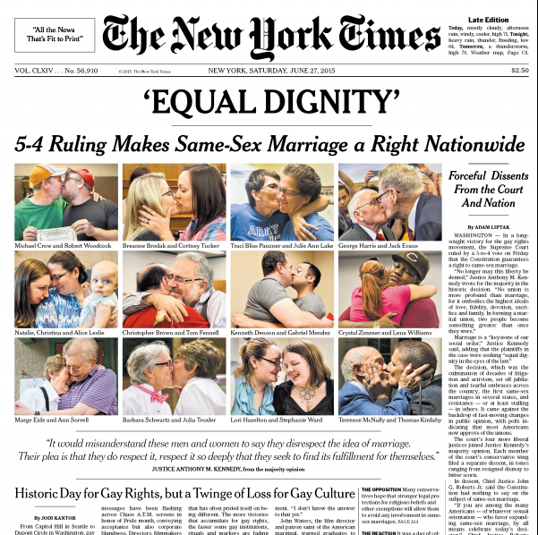
Notes:
Marriage equality is historic and an amazing step forward to equitable healthcare in the united states
In fact there are 1138 rights and privileges
Employer sponsored health plans
Including coverage for children
Taxes
FMLA
Survivor benefits
Visitation rights and advanced directives
Nursing home separation
Marriage and the literature
LGBT people living in states that ban same-sex marriage are more likely than their counterparts in other states to report symptoms of depression, anxiety, and alcohol use disorder.

Slide 30
Marriage and Healthcare
1138 Rights and Privileges
Family Medical Leave Act
Visitation rights and advanced directives
Nursing home separation
Employer sponsored health plans
  Including coverage for children
Taxes and Probate
Denial of Social Security Survivor benefits
Denial of spousal benefits in Medicare and Medicaid (including Medicaid liens)
Notes:
As a result of marriage inequality many rights and privileges afforded to heterosexual couples are denied to gay and lesbian couples.
Although the key provisions of the defense of marriage act have been stuck down, benefits in states without marriage equality will not be available anytime soon. Many government agencies have yet to issue new policies that are inclusive of gay and lesbian couples as a result couples in marriage equality states may not yet have certain rights and privileges, but are expected in the upcoming future.
Employee sponsored health insurance
Has to be offered to spouses and families. This does not apply to domestic partners or there children which decreases access to affordable health care insurance. This is thought to at least in part contribute to the lower rates of health care coverage by LGBT people.
Even when domestic partners are covered by employers, the benefit is taxed costing often thousands more in cost to same sex couples than there heterosexual counterparts
Tax Benefits for same sex couples include now invalidation of inheritance tax, gift tax, employee sponsored health plan taxes, and decreased tax on gain of principle sale of house
Medicaid has the right to re-coop costs for particular expenses incurred including nursing home costs. It may do this by placing a lien on your home, however this is prohibited if a spouse resides in this home. Unfortunately this does not apply to domestic partners, and homes have been forclosed leaving a dependent domestic partner homeless. This can not occur if married.
Marriage allows equal access to the rights and benefits of the family medical leave act
Domestic partners have been separated into different nursing homes at the latter stages of life
Resources:
Available at: http://www.lambdalegal.org/after-doma. Accessed February 11, 2015.
Available at: http://www.vancouversun.com/life/Photos First fair Paris/8305615/story.html. Accessed February 11, 2015.
Former cartoons were not cited. Listed above is citation for new cartoon if needed.

Slide 31
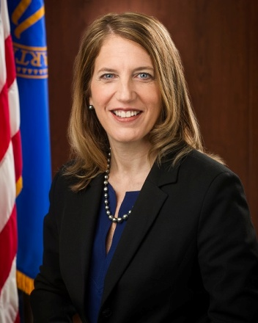
HHS and Visitation
Centers for Medicare and Medicaid
Inform each patient (or support person, where appropriate) of the right, subject to his or her consent, to receive the visitors whom he or she designates, including but not limited to, a spouse, a domestic partner (including a same-sex domestic partner), another family member, or a friend, and of his or her right to withdraw or deny such consent at any time.
Not restrict, limit, or otherwise deny visitation privileges on the basis of race, color, national origin, religion, sex, gender identity, sexual orientation, or disability.
Ensure that all visitors enjoy full and equal visitation privileges consistent with patient preferences.
“Notably, the final rule makes it clear that Medicare and Medicaid participating hospitals and critical access hospitals (CAH) may not restrict, limit, or otherwise deny visitation privileges on the basis of, among other things, sexual orientation or gender identity.”
Notes:
Sylvia Matthew Burwell: Secretary of the Department of Health and Human Services
Kathleen Sebelius: former.
Too often LGBT couples and family have been denied visitation with often painful results, leaving LGBT individuals without those who were closest to them at there most vulnerable moments.
After a patient named Lisa Pond was kept from her partner Janice Langbehn and there 4 children at Jackson Memorial hospital after suffering a intracranial hemorrhage President Obama sought to change the visitation policies for participating hospitals in meidcare and medicaid to be inclusive of LGBT families. More information on the details of the Lisa Pond case can be found at: http://www.lambdalegal.org/in-court/cases/langbehn-v-jackson-memorial
April 2010 President Obama issues a memo directing the Secretary of Health and Human Services to take steps to address hospital visitation and other health care issues affecting LGBT families.
Nov9th 2011 CMS publishes “Changes to the Hospital And critical Access hospital Conditions of participation to ensure visitation rights of all people”. See above slide.
3. This is a joint commission requirement!!!
Pic citation:
Available at: http://www.hhs.gov/secretary/about/biography/index.html. Accessed February 11, 2015.
HHS/White page that originally covered this are now gone? However Lambda Legal still has it…
Available at: http://www.lambdalegal.org/in-court/legal-docs/exec_us_20101117_hhs-changes-to-visitation-rights. Accessed February 11, 2015.
Code of Federal Regulations, at 42 CFR 482.13(h) and 42 CFR 485(f).

Slide 32
Visitation
As a result of marriage equality all, all states now have visitation protection through marriage
Unclear if state laws could impact visitation if not married. and there is significant variation in state law
Physicians should check with their local
legal counsel to be familiar with the laws in
their state.

Slide 33
Advanced Directives
As a result of marriage equality, state default surrogate decision making laws should allow for married couples to make to medical decisions for spouses
Unmarried same sex couples should have advanced directives in place
Notes:
Additional guidelines were set to be issued in 202 that on “existing regulations to make it easier for family members, including same-sex partners, to make informed care decisions for incapacitated loved ones”. No such guidelines have been issued.
From the Human Rights Campaign:
Healthcare Equality Index: Advance Healthcare Directives
Note: In September of 2011, the Centers for Medicare & Medicaid Services released updated guidance on existing regulations to make it easier for family members, including same-sex partners, to make informed care decisions for incapacitated loved ones.
An advance healthcare directive is an individual healthcare instruction or a power of attorney for healthcare. Common names for types of advance healthcare directives include healthcare powers of attorney, durable powers of medical attorney, healthcare proxies and living wills. Advance healthcare directives honor the right of a competent individual to control the course of their medical care in all circumstances, as well as the corollary right to designate another person to make these choices in the event of the individual’s mental incapacity.
To ensure equal treatment of the LGBT community in the area of advance healthcare directives, the Healthcare Equality Index surveys participants on staff training related to the recognition of advance healthcare directives and their unique importance to the LGBT community.
The Unique Importance of Advance Healthcare Directives to the LGBT Community
The right of every American adult to create an AHD and the obligation of every hospital to honor these documents is critically important. Individuals place tremendous trust in their designated agents, who will guide medical care at a time of the individual’s incapacity. Default state medical decision-making laws are meant to provide a safety net for Americans who fail to execute advance healthcare directives. This default law provides a list of potential surrogate decision-makers from which healthcare providers select the patient’s default surrogate in the absence of an advance healthcare directive. These lists reflect the presumption that the most appropriate default surrogate is the spouse of the incapacitated individual. Due to the lack of relationship recognition laws in the majority of states, most same-sex couples are not protected by default surrogate-selection law.
Advance Healthcare Directive Policy Recommendations
Every validly executed advance healthcare directive deserves and legally demands recognition. Unfortunately, there have been tragic incidents involving hospital refusals to honor valid advance healthcare directives, simply because the directive involved same-sex couples.
Some of the most promising policies bearing on advance healthcare directive recognition for same-sex couples confront the obstacles that often hinder recognition of these advance healthcare directives. These best practices concern reciprocity and presumptive validity of advance healthcare directives, as well as the definition of designated agent.
Reciprocity involves a hospital’s recognition of an advance healthcare directive that was executed in another state. Below are two examples of hospital policy language which treat advance healthcare directive reciprocal recognition:
A living will or other type of advance directive from another state, even though it does not meet the requirements of [HOME STATE], is legally valid and enforceable in [HOME STATE] if it satisfies the legal requirements of the state in which it was executed.”
“A patient may have completed an AHD in another state which follows that state’s law. Healthcare personnel should generally follow such an AHD to the same extent that they would follow one completed in [HOME STATE]. Questions about out-of-state AHD should be referred to your administrative manager or the administrator on call after hours.”
Presumptive validity involves the presumption that a presented advance healthcare directive is valid in the absence of actual knowledge to the contrary. The following submitted hospital policy treats presumptive validity:
“Ordinarily, all adult patients are presumed to be competent to execute and revoke a [AHD], and all [AHDs] are presumed to be valid, unless a court has determined otherwise.”
Designated agent definitions involve delineating the persons who can be appointed as the designated agent in an AHD. State law is very consistent with these definitions. The following submitted hospital policy language treats designated agent issues:
“Who may serve as agent: any competent adult may be an agent, EXCEPT THAT: a [HEALTHCARE INSTITUTION] employee cannot be appointed as an agent during the patient’s hospitalization unless that administrator or employee is related to the patient by blood, marriage, or adoption.”
The above policy language recommendations are not required for purposes of the Healthcare Equality Index. Many advance healthcare directive policies already express the institution’s commitment to follow all applicable state and federal advance healthcare directive law. These commitments would necessarily encompass the above legal concepts. The Healthcare Equality Index, instead, focuses on training related to advance healthcare directives.
Training on Advance Healthcare Directives
Healthcare facilities should provide training modules to staff that are specifically tailored to the special case of advance healthcare directives and same-sex couples.
These training modules should make explicit mention of LGBT individuals and detail the unique consequences that can result from a failure to recognize the advance healthcare directive of a same-sex couple. The training modules should reiterate the staff’s duty to follow all applicable state and federal advance healthcare directive law, especially in the areas of reciprocity, presumptive validity, and the definition of designated agents. Hospitals participating in the Healthcare Equality Index survey will be required to provide details of these training modules, including the content and frequency of these trainings, as well information about staff participation.
Available at: http://www.hrc.org/resources/entry/healthcare-equality-index-advance-healthcare-directives. Accessed February 26, 2015.

Slide 34
Employment Non-Discrimination Act (ENDA)
Would protect Americans from being fired for being LGBT
90% of Americans think law already, >70% support
May be less likely to be hired if your LGBT
Notes:
A study conducted for the American Journal of Sociology sent two fictitious, but realistic, resumes to more than 1,700 entry-level, white-collar job openings, the only difference between the two being that one resume listed membership in a gay organization during college, while the other claimed experience in a "Progressive and Socialist Alliance" (since both groups are considered left-leaning, the purpose was to separate any “gay penalty” from political discrimination). The result was that the resume without the LGBT organization membership had an 11.5 percent call-back rate for an interview; the gay application had only 7.2 percent. The difference amounts to a 40 percent higher chance of seemingly straight applicants getting called back than explicitly gay applicants.
Citations for above:
Frazer, M. Somjen. (2009) NYS-wide survey on LGBT Health and Human Services Needs in New York State.
New Patterns of Poverty in the Lesbian, Gay, and Bisexual Community
By M.V. Lee Badgett, Laura E. Durso, Alyssa Schneebaum
June 2013
As poverty rates for nearly all populations increased during the recession, lesbian, gay, and bisexual (LGB) Americans remained more likely to be poor than heterosexual people. Gender, race, education and geography all influence poverty rates among LGB populations, and children of same-sex couples are particularly vulnerable to poverty.
Key findings include:
• In the American Community Survey, 7.6% of lesbian couples, compared to 5.7% of married different-sex couples, are in poverty.
• African American same-sex couples have poverty rates more than twice the rate of different-sex married African Americans.
• One third of lesbian couples and 20.1 % of gay male couples without a high school diploma are in poverty, compared to 18.8% of different-sex married couples.
• Lesbian couples who live in rural areas are much more likely to be poor (14.1%), compared to 4.5% of coupled lesbians in large cities. 10.2% of men in same-sex couples, who live in small metropolitan areas, are poor, compared with only 3.3% of coupled gay men in large metropolitan areas.
• Almost one in four children living with a male same-sex couple and 19.2% of children living with a female same-sex couple are in poverty, compared to 12.1% of children living with married different-sex couples. African American children in gay male households have the highest poverty rate (52.3%) of any children in any household type.
• 14.1% of lesbian couples and 7.7% of gay male couples receive food stamps, compared to 6.5% of different-sex married couples. Also, 2.2% of women in same-sex couples receive government cash assistance, compared to .8% of women in different sex couples; 1.2% of men in same-sex couples, compared to .6% of men in different-sex couples, receive cash assistance.
The study updates and extends a similar, first-of-its kind Williams Institute report released in 2009 that was based on data from the first half of the last decade. The new report draws on recent data from four datasets to estimate recent poverty rates for different groups of the lesbian, gay, and bisexual population: the 2010 American Community Survey (for same-sex couples), the 2006-2010 National Survey of Family Growth (for LGB people aged 18-44), the 2007-2009 California Health Interview Survey (for LGB people 18 and older living in California), and the Gallup Daily Tracking Poll (for single LGBT-identified adults) over the June 1 – September 30, 2012 time period.
- See more at: Available at: http://williamsinstitute.law.ucla.edu/research/census-lgbt-demographics-studies/lgbt-poverty-update-june-2013/#sthash.wVW3ldZB.dpuf. Accessed February 26, 2015.
Full report at New Patterns of Poverty in the Lesbian, Gay, and Bisexual Community
By M.V. Lee Badgett, Laura E. Durso, Alyssa Schneebaum
June 2013
As poverty rates for nearly all populations increased during the recession, lesbian, gay, and bisexual (LGB) Americans remained more likely to be poor than heterosexual people. Gender, race, education and geography all influence poverty rates among LGB populations, and children of same-sex couples are particularly vulnerable to poverty.
Key findings include:
• In the American Community Survey, 7.6% of lesbian couples, compared to 5.7% of married different-sex couples, are in poverty.
• African American same-sex couples have poverty rates more than twice the rate of different-sex married African Americans.
• One third of lesbian couples and 20.1 % of gay male couples without a high school diploma are in poverty, compared to 18.8% of different-sex married couples.
• Lesbian couples who live in rural areas are much more likely to be poor (14.1%), compared to 4.5% of coupled lesbians in large cities. 10.2% of men in same-sex couples, who live in small metropolitan areas, are poor, compared with only 3.3% of coupled gay men in large metropolitan areas.
• Almost one in four children living with a male same-sex couple and 19.2% of children living with a female same-sex couple are in poverty, compared to 12.1% of children living with married different-sex couples. African American children in gay male households have the highest poverty rate (52.3%) of any children in any household type.
• 14.1% of lesbian couples and 7.7% of gay male couples receive food stamps, compared to 6.5% of different-sex married couples. Also, 2.2% of women in same-sex couples receive government cash assistance, compared to .8% of women in different sex couples; 1.2% of men in same-sex couples, compared to .6% of men in different-sex couples, receive cash assistance.
The study updates and extends a similar, first-of-its kind Williams Institute report released in 2009 that was based on data from the first half of the last decade. The new report draws on recent data from four datasets to estimate recent poverty rates for different groups of the lesbian, gay, and bisexual population: the 2010 American Community Survey (for same-sex couples), the 2006-2010 National Survey of Family Growth (for LGB people aged 18-44), the 2007-2009 California Health Interview Survey (for LGB people 18 and older living in California), and the Gallup Daily Tracking Poll (for single LGBT-identified adults) over the June 1 – September 30, 2012 time period.
Available at: http://williamsinstitute.law.ucla.edu/research/census-lgbt-demographics-studies/lgbt-poverty-update-june-2013/#sthash.wVW3ldZB.dpuf. Accessed February 26, 2015.

Slide 35
Employment Non-Discrimination Act (ENDA)
LGBT people lower rates of Health Insurance
More LGBT live below the poverty line
  African-Americans, women particularly vulnerable
Negative health impact of not being out at work
  Increased depression and anxiety
Notes:
A study conducted for the American Journal of Sociology sent two fictitious, but realistic, resumes to more than 1,700 entry-level, white-collar job openings, the only difference between the two being that one resume listed membership in a gay organization during college, while the other claimed experience in a "Progressive and Socialist Alliance" (since both groups are considered left-leaning, the purpose was to separate any “gay penalty” from political discrimination). The result was that the resume without the LGBT organization membership had an 11.5 percent call-back rate for an interview; the gay application had only 7.2 percent. The difference amounts to a 40 percent higher chance of seemingly straight applicants getting called back than explicitly gay applicants.
Citations for above:
Frazer, M. Somjen. (2009) NYS-wide survey on LGBT Health and Human Services Needs in New York State.
New Patterns of Poverty in the Lesbian, Gay, and Bisexual Community
By M.V. Lee Badgett, Laura E. Durso, Alyssa Schneebaum
June 2013
As poverty rates for nearly all populations increased during the recession, lesbian, gay, and bisexual (LGB) Americans remained more likely to be poor than heterosexual people. Gender, race, education and geography all influence poverty rates among LGB populations, and children of same-sex couples are particularly vulnerable to poverty.
Key findings include:
• In the American Community Survey, 7.6% of lesbian couples, compared to 5.7% of married different-sex couples, are in poverty.
• African American same-sex couples have poverty rates more than twice the rate of different-sex married African Americans.
• One third of lesbian couples and 20.1 % of gay male couples without a high school diploma are in poverty, compared to 18.8% of different-sex married couples.
• Lesbian couples who live in rural areas are much more likely to be poor (14.1%), compared to 4.5% of coupled lesbians in large cities. 10.2% of men in same-sex couples, who live in small metropolitan areas, are poor, compared with only 3.3% of coupled gay men in large metropolitan areas.
• Almost one in four children living with a male same-sex couple and 19.2% of children living with a female same-sex couple are in poverty, compared to 12.1% of children living with married different-sex couples. African American children in gay male households have the highest poverty rate (52.3%) of any children in any household type.
• 14.1% of lesbian couples and 7.7% of gay male couples receive food stamps, compared to 6.5% of different-sex married couples. Also, 2.2% of women in same-sex couples receive government cash assistance, compared to .8% of women in different sex couples; 1.2% of men in same-sex couples, compared to .6% of men in different-sex couples, receive cash assistance.
The study updates and extends a similar, first-of-its kind Williams Institute report released in 2009 that was based on data from the first half of the last decade. The new report draws on recent data from four datasets to estimate recent poverty rates for different groups of the lesbian, gay, and bisexual population: the 2010 American Community Survey (for same-sex couples), the 2006-2010 National Survey of Family Growth (for LGB people aged 18-44), the 2007-2009 California Health Interview Survey (for LGB people 18 and older living in California), and the Gallup Daily Tracking Poll (for single LGBT-identified adults) over the June 1 – September 30, 2012 time period.
- See more at: Available at: http://williamsinstitute.law.ucla.edu/research/census-lgbt-demographics-studies/lgbt-poverty-update-june-2013/#sthash.wVW3ldZB.dpuf. Accessed February 26, 2015.
Full report at New Patterns of Poverty in the Lesbian, Gay, and Bisexual Community
By M.V. Lee Badgett, Laura E. Durso, Alyssa Schneebaum
June 2013
As poverty rates for nearly all populations increased during the recession, lesbian, gay, and bisexual (LGB) Americans remained more likely to be poor than heterosexual people. Gender, race, education and geography all influence poverty rates among LGB populations, and children of same-sex couples are particularly vulnerable to poverty.
Key findings include:
• In the American Community Survey, 7.6% of lesbian couples, compared to 5.7% of married different-sex couples, are in poverty.
• African American same-sex couples have poverty rates more than twice the rate of different-sex married African Americans.
• One third of lesbian couples and 20.1 % of gay male couples without a high school diploma are in poverty, compared to 18.8% of different-sex married couples.
• Lesbian couples who live in rural areas are much more likely to be poor (14.1%), compared to 4.5% of coupled lesbians in large cities. 10.2% of men in same-sex couples, who live in small metropolitan areas, are poor, compared with only 3.3% of coupled gay men in large metropolitan areas.
• Almost one in four children living with a male same-sex couple and 19.2% of children living with a female same-sex couple are in poverty, compared to 12.1% of children living with married different-sex couples. African American children in gay male households have the highest poverty rate (52.3%) of any children in any household type.
• 14.1% of lesbian couples and 7.7% of gay male couples receive food stamps, compared to 6.5% of different-sex married couples. Also, 2.2% of women in same-sex couples receive government cash assistance, compared to .8% of women in different sex couples; 1.2% of men in same-sex couples, compared to .6% of men in different-sex couples, receive cash assistance.
The study updates and extends a similar, first-of-its kind Williams Institute report released in 2009 that was based on data from the first half of the last decade. The new report draws on recent data from four datasets to estimate recent poverty rates for different groups of the lesbian, gay, and bisexual population: the 2010 American Community Survey (for same-sex couples), the 2006-2010 National Survey of Family Growth (for LGB people aged 18-44), the 2007-2009 California Health Interview Survey (for LGB people 18 and older living in California), and the Gallup Daily Tracking Poll (for single LGBT-identified adults) over the June 1 – September 30, 2012 time period.
Available at: http://williamsinstitute.law.ucla.edu/research/census-lgbt-demographics-studies/lgbt-poverty-update-june-2013/#sthash.wVW3ldZB.dpuf. Accessed February 26, 2015.

Slide 36
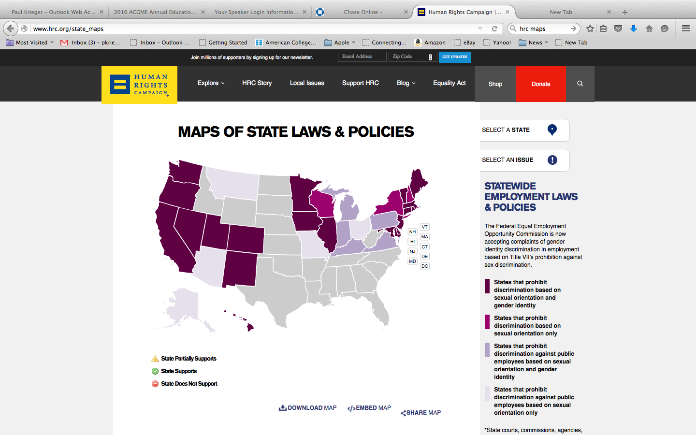

Employment

Slide 37
Housing
Most states do not have laws prohibiting housing or mortgage discrimination
No federal law exists prohibiting housing or mortgage discrimination

Slide 38
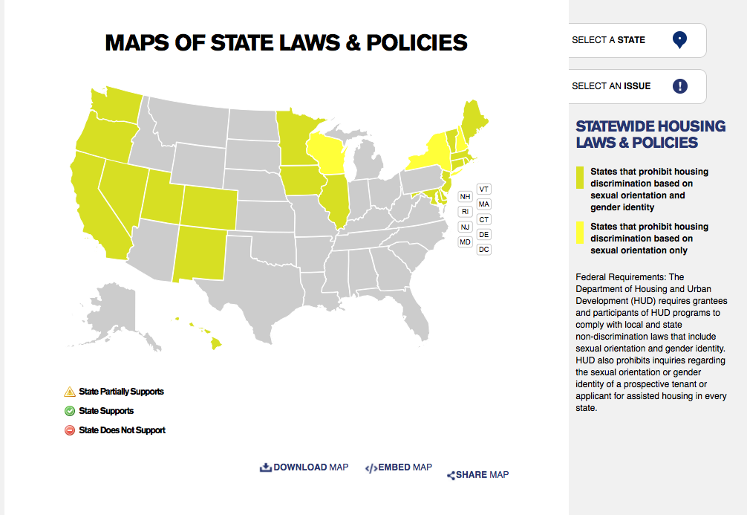
Housing

Slide 39
Hate Crimes
Many states do not classify crimes against LGBT persons as hate crimes
Fewer states have laws against LGBT bullying
A few states prohibit discrimination against LGBT students
1,261 LGBT hate crimes in 2013
Notes:
Available at: http://www.hrc.org/press-releases/entry/new-fbi-data-shows-hate-crimes-based-on-sexual-orientation-on-the-rise. Accessed February 26, 2015.

Slide 40
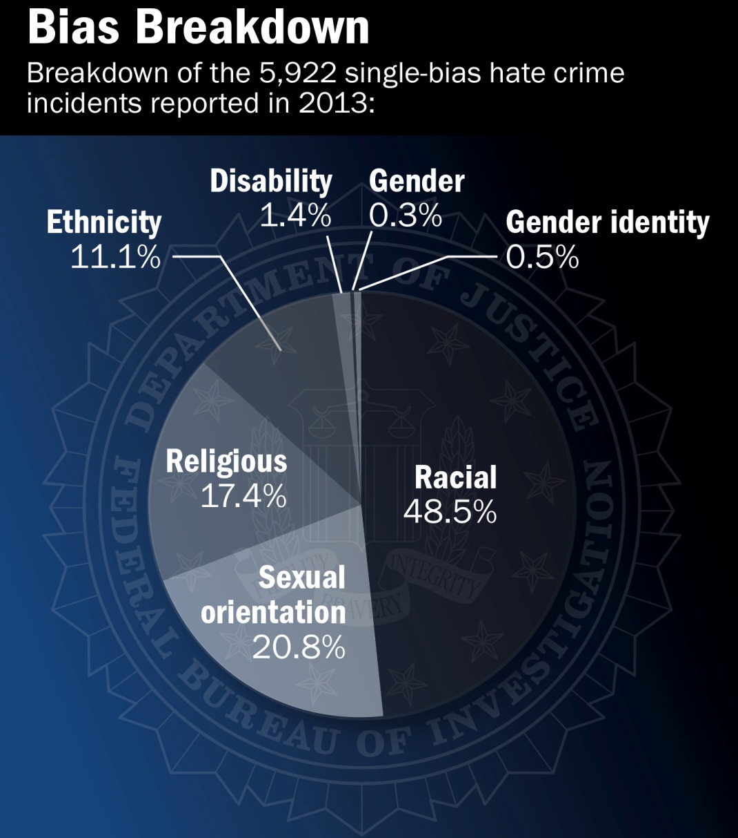
Notes:
Available at: http://www.fbi.gov/news/stories/2014/december/latest-hate-crime-statistics-report-released/image/bias-breakdown-chart/image_view_fullscreen. Accessed February 26, 2015.

Slide 41
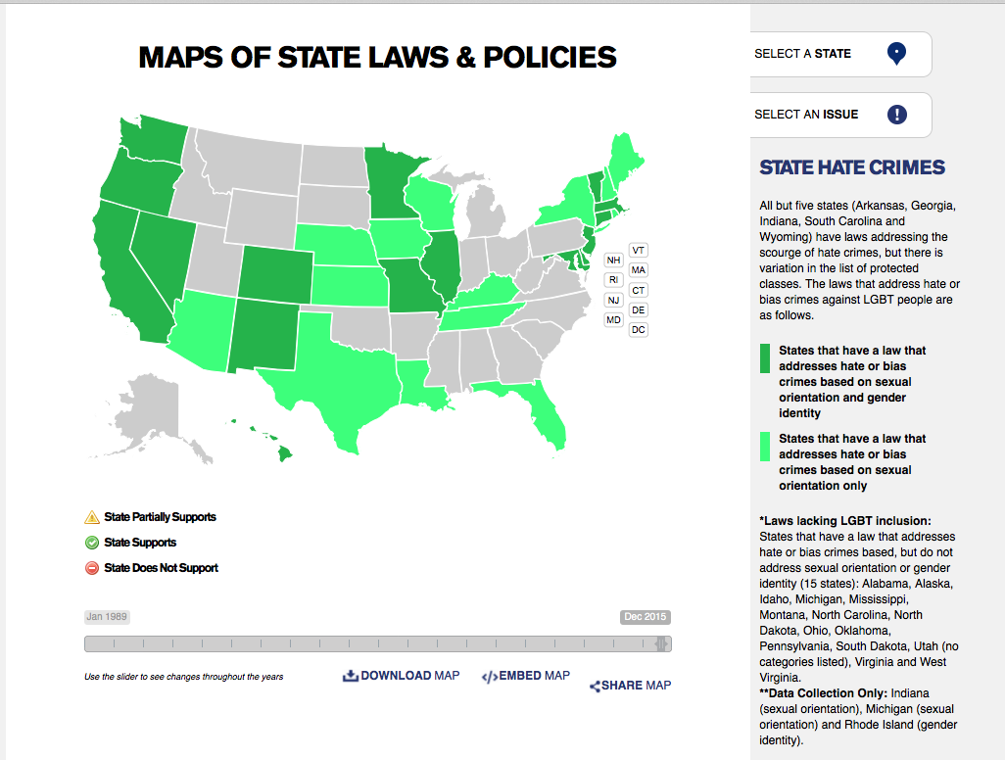
Hate Crimes

Slide 42
Youth
Twice as likely to have attempted suicide
Twice as likely to experiment drugs/alcohol
More likely to be physically abused
Twice as likely verbally harassed or physically assaulted
25% report missing school because feel
unsafe.
Notes:
25% report missing school because they feel unsafe.

Slide 43
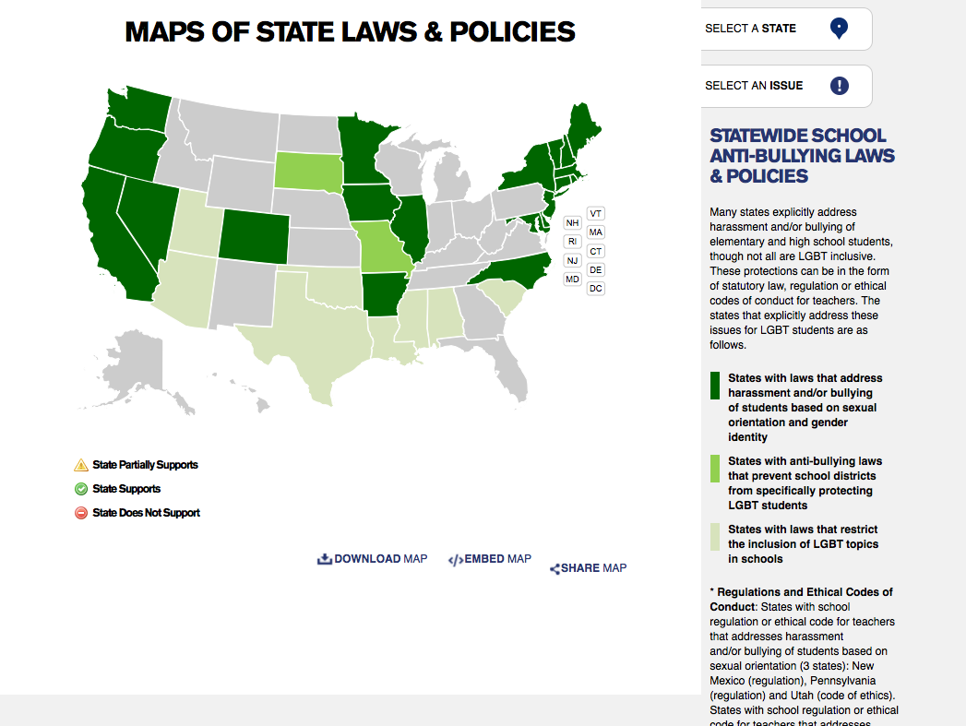
LGBT Bullying

Slide 44
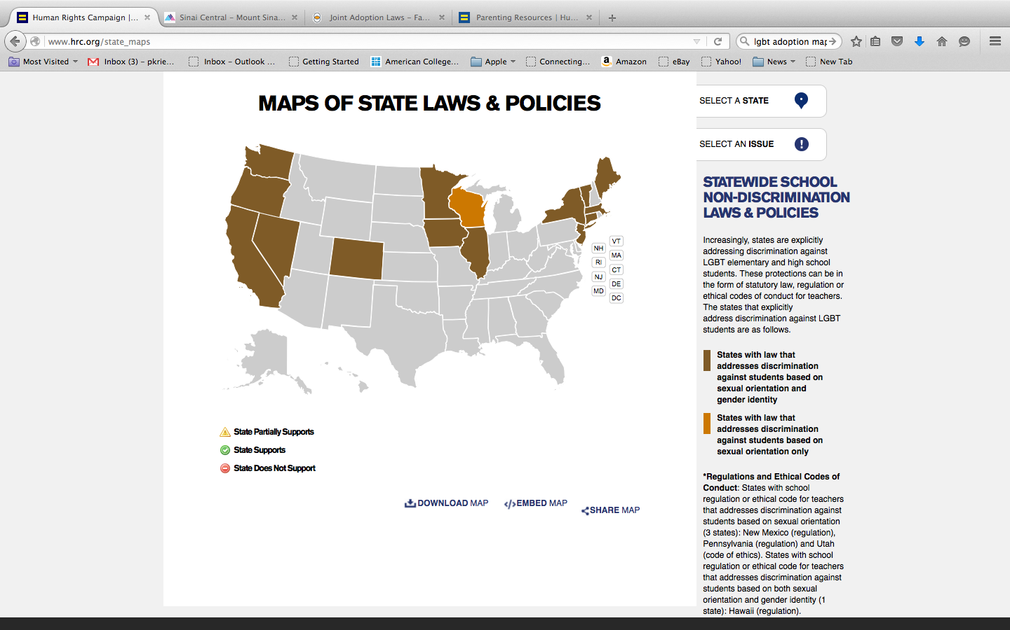
LGBT Student Discrimination

Slide 45
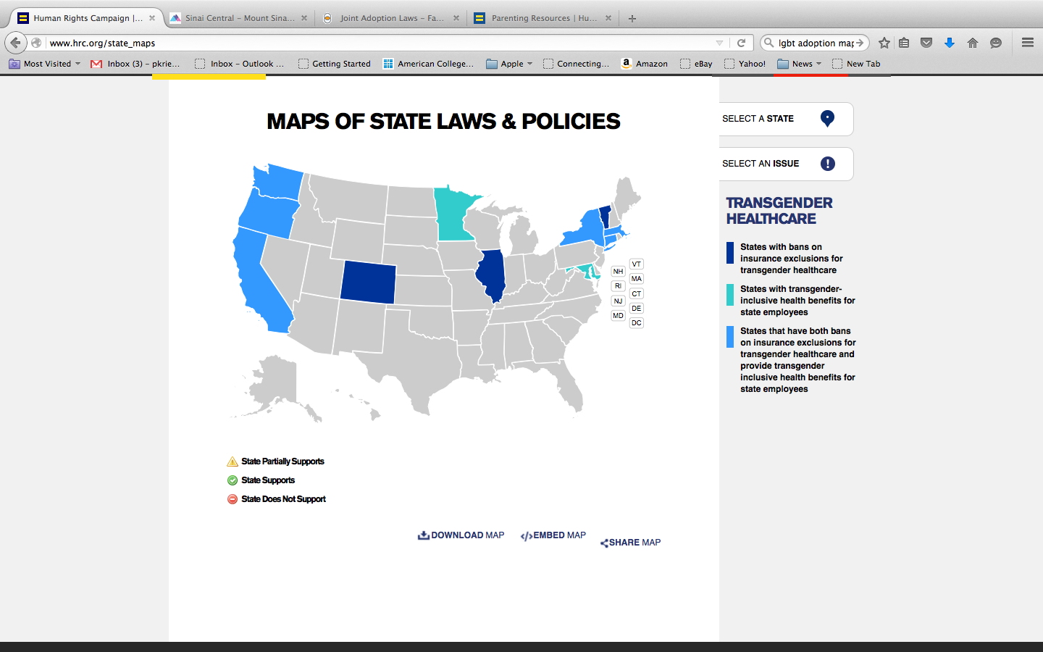
Transgender Healthcare
Notes:
Transgender health care disparities, laws contribute to disparities
1. Hiv
2. victimization
3.mental health
4. suicide
5.unemployment
6. health insurance
7. primary care providers

Slide 46
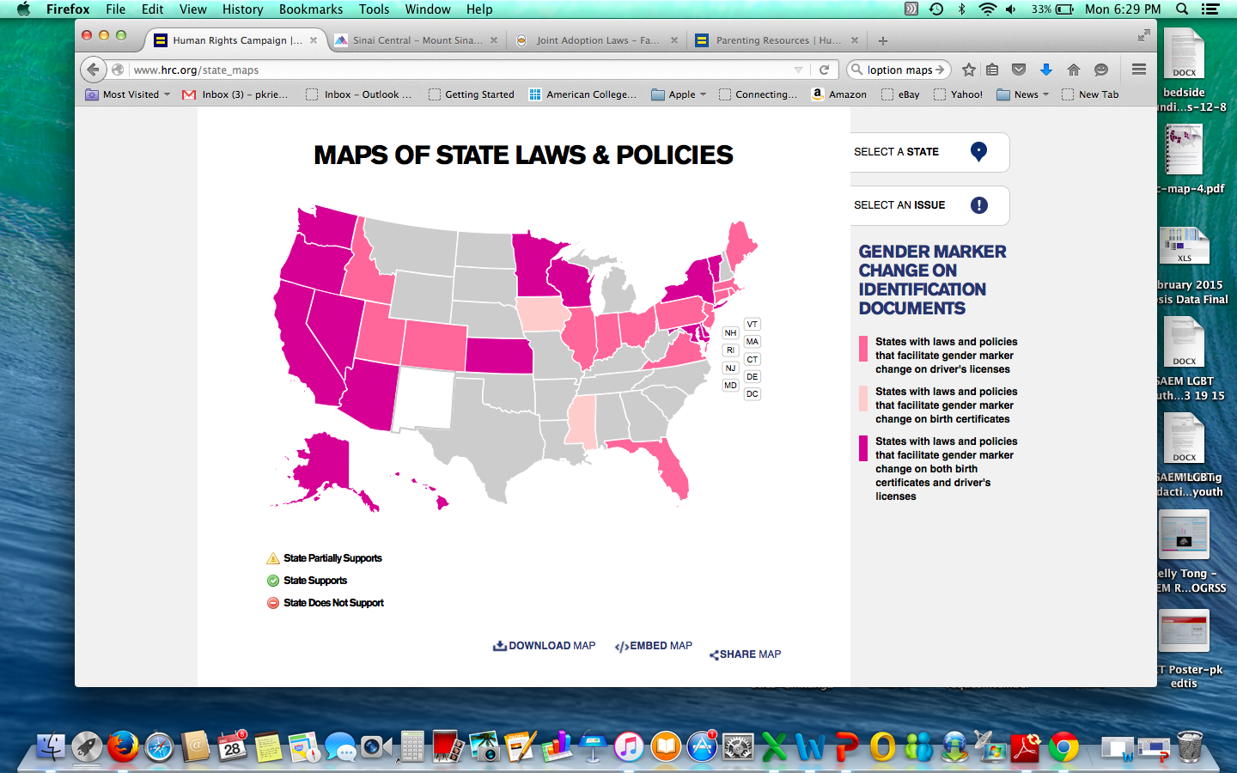
Transgender specific laws
Notes:
Transgender health care disparities, laws contribute to disparities
1. Hiv
2. victimization
3.mental health
4. suicide
5.unemployment
6. health insurance
7. primary care providers

Slide 47
Summary
Marriage confers numerous rights, in whose absence may affect non-married same-sex couples and their families
Laws vary by state, inconsistently applied, and are under legal challenge leaving LGBT patients vulnerable with less protection
Significant legal barriers exist for transgender patients which result in less access to care

Slide 48
Module 2 Post Test
Notes:
JOEL

Slide 49
Post Test
Which of the following statements are false?
  As a result of marriage equality married same sex couples should have equal visitation rights in all hospitals
  Hospital visitation laws vary state by state
  Medicare and Medicaid participating hospitals may not restrict, limit, or otherwise deny visitation privileges based on gender identity or sexual orientation.
  Federal law states that you many not deny hospital visitation privileges based on gender identity or sexual orientation

Slide 50
Post Test
Which of the following statements are false?
  As a result of marriage equality, married same sex couples should have equal visitation rights in all hospitals
  Hospital visitation laws vary state by state
  Medicare and Medicaid participating hospitals may not restrict, limit, or otherwise deny visitation privileges, gender identity or sexual orientation.
  Federal law states that you many not deny hospital visitation privileges based on gender identity or sexual orientation

Slide 51
2. Which of the following is true about advanced directives?
  Advanced directives do not have to be legally honored if you are not in your state of domicile for same sex couples
  Almost all states have reciprocity for advanced directives and those directives should legally be recognized regardless of sexual orientation
  Medicaid and Medicare services has mandated hospital training for all employees on advanced directives for participating hospitals
  None of the above

Slide 52
2. Which of the following is true about advanced directives?
  Advanced directives do not have to be legally honored if you are not in your state of domicile for same sex couples
  Almost all states have reciprocity for advanced directives and those directives should legally be recognized regardless of sexual orientation
  Medicaid and Medicare services has mandated hospital training for all employees on advanced directives for participating hospitals
  None of the above

Slide 53
3. Which of the following statements is true about social security benefits
  As a result of marriage equality same sex couples who are legally married are entitled to spousal social security benefits
  The government uses state of domicile to decide if you are eligible for social security benefits, thus prior to marriage equality if you live in a non-marriage equality state you were not eligible for benefits even if married somewhere else
  Children of domestic partners can receive social security benefits even if not legally adopted
  A and B
  None of the above

Slide 54
3. Which of the following statements is true about social security benefits
  As a result of marriage equality same sex couples who are legally married are entitled to spousal social security benefits
  The government uses state of domicile to decide if you are eligible for social security benefits, thus prior to marriage equality if you live in a non-marriage equality state you were not eligible for benefits even if married somewhere else
  Children of domestic partners can receive social security benefits even if not legally adopted
  A and B
  None of the above

Slide 55
4. Transgender patients in the emergency department
  May have a different official name and sex in the medical record than their appearance or preference
  Should be asked how they prefer to be addressed by providers
  Are legally entitled to the same protection for healthcare information as any other patient
  All of the above

Slide 56
4. Transgender patients in the emergency department
  May have a different official name and sex in the medical record than their appearance or preference
  Should be asked how they prefer to be addressed by providers
  Are legally entitled to the same protection for healthcare information as any other patient
  All of the above

Slide 57
5. An LGBT EM Resident in the United States
  A. Is legally protected from discrimination under federal law by the Employment Non-Discrimination Act
  Is legally considered a student so employment law does not apply
  Is recognized and legally protected as an underrepresented minority
  D. May have protection against discrimination for being gay or transgender depending on state law

Slide 58
5. An LGBT EM Resident in the United States
  A. Is legally protected from discrimination under federal law by the Employment Non-Discrimination Act
  Is legally considered a student so employment law does not apply
  Is recognized and legally protected as an Underrepresented Minority
  D. May have protection against discrimination for being gay or transgender depending on state law

Slide 59
Share Your Experiences
Notes:
JOEL
The group should share there experiences that have occurred at there own institutions or prior experiences with patient for discussion

Slide 60
Summary
LGBT patients are ubiquitous to EM
Legal and ethical barriers exist that affect health for LGBT individuals
Most LGBT patients face barriers to healthcare equality due to lack of legal recognition and ethical conflicts
Most LGBT physicians and learners have less or no protection against workplace or school discrimination
Notes:
JOEL

Slide 61
ADIEM LGBT Curriculum Modules
Anticipated completion May, 2016
Contact
  Paul Krieger
  Pkrieger@chpnet.org

Slide 62
Key Resources
Lambda Legal
Human Rights Campaign (HRC)
  Healthcare Equality Index (HEI)
The Williams Institute

Slide 63
Thank you!
Questions?
Paul Krieger | PKrieger@chpnet.org
Joel Moll | joel.moll@vcuhealth.org
Notes:
ALL

Slide 64
Thank You!

