Slide 1
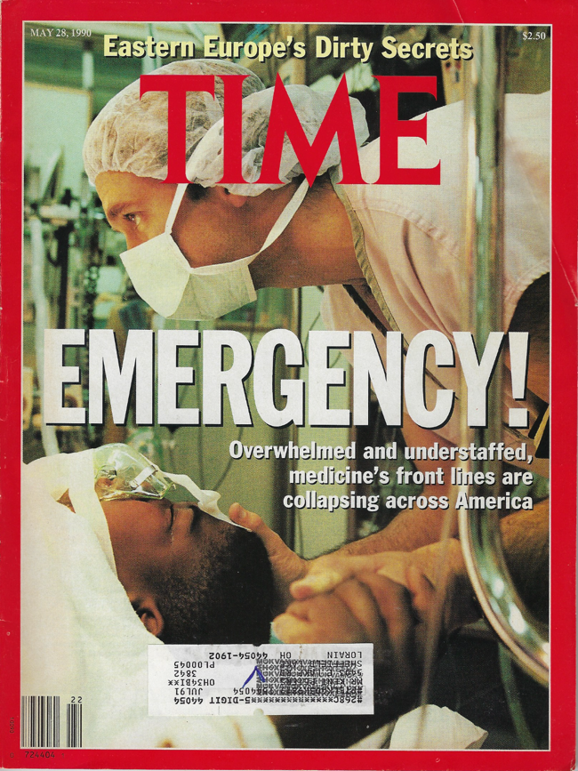
Workforce workshop: “Where you stand depends on where you sit.”
Richard J. Hamilton, MD MBA
AACEM President Elect 2021-2022

Slide 2
Miles’ Law
“Where you stand depends on where you sit.”
Originated with Rufus Miles (1910-1996): Chief of the Labor and Welfare Branch of the Bureau of the Budget
Noted that individuals who argued for budgets increases when they were running Government Agencies typically switched to arguing for budget cuts when working in the Bureau of Budget
Be forewarned:
Miles’ Law is also seen when…
Chairs become Deans, Vice Chairs become Chairs etc

Slide 3
Mile’s Law leads to suboptimal outcomes
Individuals choose strategies and policy goals based on different ideas of which outcomes will best serve their organizational and personal interests.
Bargaining:
pluralist process of give-and-take
reflects
the prevailing rules of the game and
power relations among the participants.
Process:
Factions Predominate (Balkanization)
Tends not to be objective
Lacks strictly rational decision making with respect to the wellbeing of entire enterprise
Results:
suboptimal outcomes that fail to fulfill the objectives of any of the individual participants.

Slide 4
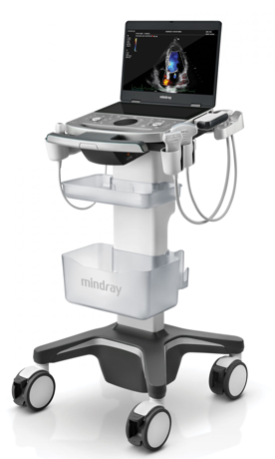
Departments, Chairs, Program Directors, and Division heads have diverse personal and organizational interests
Notes:
Where do we stand as AACEM/AAAEM

Slide 5
Our objective
Miles’ Law
Notes:
Where do we stand as AACEM/AAAEM

Slide 6
So where do I sit?
1998 – Bankruptcy of Allegheny University Health Sciences
2005 - Closure of Medical College of Pennsylvania Hospital
2019 - Closure of Hahnemann University Hospital …
… six month termination notice…

Slide 7
So where do I sit?
1998 - Bankruptcy of Allegheny University Health Sciences
2005 - Closure of Medical College of Pennsylvania Hospital
2019 - Closure of Hahnemann University Hospital
2020
Academic Chair of EM and Associate Dean for Drexel for Crozer Regional Campus (Drexel)
EM System Chair for Crozer Health System (TeamHealth)

Slide 8
As you answer these questions together, consider Aristotle’s classification of knowledge
Techne (Knowledge of Craft)
“Know How”
Episteme (Scientific Knowledge)
Evidence
Phronesis (Ethical Knowledge)
Practical wisdom to make ethical judgements

Slide 9
I’m worried that my Dept will struggle with the workforce recommendation for …
The ACEP Workforce considered several recommendations. Some examples:
25% of Core Faculty are Fellowship Trained
Increase procedure requirements for Ultrasound, US Guided Regional Blocks, chest tubes, intubations
Scale Residency Size (up or down) based on patient volume
increase scholarly output and research
Each Chair at the table must consider where their department would struggle to adopt recommendations
DISCUSS THIS WITH THE OTHER CHAIRS AND ADMINISTRATORS.
How do the obstacles your fellow Chairs would face change/reshape your opinion about that workforce recommendations?

Slide 10
Start a new program or expand…?
The President of your HealthCare System wants to meet with you to discuss the recent acquisition of a large Community Hospital system. The system has sufficient resources and setting to meet the requirements of a new EM Residency. The President wants to start a new program or expand your current EM Residency into the site. The President asks you to develop a plan. How do you respond?

Slide 11
Would you expand your residency?
Yes
No Way!
Can I get back to you on that?
Yes but…

Slide 12
Does knowing that the President is discussing the situation with an outside group (e.g. CMG) change your response?
Answer is still yes – need to outcompete
Answer is still no – give it to the CMG – they can have it.
Can I get back to you on that?
Yes – but you need to fund my research program too…

Slide 13
New roles and unfunded mandates…
The ACEP Workforce recommendations seem to place a high reliance on simulation for education needs and also asks each residency to have a Research Director. At the same time, the ACGME and the EM RRC don’t acknowledge either of these roles in the administration of the program. What are the implications of these recommendations for residencies of various sizes (small to large, rural to urban, academic to community) and what should be AACEM’s approach to inform/educate the ACGME and EM RRC about these unrecognized roles?

Slide 14
Conclusion

