Slide 1
EM Workforce
Deb Diercks, Rich Hamilton, Peter Sokolove, Lewis Nelson, and Ian Martin

Slide 2
History of Workforce Group
April 2021 – virtual summit to discuss ACEP workforce report
  Oversupply of up to 10K EPs by 2030
  Many underlying assumptions
Multiple EM organizations represented
AACEM paid to participate
Breakout groups to discuss major variables:
  Supply
  Demand

Slide 3
AACEM Engagement: June to Present
ACEP-led workgroups with multiple issues raised:
  Antitrust considerations
  Rural EM requirement
  Procedural competency standards
  Length of training
  Patient volume at primary site
  Scholarship
  Many others…

Slide 4
AACEM Engagement: June to Present
Focus on raising quality of training
Drafted recommendations to ACGME
AACEM EC feedback:
"We/AACEM appreciate the hard work and thoughtfulness that has been put into the creation of this document. However, we are unable to endorse the document in its current form. We fully support the higher expectation of core faculty with the additional suggestion of 25% having fellowships. However, we have concerns with the following areas:
Increasing the number of procedure requirements especially in the area of US, intubations, chest tubes, and central lines
Inclusions of a trauma center at the primary site for a residency
Determination of residency size based on patient volume.
We support the overall recommendations in scholarly activity but feel the background text minimizes the importance of dissemination of knowledge.”
Now continuing discussions to find consensus, if possible

Slide 5
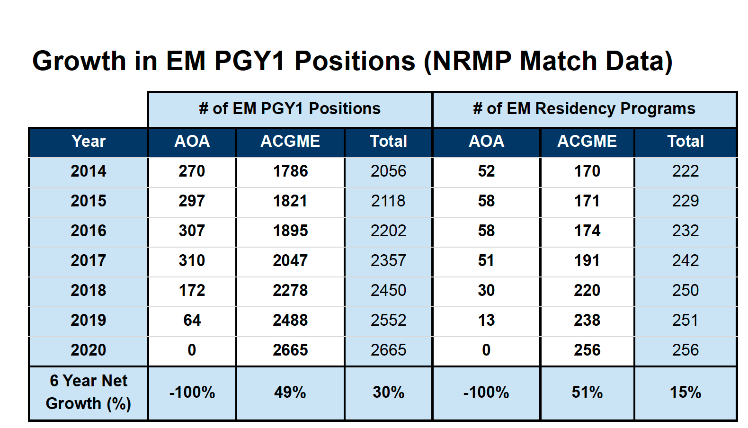

Slide 6
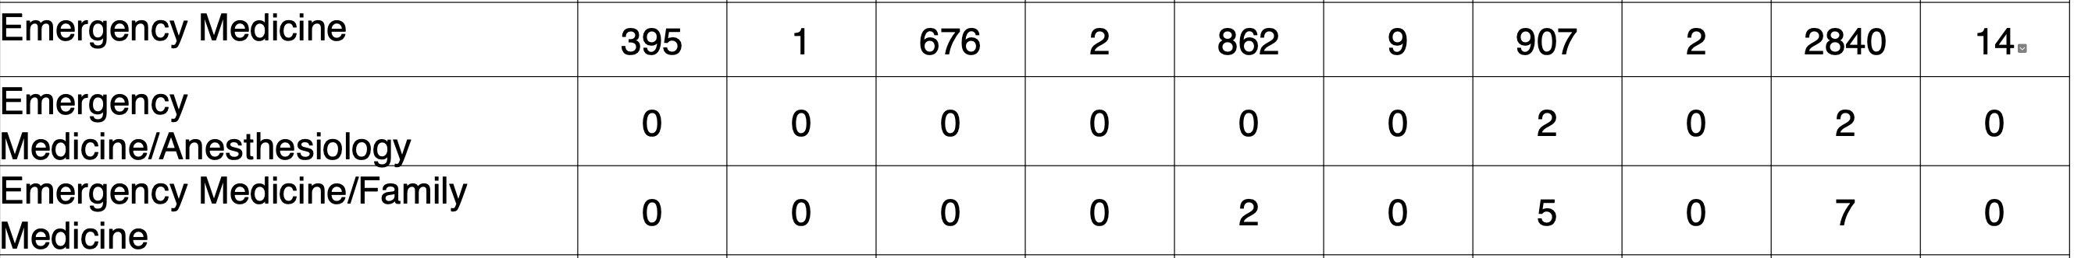
2021 Match

Slide 7
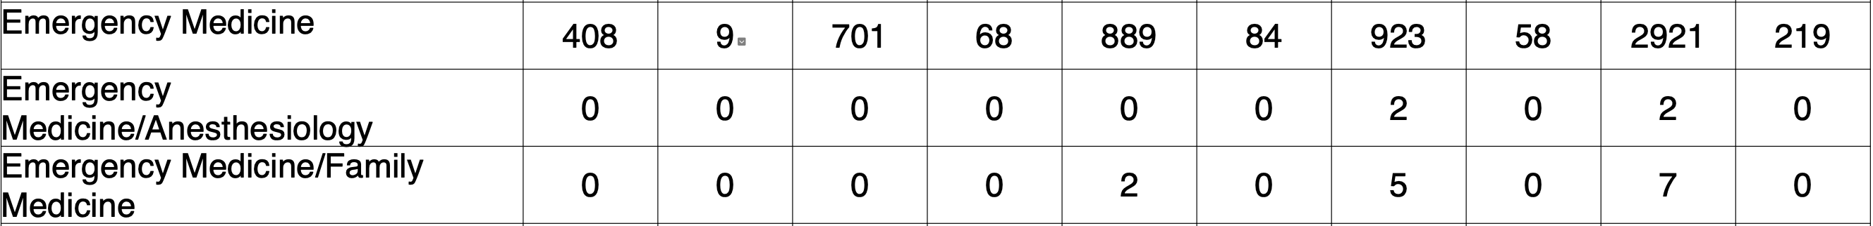
2022 Match

Slide 8
Discussion Questions
What new career opportunities can we develop for our residency graduates?
What do we suspect were the major factors for the 200+ unfilled EM residency slots this year?
What midcourse corrections can we take now?

