Slide 1
What’s Next: Life After Chair

Slide 2
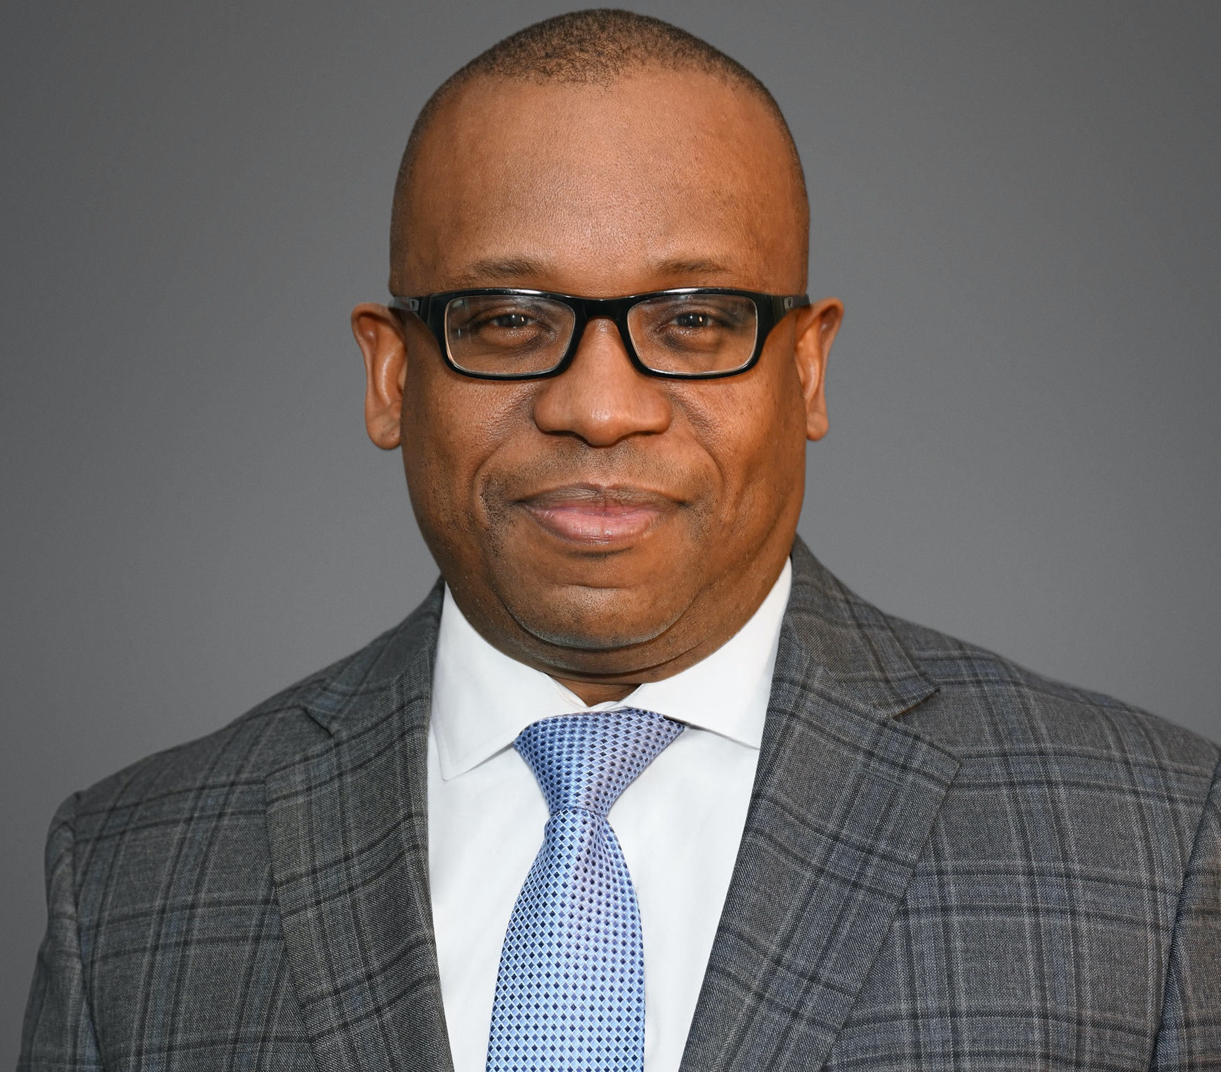
Adrian Tyndall, MD
Executive Vice President for Health Affairs
and Dean of Morehouse School of Medicine

Slide 3
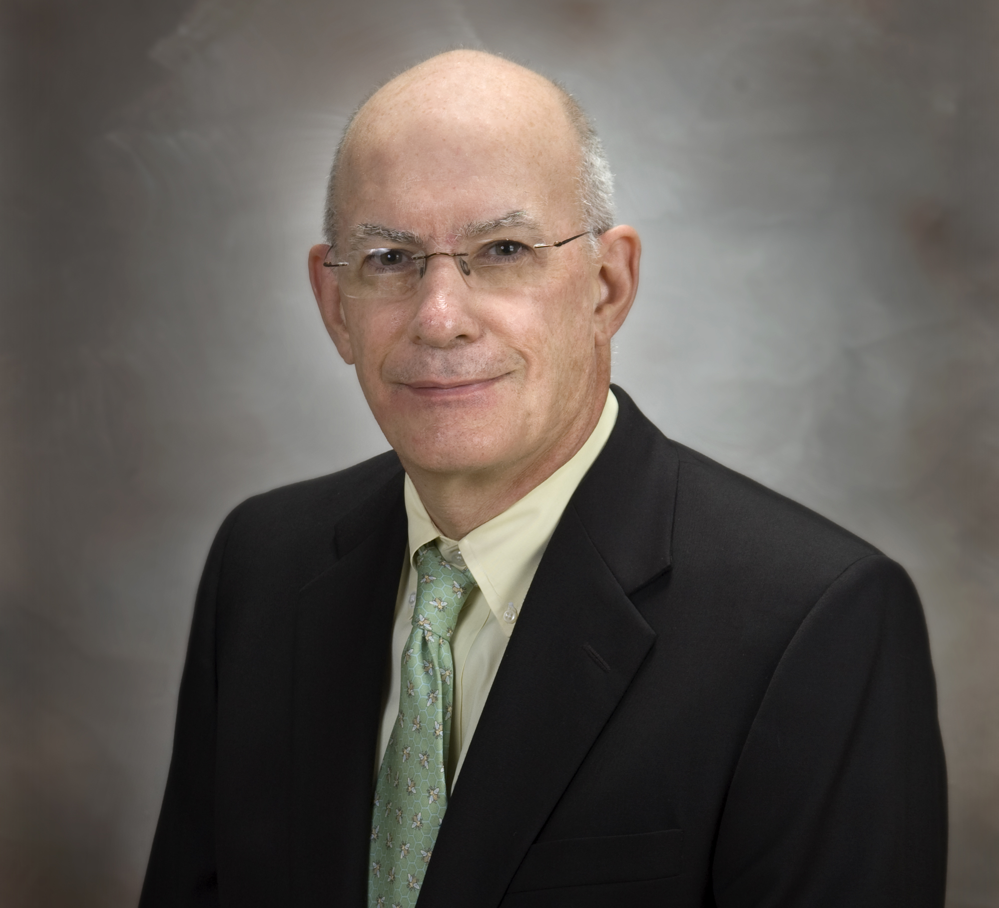
Brent R. King, MD
Chief Medical Officer
and Physician-in-Chief at Nemours Alfred l. dePont Hospital for Children

Slide 4
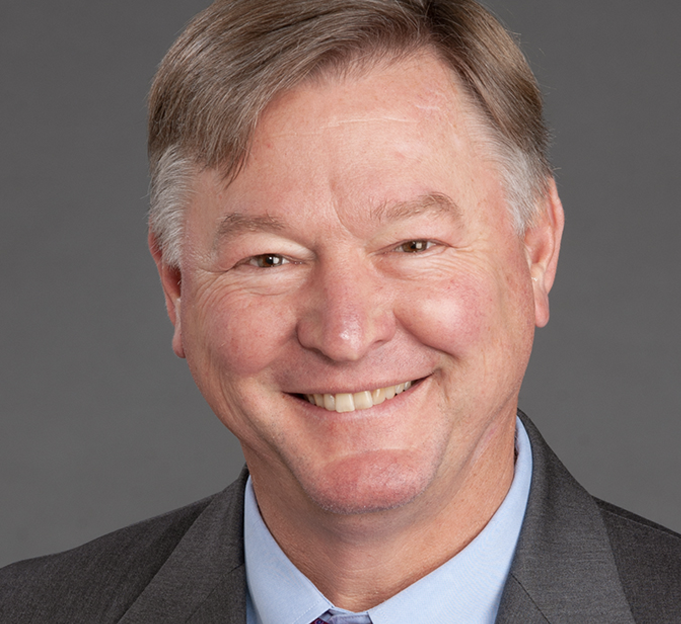
James W. Hoekstra, MD
President, High Point Medical Center, Wake Forest Baptist Heath

