Slide 1
Implementation Strategies to Achieve 2030 Strategic Goals for EM Research
AACEM/AAAEM Annual Retreat March 22, 2022
Andra Blomkalns
Gail D’Onofrio, Co-Chair
Michael Gibbs
Nate Kuppermann
Robert Neumar, Co-Chair
Brian O’Neil
Niels Rathlev
Peter Sokolov
David Wright
Michelle Aguirre
Megan Shagrin

Slide 2
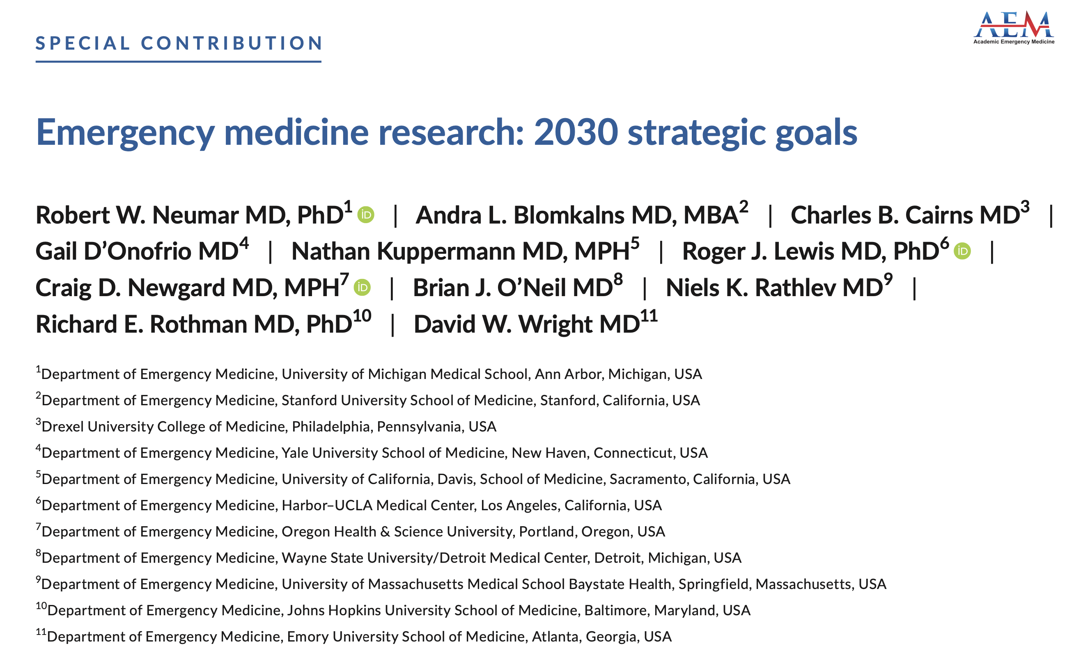
Acad Emerg Med. 2022;29:241–251

Slide 3
Benchmarking EM against other Clinical Departments
Percent of Full-Time Faculty that are NIH-Funded PIs (2019)
Emergency Medicine
5572 Full-Time Med. School Faculty
97 NIH-Funded PIs

Slide 4
Benchmarking EM to other Clinical Departments
Percent of U.S. Medical Schools with Respective Clinical Departments that have NIH-Funded PIs in those Departments (2019)
Emergency Medicine
113 Med. School Depts.
36 Depts. with NIH-Funded PIs

Slide 5
Benchmarking EM to other Clinical Departments
Percent of Full-Time Faculty that have MD-PhD Degrees (2019)
Percent of Full-Time Faculty that have PhD or other Doctoral Degree (without MD) (2019)
Emergency Medicine
5572 Full-Time Med. School Faculty
165 MD-PhDs
Emergency Medicine
5572 Full-Time Med. School Faculty
116 PhDs

Slide 6
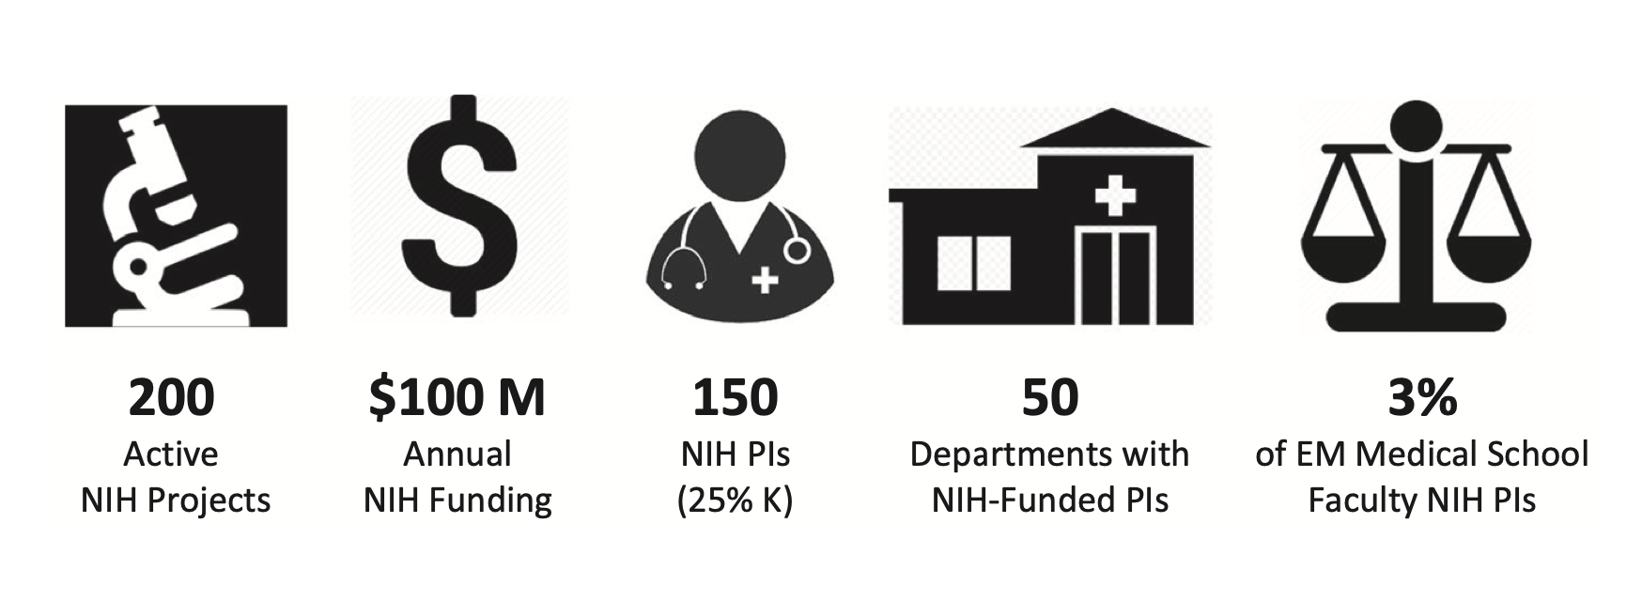
Acad Emerg Med. 2022;29:241–251

Slide 7
Barriers to Federally-Funded Research
AACEM Survey March 2022
TOP THREE BARRIERS
Lack of faculty pipeline (faculty interest/trained in research)
Inadequate financial resources to support research (startup pkgs, dedicated research time, etc)
Lack of experienced federally funded mentors in my EM department, or at my institution
Human Capital
Financial Capital
Human Capital

Slide 8
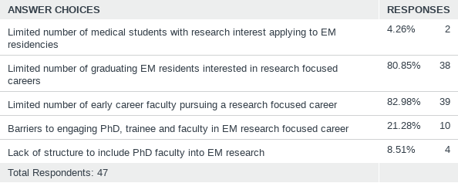
Q2: Lack of Faculty Pipeline
Answered: 47 Skipped: 1

Slide 9
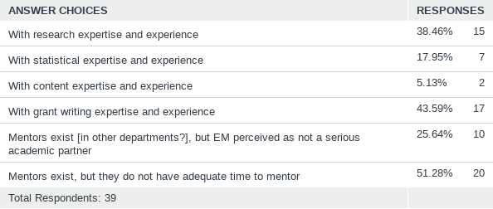
Q8: Lack of experienced mentors - In my EM department, or at my institution outside of EM:
Answered: 39 Skipped: 9

Slide 10
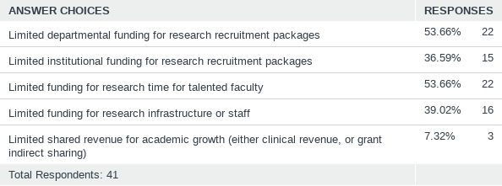
Q14: Inadequate financial resources to support research
Answered: 41 Skipped: 7

Slide 11
Table Discussion
Investigator Pipeline
Mentorship
Financial Resources

Slide 12
Report Out

Slide 13
Supplemental Slides

Slide 14
2030 NIH Funding Projections Based on Sustaining Historic Growth Rates
2030 Projection
148 PIs
52 Depts
Projected
2030 Projection
$104M Funding
200 Projects
Projected
Principal Investigators

Slide 15
Increase NIH Grant Applications
Correlation of percent NIH funded PIs with the number of NIH grant applications/100 Faculty/Year
Adjusted R²=0.90 (p = 0.03)
Neurology
Psychiatry
Pediatrics
Emergency Medicine

Slide 16
Increase EM Faculty MD-PhDs and PhDs
Correlation of % MD-PhD Faculty with % NIH-Funded PIs
Correlation of % PhD or other Doctoral Degree
(without MD) Faculty with % NIH-Funded PIs
Adjusted R-Squared = 0.72
Adjusted R-Squared = 0.63

Slide 17
Increase EM Departments with NIH-Funded PIs
NIH-Funded Emergency Medicine PIs and Emergency Medicine Departments with NIH-Funded PIs
Departments and PIs
PIs per Department

Slide 18
Increase Individual and Institutional Training Grants
Emergency Medicine NIH Career Development and Training Grants
Projects

Slide 19
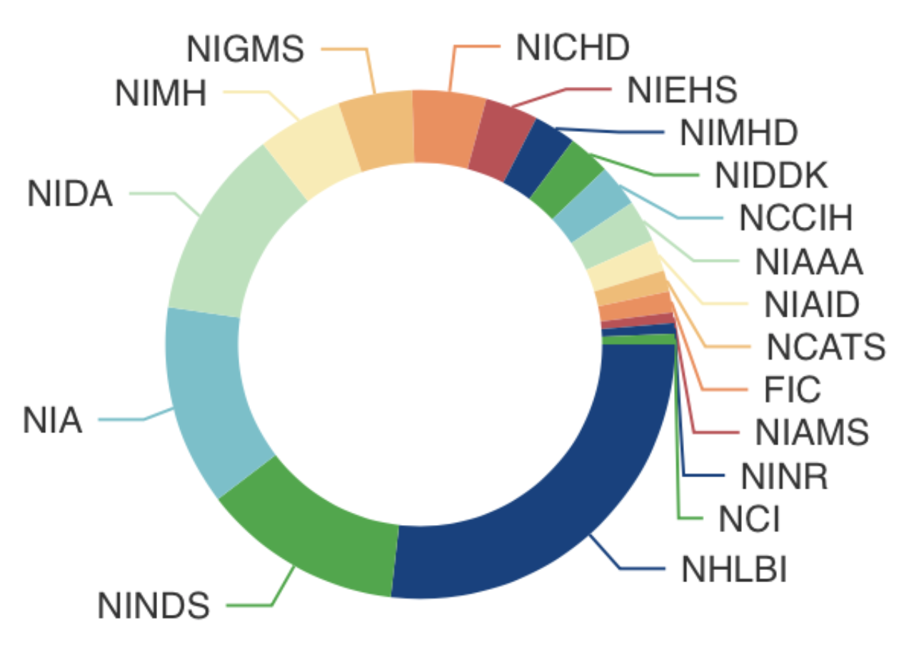
Diversity of Emergency Medicine NIH Portfolio FY20 Project Distribution by Institute
7
7
6
8
18
19
40
19

