Slide 1

Academy of Administrators in Academic Emergency Medicine
Benchmark and Salary Survey
Fiscal Year 2021
James Scheulen, PA, MBA
On behalf of the
AAAEM Benchmark Committee
March, 2022

Slide 2
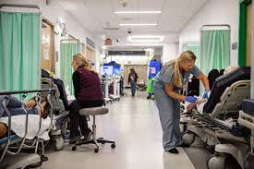
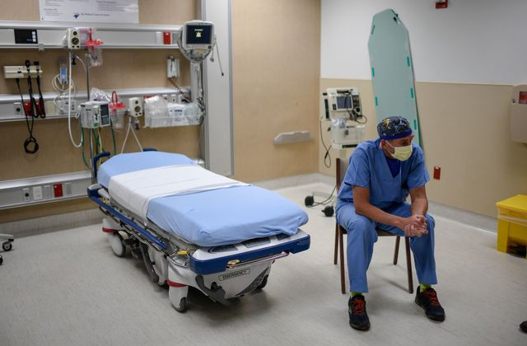
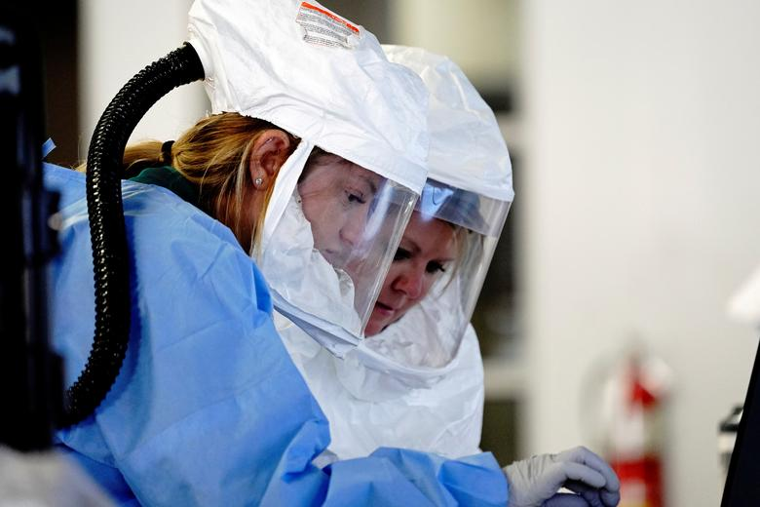
Survey Timeline
July
Aug
Sept
Oct
Nov
Dec
Jan
Feb
Mar
Apr
May
June
FY 2019
FY 2020
July
Aug
Sept
Oct
Nov
Dec
Jan
Feb
Mar
Apr
May
June
July
Aug
Sept
Oct
Nov
Dec
Jan
Feb
Mar
Apr
May
June
FY 2021

Slide 3
Survey Timeline
July
Aug
Sept
Oct
Nov
Dec
Jan
Feb
Mar
Apr
May
June
FY 2019
FY 2019—our last “normal” year
July
Aug
Sept
Oct
Nov
Dec
Jan
Feb
Mar
Apr
May
June
FY 2020
FY 2020—“anything but normal” year
July
Aug
Sept
Oct
Nov
Dec
Jan
Feb
Mar
Apr
May
June
FY 2021
FY 2021—our “new normal” year??

Slide 4
This year…
Benchmark & Salary:
  COVID survey update
  Wellness questions
  Boarding questions
  Per diem pay rates
  Complexity index next steps
  Research section development
  APP salary data
Data Insights Portal:
Research
Teaching
Patient Care
https://saem.roundtableanalytics.com/insights/

Slide 5


Benchmark Committee
Steve Maxwell
Becky McGowan
Ashlee Miller Melendez
Jennifer Muir
Steven Petrovic
Kain Robbins
Travis Schmitz
Jim Scheulen
Benjamin Sun
Gregory Volturo
Robert Eisenstein
Gregory Archual
Kathleen Acevedo
Antoinette Brooke
Louis Burton
David Calder
David Christiansen
Gai Cole
Richard Hamilton
Cathi Harbertson
Amy Jameson
Kenny Lopiano

Slide 6
Data Set: Demographics
 | 2018 | 2019 | 2020 | 2021 | 2022
Academic Hospital | 85 | 79 | 74 | 72 | 70
Academic Affiliated | 13 | 17 | 17 | 18 | 18
Academic/Affiliated | 98 | 96 | 91 | 90 | 88
Community | 21 | 33 | 34 | 28 | 34
Freestanding ED | 3 | 6 | 5 | 7 | 6
Adult Departments | 121 | 135 | 130 | 125 | 127
Pediatric ED | 17 | 25 | 24 | 18 | 20
Total ED Reports | 138 | 160 | 154 | 143 | 127

Slide 7
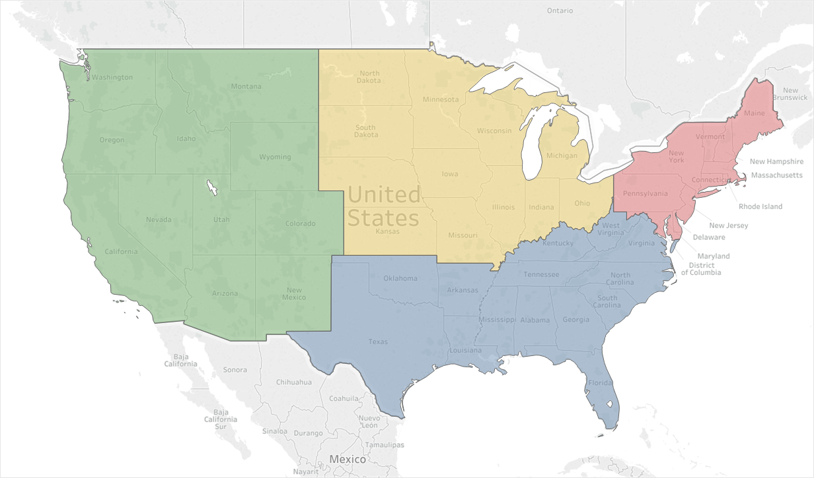
Data Set
Adult Academic and Affiliate Responses: 85
14
16
33
22
5,743,477 Emergency Visits
1,250,281 Hospitalizations
$520,696,139 Collected Revenue

Slide 8

Data Set: Demographics
57% Private
43% State
76% Level 1 Trauma
24% Level 2 or 3
Hospitals are operating 95%
of licensed beds
Turnover = 51 patients/bed
Last year = 57 patients/bed
47% Pediatric ED is physically separate
42% of departments staff the Peds ED

Slide 9


Inpatient Length of Stay
Staffed beds: 637
Patient Days: 232,505
Hospitalized: 29,841
Mean LOS: 7.79 days
FY 2020: 6.60 days
Increase: 1.19 days
Occupancy: +15%

Slide 10

The Academic ED
Fiscal Year 2021 | Median
Hospital Beds | 656
Licensed ED Beds | 58
Total Bed Hours | 534,360
% Bed Hours to MAIN | 68%
ED Treat & D/C | 35,748
ED Admissions | 14,831
Hospital Observation | 2,868
Total Visits | 56,235
Hospitalized Rate (Calc) | 28.8%
Unique visits | 66.4%
56,235 Visits
Range: 23,546 – 104,251

Slide 11
The Academic ED
 | 2019 Median | 2020 Median | 2021 Median
Hospital Beds | 632 | 664 | 656
Licensed ED Beds | 52 | 59 | 58
Total Bed Hours | 495,670 | 520,689 | 534,360
% Bed Hours to MAIN | 70% | 67% | 68%
ED Treat & D/C | 42,244 | 38,875 | 35,748
ED Admissions | 14,702 | 14,258 | 14,831
Hospital Observation | 3,262 | 3,215 | 2,868
Hospitalized Patients | 17,964 | 17,473 | 17,699
Total Visits | 64,326 | 59,417 | 56,235
Hospitalized Rate (Calc) | 27.9% | 29.4% | 31.5%
Unique Visits (65%) | 65% | 65% | 66.4%

Slide 12
The Academic ED
 | 2019 Median | 2020 Median | 2021 Median
Hospital Beds | 632 | 664 | 656
Licensed ED Beds | 52 | 59 | 58
Total Bed Hours | 495,670 | 520,689 | 534,360
% Bed Hours to MAIN | 70% | 67% | 68%
ED Treat & D/C | 42,244 | 38,875 | 35,235
ED Admissions | 14,702 | 14,258 | 14,831
Hospital Observation | 3,262 | 3,215 | 2,868
Hospitalized Patients | 17,964 | 17,473 | 17,699
Total Visits | 64,326 | 59,417 | 56,235
Hospitalized Rate (Calc) | 27.9% | 29.4% | 31.4%
Unique Visits (65%) | 65% | 65% | 66.4%
12.5% or 22 pts/day
(7.6%)
(5.4%)

Slide 13
Patient Populations
 | 2019 Median | 2020 Median | 2021 Median
Total | 64,326 | 59,417 | 56,235
EMS Arrivals | 18,005 | 15,876 | 16,515
EMS Percent | 26.2% | 25.9% | 28.1%
EMS Admit Rate | 42.9% | 42.6% | 45%
Behavioral Health | 5.5% | 4.9% | 5.0%
Patients > 65 Years | 20.7% | 21.0% | 21.5%
Pediatric Visits | 2.1% | 1.7% | 0.8%
Dedicated Pediatrics | 24,921 | 22,160 | 19,766
Increase as a % of total

Slide 14
Patient Volume Trend: Median
Patient Volume Trend—All Responders FY 21

Slide 15
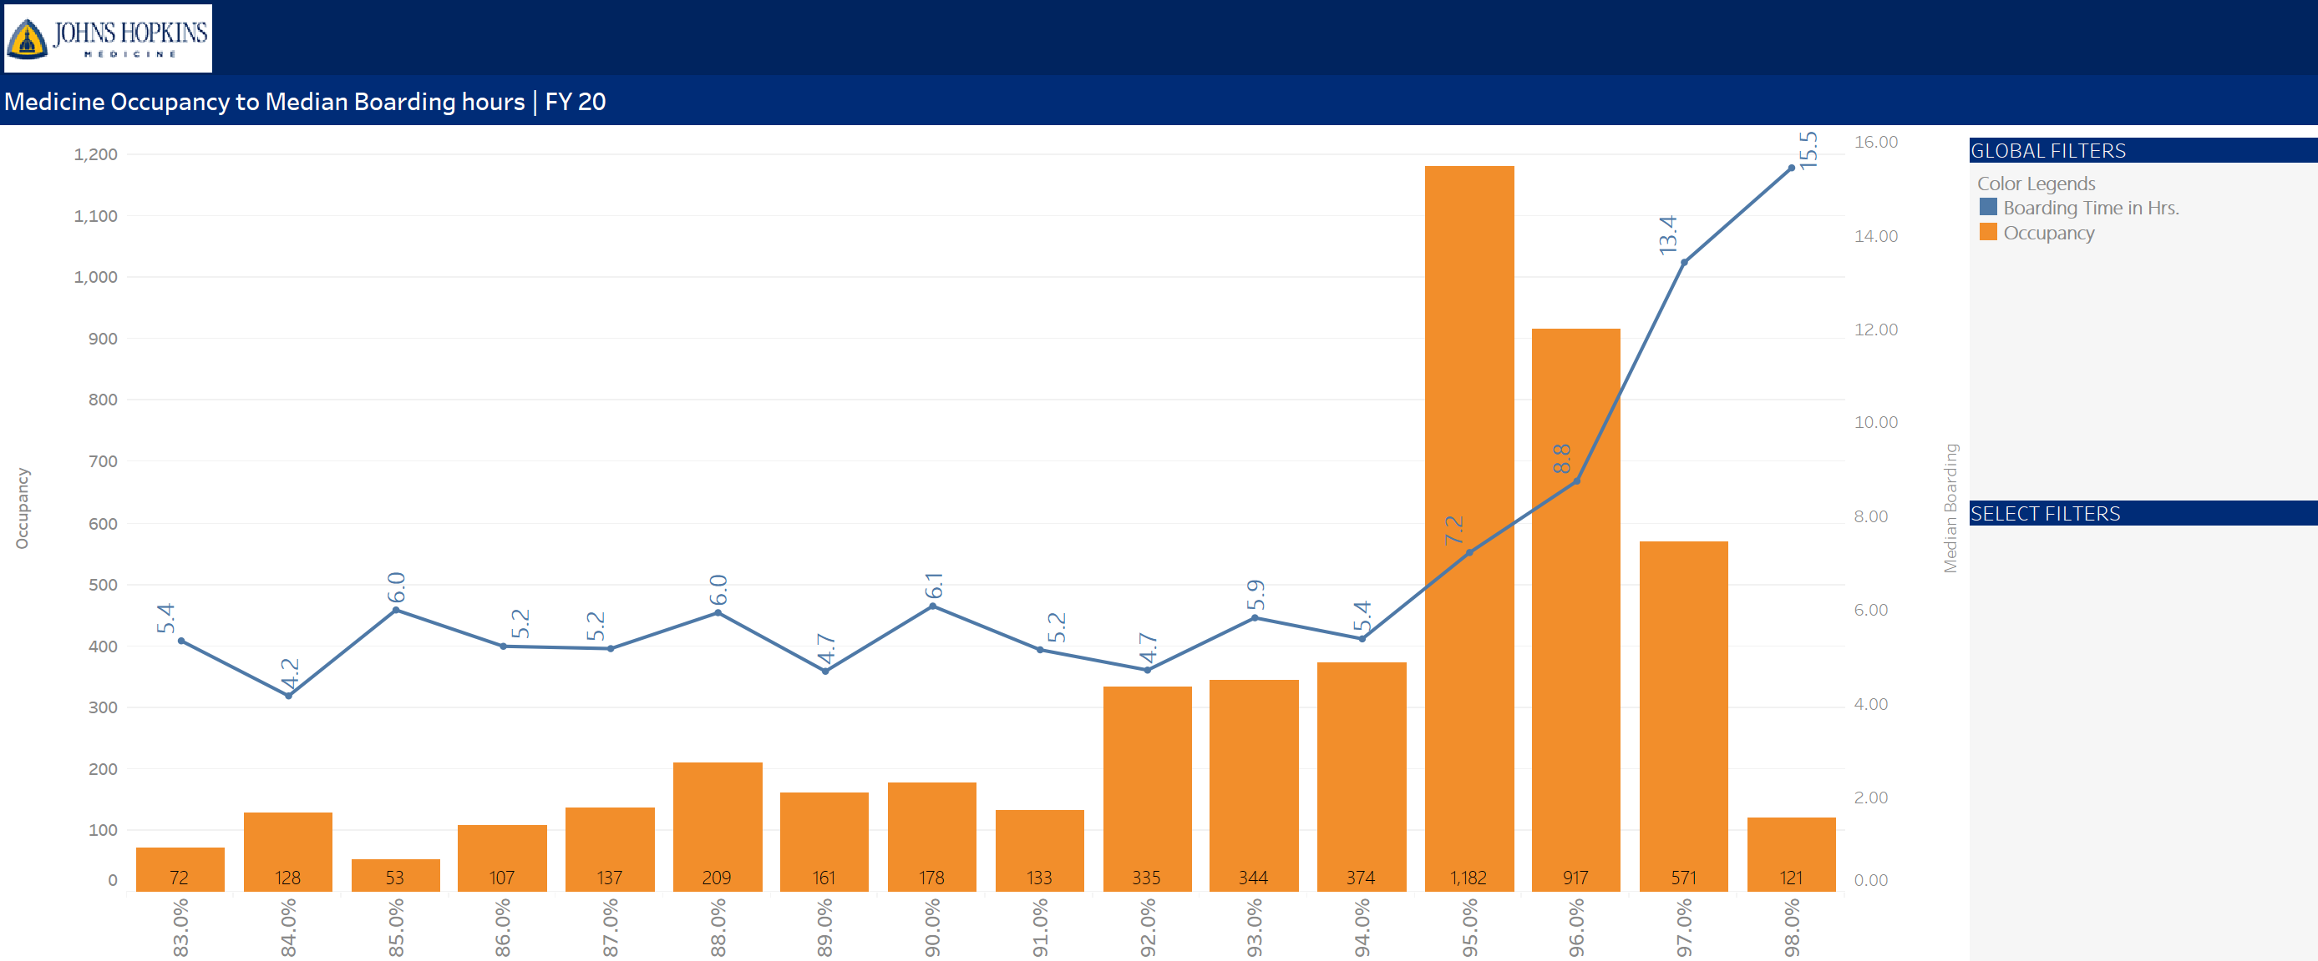
Hospitalization Data
Increased volume +
Increased LOS =
Increased Occupancy =
Increased Boarding

Slide 16
Patient Volume Trend: Median
Patient Volume Trend—What might NEXT year be like?

Slide 17
LOS Trend: Median LOS
Median Length of Stay
Hours
Median times represented here
Mean times are longer
Distribution with a long right tail

Slide 18
LOS Trend: Bed to Decision Time
Median “Main” Bed to Decision Time: Admit vs D/C
Hours
Assuming 30 minutes saved per patient
28,118 bed hours saved
Increased capacity by 3 beds

Slide 19
Boarding Time
Mean and Median Boarding Time
Hours
Assuming 90 minutes INCREASE per patient
26,549 bed hours LOST
DECREASED capacity by 3 beds

Slide 20
Boarding Time
Total Boarding Hours
13 beds fully
dedicated to
Inpatient care
Hours
10 beds fully
dedicated to
Inpatient care
9 beds fully
dedicated to
Inpatient care

Slide 21
Boarding Time
Total Boarding Hours for FY 22 could be…
Based upon boarding
hours from AAAEM
sample July–Dec 2021
16 beds fully
dedicated to
Inpatient care
Hours
13 beds fully
dedicated to
Inpatient care
10 beds fully
dedicated to
Inpatient care
9 beds fully
dedicated to
Inpatient care

Slide 22
Boarding Distribution
FY 2015 vs FY 2021
Percent of Patients
Boarding Hours

Slide 23
Boarding Time
Boarding Time Start: Other
2 hours post admit (4)
4 hours post admit (4)
30 min post admit
Handoff to inpatient team
Admit certification
Differs by service
ED cares for boarders

Slide 24
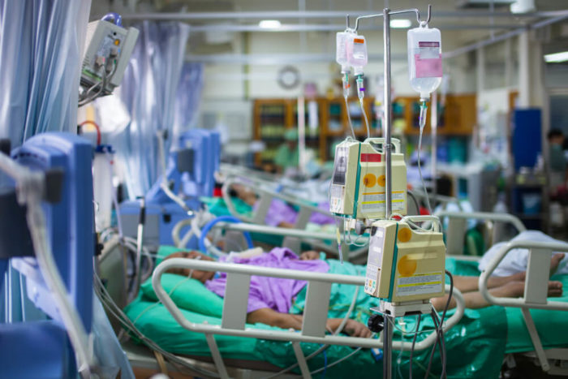
Inpatients in the ED
Mean and Median Boarding Time
Who provides patient care:
67.1% Inpatient teams for non-ICU patients
50.0% Inpatient teams for ICU patients
Hours
Hospital Support:
33% provide nursing support for boarders
24% provide financial support for boarders
30 minutes increase in boarding
17000 hospitalized patients
8500 additional bed hours used
Equals 1 additional bed per day out of service

Slide 25
Care for inpatients in the ED
Mean and Median Boarding Time
When is a patient considered to be boarding?
38.5% said < 2 hours
32.7% said between 2 and 4 hours
25.0% said > 4 hours
3.8% said some other time (Consultant)
Hours
Measures to help minimize boarding?
Discharge time of day initiatives
  Noon, 2 pm
Discharge Lounge
Divert low acuity ED patients
Huddles, alerts, surge plans, limiting inbound transfers
30 minutes increase in boarding
17000 hospitalized patients
8500 additional bed hours used
Equals 1 additional bed per day out of service

Slide 26
Inpatients in the ED
Mean and Median Boarding Time
If yes, who?
Even combination: 40%
Non-mental health: 32%
New ED admits: 14%
Pts awaiting D/C: 11%
Mental Health pts: 3%
Board in inpatient hallways?
47% said NO
25% said YES during surge
9% said YES routinely
11% were unsure
Hours
Does your hospital have:
An ED specific surge plan: 89%
A Discharge Lounge: 54%
An EMS Diversion plan: 56%
Surgery delayed 2019?
39% were unsure
37% said NEVER
12% said RARELY
12% said > 5 times per month
30 minutes increase in boarding
17000 hospitalized patients
8500 additional bed hours used
Equals 1 additional bed per day out of service

Slide 27
Ancillary Resource Utilization
Resource | FY 16 | FY 17 | FY 18 | FY 19 | FY 20 | FY 21
CT Utilization | 21.2% | 22.5% | 23.3% | 25.5% | 28.3% | 31.3%
MRI Utilization | 2.1% | 2.0% | 2.1% | 2.7% | 2.8% | 2.8%
Plain Film (% visits) | 40.8% | 39.4% | 40.3% | 40.2% | 43.0% | 44%
Laboratory (% visits) | 64.9% | 63.9% | 68.3% | 69.6% | 70.5% | 72.2%
EKG (% visits) |  |  |  | 33.4% | 35.9% | 39.9%
U/S (Radiology) |  |  | 6.3% | 7.9% | 6.9% | 7.6%
Consult & D/C |  |  | 6.8% | 7.0% | 7.5% | 8.5%
MRI Turnaround |  |  | 4.0 Hr | 4.0 hr | 4.3 hr | 5.1 hr
MEAN MRI Turnaround = 8.6 hours

Slide 28
Complexity Metrics: Sicker patients?

Slide 29
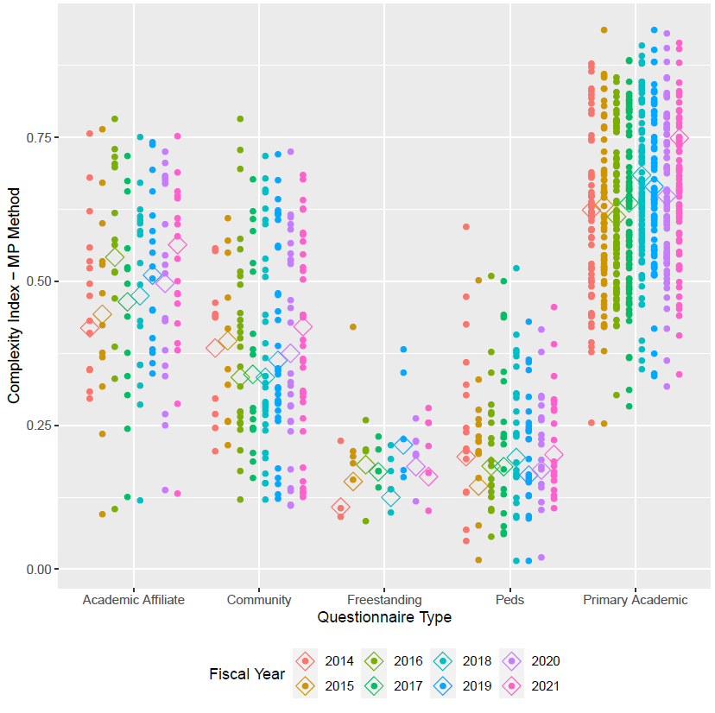
Complexity Index
.749
.564
.421
.161
.199
Notes:
There are 2 options we can pursue.
Looking at acuity as a stand-alone concept for our patient population where we seek to quantify and contrast how sick our patients are. High acuity patients are more likely than low acuity patients to die, require surgery, or be medically admitted. Question: is your average behavioral health patient high or low acuity?
The other option is to expand this concept and incorporate additional factors that serve as indicators of how complex it is to clinically and operationally manage these patients. This option isn’t just about how sick the patients are but how resource intensive they are and how much pressure the place on the internal system of the ED.

Slide 30
ED Admitted CMI Trend
Case Mix Index: Academic Vizient Hospitals
Hours

Slide 31


Complexity Index 2.0
Collaboration with Vizient
  Considering patient level data
    Demographics
  Operational metrics
  Encounter specific metrics
    Clinical information
    Co-morbidities
  Social Determinants of Health
Notes:
There are 2 options we can pursue.
Looking at acuity as a stand-alone concept for our patient population where we seek to quantify and contrast how sick our patients are. High acuity patients are more likely than low acuity patients to die, require surgery, or be medically admitted. Question: is your average behavioral health patient high or low acuity?
The other option is to expand this concept and incorporate additional factors that serve as indicators of how complex it is to clinically and operationally manage these patients. This option isn’t just about how sick the patients are but how resource intensive they are and how much pressure the place on the internal system of the ED.

Slide 32
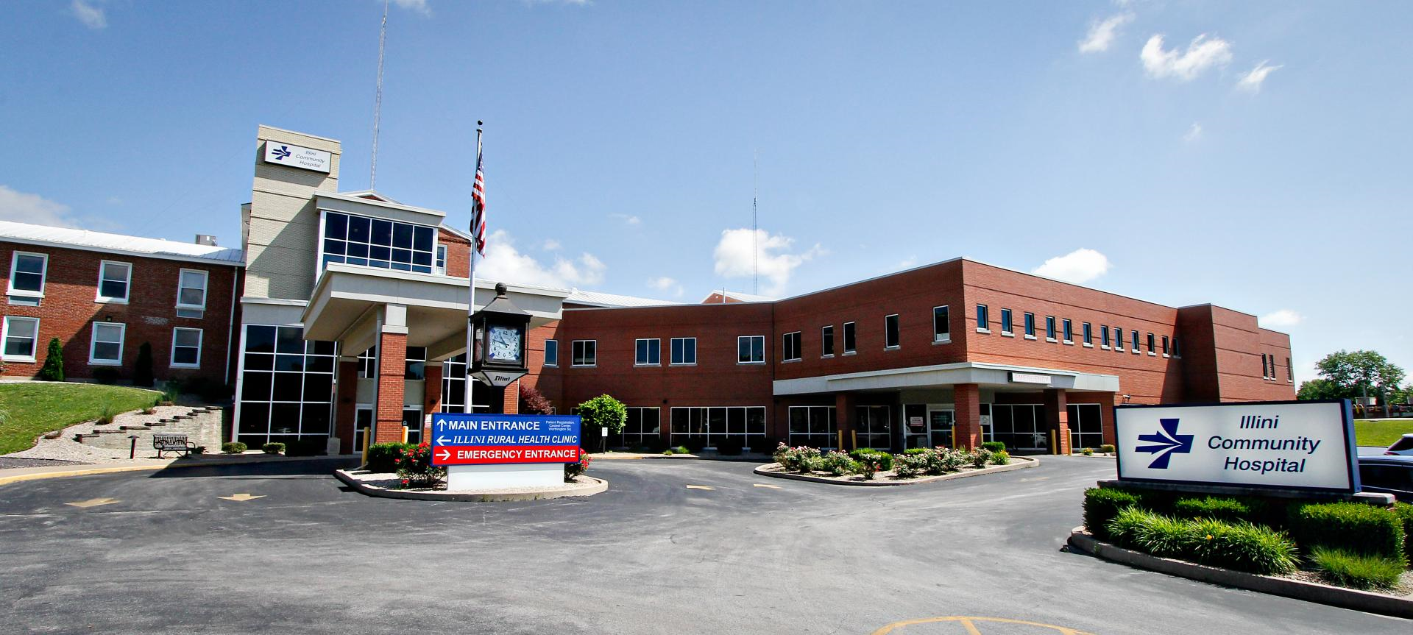
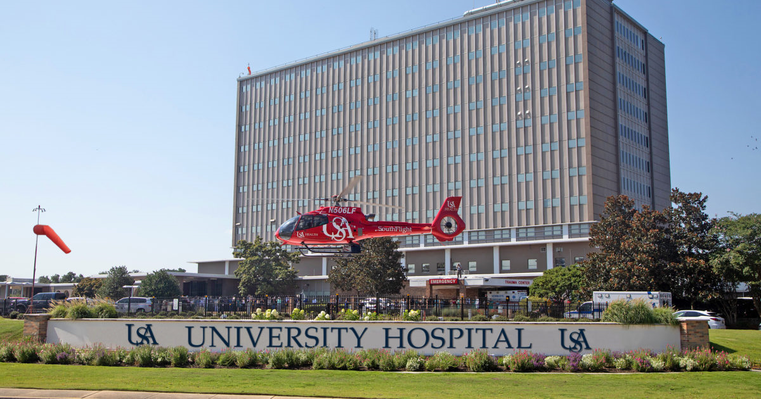
Academic vs Others
 | Arrivals | Unique Visits | ED Beds | Pts Per Bed | Hospitalized Rate | CMI ED Admit | ED Index
Academic | 56,235 | 66.4% | 58 | 969 | 28.8% | 1.90 | .749
Community | 26,003 | 67.1% | 25 | 1040 | 20.3% | 1.50 | .421
Freestanding | 22,224 | 71.0% | 13 | 1709 | 9.3% | ------ | .161
Pediatrics | 19,613 | 74.4% | 20 | 981 | 17.6% | ------ | .199

Slide 33
Value Added Time
Discharged Patients
Admitted Patients
Total LOS | Bed to Decision | Other | Value Time % |  | Total LOS | Bed to Decision | Other | Value Time %
4.2 | 3.5 | 1.2 | 71.4% | Academic | 8.0 | 3.0 | 5.0 | 37.5%
3.0 | 2.3 | 0.7 | 76.7% | Community | 5.7 | 3.1 | 2.6 | 54.4%
2.5 | 1.6 | 0.9 | 64.0% | Freestanding | 8.0 | 2.1 | 5.9 | 26.3%
2.9 | 1.9 | 1.3 | 65.6% | Pediatrics | 5.5 | 2.9 | 2.6 | 52.7%

Slide 34
Value Added Time
Arrival to Provider same
Reduced decision time
Increased Boarding

Slide 35
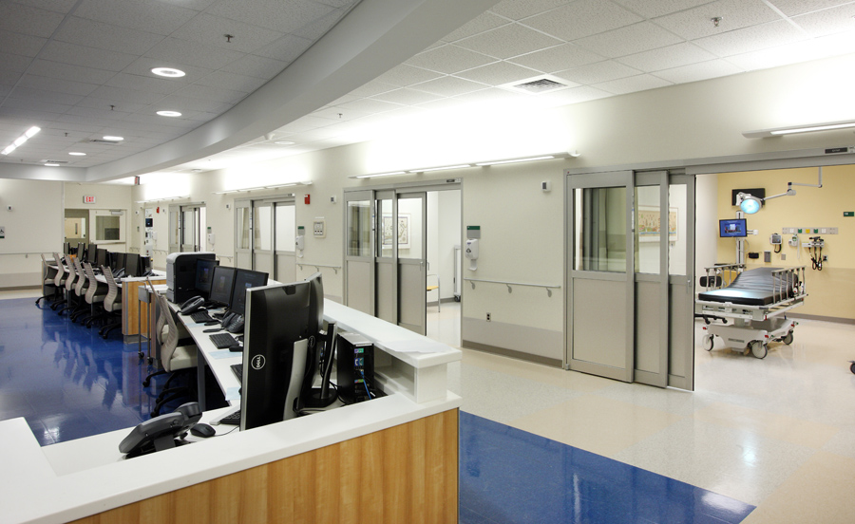
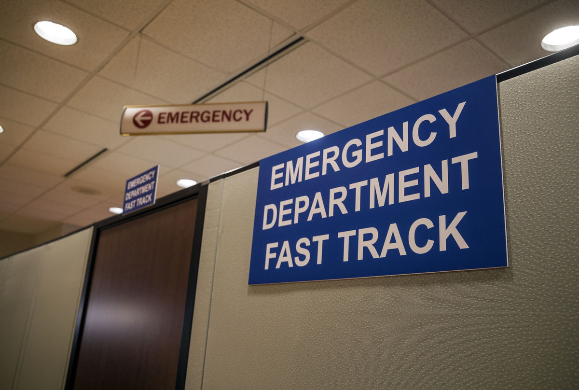


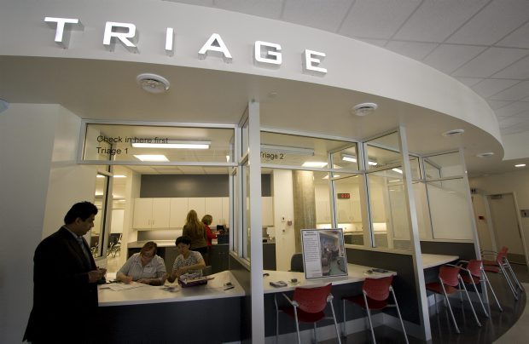
Nursing and Support Hours
 | Median Budgeted Hours | Median Worked Hours | Percent Worked Hours
Nursing | 193,116 | 170,680 | 94.5%
Support | 80,926 | 71,481 | 91.7%
 | % Yes | Weekday | Weekend
Case Management | 91% | 16 | 12
Social Work | 90% | 24 | 24
Pharmacist | 93% | 16 | 16

Slide 36
FY 2021
Physician and Provider Hours

Slide 37
Physician Staffing
Arrivals per
faculty hour:
2.4
Arrivals per
faculty hour:
2.1
4.2% Reduction in hours
Notes:
The mean increase was 2075 hours across the board, but hard to make year to year comparisons because of the varying participation among sites and data entry. But it does appear that we have been adding more clinical hours over the past few years

Slide 38
Clinical Hours: Rank & Site
Do you require a minimum number
of clinical hours?
66% = Yes
Median = 384
25th to 75th = 373 to 425
Do shifts recognize sign in & out?
37% = Yes
Assumed work week hours?
40 hours

Slide 39
Daily Provider Coverage
Hours per Day
56%
52%
52%
Attending
Hours
33.3%
54%
Attending
Hours
32.7%
Resident
Hours
54.2%
Resident
Hours
46.6%
APP
Hours
10.6%
APP
Hours
20.6%
188 Hours of provider coverage per day in the Main ED
210 Hours of provider coverage per day in all areas of ED
Approximate 6% reduction in overall hours from 2020
Notes:
Medians :184 hours in main ED 2016 ; 2017 186 hours as was 186 in 2012, essentially resident coverage has remained flat we have added attending hours to compensate for increase volume On average 50 %f the daily ED coverage hours are provided by residents for EDs> 40 K
From 2012 through 2017 the percent resident coverage 55%, 55%,56%,54%, 52%, 52%

Slide 40
Daily Provider Coverage
Hours per Day
56%
52%
52%
Attending
Hours
33.3%
54%
APP
Hours
25%
Resident
Hours
54.2%
APP
Hours
10.6%
Attending
Hours
75%
Common for APP coverage in fast track areas in community
Notes:
Medians :184 hours in main ED 2016 ; 2017 186 hours as was 186 in 2012, essentially resident coverage has remained flat we have added attending hours to compensate for increase volume On average 50 %f the daily ED coverage hours are provided by residents for EDs> 40 K
From 2012 through 2017 the percent resident coverage 55%, 55%,56%,54%, 52%, 52%

Slide 41
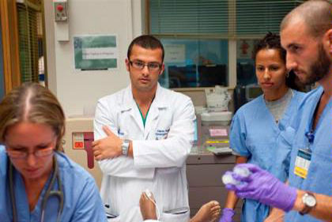
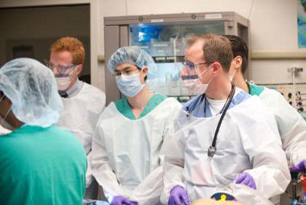
Education: Residency
76% of programs are 3 years
13 residents per year
29% with departmental funded residents
60% report a required EM Clerkship
FY 2021 Job Duty Allocation | 25th | Median | 75th
Residency Director | 528 | 620 | 744
Residency Director- Associate | 288 | 360 | 576
Residency Director - Assistant | 216 | 328 | 420

Slide 42
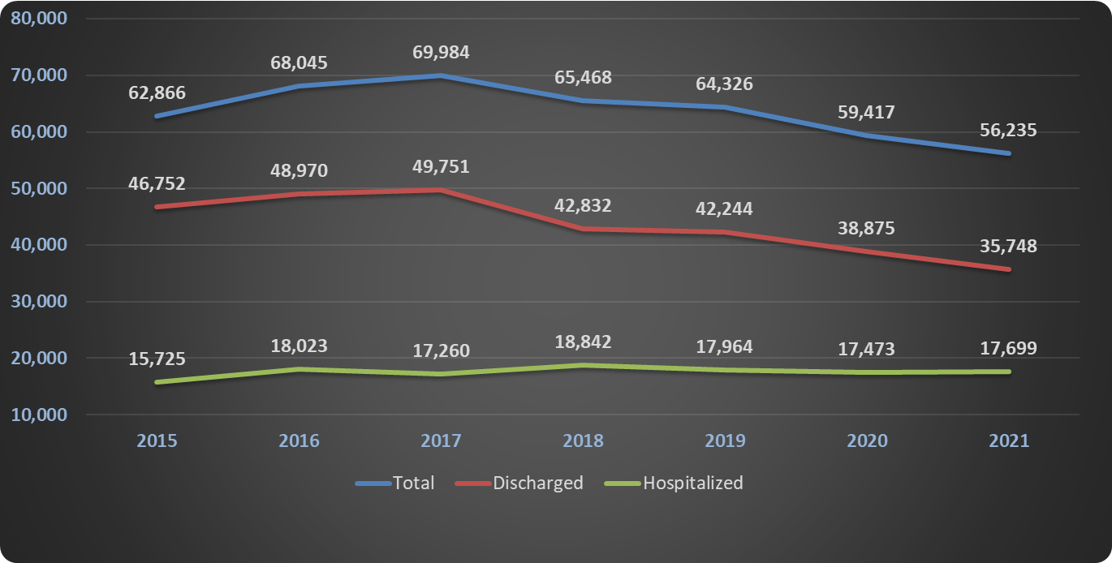
Charge Data
 | FY 17 Median | FY 18 Median | FY 19 Median | FY 20 Median | FY 21 Median
Collection/Work RVU | $45.76 | $46.11 | $47.19 | $47.05 | $46.95
Work RVU/Hour | 6.73 | 6.8 | 7.2 | 6.8 | 6.0
Work RVU/Patient | 2.86 | 2.9 | 3.0 | 3.0 | 3.2
Collections ($) | $7,681,213 | $8,18,2346 | $8,480,310 | $8,174,995 | $7,737,646
Collections/Visit | $109.76 | $128.50 | $128.27 | $136.30 | $140.61
FY 19 Variance = $1,129,098
FY 20 Variance = $447,421

Slide 43
Professional Fee Billing
E & M Codes
Percent
82.9% Levels 4, 5 and CC
90% of charges from E&M Codes

Slide 44
Payer Mix
Mean Payer Mix Distribution

Slide 45

Faculty Level Benchmarks
RVU Productivity
  Per hour
  Total
Publications
  First vs any author
  Journal quality
  Type of publication
Grants submitted/Awarded
  Submission or award
  NIH or all
  PI or other
Notes:
2016 =160356 total median COLLECTION $44.44, PER MD HOUR 6.54; PER PATIENT BILLED 2.88; RVU PER CLINICAL fte 10613
2017= 173902 total median; Collection $45.76; PER MD HOUR 6.73; PER PATIENT BILL 2.86, PER FTE 10127
Work RVU per MD hour up slightly from last yeas as is collection per RVU.
RVU collection range 93.63-9.92
25th percentile = 39.08
75th percentile 51.77

Slide 46
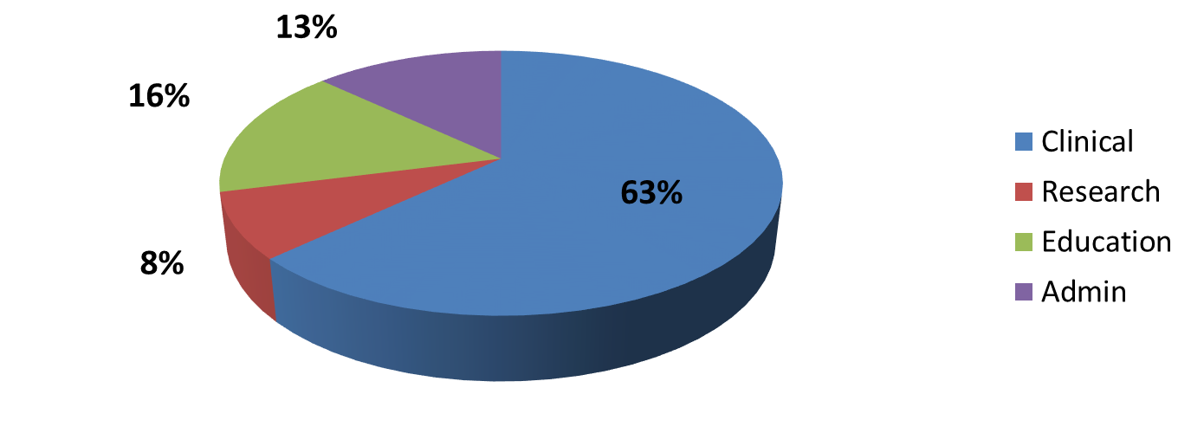
Faculty Effort
Percent Faculty Effort: Multiple Missions
FY 2015
FY 2021
Academic Centers

Slide 47
Faculty Level Benchmarks
  RVU Productivity
Overall All Rank WRVU/Hour = 5.3
Overall All Rank Total WRVU/FTE = 5,363 (All faculty)
Overall All Rank Total WRVU/FTE = 9,459 (Clinical FTE)
Rank | Total WRVU | WRVU/hour
Instructor | 7047 | 5.3
Assistant Professor | 5559 | 5.1
Associate Professor | 5087 | 5.5
Professor | 4423 | 5.7
Notes:
2016 =160356 total median COLLECTION $44.44, PER MD HOUR 6.54; PER PATIENT BILLED 2.88; RVU PER CLINICAL fte 10613
2017= 173902 total median; Collection $45.76; PER MD HOUR 6.73; PER PATIENT BILL 2.86, PER FTE 10127
Work RVU per MD hour up slightly from last yeas as is collection per RVU.
RVU collection range 93.63-9.92
25th percentile = 39.08
75th percentile 51.77

Slide 48
Faculty Level Benchmarks
  PUBLICATIONS
Total Peer Review Publications: 1,871
Rank | Publications
Instructor/Asst Prof | 929
Associate/Professor | 942
Rank | Annual
Instructor | 0
Assistant Professor | 1
Associate Professor | 1
Professor | 2
Ranks below Professor are most
productive In years 2 through 9
Professors continue to be
productive throughout career
Notes:
2016 =160356 total median COLLECTION $44.44, PER MD HOUR 6.54; PER PATIENT BILLED 2.88; RVU PER CLINICAL fte 10613
2017= 173902 total median; Collection $45.76; PER MD HOUR 6.73; PER PATIENT BILL 2.86, PER FTE 10127
Work RVU per MD hour up slightly from last yeas as is collection per RVU.
RVU collection range 93.63-9.92
25th percentile = 39.08
75th percentile 51.77

Slide 49
Faculty Level Benchmarks
RVU Productivity
  Per hour
  Total
Publications
  First vs any author
  Journal quality
  Type of publication
Grants submitted/Awarded
  Submission or award
  NIH or all
  PI or other
Notes:
2016 =160356 total median COLLECTION $44.44, PER MD HOUR 6.54; PER PATIENT BILLED 2.88; RVU PER CLINICAL fte 10613
2017= 173902 total median; Collection $45.76; PER MD HOUR 6.73; PER PATIENT BILL 2.86, PER FTE 10127
Work RVU per MD hour up slightly from last yeas as is collection per RVU.
RVU collection range 93.63-9.92
25th percentile = 39.08
75th percentile 51.77

Slide 50

Academic Faculty Life
Wellness
Faculty Salary
Faculty Benchmarks
Compensation Plans
Research Benchmarks
Steve Maxwell
James Scheulen
On behalf of the AAAEM Benchmark Committee
March, 2022

Slide 51
Academic Emergency Medicine
Tripartite Mission
Research
Teaching
Patient Care

Slide 52


Research – Where have we been
Emergency Medicine Grant Activity FY 21
  Institutions reporting Active Grants: 45
  Institutions reporting Active NIH Grants: 37
Notes:
Number of institutions have trend in decline over five years from 55 to 49 to 42 to 48 to 45
NIH decline follows similar 44 to 43 to 37 to 41 to 37

Slide 53
Submissions and Awards
Reported Grant Submissions and Awards
 | FY 14 | FY 15 | FY 16 | FY 17 | FY 18 | FY18 | FY20 | FY21
Number Submitted | 784 | 733 | 1,026 | 915 | 782 | 938 | 1,158 | 892
Awarded from Submissions | 336 | 342 | 507 | 373 | 334 | 350 | 356 | 283
Conversion Rate | 42.9% | 46.7% | 49.4% | 40.7% | 47.6% | 37.4% | 44.3% | 38.4%
Awarded from submissions is a calculation based upon a subset of institutions that reported conversion rate and
submitted 736 of the grants submitted.
Notes:
Awarded from submissions is calculation based on submitted grants and the conversion rate for those that reported conversions

Slide 54
Grant Spending
Notes:
NIH other, other federal are increasing in dollars and grants
NIH K and R down
Foundations and industry are down relative to FY20 but more consistent with prior year spending / awards
NIH awards as a percentage of total awards runs between 30% and 33% - FY21 is 32.8%
NIH spend as a percentage of total spend ran around 46% until covid and increased to 50% last year and 52% this year

Slide 55
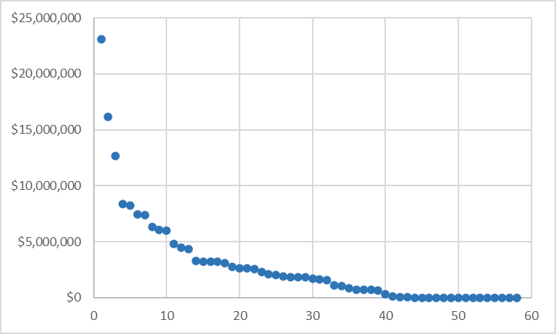
Total spending by institution
Total Grant Spending
Reporting Institutions
Notes:
Number of institutions >$5M consistent year over year, but those institutions with higher spending increased spending at higher rate than overall survey

Slide 56
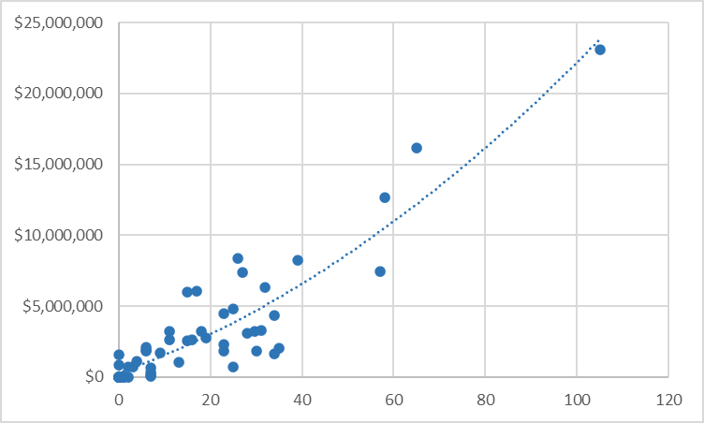
Grants submitted to total spending
Total Grant Spending
Number of Grants Submitted
Notes:
Correlation between the number of grants submitted and the total spending. Could be more spending leads to submitting more grants or submitting more grants leads to more research spending.

Slide 57
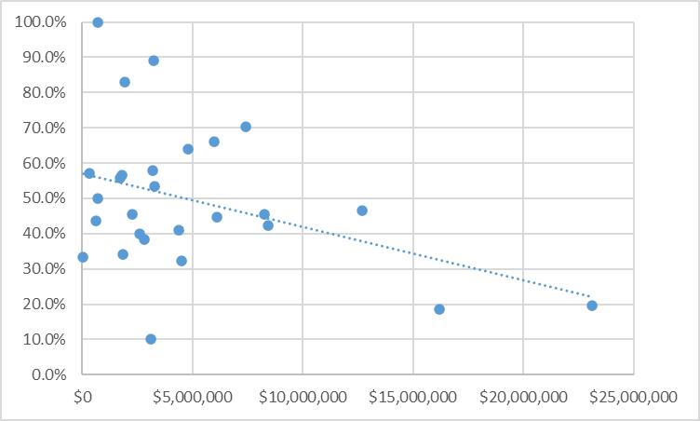
Grant success rate to total spending
Grant Success Rate
Total Grant Spending
Notes:
We looked at grant success rate by rank, by size of spending, number of grants submitted, all the data seems to indicate an approximate success rate of about 40% and does not appear to be dependent on any variable, ie the institutions with high submisssions and by rank all seem to have approximately the same success rate, this is consistent over a couple years.

Slide 58
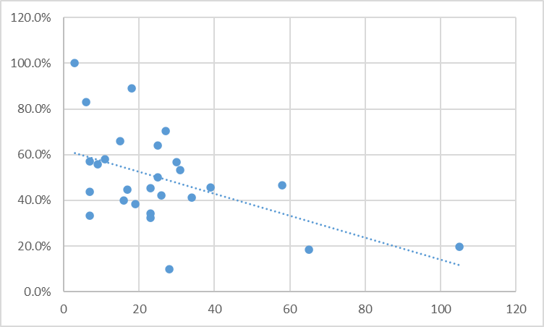
Grant success rate to grants submitted
Grant Success Rate
Number of Grants Submitted
Notes:
Success rate was typically around 40% for all, will be interesting to see if the two higher sites go back up

Slide 59
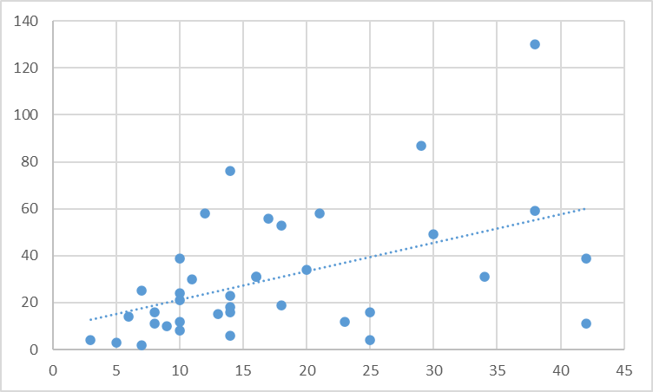
Grants compared Faculty with >10% Research funding
Number of faculty doing research
Number of Active Grants
Notes:
Same sloped line when doing tenured faculty vs any faculty but smaller sample size

Slide 60
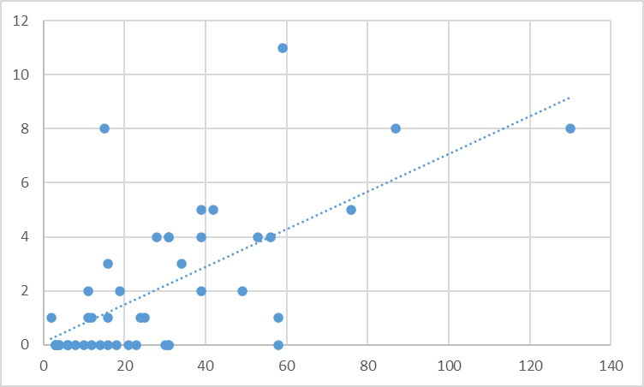
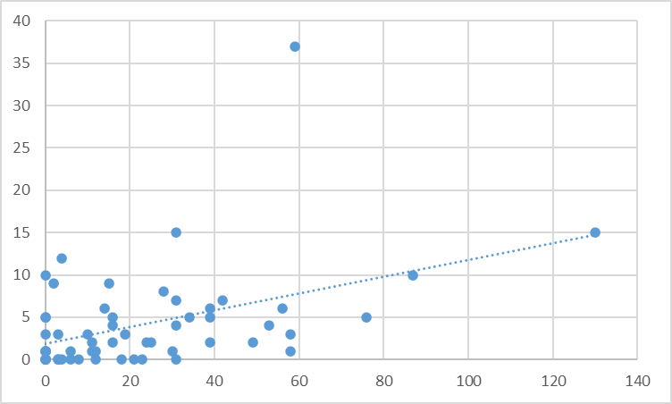
Number of Active Grants compared to MD/PhD’s and PhD’s in department
Number of MD/PhD’s & PhD’s
Number of PhD’s
Number of Active Grants
Number of Active Grants
Notes:
There does seem to be some correlation between number of active grants and the number of PhD’s

Slide 61
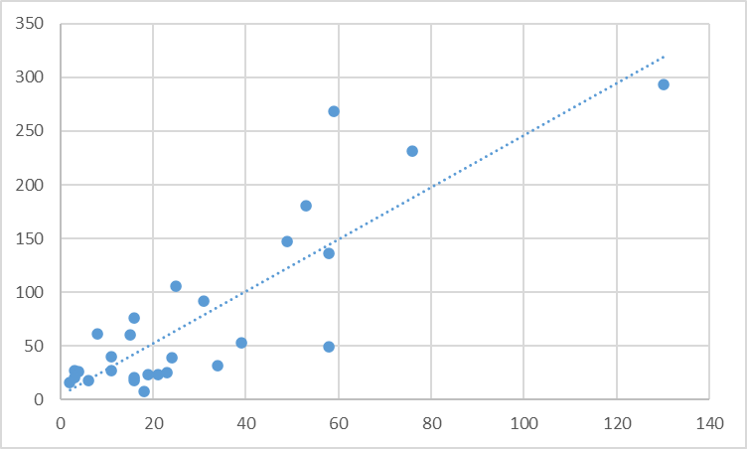
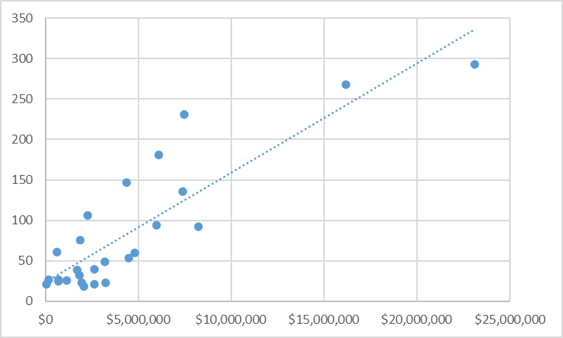
Peer Reviewed publications and annual research grants and spending
Total Publications
Total Publications
Number of Active Grants
Total Grant Spending
Notes:
Amount of the grants does not seem to impact the number of publications – more grants is same slope as funding

Slide 62
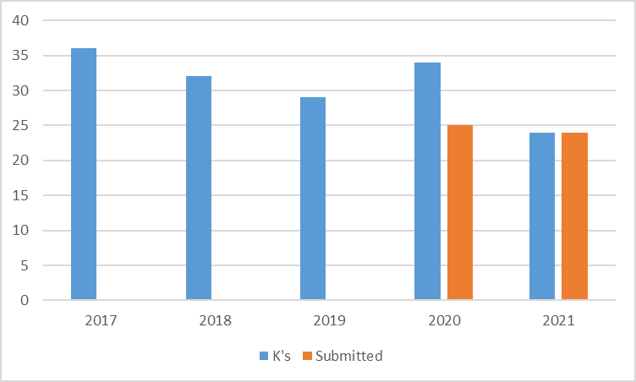
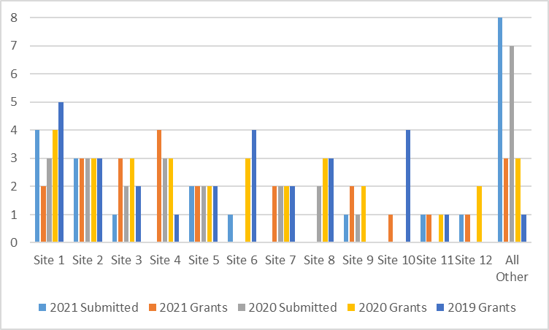
Use of Funds to support K awards
Active K’s declined from 34 to 24
Institutions reporting K’s declined
from 16 to 14
Institutions submitting new K’s
remained 16
7 institutions without active K’s
submitted new K which is
consistent with prior year
Number of K awards
Number of K awards
Notes:
The graphs show institutions that had active K awards or submitted K awards this year. There are 7 institutions that currently do not have K awards and of those 16 institutions that do have K’s, 10 submitted new awards.

Slide 63


Limitations
Institutional reporting of grants and spending.
Publicly available sources dependent on contact PI and home department.
AAAEM survey has had variability in the number of institutions that participate which can contribute to some data variation
Institutions reporting to AAAEM may not utilize the same definitions / process in reporting their data

Slide 64
What did we learn?
Correlation between grant submission and funding.
Historically, success rate consistent across rank and institutional funding. This years survey showed increased submissions correlated with lower award rate.
There is a link between increasing the number of grants, the amount of grant funding and the number of faculty with greater than 10% research effort.
Correlation between research funding and the number of publications.

Slide 65
What is the good news?
Number of institutions reporting research activity is declining but the amount of research at those institutions is growing.
Number of NIH grants and amount of funding is growing.
Industry funding is up relative to historic rate but lower than 2020.
The number of K awards submitted should support increased investigators within the specialty.

Slide 66
Academic Faculty Life
Wellness
Faculty Salary
Steve Maxwell
James Scheulen
On behalf of the AAAEM Benchmark Committee
March, 2022

Slide 67



Wellness Survey
Department Wellness Initiatives
  Specific to Department/Division
  Not institutional programs
Dedicated Wellness Faculty
  71% have dedicated faculty
  97 faculty hours allocated
    (Range = 59 to 145)
Dedicated Wellness Staff
  18% have dedicated staff

Slide 68
Wellness Survey
Wellness Didactics Offered in Department
Wellness: 83%
Burnout: 82%
Financial health: 82%
Sleep: 69%
Communication: 69%
Conflict Resolve: 67%
Addiction: 64%
Coping Strategy: 62%
Shift Work: 56%
Managing Time: 56%
Suicide: 56%
Compassion fatigue: 56%
Health/Fitness: 56%
ED violence: 54%
Second victim: 54%
Circadian Rhythm: 51%

Slide 69
Faculty Salary Survey
Faculty Demographics

Slide 70
Faculty Demographics
2021 Salary Survey Demographics
 | FY 17 | FY 18 | FY 19 | FY 20 | FY 21
# Faculty | 2773 | 2571 | 2468 | 2530 | 2560
Experience
Years at Current EM | 9.0 | 9.1 | 8.2 | 8.8 | 8.5
Years post Residency | 11.2 | 11.3 | 11.5 | 11.6 | 10.8
Degree
MD/Master/PhD | 96% | 95% | 98% | 96% | 95%
DO | 4% | 5% | 2% | 4% | 5%
Notes:
Slide 3

Slide 71
Faculty Demographics
Years in Practice
28.3% < 5 years
56.8% < 10 years
28.5% = 10 to 20 years
14.7% > 20 years
Increasing numbers <15 years
Decreasing numbers >15 years

Slide 72
Faculty Demographics
Faculty Rank

Slide 73
Faculty Demographics

Slide 74
Salary Trends: All Faculty
Mean Total Salary = $321,778 (+3.3%)
$316,266
No Chairs and Chiefs
Chairs and Chiefs included

Slide 75
Salary Trends: All Faculty
Mean Total Salary = $321,778 (+3.3%)
Mean Base Salary = $272,306 (+3.6%)
2021 Base = 85% of total
Chairs and Chiefs included

Slide 76
Salary Trends: All Faculty
2021 Base = 85% of total
23% increase in Total Salary over 8 years
Chairs and Chiefs included

Slide 77
Salary Trends: No Chair & Chief
Mean Total Salary = $316,266 (+3.3%)
Chairs and Chiefs and Pure Pediatrics excluded

Slide 78
Salary Trends
Mean Total Salary = $316,266 (+3.3%)
Mean Base Salary = $266,662 (+3.5%)
2013 Base = 87% of total
2019 Base = 85% of total
2021 Base = 84% of total
Chairs and Chiefs and Pure Pediatrics excluded

Slide 79
Salary Trends
First Year Faculty
Mean Total Salary = $288,872 (+5.5%)
Note: 6.2% increase in 2020
5.5% increase in 2021

Slide 80
Salary by Rank
9.4%
4.4%
3.3%
2.1%
84% Base
85% Base
85% Base
84% Base
5 Years
as faculty
7 Years
as faculty
14 Years
as faculty
22 Years
as faculty
Chairs, Chiefs, pure Peds EM excluded
Notes:
Cathi’s Note: for 2018 instructors, I excluded affiliate sites since those are the main outliers in that group. All others include all sites.

Slide 81
Salary Trends: Regions

Slide 82
Salary Trends: Regions

Slide 83
Salary Trends: Regions

Slide 84
Salary Trends: Regions
8%

Slide 85
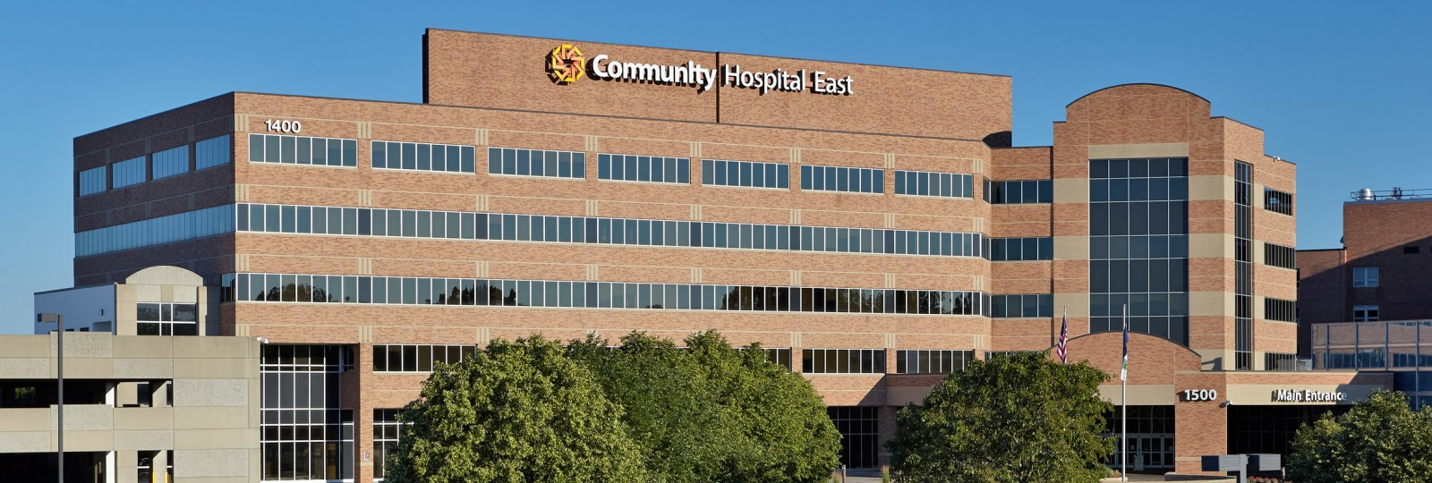
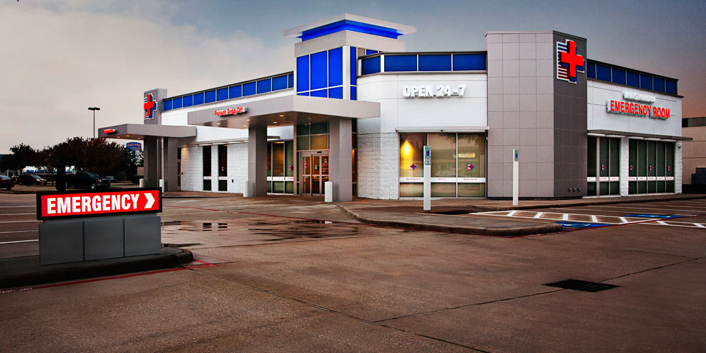
Faculty Salary
Practice setting
 | Clinical Hours | Total Salary
Academic | 961 | $316,637
Academic Affiliate | 1,060 | $318,519
Community | 1,319 | $339,801
Freestanding | 1,473 | $330,825

Slide 86

Per Diem Rates
Physician per diem rate:
APP per diem rate:
Day per diem rate: $188 ($120—$250)
Night per diem rate: $200 ($135—$250)
Day per diem rate: $65 ($53—$100)
Night per diem rate: $70 ($53—$100)

Slide 87
Compensation Plans

Slide 88

How do we pay our faculty?
Faculty Compensation Plans
Single component
Salary only
Three component
Base + Extra + Stipend
Base + Extra + Bonus
Base + Stipend + Bonus
Two component
Base + Extra hours
Base + Stipend
Base + Bonus
Four component
Base + Extra+ Stipend + Bonus

Slide 89
Salary Components
4%
of MD
27%
of MD
49%
of MD
19%
of MD
100%
Base
90%
Base
84%
Base
84%
Base
Chairs, Chiefs, pure Peds EM faculty excluded

Slide 90
Salary Components

Slide 91
APP Salary Survey
Fiscal Year 2021 Data

Slide 92


PA and NP Demographics
488 Advanced Practice Providers
  8.2 years post training
  62% Physician Assistant
  38% Nurse Practitioner
  75% Female
  25% Male

Slide 93

PA and NP Demographics
ED area worked
More than one area | 60%
Main ED only | 22%
Observation only | 9%
FT/Arrival/Triage | 1%
1,753 Total hours
$124,375 Total salary
8% increase from 2019
No difference PA/NP
350 hour reduction for lead or administration
$20,000 difference between administrative role and none

Slide 94
PA and NP Salary

Slide 95
PA and NP Salary
No significant change in total hours worked
Pay rate changes with years of service

Slide 96
PA and NP Salary
 | Total Salary | Total Hours | Hourly rate | % PA
Midwest | $126,809 | 1609 | $78.81 | 72%
Northeast | $132,588 | 1739 | $76.24 | 88%
South | $124,218 | 1701 | $73.03 | 56%
West | $137,758 | 1730 | $79.62 | 57%
No significant difference in location of work in ED
Pay rate changes with years of service

Slide 97
Thank You

Slide 98
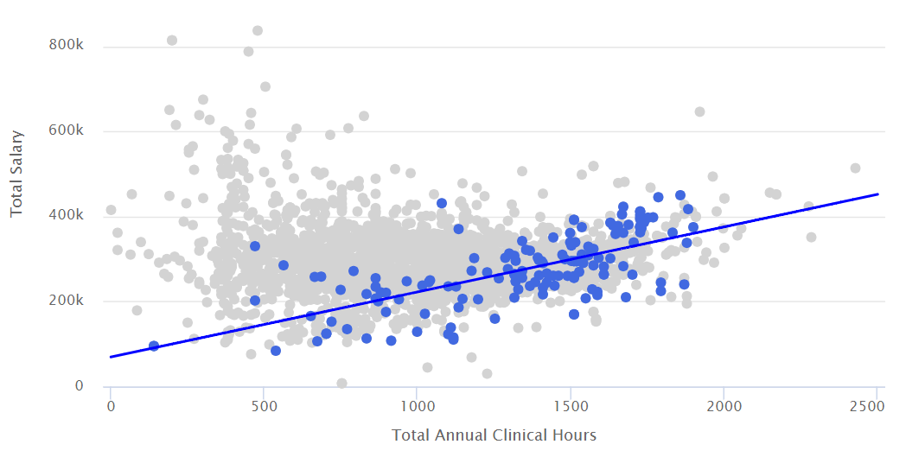
Job Duty
Administrative Duties
Clinical hours with: 828
Salary with: $329,899
Administrative Duties
Clinical hours without: 1084
Salary without: $303,902

