Slide 1
AACEM Executive Committee and Committee Updates

Slide 2
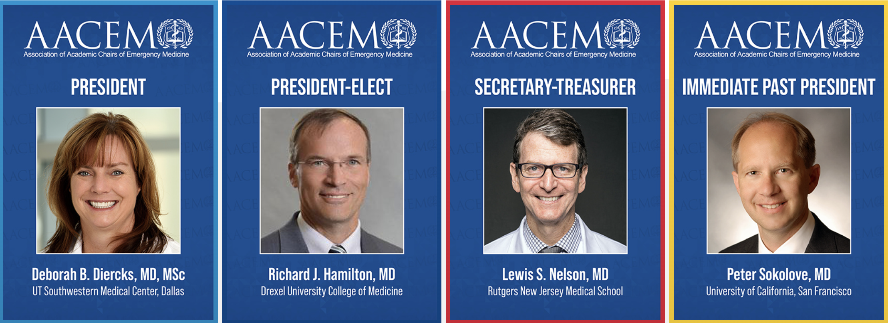
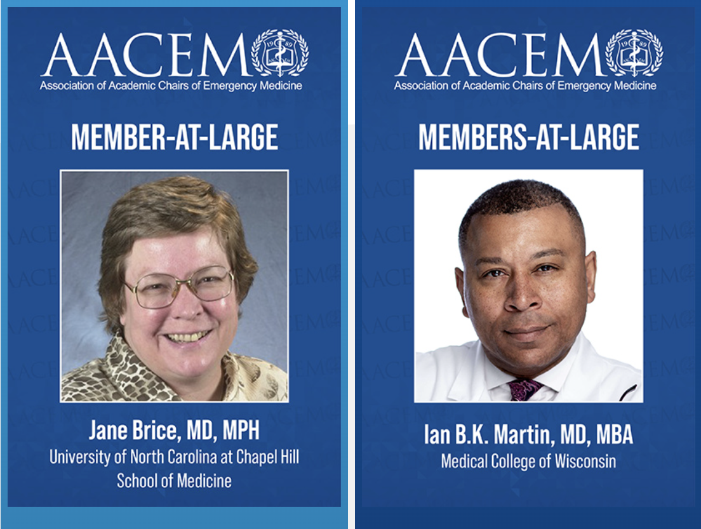
Welcome from your Executive Committee
… and Congratulations to Dr. Tony Seupaul who will
join the AACEM Executive Committee at SAEM22.

Slide 3
Mission and Membership
Our Vision: To be the essential resource for the successful academic chair of emergency medicine
Representing: Over 150 Chairs
Professional Development
Networking
Chair Resources
Benchmarking Data

Slide 4
Collaboration and Representation
AACEM Regularly collaborates with SAEM, AAEM, ABEM, ACEP, CORD, EMRA and SAEM-RAMS
ACEP-led All EM Workforce Taskforce
Accreditation Council for Graduate Medical Education (ACGME)
Association of American Medical Colleges (CFAS)
Emergency Medicine Policy Institute (EMPI)

Slide 5
Call for Committee Membership and Chairs
Needs a Committee Chair
Sign up for a committee at the Registration Desk before the end of the Retreat!
Needs a Committee Chair

Slide 6
New Funding
AACEM has grow to be $1,000,000 strong
Much is invested and protects the organization for rainy days
New Committee Funding
$20,000 annually
Project proposal submission form being released in fall 2022 for 2023 funding.
Additional funding provided by AACEM for Scholarships (CDP, eLead)

Slide 7
New Chair Mentorship Program
PURPOSE
Provide a resource for newly appointed chairs of academic departments of emergency medicine
Provide an opportunity for established chairs to share their knowledge, insights, and experiences with developing chairs
Enhance networking among new and established members of the Association
Facilitate an on-site visit of either ($1,500 travel stipend provided by AACEM)
The mentor to the new chair's program, or
The new chair to the mentor's program
Mentee Eligibility – Email AACEM@saem.org to join program Any AACEM active/full or associate member in good standing who is within 6 to 18 months of assuming a chair position may apply to be a mentee.

Slide 8
Unfilled EM Positions
APPs in the ED
ACGME Common Program Requirement Changes
Other?

Slide 9
Committee Updates
Next, I invite our AACEM Committee and Workgroup Chairs in attendance to provide you updates on their impressive work:
Membership Committee: Richard E. Wolf, MD
Leader Development: Jane H. Brice, MD, MPH
Research Workgroup: Robert Neumar, MD
DEI Workgroup: Nathan Kuppermann, MD, MPH and Angela M. Mills, MD

Slide 10
Membership Committee
Membership Committee:
Current Chair: Richard E. Wolfe, MD
2022-2023 Chair: Carl Chudnofsky, MD
Review the list of academic emergency medicine institutions and their membership levels quarterly and report to the AACEM Executive Committee.
Review and provide recommendations for associate membership and active membership status.
Submit nominees for the AACEM Distinguished Service and Lifetime Awards.

Slide 11
Leadership Development Workgroup Update
Jane H. Brice MD MPH
March 25, 2021

Slide 12
Leadership Development Workgroup Members
Jane Brice
Deborah Diercks
Charles Emerman
Azita Hamedani
Ian Martin
Robert McCormack
Ralph Riviello
Rahul Sharma
Susan Stern
Benjamin Sun
Stephen Wolf
David Wright

Slide 13
Leadership Development Workgroup Charge
Create a resource for the identified Leader Development Workgroup Series
Develop and submit at least one topic for the 2022 AACEM/AAAEM Annual Retreat
Increase the effectiveness of the CDP to foster the success of future Chairs
Submit one topic for the 2022 AACEM/AAAEM Annual Retreat focused on increasing the diversity of EM leadership
Submit a didactic or workshop for SAEM 22 that focuses on increasing diversity of EM leadership
Create a catalog of resources for new Chairs

Slide 14
Create a resource for the identified Leader Development Workgroup Series
Collaborating with CORD and the SAEM Vice Chair Committee to conduct a survey of Best Practices in Leadership Development with the intent to publish a white paper

Slide 15
Create a resource for the identified Leader Development Workgroup Series
Webinar: Recruitment and Retention of Diverse Trainees and Faculty
Tuesday, February 15, 4:00 - 5:00 pm CST.

Slide 16
Charge #1
Create a resource for the identified Leader Development Workgroup Series

Slide 17
Develop and submit at least one topic for the 2022 AACEM/AAAEM Annual Retreat
In collaboration with the DEI Committee, we submitted several topics

Slide 18
Charge #2
Develop and submit at least one topic for the 2022 AACEM/AAAEM Annual Retreat

Slide 19
Increase the effectiveness of the CDP to foster the success of future Chairs
Emerging Leader Development Program (eLEAD)
Year-long course
Target: Emerging (early to early mid-career) leaders in academic emergency medicine
Product: Structured, longitudinal experience designed to develop foundational leadership skills, cultivate a meaningful career network, and build a bridge to countless opportunities in their field

Slide 20
Increase the effectiveness of the CDP to foster the success of future Chairs
Emerging Leader Development Program (eLEAD)
Kick-Off at SAEM 2022
Course Directors
Stephen Wolf
Jane Brice
Please let one of us know if you are interested in presenting a leadership topic

Slide 21
eLEAD Draft Curriculum
Personal Domain
Time Management
Emotional Intelligence
Self-management
Personal Leadership
Values/Guiding Principles
Leading from Within
Managing Failure - Fail Fast, Learn Faster
Managing and Adapting Your Brand
Importance of Developing Mentor and Coaching Networks
How to Run Effective Meetings
Interpersonal and Communication Domain
Negotiation
Leading Teams and Other People
Conflict Resolution
Business Communication
Interpersonal Communication
Influence and Persuasion
Managing Up and Down
Seeing the world through the eyes of your boss
Seeing the world through the eyes of your staff
Systems-based Domain
Organizational Design
Change Management
Project Management
Leading in Crisis
Speaking with the Media
Polarity/Ambiguity Management
Finance
Strategic Thinking, Planning and Execution
Social Domain
Unconscious Bias Management
Systemic Racism
Social Disparities
Public Advocacy
Diversity, Equity, Inclusion, and Belonging
Prioritizing
Developing
Business Case
Social Case
Capstone

Slide 22
Charge #3
Increase the effectiveness of the CDP to foster the success of future Chairs

Slide 23
Submit a topic for Annual Retreat focused on increasing the diversity of EM leadership
Topics submitted in collaboration with the DEI Workgroup

Slide 24
Charge #4
Submit a topic for Annual Retreat focused on increasing the diversity of EM leadership

Slide 25
Submit a didactic or workshop for SAEM 22 on increasing diversity of EM leadership
In collaboration with the DEI Workgroup, we submitted topics to SAEM22

Slide 26
Charge #5
Submit a didactic or workshop for SAEM 22 on increasing diversity of EM leadership

Slide 27
Create a catalog of resources for new Chairs
In the process of collating a variety of resources for new chairs
Experiential
Self-paced
Books
Podcasts
Other
Will be complete by end of April

Slide 28
Charge #6
Create a catalog of resources for new Chairs

Slide 29
Shout-Out
Enormous Shout-Out
Michele Aguirre
Kayla Belec
Megan Schagrin
AND
DEI Workgroup

Slide 30
AACEM Research Working Group Report AACEM/AAAEM Annual Retreat March 22, 2022
Andra Blomkalns
Gail D’Onofrio, Co-Chair
Michael Gibbs
Nate Kuppermann
Robert Neumar, Co-Chair
Brian O’Neil
Niels Rathlev
Peter Sokolov
David Wright
Michelle Aguirre
Megan Schagrin

Slide 31
2021-2022 Objectives
AACEM Research Working Group
1 | Finalize and present to the AACEM Executive Committee the needs analysis for research in academic EM departments with strategies to address gaps and meet the targets. (NEW) | In Progress
2 | Track progress towards research targets and report to membership annually. (EVERGREEN) | In Progress
3 | Finalize and submit for publication the 2030 EM Research Strategic Goals White Paper. (CONTINUING) | Completed
4 | Compile data for the creation of a public facing dashboard to monitor progress toward these 2030 NIH funding goals and report to the membership on progress annually. (Emergency Medicine Research: 2030 Strategic Goals white paper) | Completed

Slide 32
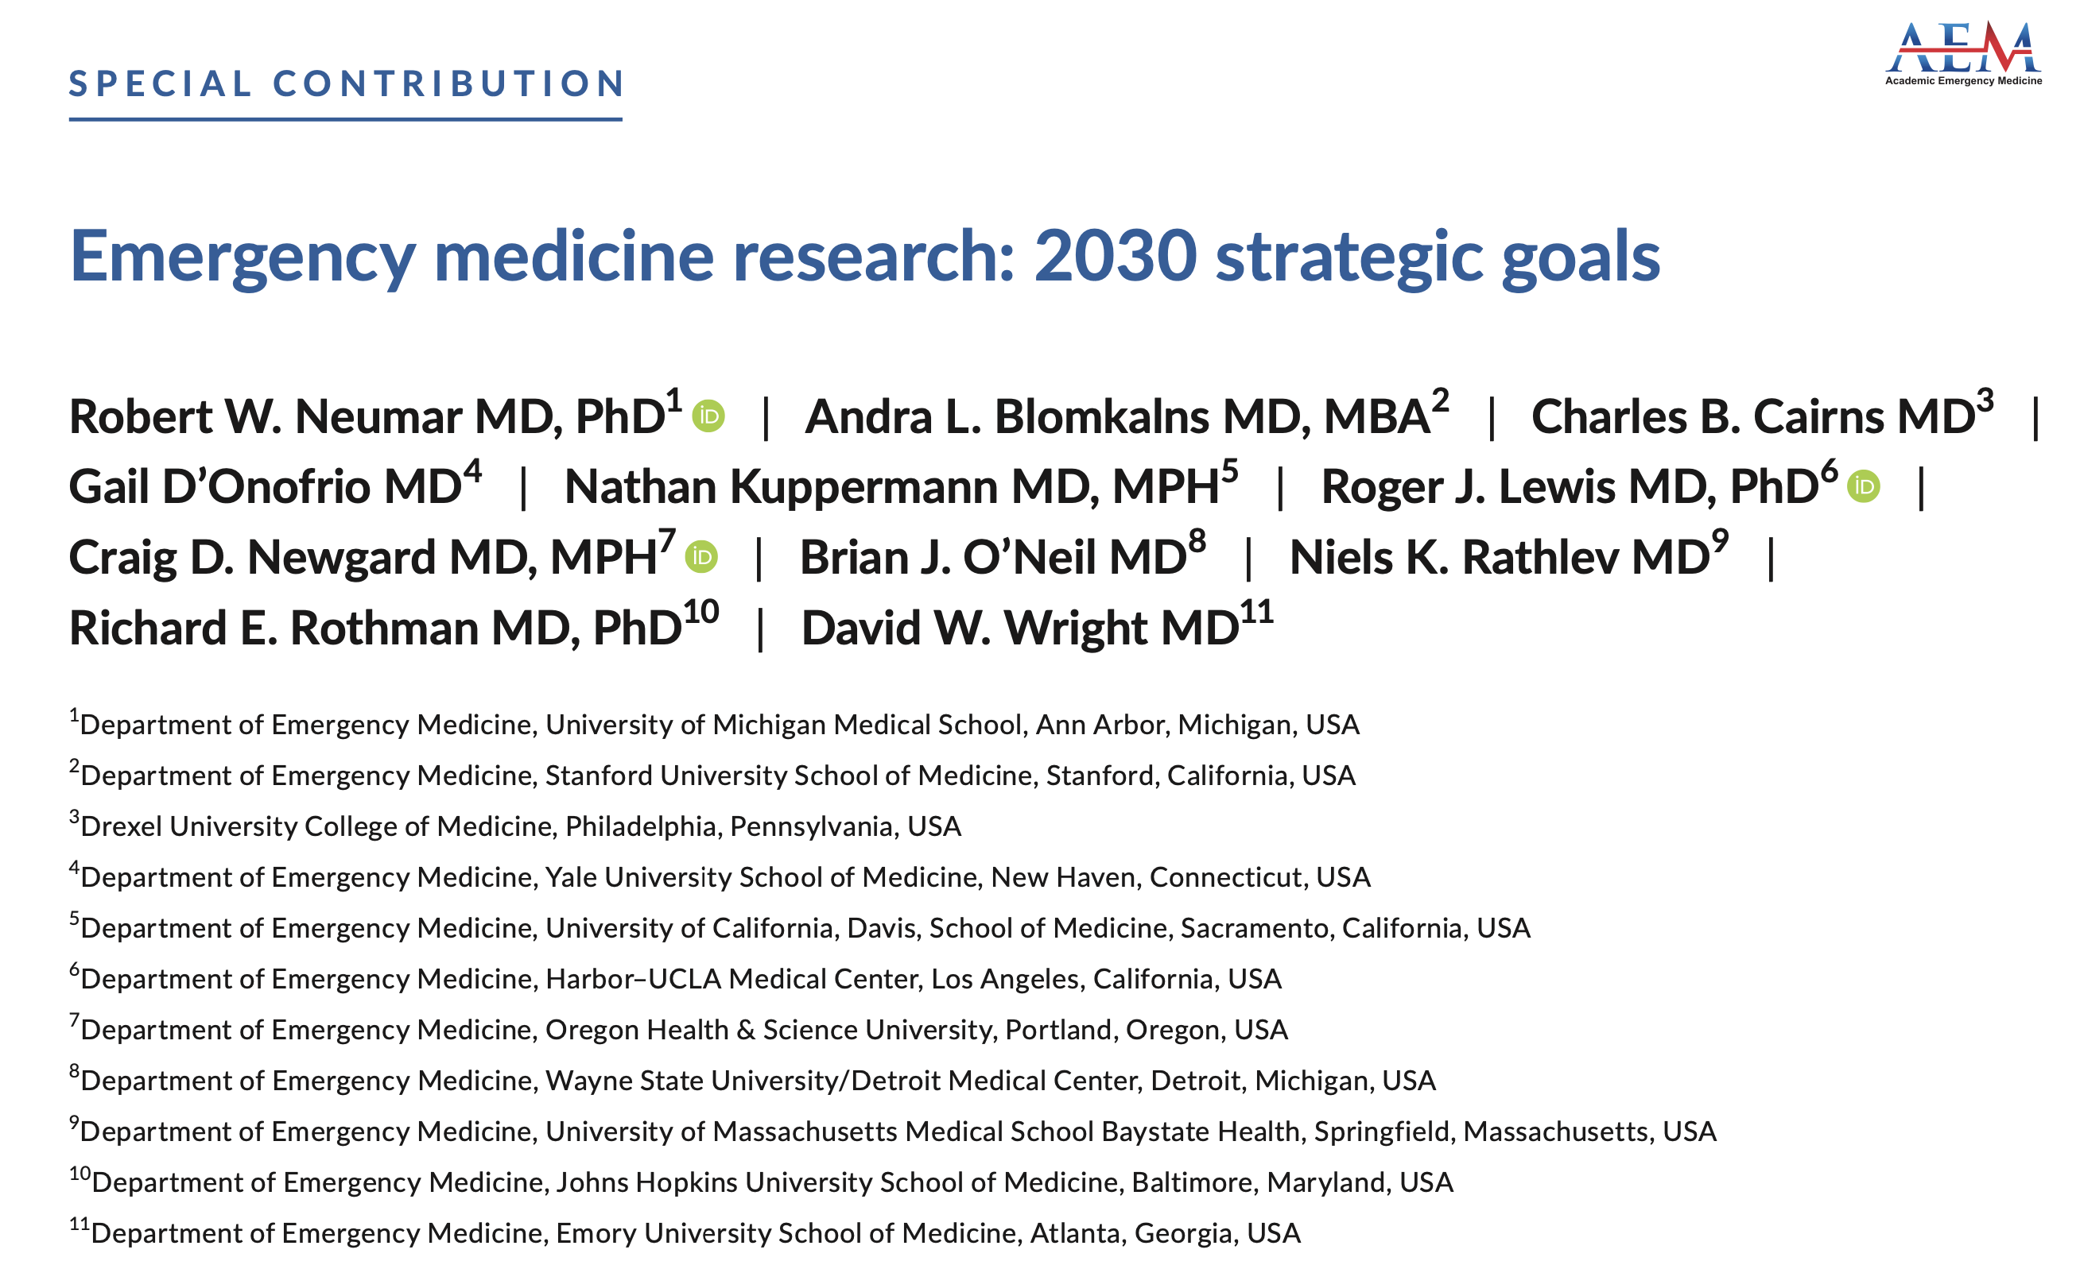
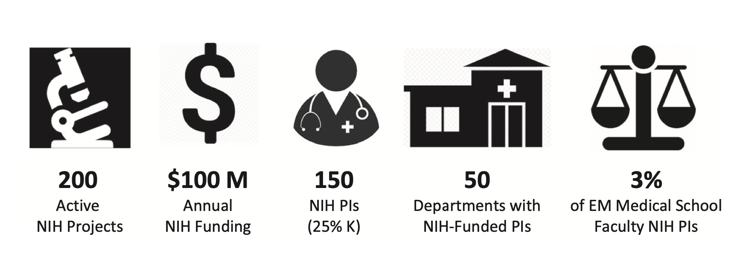
Acad Emerg Med. 2022;29:241–251

Slide 33
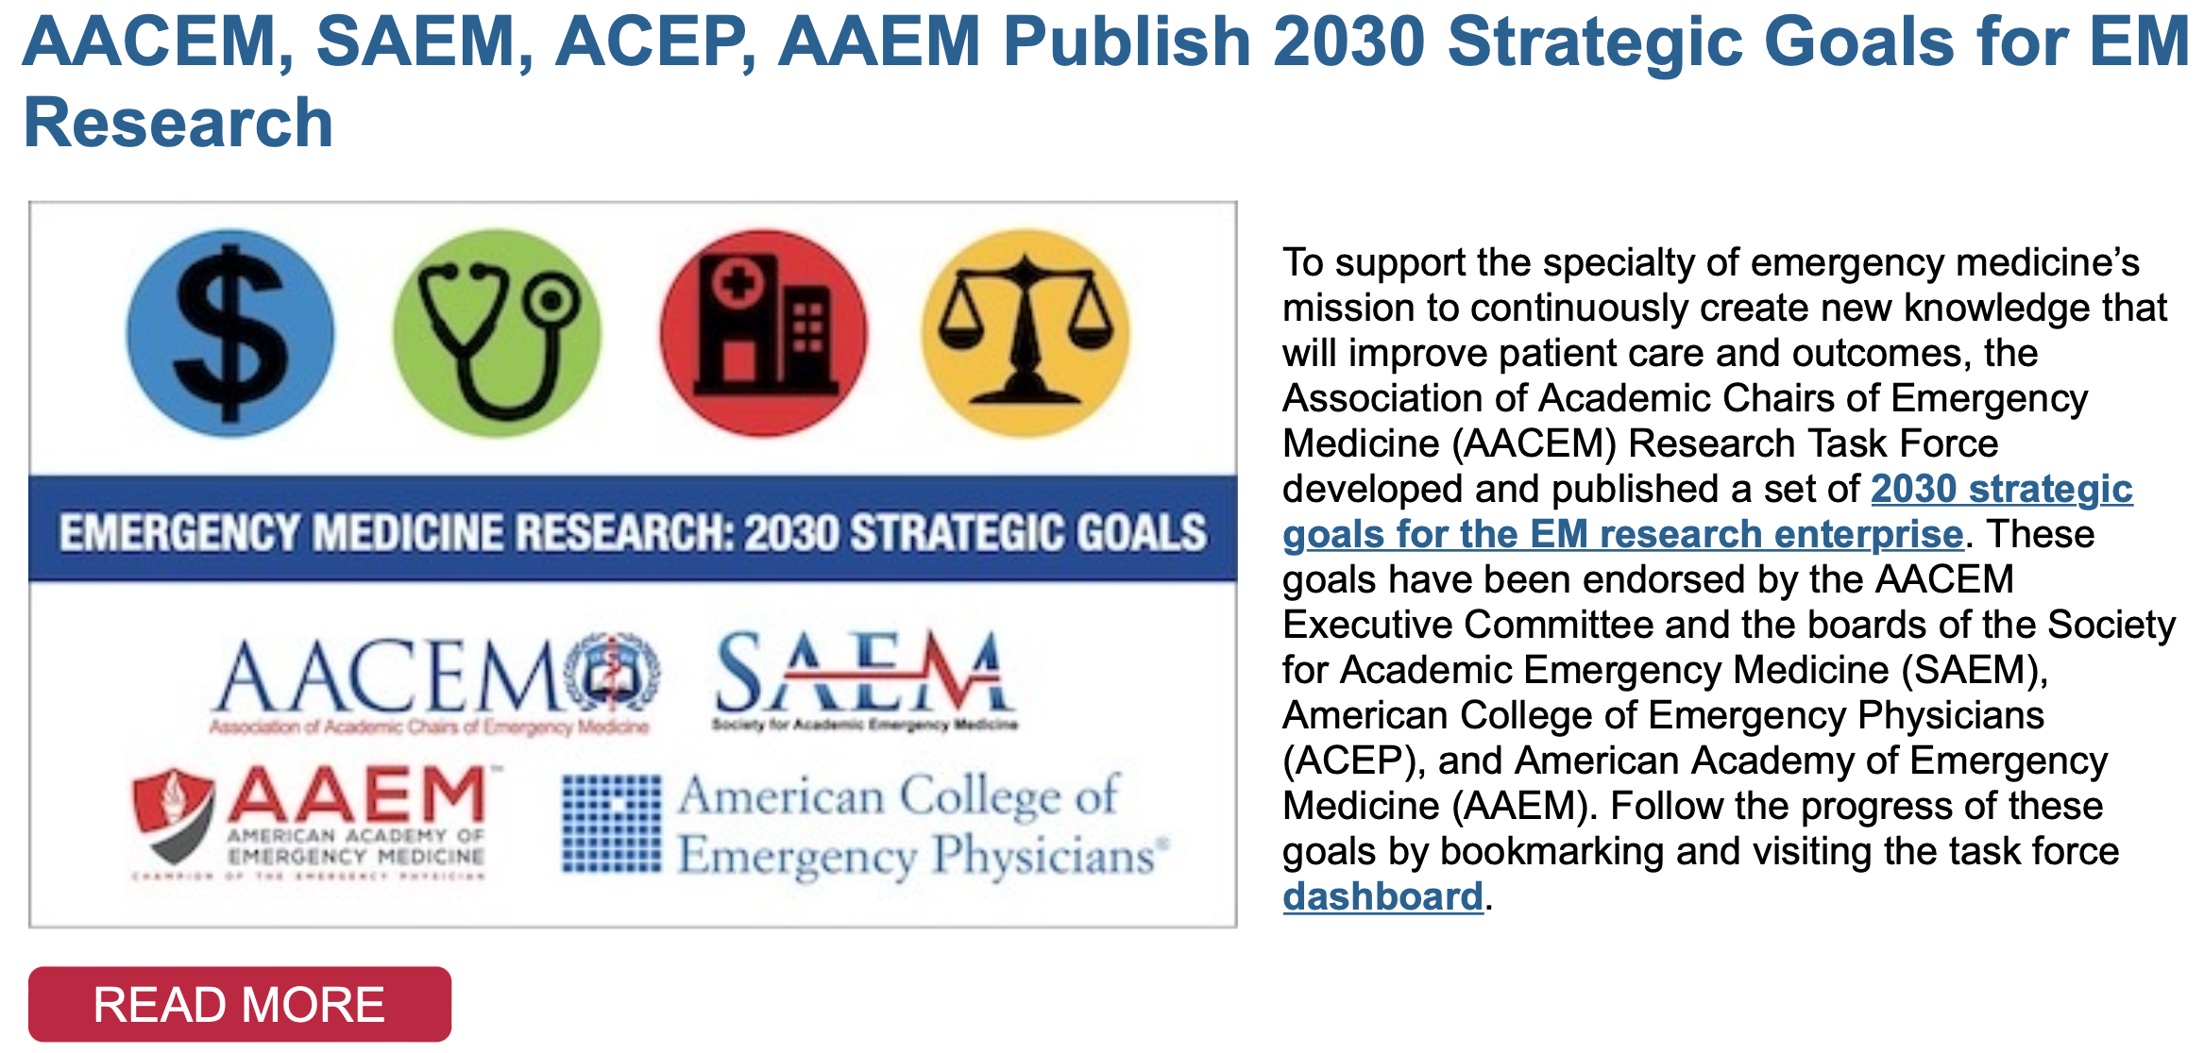
March 2nd 2022
https://www.saem.org/about-saem/academies-interest-groups-affiliates2/aacem/resources/strategic-goals-for-emergency-medicine-nih-funding

Slide 34
AACEM Dashboard To Monitor Progress Toward 2030 Goals
https://report.nih.gov
http://www.brimr.org/NIH_Awards/NIH_Awards.htm
https://www.aamc.org/data-reports/faculty-institutions/report/faculty-roster-us-medical-school-faculty

Slide 36
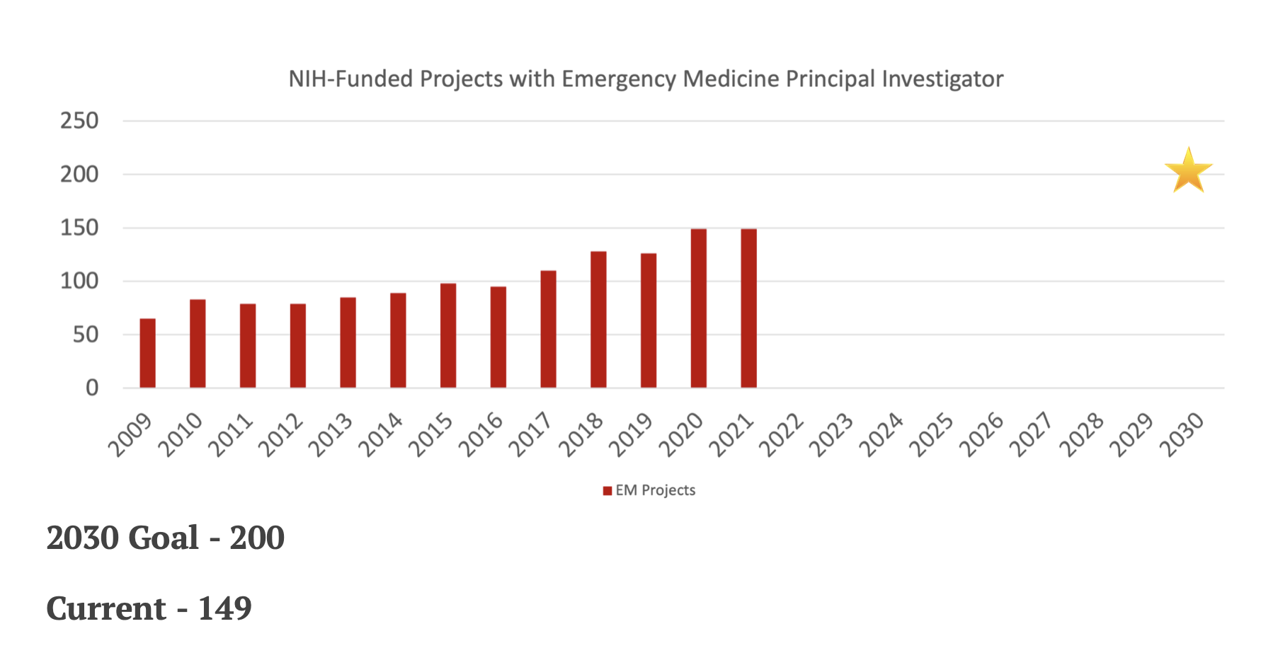
NIH-Funded Projects with Emergency Medicine PI
Active NIH-funded projects with contact PI in department of emergency medicine by fiscal year based on NIH Reporter. This data does not include projects at institutions that do not attribute NIH funding to academic departments. In also does not include NIH research contracts or Small Business Innovation Research (SBIR) and Small Business Technology Transfer (STTR) grants.

Slide 37
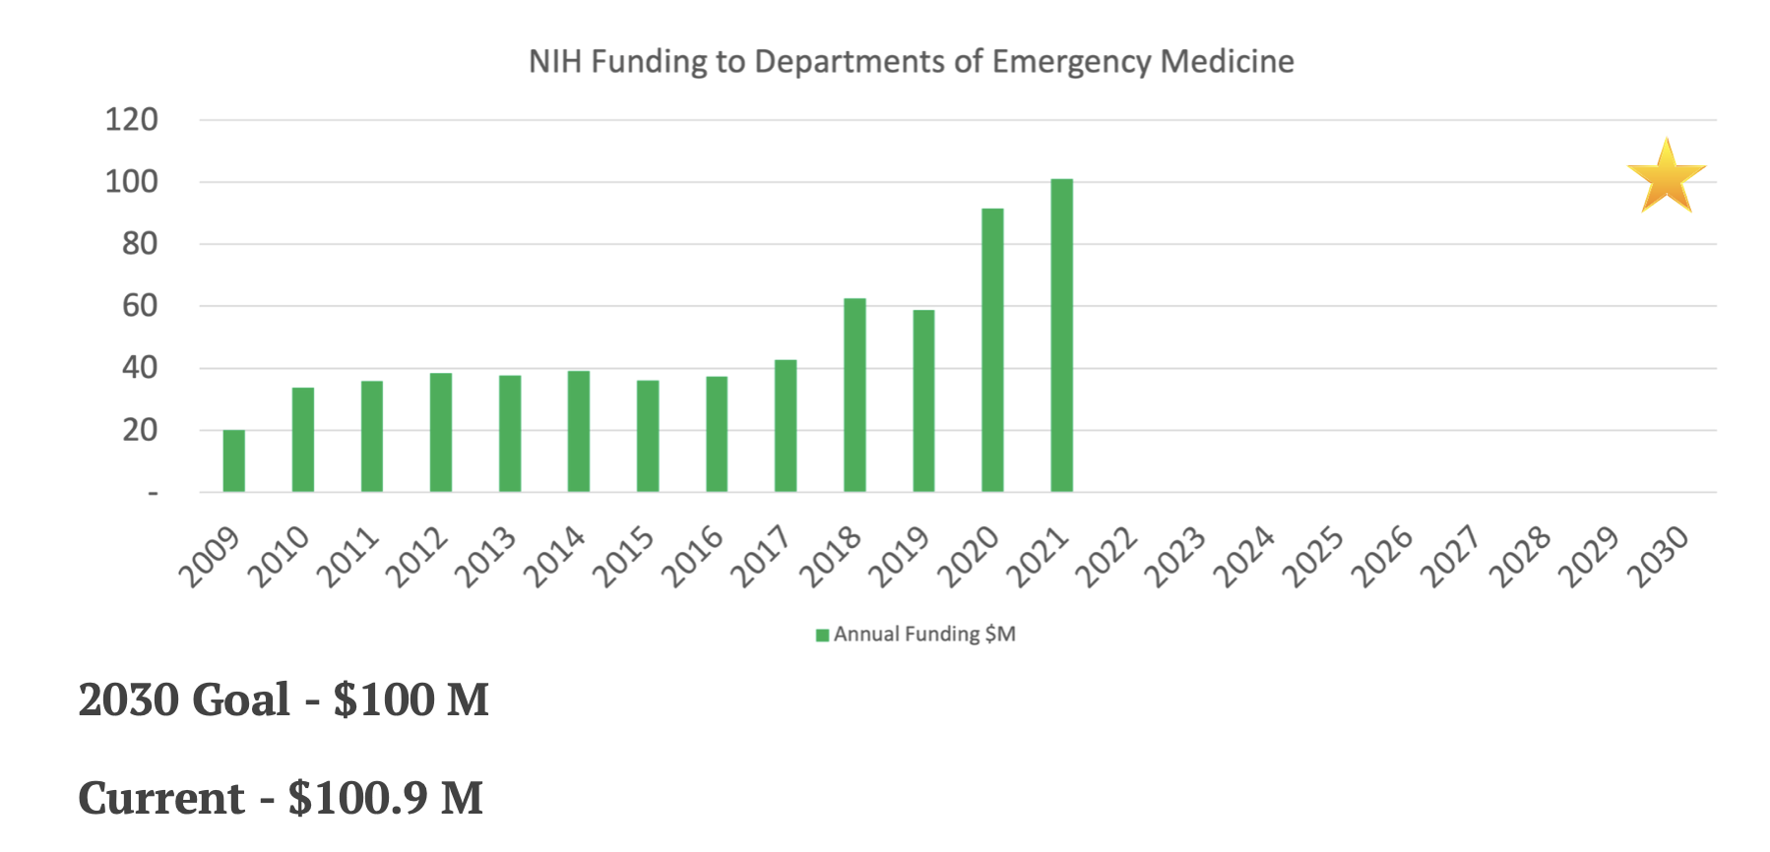
NIH-Funding to Departments of Emergency Medicine
NIH funding to departments of emergency medicine by fiscal year as reported by the BRIMR. This data does not include projects at institutions that do not attribute NIH funding to academic departments. In also does not include NIH research contracts or Small Business Innovation Research (SBIR) and Small Business Technology Transfer (STTR) grants.

Slide 38
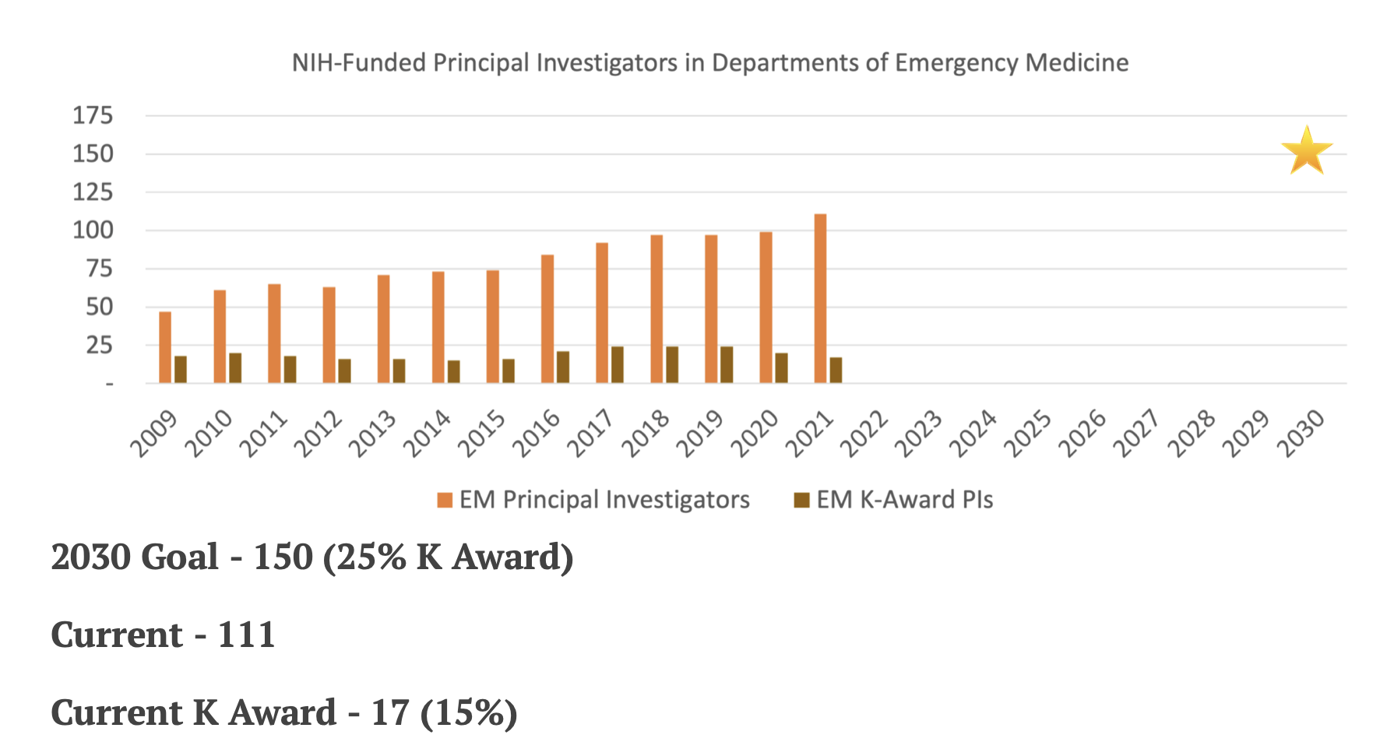
NIH-Funded Emergency Medicine Principal Investigators (PIs)
NIH funded emergency medicine contact PIs (total) and individual NIH K-award PIs by fiscal year as reported by the BRIMR and NIH Reporter. This data does not include PIs at institutions that do not attribute NIH funding to academic departments. In also does not include PIs of NIH research contracts or Small Business Innovation Research (SBIR) and Small Business Technology Transfer (STTR) grants.

Slide 39
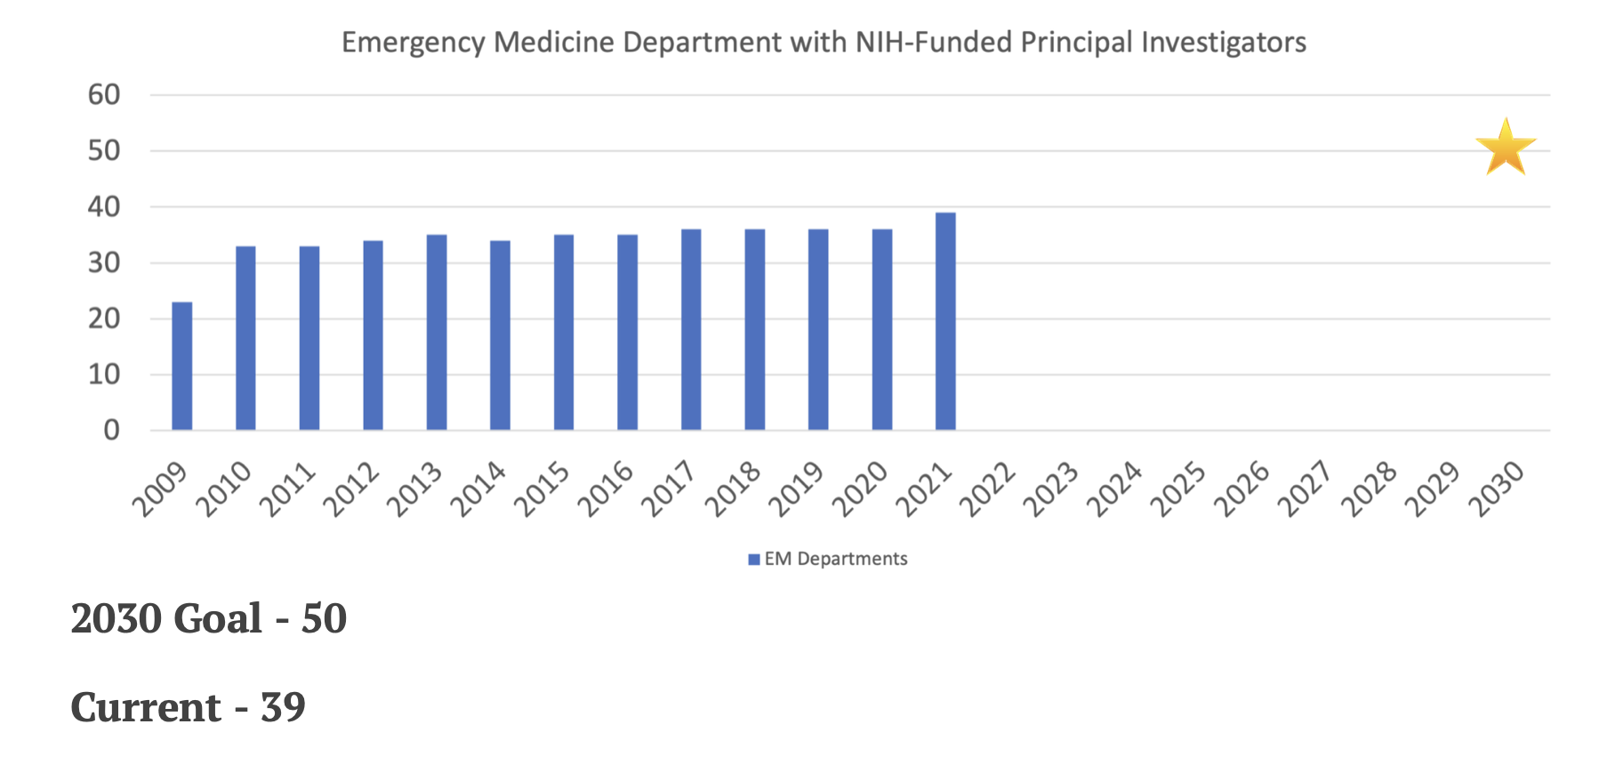
Emergency Medicine Departments with NIH-Funded PIs
Emergency medicine departments with NIH-funded contact PIs by fiscal year as reported by the BRIMR. This data does not include departments at institutions that do not attribute NIH funding to academic departments. In also does not include departments with NIH research contracts or Small Business Innovation Research (SBIR) and Small Business Technology Transfer (STTR) grants.

Slide 40
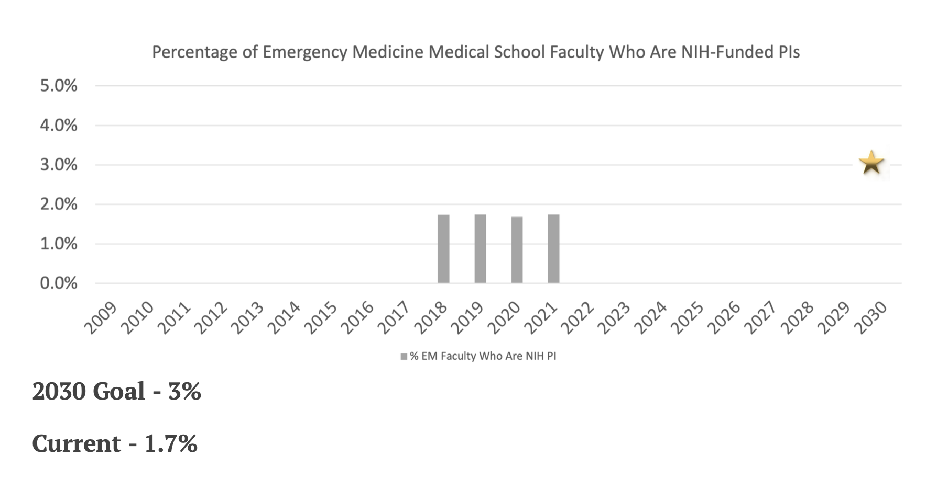
% EM Medical School Faculty who are NIH-Funded PIs
The percent of full-time medical school faculty members in departments of emergency medicine that are NIH-funded PIs each year is calculated using the number of NIH-funded Emergency Medicine PIs reported by BRIMR as the numerator and the number of full-time medical school faculty members in departments of emergency medicine reported by the AAMC as the denominator. This data does not include PIs at institutions that do not attribute NIH funding to academic departments. In also does not include PIs of NIH research contracts or Small Business Innovation Research (SBIR) and Small Business Technology Transfer (STTR) grants.

Slide 41
Barriers to Federally-Funded Research
AACEM Survey March 2022
TOP THREE BARRIERS
Lack of faculty pipeline (faculty interest/trained in research)
Inadequate financial resources to support research (startup pkgs, dedicated research time, etc)
Lack of experienced federally funded mentors in my EM department, or at my institution
Human Capital
Financial Capital
Human Capital

Slide 42
2022 AACEM Retreat Session Implementation of Strategies to Achieve 2030 Strategic Goals

Slide 43
Questions

Slide 44
Barriers to Federal Research Grants Submissions
AACEM Survey February 2020
27 responses (22 funded department chairs and 5 non-funded department chairs)
AACEM Seminar 7/20/2020
Weighted Importance

Slide 45
Benchmarking EM against other Clinical Departments
Percent of Full-Time Faculty that are NIH-Funded PIs (2019)
Emergency Medicine
5572 Full-Time Med. School Faculty
97 NIH-Funded PIs

Slide 46
Benchmarking EM to other Clinical Departments
Percent of U.S. Medical Schools with Respective Clinical Departments that have NIH-Funded PIs in those Departments (2019)
Emergency Medicine
113 Med. School Depts.
36 Depts. with NIH-Funded PIs

Slide 47
Benchmarking EM to other Clinical Departments
Percent of Full-Time Faculty that have MD-PhD Degrees (2019)
Percent of Full-Time Faculty that have PhD or other Doctoral Degree (without MD) (2019)
Emergency Medicine
5572 Full-Time Med. School Faculty
165 MD-PhDs
Emergency Medicine
5572 Full-Time Med. School Faculty
116 PhDs

Slide 48
2030 NIH Funding Projections Based on Sustaining Historic Growth Rates
2030 Projection
148 PIs
52 Depts
Projected
2030 Projection
$104M Funding
200 Projects
Projected
Principal Investigators

Slide 49
Increase NIH Grant Applications
Correlation of percent NIH funded PIs with the number of NIH grant applications/100 Faculty/Year
Adjusted R²=0.90 (p = 0.03)
Neurology
Psychiatry
Pediatrics
Emergency Medicine

Slide 50
Increase EM Faculty MD-PhDs and PhDs
Correlation of % MD-PhD Faculty with % NIH-Funded PIs
Correlation of % PhD or other Doctoral Degree
(without MD) Faculty with % NIH-Funded PIs
Adjusted R-Squared = 0.72
Adjusted R-Squared = 0.63

Slide 51
Increase EM Departments with NIH-Funded PIs
NIH-Funded Emergency Medicine PIs and Emergency Medicine Departments with NIH-Funded PIs
Departments and PIs
PIs per Department

Slide 52
Increase Individual and Institutional Training Grants
Emergency Medicine NIH Career Development and Training Grants
Projects

Slide 53
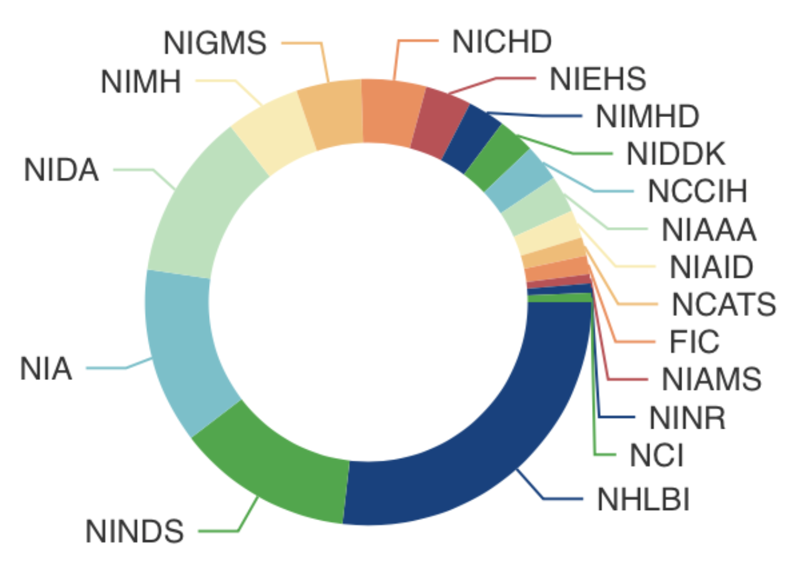
Diversity of Emergency Medicine NIH Portfolio FY20 Project Distribution by Institute
7
7
6
8
18
19
40
19

Slide 54
Diversity, Equity and
Inclusion (DEI) Workgroup
Angela Mills, MD
Columbia University College of Physicians and Surgeons
Nathan Kuppermann, MD, MPH
University of California, Davis School of Medicine
March 22, 2022

Slide 55
AACEM DEI Workgroup
Initiated July 2020 as task force
Objectives
Assist Chairs to grow diverse/inclusive depts
Increase DEI in academic EM depts
Increase DEI of academic EM leaders
Increase DEI within AACEM

Slide 56
EM Faculty Diversity
Faculty | Overall | EM
Women | 44% | 39%
Chairs | 24% | 9%
Professor | 28% | 21%
Assoc Professor | 41% | 33%
URiM | 12% | 12%
Chairs | 11% | 8%
Professor | 9% | 7%
Assoc Professor | 11% | 8%
AAMC Faculty Roster, December 31, 2021 snapshot.

Slide 57
EM Resident Diversity
 | Medical Students | EM Residents
Women | 51% | 37%
URiM | 22% | 17%
AAMC. Distribution of Residents by Specialty. 2021.
Notes:
Graduating medical students 2021

Slide 58
Educational Sessions
Equity, Diversity, & Inclusion: Moving Forward
Designing a Culture of Upstanders and Allyship: A Focus on Belonging
Nuts and Bolts for Creating and Maintaining a Thriving DEI Committee
Recruitment and Retention of Diverse Trainees and Faculty
Can We Change the Numbers? Insights from a Study of Academic EM Department Chairs

Slide 59
Chairs’ Pledge
55%

Slide 60
Chairs’ Pledge

Slide 61
Survey
Data on gender and URiM
Faculty
Rank, tenure status
Endowed professorships
Trainees
Leadership positions
Aim to distribute early fall
Notes:
Presented to and approved by AACEM and AAAEM EC

Slide 62
Coming Year
Chair’s pledge (100%)
Survey
Quarterly virtual sessions
New formats
Participation/membership from all of you
Monitor our progress

Slide 63
Thank you to our Committee Chairs and Members.

