Slide 1
The Changing Landscape of Medical Education:
The UME to GME Transition
Lisa Howley, Ph.D.
Senior Director, Strategic Initiatives and Partnerships, AAMC
lhowley@aamc.org
@LisaDHowley
March 23, 2022
2022 AACEM/AAAEM Annual Retreat

Slide 2
Disclosures
No Financial Disclosures
Work Full Time at AAMC (one of 13 members of the Coalition for Physician Accountability)
Non-MD Medical Educator (Educational Psychologist)

Slide 3

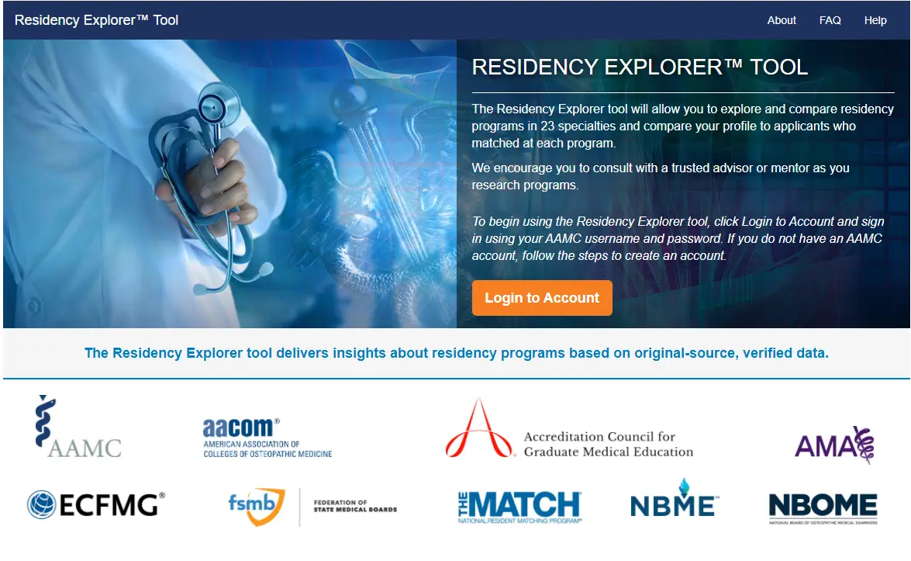


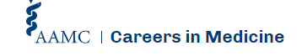


What is the AAMC?
Member
Organization
Think
Tank
Service
Organization
Notes:
The Association of American Medical Colleges leads and serves the academic medicine community
We like to think about ourselves as three organizations in one:
AAMC is a member organization. Our efforts are to directly support the work that you are doing in your institutions.
AAMC is a think tank. We have scholars and experts on staff who study national trends and work on solutions to some of academic medicine’s most vexing problems—from school and hospital finance to the physician workforce, and everything in between.
AAMC is a service organization. We provide a number of solutions that help learners, medical schools, teaching hospitals, and academic societies accomplish their goals. Most notable among our services are operating the MCAT exam, and AMCAS (American Medical College Application Service) and ERAS (Electronic Residency Application Service). Relevant services to the transition to residency portfolio include the Residency Explorer Tool and Careers in Medicine.

Slide 4



Our Members
  The members of the AAMC are institutions rather than individuals. They include:
Medical Schools
155
  LCME-accredited U.S. medical schools
16
  LCME-accredited Canadian medical schools
Teaching Hospitals
  400
major teaching hospitals and health systems, including
  51
  Veterans Affairs medical centers
Nearly
Incl AACEM
Academic and Professional Societies
  80
  academic and professional societies
More than

Slide 5
Session Objectives
The Changing Landscape of Medical Education:
The UME to GME Transition
Describe the Coalition for Physician Accountability and its Review Committee for Undergraduate (UME) to Graduate Medical Education (GME)
Differentiate Nine Themes for Improving the UME-GME Transition
Examine Several New Recommendations for Improving the UME-GME Transition & Related Actions That Are Underway
Notes:
Review objectives of the session

Slide 6
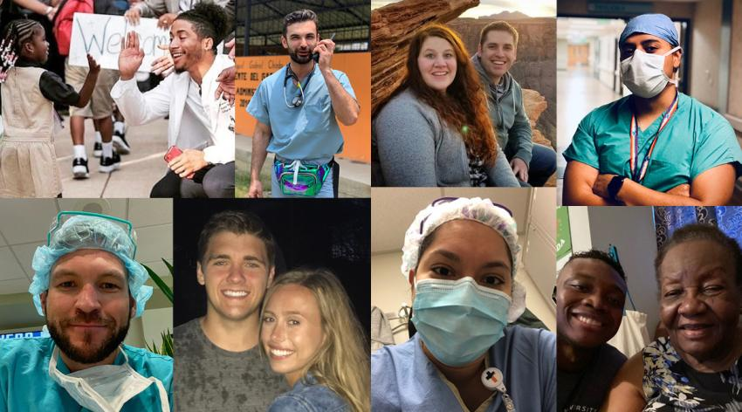
The UME to GME Transition
Transition to residency is a “complex ecosystem involving many individuals and organizations.” The transition begins during the preclinical phase of medical school and extends until new residents enculturate into their GME context – new program and sponsoring institution.
Enculturation = the process whereby individuals learn their group's culture, through experience, observation, and instruction
Notes:
As we begin I want to clarify what is meant by the UME to GME transition. This critical phase within a physicians professional development is a complex ecosystem involving many individuals and organizations. The transition begins in the preclinical phase of med school and extends until new residents enculturate into their GME context into their new program and sponsoring institution.
Today the transition is more complex than a decade ago. Give examples why
W Bridges -
Change is the external event or situation that takes place: a new business strategy, a turn of leadership, a merger or a new product. The organization focuses on the desired outcome that the change will produce, which is generally in response to external events. Change can happen very quickly.
Transition is the inner psychological process that people go through as they internalize and come to terms with the new situation that the change brings about. Empathetic leaders recognize that change can put people in crisis. The starting point for dealing with transition is not the outcome but the endings that people have in leaving the old situation behind.
Change will only be successful if leaders and organizations address the transition that people experience during change. Supporting people through transition, rather than pushing forward is essential if the change is to work as planned. This is key to capitalizing on opportunities for innovation and creating organizational resilience.

Slide 7
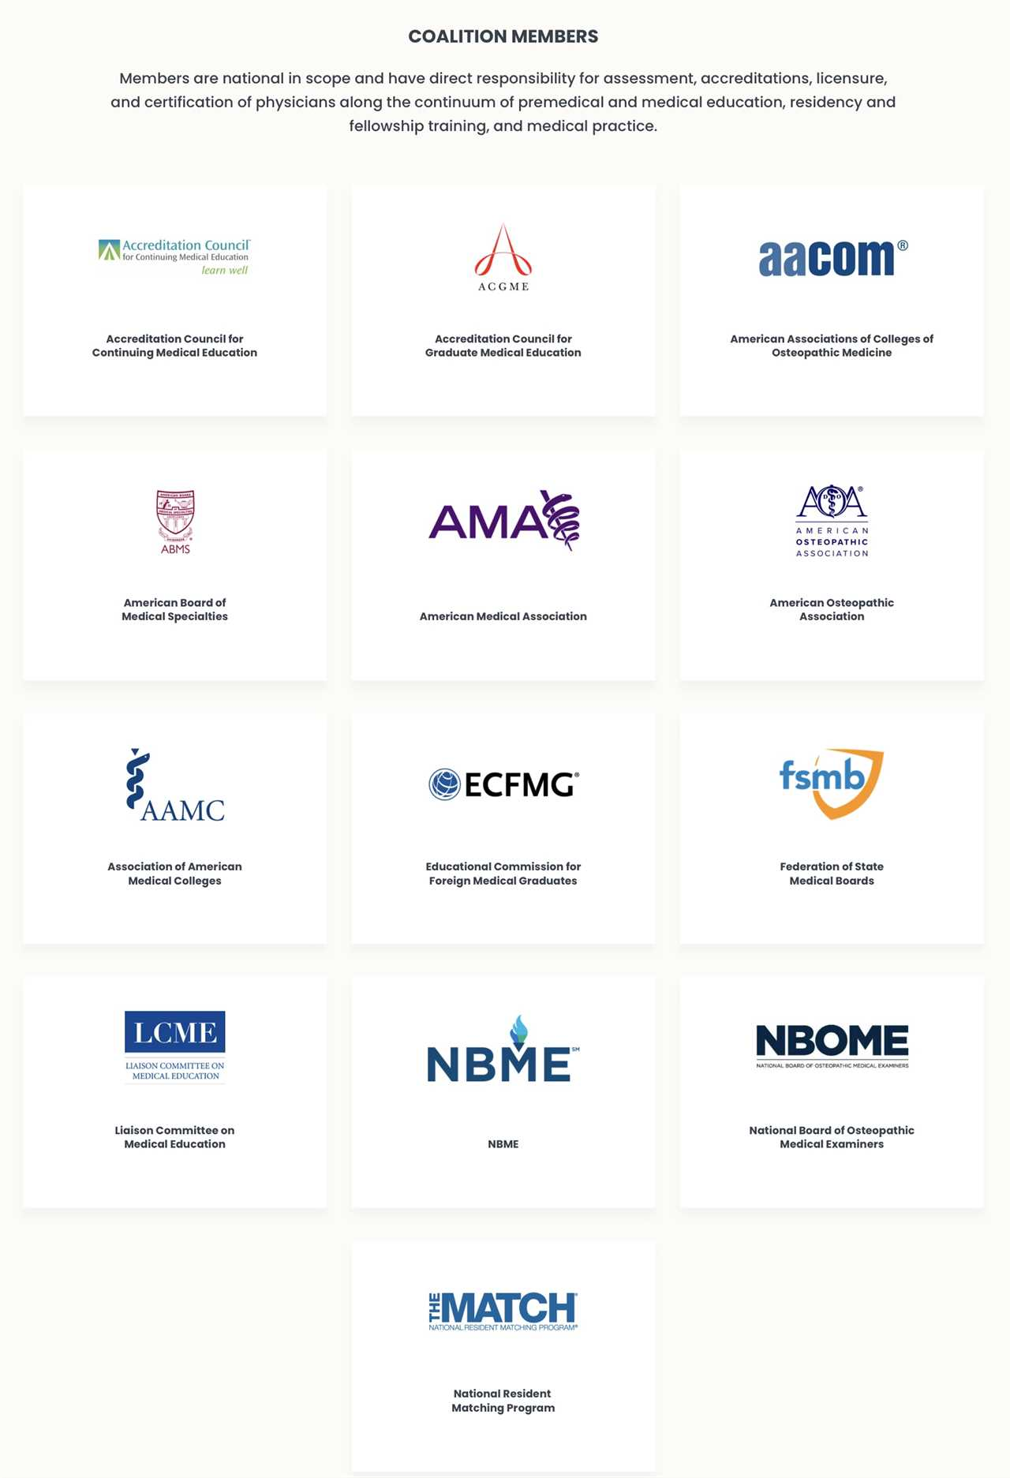
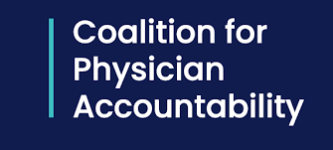
The mission of the Coalition is to advance health care and promote professional accountability by improving the quality, efficiency, and continuity of the education, training, and assessment of physicians.
13 members of the Coalition for Physician Accountability (CoPA) are national in scope and represent the continuum from premedical and medical education, residency and fellowship training, to medical practice.
Notes:
I was invited to join you today to talk specifically about the new recommendations for improving this transition phase. The COPA is a 13 member coalition consists of representatives from these 13 organizations – the AAMC is one of them. Their mission is to advance health care and promote professional accountability by improving the quality, efficiency and continuity of the education, training and assessment of physicians.

Slide 8
The Undergraduate Medical Education-Graduate Medical Education Review Committee
Formed by CoPA in 2020 to examine the transition from UME to GME and recommend solutions to identified challenges within the transition.
Thirty member UGRC met for 10 months
  Chaired by Elise Lovell, MD & George Mejicano, MD, included three trainees and public member
  Identified ideal future state, conducted RCAs of challenges, Sought input from broad communities, Reviewed literature, and Relevant past or current innovations
  Released final set of 34 interconnected recommendations among nine themes.
Notes:
In 2020 COPA formed a special committee called the UGRC to examine the transition from UME to GME and recommend solutions to ID challenges within the transition.
The thirty members met for 10 months – they ID ideal future state, conducted RCAs of the existing challenges and south input from broad communities, reviewed relevant literature as well as past or current innovations in this space. Ultimately, the committee released 34 recommendations among nine themes.

Slide 9
The Undergraduate Medical Education-Graduate Medical Education Review Committee
Fall 2019:
UGRC Proposed
Spring-Summer 2020: Planning Comm Convenes & Plans
Sept 2020: UGRC Begins Work
April 2021:
Draft Recommendations Open for Public Comment
July 2021: UGRC Concludes Work
https://physicianaccountability.org/
Notes:
This slide depicts the timeline of their work leading to the full report pictured on the right which is freely available online at the COPA website.

Slide 10
The UME-GME Transition: Themes
1. Collaboration and Continuous Quality Improvement (3)
2. Diversity, Equity and Inclusion (2)
3. Trustworthy Advising and Definitive Resources (3)
4. Outcome Framework and Assessment Processes (4)
5. Away Rotations (1)
6. Equitable Mission Driven Application Review (7)
7. Optimization of Application Interview and Selection Processes (4)
8. Educational Continuity and Resident Readiness (6)
9. Health and Wellness (4)
https://physicianaccountability.org/
Notes:
The nine themes are listed here and we will discuss most of these during this session. The numbers beside each theme correspond to the total number of recommendations within that thematic area.

Slide 11

Note to Self, Part 1
1. If I could give my younger self some nurturing advice, I would tell him/her...
“To transform a transition from a threat to a learning opportunity, medical education should assist students and doctors in developing the coping skills they need to effectively deal with the challenges presented by new environments.”
–Pim Teunissen, MD
Notes:
Before we dive in deeper to the UGRC work, I want to step back and ask you to complete this sentence.
When you reflect back on your transition to residency OR your transition to your first professional job – what advice would you give yourself?
Write one phrase, sentence or brief paragraph giving your younger self advice. Keep this in mind and we will return to it later in the session. If you would like to share with your table mates, please do so. Very optional but consider taking just a few moments to share.

Slide 12
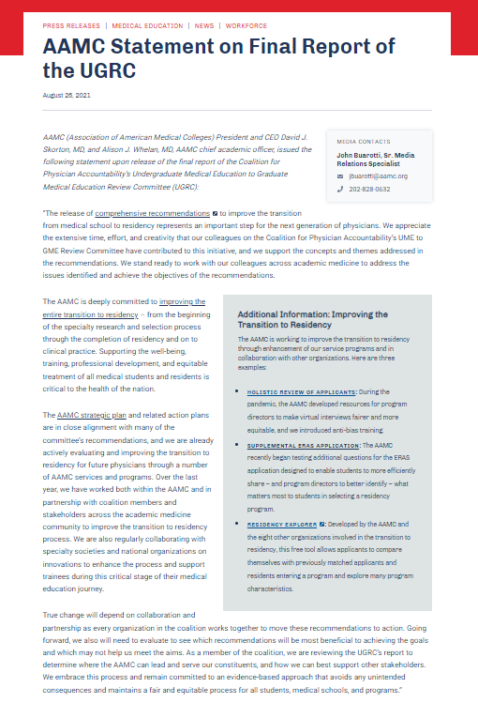
The AAMC’s Transition to Residency Portfolio
& Response to UGRC Recommendations
“We support the concepts and themes addressed in the recommendations. We stand ready to work with our colleagues across academic medicine to address the issues identified and achieve the objectives of the recommendations.”
August 26, 2021
Notes:
Thank you for completing step 1 of that exercise.
Lets move along.
Before we further discuss the specific themes and recommendations of the UGRC report, I want to briefly mention our AAMC response. Of course, we are just 1 of 13 members of the coalition and similar to other members we support the concepts and themes addressed in the recommendations and stand ready to work collaboratively to further explore and address ways to improve the TTR. The image on the right is our formal statement about the report which is still available on our website.
UGRC presented report to COPA – all voted to accept report but does not mean they endorse each individual recommendation. Other orgs did similar – made statement about support
Worked relatively short time and many need more exploration

Slide 13
The AAMC’s Transition to Residency Portfolio
& Response to UGRC Recommendations
1 - Understand work already underway & enhance communications
2 - Align AAMC Strategic Priorities with UGRC work where appropriate
3 - Identify potential new areas of focus
4 - Engage with constituents, members, external national organizations to collaboratively problem-solve
Co-create with learners a positive, personalized experience as they navigate the transition to residency, recognizing their investment and vulnerability in this process
Balance the needs of multiple diverse groups
Ensure reliable, efficient solutions and intuitive experiences for residency programs, as they are the primary driver in determining both the criteria and processes by which learners will be evaluated
Analyze the underlying and proposed structures, systems, and processes of each innovation effort to ensure that it promotes positive and equitable impacts for all those impacted in the process
Focus on improving the process for learners, programs, and schools to strengthen well-being and minimize the financial burden in the transition to residency process
Notes:
AAMC Process and principles

Slide 14

UGRC Theme: Diversity, Equity and Inclusion
Develop and disseminate recruitment practices to increase diversity across the educational continuum
Faculty complete training regarding anti-racism and bias mitigation
EM Ex: DEI Resource Library by ADIEM; AACEM National Chair’s Commitment to DEI (Pledge)
Notes:
First of 8 themes to be reviewed –
Two recommendations fall into this theme and include the development and dissemination of strong recruitment practices to increase diversity across the continuum and the training of faculty to address racism and bias.
Although a challenge across all specialties, EM has unique opportunity to improve their diversity. [65.8% of active U.S.-citizen Emergency Medicine residents in 2020-21 reported White compared to 50% overall. Orthopedic Surgery and Plastic Surgery were only other programs with higher percentage reporting White. --% of active emergency medicine residents report as female]
The DEI resource library by the ADIEM and the national chairs commitment to DEI are two great examples of actions that support these recommendations.
https://www.mededportal.org/anti-racism
https://www.aamchealthjustice.org/narrative-guide
https://www.aamchealthjustice.org/resources/trustworthiness-toolkit
https://www.aamc.org/what-we-do/equity-diversity-inclusion/anti-racism-resources

Slide 15
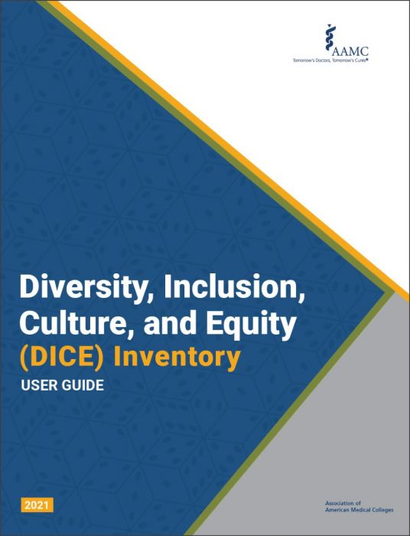
Select DEI Actions and Resources by AAMC:
AAMC Framework for Addressing and Eliminating Racism at the AAMC, in Academic Medicine, and Beyond
Curating existing resources, identifying gaps and providing medical educators with the tools and resources for addressing racism, including MedEdPORTAL Anti-Racism in Medicine Collection
Soon to release tiered (student, resident and faculty) competencies in DEI (including ACGME, ACCME collaborators)
A new inventory available – DICE – for academic medicine professionals striving to understand and improve diversity and inclusion within their institution
Notes:
The AAMC has many resources including the few that are listed here that are helpful to the UGRC recommendations
https://www.aamc.org/news-insights/medical-schools-need-do-much-more-protect-students-color-racism

Slide 16
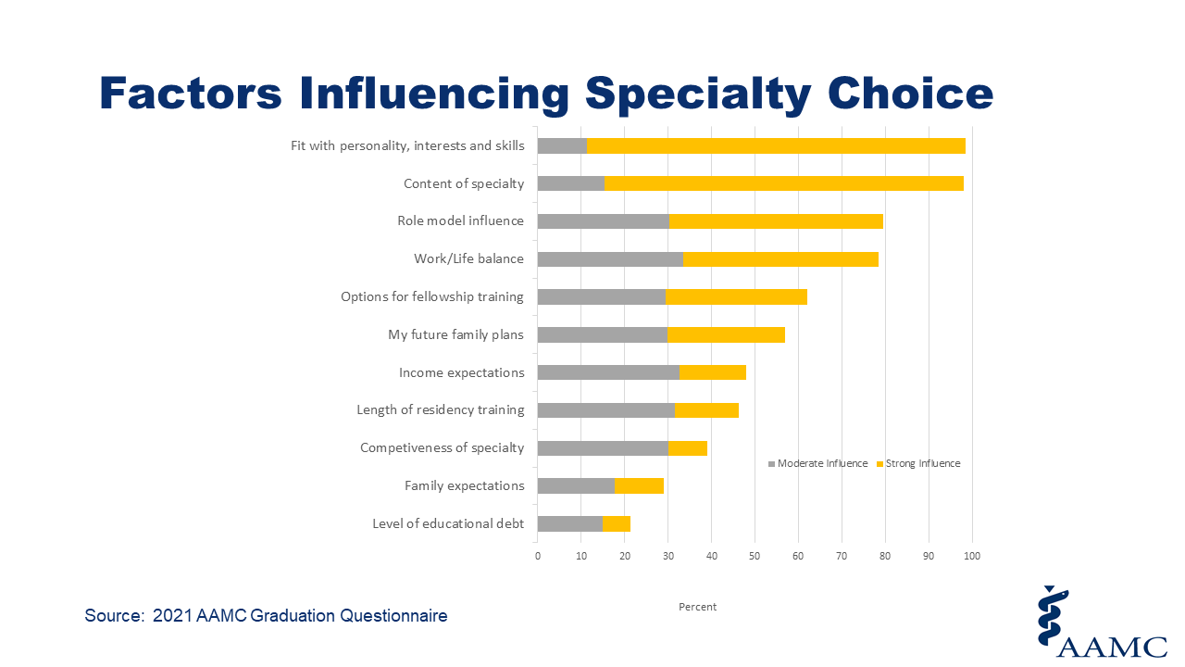
UGRC Theme: Trustworthy Advising and Resources
Improve evidence-informed and data driven advising resources that address workforce needs
Reduce stigma and competition among specialties
Differentiate specialty specific advisors from other faculty and staff
Better prepare advisors for their role via a common curriculum for career advising
EM Ex: EMRA & CORD Student Advising Guide
Notes:
Three recommendations were made in regards to advising students on specialty and program choices. Although the EMRA and CORD student advising guide is strong example, we do not have standard development opportunities for advisors across medicine. The UGRC envision three areas of focus – basic advising information for all faculty and staff who interact with students to promote common understanding, general career advising for those serving in this formal capacity that is differentiated from specialty based, and finally specialty-specific match advising which would include training in equity in advising and mitigation of bias.

Slide 17

Select Advising Actions and Resources by AAMC:
Emergency Medicine one of 15 specialties participating in a new virtual specialty forum - This event is provided by the AAMC as a free service to the medical student community to help ensure all medical students have equitable access to specialty information.
Notes:
I want to call your attention to a new offering by the AAMC. This is the 2nd year we are hosting the virtual specialty forum at the end of the month. EM is one of 15 specialties participating in the forum. We modeled this after our school forum for pre-medical students learning about various medical school options.
In addition to this forum, we have also begun offering unconscious bias training to medical student advisors and we are revising our Careers In Medicine advisement program
AAMC related works –
https://aamcspecialtyforum.vfairs.com/
Creating and offering unconscious bias training to medical student advisors
Working with medical school advisor/SMEs to revise the Careers in Medicine (CiM) advising program.

Slide 18
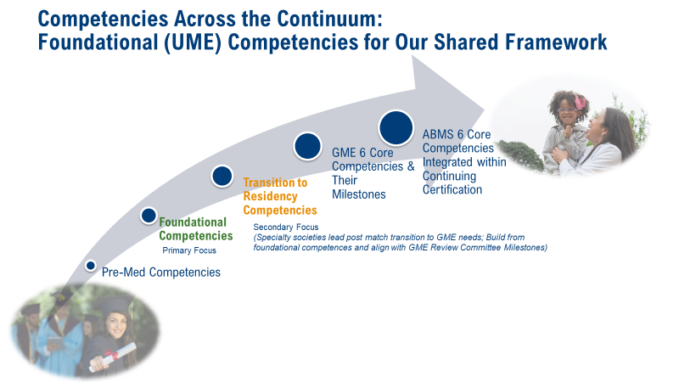
UGRC Theme: Outcome Framework and Assessment Processes
Jointly define and implement a common framework and set of outcomes (competencies) to apply to learners across the UME-GME transition
  Develop common assessment tools for progression of the competencies
  Train faculty in assessment practices
Recognize and mitigate bias (race, ethnicity and gender) in grading and assessment within the clinical learning environment
EM Ex: Stanford EM Residency Program and the EM Residency Program Evaluation and Assessment Consortium, AMA grant, “Development of a Unified System of Assessment and Predictive Learning Analytics Utilizing EPAs Across Emergency Medicine Residency Programs”
Notes:
The next theme includes 4 recommendations for competency based education. The theme is titled “outcome framework and assessment processes” and a summary of the recommendations is included here.
I have some recent news to share about new work in this area - my team is leading an extensive project in partnership with the ACGME and AACOM. Through an inclusive and iterative process with national organizations and the academic medicine community at large, we will be working to create a common set of national foundational competencies for use in undergraduate medical education programs in the U.S. that align horizontally among UME programs and vertically across the continuum of medical education.
Although we are about 20 years into adopting CBE across medical education, we have not worked collaboratively across schools or the continuum to align competency based teaching and assessment approaches. We will be formally announcing this new project next month and will be inviting advisors from a number of affiliate organizations including the AMA, ECFMG, specialty societies and many others.
The work being done at Stanfords EM program and the EM residency program evaluation and assessment consortium is a good example of competency work at the specialty level that we would like to align with the earlier foundational competencies to be developed.
AMA Grant Background –
A Unified System of Assessment and Predictive Learning Analytics Utilizing Entrustable Professional Activities Across Emergency Medicine Residency Programs
Medical education is moving toward a competency-based system, but there is a significant gap between medical school and residency training.
Our goal is to develop specific, measurable outcomes of tiered entrustable professional activities (EPAs) to optimize the transition from medical school to residency and throughout emergency medicine training. Research includes:
A multi-site pilot study of six diverse emergency medicine residency programs.
Draft and authenticate tiered EPAs for entering interns, junior residents, senior residents, and those transitioning to independent practice. These will be supported by granular observable practice activities (OPAs).
Develop, pilot, and implement a learning analytics dashboard that integrates multi-modal assessment data for EPAs and OPAs.
Provide the infrastructure for development of individualized learning plans, clinical competency committee summative decision-making processes, and predictive analytics curves.
EXPECTED OUTCOMES
Predictive analytics curves for early identification of areas for improvement and concrete targets for individualization of learning.
A model for specialty residency programs to align medical education assessment and individualize residency training in a competency-based framework.
Transformation of competency-based assessment across all ACGME-accredited Emergency Medicine training programs.
This project is funded by the American Medical Association

Slide 19
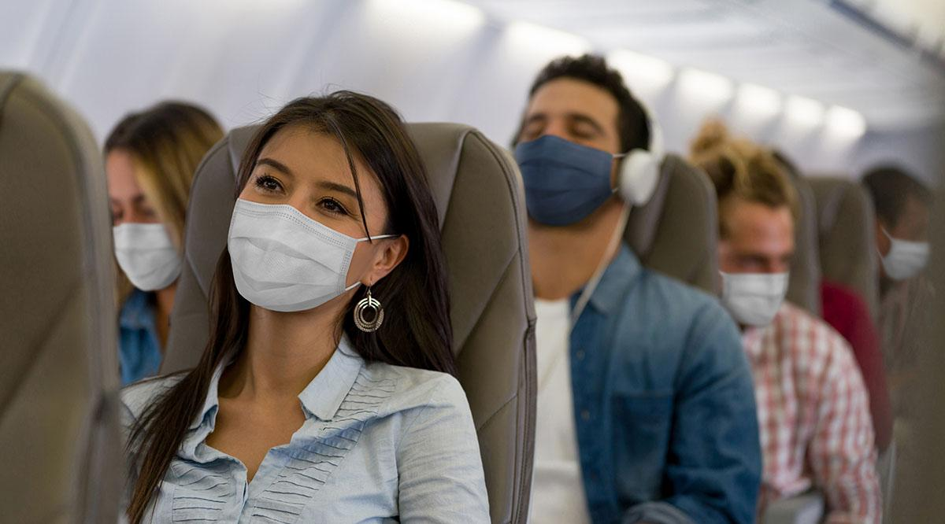
UGRC Theme: Away Rotations
Convene committee to explore goals and utility of away rotation experiences, their impact and issues of equity
  Conduct cost vs benefit analysis
  Make recommendations that are equitable
Notes:
The next theme is Away Rotations - The value of away rotations and sub-internships is clear but they can also be cost prohibitive. The UGRC recommends that a comm be formed to consider the goals and utility of these educational experiences, their impact and equity.

Slide 20
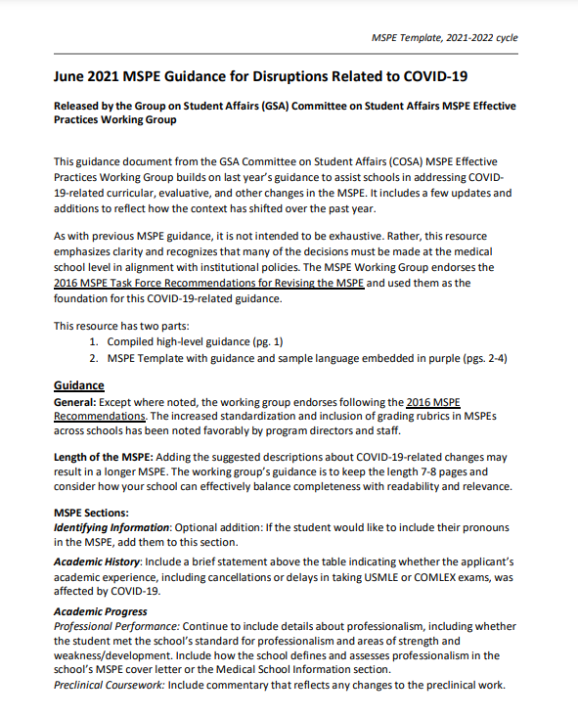
UGRC Theme: Equitable Mission Driven Application Review
Improve Medical School Performance Evaluations (MSPE)
Replace letters of recommendation (LOR) with structured evaluative letters as universal tool
Critically evaluate use of filters and unintended effects on applicant review
EM Ex: EM CORD Standardized Letter of Evaluation (SLOE)
Notes:
The next theme is titled “Equitable mission driven application review” and includes 7 recommendations from improving the MSPE, replacing LORs with structured standardized letters of evaluation and evaluating the use of filters by programs when searching for applicants. Recent PD survey data on this topic shows that, on average, about 200 hours of person hours are spent reviewing applications each year by a single program.
In regarding to the MSPE – there is certainly room here to make improvements and we have a standing committee dedicated to advising on the MSPE. Just last week, we closed a national PD survey, which included items about the utility of the MSPE we and will be using that information to update and adapt guidance for MSPE writers at our medical schools.
Of course the EM CORD SLOE is an exemplary model for replacing traditional letters of recommendation. This is specifically called out in this section of the report as a relevant example.
MSPE – no substantive change until comps roll out; searchable data fields on pause till we further understand the context and need
Report # of hours spent reviewing applications = average 196 person hours reviewing applications each year (1 FTE working 40 hrs / week for 5 weeks)

Slide 21
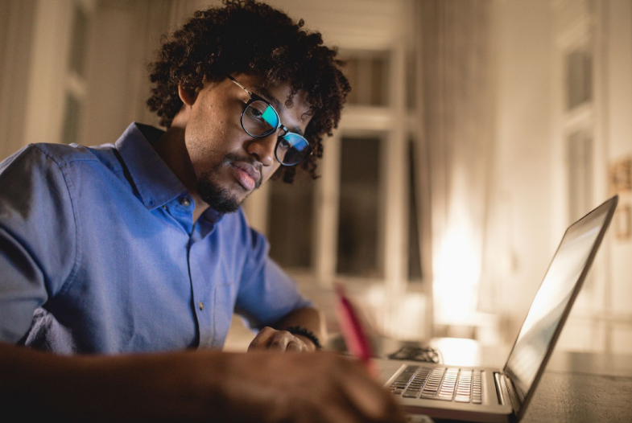
UGRC Theme: Optimization of Application Interview and Selection Processes
Virtual interviewing for 2021-22 season with ongoing study of impact as a potential permanent process
  Convene diverse individuals to review interview data and options for future seasons
Develop standards for interview offers and acceptances
Pilot innovations to reduce application and interview numbers
EM Interview guidance: Students should ideally interview at 12 EM residency programs, with an absolute maximum of 17
Notes:
The next theme is “optimizing application interview and selection processes” and includes 4 recommendations. This is another example where the AAMC Is not driving innovations but partnering and supporting specialty organizations as they take the lead.
Specialty-specific application caps will be pilot tested this summer with __.
We are also partnering with three specialties (IM, derm, and general surgery) to offer a supplemental application within ERAS. It is an optional process for applicants to select programs and year 2 will include preference signaling for geographic location.
Optimization of Application, Interview and Selection
Specialty-specific application caps research: Expected Summer 2022
ERAS Supplemental Application Pilot (Year 2 pilot in preparation to include additional questions, geographic preferences, preference signaling) - Only applicants (MD, DO, and international graduates) applying to participating residency programs in internal medicine, dermatology, and general surgery are eligible to complete the supplemental ERAS application. It is optional for applicants to these residency programs to complete the supplemental ERAS application.
https://www.cordem.org/globalassets/files/2020-res-app-consensus-statement-v2.pdf
5. Interview numbers: Students should ideally interview at 12 EM residency programs, with an absolute maximum of 17. Historical data clearly demonstrate that greater than 95% of EM applicants (allopathic, osteopathic, and international medical graduates) who interview at 12 programs will match. 2,3,4,5 However, some leeway is needed to accommodate students participating in the couples match and those who are at particularly high risk of not matching. Students who are offered extra interview invitations should decline interviews at programs that are lower on their preference lists to make these interview slots available to other students. There are a finite number of interview positions. When students who have prioritized other programs occupy these slots, this disadvantages these programs as well as their peers, contributing to peers not matching and/or programs not filling.

Slide 22
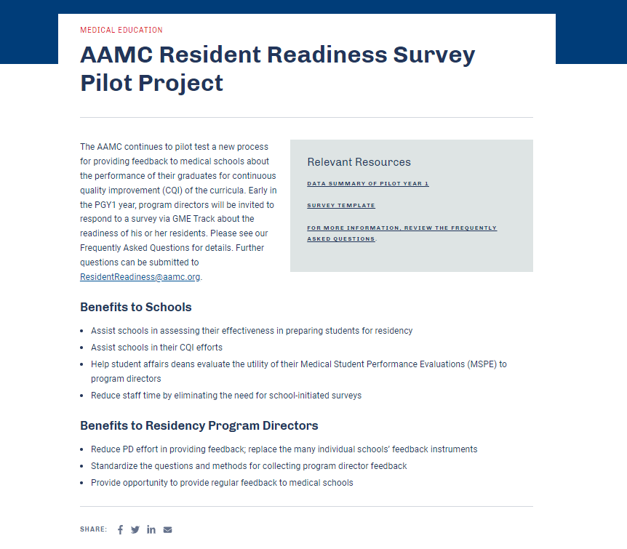
UGRC Theme: Educational Continuity and Resident Readiness
Specialty specific resident assessment data auto fed back to medical schools through standardized process to enhance accountability and inform CQI of UME programs
Develop centralized source of resident support resources for PDs, DIOs
Foster positive coaching relationships to support the transition to residency
Provide equitable specialty-aligned knowledge and skills training during final year in medical school
Improve orientation to GME
Notes:
The next theme is “educational continuity and resident readiness” and includes 6 recommendations.
In regards to the first (#25) on this slide, my team has been pilot testing a new process that directly responds to this recommendation.
The pilot is called the Resident Readiness Survey and we just closed our 2nd year last Wednesday. The Resident Readiness Survey Pilot: in collaboration with the ACGME and AACOM, we developed a new process for providing feedback to medical schools about the performance of their graduates for continuous quality improvement (CQI) of the curricula. During the PGY1 year, program directors are invited to respond to a survey via GME Track about the readiness of his or her residents. This information is fed back to the relevant school via a tailored and confidential report in the Medical School Profile System (MSPS).

Slide 23
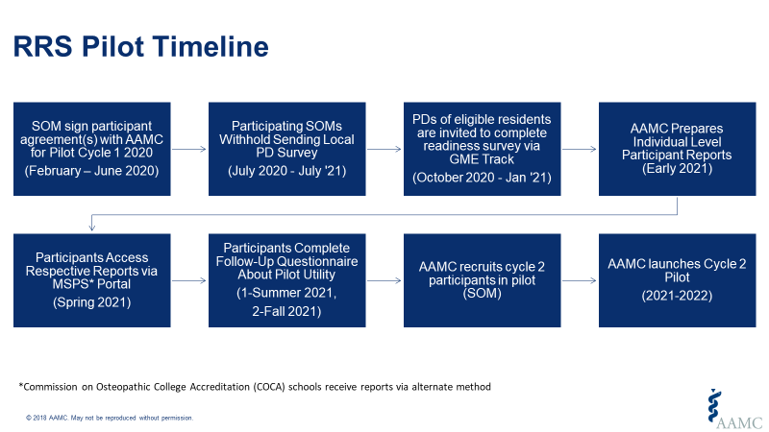
Resident Readiness Survey Pilot:
A National Feedback System for Continuous Curricular Improvements in Medical Education
In collaboration with ACGME, AACOM and participating schools and residency programs
  62% of U.S. MD and DO granting medical schools are participating (Year 2)
A shared overall goal is to improve the medical schools’ ability to make data informed improvements in their curricula and streamline the process for PDs
This new streamlined, standard approach to collecting assessment data of resident readiness from PDs has been piloted for 2 years
Year 1 data summary available online and year 2 in process
Notes:
We anticipate that this new system would help program directors by eliminating the need to complete numerous variable school-specific surveys throughout the year. We also anticipate that the new system will help the medical schools by assisting them in meeting LCME accreditation standard 8.4, which pertains to the use of outcomes data to enhance medical education program quality, and assist in the evaluation of the school’s overall effectiveness in preparing students for graduate medical education.

Slide 24
Resident Readiness Assessment Data for CQI
Preliminary Results
Overall: 53% of eligible residents and 62% of eligible programs participated in year 2
EM: 70% of eligible residents and 74% of eligible Emergency Medicine programs participated in year 2
Overall Performance per PD: During the Transition to GME, Did this Resident Meet Overall Performance Expectations? | Residents in Emergency Medicine |  | Residents in all Other Specialties (excluding EM)
 | Count | Percent | Count | Percent
Exceeded overall performance expectations | 402 | 32.8 | 2,592 | 31.0
Met overall performance expectations | 786 | 64.1 | 5,464 | 65.3
Did not meet overall performance expectations | 38 | 3.1 | 316 | 3.8
Notes:
This slide includes preliminary data from our year 2 pilot. Overall 53% of eligible residents and 62% of programs participated in year 2.
EM had a very strong response with 74% of program directors providing information on 70% of residents.
The table here reflects the responses to one of the questions on the survey. PDs were asked “during the transition to GME, did this resident meet overall expectations?” ~33% exceeded expectations, 64% met and about 3% failed to meet expectations.
There is much more data that was collected about specific performance areas and a summary of our year 1 pilot data is available online. We will be sharing a similar summary for year 2 very soon.
RRS pilot year 2 closed 3/15 - There were 9,688 resident responses, out of 18,372 eligible residents, which is 52.7% of eligible residents (compared to 51.9% last year). There were 2,107 programs that participated in at least one survey, out of 3,406 eligible programs, which is 61.9% of eligible programs (compared to 62.6% last year). This year, we received 9,688 responses, compared to 5,578 responses last year. Additionally, 2,107 distinct programs participated in at least one survey, compared to 1,791 programs last year.

Slide 25
Resident Readiness or
Contextual Competence
Autonomy
Competence:
Clarity on New Role and Expectations; Ongoing Constructive Feedback
Legitimacy and Belonging:
Meeting New Colleagues, Learning New Routines, Social Norms for Emergency Medicine
Practical Needs:
Obtaining Training License, Orientation to Space, Electronic Health Records
Physiological Needs:
Relocating to New City, State, Country; Securing Health Care; Wellness Resources; Financial Security
Transition to residency is a “complex ecosystem involving many individuals and organizations.” The transition begins during the preclinical phase of medical school and extends until new residents enculturate into their GME context – new program and sponsoring institution.
Consider the hierarchy of learner needs when transitioning to new settings.
How can academic medicine, education program leaders (UME-GME) consider these needs throughout the transition process?
Adapted by LDH from “Bates Hierarchy of Contextual Competence.” Source: Teunissen PW, Watling CJ, Schrewe B, et al. Contextual Competence: How residents develop competent performance in new settings. Med Educ. 2021;55:1100– 1109. https://doi.org/10.1111/medu.14517
Notes:
One of the recommendations in this theme is to improve residency orientation. I want to return to this definition of the transition and share a graphic for your consideration. This hierarchy was adapted from a recent article “how residents develop competent performance in new settings” and I adapted it to reflect the transition to GME as new residents enculturate into new communities, health systems and programs. As we orient new residents how can we consider the breadth of these needs, support our new residents and “transform a transition from a threat to a learning opportunity.” –Pim Teunissen, MD

Slide 26
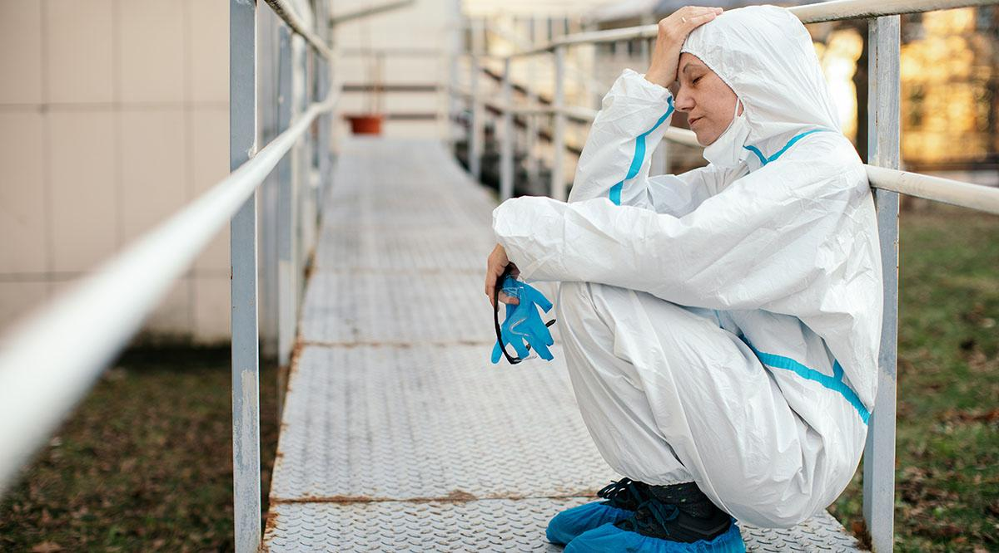
UGRC Theme: Health and Wellness
Guarantee that wellness resources are available for each learner
Provide adequate and appropriate time between UME-GME to facilitate major life transition (ideally 6 weeks)
Incorporate financial planning into UME to support transitional expenses
EM Ex: ACEP Wellness Week
Notes:
I think that model for considering contextual competence is also relevant here to the final theme -“Health and Wellness” which includes 4 recommendations summarized here.
EM residents 76% report burnout

Slide 27
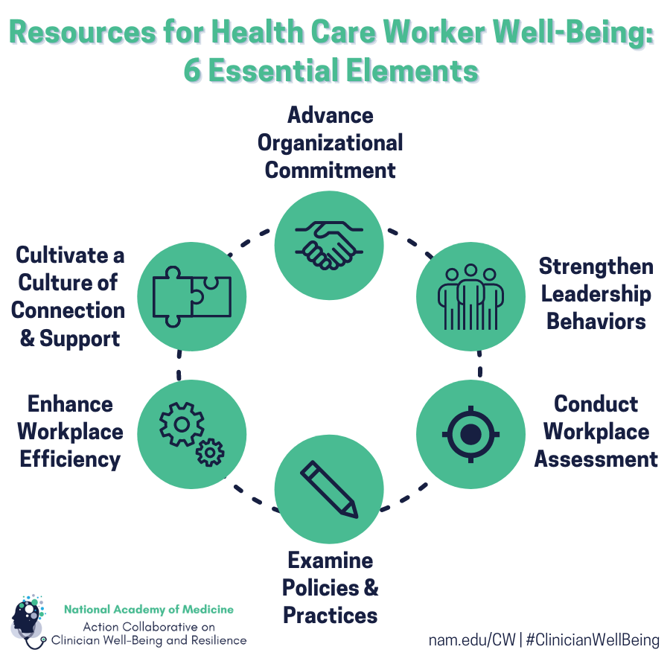
Select Actions and Resources by AAMC:
The Rise of Wellness Initiatives in Health Care is a new AAMC report presenting data from two recent surveys of health care professionals on common elements of wellness programming and the roles of the leaders that support wellness efforts.
The National Academy of Medicine Action Collaborative on Clinician Well-Being and Resilience offers a new compendium of resources for use across practice settings to take action toward decreasing burnout and improving clinician well-being. Organizational Evidence-Based and Promising Best Practices for Clinician Well-Being.
Transition in a Time of Disruption by AACOM, AAMC, ACGME, ECFMG: Practical Guidance to Support the Move from Undergraduate Medical Education to Graduate Medical Education
Notes:
https://www.ecfmg.org/annc/ume-gme.pdf

Slide 28
Note to Self, Part 2
1. If I could give my younger self some nurturing advice, I would tell him/her...
“To transform a transition from a threat to a learning opportunity, medical education should assist students and doctors in developing the coping skills they need to effectively deal with the challenges presented by new environments.”
–Pim Teunissen, MD
2. How can this advice support those enculturating into the specialty of emergency medicine?
Notes:
Return to: When you reflect back on your transition to residency OR your transition to your first professional job – what word or words come to mind?
Earlier I asked you to “Write one phrase, sentence or brief paragraph giving your younger self advice.” Lets return to that advice – consider how this can be integrated into your own leadership role at the local or national level for those transitioning to residency and enculturating into the specialty of emergency medicine.
Take a moment to share with a colleague (time allowing)

Slide 29
Exploring & Problem Solving: Consider (Local or National) Areas of Strength and Opportunities for Improvement, Innovation, or Collaboration
Theme | Areas of Strength | Opportunities
Diversity, Equity, Inclusion
Trustworthy Advising and Resources
Outcome Framework and Assessment Processes
Away Rotations
Equitable Mission Driven Application Review
Optimization of Application Interview and Selection
Educational Continuity and Resident Readiness
Health & Wellness (incl Contextual Competence)
Email lhowley@aamc.org
Notes:
Finally one more activity for you to take with you. Consider the themes from the UGRC report and your local or national areas of strength, opportunities for improvement, innovation or collaboration. If you are willing to share, please do so. We would like to stay updated on your efforts to improve the UME-GME transition. Email address included here for reference.
Collectively what are priorities for AACEM that AAMC can learn from?

Slide 30
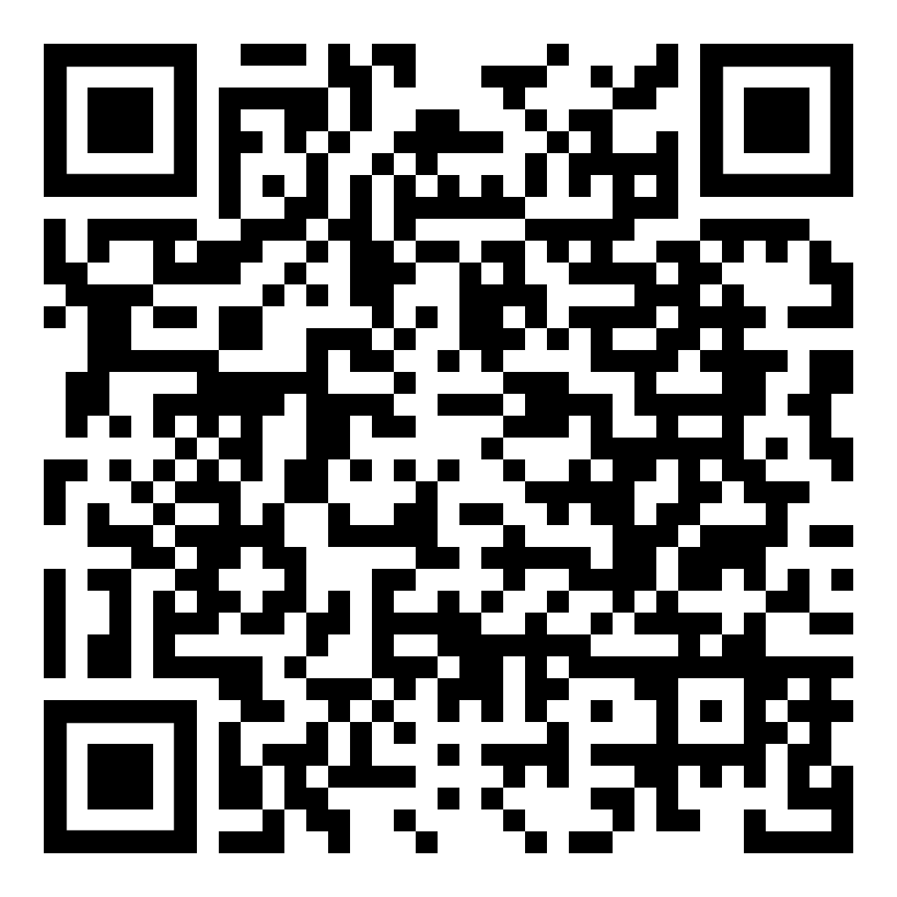
Thank You!
Lisa Howley, Ph.D.
Senior Director, Strategic Initiatives and Partnerships, AAMC
lhowley@aamc.org
@LisaDHowley
March 23, 2022
2022 AACEM/AAAEM Annual Retreat
Notes:
https://www.aamc.org/collaborative-transformation-transition-residency

