Slide 1

AAAEM / AACEM
COVID Impact Survey
Impact of COVID-19 on Emergency Department Operations
James Scheulen, PA, MBA
On behalf of the
AAAEM Benchmark Committee
March, 2022

Slide 2


Slide 3

COVID Operations
March 15, 2020

Slide 4
COVID Operations
Pre-COVID Monthly Data
January 2019 thru Dec 2019
Post COVID Monthly Data
July 2020 thru Dec 2021
Pre-COVID
January 2020
March 15, 2020
Short term Post-COVID
Through June 2020
Reported last year

Slide 5

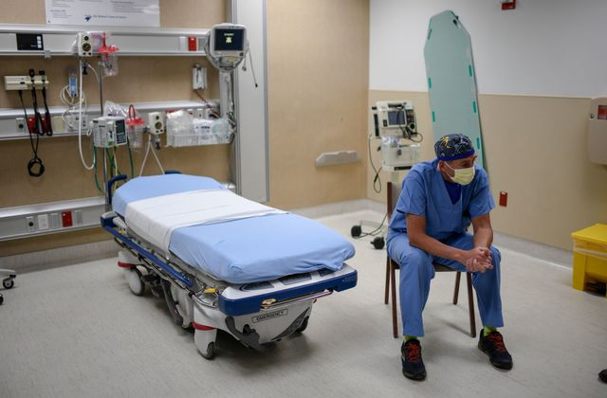

Survey Timeline
Jul
Aug
Sep
Oct
Nov
Dec
Jun
May
Apr
Mar
Feb
Jan
2019
FY 20
Jul
Aug
Sep
Oct
Nov
Dec
Jun
May
Apr
Mar
Feb
Jan
2020
FY 21
Jul
Aug
Sep
Oct
Nov
Dec
Jun
May
Apr
Mar
Feb
Jan
2021
3 Calendar Years
Fiscal Year 2020—Reported last year
Fiscal Year 2021—Reporting this year

Slide 6
COVID Operations Data
Our 31 very loyal and patient participants
Beaumont University
Brown University
Columbia / NewYork-Presbyterian
Dartmouth
Harvard University / Massachusetts General Hospital
Harvard University / Beth Israel Deaconess
Johns Hopkins University
Medical College of Wisconsin
Medical University of South Carolina
Northwestern University
Penn State University
Robert Wood Johnson / Rutgers University
Stanford University
The Ohio State University
The University of North Carolina, Chapel Hill
Tufts University
University of Arizona / Maricopa District
University of California, San Francisco
University of Colorado
University of Florida, Gainesville
University of Illinois, Chicago
University of Iowa
University of Louisville
University of Michigan
University of Missouri, Columbia
University of Nebraska
University of Pennsylvania
University of Texas Health Sciences - San Antonio
University of Wisconsin
Vanderbilt University
Yale University

Slide 7
COVID Operations Data
Four separate rounds of data collection
Okay, c’mon now---has anyone really ever used the word “tranche” before??
10 Common Data Elements
• Total ED Registrations
• Total ED Hospitalizations
• Total ED LWBS
• Total ED SAL
• Total ED Discharges + Other Dispos
• Total EMS Arrivals
• Total EMS Hospitalizations
• Triage Level 1-5 (individual #s)
• Total Boarding Hours (monthly sum)
• Profee Level 1-5, CC (individual #s)

Slide 8
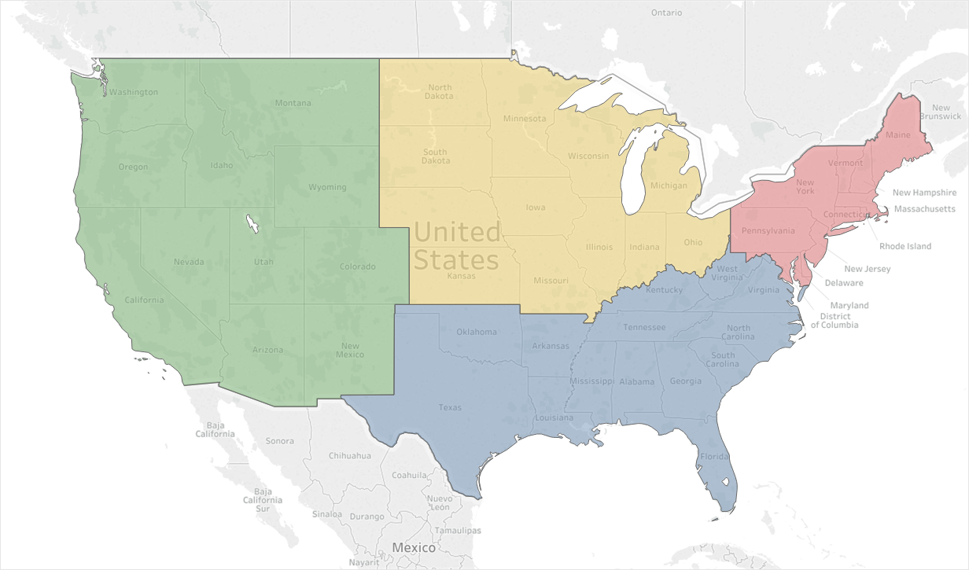
Data Set
3
10
10
5

Slide 9
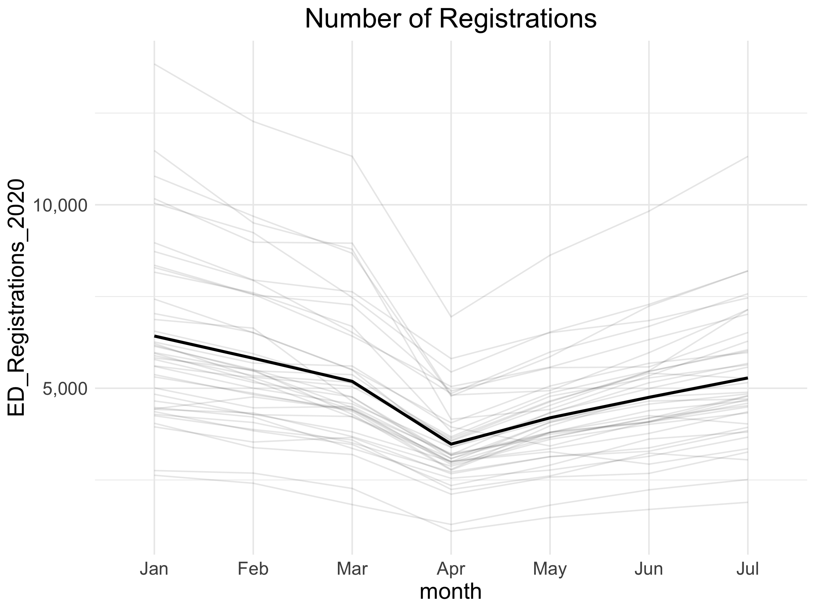
What we knew last year
6,126
5,134
84% of
Pre-COVID
volumes
3,360
-46%
Notes:
Avg Registrations were 6,423 in January which dropped to 3,477 by April. Represents a 46% drop. Avg Registrations in July were 5,281. Which represents around 82% of the volume in January
85% of EDs had registrations greater than 75% of their January numbers in July
37.5% of EDs had registrations greater than 85% of their January numbers in July
Looking at January to April:
Largest Drop: MAIMON dropped from 11,477 to 4,156 (63.8%)
Smallest Drop: JHBMC dropped from 3,948 to 2,670 (32.4%)
Looking at January to July:
Largest Drop: MAIMON dropped from 11,477 to 6,284 (45.2%)
Smallest Drop or Increase: UMOUH increased from 4,438 to 4,526 (2%)

Slide 10
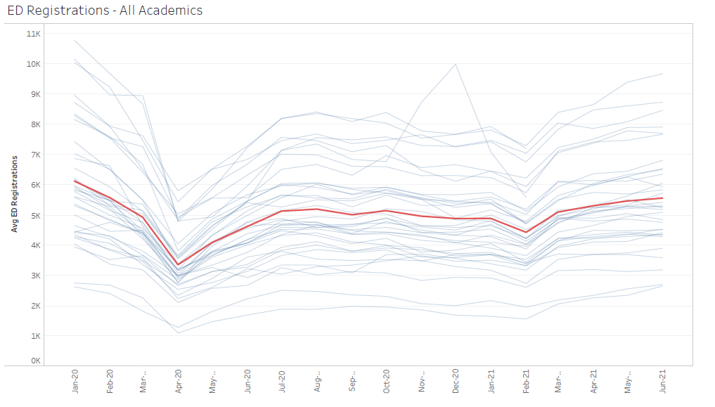
And since then…
1 year
Recovery
June 2021
Recovery
July 2020
1 year
since peak
April 2021
Peak loss
April 2020
6,126
5,312
5,566
5,134
Overall volume
(9.1%)
(560 pt/month)
3,360

Slide 11
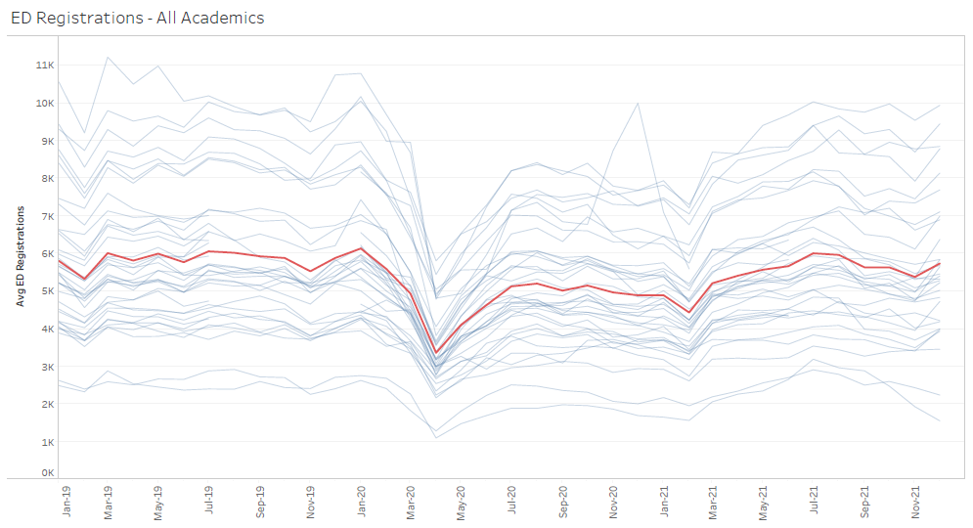
Before and After
1 year
Recovery
June 2021
Pre-COVID
Jan 2019 thru Dec 2019
January 2020
6126
Recovery
July 2020
1 year
Since peak
April 2021
Peak loss
April 2020
5,803
5,708
5,312
5,566
5,134
3,360
Recovery
July--Dec 2021

Slide 12
What was happening before?
5838
5664
5132
4256
FY 20 was moving towards
a 2% volume increase before
March 2020
End of
FY 20
End of
FY 21

Slide 13
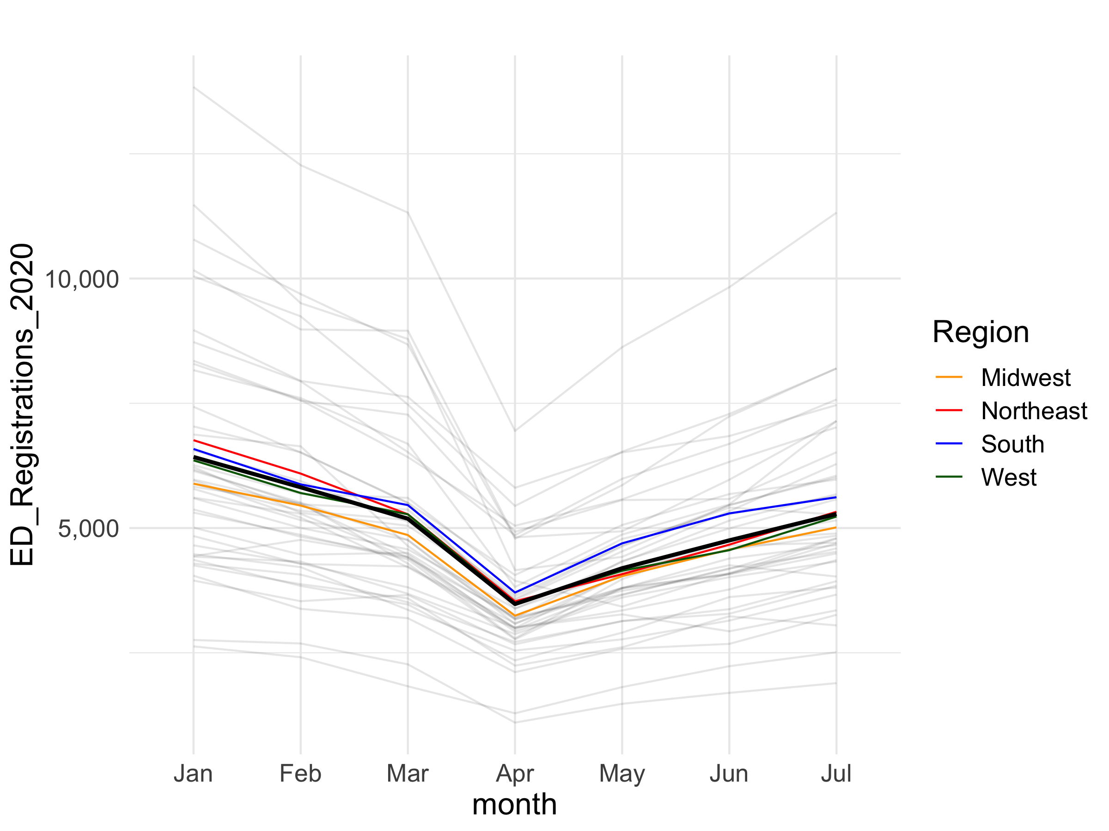
Regional Patterns

Slide 14
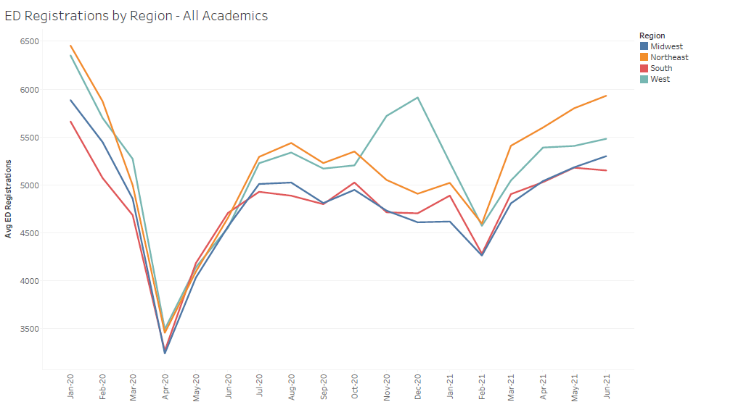
Regional Patterns

Slide 15

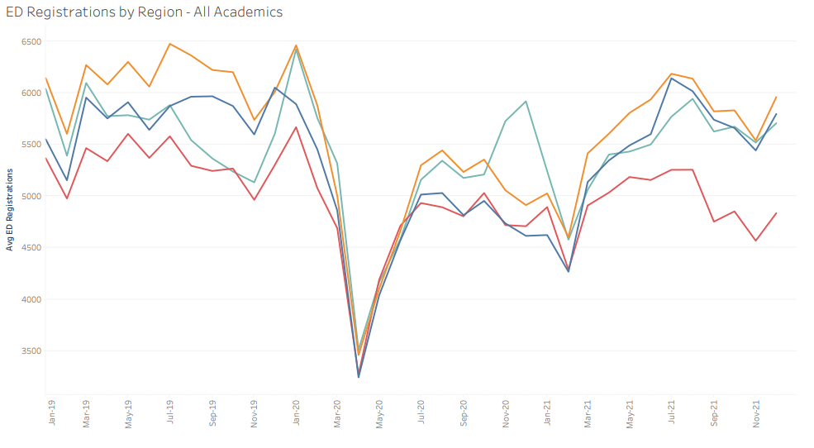
Regional Patterns
~15%
~20%
February
volume dips
January
spike
June
recovery
FY 21
end
CY 21
end
February
volume dips

Slide 16
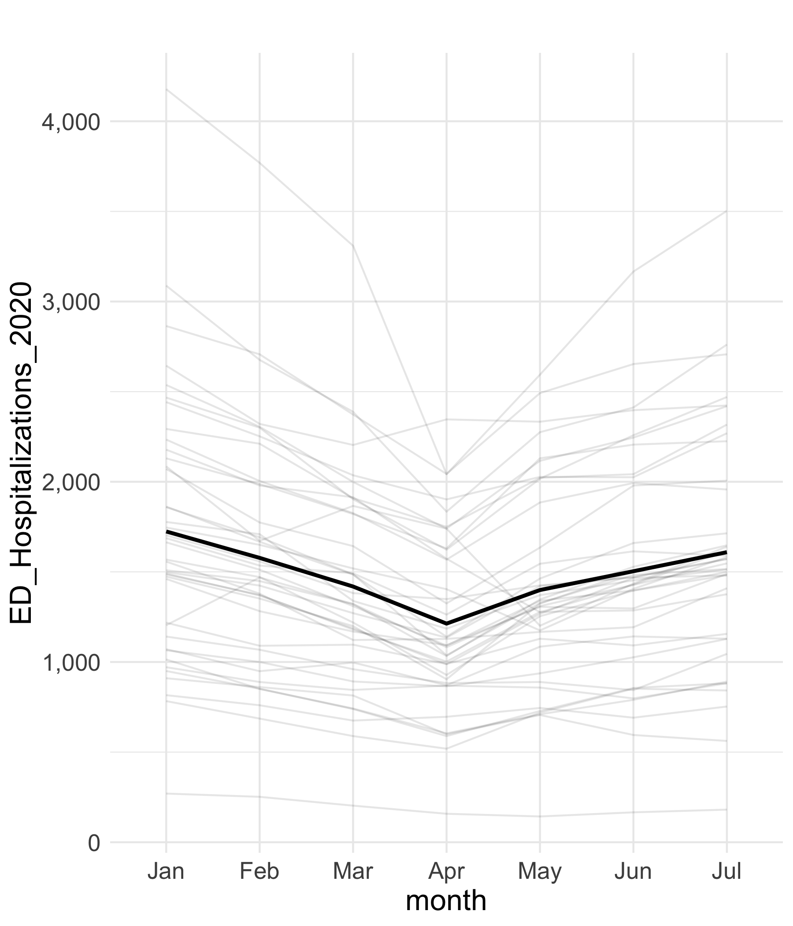
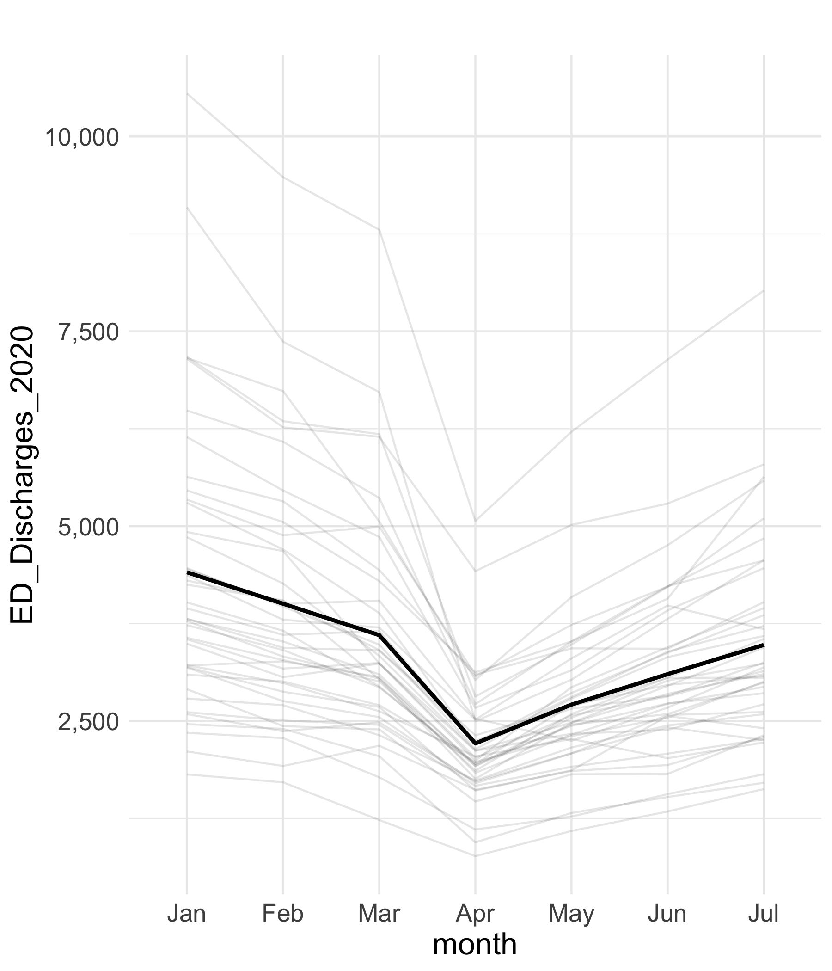
What we knew last year
Discharges
Hospitalizations
While Total Visits fell by 46%,
Discharges fell by 49%
Discharges have recovered
to 79% of pre-COVID volume
While Total Visits fell by 46%,
Hospitalizations fell by 30%
Hospitalizations have recovered
to 93% of pre-COVID volume
-49%
-30%
Notes:
Total Discharges: Drop from an average of 3,602 March to 2,212 April discharges) 38.5% drop
Dropped from 4,408 in Jan which represents a 50% drop to April
Percent Discharged: Decrease from 69% in March to 64% April
Looking at Jan to April:
Largest Drop: MAIMON decreased by 72.5%
Smallest Drop: JHBMC decreased by 23.3%
Looking at January to July:
Largest Drop: MAIMON decreased by 49.8%
Smallest Drop: JHBMC increased by 8.9%

Slide 17
What we knew last year
Discharges
While Total Visits fell by 46%,
Discharges fell by 49%
Discharges have recovered
to 79% of pre-COVID volume
-49%
Notes:
Total Discharges: Drop from an average of 3,602 March to 2,212 April discharges) 38.5% drop
Dropped from 4,408 in Jan which represents a 50% drop to April
Percent Discharged: Decrease from 69% in March to 64% April
Looking at Jan to April:
Largest Drop: MAIMON decreased by 72.5%
Smallest Drop: JHBMC decreased by 23.3%
Looking at January to July:
Largest Drop: MAIMON decreased by 49.8%
Smallest Drop: JHBMC increased by 8.9%

Slide 18
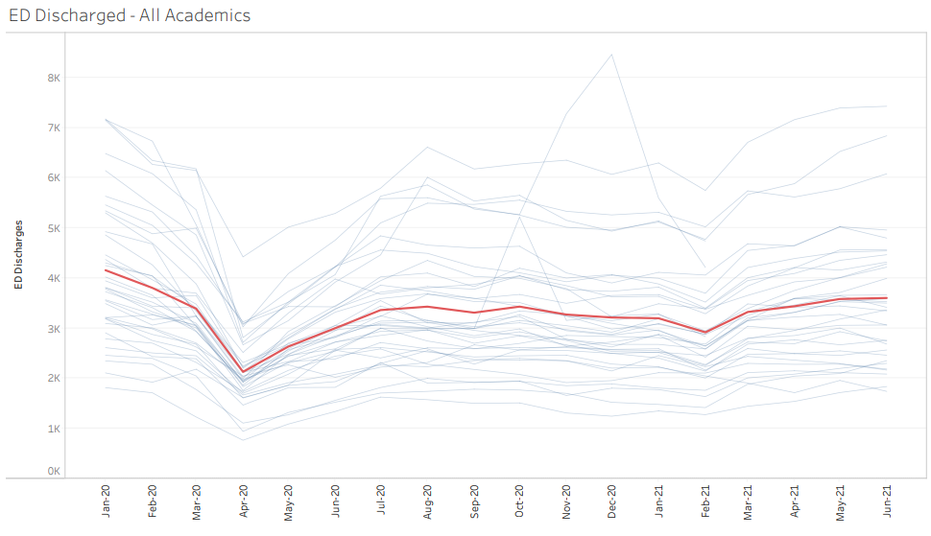
And since then… Discharged
1 year
Recovery
June 2021
Overall patient volume variability is driven
by the Discharged patient population
1 year
Since peak
April 2021
Recovery
July 2020
Peak loss
April 2020
4,157
3,439
3,604
3,362
Discharged volume
(13.3%)
(553 pt/month)
2,130

Slide 19
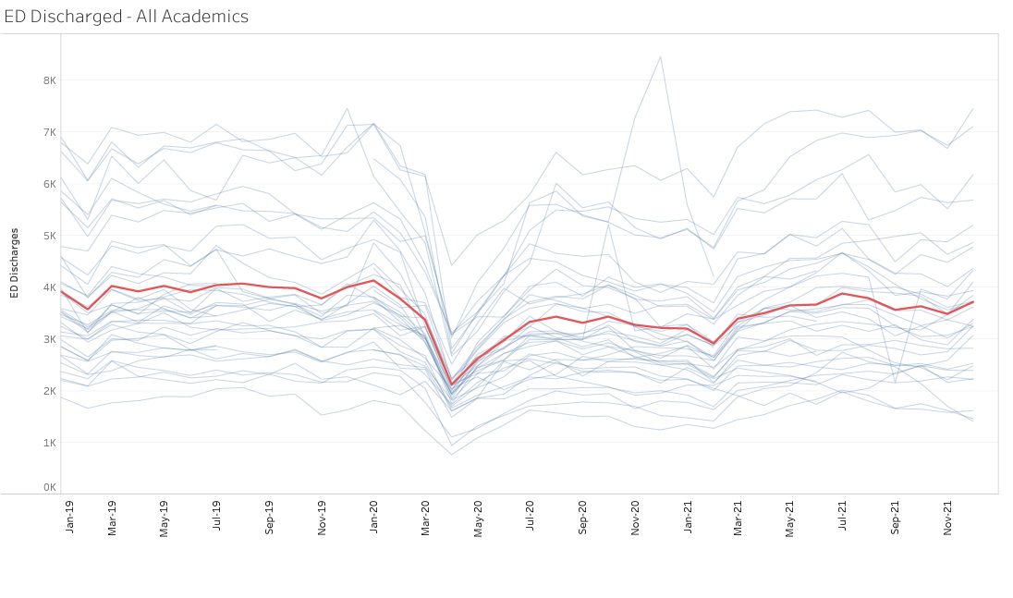
Discharged: Before & After
Initial
Recovery
July 2020
Pre-COVID
Jan 2019 thru Dec 2019
Next 12
Months
Next 6
Months
3,362
3,604
Peak loss
April 2020
3,100
3,414
2,130
~95% of
pre-COVID
~86% of pre-COVID

Slide 20
What we knew last year
Hospitalizations
While Total Visits fell by 46%,
Hospitalizations fell by 30%
Hospitalizations have recovered
to 93% of pre-COVID volume
-30%
Notes:
Total Discharges: Drop from an average of 3,602 March to 2,212 April discharges) 38.5% drop
Dropped from 4,408 in Jan which represents a 50% drop to April
Percent Discharged: Decrease from 69% in March to 64% April
Looking at Jan to April:
Largest Drop: MAIMON decreased by 72.5%
Smallest Drop: JHBMC decreased by 23.3%
Looking at January to July:
Largest Drop: MAIMON decreased by 49.8%
Smallest Drop: JHBMC increased by 8.9%

Slide 21
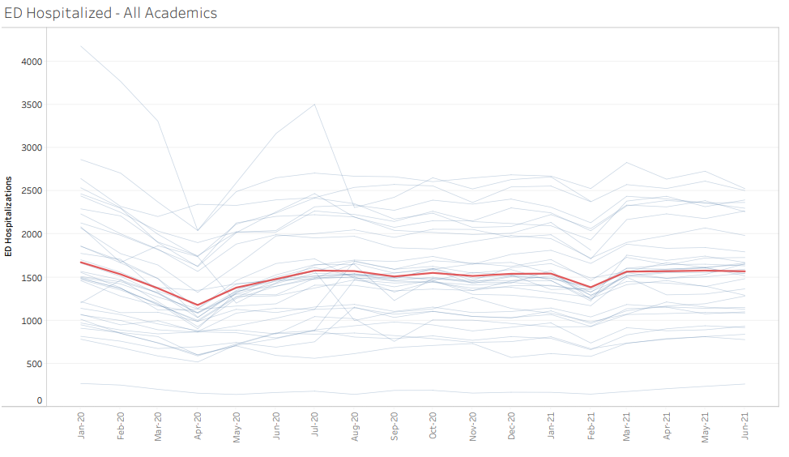
And since then… Hospitalized
1 year
Recovery
June 2021
1 year
Since peak
April 2021
Recovery
July 2020
Peak loss
April 2020
1,674
1,570
1,570
1,578
1,179
Hospitalized volume
(6.2%)
(104 pt/month)

Slide 22
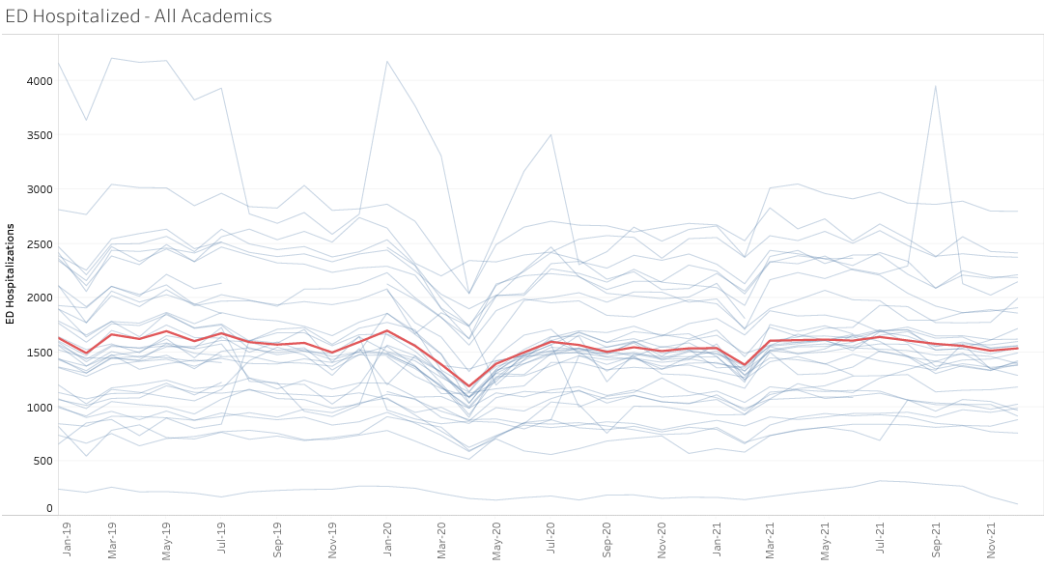
Hospitalized: Before & After
Initial
Recovery
July 2020
Pre-COVID
Jan 2019 thru Dec 2019
Next 12
Months
Next 6
Months
1,578
Peak loss
April 2020
1,541
1,510
1,548
1,179
~98% of pre-COVID
@ pre-COVID

Slide 23
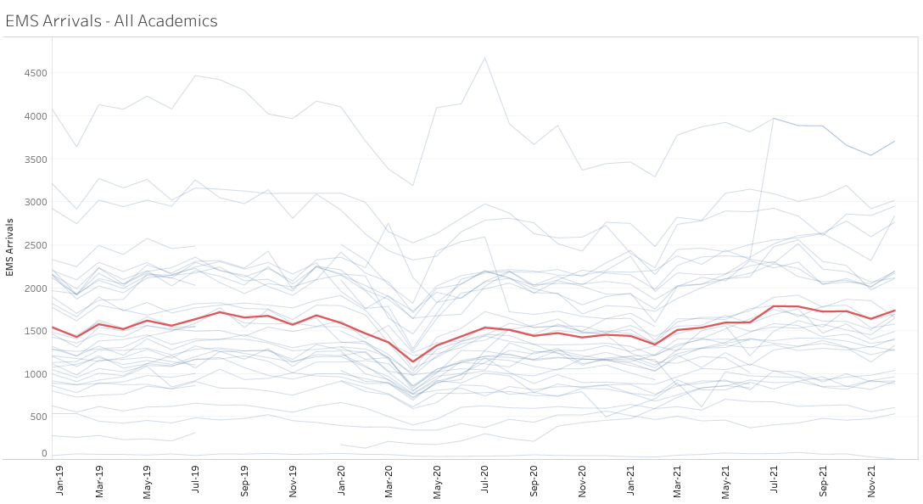
EMS Arrivals
Initial
Recovery
July 2020
Pre-COVID
Jan 2019 thru Dec 2019
Next 12
Months
Next 6
Months
Peak loss
April 2020
1,538
1,352
1,530
1,477
1,141
~92% of pre-COVID
> pre-COVID

Slide 24
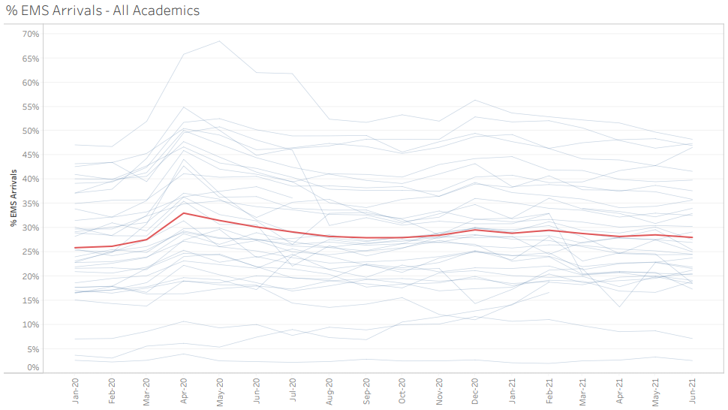
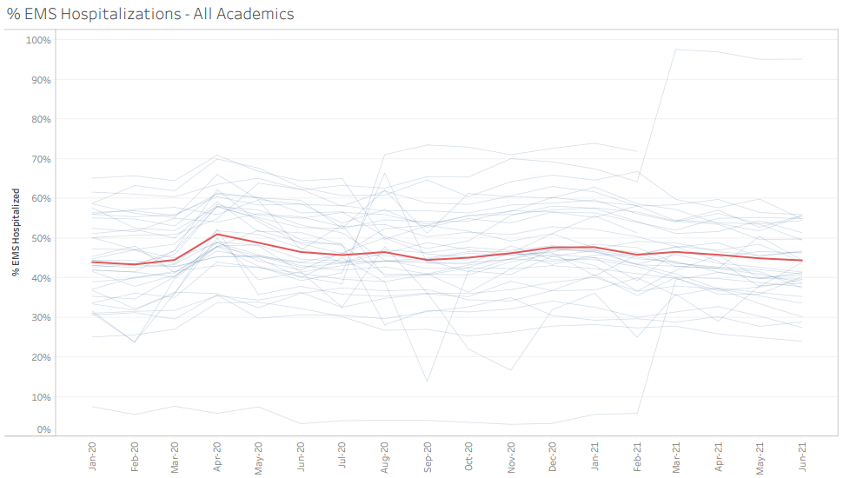
EMS Arrivals
Decrease in overall patient volume with equal EMS volumes
Slight increase in percentage of patients arriving by EMS
26.2%
28.0%
No change in the percentage of patients arriving by EMS
who are hospitalized
44.7%
44.4%
Overall patient volume variability is driven
by the Walk In Discharged patient population

Slide 25
Trauma: Maryland Data Only

Slide 26
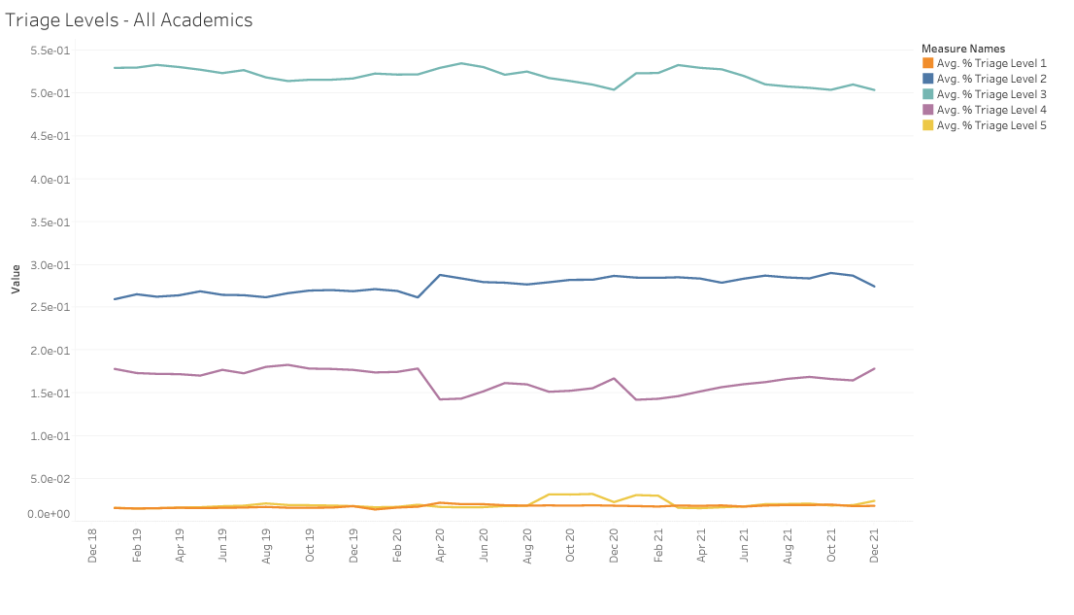
Patient Acuity: Triage Levels
Acuity Ratio Triage Levels 1&2 vs 4&5
Pre-COVID
Jan 2019 thru Dec 2019
Initial
Recovery
July 2020
Next 12
Months
Next 6
Months
Peak
3.0
2.0
2.8
2.5
2.3
Level 2
Level 4
Notes:
Defined as: Triage Ratio = Triage Level 1 + 2 / Triage Level 4 + 5
Triage Ratio Values:
Jan: 2.11
Feb: 2.11
Mar: 1.96
Apr: 3.02
May: 2.81
Jun: 2.67
Jul: 2.43

Slide 27
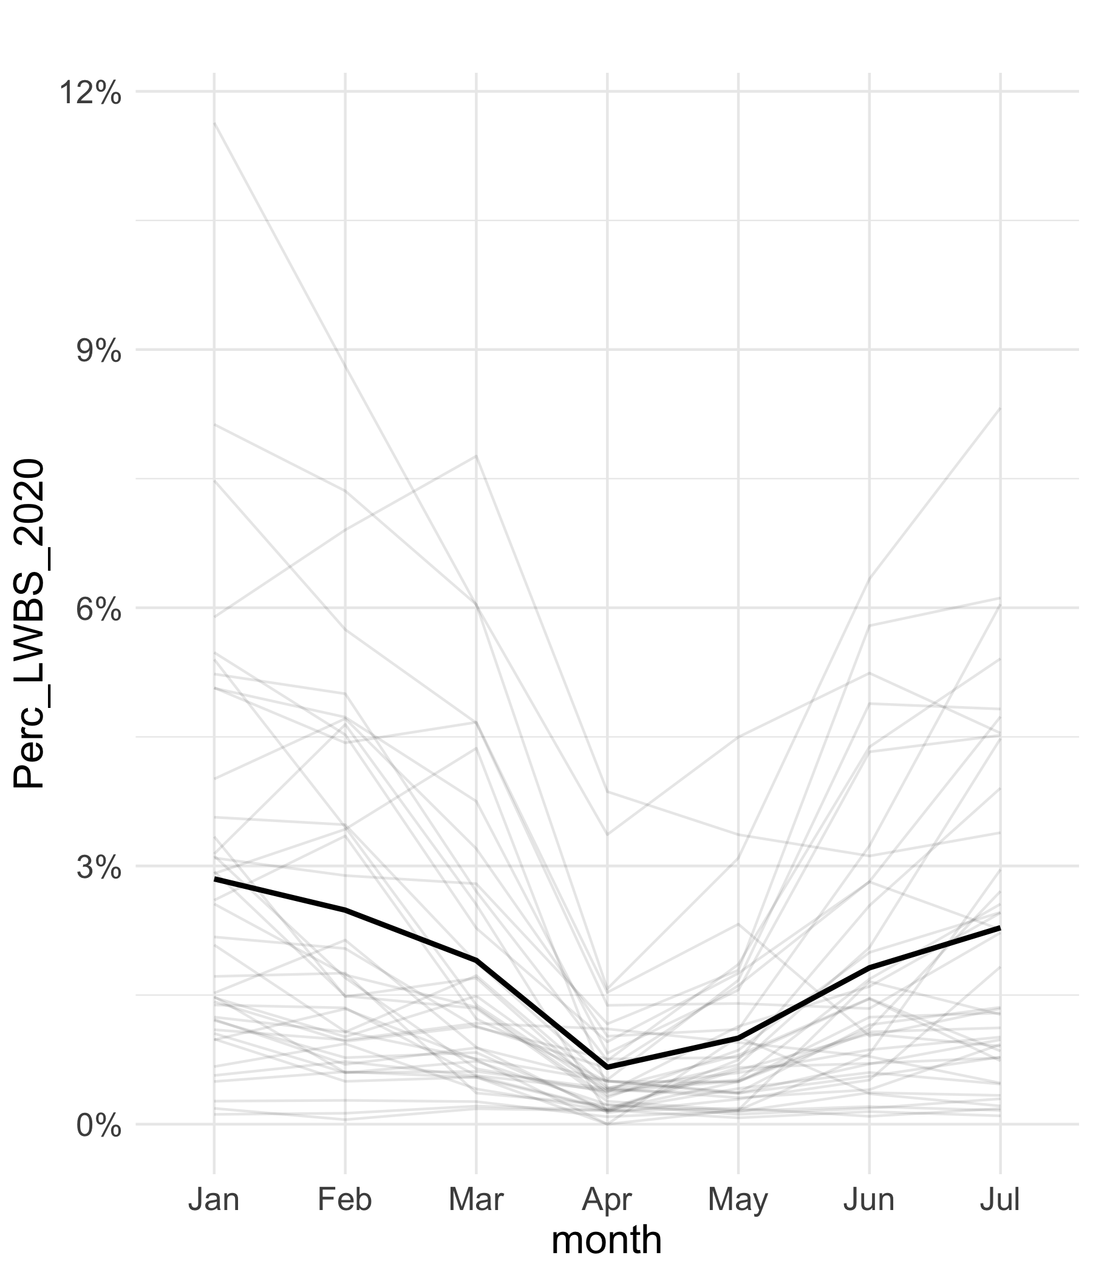
LWBS in 2020
2.7%
2.3%
0.6%

Slide 28
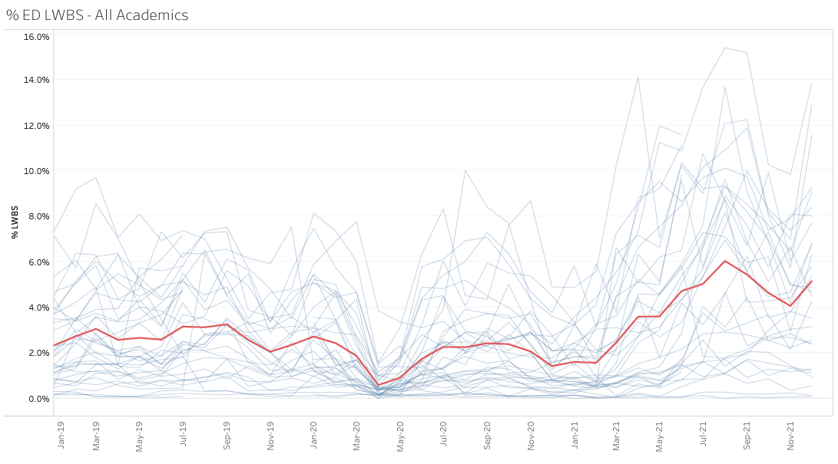
LWBS
Aug
2021
6.4%
Dec
2021
5.1%
Initial
Recovery
July 2020
April
2021
3.6%
Peak
2.3%
0.6%
2.3%
2.7%

Slide 29


What could cause LWBS rise?
BOARDING
BOARDING

Slide 30
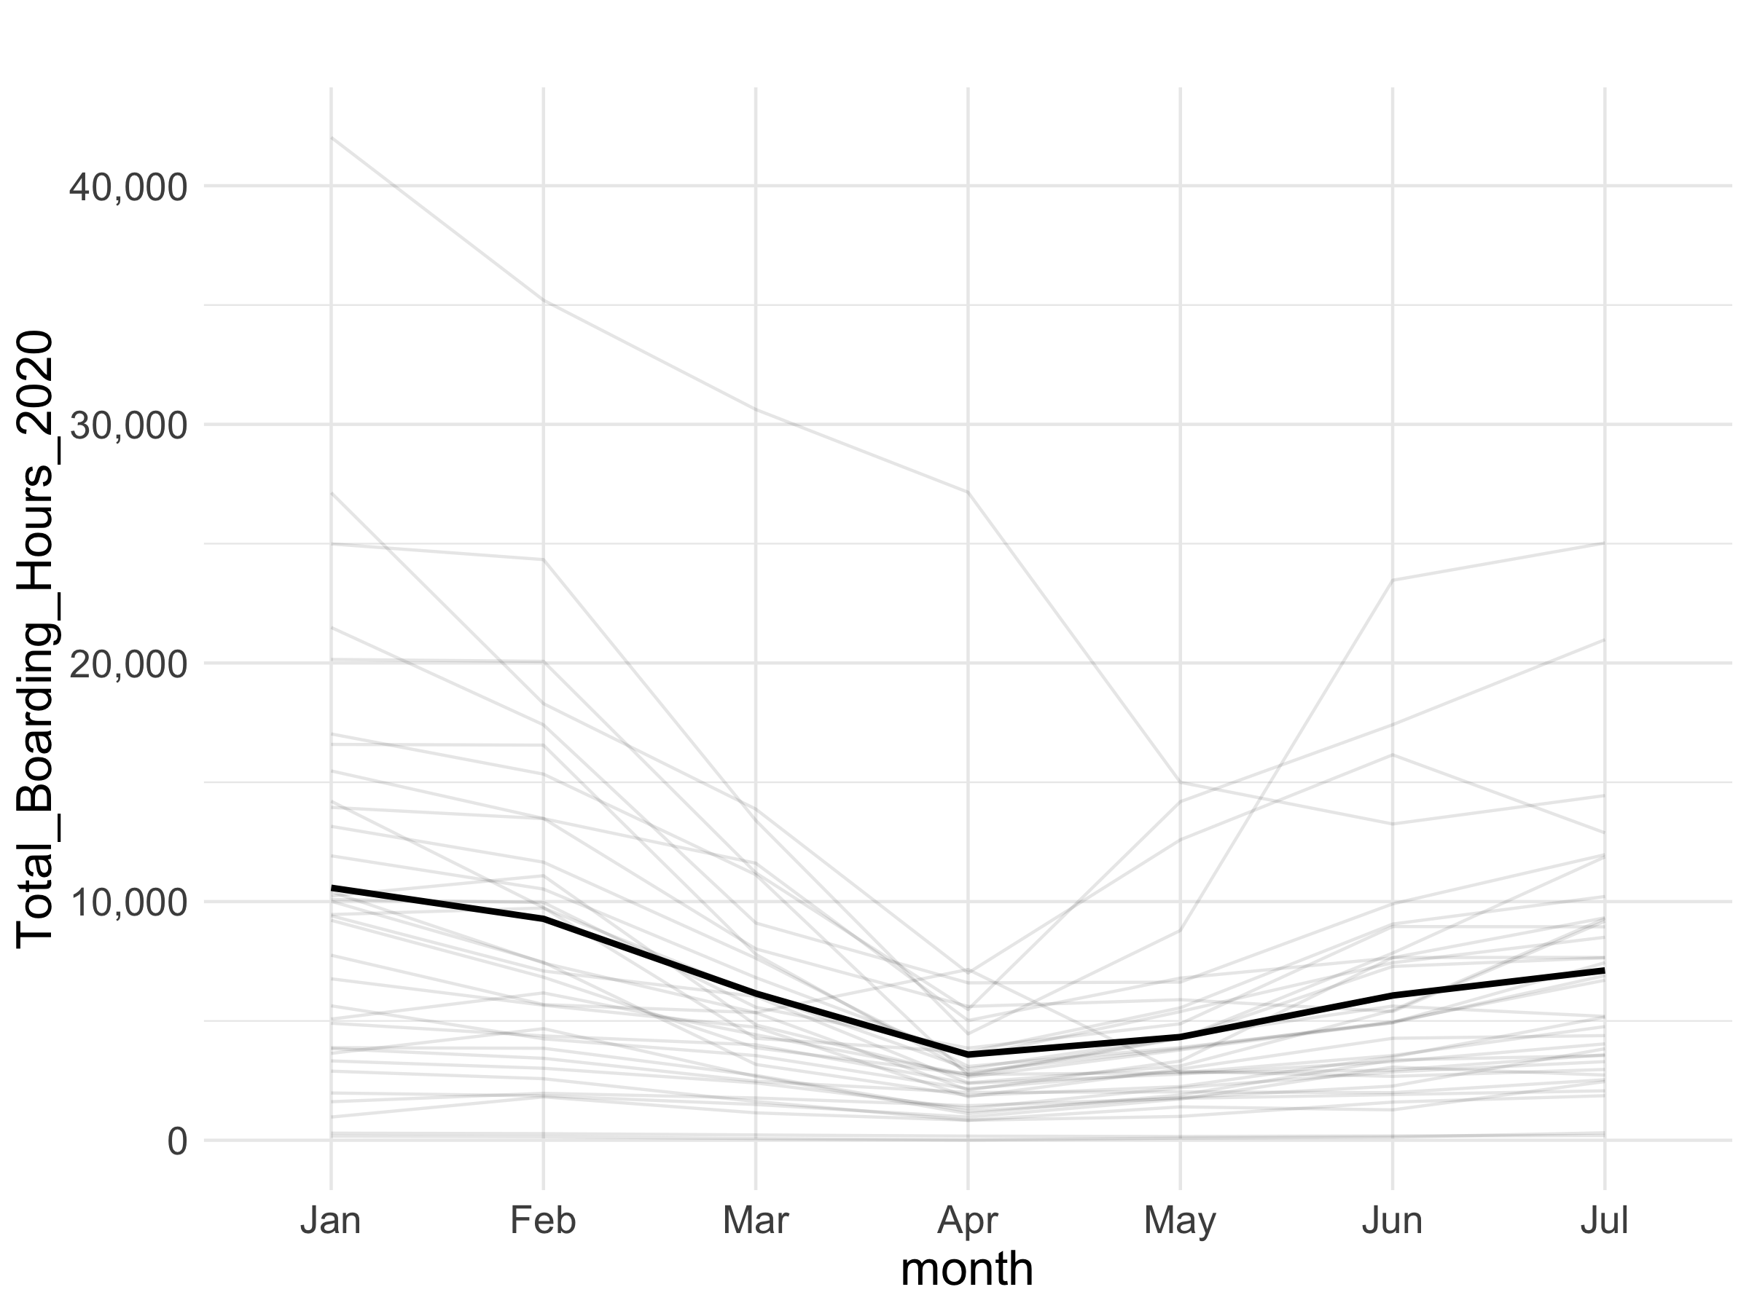
What we knew last year
Total Boarding Hours
Total boarding hours
fell by 66% in April
and were still down
by 33% in July
Notes:
Jan to April: 66.1% Decrease
April to July: 98.3% Increase
Numbers
Jan: 10580
April: 3589.7
July: 7116

Slide 31
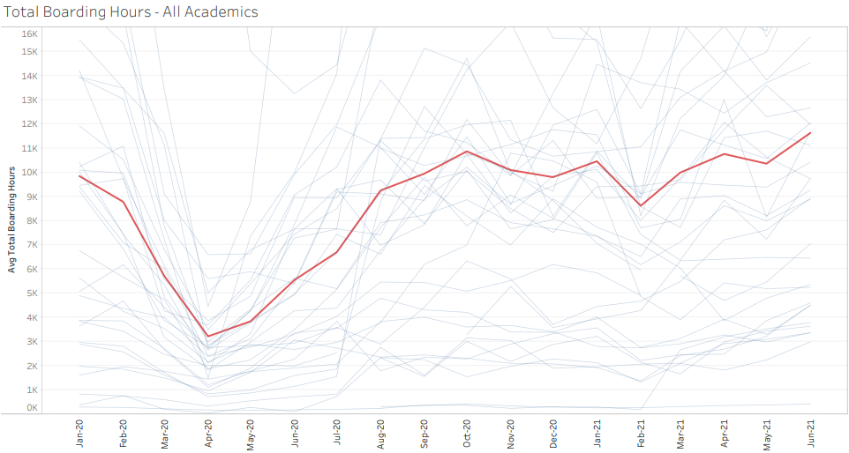
And since then: Boarding Hours
1 year
Since peak
April 2021
1 year
Recovery
June 2021
Peak loss
April 2020
Recovery
July 2020
9,844
10,757
11,629
18%
6,696
3,217
(67%)

Slide 32
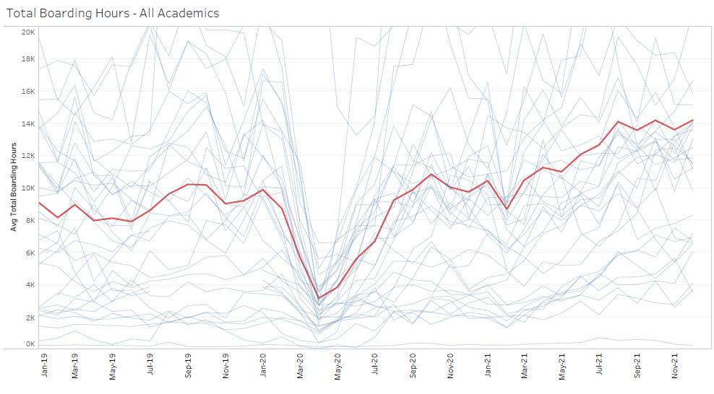
Before and After
Next 6
Months
Next 12
Months
11,740
Peak impact
April 2020
8,361
Pre-COVID
Jan 2019 thru Dec 2019
3,217
8,353
ED volume slightly down
ED Hospitalizations even
Inpatient operations/LOS
Patients per bed = 57 vs 51
Initial
Recovery
July 2020
6,696

Slide 33
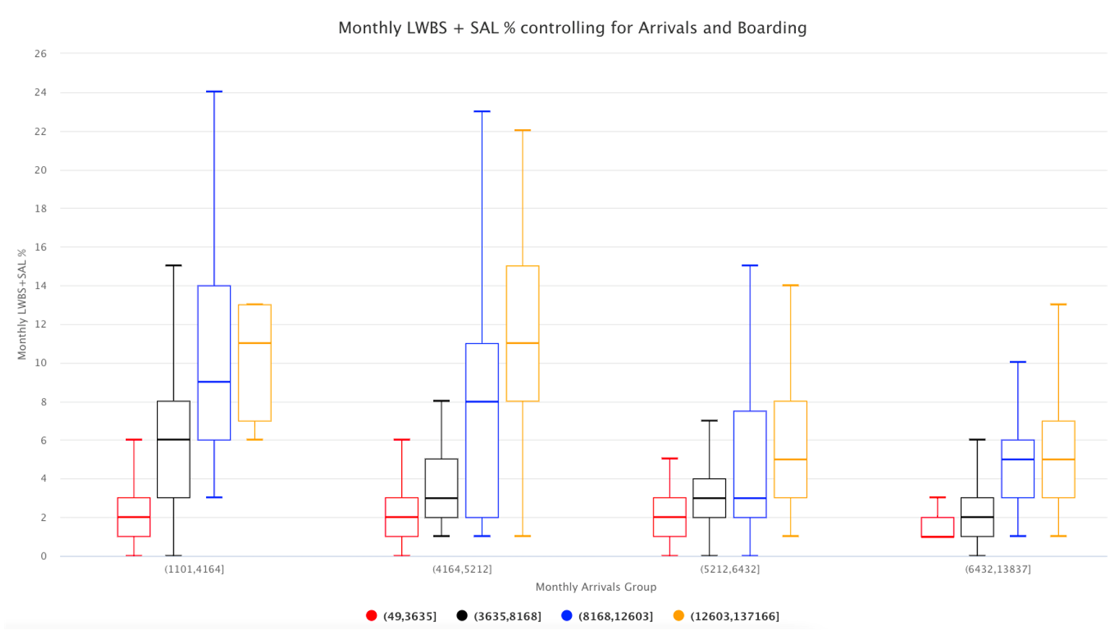
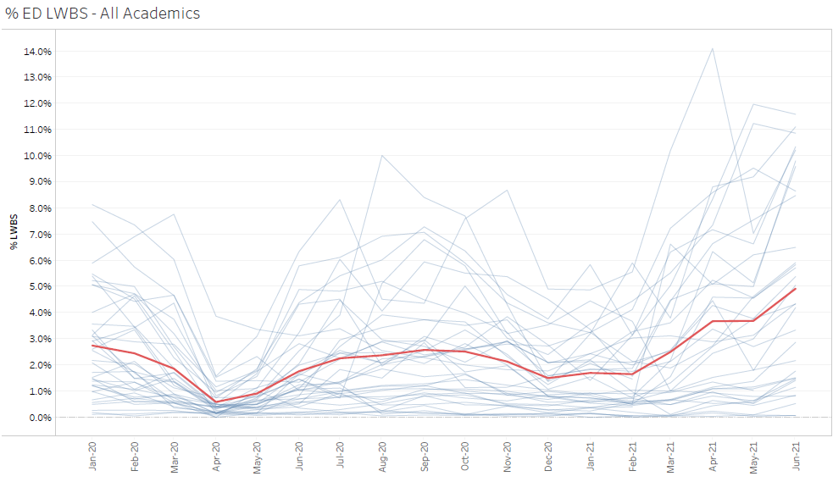
LWBS & Boarding Hours
13,212--49,968
Min to 25th %ile
49,968—62,544
25th to Median
62,544—77,184
Median to 75^{th %ile}
77,184--166,044
75th to Maximum

Slide 34
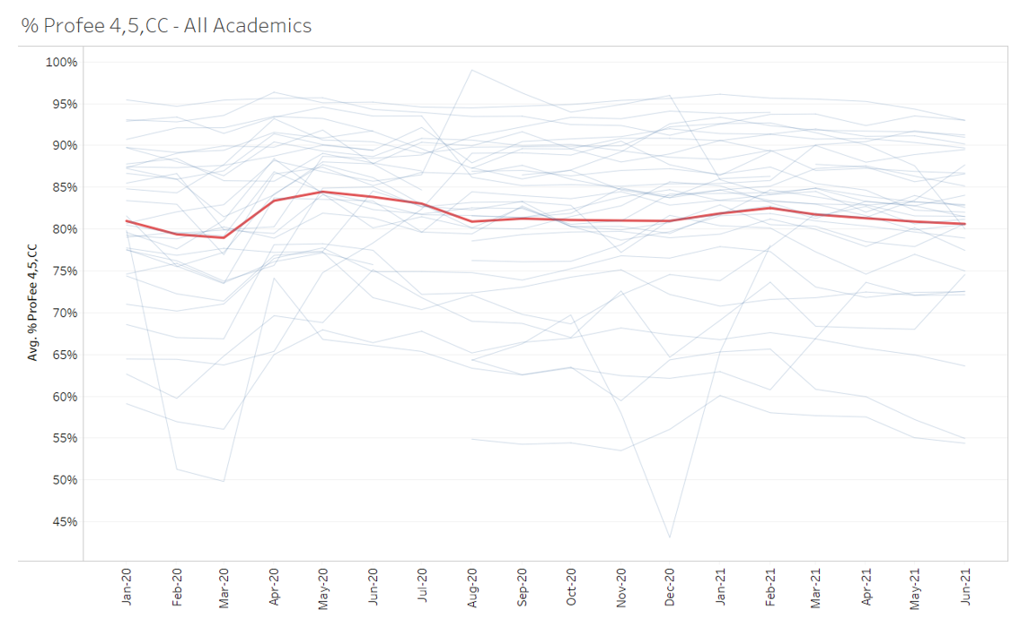
Professional Fee Charges
84.5%
81.0%
80.9%
80.6%

Slide 35
Changes in Patient population between 2019 and 2021

Slide 36
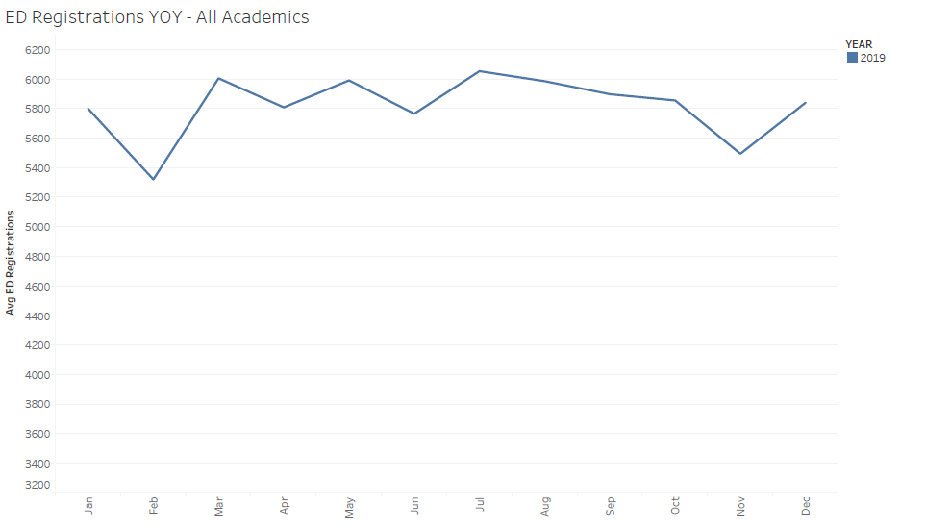
2019—2021 Visits
69,860

Slide 37
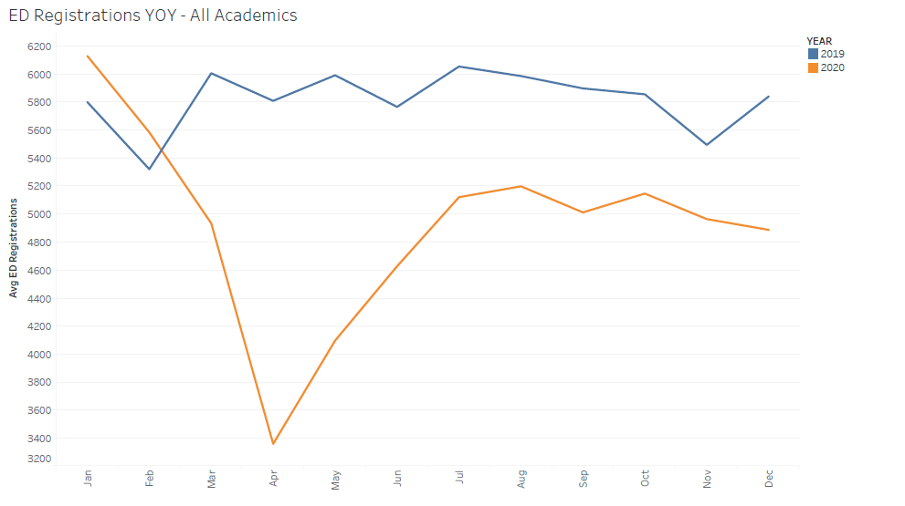
2019—2021 Visits
+593
69,860
(10,772)
59,088
Similar billing patterns as pre-COVID
  Collections @ $140/visit
  Revenue impact = $1.5 million

Slide 38
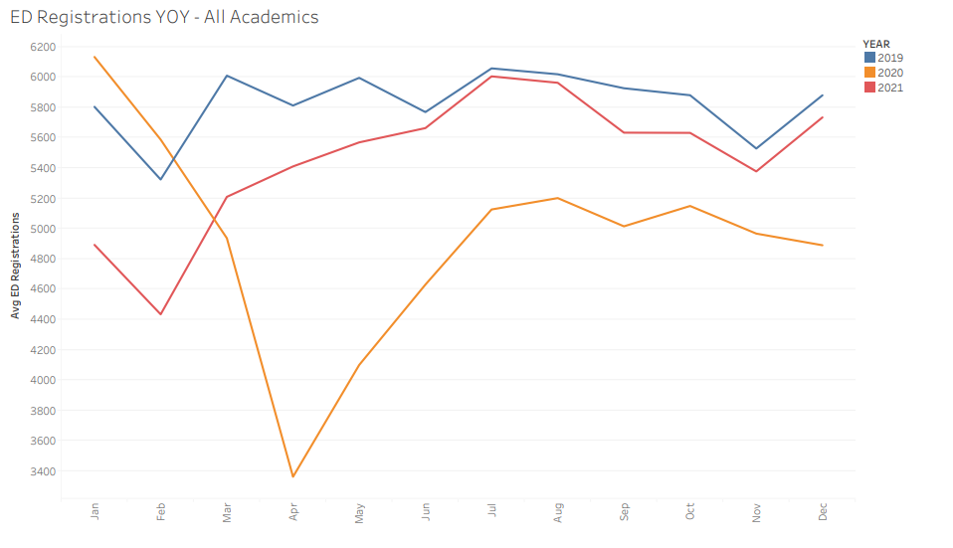
2019—2021 Visits
69,860
65,222
59,088
Calendar Year 2021
4,639 less than 2019
6,134 more than 2020
Revenue impact = $650,000
We are better than last year
But, we are not back to pre-COVID volumes

Slide 39
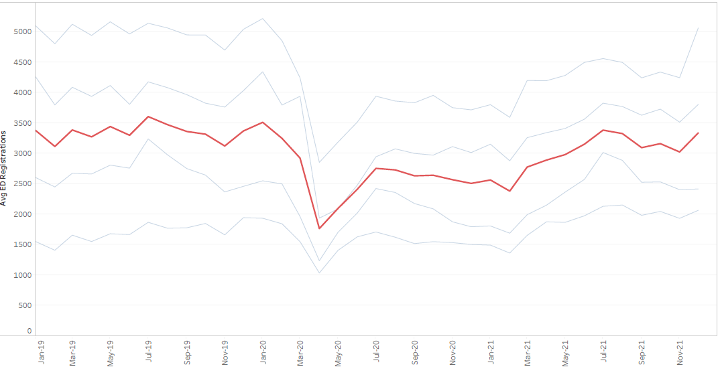
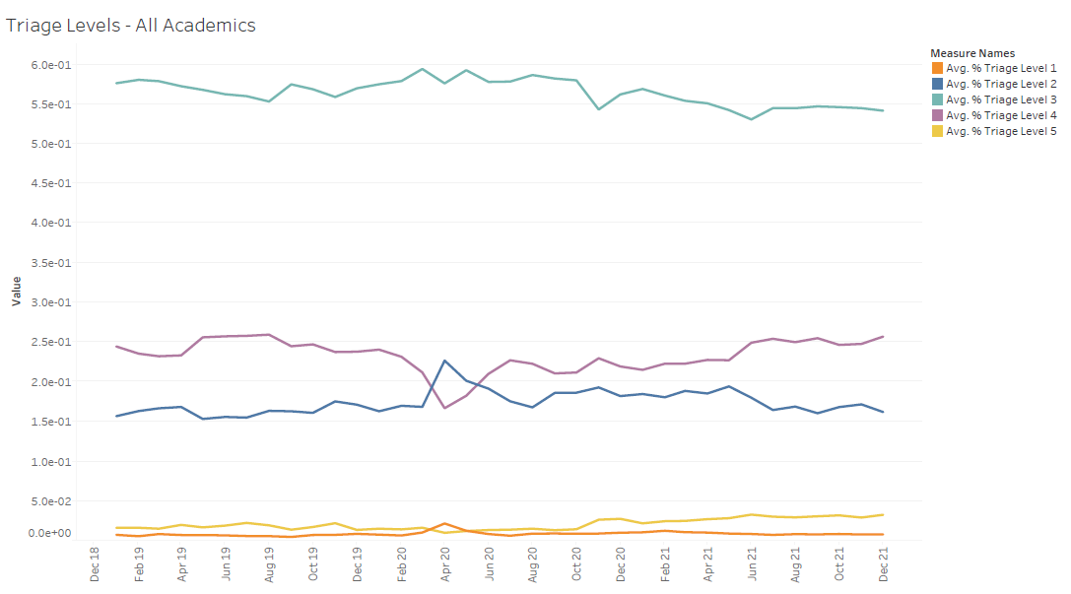
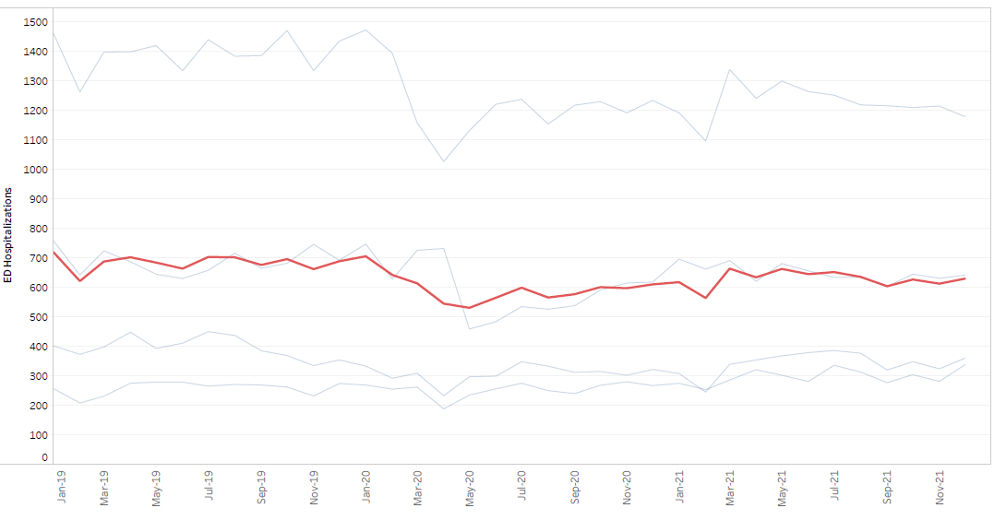
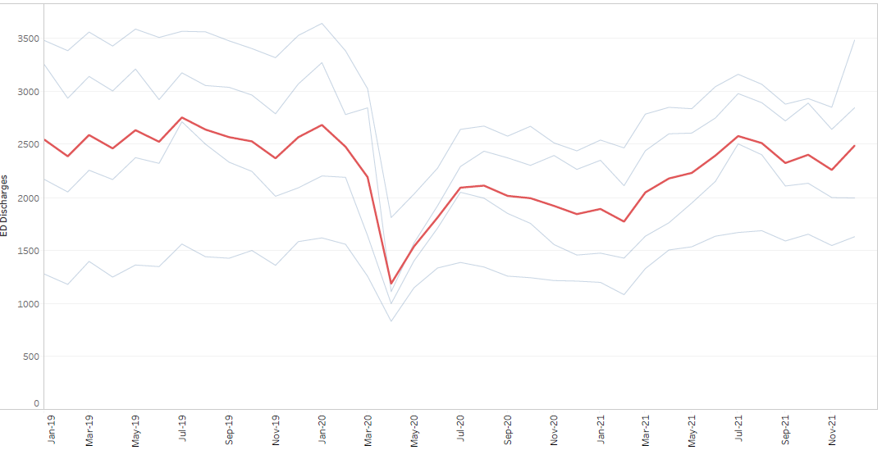
Community Hospitals
Total Visits
Triage Levels
Hospitalizations
Discharges

Slide 40
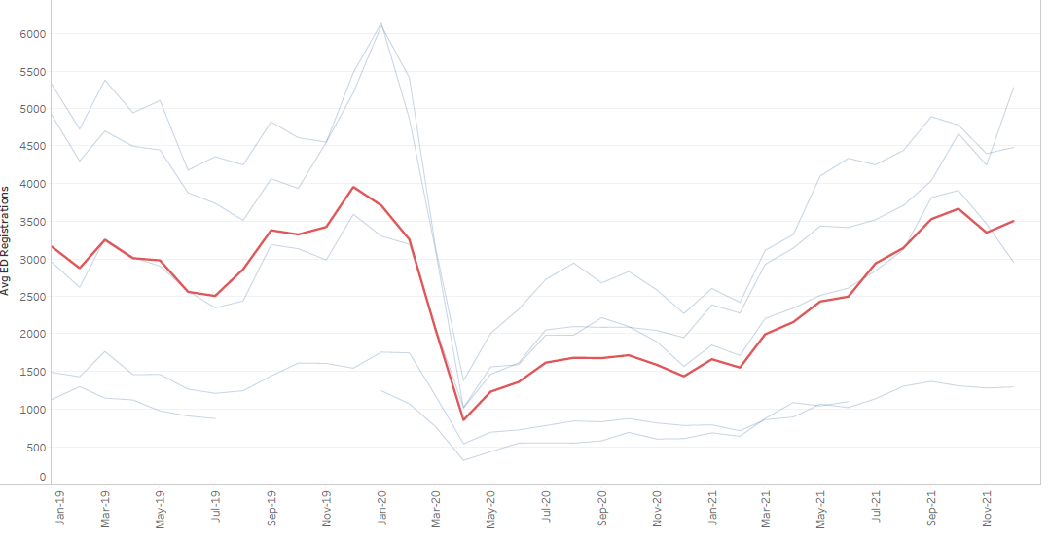
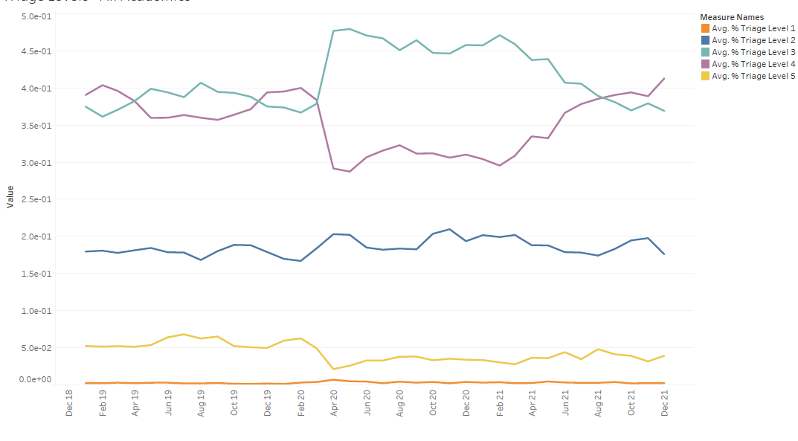
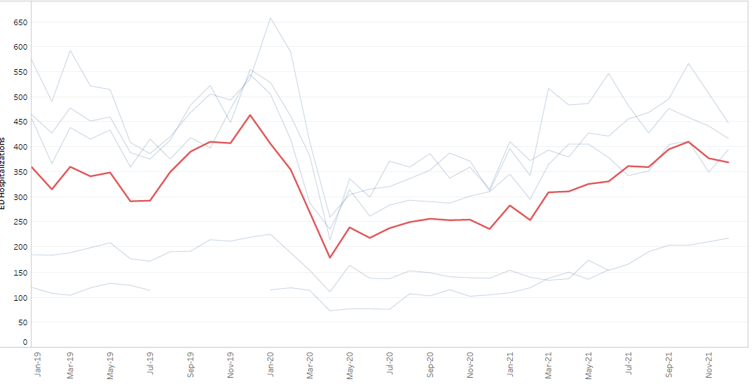
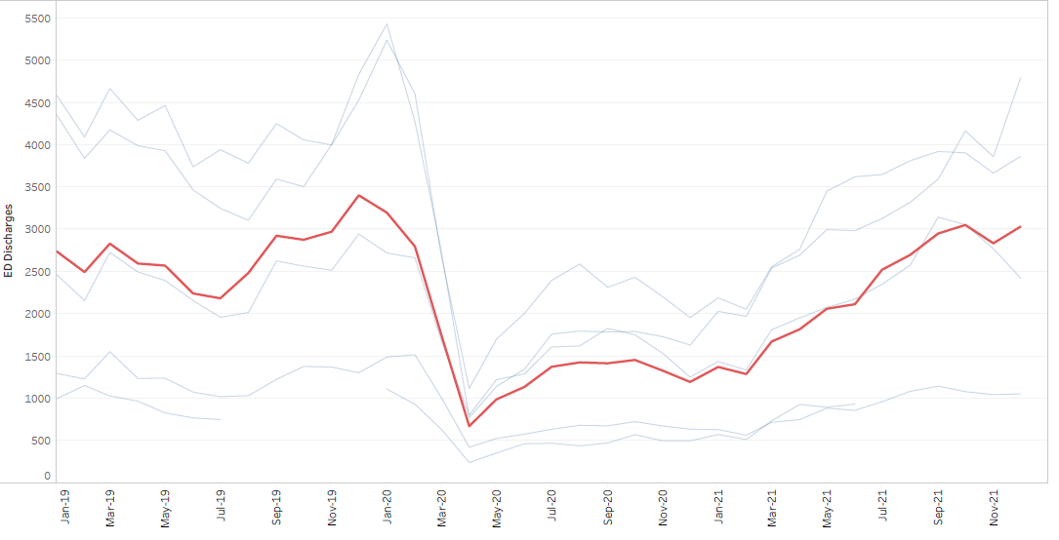
Pediatric ED
Total Visits
Triage Levels
Hospitalizations
Discharges

Slide 41
Questions

