Slide 1
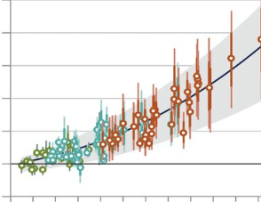
Can We Change the Numbers?
Insights from a Study of Academic Emergency Medicine Department Chairs
Cherri Hobgood MD

Slide 2
Disclosures
No Financial Disclosures
Professional Disclosures
Past President SAEM and SAEM-Foundation
Past Chair the ACEP Board of Directors
Executive Board of International Federation for Emergency Medicine
Chair Emeritus Indiana University School of Medicine
Founder Center for Leadership Life

Slide 3
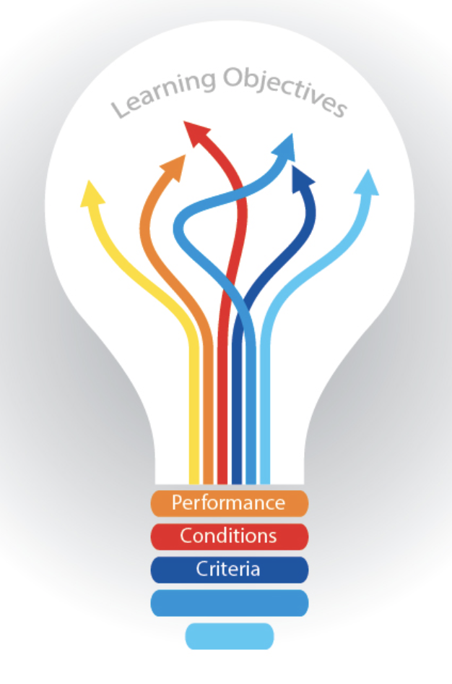
Learning Objectives
Understand the current status of women’s rank advancement in EM
Gain an awareness of the barriers that limit women’s advancement and leadership endurance
Describe new ways to measure parity and advancement for all facets of the EM workforce
Define ways our discipline and your department can support the advancement of women’s leadership

Slide 4
Share national and EM specific data on women in the academic medicine workforce
Academic Medicine
Emergency Medicine
Department
The Plan
Individual

Slide 5
Session Format
25-minute Didactic
30-minutes Open Discussion of Solutions
5-minute Wrap-Up

Slide 6
Solicit your input and assistance to create a gender diverse workforce in emergency medicine
Goal 1

Slide 7
Identify key drivers we can change
Goal 2

Slide 8
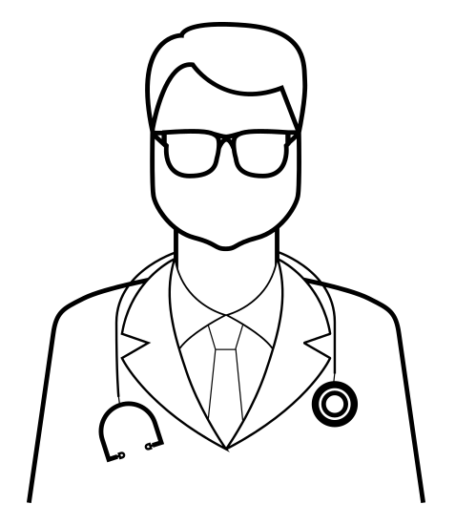
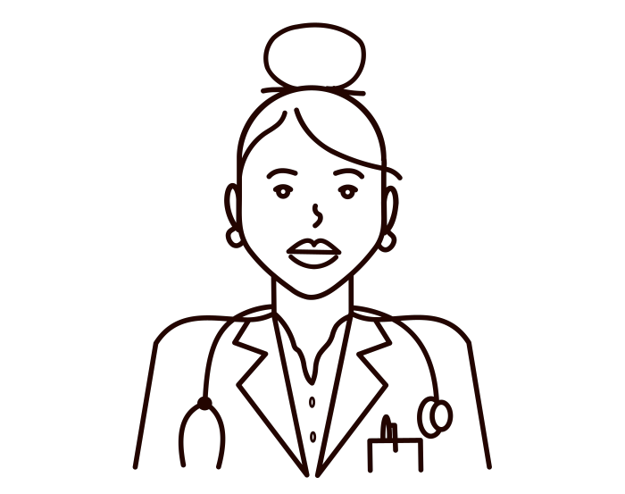
“….A table for 12, please”
Women EM Chairs
2001 = 10% 2020 = 11.3% ^{1,2}
1. Acad Med. 2002;77(10):1043-1061.
2. Association of American Medical Colleges: Faculty Roster—Table C: Department Chairs by Department, Sex, and Race/Ethnicity, 2020.

Slide 9
Expansion of Academic Emergency Medicine
2001= 60
2021 = 114
Academic Departments of Emergency Medicine
+90% in 20 years

Slide 10
“Talking about what is happening now means we are behind”
Jim Meffert

Slide 11
EM has a Workforce Issue

Slide 12
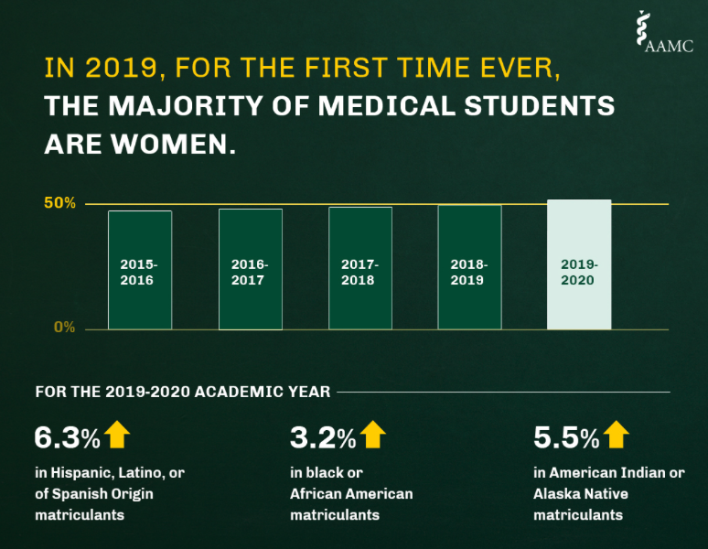

Slide 13
Percent of EM Residents by Gender 2015-2021
Opportunity

Slide 14
What Matters at Work to Millennials and Gen Z
Notes:
When Asked what do you care about in your career ??

Slide 15
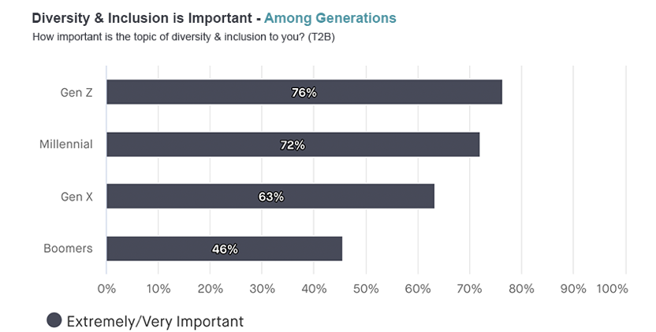
Generational Issues are Different
Current medical students are millennials (1980- 1995)
Generation Z (1997-2012) began matriculating in 2020
More than 70% of Gen Z and Millennials believe Diversity and Inclusion is Important

Slide 16
Values by Generation
https://www.campaignlive.com/article/gen-z-demands-diversity-inclusion-brands/1705491
Notes:
Gen Z is the most diverse generation in American history, and would like to see that same representation reflected by the brands they shop with, according to a December study by quantilope.
The report, which asked consumers what they want to see from brands and entertainment companies when it comes to race and representation this year, is based on responses from 630 Americans across demographics including age, gender, sexual orientation and race.
Gen Zers made clear throughout the study that they want brands to step up their efforts around representation. For example, 76% of Gen Zers said they feel diversity and inclusion is an important topic for brands to address, compared to 72% of millennials, 63% of Gen Xers and 46% of Baby Boomers who felt the same.

Slide 17
Notes:
Only Professor, Associate, and Assistant professor
In these three categories the total number of faculty overall increased by 657 faculty
From 4811 in 2019 to 5468 in 2020.
Total faculty including instructor category 5572 in 2019 and 6326 in 2020.
Instructors ~46 more men in 2019 (350 vs 304) ~ EQUAL in 2020. (375 vs 372)

Slide 18
Total & Percentage EM Faculty by Gender 2015-2017-2019

Slide 19
EM
11.3%
The State of Women in Academic Medicine,2018-2019: Association of American Medical Colleges (AAMC);2020.

Slide 20
How Can We Look at This Differently?

Slide 21
Rank Equity Index (REI)
Tool to evaluate progress of rank attainment
Ratio of cohort's percentage representation at a higher academic rank relative to their percentage at a lower academic rank
REI =
% women professors
% women assistant professors
REI highlights inequities in faculty rank that may be masked when using aggregate faculty proportions, which do not account for rank
Fassiotto M. et al. Acad Med. 2020;95(12):1844-1852.
Notes:
Reliable & simple
Tracks faculty progress & identifies rank disparities

Slide 22
REI by Gender 2015, 2017, 2019, 2020
 | Male |  |  | Female
 | 2015 | 2017 | 2019 | 2015 | 2017 | 2019 | 2020
Professor/ Assistant Professor | 1.32 | 1.34 | 1.37 | 0.46 | 0.46 | 0.47 | 0.48
Professor/ Associate Professor | 1.09 | 1.14 | 1.16 | 0.71 | 0.65 | 0.63 | 0.63
Associate Professor/ Assistant Professor | 1.2 | 1.18 | 1.17 | 0.66 | 0.71 | 0.75 | 0.76
*Parity is a score of 1
Hobgood C, Fassiotto M. Acad Emerg Med. 2021;28(9):966-973

Slide 23
Professor/ Assistant Professor by Gender and Specialty

Slide 24
EM REI by Gender and Race 2019

Slide 25
EM women do not achieve parity at any rank, regardless of race / ethnicity!

Slide 26
EM REI by Gender Across the Academic Continuum—2020
What Happens Here??

Slide 27
Full-Time Clinical Science Faculty Promotions by Rank and Gender 2005-2006 through 2017-2018
Seven Year Promotions Ten Year Promotions

Slide 28
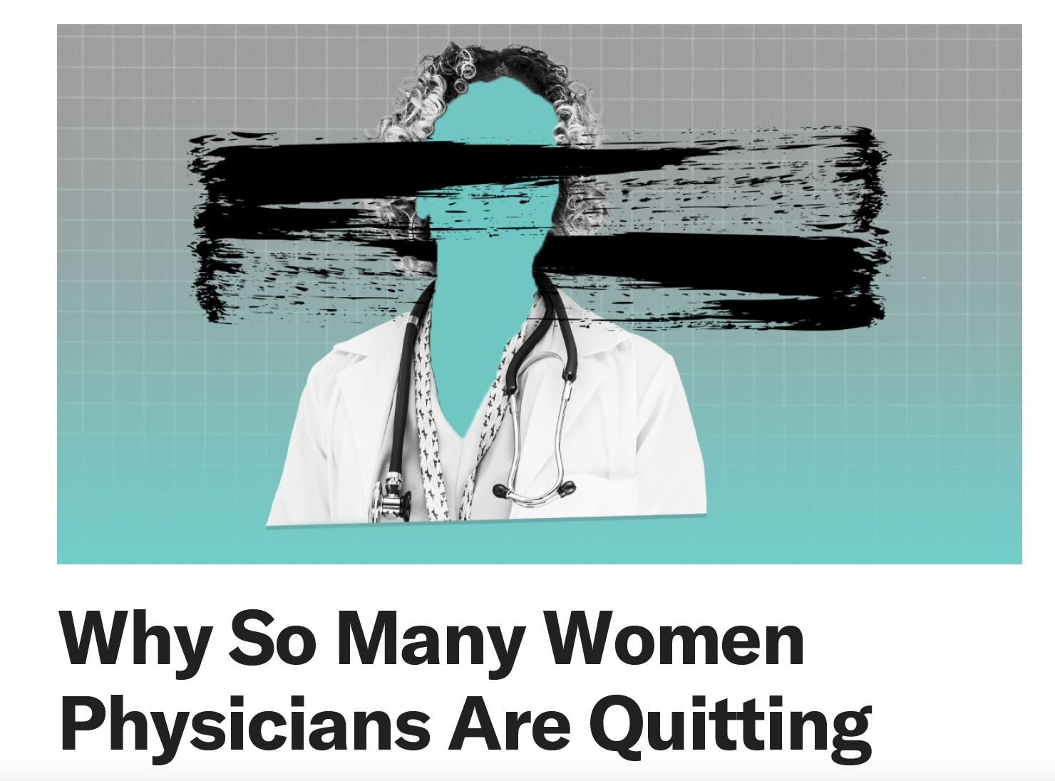
HBR.org Jan,19, 22

Slide 29
https://www.medscape.com/slideshow/2020-women-physicians-6013042?faf=1#3

Slide 30
Is EM a Good Place for Women to Work?

Slide 32
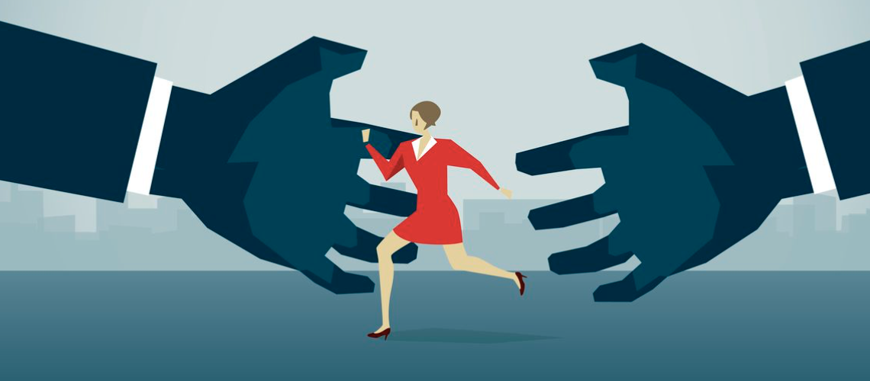
Graham EM et al. Gender-based Barriers in the Advancement of Women Leaders in Emergency Medicine: A Multi-institutional Qualitative Study. West J Emerg Med. 2021;22(6):1355-1359.
68% EM Women Experience Gender Based Disrespect
9.5% report at least one encounter of sexual assault by a colleague or supervisor during their career

Slide 33
Leadership Challenges Faced by EM Women Chairs
Negative faculty reactions
Feeling unprepared for role
“Push back” from both male and female faculty
Some received institutional support to resolve the issues, others did not
HR—People management
Emotional isolation

Slide 34
Leadership Challenges Faced by Women EM Chairs
Being one of few women in leadership
Inheriting an unhealthy department culture
“Solitary outsiders”
Exclusion from & gendered settings and social activities
Inheriting toxic workplace cultures
Met with substantial resistance when trying to improve culture
Notes:
We Interviewed 19 current and emeritus women in EM medicine and asked them about challenges

Slide 35
Powerful subtle, inadvertent obstacles encountered by women that are frequently invisible and often unrecognized—even by those experiencing them. These biases are the product of organizational culture and social cultural assumptions that yield behavioral ambiguity and create work practices and expectations that systematically disadvantage women.
Second Generation Bias
Ibarra H, Ely R, Kolb D. Women Rising: The Unseen Barriers. Harv Bus Rev. 2013;91:60–66.

Slide 36
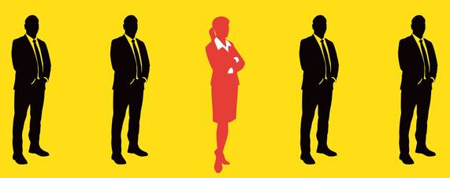
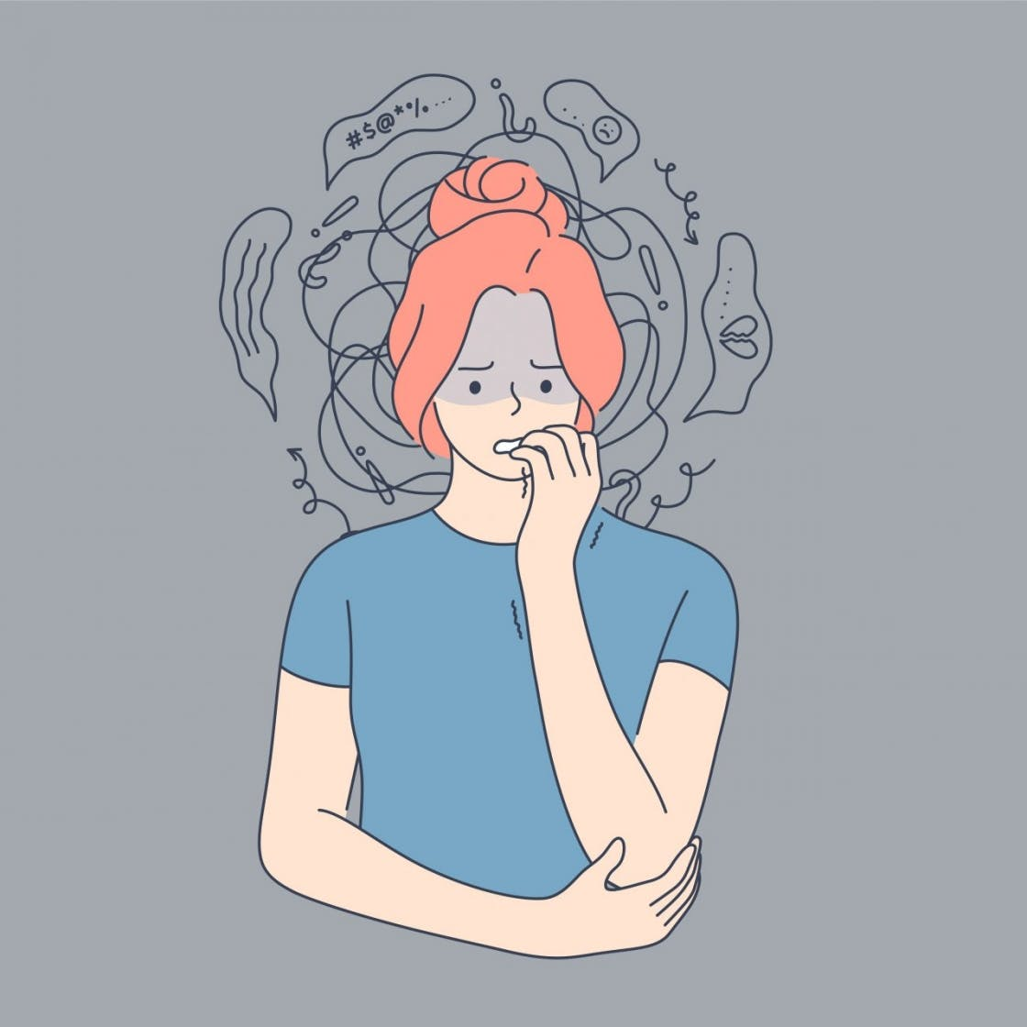
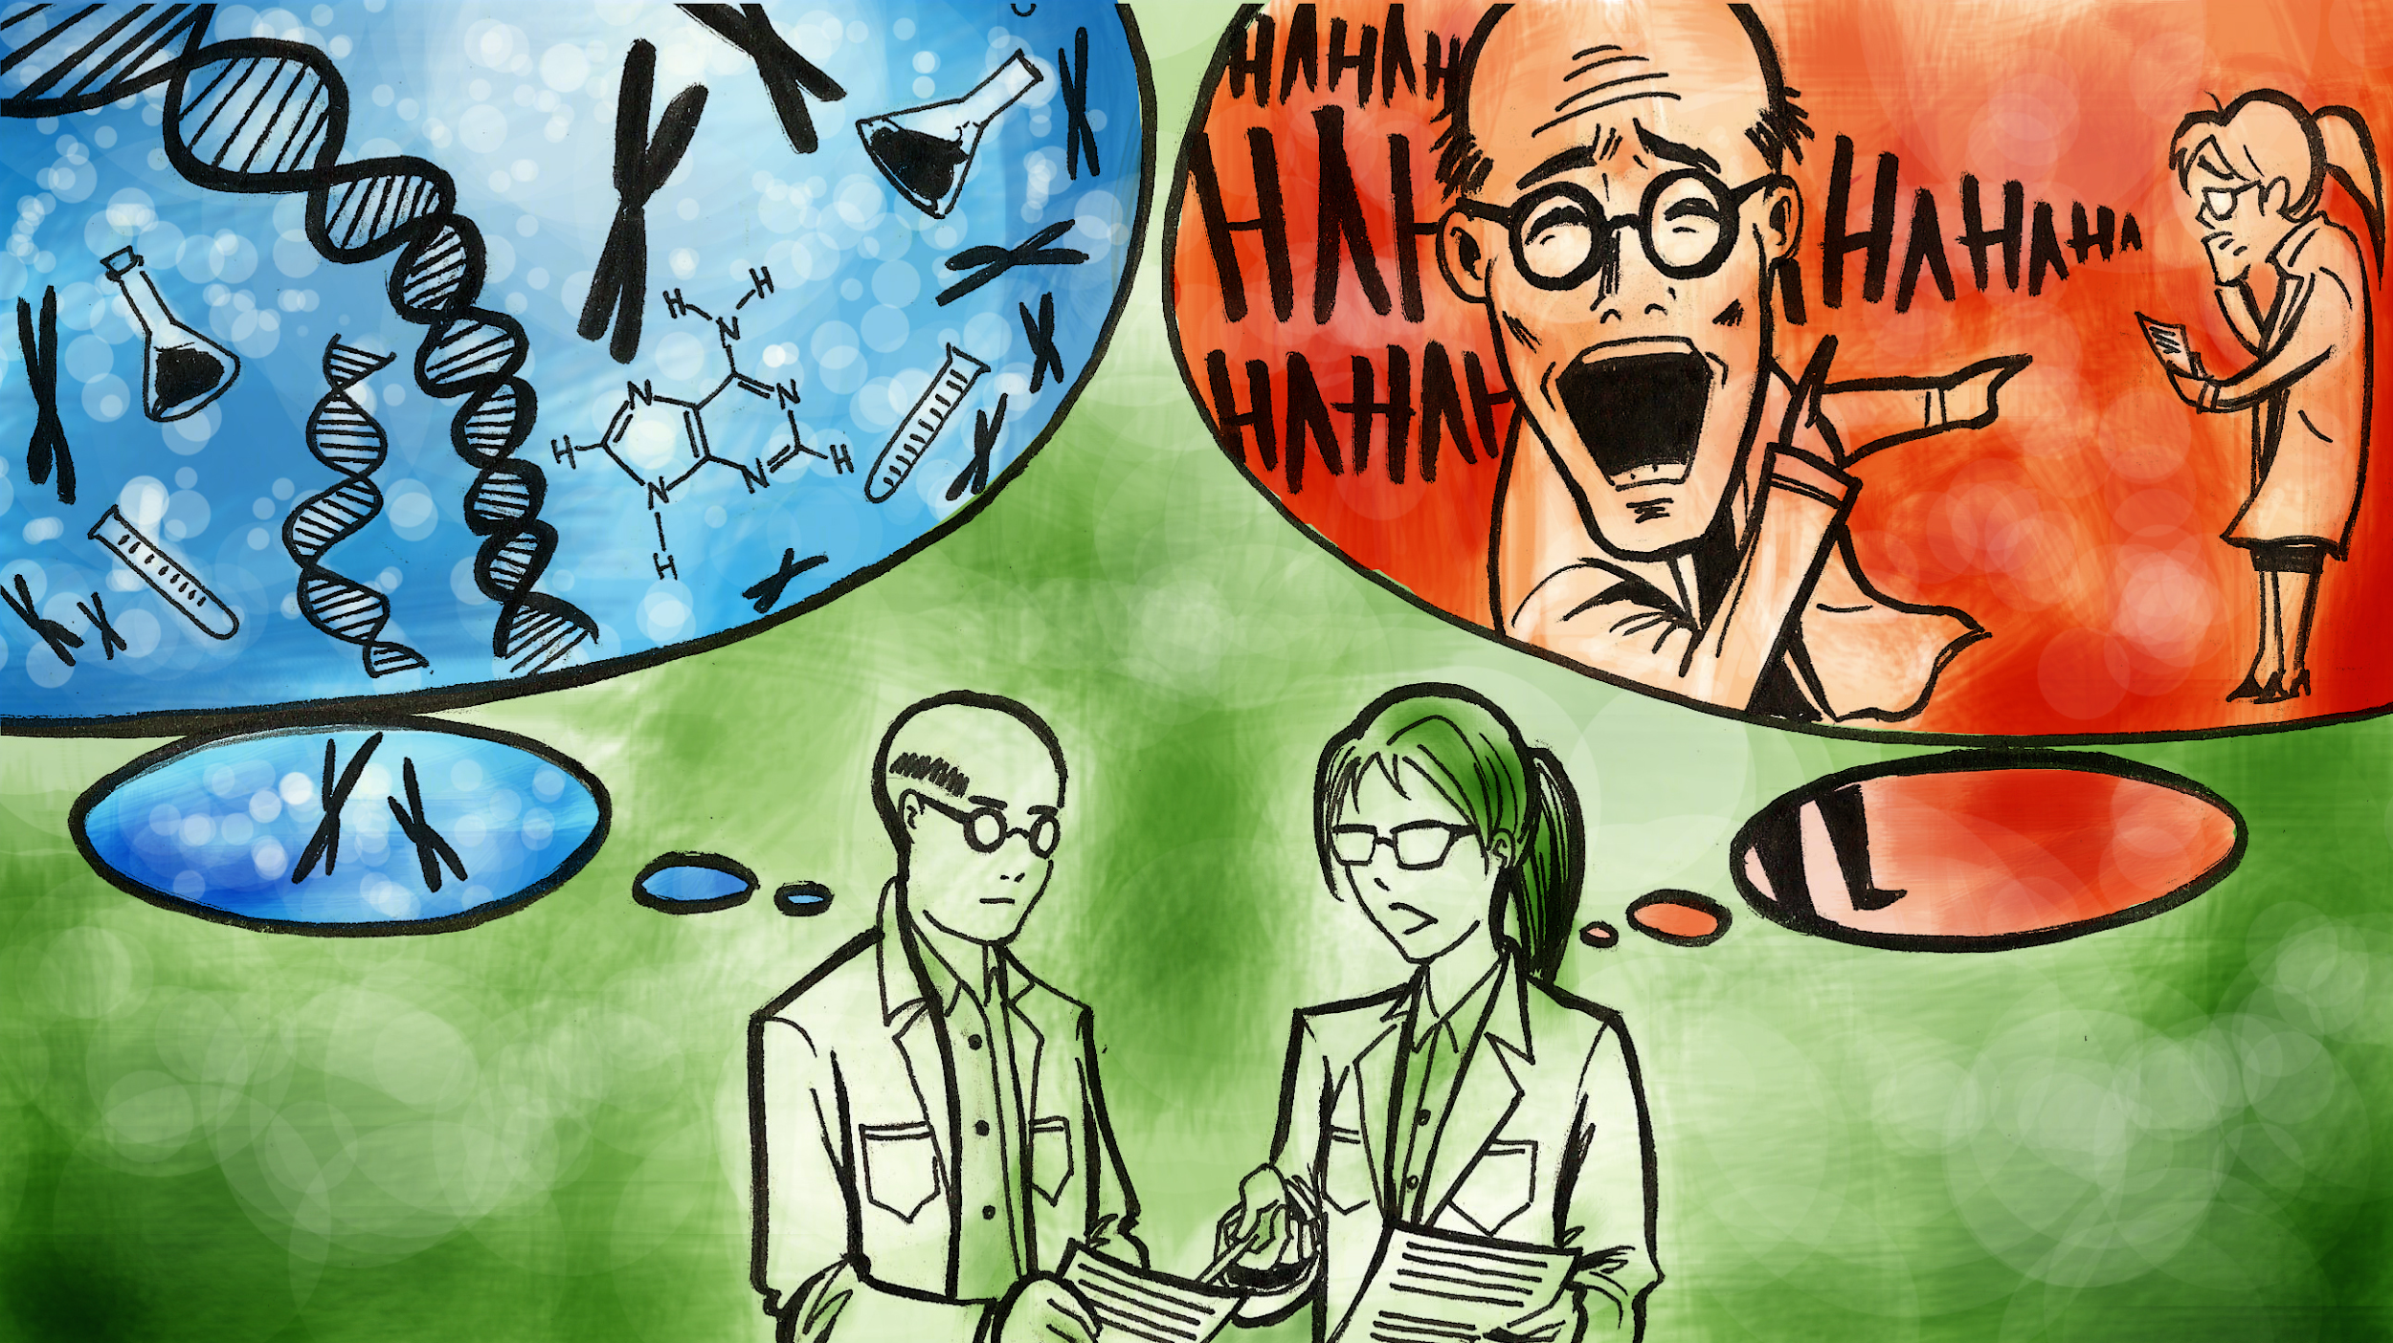
Second-Generation Biases
Gender-Based Workplace Isolation
Gender Role Stereotypes
Belonging Uncertainty
Stereotype Threat
Masculine Leadership Constructs

Slide 37
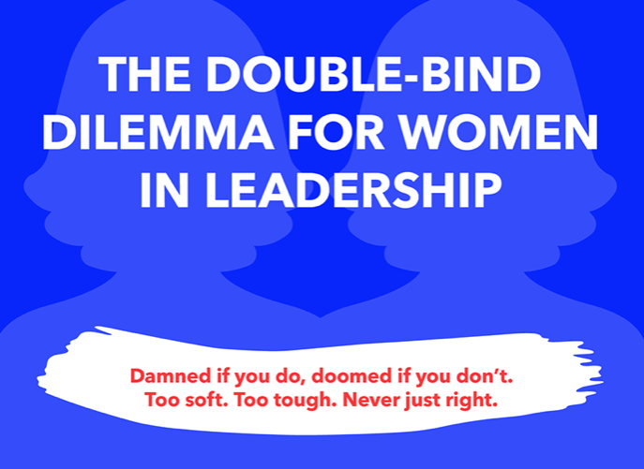

Slide 38
“When you exert your authority, people, come across surprised, they don't expect it and they just think you're just going to roll over and let them do whatever they want to do.”
“They think I'm a woman, I'm going to be a pushover.” "She's nice, so she wouldn't really do that to me.””

Slide 39
SOCIAL PENALTIES
Labeling, derision, and character assaults applied to women
Examples applied to EM women leaders—“bitchy”, “witchy”, “dishonest”, “lacking integrity”, “bullies”, “mean”
Applied equally by both genders
MAJOR DERAILER OF WOMEN LEADERS
Social penalties stick—become known as unlikable & difficult
Reputational power is decreased –viewed as less influential & capable
Increases Emotional Labor

Slide 40
***Women are more vulnerable to social penalty when they actively assume a typically male leadership role—demonstrating an active choice to violate proscriptive social norms***
Social Penalties Double Down When Women are Successful in Those Roles

Slide 41
Another type of social penalty Gendered Feedback…

Slide 42
Words Used to Describe Men are more Positive

Slide 43
Triggers
Competency
Efficiency
Use of the Same Tone or Behavior as Men
Unfortunately, many great women faculty receive this feedback in the course of their normal jobs
How to Spot IT
Feedback is vague and includes personality-laden descriptors
“aggressive”
“abrasive”
”intimidating”
“not friendly enough”
“bossy”
The Damage
Lower Salary
Fewer & Later Promotions
Wasted Time
Emotional Tax
To progress, women must work harder and juggle a collection of contradictory behaviors and all the while…….
Smiling more

Slide 44
Leadership Emerges Differently

Slide 45
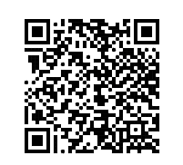
Department Chair Leadership Emergence—Men
“Destined to Lead”
Viewed themselves as leaders in early career
Chair role was deliberate and opportunistic
Gain Influence
Wanted to gain influence within institution & medical community
Dismissed Risks Involved
Acknowledged failure as a risk but comfortable with taking the risk
Sponsored
Attaining leadership role was enhanced by sponsorship of senior leaders

Slide 46
Department Chair Leadership Emergence—Women
Preparation
Viewed leadership as something they have long prepared for
Many needed to be coaxed into roles
Making Things Better
Wanted to make a difference
Inspired by potential of department, faculty, institution
Cautious
Acknowledged risk of failure—concerned that it could disadvantage career
Self-Directed
Attaining leadership was a result of their own efforts

Slide 47
They say it’s a leaky pipeline…I’d say its in the water

Slide 48
What are the drivers that we can change?

Slide 49
Collective Solutions
Notes:
Social services
Child care
Food

Slide 50
“I have not failed. I’ve just found 10,000 ways that won’t work.”
– Thomas A. Edison

Slide 51
To recap….
The rate of EM women attaining chair leadership roles is stagnant
Women have not achieved parity (REI score of 1)
across any academic rank
Women chairs in EM experience unique challenges that differ from men when assuming leadership positions
Second-generation biases disadvantage women leaders

Slide 52
Identify Embedded System Barriers that Constrain Women
Make promotions and hiring more equal
Identify policies and procedures that can level the playing field
Modify expectations to support working parents—so women are not forced to make work or family decisions
Approach gender parity and the path to equality with hard data
When are women dropping out?
Do women really ACT differently than men?
Asking and identifying what about the culture is limiting women’s growth?
Consider additional training for all faculty
Bias Reduction programs
Coaching

Slide 53
Five Solutions to Facilitate Gender Equity in Leadership
Gaining & Maintaining Confidence º
Maintaining Accountability & Mission Alignment º
Facilitating Teamwork º
Support Women’s Leadership*
Creating Safe Leadership Cultures *
º Individual level solution
* Institutional level solutions

Slide 54
“There are decades where nothing happens, and there are weeks when decades happen”
Vladimir Lenin

Slide 56
Supporting Women? or Holding Women Back?
Encouraged to take accommodations
Part-time
Delayed promotion and tenure
Leadership opportunities are not equivalent
Internally facing roles
Operational rather than strategic responsibilities
Lack of people or budgetary oversight

Slide 58
Interrupting Sexism at Work. Catalyst https://www.catalyst.org/reports/interrupting-sexism-workplace-men/

Slide 59
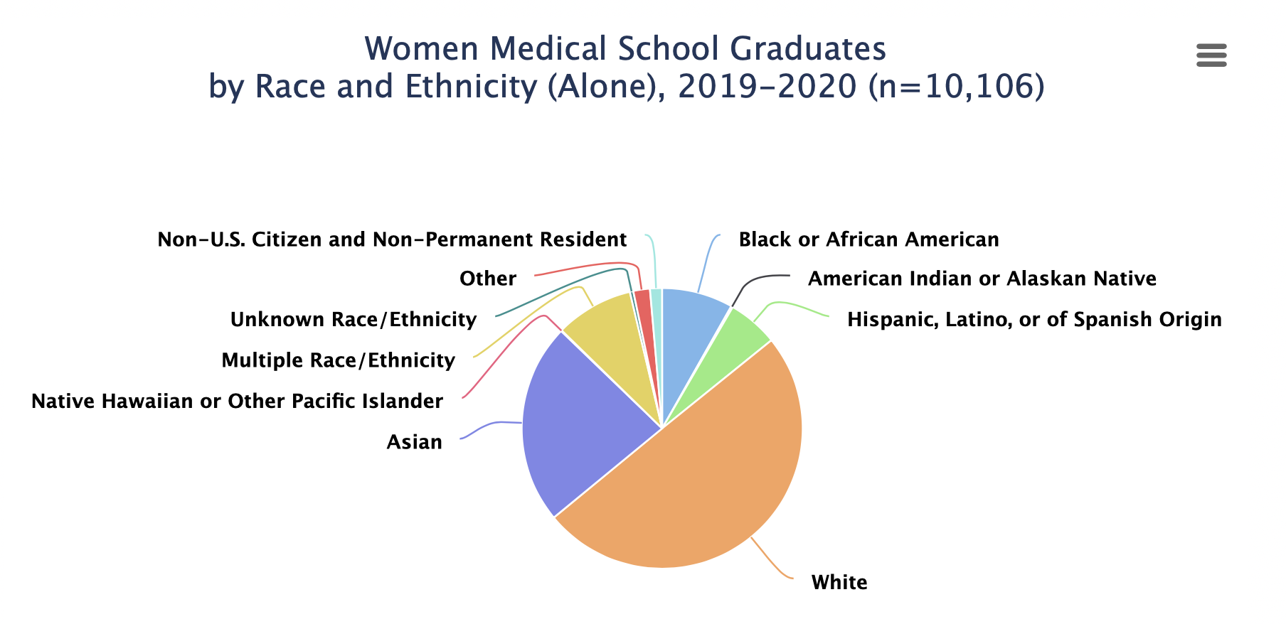

Slide 60
Race/ Ethnicity | Percent Overall | Percent Women
White | 50 | 49
Asian | 22 | 6
Hispanic | 8 | 6
Black/ AA | 6 | 8
American Indian /Alaska Native | 0.6 | 0.2
Native Hawaiian or Pacific Islander | 0.2 | 0.1

