Slide 1


ED crowding: Canary in the Health Care System

Slide 2
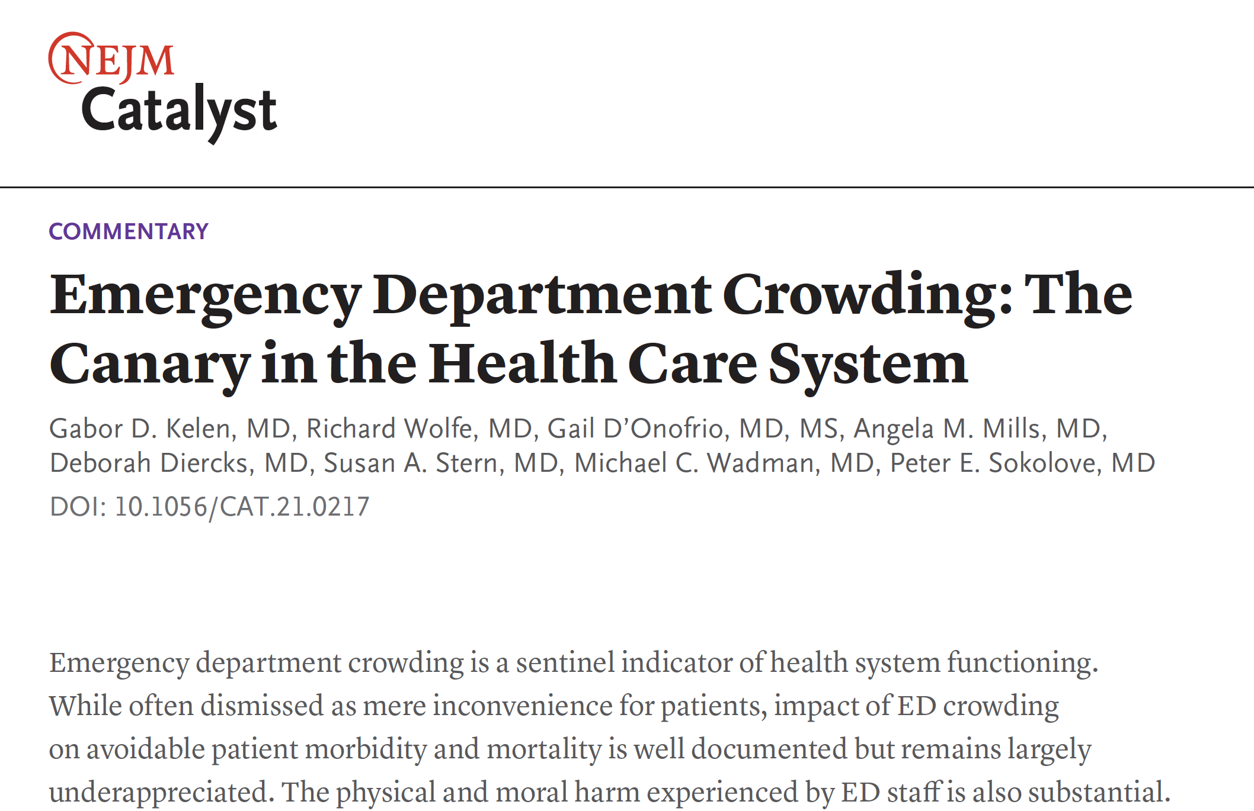

Slide 3

Normalization of Crowding as a Tolerable Dysfunction

Slide 4
Harms
Not an issue of Inconvenience
Biggest Patient Safety Issue of Our Time
Hidden in Plain Site

Slide 5
Goal Today
Present the Core Underlying Issue (R. Wolfe)
What can we as AACEM do (G. D’Onofrio)
How to engage ED faculty staff (P. Sokolove)

Slide 6
ED CROWDING
Health System and Regulator
Notes:
While crowding is a global problem, in the United States (which spends on average twice as much on health care as other developed countries30) crowding is readily traced to health care structure and economics.
Health System Incentive Structure
Health care financing forces many hospitals to structure operations that ensure the inevitability of both hospital and ED crowding.4 ED crowding arises from admitted patientsboarding in the ED, rendering these beds as unavailable for other ED patients awaiting evaluation and management. Boarding is defined as time from admission decision until the patient leaves the ED.5 Excessive ED boarding results fromaccess block, i.e., the inability to access appropriate hospital beds within a reasonable time. Access block itself occurs due to high inpatient occupancy rates, whether related to overwhelming service demand, inefficient patient flow processes, or both. Boarding patients effectively reduce ED size and function. In some settings, it is not uncommon to experience functional decreases in ED capacity of 50% or more due to boarding for a substantial portion of the day.
Between 2005 and 2017, there were about 1,000 hospital mergers and acquisitions affecting nearly 50% of acute care hospitals in the United States.31 Health system consolidation driven by marketshare motivations and “financial survival” particularly affects inpatient capacity in major AMCs. Highly complex patients are referred/transferred to the tertiary/quaternary center institution of the consolidated health system entity.
Budget requirements or misaligned financial incentives compel hospitals to set inpatient census goals at levels that predictably result in ED access block. Crowding will occur when hospital occupancy exceeds 85%–90%. Our experience finds that in most institutions, ED gridlock is assured when inpatient occupancy exceeds 90%.32
The 2007 Institute of Medicine report particularly stressed that financial disincentives are an impediment to addressing ED crowding because financial drivers force inequitable queuing of ED admissions in many hospitals.4 ED patients are considered to generate less revenue, even among the insured,4,
10 and are thus often not prioritized as they are thought of as financially less
desirable.33 Thus, ED admissions vie for hospital beds with patients considered more financially rewarding, such as elective admissions, some transfers, and patients undergoing major procedures/ surgeries. Indeed, in some hospitals, patients often board in the ED despite open beds held for specialty patients or in anticipation of other financially desirable elective admissions or transfers.4
Insufficient Health Care Capacity
Lack of capacity in the U.S. health system also promotes ED crowding. ED visits in the last 2 decades have strongly outpaced population growth.31 However, during this time frame, admissions rose 21% while acute care hospitals and staffed beds decreased by 7% and 11%, respectively. Total EDs have decreased, and inpatient bed capacity has decreased by 27%, to 2.41 from 3.32 per 1,000 population.31
To fulfill their multiple missions, many tertiary care and AMC hospitals experience insatiable demand for specialty services, need to comply with EMTALA (Emergency Medicine Treatment and Labor Act)36 requirements to accept complex referred patients, and often have local community obligations, as well as resident and fellow training-related volume requirements. In such hospitals, census can be well over 100% at any given point in time (i.e., more patients slated for admission than actual staffed beds). Where this occurs, adjusting hospital financing and redistributing service beds will not dampen high occupancy. Hospitals are largely restricted to weekday daytime operations. This creates a functional capacity mismatch with the ED that operates 24-7 and thus requires resources to accommodate a predictable flow of patients and admissions. Much of the resource requirements are during the evening and weekends, and less so during traditional weekday work hours. Although smoothing of admissions and surgeries over the full week has been shown to be very effective at reducing crowding,37,
38 this practice is largely avoided. In
the experience of some of us, we find it has been tried but strongly resisted by the surgeons and other proceduralist. Indeed, despite some hospitals investing millions of dollars to mitigate crowding, and developing “command centers” that attend to inefficiencies, boarding today has actually worsened.28 Demand for services in many hospitals, particularly AMCs, is so high that improvements are rapidly overcome.
Capacity in other venues of health care is also severely wanting. Lack of availability of postdischarge facility beds leads to long-term hospital occupancy.39 Inpatient units experience eroding functional capacity as patients await placement in post-discharge health care settings (rehabilitation centers, skilled nursing facilities, or nursing homes).
Compounding the capacity challenges, the United States is experiencing a nursing shortage — including highly skilled ICU and ED nurses — that has reached crisis levels in some jurisdictions.40 Reasons for staff shortages are complex and not only budget-related. Covid-19 has had its own impact on staffing generally, and accentuated nursing shortages. Regardless, unstaffed inpatient beds decrease capacity, further debilitating ED flow and efficiency.
Functional outpatient capacity is also wanting. Outpatient health care availability also largely exists on a weekday daytime model, which impedes access for many patients who work or have childcare responsibilities during those hours.41 Patients seek ED care because alternatives are difficult due to factors such as general lack of outpatient services, inadequate primary care capacity, unavailability of after-hours care, and lengthy waits for primary and specialty care appointments.6 These impediments lead to poor control of chronic illness, which, in turn, lead to increased likelihood of decompensated illness presenting to EDs, further increasing admission pressures. While various outpatient services, including telehealth visits, may have been increased due to Covid-19, a considerable proportion of ED visits occur outside the time frame that such venues are available.41 These obstacles persist and will continue post–Covid-19 despite augmentation of alternate outpatient modalities during the height of Covid-19. Although telehealth visits increased considerably during the pandemic and are likely to endure, this modality is not an easy option for lower socioeconomic groups or the elderly, and some in rural settings who are less likely to readily participate in this modality due to technology issues.42 In addition, insurers are already levying copays. Based on the recent survey of AACEM members, high-acuity patients and patients requiring admission, i.e., those most responsible for ED crowding, remain largely the same as pre–Covid-19 levels.
As many as one in four people are affected by behavioral health disorders, a leading cause of disability worldwide. Despite the extent of this public health problem, stigma against mental illness has resulted in prioritization of physical illness over mental illness.43 The profound lack of both inpatient and outpatient psychiatric and substance use services, and the labyrinthian processes for psychiatric services driven by byzantine insurance coverage, have placed extraordinary pressure on EDs. Further, inpatient psychiatric beds have decreased.44 Thus, the ED has become the default location for evaluation and placement of acutely decompensated psychiatric patients. Between 2006 and 2014, ED visits for mental health or substance use disorders rose 44%, from 14.1 to 20.3 visits overall per 1,000 population.45 Suicidal ideation, which generally requires extensive evaluation, has increased more than 400%, from 43,800 first-listed ED diagnoses in 2006 to 225,600 in 2014.45 Patients with overdoses increased considerably during the pandemic, to a mean of 14,959 ED visits in 2020 compared to 12,891 during a similar 41-week period in 2019.46
Data show that behavioral health patients are disproportionately affected by boarding.47 Thus, it is common to have patients with acute psychiatric issues stay in the ED for 3 to 5 days or more, while trying to find an accepting inpatient facility. Issues related to placement of psychiatric patients during the pandemic extended ED boarding of upwards of 10 days and even more in some of our facilities. The discriminatory lack of mental health care resources including inpatient beds renders patients with psychiatric conditions the most common victims of ED boarding. While most nonrespiratory–related visits decreased dramatically at the height of Covid-19 surge, mental and substance use disorders remained the same.2
Hospital-based inpatient psychiatry units caring for the sickest, least stable patients have become revolving doors. In our experience, these hospital-based units are nearly always full. Due to intense pressure to take the next qualifying admission, (which often comes from the ED) inpatient psychiatric services practice a form of reverse triage. Inpatients who are barely stabilized are discharged, often back into their original unstable environment, to be able to care for a patient in the ED who is less stable and thus at higher risk.

Slide 7
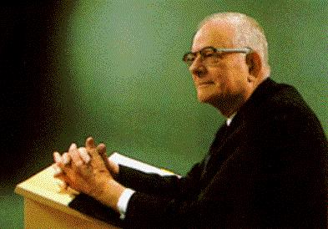



“Every system is perfectly designed to get the results it gets.”
W. Edwards Deming
Paul Batalden, MD
The Dartmouth Institute for Health Policy and Clinical Practice
Notes:
Roughly 2,000 peer review publications on crowding
The source of this quote is in question: It is certainly very consistent with Deming’s ideas on management. There seems to be a good chance Paul Batalden altered a quote from Arthur Jones: “All organizations are perfectly designed to get the results they get!”
An early source exploring the origin suggested 1 of 2 people Dr. Deming worked with, Dr. Paul Batalden or Donald Berwick originated the quote. Given that the newer article from IHI lists Paul Batalden as a co-author and he remembers slightly altering Arthur Jones’ quote it seems likely Arter was the original source.
We worked together as co-chairmen of the US Quality Council of the Conference Board in the 1970s. While together, we learned that both of us had been tremendously influenced by the thought and practice of Dr. W. Edwards Deming. His invitation to think in terms of results generated by systems within which we all work were deeply important to us then — and now. His teachings build on the Theory of Variation and the need to redesign (i.e., improve) the system to narrow variation as the principal cause of error.
William Edwards Deming (October 14, 1900 – December 20, 1993) was an American engineer, statistician, professor, author, lecturer, and management consultant. Educated initially as an electrical engineer and later specializing in mathematical physics, he helped develop the sampling techniques still used by the U.S. Department of the Census and the Bureau of Labor Statistics.
n 1993, he founded the W. Edwards Deming Institute in Washington, DC, where the Deming Collection at the U.S. Library of Congress includes an extensive audiotape and videotape archive. The aim of the institute is to "Enrich society through the Deming philosophy." ^{[2]}
Deming's teachings and philosophy are clearly illustrated by examining the results they produced after they were adopted by Japanese industry,^{[3]} as the following example (called the Ford-Mazda study) shows. Ford Motor Company was simultaneously manufacturing a car model with transmissions made in Japan (by Mazda) and the United States (by Ford). Soon after the car model was on the market (c. 1950),^{[4]} Ford customers were requesting the model with Japanese transmissions over the US-made transmissions, and they were willing to wait for the Japanese model. As both transmissions were made to the same specifications, Ford engineers could not understand the customer preference for the model with Japanese transmissions. Finally, Ford engineers decided to take apart the two different transmissions. The American-made car parts were all within specified tolerance levels. However, the Japanese car parts were virtually identical to each other, and much closer to the nominal values for the parts—e.g., if a part was supposed to be one foot long, plus or minus 1/8 of an inch (300 mm ± 3 mm)—then the Japanese parts were all within 1/16 of an inch (1.5 mm), less variation. This made the Japanese cars run more smoothly and customers experienced fewer problems.^{[5][6]}
In his book The New Economics for Industry, Government, and Education^{[7]} Deming championed the work of Walter Shewhart, including statistical process control, operational definitions, and what Deming called the "Shewhart Cycle,"^{[8]} which had evolved into Plan-Do-check-Act (PDCA). Deming is best known for his work in Japan after WWII, particularly his work with the leaders of Japanese industry. That work began in July and August 1950, in Tokyo and at the Hakone Convention Center,^{[9]} when Deming delivered speeches on what he called "Statistical Product Quality Administration". Many in Japan credit Deming as one of the inspirations for what has become known as the Japanese post-war economic miracle of 1950 to 1960, when Japan rose from the ashes of war on the road to becoming the second-largest economy in the world through processes partially influenced by the ideas Deming taught:^{[10]}

Slide 8
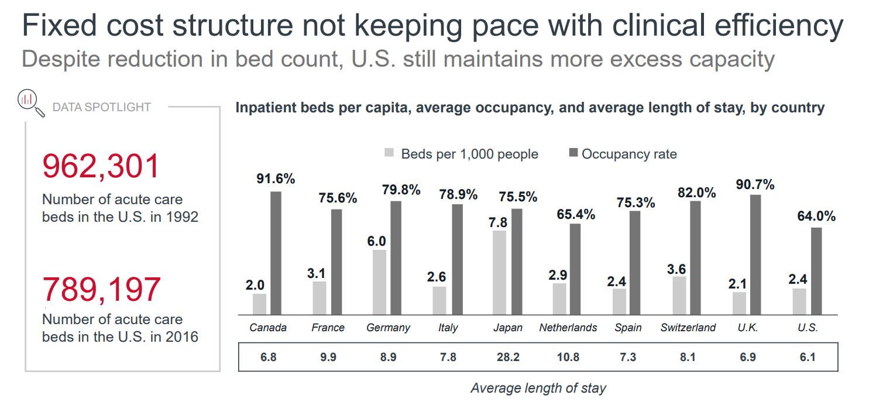

Slide 9
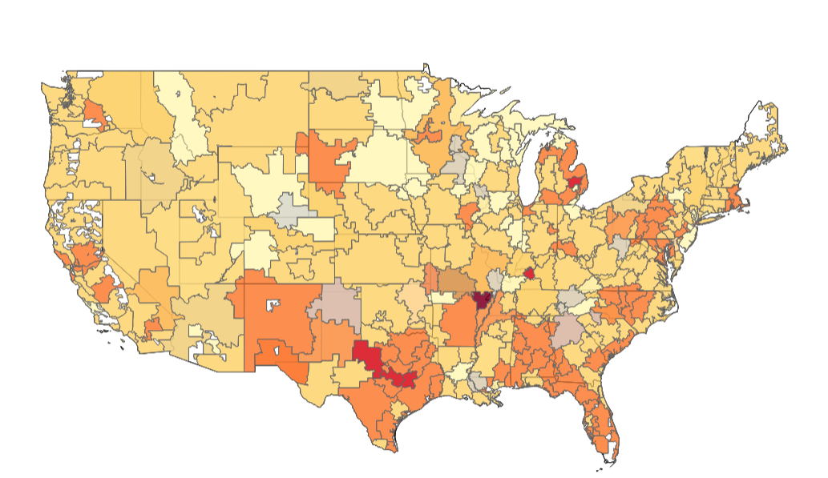
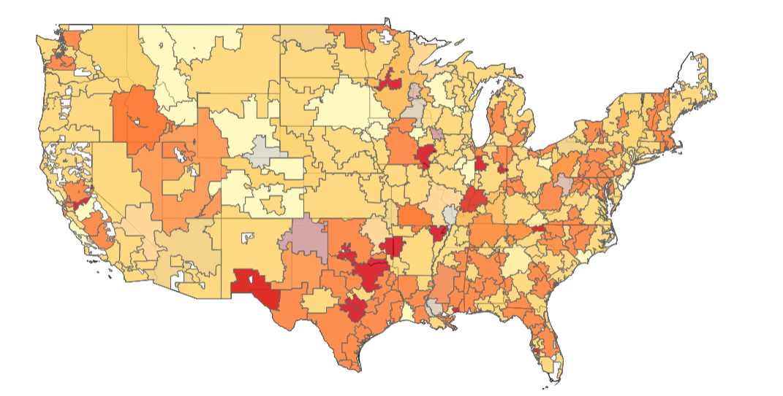

Bed Occupancy %
March 2021
March 2022

Slide 10
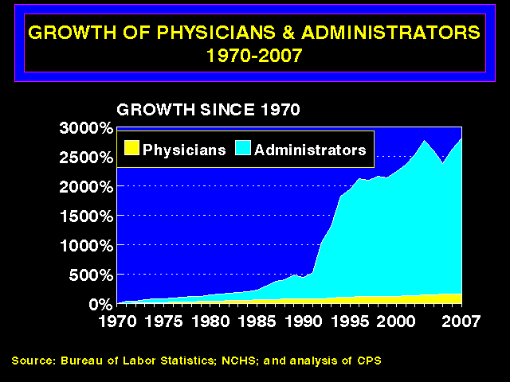
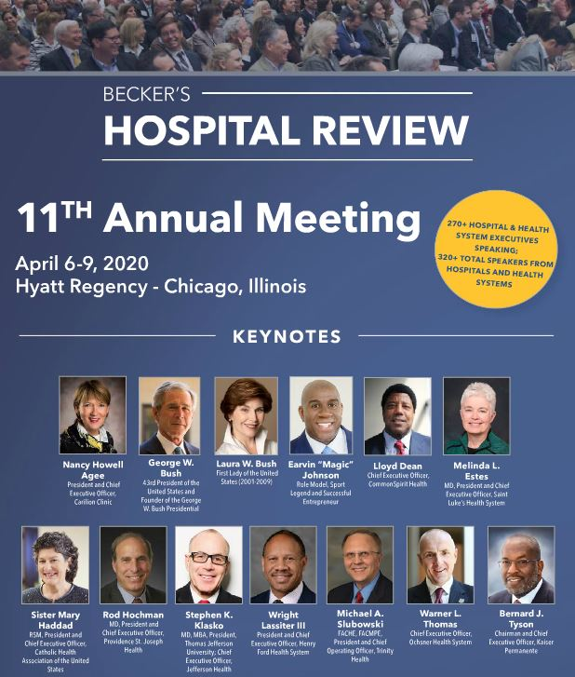
ADMINISTRATIVE COSTS PER CAPITA
US: $2,696
CANADA: $551

Slide 11
Hospital Profit Margins
Revenue/Bed most important
Non-Medicare Reimbursement
Cost of care/bed not a major driver
Cost of ED boarding/h is 2x that of an inpatient bed (TDABC)
Medicare 2008 ED -$712 Medic vs. Elective +$22
  →Incentive to favor elective admissions over ED admissions.
Ly, D.P., Cutler, D.M. Factors of U.S. Hospitals Associated with Improved Profit Margins: An Observational Study. J GEN INTERN MED 33, 1020–1027 (2018).
Schreyer KE, Martin R. The Economics of an Admissions Holding Unit. West J Emerg Med. 2017;18(4):553-558. doi:10.5811/westjem.2017.4.32740
McHugh, M., M. Regenstein, and B. Siegel. 2008. 'The profitability of Medicare admissions based on source of admission', Acad Emerg Med, 15: 900-7.
Notes:
McHugh, M., M. Regenstein, and B. Siegel. 2008. 'The profitability of Medicare admissions based on source of admission', Acad Emerg Med, 15: 900-7.

Slide 12

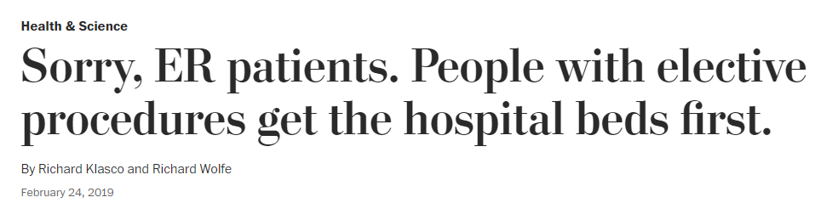
Notes:
In a medical emergency, you may have a surprisingly difficult time finding a bed in a hospital. This is because elective admissions — that is, patients whose hospital stays have been scheduled in advance — take priority over emergencies.
Such a preference for elective admissions might be unexpected, as emergency patients are, by definition, emergencies. But elective patients have attributes that make them financially attractive. They arrive promptly in the morning; they are well-insured; and they undergo invasive procedures that represent a significant revenue stream for hospitals.
An analysis of more than 1 million Medicare cases indicates that hospitals earn about $700 more on each elective admission than on each patient admitted through the emergency department (ED).
Predictability is often touted as a reason for prioritizing elective admissions. But while predictability is thought to be in short supply in the ED, the data — and our experience as ED doctors — argue otherwise. The number of patients admitted through the ED are about the same every day of the week, whereas elective admissions peak Mondays through Thursdays and tail off toward the weekend. This is designed to minimize the need for weekend work by the doctors who perform procedures.
The weekday peak in elective admissions creates a bottleneck that results in admitted patients “boarding” in the ED. Boarded patients have nominally been admitted to the hospital, yet they physically remain in the ED until vacancies in the hospital arise. But vacancies may not arise for hours or, in extreme cases, days.
Boarding increases the risk for patients whose condition might become unstable: patients with new-onset diabetes who require intensive monitoring; patients with metastatic cancer, who require high doses of pain medication; and critically ill patients, who require advanced life support.
A 2007 publication by the national Institute of Medicine found that “ED overcrowding is a nationwide phenomenon, affecting urban and rural areas alike” and noted that “on a typical Monday evening, 73 percent of hospitals reporting boarding two or more admitted patient
Boarding is not merely inconvenient. It is also unsafe. As the Institute of Medicine report put it: “The potential for errors, life-threatening delays in treatment, and diminished overall quality of care is enormous in these situations.” In a 2011 study of more than 40,000 ED admissions, the risk of in-hospital death nearly doubled, from 2.5 percent to 4.5 percent, in patients who boarded for more than 12 hours compared with those who boarded for less than two hours.
Boarding also tends to exert a disproportionate effect on vulnerable populations. The length of ED stay has been found to be longer for African American and Hispanic patients. The elderly and patients with mental-health issues are more likely to receive their initial inpatient care on gurneys in the ED.
The problem of boarding can be solved by increasing inpatient hospital bed capacity, but the cost of increasing capacity can be daunting to many medical institutions that are already struggling to maintain profitability.
An alternative is to increase efficiency by a process known as “smoothing.” Smoothing reorients schedules to distribute surgical cases uniformly across the workweek, mitigating the bottleneck to emergency admissions. At the Mayo Clinic, smoothing resulted in “improvement in operating room operational and financial performance.” At Massachusetts General Hospital, which performs more than 36,000 operations a year, smoothing decreased congestion and improved effective operating room capacity.
But smoothing can be disruptive to the doctors who perform the surgeries and procedures that drive hospital revenues.
It can require them to work less desirable hours and alter long-standing practices, such as having a dedicated day of the week in the operating room. As a result, adoption has been slow, according to research published in 2012 in Health Affairs. Only 6 percent of hospitals with the busiest EDs were found using smoothing for surgical scheduling in a 2015 study.
At the institutions where we work, the University of Colorado improved efficiency by decreasing unnecessary admissions by 20 percent, despite a 53 percent increase in ED volume. And, Boston’s Beth Israel Deaconess Medical Center implemented a number of techniques to speed patient flow through the system: bedside registration, electronic dashboard that displays bed status throughout the hospital, physical expansion of the ED, and a paging protocol to notify senior leadership of impending capacity issues. When hospital capacity is strained, BIDMC administrators work with doctors in the community to direct emergency admissions to other hospitals that have capacity.
Achieving these gains on a national level will require Medicare and private insurers to up their reimbursement rates to hospitals for emergency admissions. Making that change will be costly, but it will help ensure that, in an emergency, your hospital bed is ready when you need it.

Slide 13

INSTITUTIONAL GUARD RAILS OR COWARD FENCES?
Notes:
inally, failure to address end-of-life care and lack of awareness or availability of hospice/palliative care options constrains inpatient and ICU capacity.
Failure of Regulatory Agencies, Payers, and Legislative Bodies
The vision of The Joint Commission (TJC) is that “all people always experience the safest, highest quality, best-value health care across all settings.”48 The TJC’sStandard LD.04.03.11,EP 6 sets a 4-hour time frame as a “reasonable goal” for boarding.
However, TJC did not want to establish a requirement that “in some cases” was not within institutional control and states that the recommended 4-hour time frame for boarding is not a requirement for accreditation and is not scored.49
Even though the unenforced guideline was arrived at by TJC, in part, through stakeholder consensus, the 4-hour time frame remains controversial; the emergency medicine community had vociferously advocated for a maximum boarding time of 2 hours. TJC acknowledged that a 2-hour time frame represented the second-highest number of responses in the feedback it received at the time (December 2011 to January 2012) — for both medical and behavioral patients.49 We continue to assert that 2 hours or less should be the standard for ED boarding.

Slide 14

4-hour time frame is a “reasonable goal” for boarding.
NOT A REQUIREMENT
Notes:
The vision of The Joint Commission (TJC) is that “all people always experience the safest, highest quality, best-value health care across all settings.”48 The TJC’sStandard LD.04.03.11,EP 6 sets a 4-hour time frame as a “reasonable goal” for boarding.
However, TJC did not want to establish a requirement that “in some cases” was not within institutional control and states that the recommended 4-hour time frame for boarding is not a requirement for accreditation and is not scored.49
Even though the unenforced guideline was arrived at by TJC, in part, through stakeholder consensus, the 4-hour time frame remains controversial; the emergency medicine community had vociferously advocated for a maximum boarding time of 2 hours. TJC acknowledged that a 2-hour time frame represented the second-highest number of responses in the feedback it received at the time (December 2011 to January 2012) — for both medical and behavioral patients.49 We continue to assert that 2 hours or less should be the standard for ED boarding.
By Joint Commission’s Publications Editorial Board
Boarding of psych patients in the emergency department (ED) is a long-standing problem in many hospitals today.
There’s a nationwide lack of inpatient beds but the reason at the root of the problem is lack of funding for: community mental health clinics
intensive outpatient programs
community crisis stabilization units
respite services
inpatient psychiatric units/ beds
I’ve noticed anecdotally that patients boarded in the ED are those without an option for discharge that is safe for them. .Studies have found that these are often the patients with less social support.
Stress on Staff and Other Patients
Patients boarded in the ED are understandably stressed and that tends to extend to those involved in their ED stay—including other patients and staff.
The cascade of issues includes:
increased psychological stress on patients who may already be in depressed or psychotic states
delayed mental health treatment that could mitigate the need for a mental health inpatient stay
consumption of scarce ED resources
increased pressure on staff
worsened ED crowding
increases wait times
increases use of ancillary support, such as security officers or safety attendants, especially if a psychiatric patient is agitated
delayed treatment for other ED patients – some of whom may have life-threatening conditions
increased rates of patients who leave without being seen
lengthened inpatient stays
financial impact on ED reimbursement
During the pandemic, the stress on staff from overcrowded hospitals is nearing a breaking point, as Joint Commission associate director Elizabeth Even, MS, RN, shared in her recent blog post.
Possible Solutions
For many years, hospitals in the U.S. have been struggling to meet the needs of psychiatric patients seeking help in the ED. Some creative solutions have gained recent attention, such a community collaboration involving Banner Health in Tuscon, AZ, as described in a guest blog post.
There are some new strategies and actions that hospitals can take to provide better care for these patients while helping to reduce the risks associated with boarding psychiatric patients in the ED. The following strategies are categorized as those focused on the patient, on the ED staff, and the environment.
Some relevant strategies include:
Use de-escalation techniques to calm the patient. A calm patient may be better able to participate in care. Targeted medications may also be indicated, but the goal is to calm and not sedate the patient.
Limit the use of restraint and seclusion only as a last resort when the patient presents a harm to themselves or others.
Evaluate medical comorbidities. Evaluations should be specific to the patient’s signs and symptoms, with results clearly communicated between the ED and any receiving facilities.
Initiate active treatment of underlying psychiatric illness. Treatment can include medication and brief interventions (e.g., solution-focused, or supportive therapy, for example ). Find out about past helpful treatments from the patient, family, or outside treatment providers.
Initiate active treatment for substance intoxication or withdrawal.
Mitigate stressors on patients boarded in the ED by providing medication assisted treatment for substance use disorder as appropriate, maintenance medications, and regular meals.
Supporting ED Staff
The pressures on ED staff are at an all-time high and boarded patients may increase their stress levels. Some winning practices for staff support include:
Developing a contingency plan to address the needs of mental health patients while they are boarded in the ED. Early identification of patients who are expected to be boarded will help in getting them much-needed care and treatment.
Provide regular training to ED staff (including security) on the management of agitation, including verbal de-escalation techniques.
Support coordination and communication around disposition. It is ideal to have a predetermined guide for medical evaluation so that medical stability is achieved prior to the patient’s transfer. If it is determined that a patient can safely be discharged to a lower level of care, fully arrange this in the ED prior to discharge.
Expand access to psychiatric services through telepsychiatry and integration of care. Telepsychiatry is being more widely used in emergency settings, and many contracts allow for 24-hour availability of psychiatrists as consultants to the ED service. Similarly, new health care integration models introduced into the ED setting allow for an embedded mental health team including staff psychiatrists to provide consultation either to care teams or directly to patients.
Designate or hire new staff to serve as bed managers or use computerized bed management systems to increase efficiency by managing inpatient capacity.
Designate case managers in the ED to help with community disposition.
Collect and monitor data to check progress toward reducing ED boarding and improving the provision of care to boarded patients. Share this data with community partners to help determine further strategies for improvement.
Environmental Changes
Implement observation units in the ED to help patients avoid the need for psychiatric hospitalization. An observation unit can be a safe place in which patients can achieve a sober state or work through strong emotions, and it may also enable discharge of the patient to a lower level of care.
Create mental health emergency room extension areas. Boarding in the chaotic, crowded, noisy, and confined spaces of an ED may potentially exacerbate psychiatric symptoms. Areas designated for emergency psychiatric care provide a therapeutic environment more conducive to patients with psychiatric illness.
Improve the management of patient flow to stave off some of the pressures leading to ED boarding.
When it comes to ED boarding, there are no easy answers. If there’s anything that’s worked for your organization that isn’t mentioned here, please share in the comments when this blog is posted on Joint Commission’s Facebook, LinkedIn, Twitter or Instagram.

Slide 15
Electronic Clinical Quality Measures (eCQMs) for Accreditation
ED-2 Admit Decision Time to ED Departure Time for Admitted Patients

Slide 16


There are no Emergency Department eCQMs applicable or available for Certification purposes.
NQF ENDORSEMENT STATUS: Not Endorsed
Important to measure
Scientifically acceptable,
Useable and relevant
Feasible to collect
Notes:
Reducing the time patients remain in the emergency department (ED) can improve access to treatment and increase quality of care. Reducing this time potentially improves access to care specific to the patient condition and increases the capability to provide additional treatment. In recent times, EDs have experienced significant overcrowding. Although once only a problem in large, urban, teaching hospitals, the phenomenon has spread to other suburban and rural healthcare organizations. According to a 2002 national U.S. survey, more than 90 percent of large hospitals report EDs operating "at" or "over" capacity. Approximately one third of hospitals in the U.S. report increases in ambulance diversion in a given year, whereas up to half report crowded conditions in the ED. In a recent national survey, 40 percent of hospital leaders viewed ED crowding as a symptom of workforce shortages. ED crowding may result in delays in the administration of medication such as antibiotics for pneumonia and has been associated with perceptions of compromised emergency care. For patients with non-ST-segment-elevation myocardial infarction, long ED stays were associated with decreased use of guideline-recommended therapies and a higher risk of recurrent myocardial infarction. Overcrowding and heavy emergency resource demand have led to a number of problems, including ambulance refusals, prolonged patient waiting times, increased suffering for those who wait, rushed and unpleasant treatment environments, and potentially poor patient outcomes. When EDs are overwhelmed, their ability to respond to community emergencies and disasters may be compromised.
What NQF Endorsement Means
Examples: Diabetes blood sugar care
Removed: Reducing the risk of falling
Most developers put their measures through a rigorous process long before NQF considers them for endorsement. NQF’s careful review and assessment gathers input from stakeholders across the healthcare enterprise and develops consensus among those stakeholders about which measures warrant endorsement as the “best in class.”
According to Tim Ferris, co-chair of NQF’s Consensus Standards Approval Committee, “Measures are the only way we can really know if care is safe, efficient, effective, and patient-centered. Performance measures also help us improve faster. We can make corrections earlier in providing care.”
NQF uses four criteria to assess a measure for endorsement:
Important to measure and report to keep our focus on priority areas, where the evidence is highest that measurement can have a positive impact on healthcare quality.
Scientifically acceptable, so that the measure when implemented will produce consistent (reliable) and credible (valid) results about the quality of care.
Useable and relevant to ensure that intended users — consumers, purchasers, providers, and policy makers — can understand the results of the measure and are likely to find them useful for quality improvement and decisionmaking.
Feasible to collect with data that can be readily available for measurement and retrievable without undue burden.
"The reason this works really well is because you get input from everyone involved in healthcare — those who receive, give, and pay for care. That allows everyone to have a voice about whether the measure is important to measure, is valid, and is feasible. I make sure our top clinical experts on an issue contribute to the NQF process." Lee A. Fleischer, MD , University of Pennsylvania Healthcare System, Co-chair, Outcomes Steering Committee

Slide 17
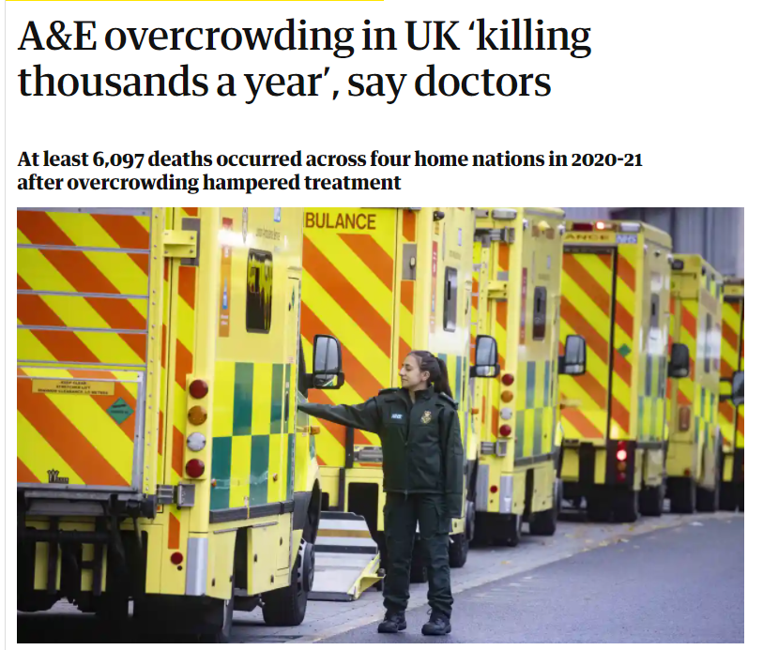
Notes:
The Media

Slide 18
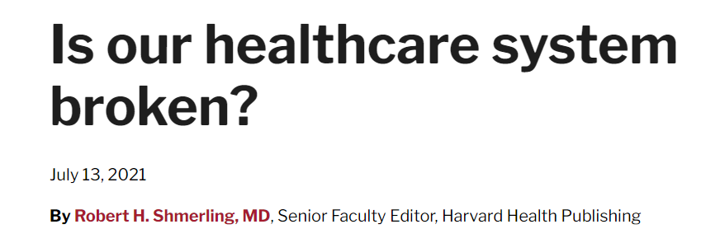
The Cost is enormous
Access in uneven
Investments in healthcare seem misdirected
Notes:
Dr. Robert H. Shmerling is the former clinical chief of the division of rheumatology at Beth Israel Deaconess Medical Center (BIDMC), and is a current member of the corresponding faculty in medicine at Harvard Medical School. As a practicing rheumatologist for over 30 years, Dr. Shmerling engaged in a mix of patient care, teaching, and research. His research interests center on diagnostic studies in patients with musculoskeletal symptoms, and rheumatic and autoimmune diseases. He has published research regarding infectious arthritis, medical ethics, and diagnostic test performance in rheumatic disease. Having retired from patient care in 2019, Dr. Shmerling now works as a senior faculty editor for Harvard Health Publishing.

Slide 19
Discussion: What Can AACEM Do

