Slide 1
Advocacy: How EM Can Help
Laura Wooster, MPH
SVP, Advocacy & Practice Affairs

Slide 2
ACEP Strategic Priorities
Career Fulfillment
Practice Innovation
Resources & Accountability
Advocacy
Member Engagement & Trust
Notes:
Expand and strengthen the role and impact of state-level advocacy.
2
Standardize advocacy strategies and approach at the federal, state and workplace level.
3
Streamline advocacy content development and delivery.
4
Identify, test, and adopt new fundraising strategies to support advocacy initiatives.
5
Create awareness around the business of emergency medicine and have difficult discussions about possibilities and protections.

Slide 3
ADVOCACY
FEDERAL
STATE
LOCAL
Congressional
Regulatory
NEMPAC
State Leg
Regulatory
Hospitals
Employers
Accreditors

Slide 4
Priority Issues
Workforce
Clinician well-being
Workplace violence
Mental health/SUD
Health equity
Telehealth
Reimbursement
Pandemic preparedness
Research funding
Notes:
SFC and E&C Mental Health hearings and Legislation

Slide 5
Workforce
GME
Rural Emergency Hospital Designation
Consolidation
Scope of Practice
VA Supremacy Project
Advocacy toolkit
Public campaign
Notes:
Student loan relief (Maloney, flagging expiring forgiveness thing)
EMRA Congressional statement
Emergency medicine HPSAs, National Health Service Corps

Slide 6
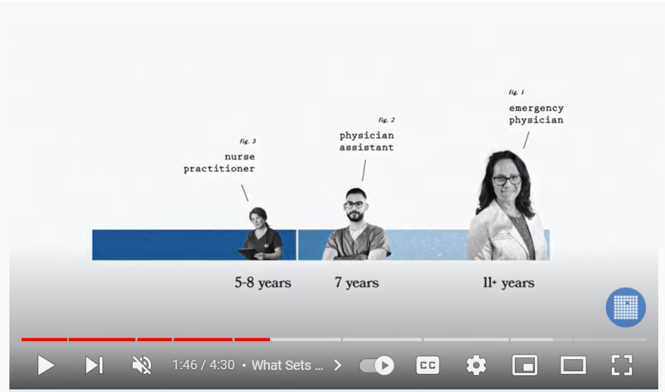
https://bit.ly/WhoIsEP

Slide 7
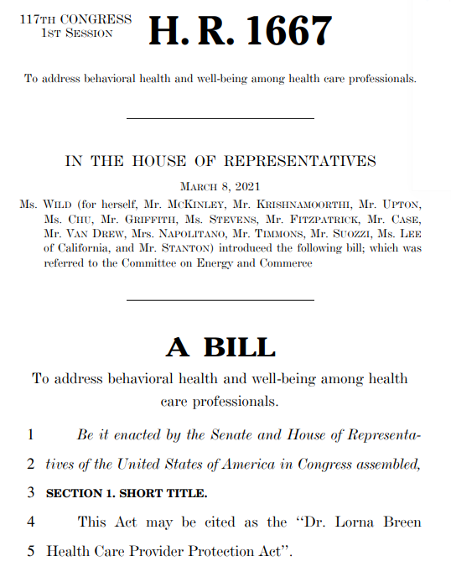
Clinician Well-being
Notes:
Introduced in March 2021, passed 2/17/22 by Congress, signed into law on Friday.
OSG/OASH meeting
ALL IN Collaboration
In April, ACEP met with the Joint Commission to discuss current barriers physicians face seeking mental health treatment. Just a few short weeks later, the Joint Commission put out a statement encouraging organizations to not ask about past history of mental health conditions or treatment and supporting the elimination of policies that reinforce stigma and fear about the professional consequences of seeking mental health treatment.
State licensure questions
ED Boarding met with CMS, etc
Lorna Breen 2.0
Other mental health work SFC, etc

Slide 8
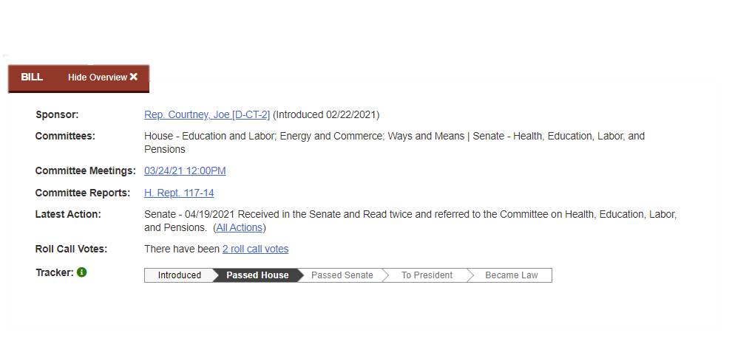
H.R.1195 - Workplace Violence Prevention for Health Care and Social Service Workers Act

Slide 9
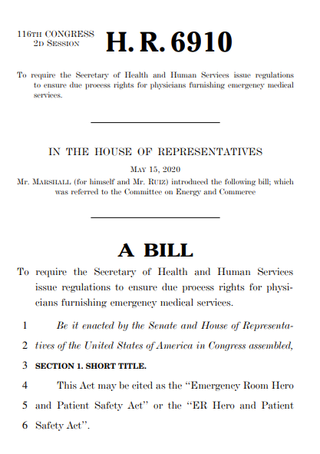
Due Process & Other Rights

Slide 10
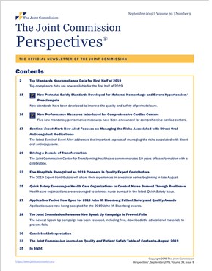

Slide 11
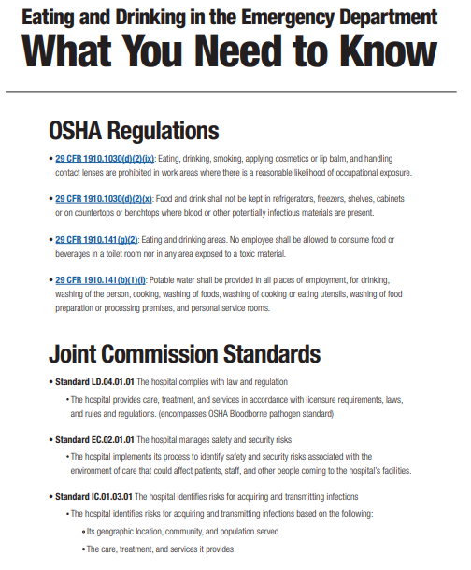

Slide 12
Mental Health/SUD
X-waiver/MAT
Regulatory relief
HR 1384/S 445: MAT Act
Access & Boarding
Improving Mental Health Access from the ED Act (HR 1205/S 2157)
Effective Suicide Screening and Assessment in the ED Act (HR 1324/W 467)
Meetings w/ CMS, AHA, Joint Commission
988 line efforts

Slide 13
Reimbursement
Surprise billing implementation
Medicare E/M cuts
RUC and CPT efforts
Congressional work
CMS advocacy
http://acep.org/NSA

Slide 14
Health Equity
SDOH
Health Disparities
Health Equity
Medicare physician fee schedule
Rural Emergency Hospital recommendations
Quality measures
LAC Congressional staff panel
Meetings with House Ways & Means Committee’s Racial Equity Initiative
Informed Senate HELP Committee hearing on COVID-19-related health disparities
Recommendations on COVID Commission
Notes:
LAC Panel: discussion “Breaking Down Barriers: Improving Health Equity Through the ED”

Slide 15
Other Priority Issues
Telehealth
Pandemic preparedness
Research funding
Notes:
SFC and E&C Mental Health hearings and Legislation

Slide 16
Other Priority Issues
Telehealth
Pandemic preparedness
Research funding
Notes:
SFC and E&C Mental Health hearings and Legislation

Slide 17
Other Priority Issues
Telehealth
Pandemic preparedness
Research funding
Notes:
SFC and E&C Mental Health hearings and Legislation

Slide 18
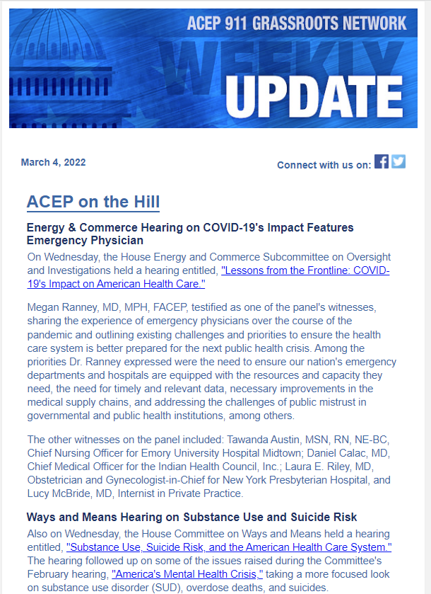
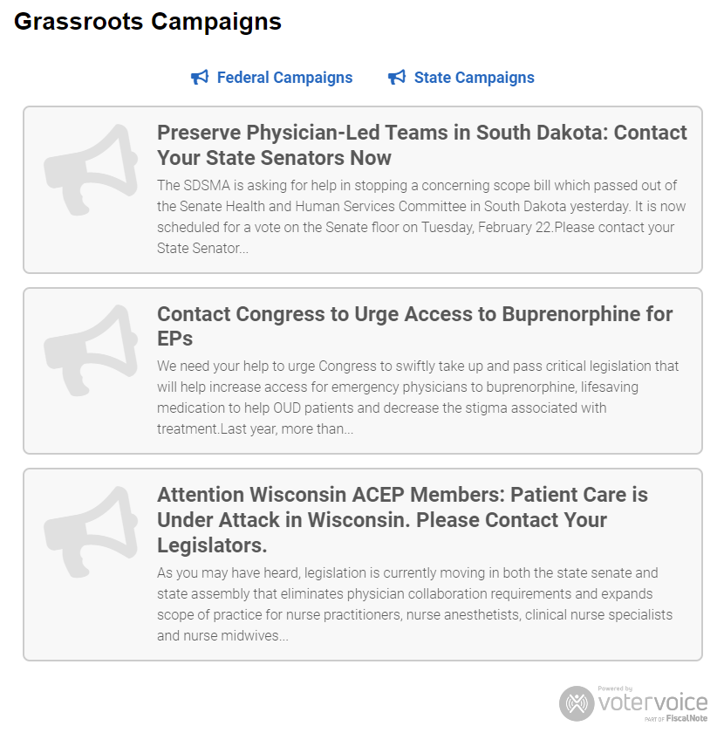
Be Involved
ACEP.org Advocacy Action Center
Social Media & Training
http://acep.org/911
Notes:
Mention NEMPAC too

Slide 19
Questions?
lwooster@acep.org

