Slide 1
Post Covid-19: Best Practices for the Workplace New Normal
Jay Schuur, MD, MHS
Warren Alpert Medical School, Brown University

Slide 2
Disclosures
No current disclosures

Slide 3
Outline & Objectives
Review employment stresses after 2 years with covid
Review Motivations for Knowledge Workers
Harness the “wisdom of the crowd” to gather and share best practices departments are using to address work challenges
Will not focus on COVID-19 workplace safety policies or clinical operations
Will not focus on ED operations

Slide 4
Format
Background (20 min)
Breakout sessions at tables (20 min each)
  Employee Engagement & Leadership Communication
  Flexibility & Autonomy: clinical and administrative work
  Professional development & Career growth (Mastery)

Slide 5
Current issues after two years with covid

Slide 6
COVID HAS WORSENED VIRTUALY EVERY CHALLENGE WE Had…
Burnout & Depression
Departmental Finances
Clinical unpredictability
ED and administrative Staffing Shortages
Personal Family & Caregiving Responsibilities
ED Boarding

Slide 7

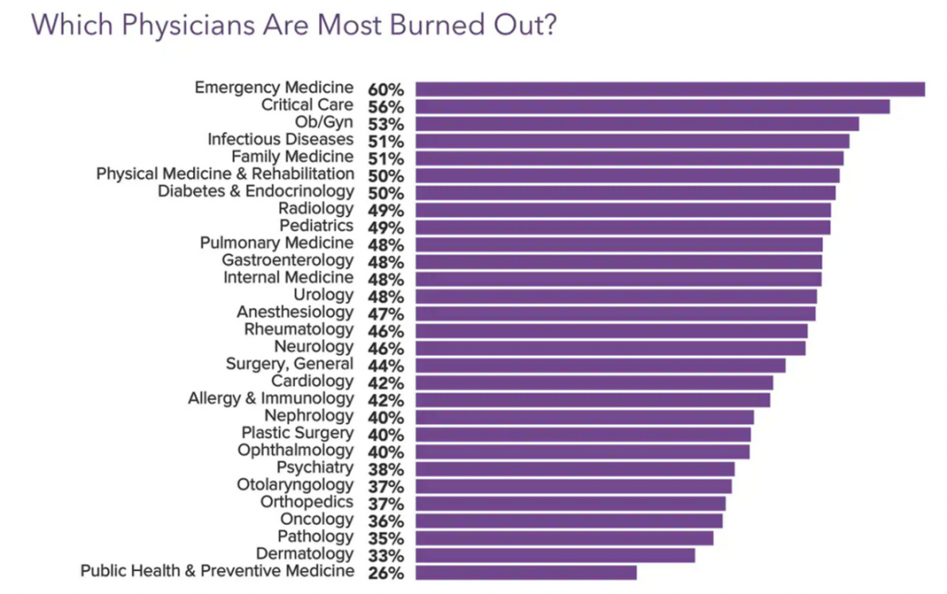
Burnout and Depression
Medscape polled 13,069 physicians across 29 specialties between late June and September 2021 via a 10-minute online survey.

Slide 8
Impact of covid in the workplace has not been equal
Parents & Caregivers
Women
Underrepresented in medicine (URiM)
Employees with more financial stress: Debt, lower salaries

Slide 9
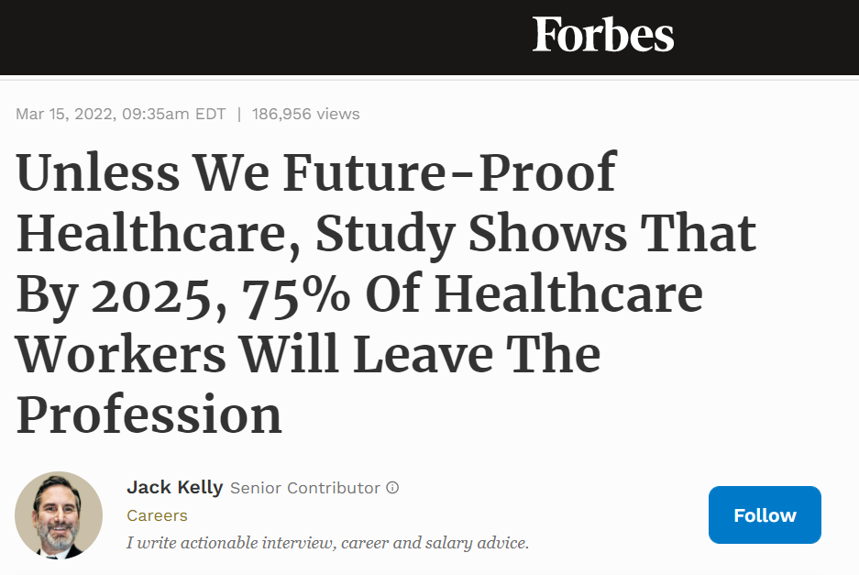

Slide 10
Doctors long for the last century. Back then, they were paid well, revered by everyone and largely left alone to practice as they please. As the war against Covid-19 winds down, doctors believe now is the time to demand a return to the glory days when physicians ruled medicine. To get there, doctors want more money, respect and autonomy. They’ll get none of that because our nation can’t afford to give it to them.
Soon, reality will set in for physicians: Any solution that depends on giving doctors more dollars or fewer responsibilities will be a nonstarter. Twentieth-century medicine is dead and, with this loss, doctors will experience the five stages of grief.
Trying to turn back the clock
Physicians have had a rough century, so far. In addition to battling Covid-19, doctors have spent the past two decades fighting the healthcare industry’s fiercest players and losing, badly.
Power in the industry now belongs to health insurance companies, major drug makers and hospital tycoons. Physicians feel beaten up, burned out and abused by a system so overrun with regulations that clinicians now spend more time filling out paperwork than helping patients.

Slide 11
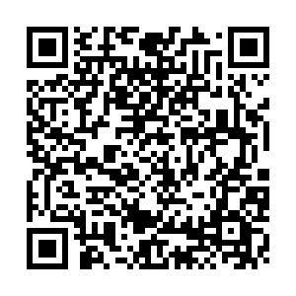
Live polling
Text EMEDSURVEY to 22333
Or go to www.pollev.com/emedsurvey

Slide 12
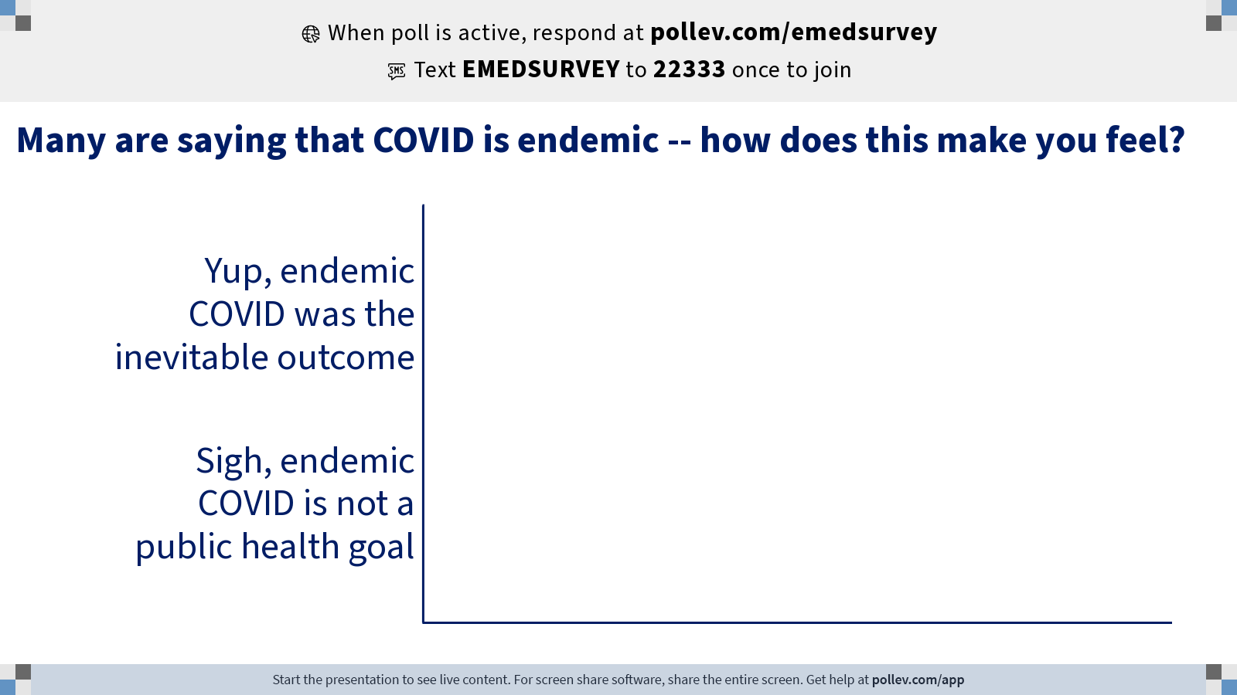
Notes:
Poll Title: Do not modify the notes in this section to avoid tampering with the Poll Everywhere activity.
More info at polleverywhere.com/support
Many are saying that COVID is endemic -- how does this make you feel?
https://www.polleverywhere.com/multiple_choice_polls/6OQOW5VzgVdWe4omsZVQt?state=opened&flow=Default&onscreen=persist

Slide 13
Poll: over the last 12 months how has your faculty attrition compared to pre-covid?
(Faculty leaving employment in your department)
Less attrition
About the same
More attrition

Slide 14
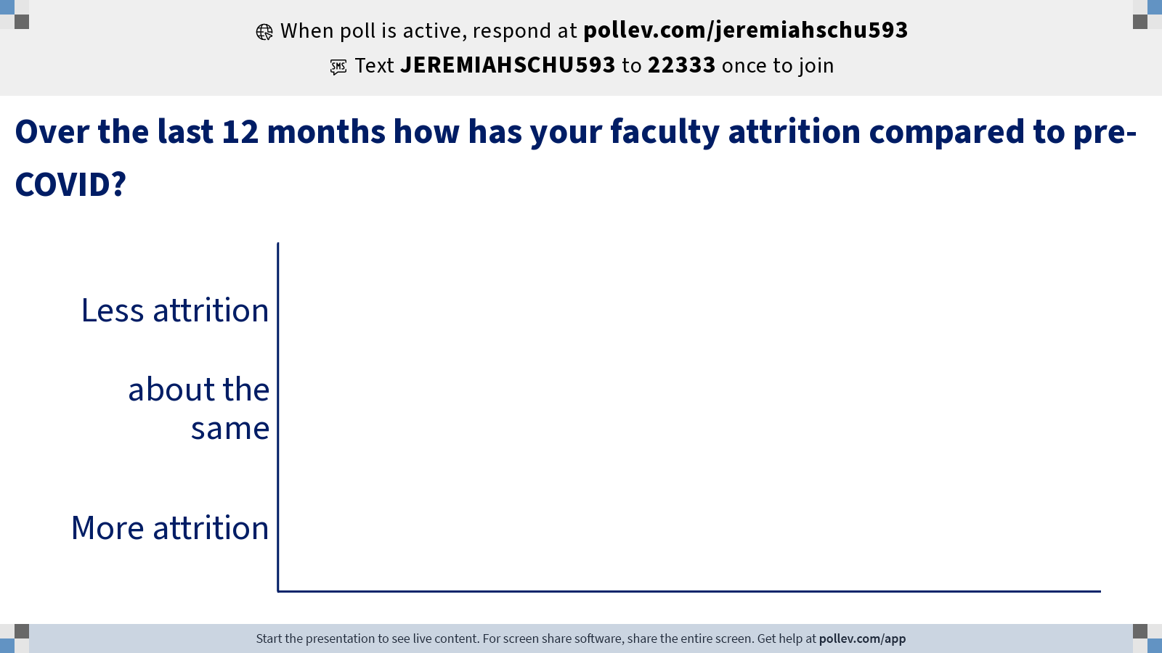
Notes:
Poll Title: Do not modify the notes in this section to avoid tampering with the Poll Everywhere activity.
More info at polleverywhere.com/support
Over the last 12 months how has your faculty attrition compared to pre-COVID?
https://www.polleverywhere.com/multiple_choice_polls/9PuI2KgXJdgqIOG80y2Fc?state=opened&flow=Default&onscreen=persist

Slide 15
Poll: over the last 12 months what has been the leading destination of faculty who have left Your Department
Left medicine / retired
A non-em practice (urgent care, wound care, etc.)
Community em (left academic job)
A different academic job

Slide 16
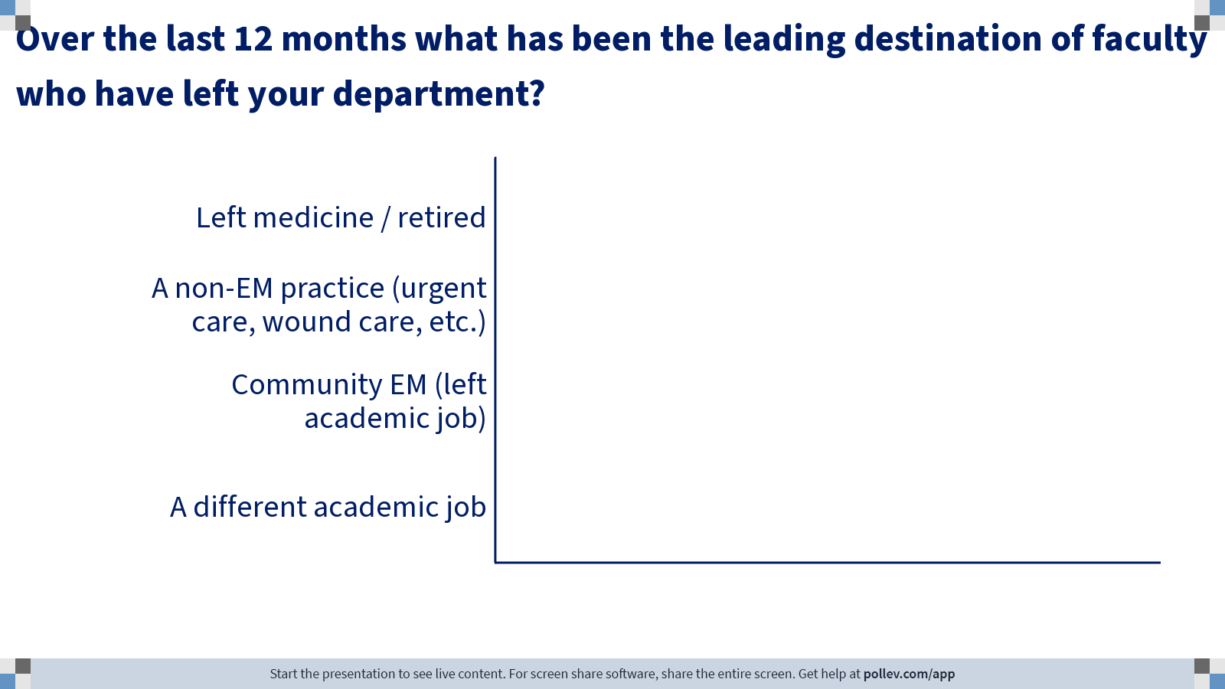
Notes:
Poll Title: Do not modify the notes in this section to avoid tampering with the Poll Everywhere activity.
More info at polleverywhere.com/support
Over the last 12 months what has been the leading destination of faculty who have left your department?
https://www.polleverywhere.com/multiple_choice_polls/EpN1tw2d0UKCYiIoIeDHv?state=opened&flow=Default&onscreen=persist

Slide 17




Slide 18
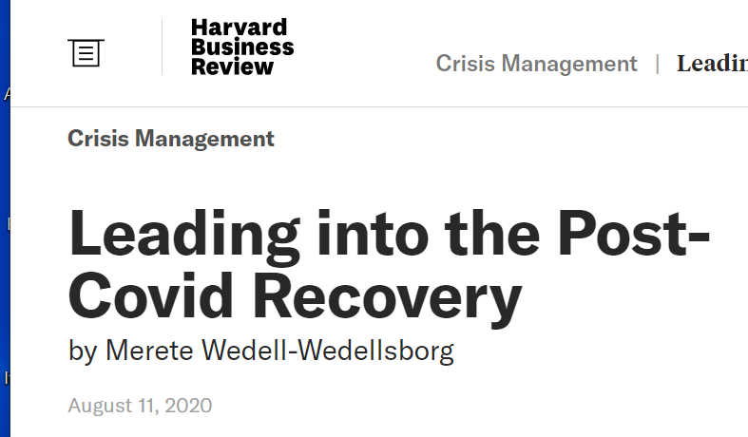
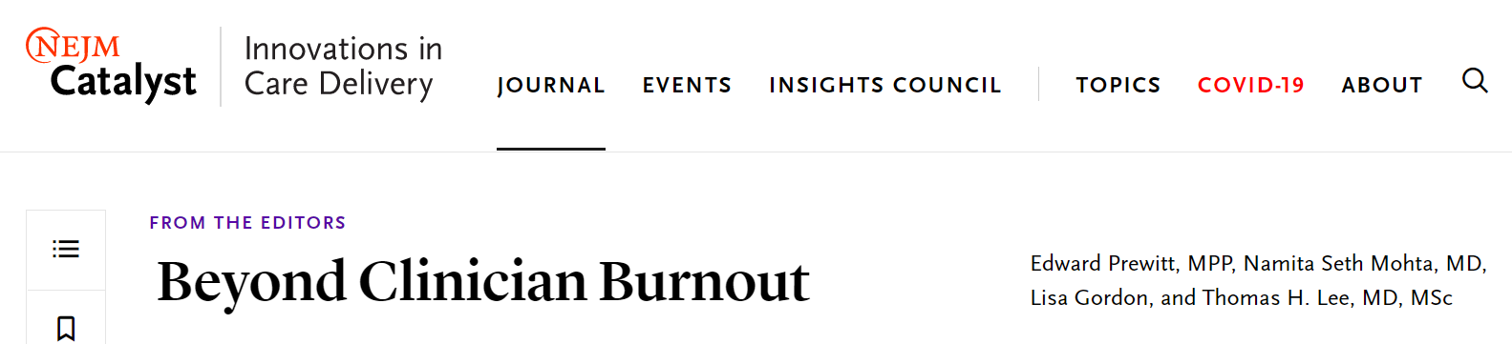
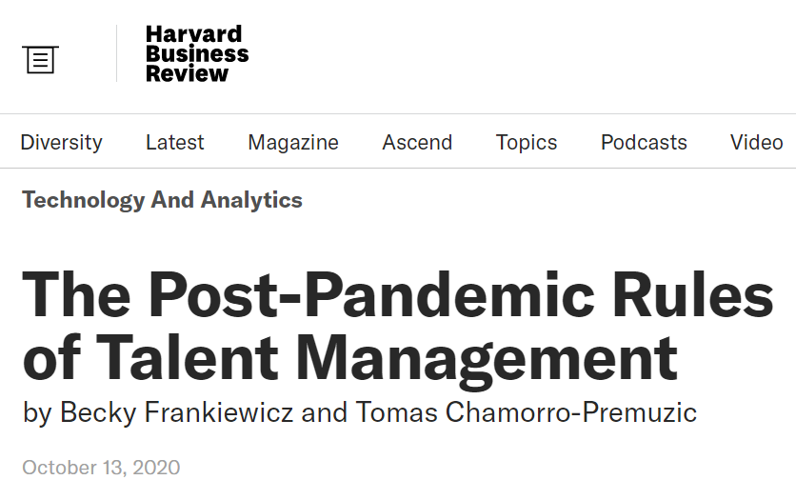
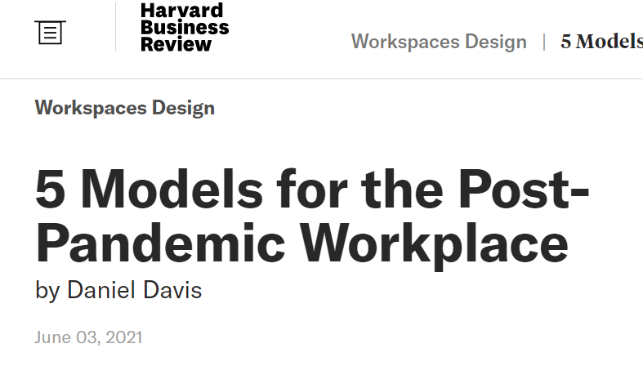
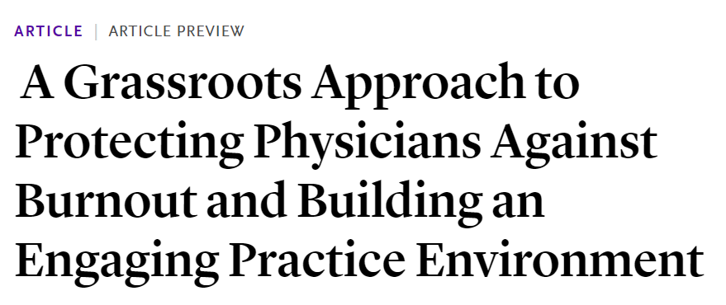

Slide 19

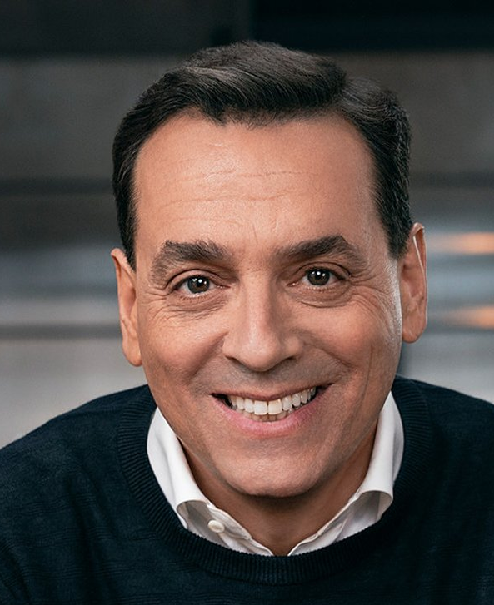
Motivating knowledge workers
Traditional carrots and sticks are not motivating to knowledge workers, and can demotivate
human motivation is largely intrinsic; the aspects of this motivation can be divided into autonomy, mastery, and purpose.

Slide 20
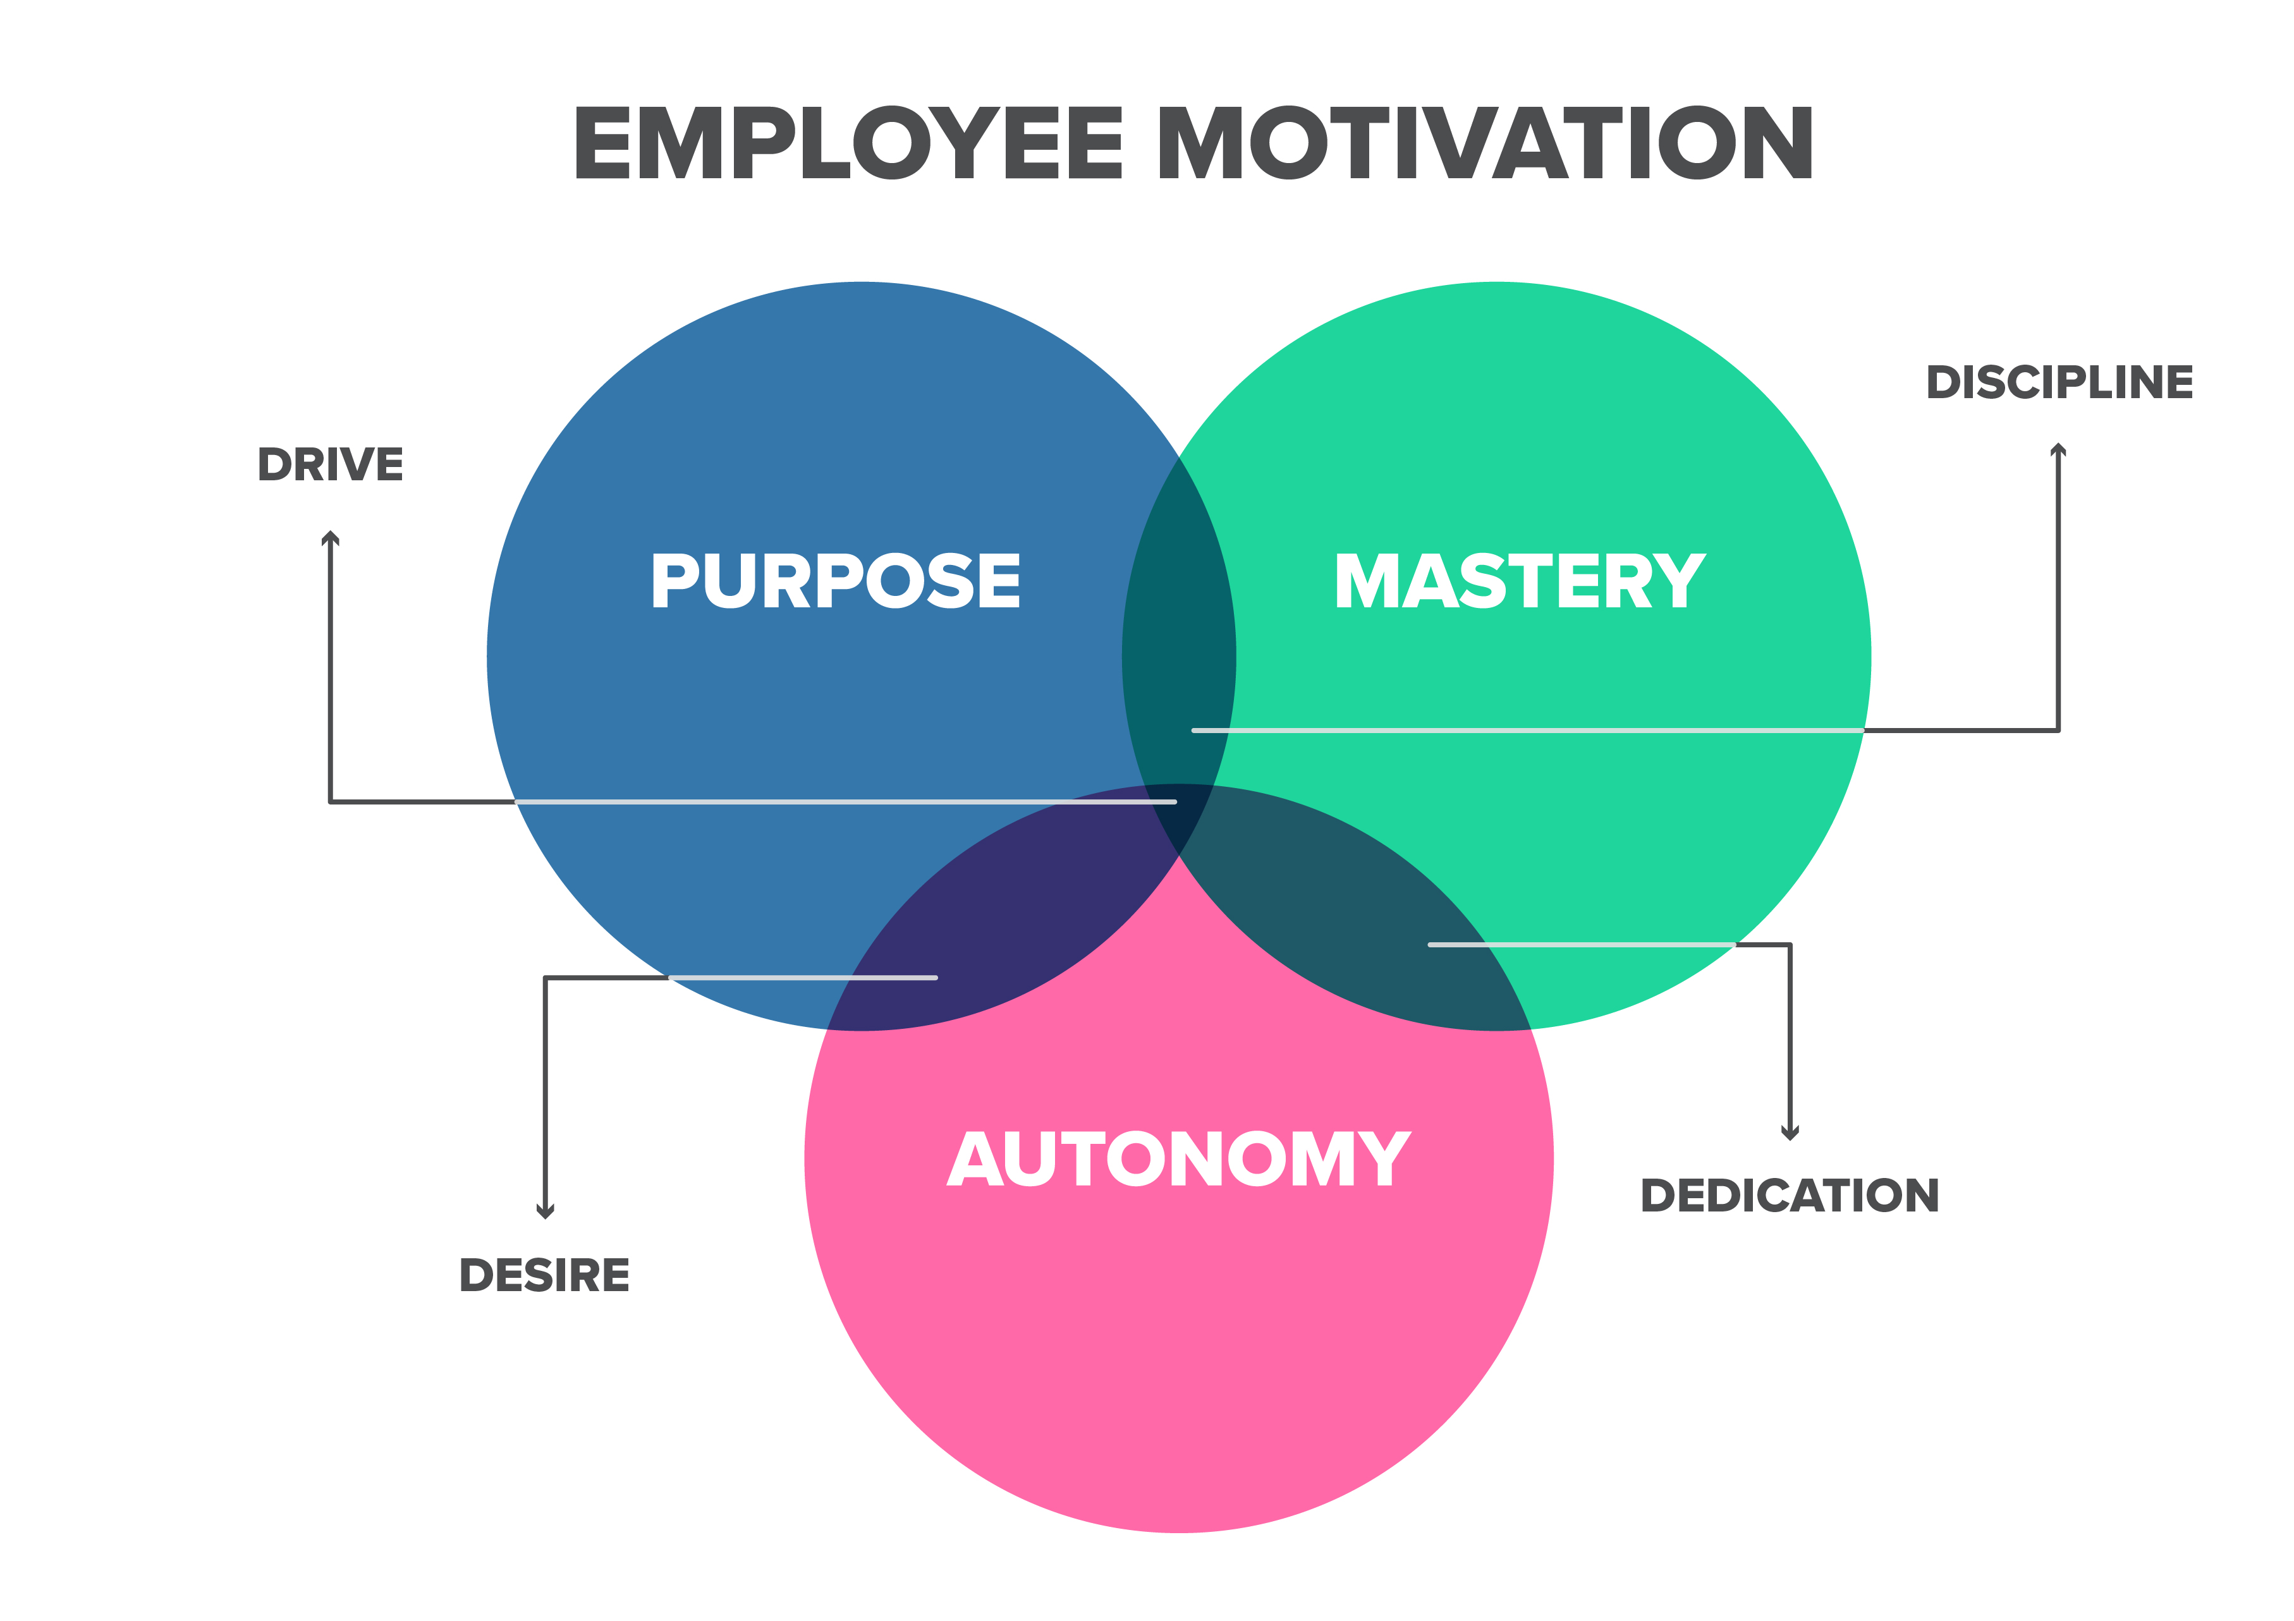
Motivating knowledge workers
Autonomy is the need to direct your own life and work.
Mastery is the desire to improve.
Purpose The "bigger picture."
https://www.gamify.com/gamification-blog/the-gamification-principles-within-daniel-pinks-drive

Slide 21
COVID Has Worsened Tensions Between what our Faculty & Staff want And
Systems in Which We Work
COVID-Related restrictions on office and social gatherings
Staffing clinical emergency departments 24/7/365
COVID-Related Barriers to Academic Productivity
Engaging a decentralized workforce (EM faculty and staff)
Flexibility & Autonomy
Career Development (Mastery)

Slide 22
COVID And Autonomy in The Workplace
increased autonomy and flexibility for some
Remote Jobs improved flexibility and autonomy
Workers do not want to or plan to give that up
For others covid has shown the price of lack of flexibility
Clinicians with challenging schedules, limited ability to swap
conflict with personal responsibilities
Covid uncertainty worsened this
Work became Difficult to impossible

Slide 23
Emphasize engagement
Look forward, not back
Mean what you say
  Communicate clearly
  Time for processing and feedback
  Avoid surprises or unnecessary changes

Slide 24
Table Discussions
  Employee Engagement & Leadership Communication
  Flexibility & Autonomy: clinical and administrative work
  Professional development & Career growth (Mastery)

Slide 25
Table discussion
Describe new practices that are working for your dept.
Be as specific as possible
Are any programs targeted at groups that have been disproportionately affected by covid? (parents, women, URIM, junior faculty)
List tools you are using: surveys, scheduling, consultant, etc.
Identify department if willing

Slide 26
Engagement & Communication

Slide 27
Poll: Are you regularly surveying your faculty & Staff to increase engagement (e.g. ‘Pulse surveys’)
No
Yes, Weekly
Yes, Monthly

Slide 28
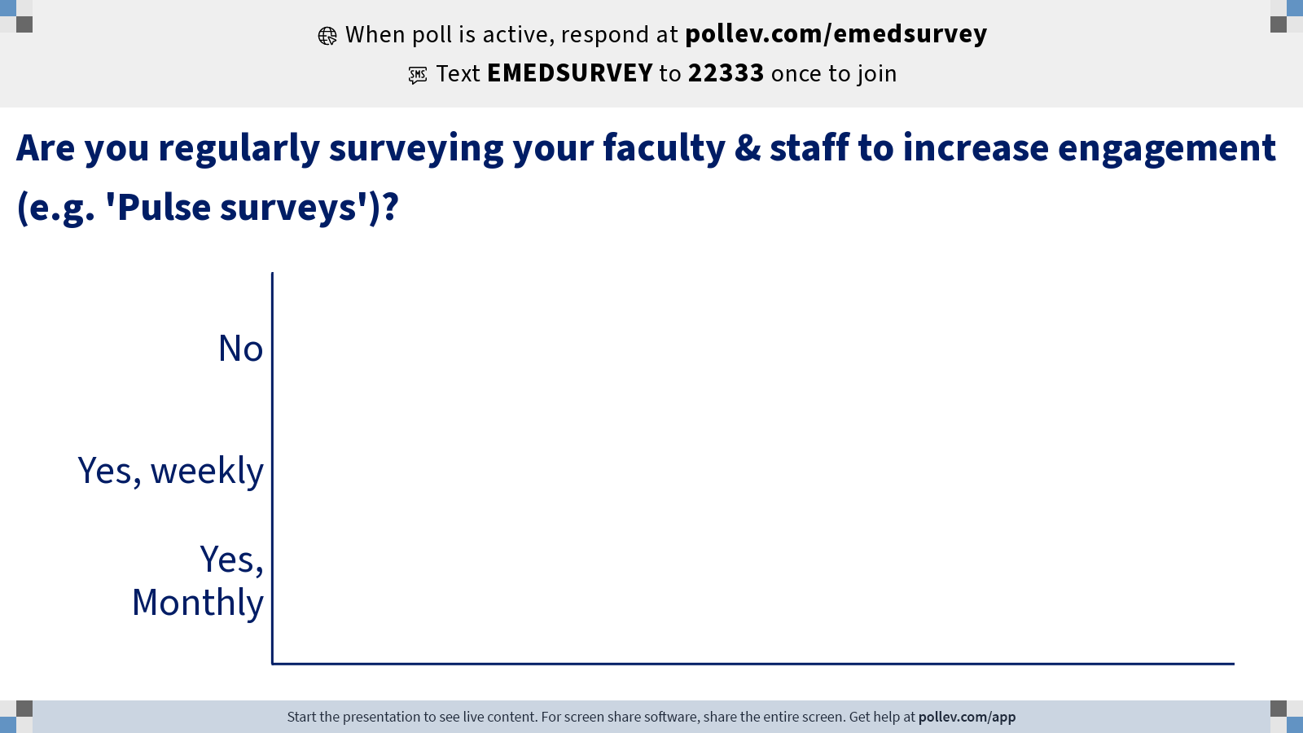
Notes:
Poll Title: Do not modify the notes in this section to avoid tampering with the Poll Everywhere activity.
More info at polleverywhere.com/support
Are you regularly surveying your faculty & staff to increase engagement (e.g. 'Pulse surveys')?
https://www.polleverywhere.com/multiple_choice_polls/DWRU4yYasUj6oxHd0vaTQ?state=opened&flow=Default&onscreen=persist

Slide 29
Poll: have you developed a system to check in on clinicians for signs of burnout and/or depression
No
Yes, informal through department
Yes, formal through a service such as an employee Assistance Program

Slide 30
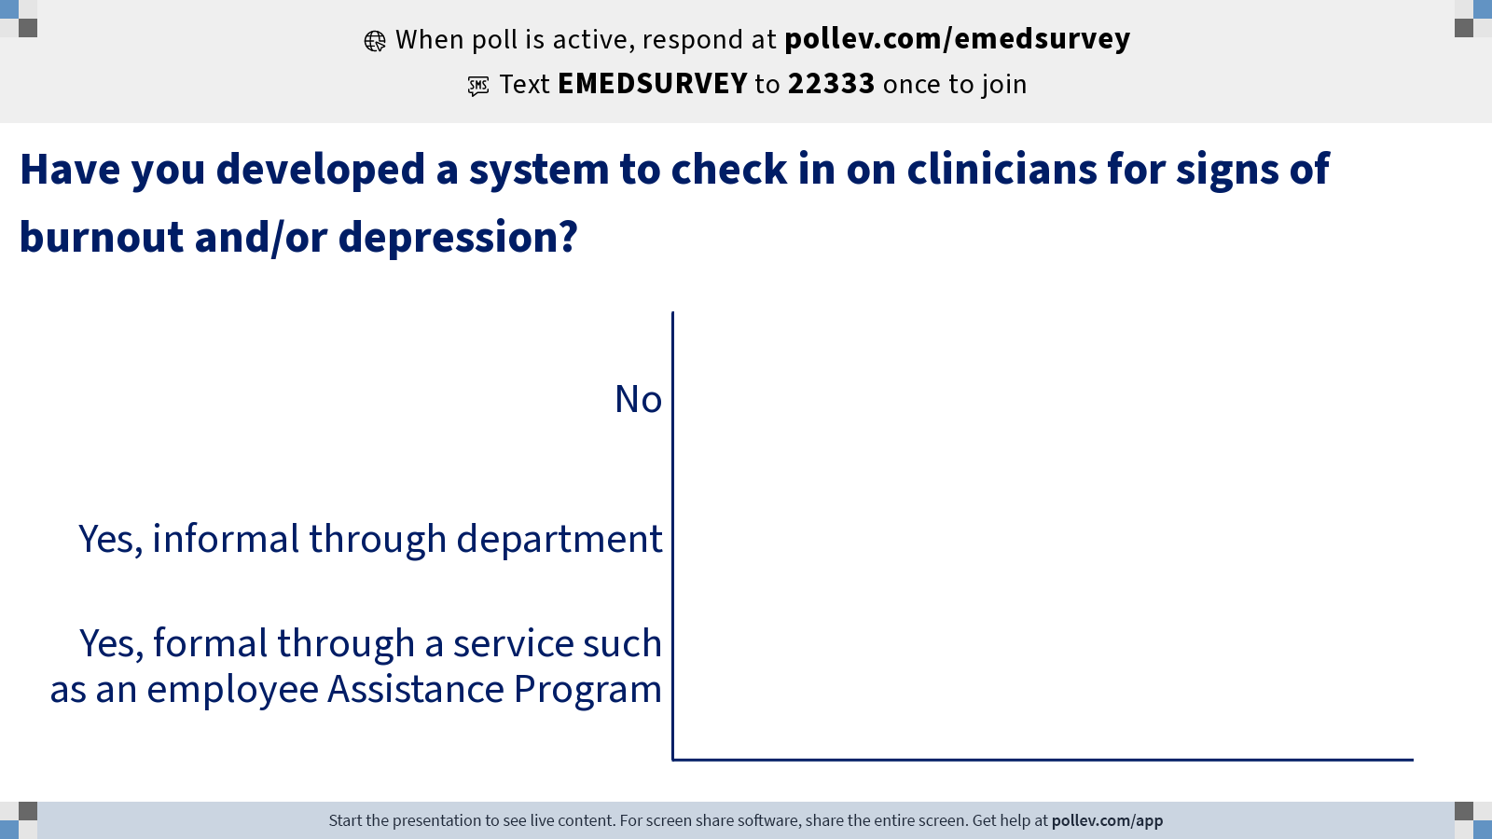
Notes:
Poll Title: Do not modify the notes in this section to avoid tampering with the Poll Everywhere activity.
More info at polleverywhere.com/support
Have you developed a system to check in on clinicians for signs of burnout and/or depression?
https://www.polleverywhere.com/multiple_choice_polls/C9hJV09BdypHo2wh9X5JO?state=opened&flow=Default&onscreen=persist

Slide 31
discussion: Engagement & Communication
What are you doing to increase engagement With faculty & Staff ?
What are you doing to improve communication to your faculty & Staff ?
Describe new practices that are working for your dept.
Be as specific as possible
Are any programs targeted at groups that have been disproportionately affected by covid? (parents, women, URIM, junior faculty)
List tools you are using: surveys, scheduling, consultant, etc.
Identify department if willing

Slide 32
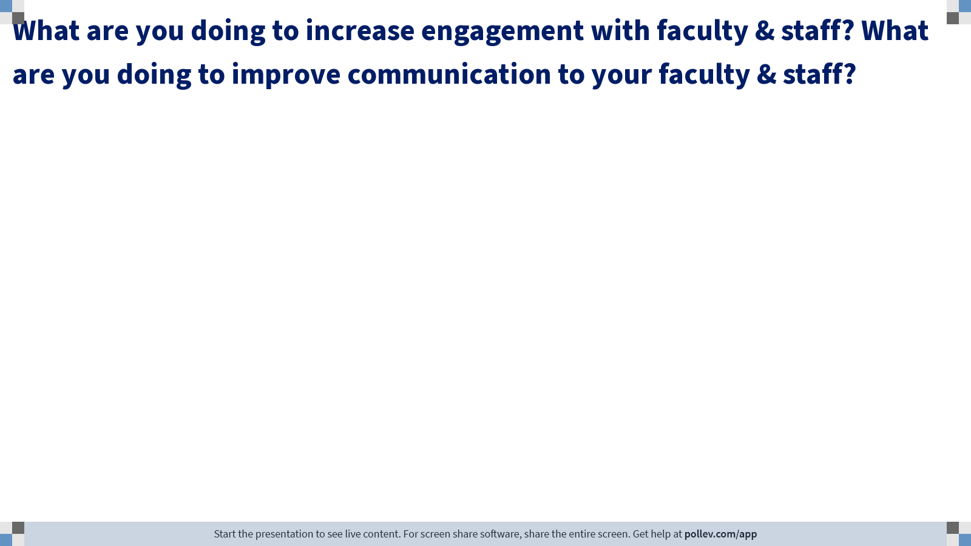
Notes:
Poll Title: Do not modify the notes in this section to avoid tampering with the Poll Everywhere activity.
More info at polleverywhere.com/support
What are you doing to increase engagement with faculty & staff? What are you doing to improve communication to your faculty & staff?
https://www.polleverywhere.com/free_text_polls/p6Ds5FSQsdD6kgESJpUq6

Slide 33
Flexibility & Autonomy in clinical and administrative work

Slide 34
Poll: how do you plan to hold your main clinical faculty meetings (e.g. faculty meeting, clinical site meeting)
Fully remote
Hybrid: in-person with remote option
Hybrid: some Mtgs in-person / others remote
Fully in-person

Slide 35
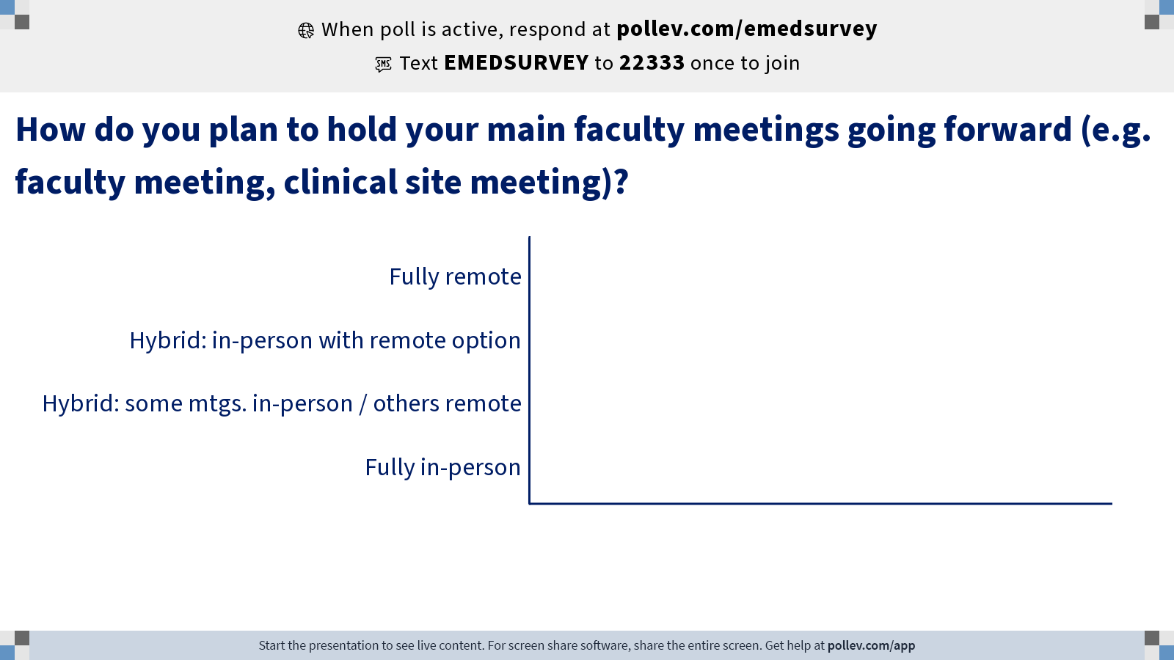
Notes:
Poll Title: Do not modify the notes in this section to avoid tampering with the Poll Everywhere activity.
More info at polleverywhere.com/support
How do you plan to hold your main faculty meetings going forward (e.g. faculty meeting, clinical site meeting)?
https://www.polleverywhere.com/multiple_choice_polls/2Y82K2s2dguSto99QiHtf?state=opened&flow=Default&onscreen=persist

Slide 36
Poll: compared to pre-covid, Have you changed clinical scheduling policies to increase flexibility (e.g. increasing templates, backup, nocturnists, leave)
No
Yes

Slide 37
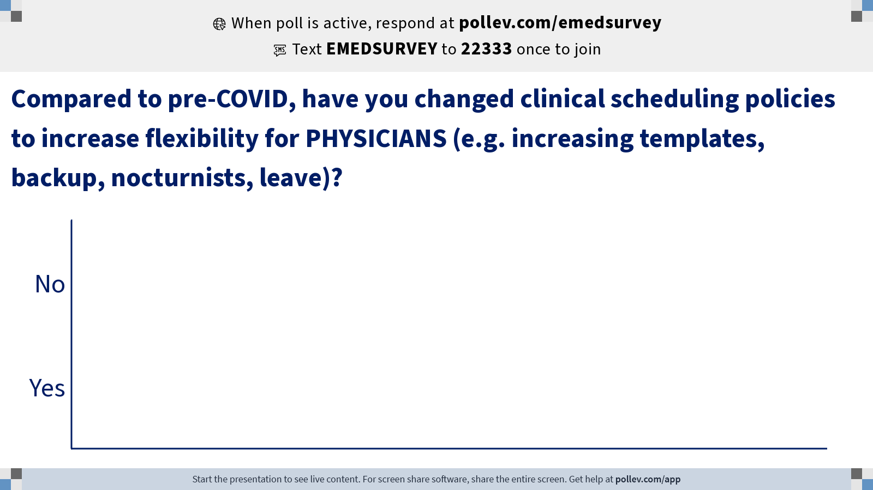
Notes:
Poll Title: Do not modify the notes in this section to avoid tampering with the Poll Everywhere activity.
More info at polleverywhere.com/support
Compared to pre-COVID, have you changed clinical scheduling policies to increase flexibility for PHYSICIANS (e.g. increasing templates, backup, nocturnists, leave)?
https://www.polleverywhere.com/multiple_choice_polls/0T5WOqk7ONvE2iOuobn0u?state=opened&flow=Default&onscreen=persist

Slide 38
discussion: flexibility & autonomy
What are you doing to increase flexibility for faculty & Staff ?
What are you doing to give autonomy to your faculty & Staff ?
Describe new practices that are working for your dept.
Be as specific as possible
Are any programs targeted at groups that have been disproportionately affected by covid? (parents, women, URIM, junior faculty)
List tools you are using: surveys, scheduling, consultant, etc.
Identify department if willing

Slide 39
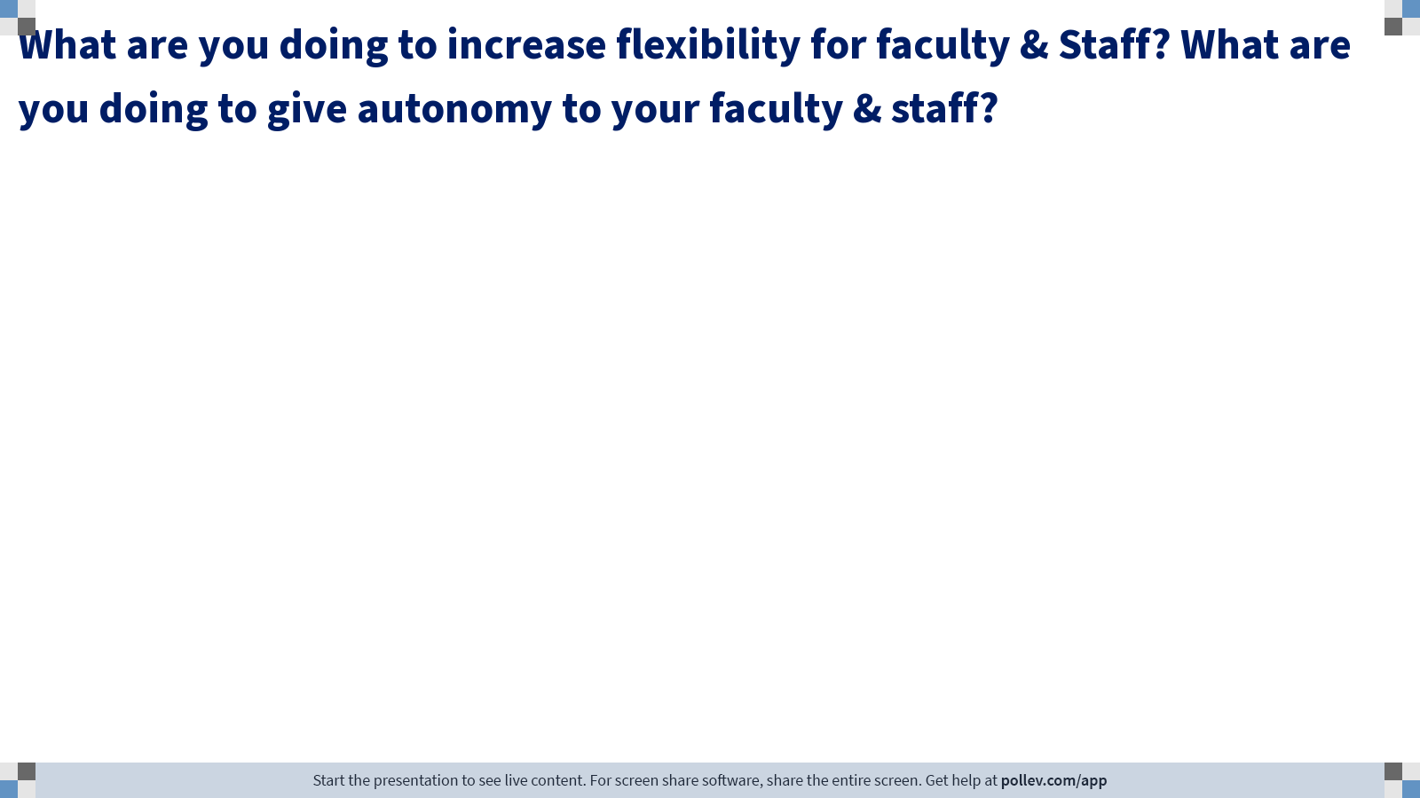
Notes:
Poll Title: Do not modify the notes in this section to avoid tampering with the Poll Everywhere activity.
More info at polleverywhere.com/support
What are you doing to increase flexibility for faculty & Staff? What are you doing to give autonomy to your faculty & staff?
https://www.polleverywhere.com/free_text_polls/5AaA6I8QbSvnrCZLw1TOm

Slide 40
Professional re-engagement and
Career Development

Slide 41
Poll: Compared to pre-COVID, how likely are faculty to be in taking on additional academic & administrative roles
Less likely than before
About the same
More likely than before

Slide 42
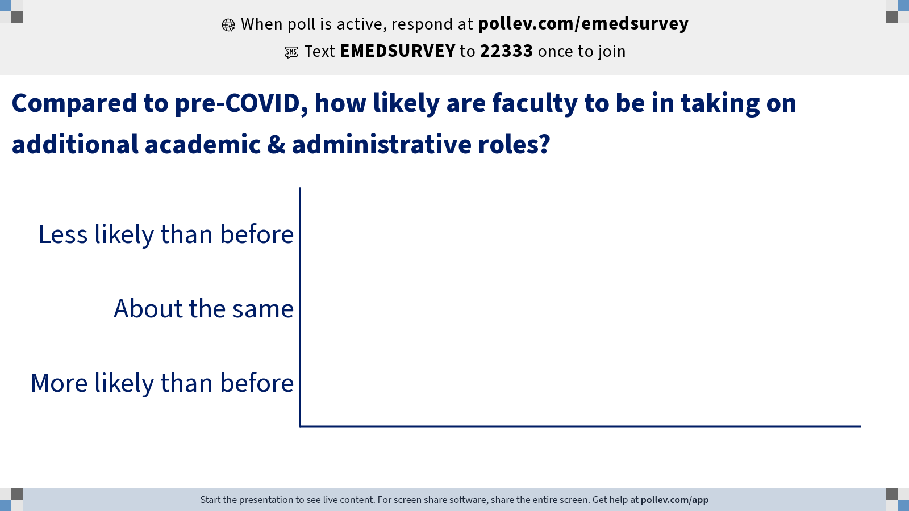
Notes:
Poll Title: Do not modify the notes in this section to avoid tampering with the Poll Everywhere activity.
More info at polleverywhere.com/support
Compared to pre-COVID, how likely are faculty to be in taking on additional academic & administrative roles?
https://www.polleverywhere.com/multiple_choice_polls/SQJqokZRPqiFuKHbhaZ3P?state=opened&flow=Default&onscreen=persist

Slide 43
Poll: have you developed a program or taken specific steps to actively re-engage faculty in their academic career growth
No
yes

Slide 44
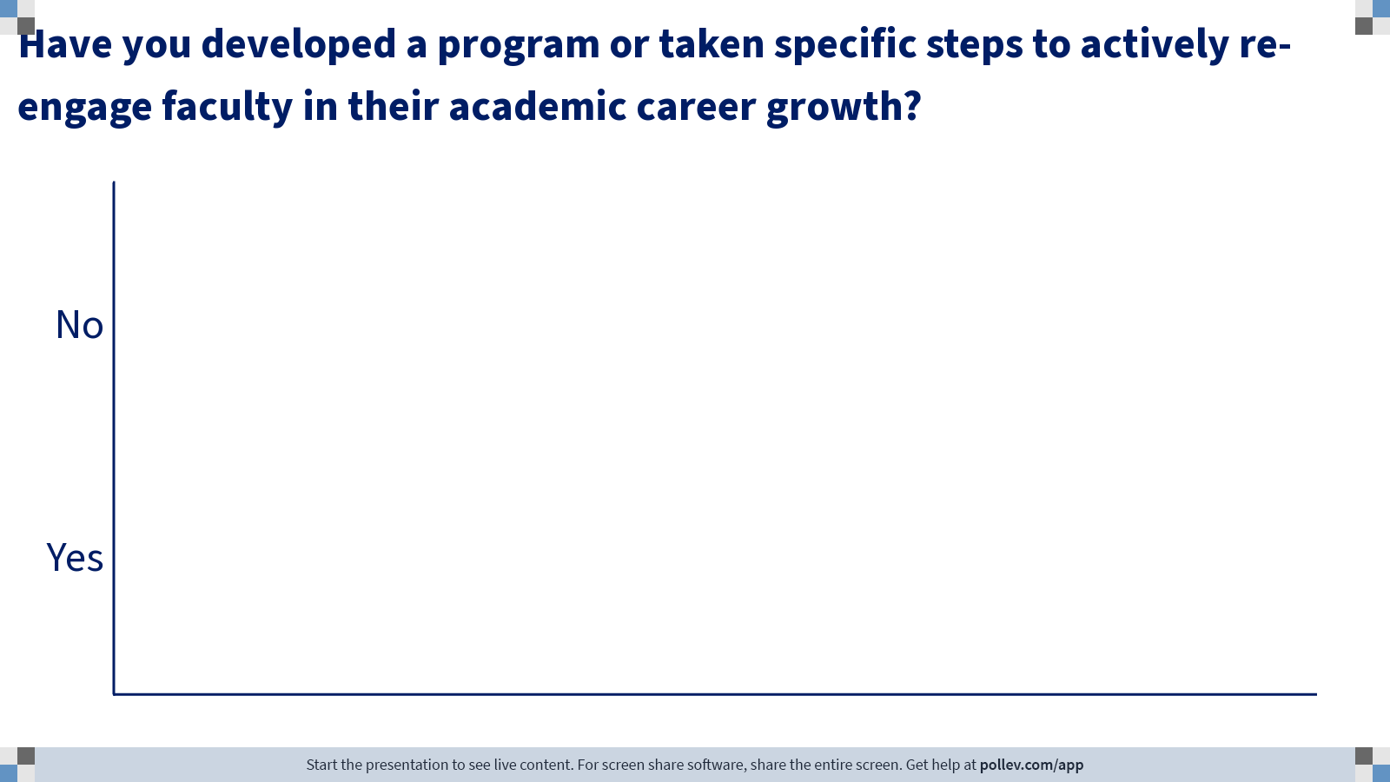
Notes:
Poll Title: Do not modify the notes in this section to avoid tampering with the Poll Everywhere activity.
More info at polleverywhere.com/support
Have you developed a program or taken specific steps to actively re-engage faculty in their academic career growth?
https://www.polleverywhere.com/multiple_choice_polls/3byvwdMjPTE52X2ESilF6?state=opened&flow=Default&onscreen=persist

Slide 45
discussion: Professional re-engagement and Career Development
What are you doing to actively re-engage faculty & Staff in their careers ?
Has your department or institution developed new programs for career development of your faculty & Staff ?
Describe new practices that are working for your dept.
Be as specific as possible
Are any programs targeted at groups that have been disproportionately affected by covid? (parents, women, URIM, junior faculty)
List tools you are using: surveys, scheduling, consultant, etc.
Identify department if willing

Slide 46
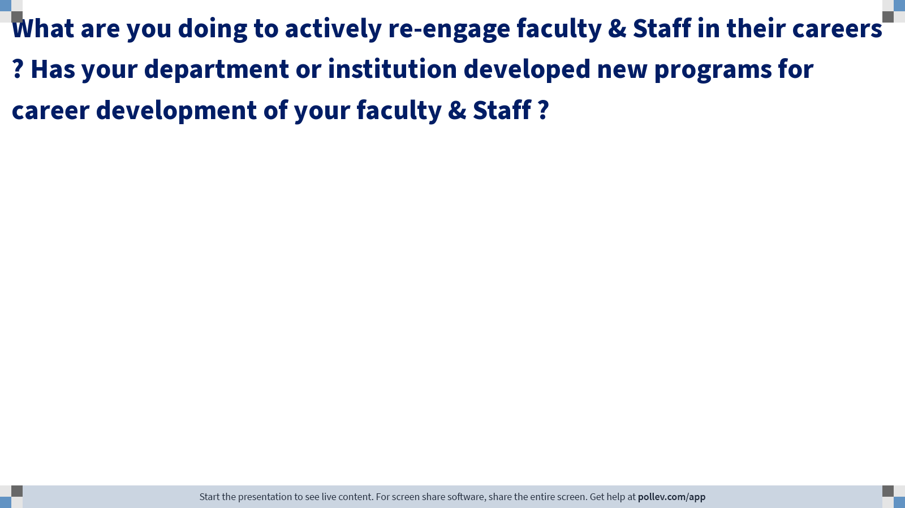
Notes:
Poll Title: Do not modify the notes in this section to avoid tampering with the Poll Everywhere activity.
More info at polleverywhere.com/support
What are you doing to actively re-engage faculty & Staff in their careers ? Has your department or institution developed new programs for career development of your faculty & Staff ?
https://www.polleverywhere.com/free_text_polls/t58PATTVNmFTuhs5W9pmN

Slide 47
Thank You!

