Slide 1
AAAEM 13th (?) Annual Meeting March 20, 2022 San Juan, Puerto Rico

Slide 2
Meeting Agenda
Call to Order – K. Robbins
2021-2022 AAAEM Highlights - K. Robbins
Treasurer Report – B. McGowan
Re(Acquaintance) – Wellness Committee
Transition of Leadership – K. Robbins
Committee Reports – Committee Chairs
Membership
Communication
Benchmark
Strategic Planning
Education
IDEA
Wellness
Nominating
Committee Time / Meet & Greet

Slide 3
AAAEM 2021-2022 In Review
Creation of the Inclusion, Diversity, Equity & Inclusion (IDEA) Committee
Graduating CAEMA Class
Annual Benchmark and Extended the COVID-19 Survey
SAEM Didactic Sessions
Enhanced Quarterly Newsletter by Communication Committee
New Website Design
Strategic Planning Survey
Alteration of the AAAEM EC Succession Order
Revision of the Annual Award Structure/Naming
Continued Virtual Education Sessions
Managed Large Transition of Members

Slide 4
AAAEM Organization

Slide 5
The Academy of Administrators in Academic Emergency Medicine (AAAEM) is a professional association for individuals managing the administrative and business functions of an academic department or division of emergency medicine. These academic units typically engage in activities related to patient care, education, and research mission, including the primary administration of an emergency medicine residency program The mission of AAAEM is:
to advance the profession of individuals serving as administrators within emergency medicine academic programs;
to provide a forum for academic emergency medicine administrators to communicate, share ideas, and generate solutions to common problems;
to use education and research to influence public policy for the benefit of patients, medical student and resident education, emergency
to serve as a unified voice for academic emergency medicine administrators;
to foster the professional development and career satisfaction of academic emergency medicine administrators;
to foster research in emergency medicine operations and management; medicine physicians, and medical schools.

Slide 6
Executive Committee
The Executive Committee is designed to provide leadership and act on behalf of the general membership to further the mission of AAAEM and conduct its business activities. All officers of the Executive Committee shall by all reasonable means attend the executive meetings, the AAAEM annual meeting and perform their assigned duties accordingly. The Executive Committee provides oversight to the other committees
The Executive Committee consists of the following roles in succession order:
Secretary (Annual Election)
Treasurer
President-Elect
President
Immediate Past ­President
Member at Large (Annual Election)
Member at Large (Annual Election)
Member at Large – SAEM Liaison
Member at Large – AACEM Liaison
5 yr committment

Slide 7
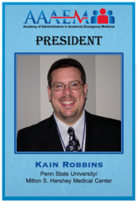
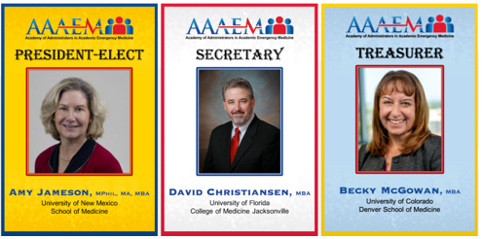
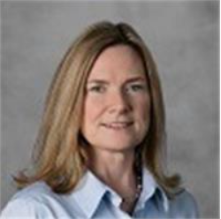
Executive Committee
PAST PRESIDENT
Rhea Begeman, MS, BSN, RN
University of Illinois College of Medicine at Chicago

Slide 8
AAAEM 2022-2023 Executive Leadership
President – Kain Robbins
Immediate Past President –Rhea Begeman, RN, BSN, MS
President Elect – Amy Jameson, Mphil, MA, MBA
Secretary – David Christiansen, MBA
Treasurer – Becky McGowan, MBA
Member at Large SAEM Liaison – Open
Member at Large AACEM Liaison – Open
Member at Large – Travis Schmitz, PhD, MBA
Member at Large – Jennifer Patton Muir, MBA
SAEM Board Liaison – Dr. Jody Vogel, MPH, MSW
SAEM Staff Liaison – Michelle Aguirre, MPA

Slide 9
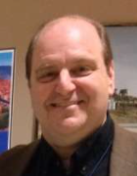
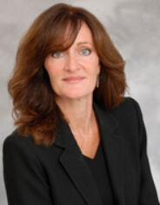
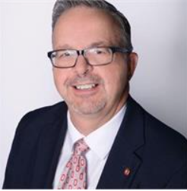
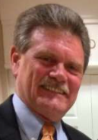
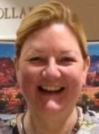
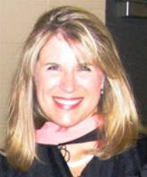
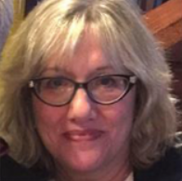
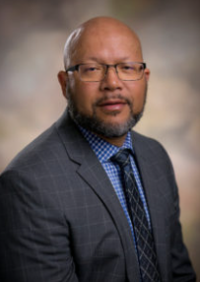
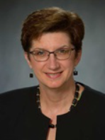
AAAEM “DEAD PRESIDENTS”
KEN MARX
LINDA DAVIS MOON
GREG ARCHUAL
JIM SCHEULEN
KIRSTEN ROUNDS
ASHLEE MELENDEZ
JILL ZAHEER
LOUIS BURTON
RHEA BEGEMAN
RICHARD MCADAMS
ANTOINETTE BROOKE

Slide 10
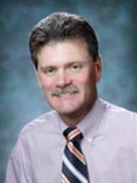
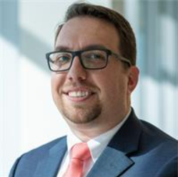
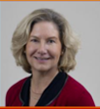
AAAEM Committees
Greg Archual, MBA
Jim Scheulen, PA, MBA
Shannon Hughen-Giger, MHA
Louis Burton, MHSM
Ashlee Melendez, MSPH, BSN
Steve Petrovic, MBA
Rhea Begeman, MS, BSN, RN
Andrew Kennedy, MBA
Amy Jameson, Mphil, MA, MBA

Slide 11
AAAEM Committees
Benchmark Committee
The Benchmark Committee is responsible for completion of the annual benchmarked EM operations and salary survey. The survey is a data gathering instrument designed to capture each site's unique information that can be used to compare across all sites. The survey has become one of our most important documents and is presented at the AACEM/AAAEM annual meeting. The Benchmark Committee has monthly conference call meetings and one onsite meeting.
Communications Committee
The Communications Committee is responsible for facilitating AAAEM communications. This is done through the SAEM website, AAAEM community, newsletters, emails, and social media portals. Also key to this group is the review of SAEM discussion portal and communications guidelines. One of the committee's goals is to ensure the website is the go-to-site and one-stop shop for existing as well as potential new members.
IDEA Committee
The new formed Inclusion, Diversity, Equity, and Antiracism (IDEA) Committee will work on tactics to improve diversity, equity, and inclusion in programs, activities, and education for Administrators. The committee will also advise, collaborate, and make recommendations to the AAAEM Executive Committee on IDEA issues and objectives.
Education Committee
The Education Committee's goal is to promote continued professional development to enhance the value of AAAEM membership to its members. The purpose of the Education Committee is to plan and coordinate educational programs for AAAEM members, informed by the AAAEM strategic plan, and with the guidance of the Executive Committee. The Education Committee will focus on both immediate educational offerings for the upcoming year as well as future programs.

Slide 12
AAAEM Committees
Membership Committee
The Membership Committee is responsible for identifying and recruiting potential new members as well as assisting in the retention of current members. This involves coordinating with the SAEM membership staff. The committee is also trying to develop processes to orient new members and make them feel welcome to the organization.
Nominating Committee
The Nominating Committee is responsible for ensuring continuity of AAAEM Leadership. This is accomplished by ensuring AAAEM Officers are identified, nominated and voted upon by AAAEM members. Annually, the committee puts forth candidate recommendations to fill positions in the Executive Committee. The Nominating Committee will solicit qualified candidates and review nominations for the elected officer positions of President, President-elect, Secretary and Treasurer. The Nomination Committee also works to identify and recommend to the Executive Committee nominees for AAAEM Awards.
Strategic Planning Committee
The Strategic Planning Committee's charter is to construct the AAAEM of tomorrow. The committee recommends AAAEM's long and short term strategies for effective operations.
Wellness Committee
The Wellness Committee has been created and charged with exploring the unique needs and resiliency factors important in developing and maintaining wellness. We have all heard the terms wellness and burn out used regarding faculty. It is just as important that we recognize that these terms also apply to Administrators, APPS, nurses, and staff as well as faculty.

Slide 13
AAAEM Treasurer’s Report
March 2022
Becky McGowan
AAAEM Treasurer

Slide 14
Finance Committee Members 2022
Becky McGowan, University of Colorado Anschutz Medical Campus
Dave Christiansen, University of Florida -Jacksonville
Rhea Begeman, University of Illinois at Chicago
Kain Robbins, Penn State University
Amy Jameson, University of New Mexico
Travis Schmitz, Northwestern University
Jennifer Muir, East Carolina University

Slide 15
Finance Committee Activities 2021
*Reviewed Monthly Revenue & Expenses for AAAEM and CAEMA
•Expanded Member Assistance Program form (fillable form) to include support for
Membership Dues and CAEMA Program
* Form changed to a fillable PDF format
•Developed 2022 Budget
*Streamlined Committee Budget Entry using a Shared Google Excel File
*Created Definition Matrix for Individual Budget Categories

Slide 16
Member Assistance Program (MAP)
Goal of the program is to increase participation and attendance to AAAEM events.
AAAEM can help support the cost registration or lodging/airfare but generally not all expenses to attend a meeting. The employee’s department/institution would be asked to contribute towards the expense.
Prioritization of requests – all applicants will need to have an active membership
Administrators – full members
Associate Members enrolled in CAEMA
Associate Members
Emeritus Members

Slide 17
2021 Year End Statement (Unaudited)

Slide 18
2022 Budget (January –December)
 |  | 2022 Budget
Balance from Prior Year |  | $ 126,382
Revenue
 | AAAEM Academy Dues (50%) | $ 29,700
 | Retreat Registration | $ 51,450
 | CAEMA Registration | $ 11,250
Total Revenue |  | $ 92,400
Expenses
 | AACEM/AAAEM Retreat | $ 79,883
 | Other | $ 86,596
 | CAEMA | $ 22,481
Total Expenses |  | $ 188,960
Net Margin |  | $ (96,560)
Balance Carry Forward |  | $ 29,822
CY 22 Budget Considerations
Expanded Member Assistance Program
Retreat Cost
Budget entry for AAAEM Committees

Slide 19
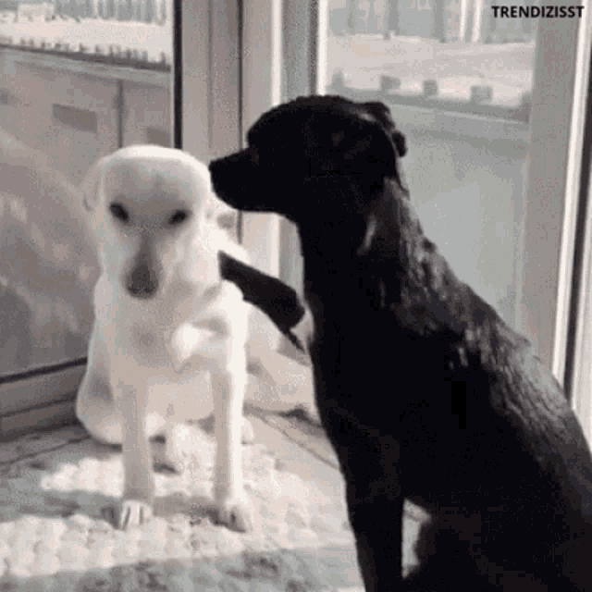
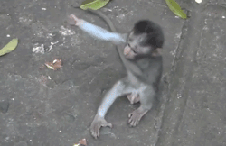
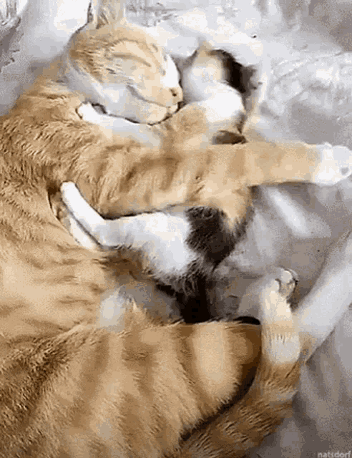
Member Re(Acquaintance)

Slide 21
Getting to know each other
Do you have kids or grandkids?
If so, how many?
What about other family members?
Do you have animals?
Prefer dogs or cats or other?
What is your favorite thing to do on the weekend?
Do you like to travel?
Favorite place?
Why?
What’s one of your favorite memories of the past year?
What’s one thing you’re trying to make a habit?
What’s the one thing you would give up at work?
What would you keep?
Who has been your favorite boss and why?

Slide 22
Transition of Leadership

Slide 23
AAAEM 2022-2023 Executive Leadership
President – Amy Jameson, Mphil, MA, MBA
Immediate Past President – Kain Robbins
President Elect – David Christiansen, MBA
Treasurer – Becky McGowan, MBA (Year 2)
Secretary – Jennifer Patton Muir, MBA
Member at Large SAEM Liaison –
Member at Large AACEM Liaison –
Member at Large – Travis Schmitz, PhD, MBA
Member at Large – Steve Maxwell, MSM
SAEM Board Liaison – Dr. Jody Vogel, MPH, MSW
SAEM Staff Liaison – Michelle Aguirre, MPA

Slide 24
Committee Reports

Slide 25
Membership Committee Report
Steven T Petrovic, MBA
Chief of Administrative Officer
University of Cincinnati Physicians
University of Cincinnati – College of Medicine

Slide 26
Membership Committee
Annual Goals:
Align AAAEM membership with the AACEM
Improve new membership onboarding
Increase membership with Associate & Emeritus Status

Slide 27
Membership Committee

Slide 28
Communications Committee
Shannon Giger, MHA Administrator UAMS College of Medicine Committee Chair

Slide 29
Communication Committee Members
Shannon Giger – Chair
Michelle Hill (half year)
Andrew Jackson
David Calder
David Christiansen

Slide 30
Communication Committee Members
Committee reviewed new website enhancements and was involved in:
Checking the links and making sure errors were fixed
New exec team updated
Reviewed member page content, reporting 55 (53%) missing profile pics out of 104 members
Researched the possibility of member page enhancements and worked with Education committee to create a database for a repository of enhanced membership information.
Better mgmt. of uploaded documents in AAAEM folders, presenting a brief tutorial at AAAEM retreat
Committee took over management of the newsletter and was involved in:
Committee produced 3 quarterly newsletters featuring 11 new members, in the ‘New Member Spotlight, adding committee updates, Q&A with a few from our exec. team and adding membership announcements like, new home, retirement, new career changes, etc.

Slide 31
Benchmark Committee
March 2022
Jim Scheulen/Greg Archual

Slide 32
Benchmark Committee
Committee met virtually 2 times in July and August to discuss changes to the survey
Committee met monthly to discuss progress and refine questions
Continued data collection/analysis on COVID specific survey
Monthly data collected covers January 2019 – December 2021
Performed annual Benchmark and Salary Survey with excellent response
In spite of COVID challenges there was strong participation
87 academic/affiliated responses
Performed Faculty, APP, & Administrator Salary Surveys
Cathi Harbertson

Slide 33
Strategic Planning Committee
2021/2022
Andrew D. Kennedy, M.B.A.
Executive Administrator
University of Alabama at Birmingham (UAB)
Committee Chair

Slide 34
AAAEM Strategic Planning Committee 2021/2022
Drew Kennedy, Chair – UAB
Ambrosya Amlong – University of Kansas
Martine Baptiste-Blayton – Mount Sinai
Gai Cole – Johns Hopkins
Janice Harvey – SUNY (retired)
Steve Maxwell – University of Michigan
Anne McDonald – University of Mississippi
Jennifer Patton Muir – East Carolina University
Tim Sullivan – Thomas Jefferson University
Special thanks to Lisa Garnes (Michigan) for survey technical support
Special thanks to Cali Sanford (UAB) for SWOT retreat session support

Slide 35
2021/2022 Key Accomplishments
Distributed strategic plan membership survey to AAAEM membership in fall 2021
23 responses vs. 28 responses in 2020
Edited 2021 survey to include SWOT questions
Shared results with Executive Committee and committee chairs, along with comparison of results from 2019 pilot survey and 2020 full membership survey

Slide 36
Strategic Membership Survey Results
GOALS / OBJECTIVES | 2020 |  | 2021
National Recognition | Responses | Mean | Responses | Mean
Continue to publish in peer-reviewed journals | 28 | 59.93 | 23 | 65.30
Continue to present scholarly activities and at regional and/or national meetings | 28 | 62.86 | 23 | 71.22
Membership Development
Continue to offer the CAEMA certificate program and attract active participation | 28 | 77.39 | 23 | 84.96
Continue to elevate and expand the value of administrators within EM through Society education offerings | 28 | 71.43 | 23 | 75.65
Academy will work with other SAEM academies to publish position papers | 28 | 59.96 | 23 | 67.87
Provide training and expertise to administrators so they can fully utilize the Round Table Analytics website tool | 28 | 75.82 | 23 | 81.78
Provide regular opportunities for continuing education and professional development between the annual retreats | 28 | 77.04 | 23 | 68.87
Greater Integration in SAEM
Advocate for AAAEM participation in the didactic review process for submissions | 26 | 55.50 | 18 | 64.11
Solicit support from AACEM to further this idea. | 25 | 55.72 | 20 | 63.95
Advocate for the development of this new area. | 28 | 53.07 | 20 | 62.85
Appoint an AAAEM group to develop the content to submit for the focus area. | 28 | 56.14 | 22 | 60.68
Create an administrative track/focus area at SAEM meeting | 28 | 57.93 | 23 | 56.00
Member Engagement with AAAEM
Promote membership successes to innovate and inspire future activities | 28 | 65.36 | 22 | 69.41
Improve new member on-boarding process | 28 | 70.29 | 23 | 70.17
Establish committee size and guidelines | 27 | 63.00 | 23 | 64.30
Enhance expectations of committee outcomes | 28 | 65.82 | 23 | 66.48
Enhance committee chair role description | 28 | 68.29 | 22 | 73.09
Communicate concurrently with membership about AAAEM activities to increase awareness | 28 | 75.61 | 23 | 71.87
Actively solicit participation in AAAEM committees/activities | 28 | 78.61 | 23 | 73.22

Slide 37
2021/2022 Key Accomplishments
II. Consulted with IDEA Committee and proposed adding pillar goal to Strategic Plan:
Inclusion, Diversity, Equity, and Anti-Racism (IDEA)
Goal: Create a culture of inclusion, diversity, equity, and anti-racism within AAAEM.
Create and resource a committee focused on inclusiveness, diversity, equity and anti-racism to advise AAAEM leaders and members on equity, diversity and inclusion issues.
Ensure alignment and harmony between AAAEM strategic objectives and the objectives of the SAEM Diversity, Equity and Inclusiveness Committee.
Align AAAEM policy efforts with tenets and objectives of the AAAEM inclusiveness, diversity, equity and anti-racism committee.

Slide 38
2021/2022 Key Accomplishments
III. Developed SWOT Analysis session for 2022 annual retreat
Tuesday, March 22, 2022, 09:45 – 10:15
Goals:
Incorporate feedback from 2021 survey
Incorporate prior SWOT Analysis items
Gather consensus perceptions from members at the retreat
Generate discussion and create engagement among AAAEM members
Inform the creation of the SWOT Analysis to be developed by the Strategic Planning Committee in 2022

Slide 39
Strategic Planning Committee Proposed Goals for 2022/2023
Distribute annual survey to AAAEM membership
Continue to refine the survey, note trends in results, and engage committee chairs as indicated
Use survey results and other assessments to inform Academy’s SWOT Analysis
Develop process to update SWOT Analysis annually
Conduct high-level review of Strategic Plan in preparation for a more in-depth biennial review in 2023

Slide 40
Education Committee March 2022
Ashlee Melendez Becky McGowan
Amy Jameson Tim Sullivan
Travis Schmitz Shannon Giger
Jennifer Muir

Slide 41
Education Committee
The current CAEMA class graduated this weekend in Puerto, Rico! Congratulations
New CAEM class start date: Retreat 2023
Special thanks to those who led webinars this past year
Roundtable Analytics
Cathi Harbertson
Greg Archual
Jim Scheulen
We will be leading the Hot Topics here at the retreat.
Please let us know if you have ideas for AAAEM educational offerings for 2022-2023

Slide 42
Inclusiveness, Diversity, Equity and Anti-Racism (IDEA) Committee Report
Louis Burton, Chair

Slide 43
IDEA Committee Members
Rhea Begeman, University of Illinois at Chicago
Louis Burton, UT Health, San Antonio
Dave Calder, Loma Linda University
Katy Oksuita, University of Wisconsin-Madison
Andrew Kennedy, University of Alabama at Birmingham
Diane Lee, Einstein Healthcare Network
Justine Murphey, Stanford University
Chelsea Pentecost, UT Health, Houston
Laura Robinson, University of Nebraska Medical Center
Tim Sullivan, Thomas Jefferson University and Hospitals
Cori Ward, University of Utah

Slide 44
IDEA Committee Members
IDEA Charter
Document Excerpt – Mission To facilitate a culture in our Academy where IDEA principles are respected and intentionally valued……
Living Document approved by AAAEM Exec
IDEA Survey
33 Responses
Email to Group
3rd Goal
Prioritize Survey Responses for Next Year Challenges

Slide 45
Wellness Committee March 2022
March 2022
Amy Jameson

Slide 46
Wellness Committee
Annual Retreat Happy Hour
Benchmark Survey included wellness questions
46 institutions responded
Significant information in the survey
How to move wellness forward?

Slide 47
Nominating Committee March 2022
Rhea Begeman Louis Burton
Gai Cole Antoinette Brooke
Becky McGowan

Slide 48
AAAEM Award Descriptions and Guidelines
The Rising Star Academy of Administrators in Academic Emergency Medicine Award: This recognizes an academic emergency medicine administrator affiliated with AAAEM who has demonstrated significant participation and/or leadership within the academy during their first five years of membership.
Minimum requirement: AAAEM member for 5 years or less
Member should demonstrate the following:
Significant participation in AAAEM activities (e.g. projects) and/or committees
Demonstrated leadership skills
Positive peer to peer interactions
Works effectively with AAAEM leadership (either at committee or organizational level or both)
Demonstrated initiative to further AAAEM goals and outcomes

Slide 49
Awards cont’d
Significant Contributions to Academic Emergency Medicine Administration Annual Award: The AAAEM Annual Academy Award recognizes an academic emergency medicine administrator who has demonstrated exceptional leadership within the past three years.
Minimum requirement: AAAEM member
Member should demonstrate the following:
Exhibits exemplary leadership qualities
Sharing best practices, Mentoring, Advocacy of the profession
Participation in AAAEM activities
Shows outstanding dedication, competence, and exceptional performance
Shows strategic and operational effectiveness
Contributes to emergency medicine education and/or research
Presentation
Other
Noteworthy contribution/s to the growth and success of AAAEM

Slide 50
Awards cont’d
James J. Scheulen Lifetime Achievement Award in Academic Emergency Medicine Administration: The AAAEM Lifetime Achievement Award in Academic Emergency Medicine Administration is the highest recognition the Academy gives an individual. It recognizes an academic emergency medicine administrator who has demonstrated noteworthy achievement, exceptional leadership, and management proficiency. One who has enhanced the strategic and operational effectiveness of academic emergency departments, emergency medicine education or emergency medicine research in his or her institution, and/or the broader academic emergency medicine community.
Minimum requirement: Must be AAAEM member for greater than 5 consecutive years and work a minimum of 10 years in academic emergency medicine
Member should demonstrate the following:
Advances interprofessional education, be involved in professional growth, and educational programs within the Academy
Commitment to the organization through AAAEM leadership
Provides leadership and service within our profession
Evidence of research and/or creative scholarship activities related to academic emergency medicine
Creates and cultivates sharing of ideas and best practices amongst AAAEM members

Slide 51
SAEM ‘22

Slide 52
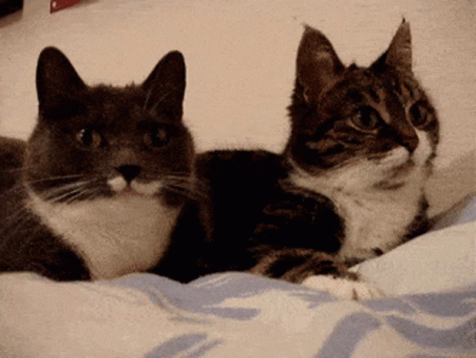
Open Discussion

Slide 53
Committee Time

