Slide 2
Joint Workforce Statement
Notes:
The pause in hiring around Covid seems to have ended…

Slide 3
Match 2024
92.7%
292 | 3,026 | 54 | 1,386 | 3,574 | 1,285 | 2,891 | 42.5 | 95.5 | 20,439 | 42,698
89.4%
292 | 3,026 | 54 | 1,171 | 3,574 | 1,047 | 2,891 | 34.6 | 95.5 | 15,342 | 42,698
77.1%
77.1%
Notes:
The pause in hiring around Covid seems to have ended…

Slide 4
Match 2024
15.5%
4.4%

Slide 5
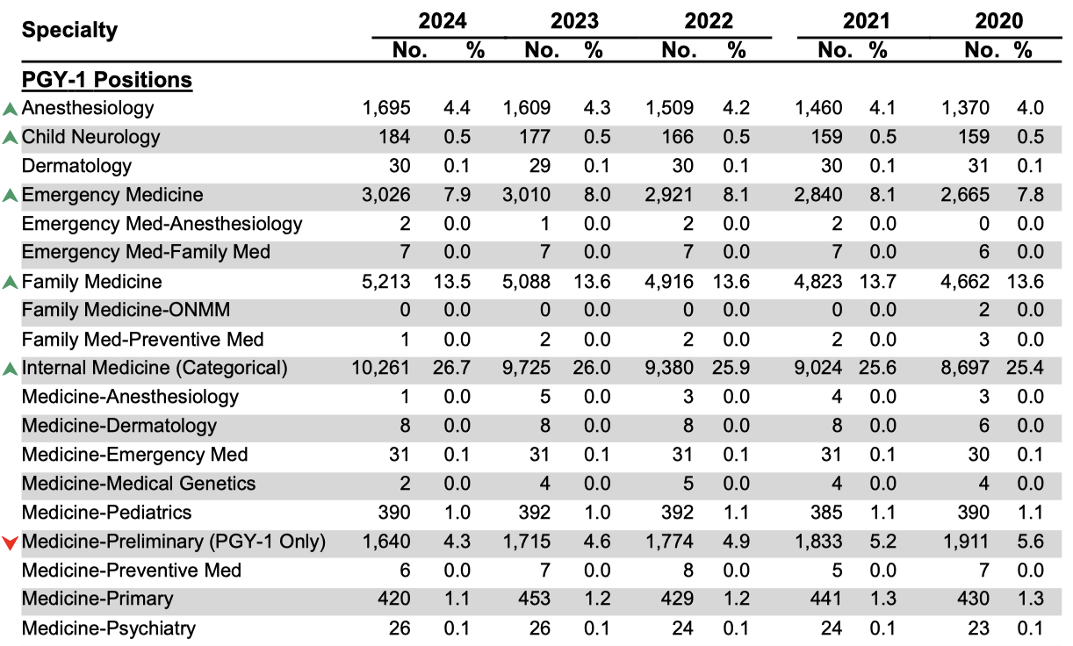
Positions Offered in the Matching Program, 2020 - 2024

Slide 6
Regional Variation
Offered vs Unfilled
1.4%
5.4%
4.9%
5.0%

Slide 7
Medical Toxicology fellowships
Year | Programs | % Filled | Positions | % Filled | Applicants | % Unmatched
2014 | 25 | 48.0% | 37 | 54.1% | 24 | 16.7%
2015 | 25 | 60.0% | 40 | 70.0% | 35 | 20.0%
2016 | 26 | 65.4% | 41 | 46.3% | 21 | 10.0%
2017 | 26 | 65.4% | 47 | 74.5% | 42 | 16.7%
2018 | 27 | 66.7% | 47 | 74.5% | 40 | 20.0%
2019 | 28 | 50.0% | 54 | 66.7% | 41 | 12.2%
2020 | 27 | 61.5% | 51 | 76.5% | 46 | 15.9%
2021 | 28 | 60.7% | 50 | 68.0% | 36 | 5.6%
2022 | 27 | 85.2% | 52 | 92.3% | 51 | 13.7%
2023 | 29 | 100.0% | 49 | 100.0% | 70 | 28.6%
2024 | 30 | 86.7% | 53 | 92.5% | 59 | 16.9%

Slide 8
The SOAP may have filled the 135 positions
Last year, Rich Hamilton asked:
Is that a good thing??????
Are we ready for the needs of students with lower exam scores and grades!!!???

Slide 9
QE Pass Rate, 1st time takers
88%
American Board of Emergency Medicine

Slide 11
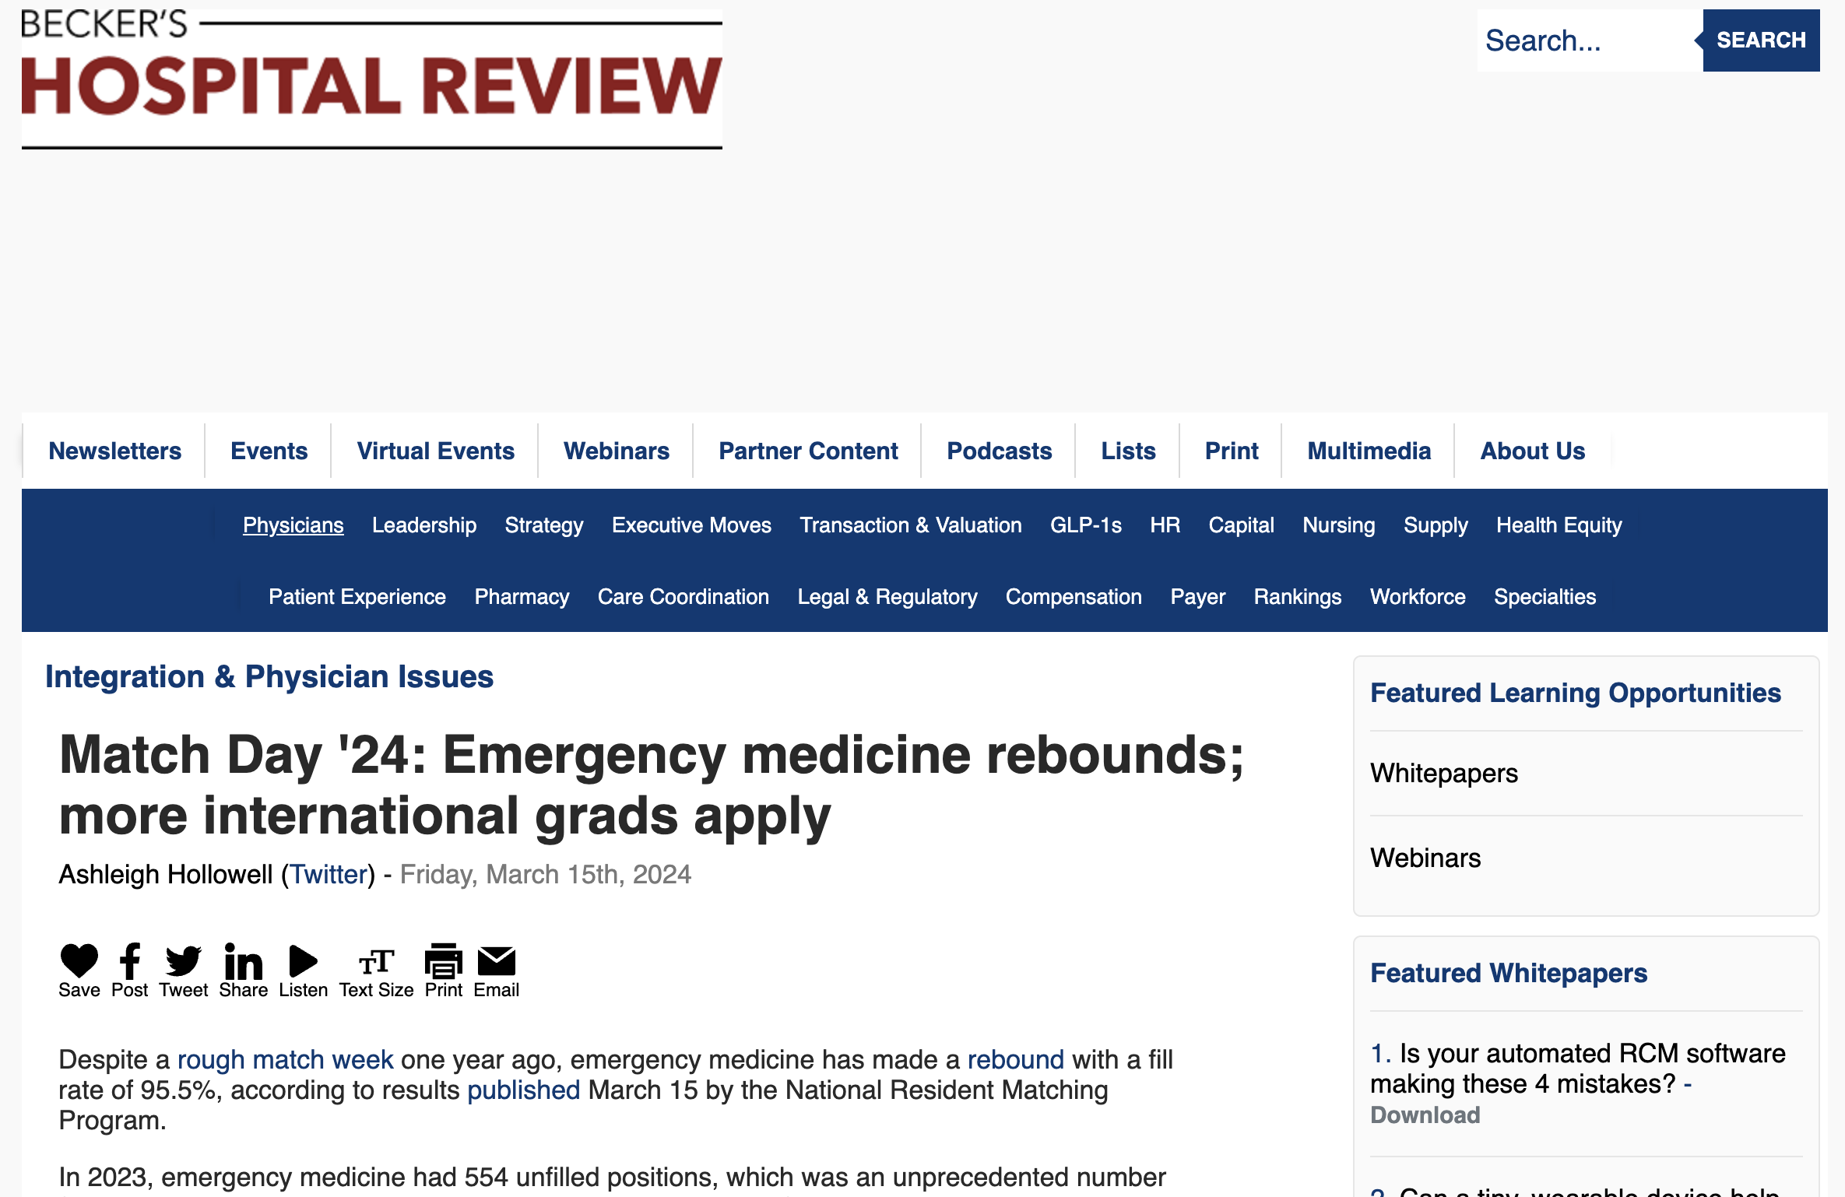

Slide 12
Inpatient Billing, Extended Stays, and Boarding Management
“The phenomenon of boarders without inpatient teams has exploded at our institution, and we are now providing inpatient coverage for days without reimbursement. If you have experience with billing obs for such cases, then please let me know- I would love to learn. Our Office of Billing Compliance wants examples of how this is done.”

Slide 13
Hot Topics
The Match:
What Went Right and How Can We (Continue to) Improve the Current Perceptions of the Specialty
Inpatient Billing, Extended Stays, and Boarding Management (Discuss boarding and observation best practices)

Slide 14
Vision and Pillars
Vision
Academic departments of emergency medicine are led by Chairs who are creating the future of emergency medicine through innovations in research, medical education, and clinical care, and fostering the development of future leaders.
LEADERSHIP DEVELOPMENT
ACADEMICS
INNOVATION
OUTREACH

