Slide 1
Software Tools to Improve Operational Efficiency Becky McGowan, MBA Amy Jameson, MPhil, MA, MBA Alyssa A. Tyransky, MTDA

Slide 2
Becky McGowan, MBA
University of Colorado
Anschutz Medical Campus

Slide 3
Problem:
The CU Department of Emergency Medicine has over 193 commitments (departmental, school, inter-departmental, university, external), contracts, or funding line agreements.
Tracking, invoicing, and monitoring payments is not easily done and requires the use of ghost accounting with data pulls from over 4 different systems.

Slide 4
Solution:
Create a tracking system utilizing Smartsheet to manage the life cycle of all contracts/ commitments
Includes:
Online form for new requests/commitments
Data pulls from existing systems
Contract Logix
Data Warehouse (cubes)
CU Medicine financial system (IDX)
Calculated fields for salary support, assessments, benefits, buy down
Automatic emails to stakeholders throughout the process
Approvals sent automatically; approvals completed with one click
Real time updates to Dashboard

Slide 5
Contract/Commitments Dashboard
Department Commitments

Slide 6
Contract/Commitment Dashboard
Non-Departmental Contract Revenue FYTD

Slide 7
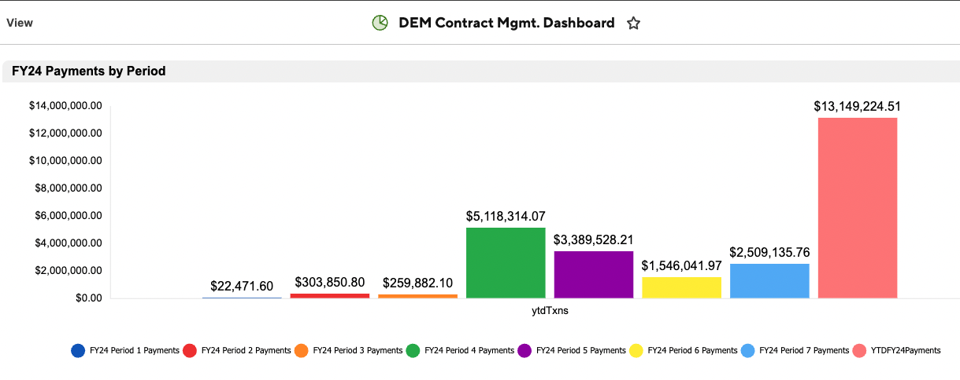
Contract/Commitment Dashboard
Payments Received FYTD

Slide 8
Amy Jameson, MPhil, MA, MBA
University of New Mexico

Slide 9
Reason to implement
Problem:
Increased need to improve processes across the HSC, without increasing fte.
Solution:
Allow Departments/centralized offices to use different software to create and implement new processes.

Slide 10
Smartsheet Uses
Creation of dashboard for department and individual use:
Centralizing information
Centralizing access to forms
Creation of forms for:
Time reporting
Leave requests
Requests for payments (extra shifts)

Slide 11
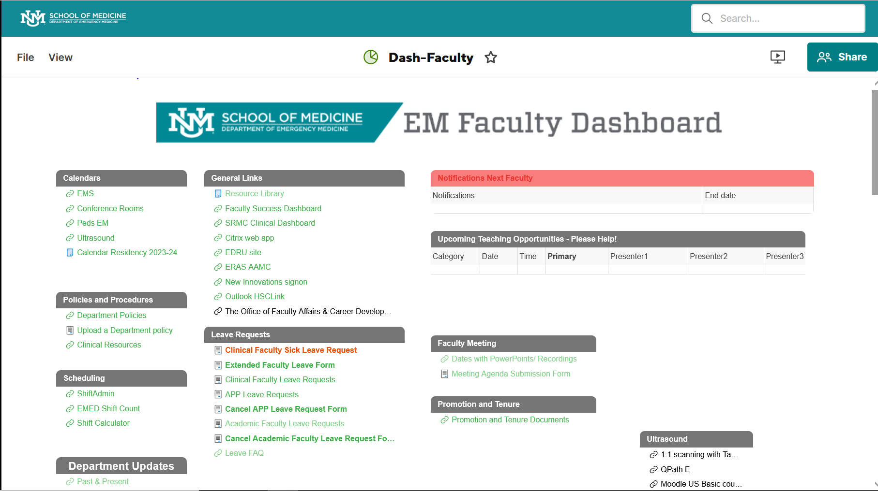
Example of Dept Dashboard

Slide 12
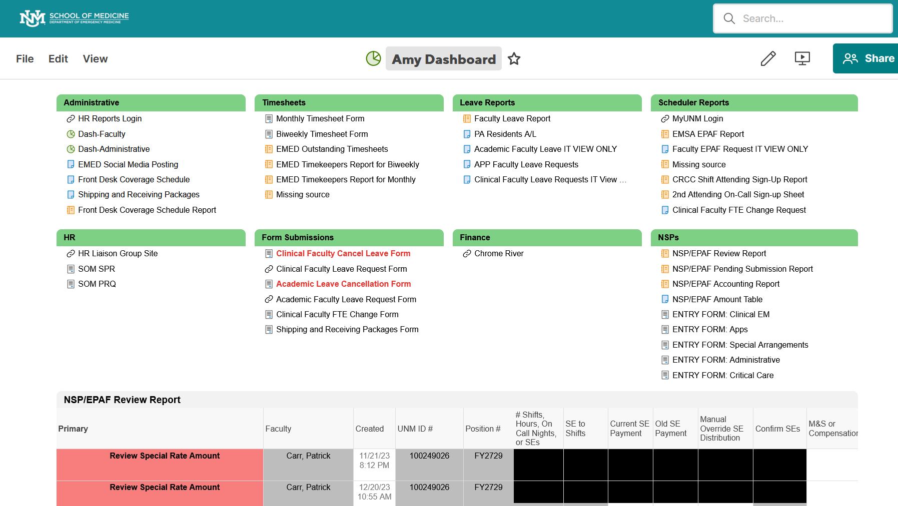
Personal Dashboard

Slide 13
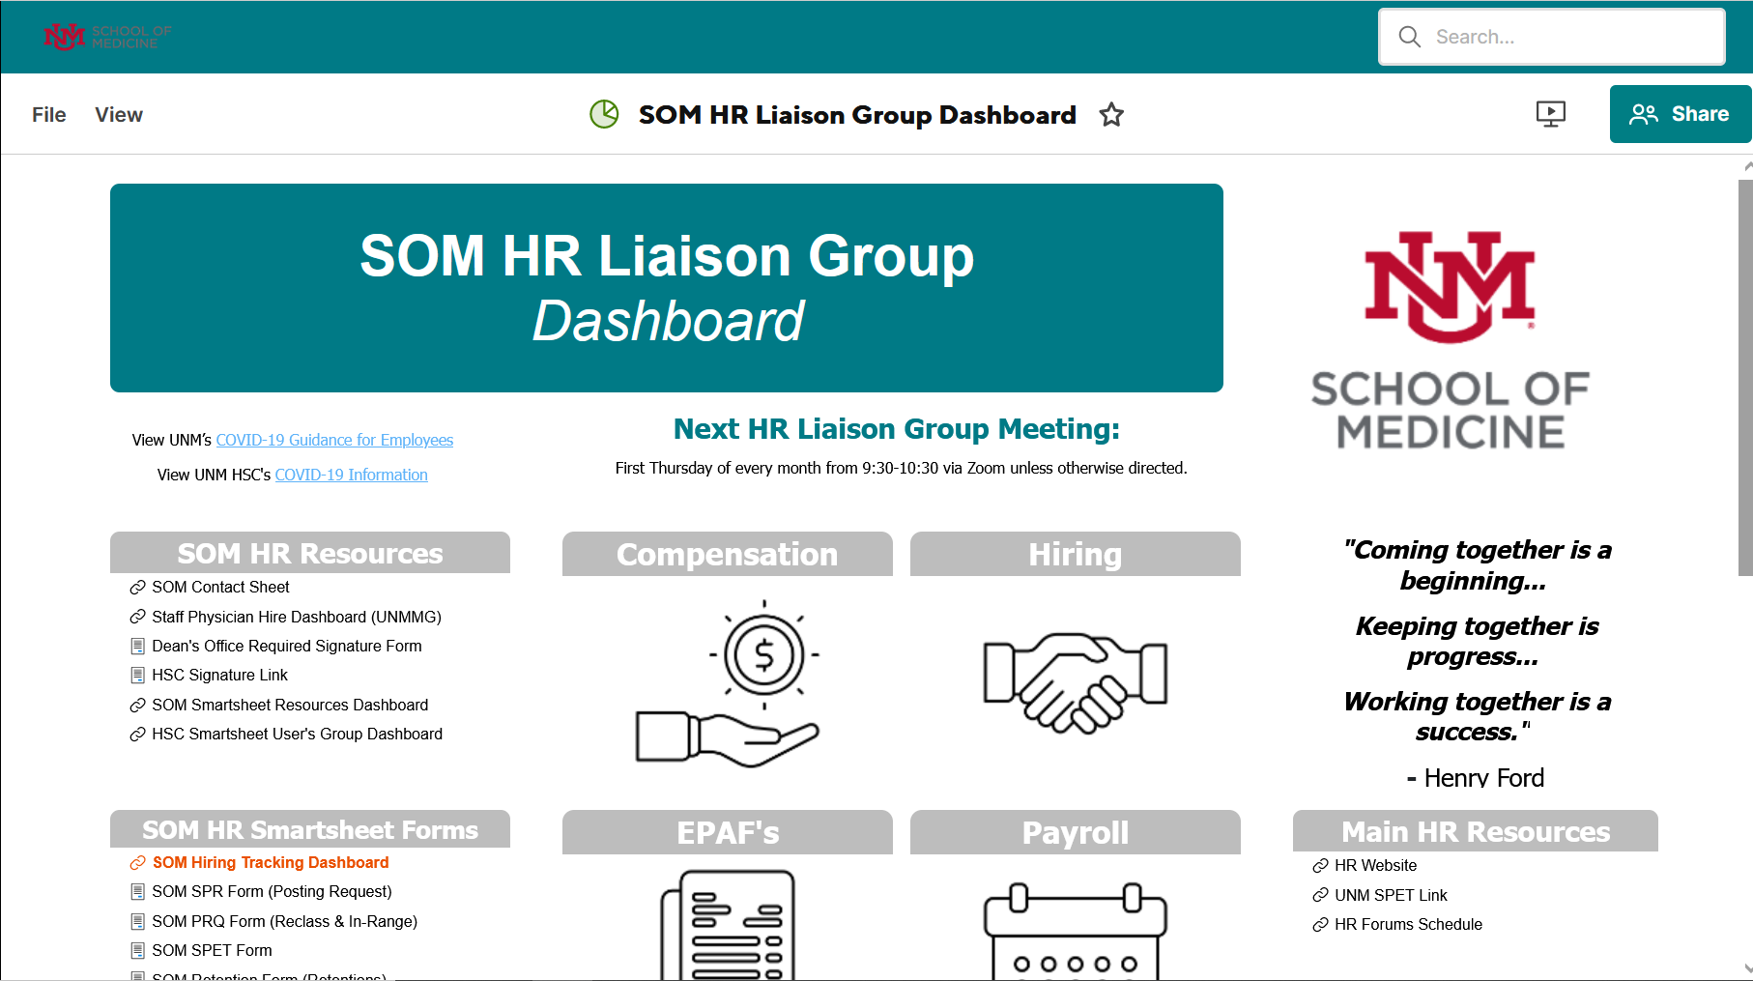
SOM Dashboard

Slide 14
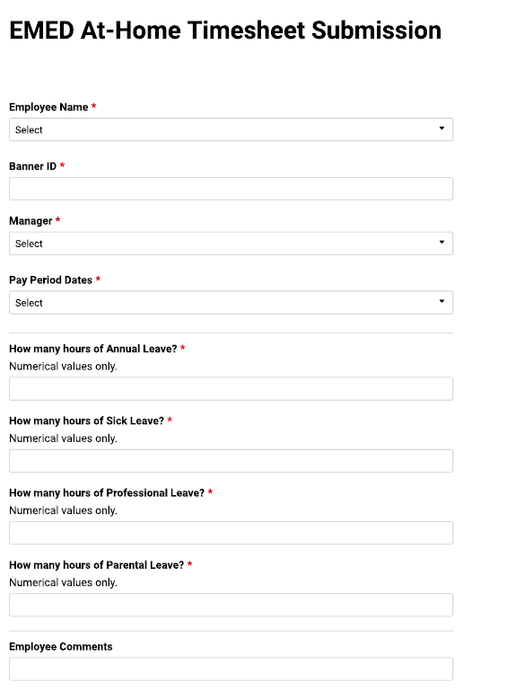
Time Reporting Form

Slide 15
Alyssa Tyransky, MTDA
The Ohio State University
Wexner Medical Center

Slide 16
Our Financial Operations Coordinator, Brutus Buckeye, in charge of all financial reimbursements in the department, went out on unexpected FMLA the week everyone got back from SAEM

Slide 17
Main Purposes of Financial Reimbursements
Spend Authorizations (Travel)
CME Requests
Non-CME Requests

Slide 18
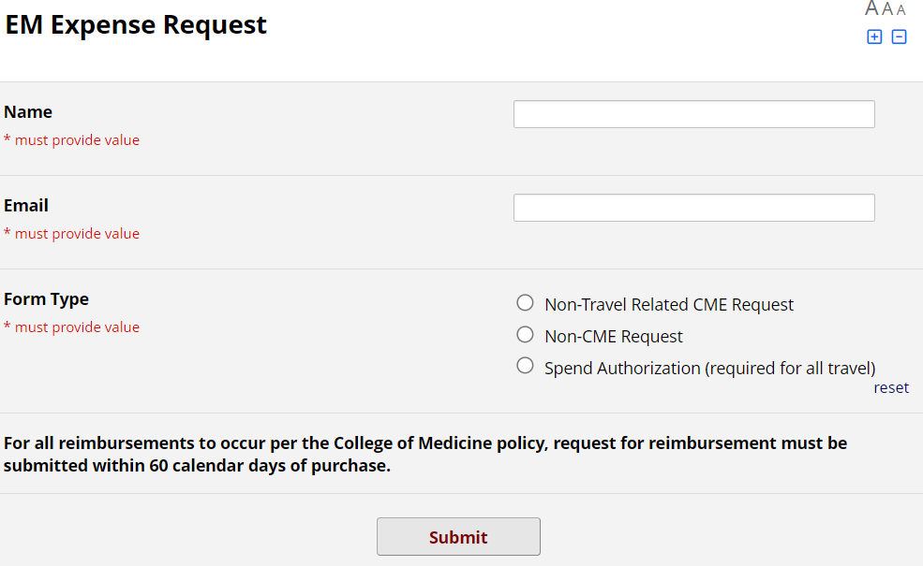
Step 1 – Make Request
Finance Team will get an automatic email from REDCap notifying them that a new request has been placed

Slide 19
Step 2 – Steps After Initial Request
Spend Authorizations (Travel)
Info entered into Workday
CME Requests and Non-CME Requests Needing Approval
Department Leadership approves/denies
‘Gimme’ CME Requests
Skips to Step 4
Notes:
‘Gimme’ CME are things like state medical board license, board exams, scrubs, etc. CME requests that don’t really need approval.

Slide 20
Step 3
Email from WorkDay for Spend Auth approval or REDCap generated email regarding approval/denial status

Slide 21
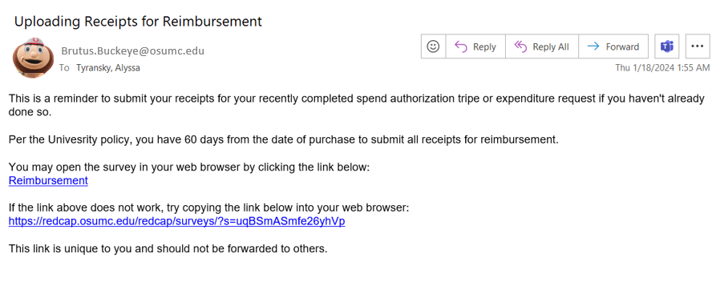
Step 4 – Reminder for Receipt Upload

Slide 22
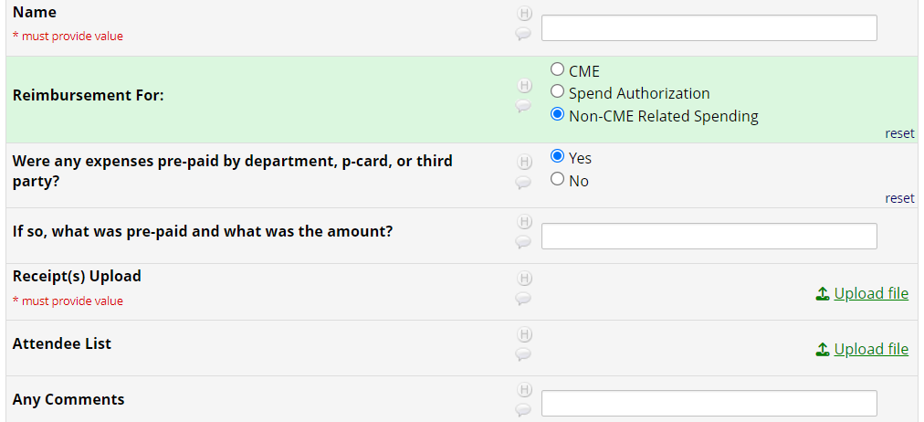
Step 5 – Uploading Receipts

Slide 23
Step 6/7 – Approval from Chair Upload Receipts to WorkDay and Close Out Request in REDCap
Step 6 – Chair must approve all CME and non-CME expenditures

Slide 24
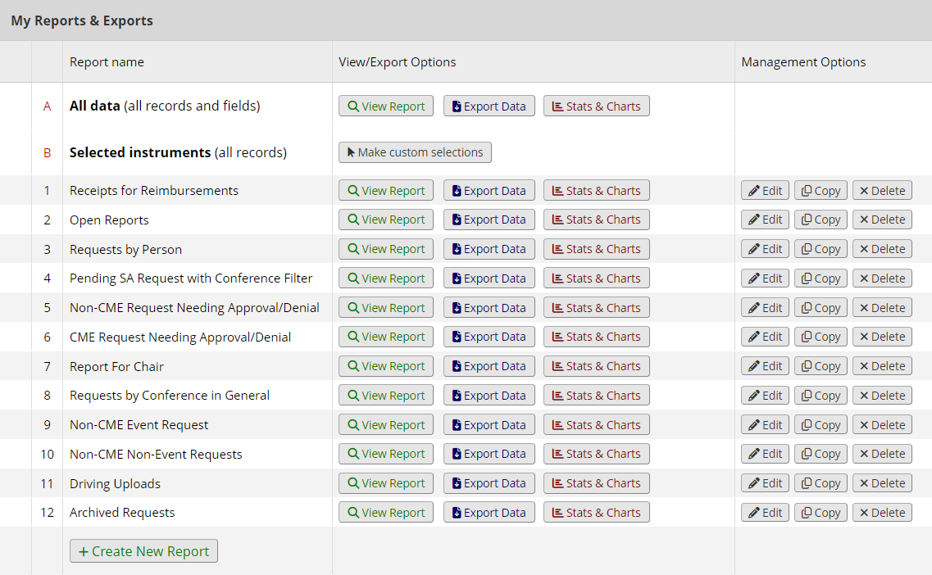
Reports

Slide 25
Considerations Before Adopting a New System

Slide 26
Before Implementation
Explore Possible Solutions:
Build own legacy database
Use existing software programs available at Institution
REDCap
Microsoft Suite (Access)
Try off the shelf products (cloud based)
Airtable
Smartsheet

Slide 27
Before Implementation
Conduct a cost-benefit analysis
Will this solve the problem? Does it improve efficiency and transparency?
How much does the solution cost (licenses) and what is the ROI to the department?
What is the learning curve?
What will ongoing training cost? Is training easily available?
Does it streamline operations?
Does it allow for direct data pulls or manual entry from current systems?
How often does the software company push updates?

Slide 28
Before Implementation
REDCap benefits
Secure and web-based
Input data from anywhere in the world with secure web authentication, data logging, and Secure Sockets Layer (SSL) encryption
Real-time data entry validation (e.g. for data types and range checks)
Ability to set up a calendar to schedule and track critical study events such as blood-draws, participant visits, etc.
HIPAA-compliant
Mark fields as identifiable; user has the option of de-identifying data during export
Smartsheet benefits
Reports and dashboards that are updated in real-time from underlying sheets
Multiple users with varying access profiles can see just what they need to see
Has tools (Data Shuttle, Data Mesh) that allow automated merges with other university data
Can communicate with stakeholders programmatically, in email, on mobile devices, and in the
system with notifications
Is scalable – and is ever-evolving. New features (often based on user requests) are regularly forthcoming
Ability to attach multiple documents (and comments) to each row
Many formulas that can be used to communicate across sheets
Sheet summary fields that can be used in reports and charts, and exported to excel to be used in other systems

Slide 29
During Implementation
Things to consider
General culture and expectations in the Department, School, and University
Will access be granted to other systems?
Will staff adopt the new system easily?
Training
Who will have access to the system?
Will there be different level of users and how to accommodate?
Testing
Who is involved? How long will it take to validate the data?
Roll Out
What is the communication strategy?
What is the change management plan?

Slide 30
Results
Smartsheet at University of Colorado
Successes:
Provided different levels of training and developed training videos for future hires
Hired a SME to help staff adopt the system
Set a SMART goal for all employees incorporating Smartsheet into a workflow or process
Opportunities:
Underestimated the amount of time to develop the system (contracts)
Realized that not all employees should develop in the system; some should just be users.

Slide 31
Results
Smartsheet at University of New Mexico
Successes:
Easier access for the faculty to locate information and forms
Creation of easy to use forms
Better tracking of requests
Improved communication
Opportunities:
Improving dashboard to be more visually interesting
Creating multiple sheets/forms/processes to avoid overly complex sheets
Reporting tools to improve better format for staff when reviewing/approving requests
Reduce duplicate efforts and competing software

Slide 32
Results
REDCap at The Ohio State University
Successes:
Centralized place for requests to be made and communicated
Transparent management tool for administrators and help lifeline for Brutus in busy times
Better communication with end user about status of their requests
Opportunities:
Very nuanced system – a lot of exceptions to the rule
Hard to make needed updates
Requires staff to learn new and not intuitive system

Slide 33
Questions?
Becky.McGowan@cuanschutz.edu
aljameson@salud.unm.edu
alyssa.tyransky@osumc.edu

