Slide 1
Using The Analytics Portal
Greg Archual
The Ohio State University

Slide 2
Huron Consulting (formally known as Rountable)
Kenny Lopiano

Slide 3
Mass General Brigham
Brendan Russell

Slide 4

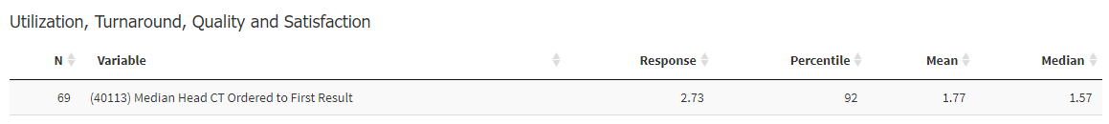
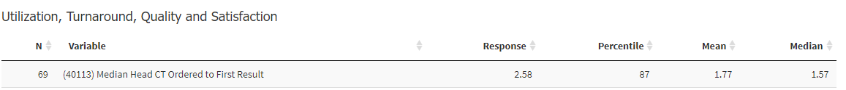
Mass General Brigham
Understanding your ED’s performance relative to national norms can be a powerful driver of change
Mass General
Brigham and Women’s
This data helped create a sense of urgency at Mass General Brigham and resulted in the system COO assigning a CT turnaround time reduction target to the enterprise radiology service

Slide 5
UT Health of San Antonio
Louis Burton

Slide 6
AAAEM Test Utilization Data
CT Total
2023 (7/1/22-6/30/23)
CT Total
2022 (7/1/21-6/30/22)
% Pts 37%
% Pts 29%
% Pts 36%
% Pts 31%

Slide 7
AAAEM Test Utilization Data
X-Ray
2023 (7/1/22-6/30/23)
X-Ray
2022 (6/1/21-6/30/22)
% Pts 42%
% Pts 50%
% Pts 45%
X-Ray Total % of Change (2023 vs. 2022)
UH = -1.89%; AAAEM = 3.46%

Slide 8
AAAEM Test Utilization Data
Ultrasound
2023 (7/1/22-6/30/23)
Ultrasound
2022 (6/1/21-6/30/22)
% Pts 8%
% Pts 10%
% Pts 7.9%
US Total % of Change (2023 vs. 2022)
UH = 21%; AAAEM = 10%

Slide 9
AAAEM Test Utilization Data
Lab
2023 (7/1/22-6/30/23)
Lab
2022 (6/1/21-6/30/22)
% Pts 70%
% Pts 53%
% Pts 70%
Lab Total % of Change (2023 vs 2022)
UH = -3.23%; AAAEM = 5.47%

Slide 10
AAAEM Data: DC LOS
2023
2022
Avg. DC LOS % of Change (2023 vs 2022)
AAAEM = 7.54%; UH 19.23%
Med. DC LOS % of Change (2023 vs 2022)
AAAEM = 9.52%; UH 15.62%

Slide 11
AAAEM Data: Admit LOS
2023
2022
Avg. Admit LOS % of Change (2023 vs 2022)
AAAEM = 17.54%; UH 45.50%
Med. Admit LOS % of Change (2023 vs 2022)
AAAEM = 20.22%; UH 69.70%

Slide 12
ED Benchmarking Alliance 2022-Academic
UH |  | EDBA
 |  | 90th Percentile | 75th Percentile | 50th Percentile | 25th Percentile | 15th Percentile
CT | 36.4 | 8 | 26 | 33 | 42 | 55
X-Ray | 50.2 | 30 | 39 | 47 | 55 | 64
US | 9.9 | 4 | 5 | 9 | 10 | 15
Admit LOS (min) | 1376 | 316 | 367 | 537 | 664 | 885
DC LOS (min | 446 | 153 | 190 | 240 | 292 | 341

Slide 13
University of Colorado
Becky McGowen

Slide 14
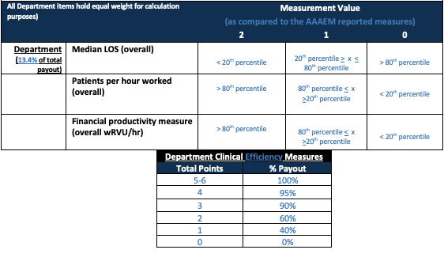
Incentive Plan

Slide 15

Department Results

Slide 16
Penn State University
Kain Robbins

Slide 17
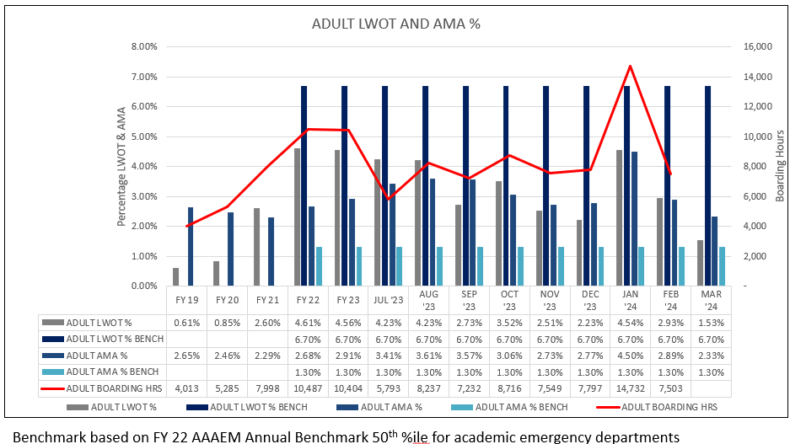
AAAEM Benchmark Standard

Slide 18
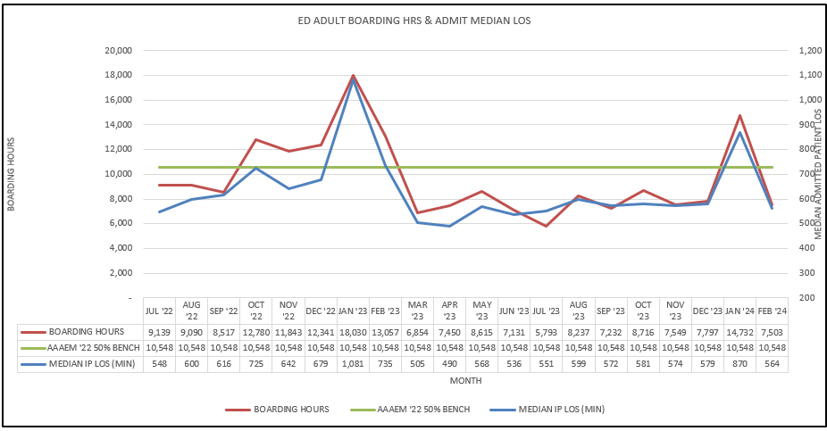
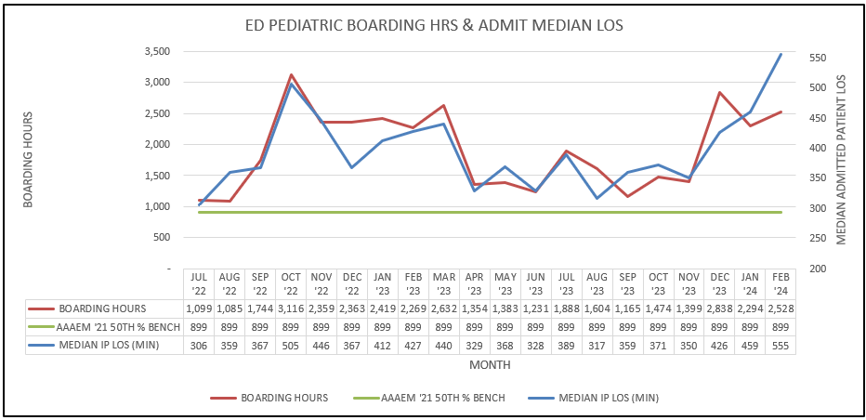
AAAEM Benchmark Standard

Slide 19
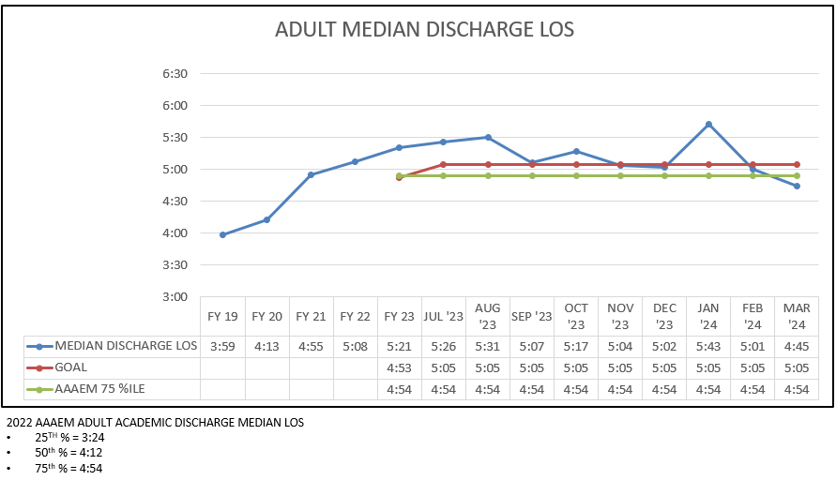
AAAEM Benchmark Standard

Slide 20
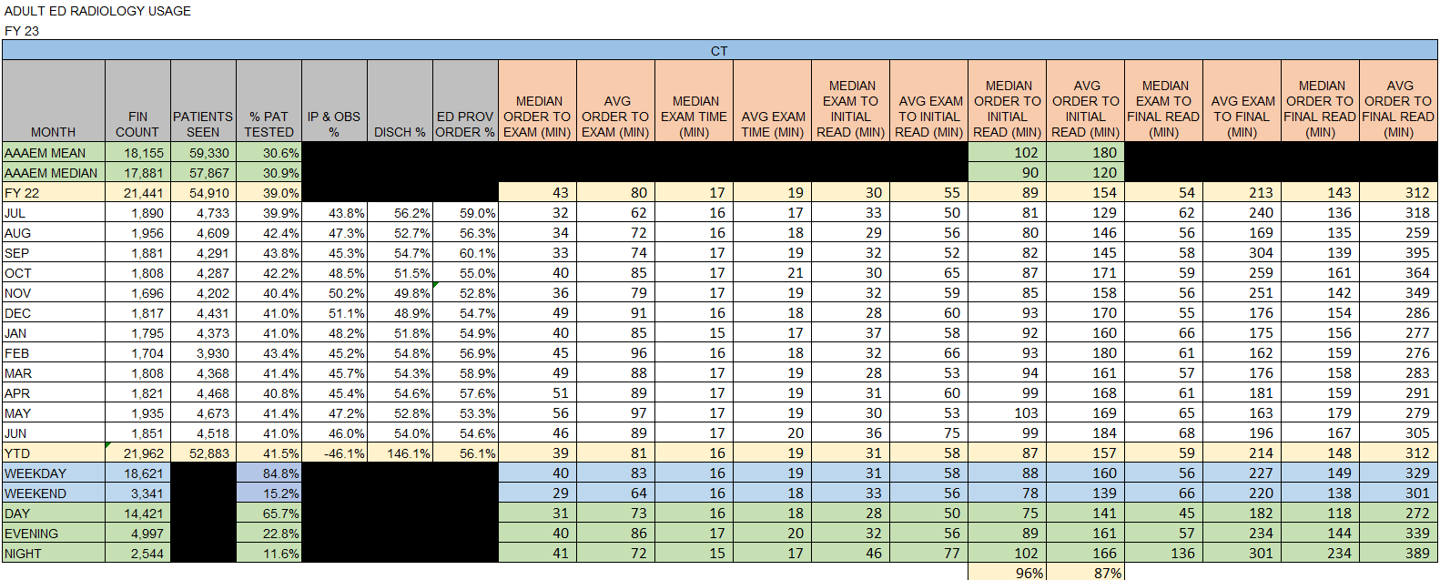
AAAEM Benchmark Standard

Slide 21
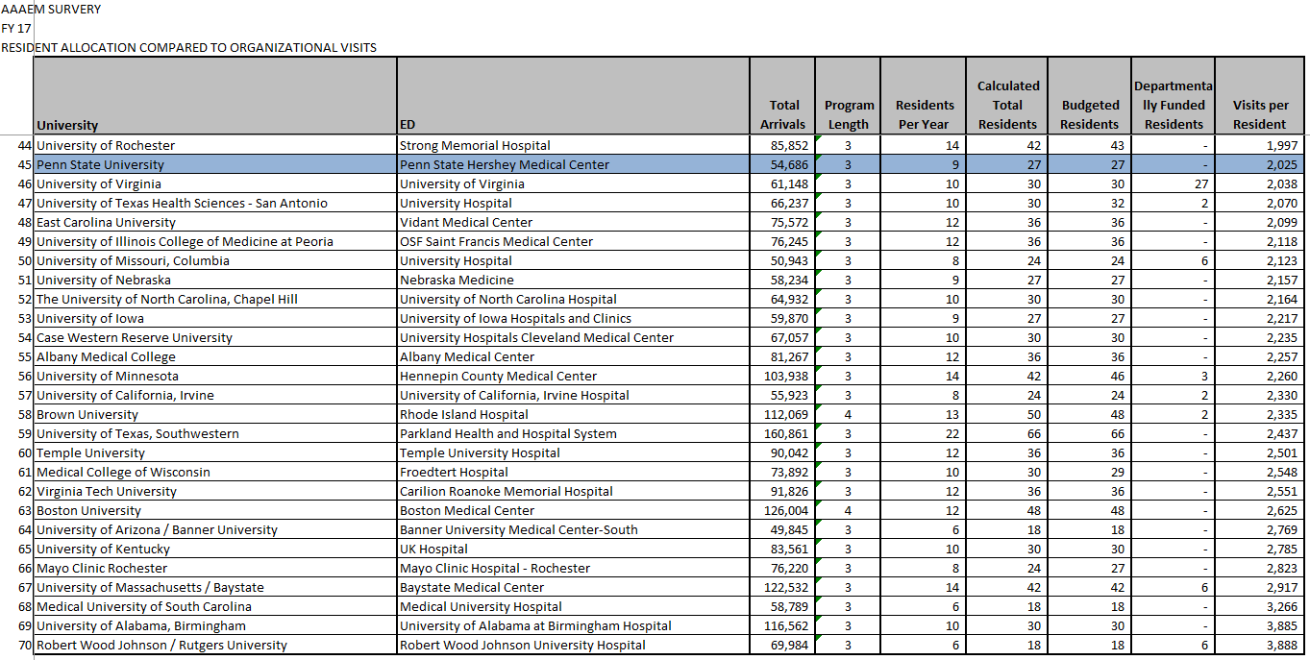
Resident Staffing Mix

Slide 22
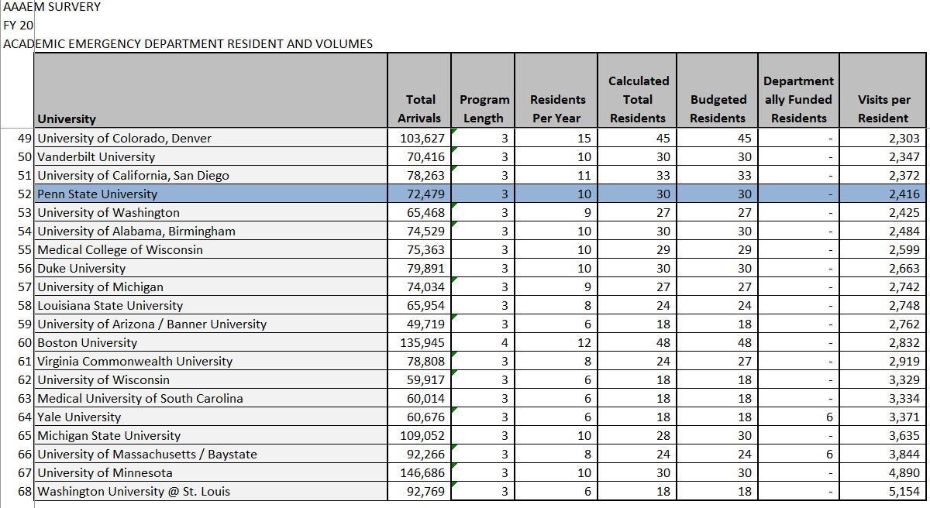
Resident Staffing Mix

Slide 23
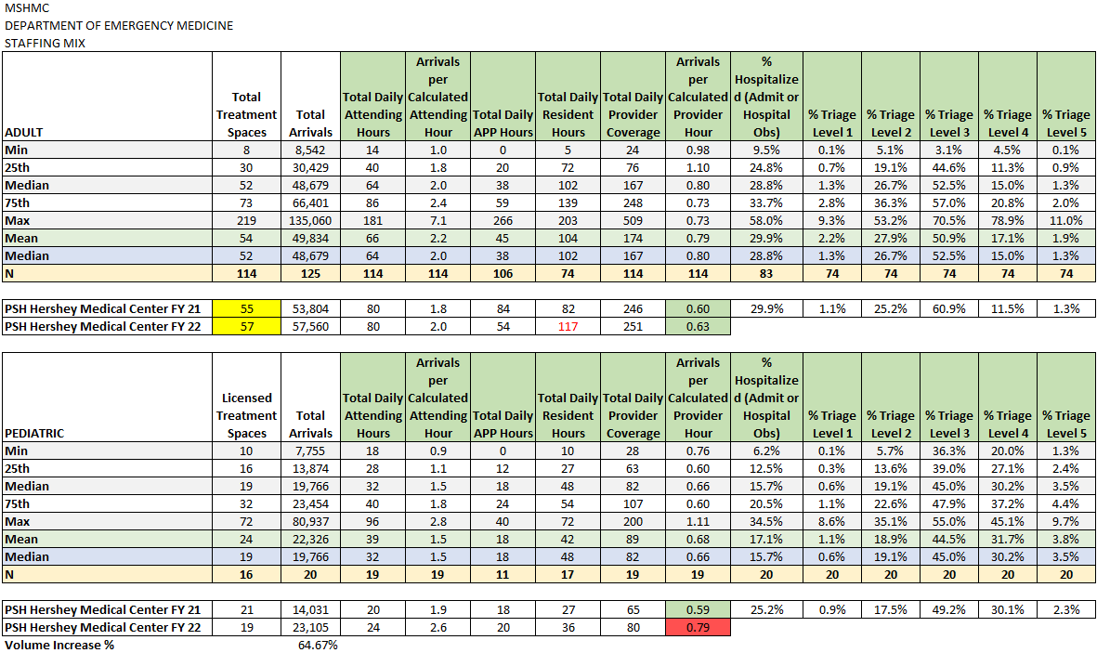
Staffing Standards

Slide 24
Johns Hopkins
Jim Scheulen

Slide 25
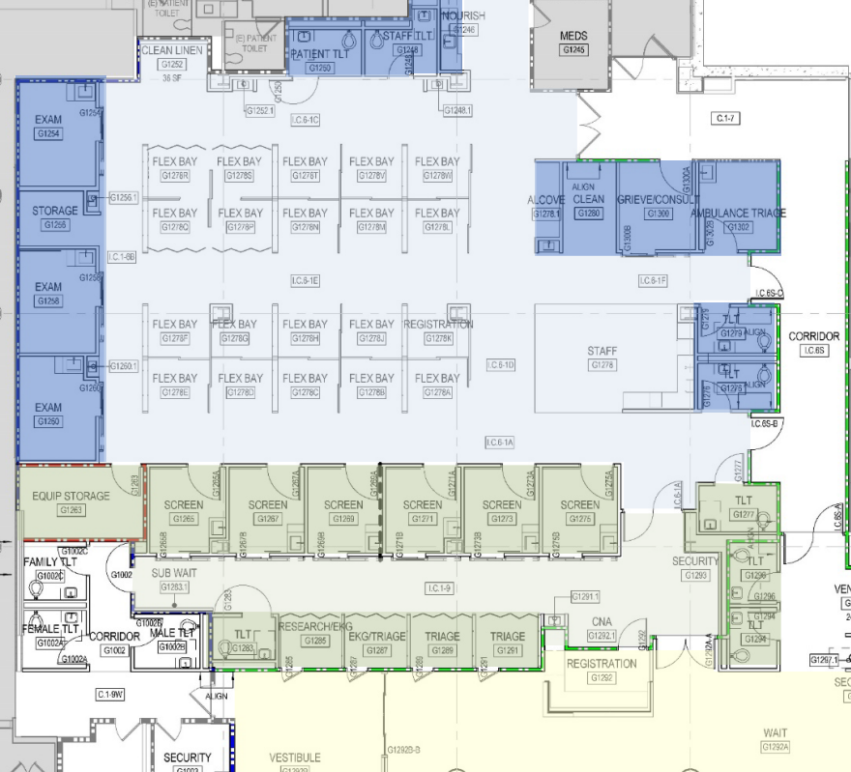
Staffing to the Space
Screening
Yellow APP – 9am to 11pm – Existing
Yellow APP – 11pm to 7am – Incremental some Existing
Dispo’ing
Purple Attending – ~10am to 10pm – Existing*
Green Attending or APP – 7am to 11pm – Existing**
Orange Attending – 24 hrs – Incremental
DISPOSITIONING
SCREENING
WAITING ROOM
* EACU attending hence the ~10am start time.
** Combination of existing flex coverage and the 3 vacant PA positions.

Slide 26
Coverage: Existing & Incremental
Legend
Existing Hours
Requested Hours
DISPOSITIONING
SCREENING
Assumption: 1440 hours per FTE add calcs. Slide 28 shows what happens if this assumption is not met.
Attending FTE = 8760 hrs / 1440 hrs = 6.1 FTE
EACU coverage requires attending to spend about 4 hours per day in the EACU and away from South A (1460 hours/year)
6.1 FTEs requested
(8760 hrs / 1440 hrs per year = 6.1 FTE)
1 FTE requested

Slide 27
ED Performance Benchmarks:
AAAEM Primary Academic (FY22)
Walkouts (LWBS+SAL): JHH 100th %tile (18.6%) – 73 AMCs [UMMS 14.8%]
% LWBS: 71 percentile
% SAL: 95 percentile
Patient arrivals per physician hour: 89th %tile

Slide 28
ED Physician Benchmarks: Hours & Productivity
 | Benchmark | Us
National Academic (75 AMCs) | 1440 | 1440
USACS | 1350
Medstar | 1400
Anne Arundel | 1450
GBMC | 1350
Howard County | 1238 – 1450
Sibley | 1238 – 1485
Suburban | 1440
Productivity: Patients per Hour | 1.5 – 2.5 | 1.93

Slide 29
Clinical Hours: Benchmarks – APP
FY18 & FY20 National Median = 1728 Hrs (68 AMC)
FY22 Median 1700 hrs (56 AMC)
Bayview 1736
JHH 1729
Suburban 1440

Slide 30
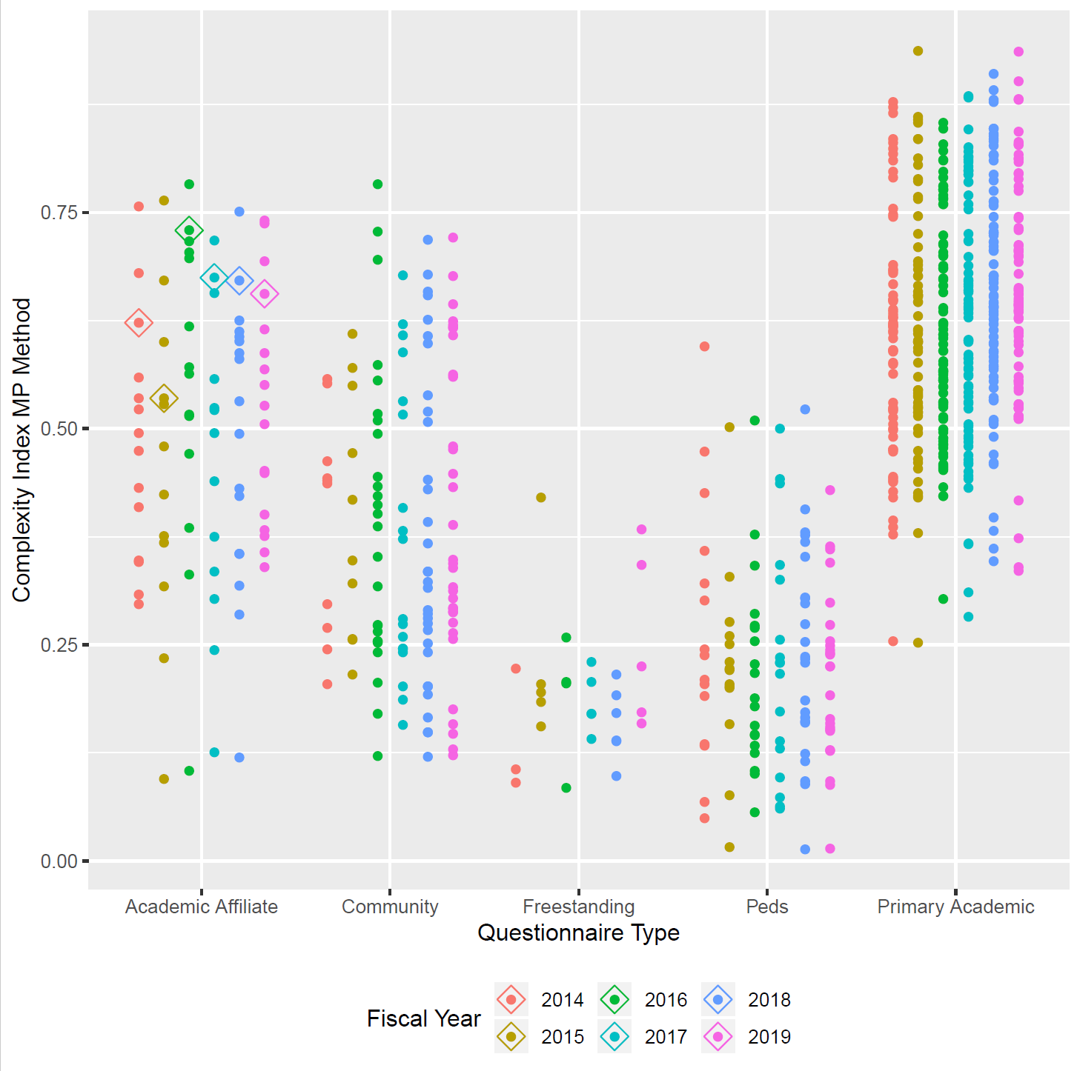
Patient Complexity Rank
Vanderbilt
Emory
Cincinnati
Stanford
Tufts
Hopkins
Mayo
Mass Gen
Brigham
RWJ
Northwestern
Ohio State
Michigan
UCLA
Nebraska
U Penn
Yale
Jefferson
UVA
Indiana
4th most complex pts Nationally
Bayview vs AMCs!b
Rank over time changes because of increasing # of survey participants

Slide 31
AAAEM
Alyssa Tyransky

Slide 32

Using Existing Data to Leverage What is Asked of You By Hospital Leadership

Slide 33
Is there anything in any of our surveys that looks at patients who are admitted from the ED and then are discharged within 1 or 2 days?

Slide 34
Actual Problem from Leadership:
Are you admitting too many patients?

Slide 35
Question from Listserv

Slide 36
There were 8 questions asked to the Listserv this year that could’ve been answered using the Insights portal
Notes:
Lots of APP questions, year over year changes

Slide 37
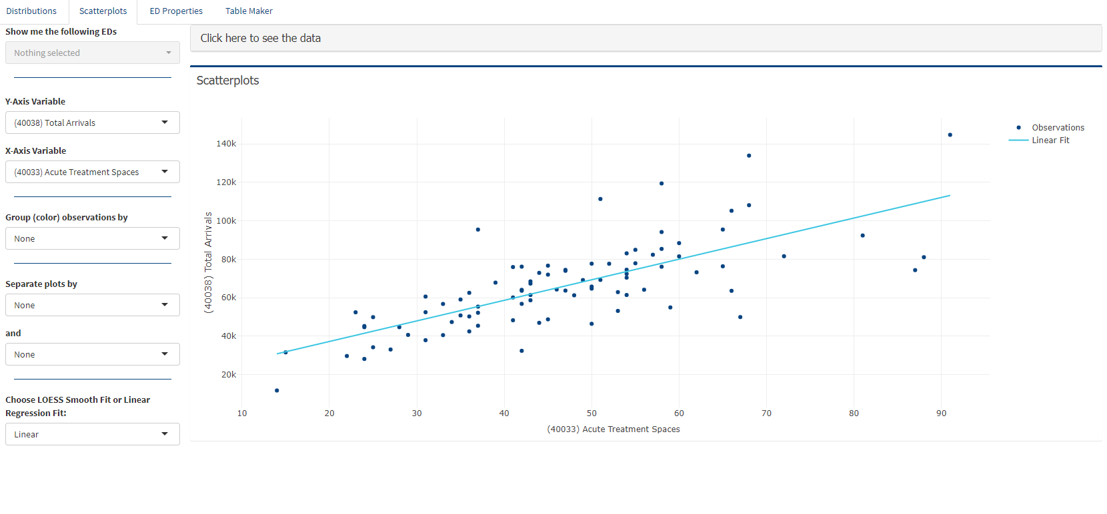

Slide 38
The Ohio State University
Greg Archual

Slide 39
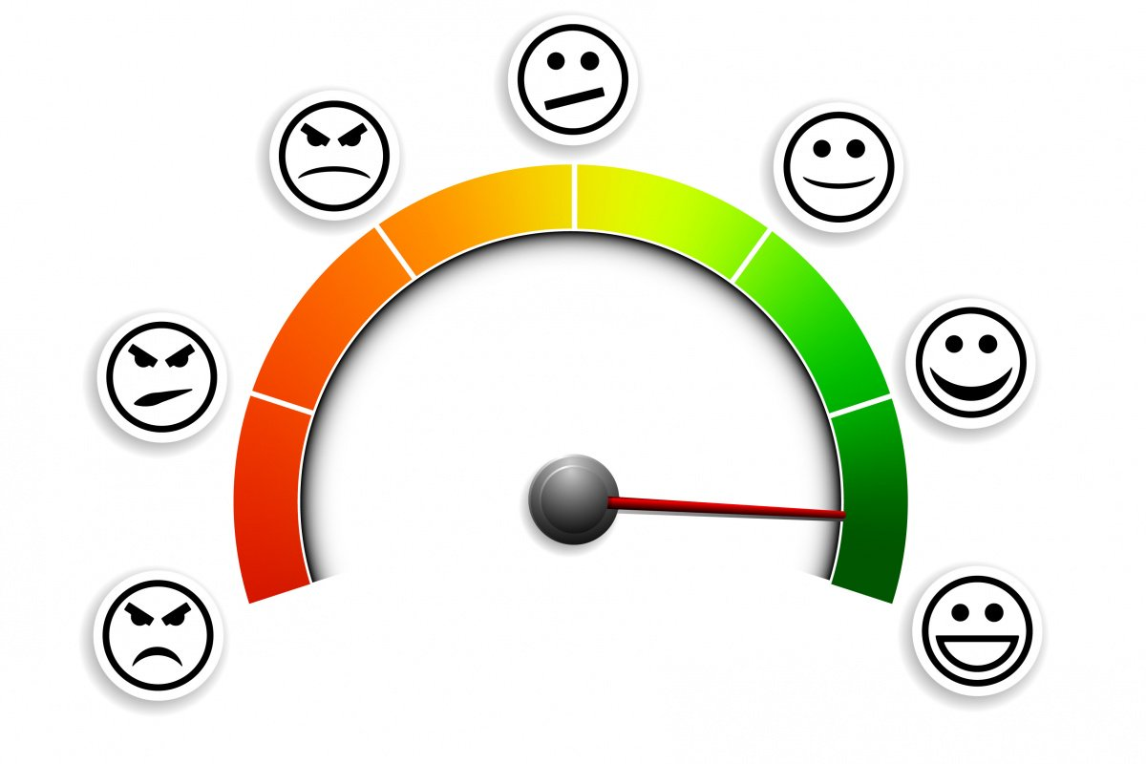
Patient Satisfaction

Slide 40
Benchmarks For Patient Satisfaction
Problem: Patient satisfaction scores for EM physicians in academic health centers are often compared to scores aggregated by Press-Ganey (PG) for use as benchmarks
PG benchmarks are based on satisfaction scores from non-academic and academic health centers combined
Since academic and non-academic health centers differ, we asked:
Is there a better benchmark for this population?

Slide 41
AAAEM Annual Survey Data
AAAEM annual survey has collected PG physician customer satisfaction raw scores by center
AAAEM raw scores converted into benchmark percentiles may serve as a better comparison cohort for academic health centers
How do AAAEM benchmark percentiles compare to those commonly produced by Press-Ganey?

Slide 42
Hypothesis
Customer Satisfaction Benchmark Percentiles from the Press-Ganey Large Hospital & Press-Ganey UHC Cohorts are different than AAAEM Benchmark Percentiles

Slide 43
Methods
AAAEM member institutions reported their PG scores to a central data repository
AAAEM raw PG scores were converted to percentile ranks
The AAAEM percentile ranks were compared to the Press Ganey percentile rank reports for Large Hospital & UHC cohorts
Statistical evaluation: Comparisons of benchmarks were done through One-way Analysis of Variance and post-hoc testing

Slide 44
Sample Dataset
Physician Scores for FY2016
Pctile Rank | AAAEM Group Scores | UHC Group Scores | PG Large Db Scores
2 | 58.300 | 74.700 | 75.600
3 | 58.300 | 75.400 | 77.000
4 | 58.300 | 75.800 | 78.100
...
58 | 82.878 | 86.500 | 87.200
59 | 82.975 | 86.600 | 87.200
...
95 | 89.925 | 91.000 | 91.400
96 | 90.324 | 91.200 | 91.800

Slide 45
Graphing Strategy
Scores
PG-Large Db
PG-UHC
AAAEM Cohort
Percentile Ranks

Slide 46
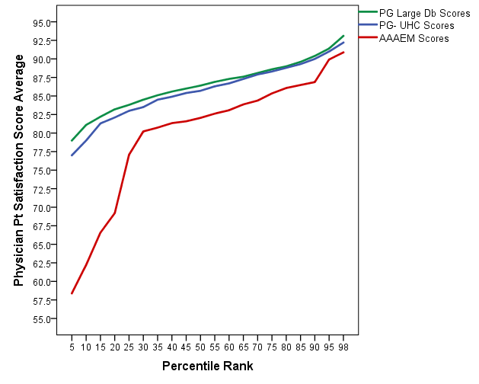
MD Results-FY16

Slide 47
MD Results-FY16
They were DIFFERENT!
Significantly different with p<0.001
More important, what is the effect size? The measured Cohen’s d effect size of 1.08 is considered large
 | Mean | Std. Deviation | F | df | p | es*
AAAEM Member Database | 79.34 | 8.82 | 37.68 | 2 | .000 | 1.08
PG UHC Member Report | 85.31 | 3.85
PG Large Database Report | 86.04 | 3.45

Slide 48
MD Results-FY16
16th
24th
54th

Slide 49
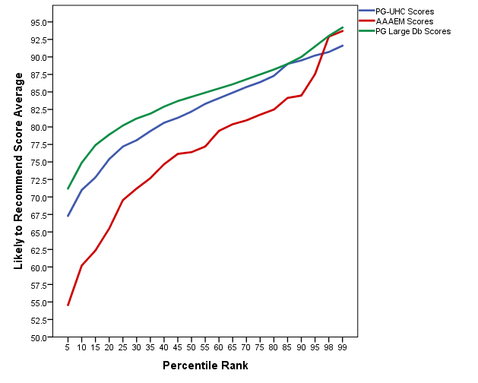
Likely To Recommend Results-FY16

Slide 50
Likely To Recommend Results-FY16
They were DIFFERENT!
Significantly different with p<0.001
More important, what is the effect size? The measured Cohen’s d and f effect sizes of 1.02 and .48 are considered large
 | Mean | Std. Deviation | F | df | p | es*
AAAEM Member Database | 75.05 | 9.49 | 34.15 | 2 | .000 | d= 1.02 f= 0.48
PG UHC Member Report | 81.39 | 6.73
PG Large Database Report | 83.50 | 5.60

Slide 51
Likely To Recommend Results-FY16
38th
52nd
81st

Slide 52
Conclusions
Different methods of aggregating Press Ganey scores result in different benchmarks
At any given percentile, the Large Hospital and UHC score is higher than the AAAEM score
These differences are statistically different, and are meaningful with medium to large effect sizes
When using Press Ganey data for high stakes decisions (e.g. physician compensation), choosing the most appropriate comparison cohort is critical

Slide 53

Benchmarking
Notes:
When benchmarking is done correctly

