Slide 1
AACEM Executive Committee Update

Slide 2
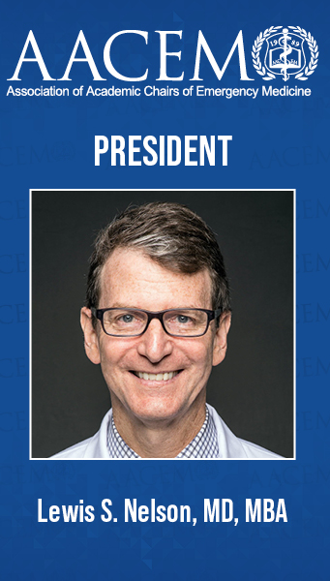
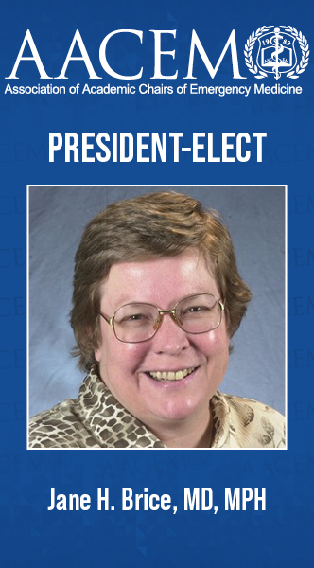
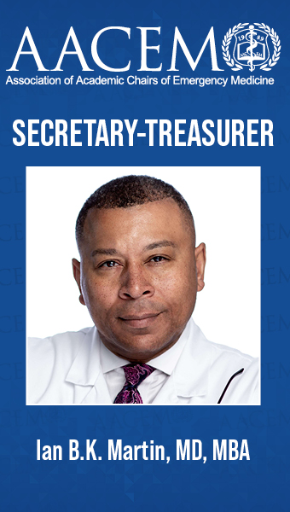
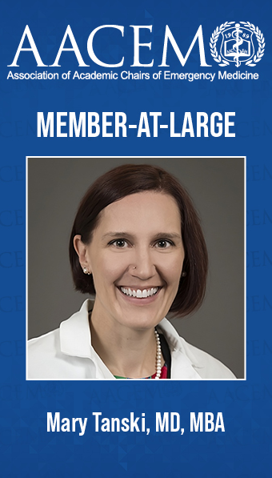
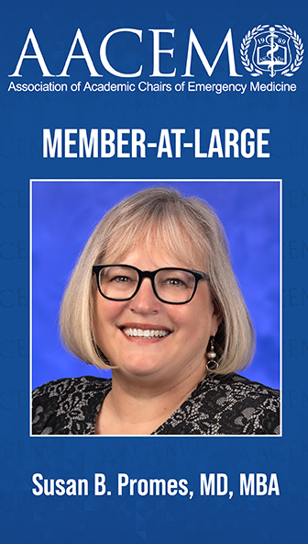
Welcome from Your Executive Committee
And congratulations to Dr. Andra Blomkalns, joining the AACEM Executive Committee at SAEM24!

Slide 3
Mission and Values
Core Purpose (Mission)
AACEM supports academic Chairs of emergency medicine to lead and innovative in research, medical education, clinical care, and faculty development in their institutions.
Core Organizational Values
Professional Integrity
Collaboration and Community
Diversity, Equity, and Inclusion

Slide 4
Vision and Pillars
Vision
Academic departments of emergency medicine are led by Chairs who are creating the future of emergency medicine through innovations in research, medical education, and clinical care, and fostering the development of future leaders.
LEADERSHIP DEVELOPMENT
ACADEMICS
INNOVATION
OUTREACH

Slide 5
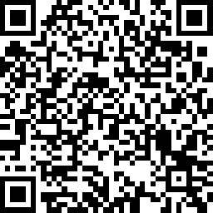
Call for Committees/Workgroups
Revised List of Committee/Workgroups for 2024-2025
Membership Committee
Leader Development Workgroup
DEI Workgroup
(New) Innovations Workgroup (to include discussions on innovations in boarding)
Apply Now!

Slide 6
Chair Mentorship Program
PURPOSE:
Provide a resource for newly appointed chairs of academic departments of emergency medicine
Provide an opportunity for established chairs to share their knowledge, insights, and experiences with developing chairs
Enhance networking among new and established members of the Association
Facilitate an on-site visit of either ($1,500 travel stipend provided by AACEM)
The mentor to the new chair's program, or
The new chair to the mentor's program
1 Chair currently enrolled as a mentee!
5 Chairs completed the 1-year program in the last year!
Mentee Eligibility: Any AACEM active/full or associate member in good standing who is within 6 to 18 months of assuming a chair position may apply to be a mentee. Email aacem@saem.org for more information!

Slide 7
AACEM Funding
AACEM has grown to be over $1,000,000 strong
Much is invested and protects the organization for a rainy day
$20,000 annually set for AACEM project proposals.
Project proposal submission form will be released in summer 2024 for 2025 funding.
Additional funding provided by AACEM for Scholarships (CDP, eLead).

Slide 8
AACEM 2023-2024 Internal Highlights
AACEM 2023-2024 Highlights:
Highest membership in history, reaching 181 members in December 2023
Largest Executive Committee election slate in AACEM history
AACEM launched the Faculty Lectures Speakers Bureau
AACEM launched the Research Federal Funding Consultation Service
AACEM held a strategic planning retreat January 2024 to strengthen the mission, vision, and priorities of the association.
Chair seat on the SAEM Board of Directors

Slide 9
AACEM Collaborations
AACEM Regularly collaborates with SAEM, AAEM, ABEM, ACEP, ACOEP, CORD, EMRA and SAEM-RAMS
ACEP-led All EM Workforce Taskforce
SAEM-led All EM DEI Taskforce
Accreditation Council for Graduate Medical Education (ACGME)
Association of American Medical Colleges (CFAS)
Emergency Medicine Policy Institute (EMPI)
Coalition on Psychiatric Emergencies (CPE)

Slide 10
Recent AACEM Position Statements
AACEM approved signing onto CFAS letter in support of the Substance Use Disorder Workforce Act (H.R. 7050).
AACEM approved the Joint EM Statement regarding the SCOTUS affirmative action decision.
AACEM approved signing onto the ACEP Joint Statement on the Emergency Medicine 2023 Match Results.
AACEM approved signing onto the HPNEC FY 24 Letter to Appropriators.
AACEM approved signing onto the CFAS Resident Physician Shortage Reduction Act Letter.
AACEM approved signing onto the Joint Statement on the Value of Peer Review and the Importance of Gathering Occurrence Data.

Slide 11
AACEM Events at SAEM24
Save the Date:
Cocktails with Chairs w/RAMS and EMRA: Thursday, May 16, 2024, 4:30-6:00 pm, Sheraton Grand Phoenix
AACEM Chairs Dinner: Thursday, May 16, 2024, 6:00-10:00 pm, Mancuso's: 201 E. Washington Street (Collier Center / Bank of America, outside on the second level)
Register by May 1st! This event is complimentary for AACEM members. Guests of AACEM members may attend for $75 per person.
AACEM Sponsored Didactic:
Challenges Junior and Mid-Career Faculty Face in Academic Emergency Medicine and How to Support Them

Slide 12
AACEM at ACEP24
SAVE THE DATE!
AACEM Annual Breakfast at ACEP24!
Date: Tuesday, October 1st, 2024
Time: 7:00 am - 9:00 am
Location: Las Vegas, TBD

Slide 13
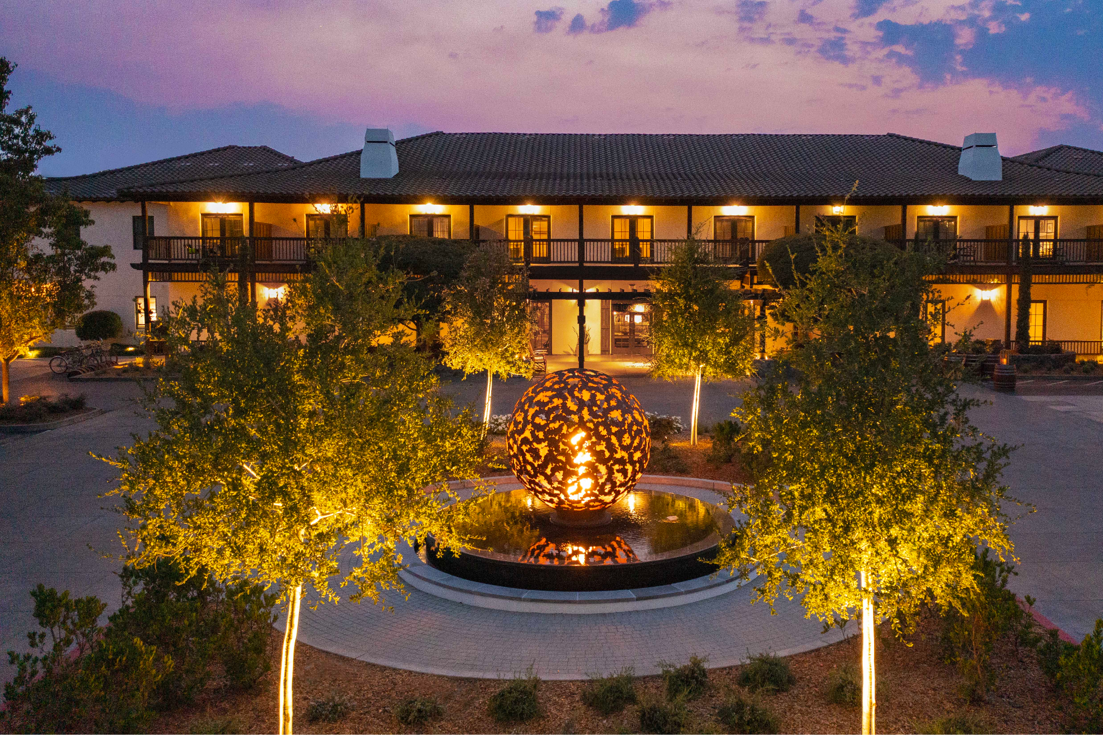
2025 AACEM/AAAEM Retreat
SAVE THE DATE!
2025 AACEM/AAAEM Annual Retreat
Dates: March 16 - 19, 2025
Location: The Lodge at Sonoma Resort, Sonoma, CA

Slide 14
Thank You!
A special THANK YOU to all those who are joining us for their last AACEM retreat!
We wish you all the very best in your future endeavors! You have all made a lasting impact on academic emergency medicine!

Slide 15
AACEM Membership Committee Update - Dr. Carl Chudnofsky

Slide 16
Membership Committee Report 2023 - 2024

Slide 17
2023-2024 Committee Members
Carl Chudnofsky, MD, Chair
Gregory Hendey, MD
Azita Hamedani, MD
Richard Hamilton, MD
Richard Wolfe, MD
Andy Godwin, MD
Andrej Urumov, MD
Denis Pauze, MD

Slide 18
Current AACEM Membership
Full – 113
Associate – 24
Emeritus – 21
TOTAL - 168

Slide 19
2023-2024 Membership Committee Goals
Review the list of academic emergency medicine programs and their membership levels quarterly and report to the AACEM Executive Committee once per year prior to elections. – Completed
Submit nominees for the AACEM Distinguished Service and Lifetime Awards. – Completed
Review and provide recommendations for associate members requesting to be active members status. – Completed
Develop and submit at least one topic for the 2024 AACEM/AAAEM Annual Retreat by August 2023. – Completed
Actively reach out to newly announced chairs and interim chairs to join the organization. – Continuously in progress
11 new members in FY 24
72 programs have not responded joined

Slide 20
Questions

Slide 21
AACEM DEI Workgroup Update -
Drs. Angela Mills and Nate Kuppermann

Slide 22
AACEM DEI Webinars
Sep 2023: Maintaining Our Focus
Jan 2024: Fostering a Sense of Belonging
Apr 2024: Co-sponsor with ADIEM
Best Practices for Inclusive Messaging During Times of Crises
Stay tuned! Next webinar – June 2024
Call for webinar participation!
Bring a friend!
Notes:
Legal challenges regarding DEI that academic EDs are facing in more and more states around country

Slide 23
Workgroup Successes
In September, Dr. Mary Tanski delivered the results of the AACEM Diversity in EM Survey
43 of 150 (29%) departments participated
Participants received self-reported data along with relevant comparisons nationally and regionally

Slide 24
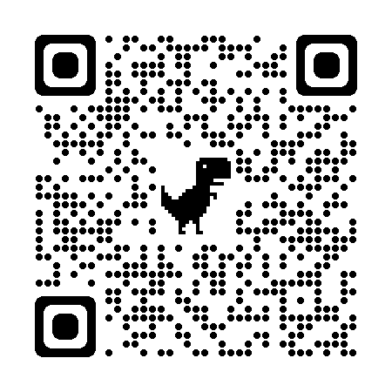
Chairs’ Commitment to DEI
All, please commit to a new DEI pledge
If you are a new Chair or haven’t completed the commitment pledge, please do so now!

Slide 25
Leadership Transition
Leigh Patterson
Many accomplishments
Many thanks to committee and all of you committed to ensuring Diversity, Equity, and Inclusion in our specialty

Slide 26
AACEM Leader Development Workgroup Update - Dr. Stephen Wolf

Slide 27
Thank You!
WG Members
C Emerman
K Heilpern
S Kayden
G Kelen
I Martin
M Patterson
S Promes
R Riviello
D Wright
B McGowan
Erin Campo & Kayla Roseen

Slide 28
Our Objectives
Leadership Opportunities Catalog
Retreat Session > Post Retreat Webinar
DEI Collaboration
eLEAD Oversight
Faculty Lecture Speakers’ Bureau

Slide 29
eLEAD Leadership Domains
Societal Leadership
Personal Leadership
Systems-level Leadership
Interpersonal Leadership

Slide 30
eLEAD Reflective Practice Paradigm
Peer Mentoring
eLEAD Sessions
Journaling
Facilitated Discussion

Slide 31
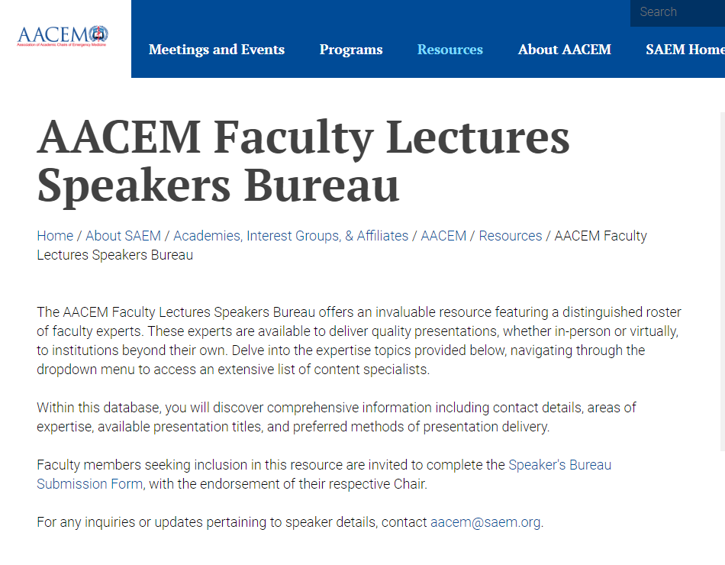
SAEM/AACEM Speakers’ Bureau
Remember to commit
to 3-1-1!
3 nominations/yr
Nominate yearly
Invited 1 speaker/yr

Slide 32
Thank You!

Slide 33
AACEM Research Workgroup Update - Dr. Robert Neumar and Dr. Andra Blomkalns

Slide 34
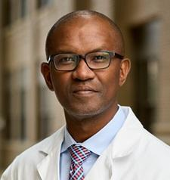
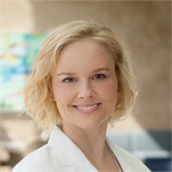
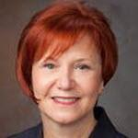
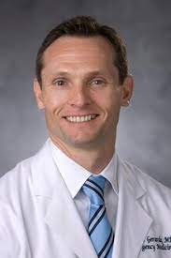
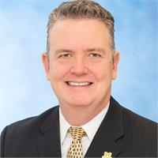
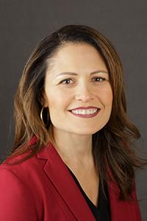
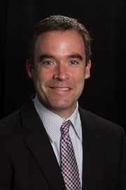
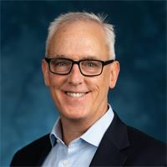
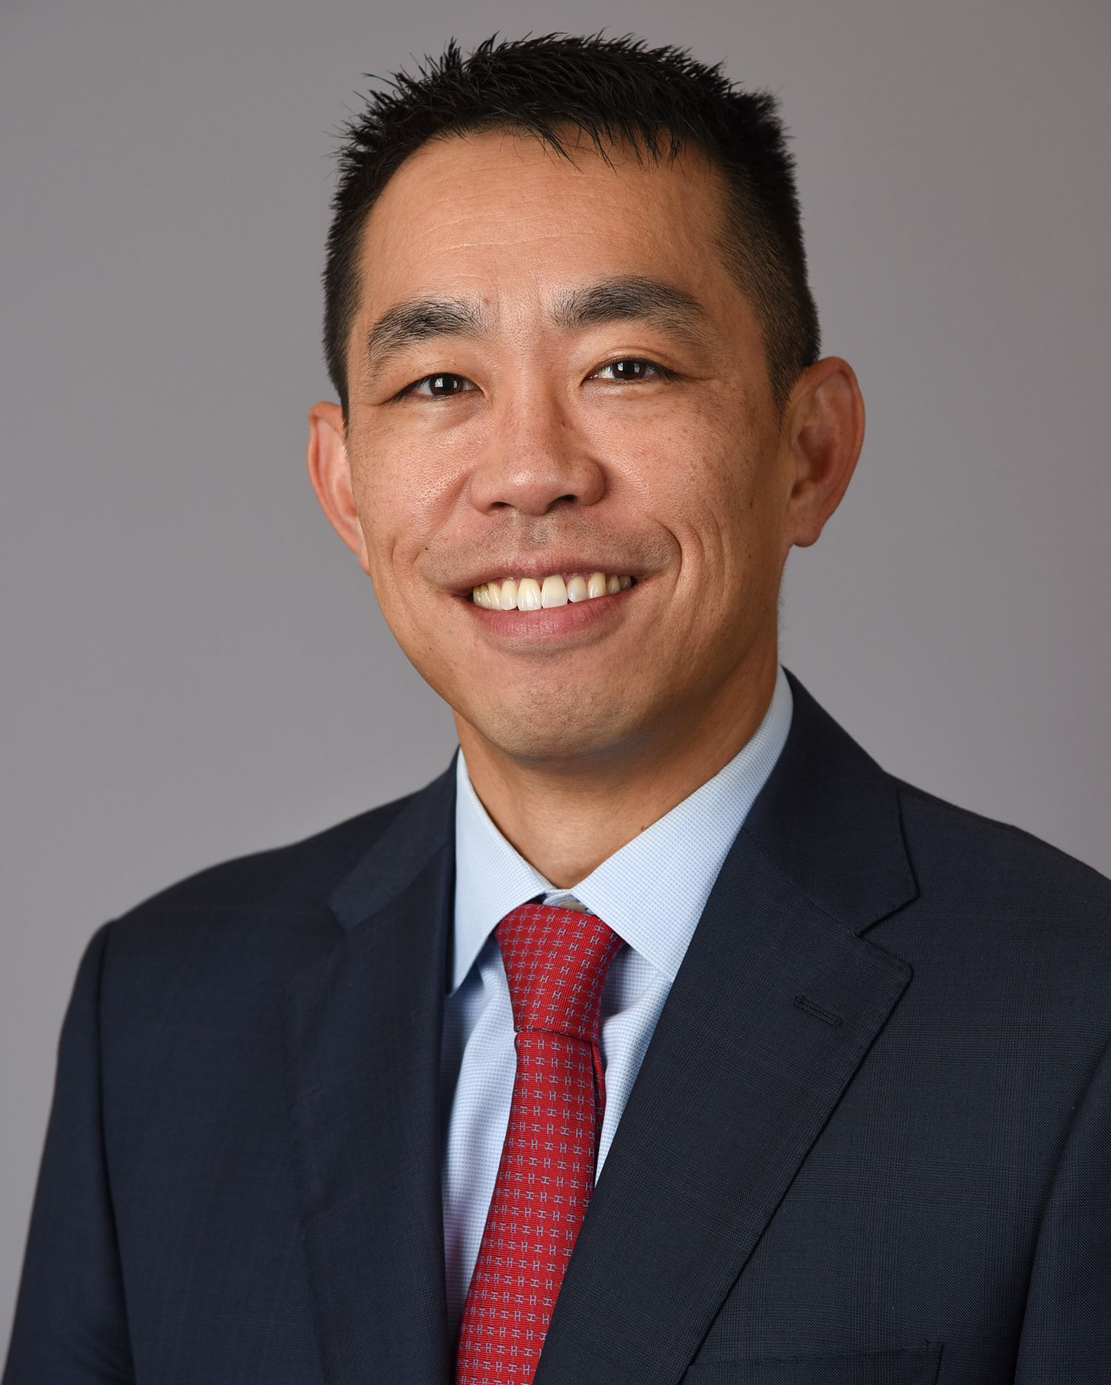
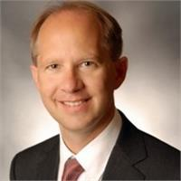
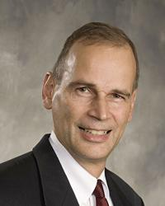
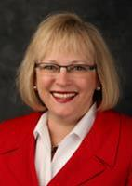
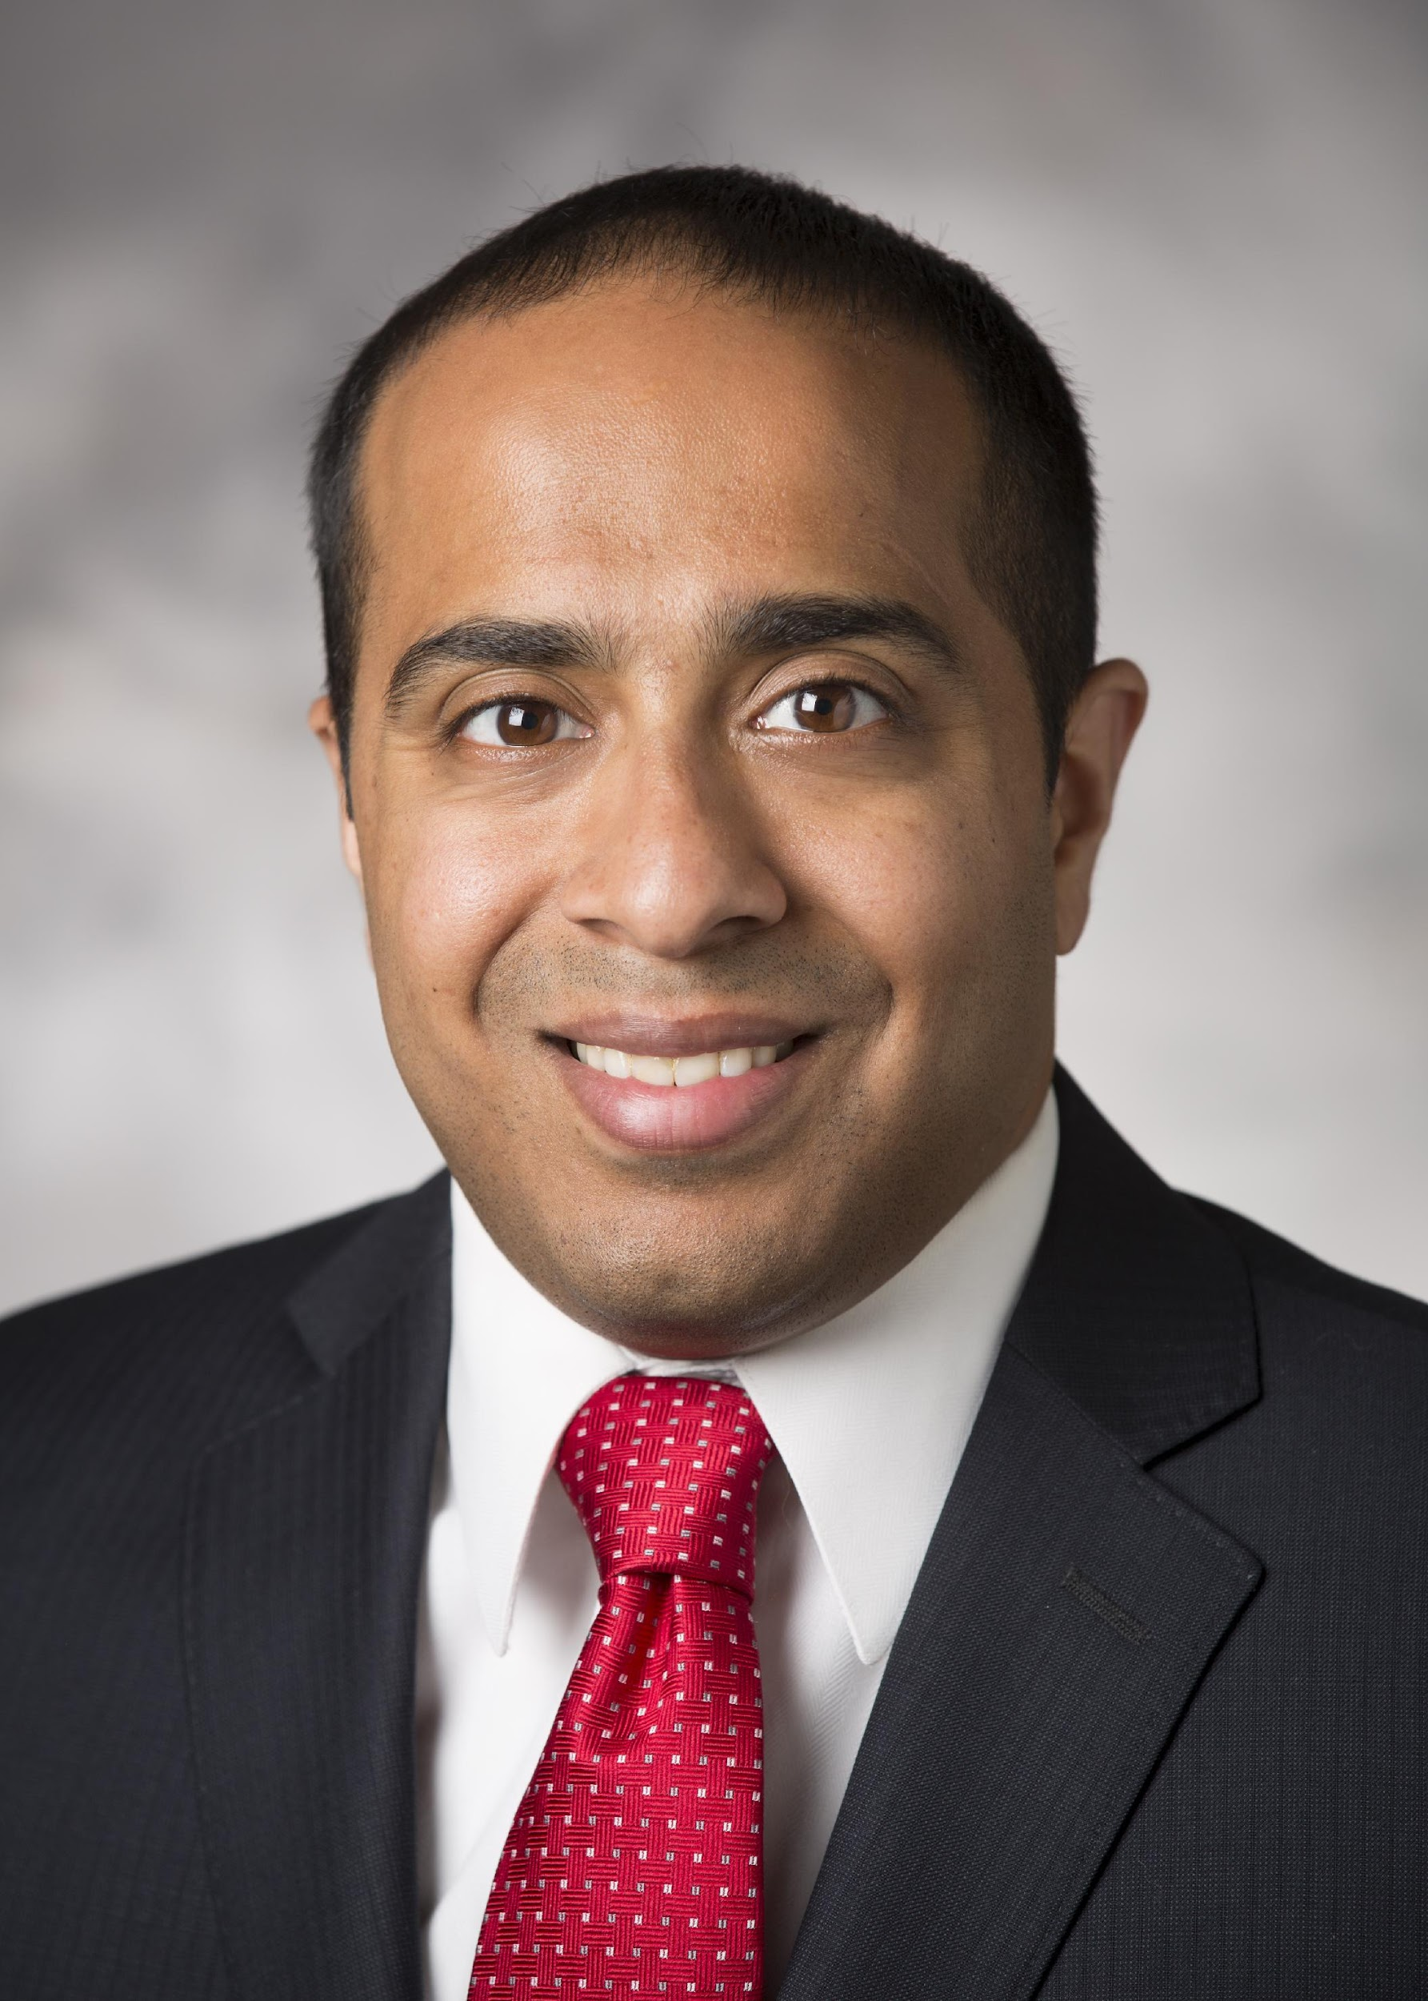
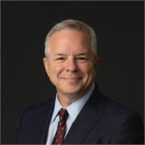
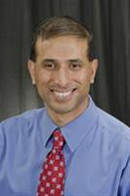
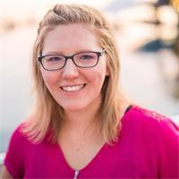
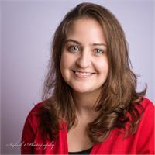
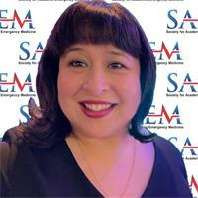
Working Group Members

Slide 35
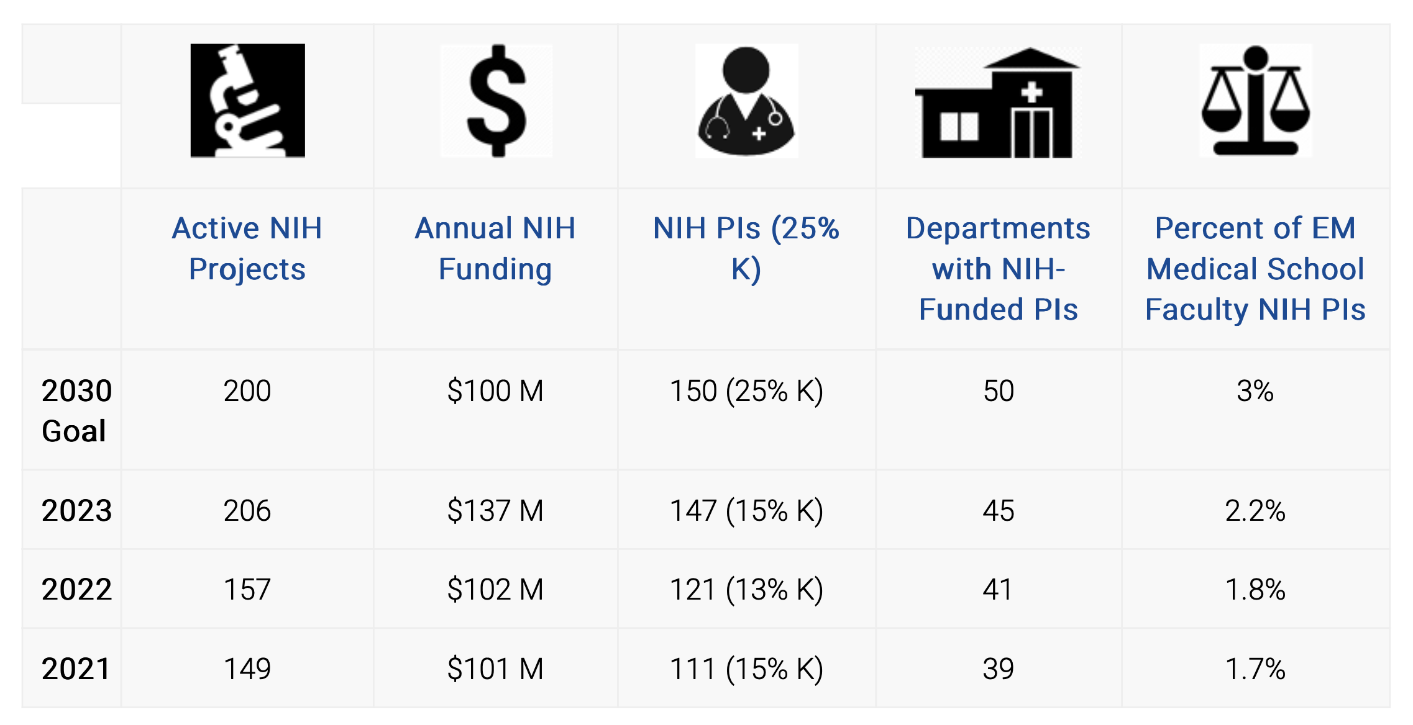
2030 Strategic Research Goals
https://www.saem.org/research/strategic-goals-for-emergency-medicine-nih-funding

Slide 36
NIH Funding Milestone
$1B

Slide 37
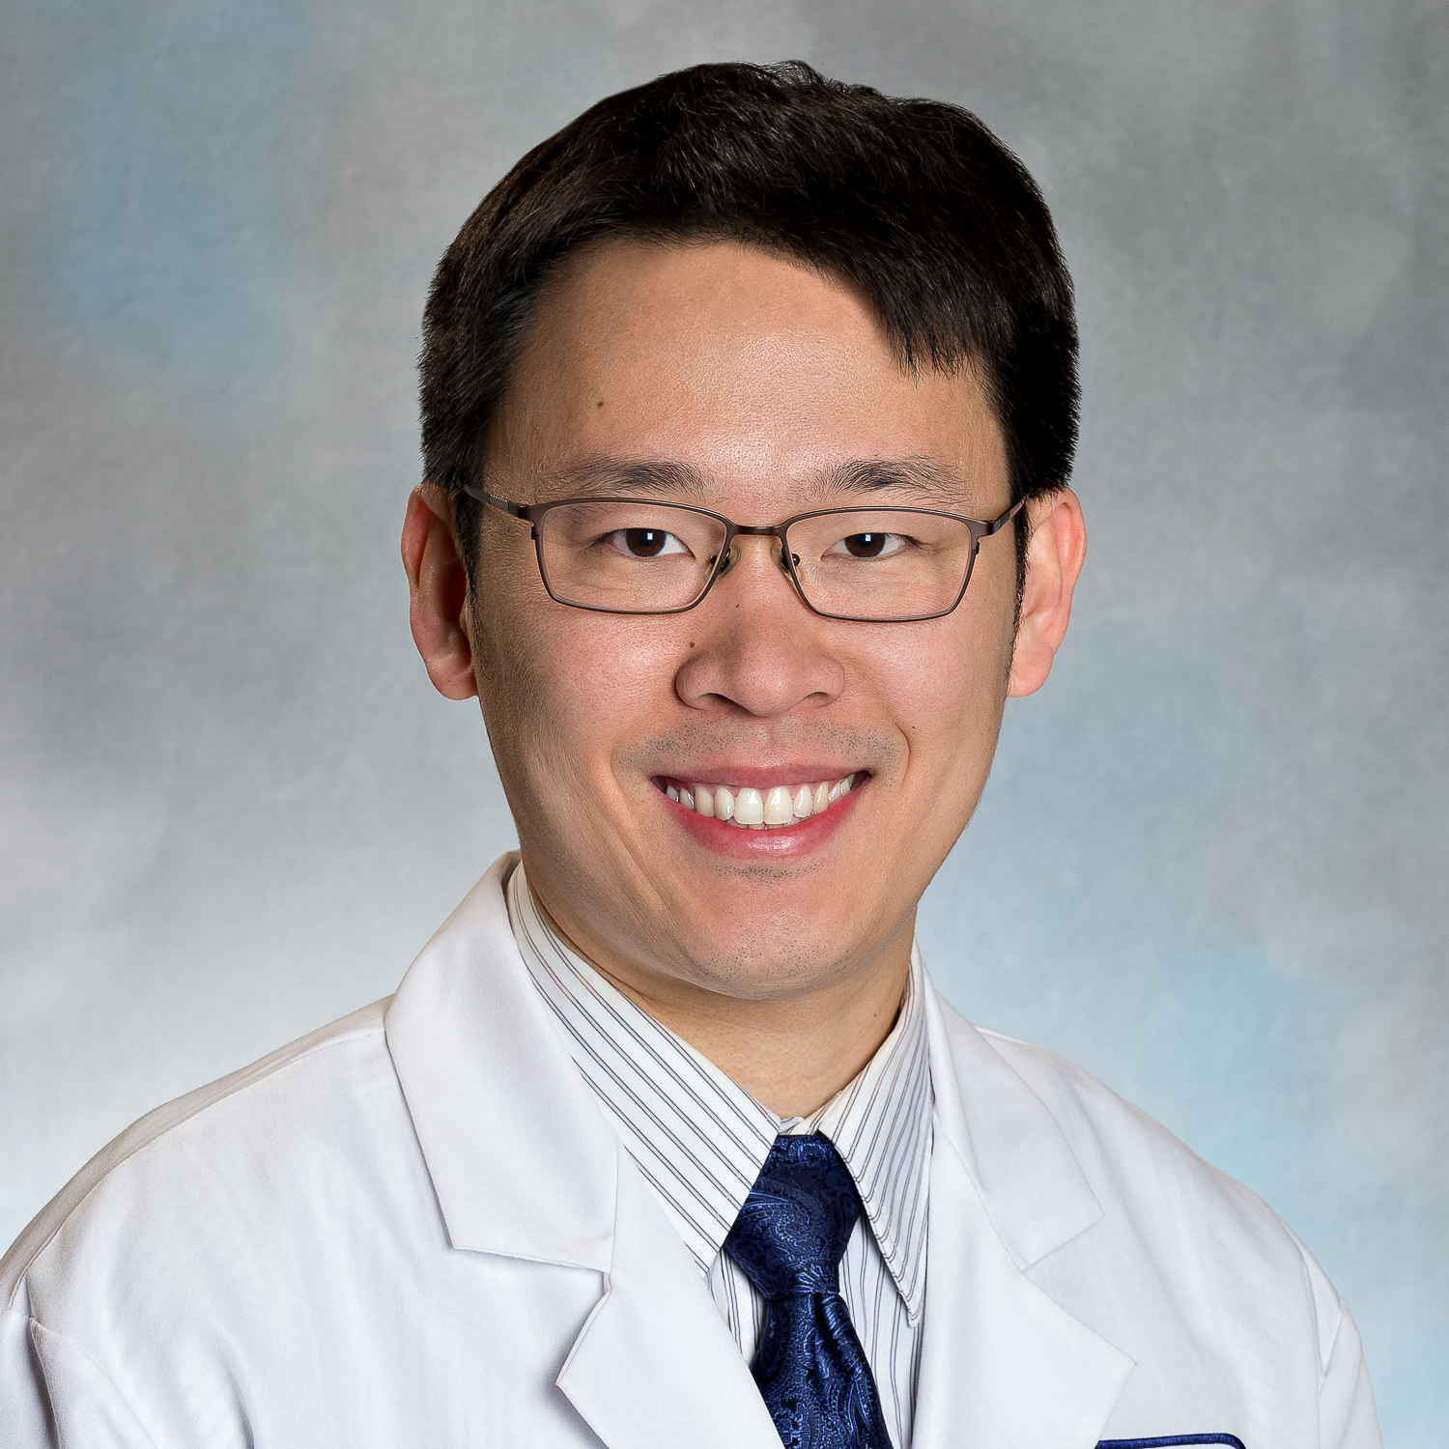
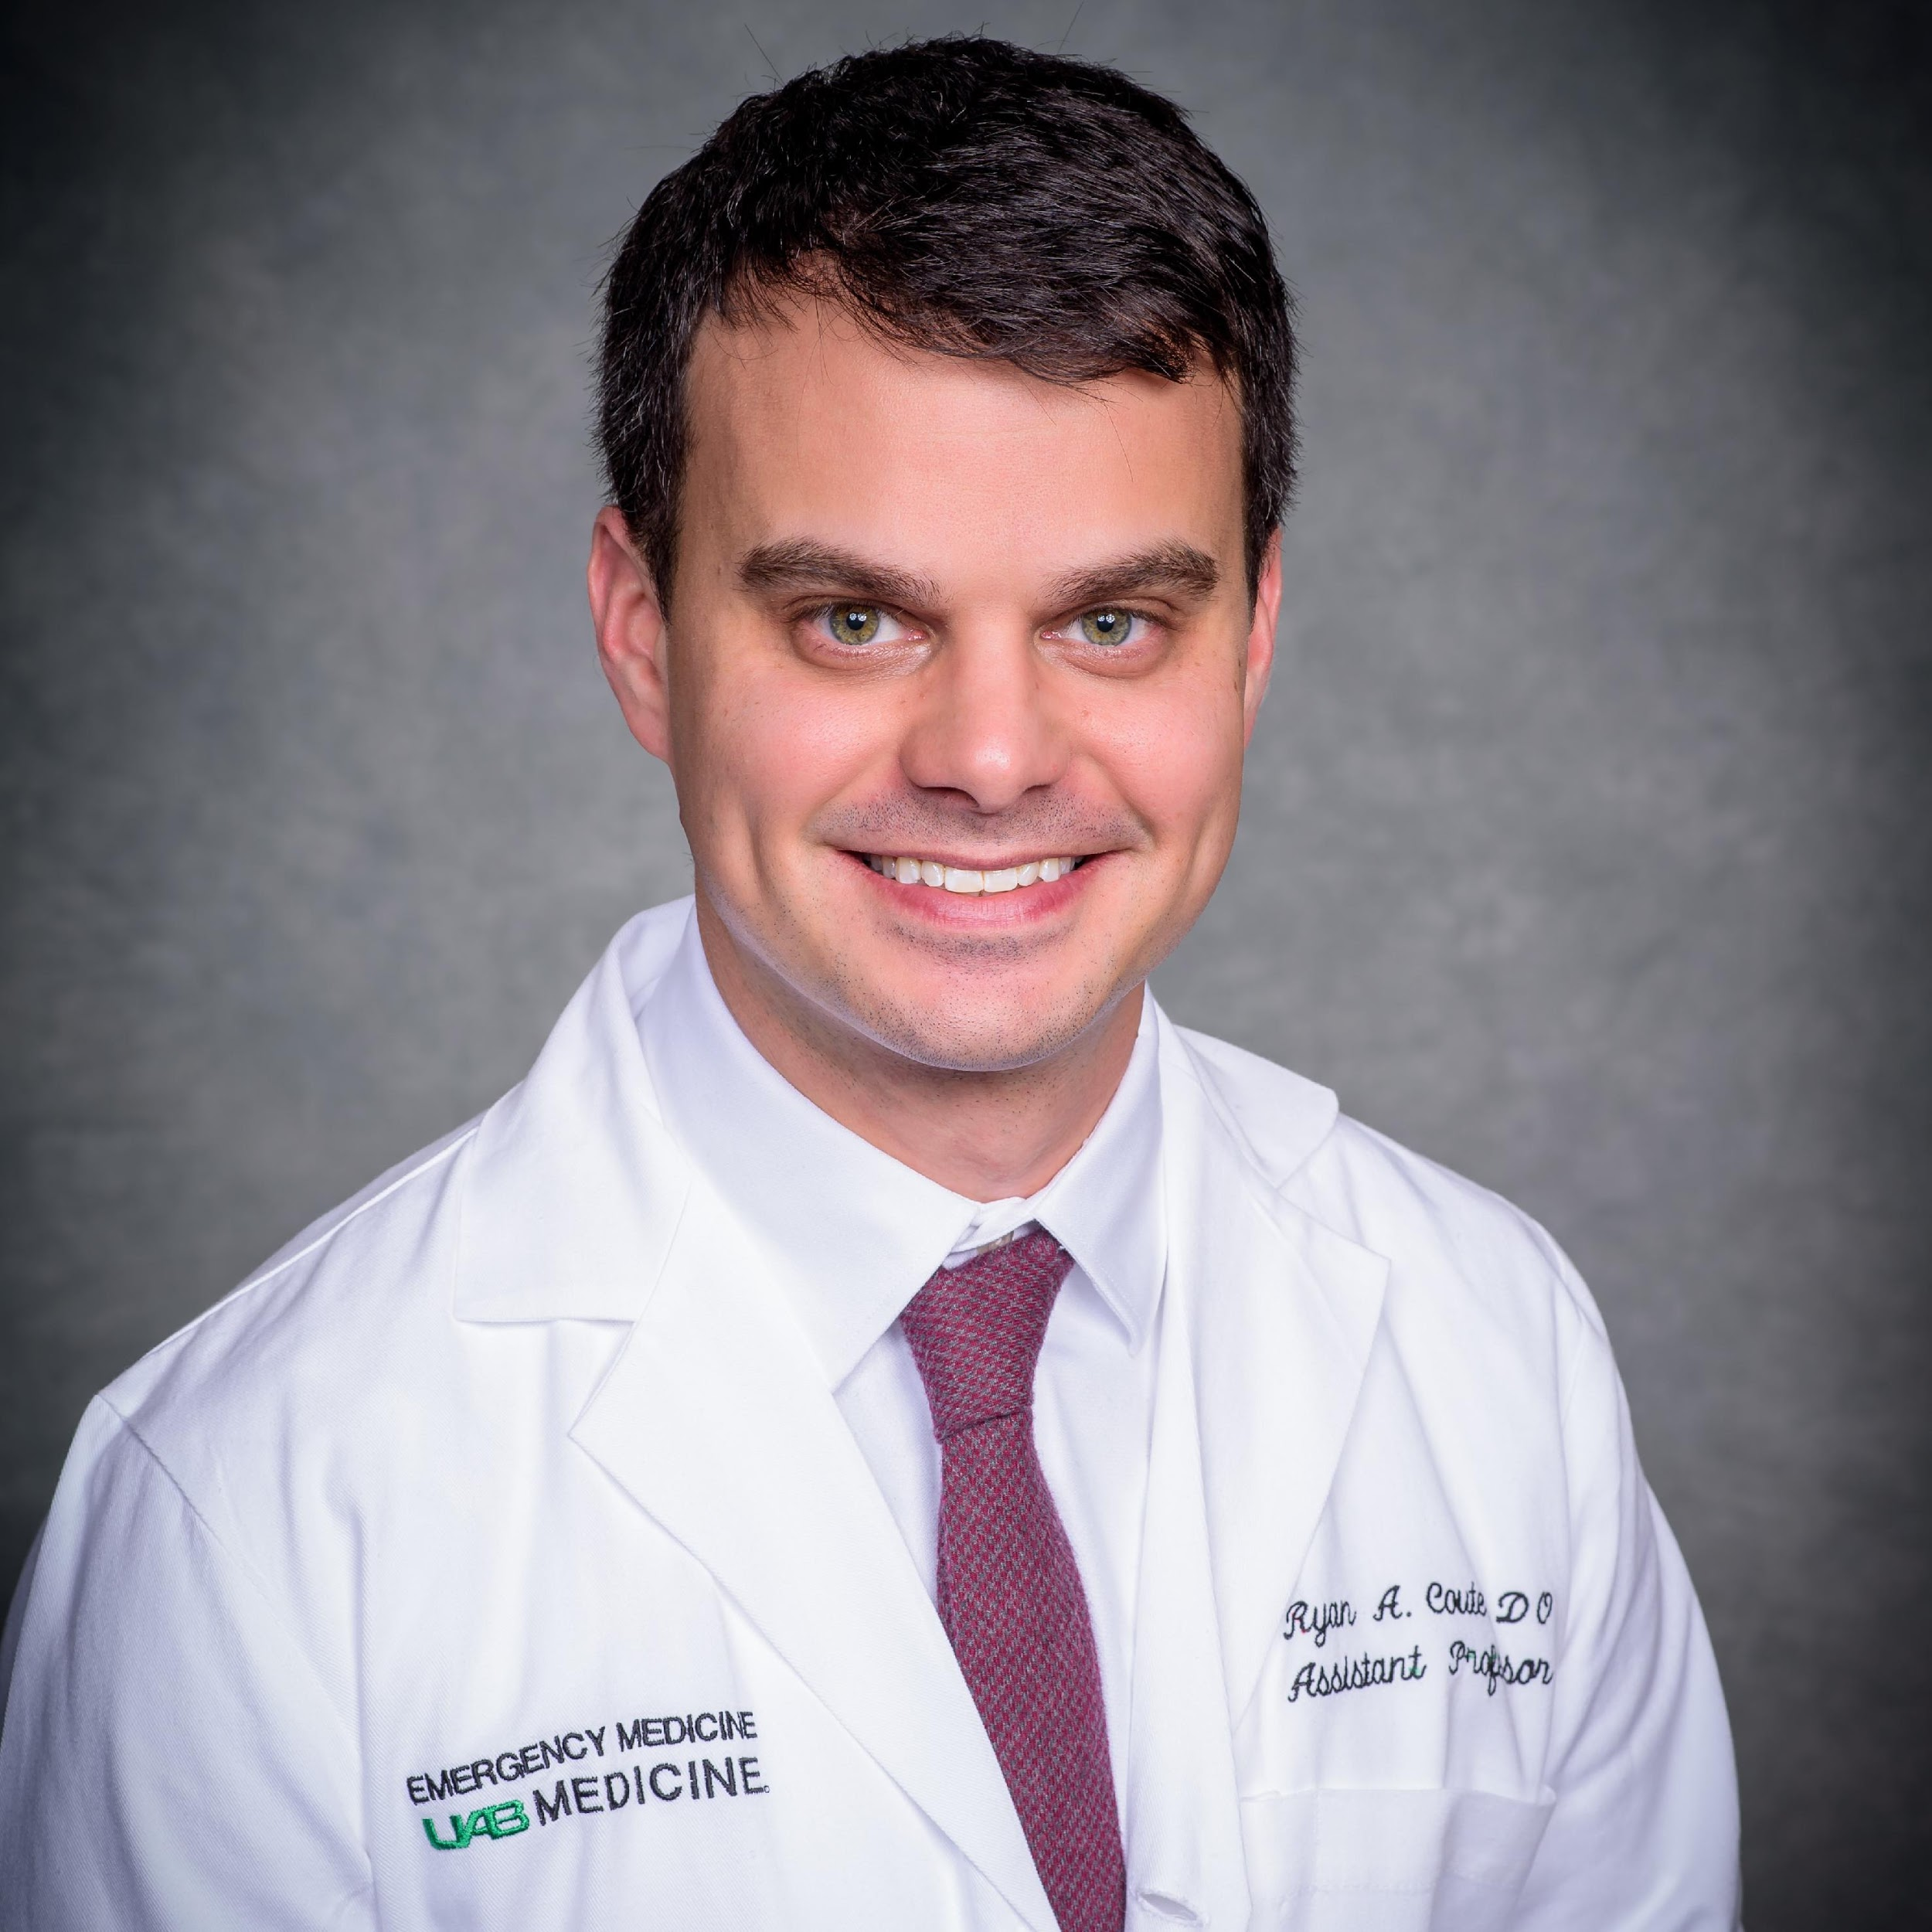
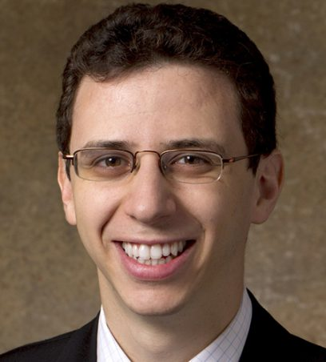
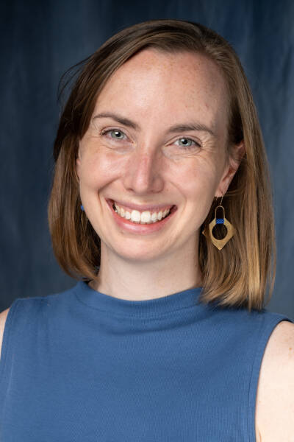
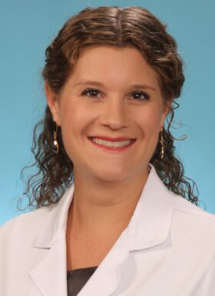
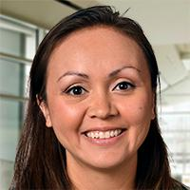
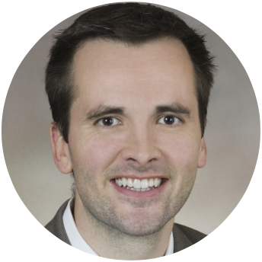
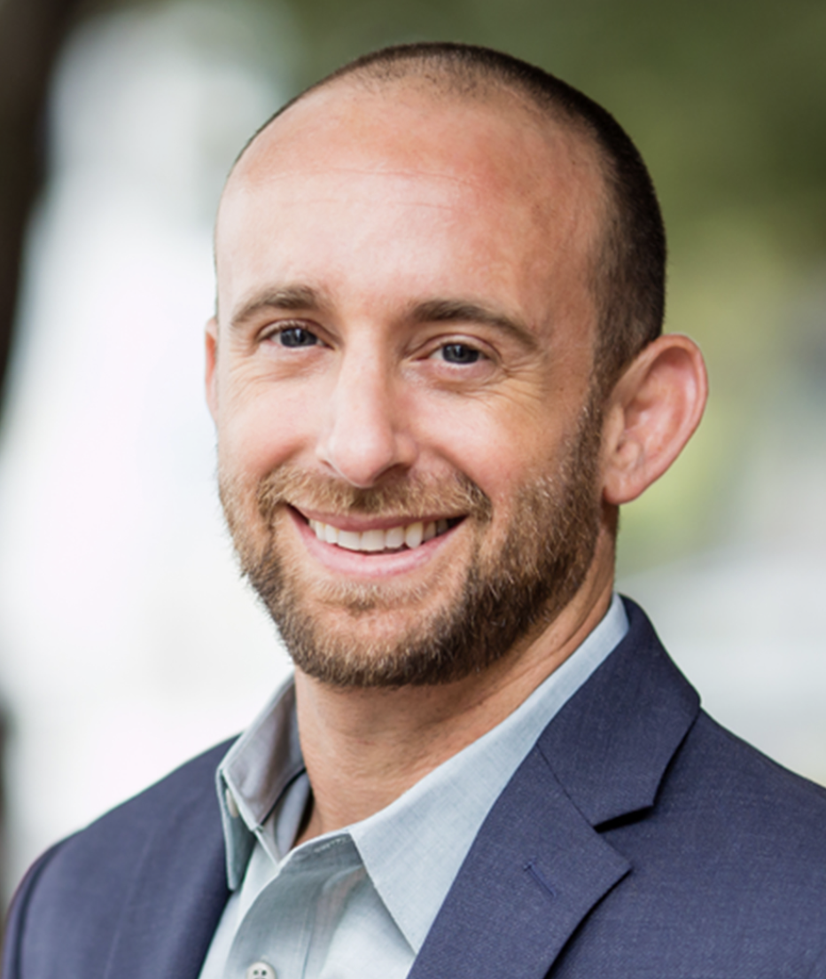
New NIH K Awardees 2023
SHIH-CHUAN CHOU
RYAN COUTE
ARI FRIEDMAN
COLLEEN GUTMAN
AARON KORNBLITH
KRISTEN MUELLER
MICHELLE NASSAL
DAVID SHERIDAN

Slide 38
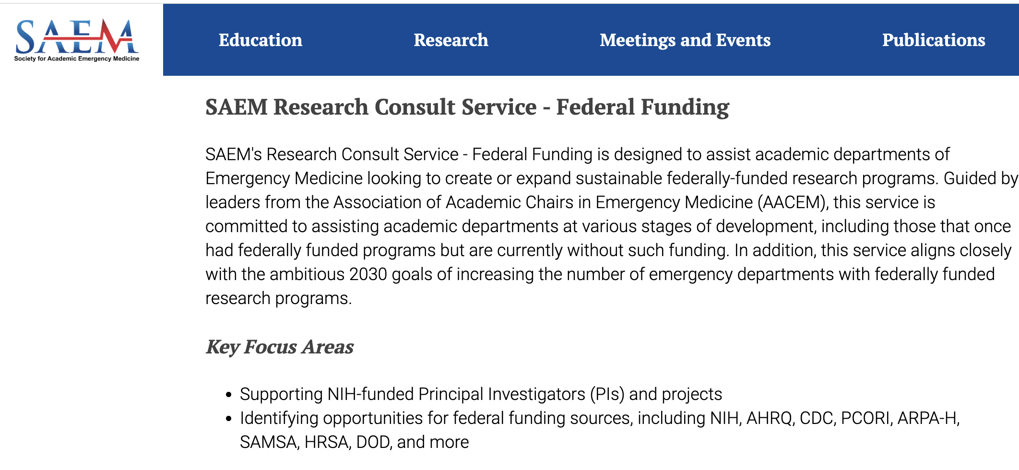
Research Program Consult Service
https://www.saem.org/about-saem/Services/consultation-services

Slide 39
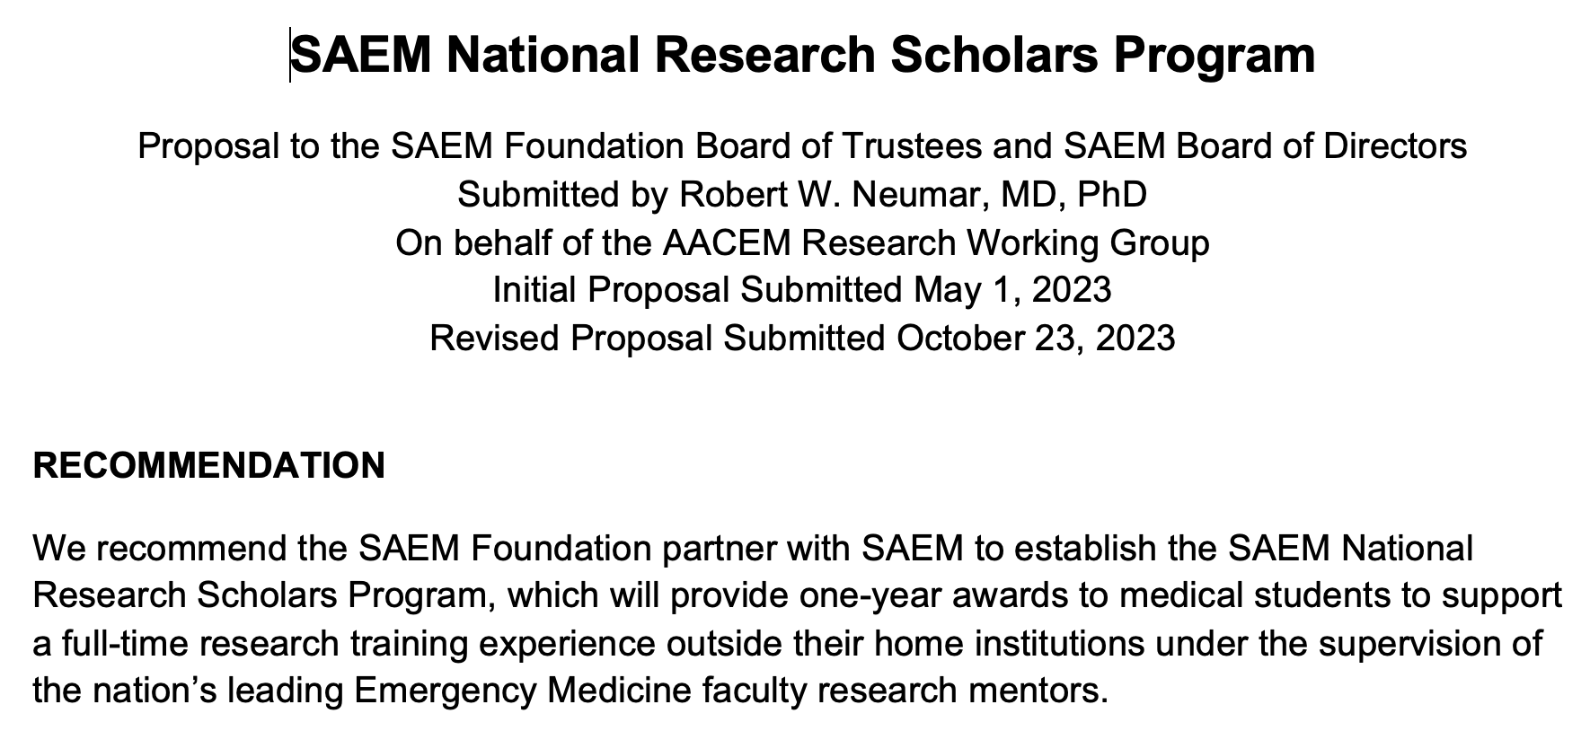
SAEM National Research Scholars Program

Slide 40
SAEM Consensus Conference
https://www.saem.org/meetings-and-events/annual-meeting/education/consensus-conference

Slide 41
National K12 Research Training Program

