Slide 1
APP Models Panel and Breakout March 20, 2023 Dana Point, CA

Slide 2
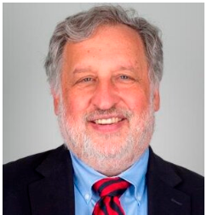
Panel Participants
Gary L. Shillin, MBA/H Chief Administrative Officer Department of Emergency Medicine Harvard Medical Faculty Physicians
Richard Wolfe, MD Chief of Emergency Medicine Beth Israel Deaconess Medical Center (BIDMC)
Associate Professor of Emergency Medicine Harvard Medical School
Rawle A. Seupaul, MD
Vice Dean of Clinical Affairs
Stanley E. Reed Professor and Chair
Department of Emergency Medicine University of Arkansas for Medical Sciences
Shannon Hughen Giger, MHA Administrator
Emergency Medicine Service Line Department of Emergency Medicine University of Arkansas for Medical Sciences

Slide 3
Listserv “Hot Topics”

Slide 4
Trending topics
Staffing (contracting, hours, APP Lead)
Pay (on call, nights and weekends)
Metrics
Retention

Slide 5
APP Salary Results Prepared by Benchmark Committee on 3/7/2022
Compensation
Base = $121K
APP Lead = $136K
Stipend = $1700
Bonus Incentive = $3400
Yrs. of Service
2-4 yrs. = 33%
5-9 yrs. = 31%
10+ yrs. = 26%
Hours
1680/yr = 11.5 shifts/month

Slide 6
2 Year Comp Study
Pros per Sr. Leadership
Level internal pay for IP (↑$17k) OP (↑$11k)
↑ with yrs. of exp. (including outside UAMS)
Cons → differential pay removed for:
Advance degrees
Certifications
Prior RN experience
Night/Weekend 10% → 2.5%
Challenges for Service Lines for implementation
Communication
APP Mindset/Perception
cFTE hrs. vs. local competition
Retention/Attrition/Recruitment
Having your “Plan B” already in place

Slide 7
Retention tools
Compensation breakdown sheet
Retention bonus = $12k
Paid over 1 year
Typically < vacation payout

Slide 8
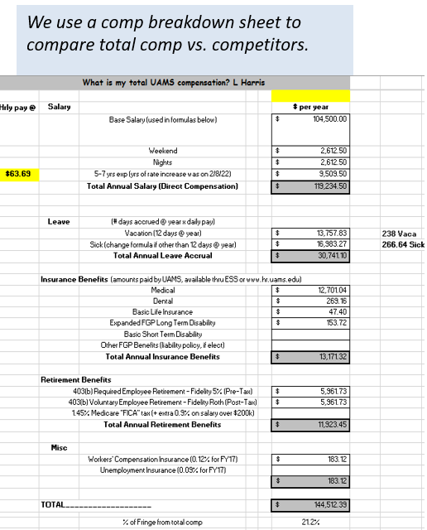
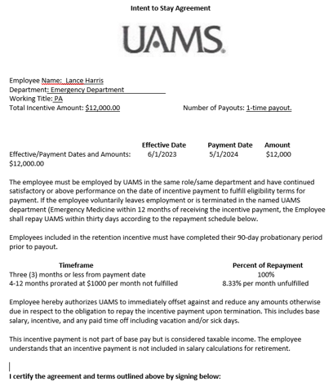
UAMS Retention Tools

Slide 9
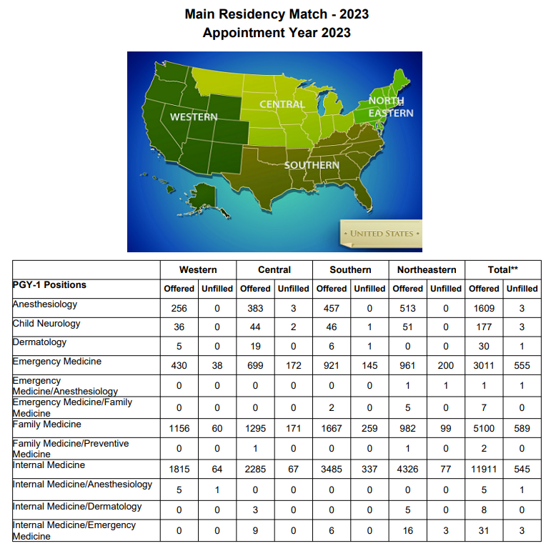
Residency Match 2023

Slide 10
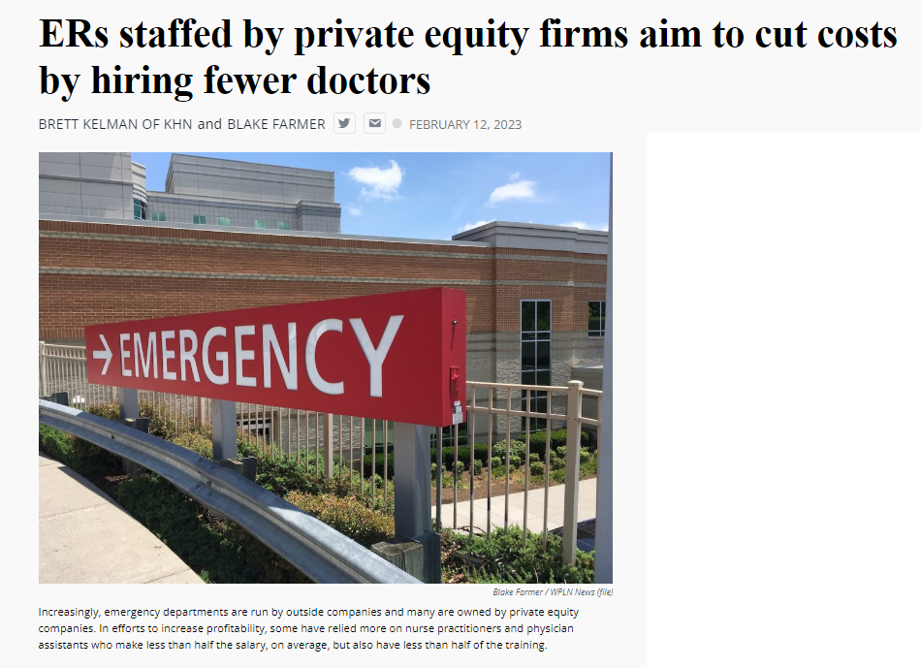
Emergency Physician Workforce
“APP has numerous cost saving initiatives underway as part of the Company’s continual focus on cost optimization,”
Notes:
Pregnant and scared, Natasha Valle went to Clarksville’s Tennova Healthcare hospital in January 2021 because she was bleeding. She didn’t know much about miscarriage, but this seemed like one.
In the emergency room, she was examined then sent home, she said. She went back when her cramping became excruciating. Then home again. Valle said it ultimately took three trips to the ER on three consecutive days, generating three separate bills, before she saw a doctor who looked at her bloodwork and confirmed her fears.
“At the time I wasn’t thinking, ‘Oh, I need to see a doctor,’ ” Valle said. “But when you think about it, it’s like, ‘Well — dang — why didn’t I see a doctor?’ ”
It’s unclear if the repeat ER visits were due to delays in seeing a physician, or if that affected her care, but the experience worried her. And she’s still paying the bills.
The hospital declined to discuss Valle’s care, citing patient privacy. But 17 months before her three-day ordeal, Tennova had outsourced its emergency rooms to American Physician Partners, a medical staffing company owned by private equity investors. APP employs fewer doctors in its ERs as one of its cost-saving initiatives to increase earnings, according to a confidential company document obtained by KHN and NPR.
This staffing strategy has permeated hospitals, and particularly emergency rooms, that seek to reduce their top expense: physician labor. While diagnosing and treating patients was once doctors’ domain, they are increasingly being replaced by nurse practitioners and physician assistants, collectively known as “midlevel practitioners,” who can perform many of the same duties and generate much of the same revenue for less than half the pay.
“APP has numerous cost saving initiatives underway as part of the Company’s continual focus on cost optimization,” the document says, including a “shift of staffing” between M.D.s and mid-level practitioners.
In a statement to KHN, American Physician Partners said this strategy is a way to ensure all ERs remain fully staffed, calling it a “blended model” that allows doctors, nurse practitioners and physician assistants “to provide care to their fullest potential.”
Critics of this strategy say the quest to save money results in treatment meted out by someone with far less training than a physician, leaving patients vulnerable to misdiagnoses, higher medical bills, and inadequate care. And these fears are bolstered by evidence that suggests dropping doctors from ERs may not be good for patients.
A working paper, published in October by the National Bureau of Economic Research, analyzed roughly 1.1 million visits to 44 ERs throughout the Veterans Health Administration, where nurse practitioners can treat patients without oversight from doctors.
Researchers found that treatment by a nurse practitioner resulted on average in a 7% increase in cost of care and an 11% increase in length of stay, extending patients’ time in the ER by minutes for minor visits and hours for longer ones. These gaps widened among patients with more severe diagnoses, the study said, but could be somewhat mitigated by nurse practitioners with more experience.
The study also found that ER patients treated by a nurse practitioner were 20% more likely to be readmitted to the hospital for a preventable reason within 30 days, although the overall risk of readmission remained very small.
Yiqun Chen, who is an assistant professor of economics at the University of Illinois-Chicago and who co-authored the study, said these findings are not an indictment of nurse practitioners in the ER. Instead, she said, she hopes the study will guide how to best deploy nurse practitioners: in treatment of simpler cases or in circumstances when no doctor is available.
“It’s not just a simple question of if we can substitute physicians with nurse practitioners or not,” Chen said. “It depends on how we use them. If we just use them as independent providers, especially … for relatively complicated patients, it doesn’t seem to be a very good use.”
Chen’s research echoes smaller studies, like one from The Harvey L. Neiman Health Policy Institute that found nonphysician practitioners in ERs were associated with a 5.3% increase in imaging, which could unnecessarily increase bills for patients. Separately, a study at the Hattiesburg Clinic in Mississippi found that midlevel practitioners in primary care — not in the emergency department — increased the out-of-pocket costs to patients while also leading to worse performance on nine of 10 quality-of-care metrics, including cancer screenings and vaccination rates.
But definitive evidence remains elusive that replacing ER doctors with nonphysicians has a negative impact on patients, said Dr. Cameron Gettel, an assistant professor of emergency medicine at Yale. Private equity investment and the use of midlevel practitioners rose in lockstep in the ER, Gettel said, and in the absence of game-changing research, the pattern will likely continue.
“Worse patient outcomes haven’t really been shown across the board,” he said. “And I think until that is shown, then they will continue to play an increasing role.”
For private equity firms, dropping ER docs is a ‘simple equation’
Private equity companies pool money from wealthy investors to buy their way into various industries, often slashing spending and seeking to flip businesses in three to seven years. While this business model is a proven moneymaker on Wall Street, it raises concerns in health care, where critics worry the pressure to turn big profits will influence life-or-death decisions that were once left solely to medical professionals.
Nearly $1 trillion in private equity funds have gone into almost 8,000 health care transactions over the past decade, according to industry tracker PitchBook, including buying into medical staffing companies that many hospitals hire to manage their emergency departments.
Two firms dominate the ER staffing industry: TeamHealth, bought by private equity firm Blackstone in 2016, and Envision Healthcare, bought by KKR in 2018. Trying to undercut these staffing giants is American Physician Partners, a rapidly expanding company that runs ERs in at least 17 states and is 50% owned by private equity firm BBH Capital Partners.
These staffing companies have been among the most aggressive in replacing doctors to cut costs, said Dr. Robert McNamara, a founder of the American Academy of Emergency Medicine and chair of emergency medicine at Temple University.
“It’s a relatively simple equation,” McNamara said. “Their No. 1 expense is the board-certified emergency physician. So they are going to want to keep that expense as low as possible.”
Not everyone sees the trend of private equity in ER staffing in a negative light. Jennifer Orozco, president of the American Academy of Physician Associates, which represents physician assistants, said even if the change — to use more nonphysician providers — is driven by the staffing firms’ desire to make more money, patients are still well served by a team approach that includes nurse practitioners and physician assistants.
“Though I see that shift, it’s not about profits at the end of the day,” Orozco said. “It’s about the patient.”
The “shift” is nearly invisible to patients because hospitals rarely promote branding from their ER staffing firms and there is little public documentation of private equity investments.
Dr. Arthur Smolensky, a Tennessee emergency medicine specialist attempting to measure private equity’s intrusion into ERs, said his review of hospital job postings and employment contracts in 14 major metropolitan areas found that 43% of ER patients were seen in ERs staffed by companies with nonphysician owners, nearly all of whom are private equity investors.
Smolensky hopes to publish his full study, expanding to 55 metro areas, later this year. But this research will merely quantify what many doctors already know: The ER has changed. Demoralized by an increased focus on profit, and wary of a looming surplus of emergency medicine residents because there are fewer jobs to fill, many experienced doctors are leaving the ER on their own, he said.
“Most of us didn’t go into medicine to supervise an army of people that are not as well trained as we are,” Smolensky said. “We want to take care of patients.”
‘I guess we’re the first guinea pigs for our ER’
Joshua Allen, a nurse practitioner at a small Kentucky hospital, snaked a rubber hose through a rack of pork ribs to practice inserting a chest tube to fix a collapsed lung.
It was 2020, and American Physician Partners was restructuring the ER where Allen worked, reducing shifts from two doctors to one doctor, he said. Once he had placed 10 tubes under a doctor’s supervision, he would be allowed to do it on his own.
“I guess we’re the first guinea pigs for our ER,” he said. “If we do have a major trauma and multiple victims come in, there’s only one doctor there. … We need to be prepared.”
Allen is one of many midlevel practitioners finding work in emergency departments. Nurse practitioners and physician assistants are among the fastest-growing occupations in the nation, according to the U.S. Bureau of Labor Statistics.
Generally, they have master’s degrees and receive several years of specialized schooling but have significantly less training than doctors. Many are permitted to diagnose patients and prescribe medication with little or no supervision from a doctor, although limitations vary by state.
The Neiman Institute found that the share of ER visits in which a midlevel practitioner was the main clinician increased by more than 172% between 2005 and 2020. Another study, in the Journal of Emergency Medicine, reported that if trends continue there may be equal numbers of midlevel practitioners and doctors in ERs by 2030.
There is little mystery as to why. Federal data shows emergency medicine doctors are paid about $310,000 a year on average, while nurse practitioners and physician assistants earn less than $120,000. Generally, hospitals can bill for care by a midlevel practitioner at 85% the rate of a doctor while paying them less than half as much.
Private equity can make millions in the gap.
For example, Envision once encouraged ERs to employ “the least expensive resource” and treat up to 35% of patients with midlevel practitioners, according to a 2017 PowerPoint presentation posted by the company online. The presentation drew scorn on social media and soon disappeared from Envision’s website.
Envision declined a request for a phone interview. In a written statement to KHN, spokesperson Aliese Polk said the company does not direct its physician leaders on how to care for patients and called the presentation a “concept guide” that does not represent current views.
American Physician Partners touted roughly the same staffing strategy in 2021 in response to the No Surprises Act, which threatened the company’s profits by outlawing surprise medical bills. In its confidential pitch to lenders, the company estimated it could cut almost $6 million by shifting more staffing from physicians to midlevel practitioners.
KHN (Kaiser Health News) is an editorially independent, national program of the Kaiser Family Foundation.

Slide 11
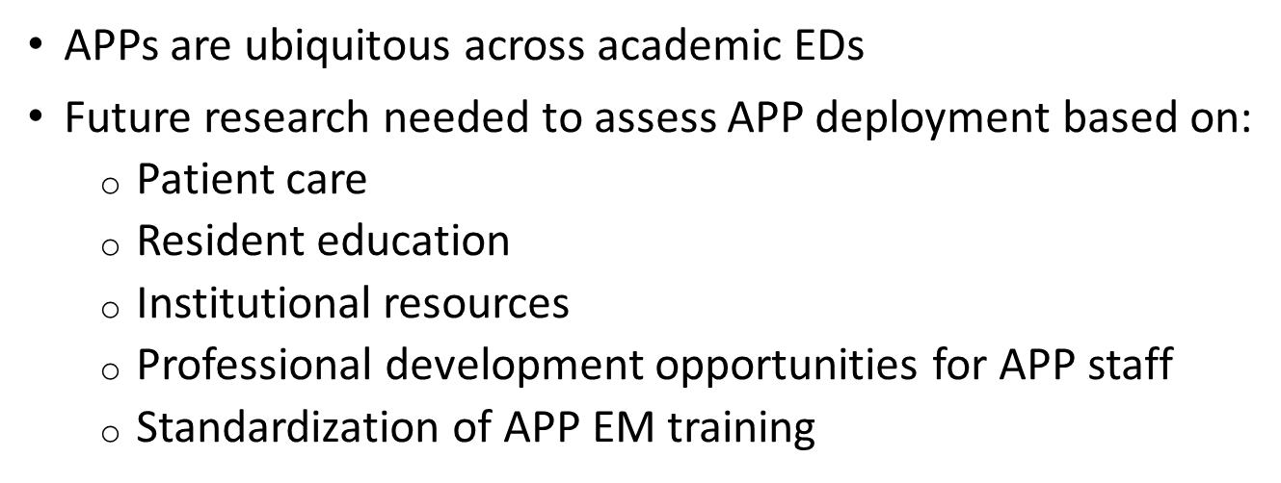
“Advanced practice providers in academic emergency medicine: A national survey of chairs and program directors.”
Carpenter CR et al. AEM 2021

Slide 12
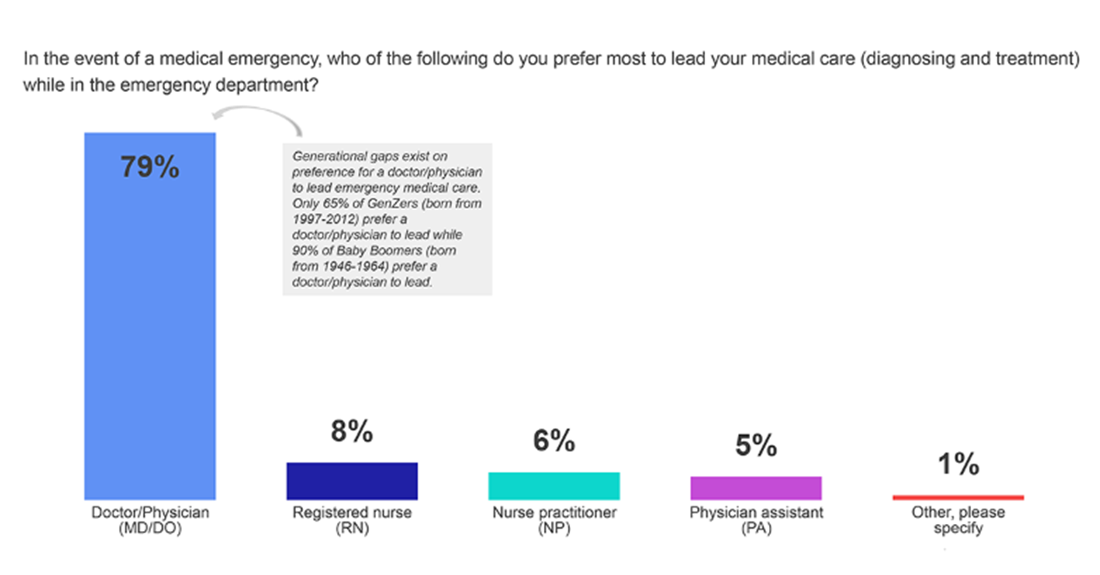
Patient Preference
Public Opinion Survey March 2022
Notes:
A March 2022 public opinion survey from the American College of Emergency Physicians (ACEP) and Morning Consult* shows that the vast majority of adults most trust a physician to lead their medical care, and many patients would be concerned if a physician was unavailable during their medical emergency.
It's clear that patients want physicians leading their care in a medical emergency. Emergency physicians have the deepest expertise, education, and training on a care team, and this makes them the most qualified to make diagnostic and treatment decisions for patients.
Very few adults prefer any of the other medical professionals to lead their emergency department medical care.
Eight-in-ten adults (79%) prefer a doctor/physician to lead their medical care while in the emergency department.
Nine-in-ten adults 65 and over (91%) prefer a doctor/physician to lead their medical care in the emergency department
After learning more about the training requirements for each of the medical professionals, adults still preferred a doctor/physician to lead their medical care in the emergency department.
Most adults would be concerned if a physician wasn't available to lead their care in a medical emergency.
Nearly three-fourths of adults (72%) would be very or somewhat concerned if a doctor/physician was unavailable to oversee their diagnosing and treatment in a medical emergency.
Adults who believe the scope of practice for nurse practitioners and physician assistants should not be expanded show the most concern for emergency medical treatment without a doctor/physician overseeing the diagnosing and treatment.
The laws that determine who can practice medicine without supervision differ across the country, so it can understandable that people are confused about who is providing their care.
Many people may not know that a physician assistant must always work under the supervision of a physician.
And, while a nurse practitioner can work independently in some states, in others the law requires that they are supervised by a physician for certain parts of their job.
It is important to remember that while everyone responsible for patient care is a qualified medical professional, physicians have the deepest expertise, education, and training.
An emergency physician is the only member of the care team that is required to complete a multi-year medical education and training program known as a "residency", where they learn to treat any illness, any injury, any unexpected complication.
Only physicians must past a series of exams to become board-certified in a specialty, such as emergency medicine.
Physicians should lead every emergency care team—which also comprises well-trained physician assistants and nurses, and essential professionals—because they are the most highly trained and qualified to make diagnostic and treatment decisions for patients.
*Methodology: This poll was conducted between March 10-March 12, 2022 among a sample of 2209 Adults. The interviews were conducted online and the data were weighted to approximate a target sample of Adults based on gender, educational attainment, age, race, and region. Results from the full survey have a margin of error of plus or minus 2 percentage points.

Slide 13
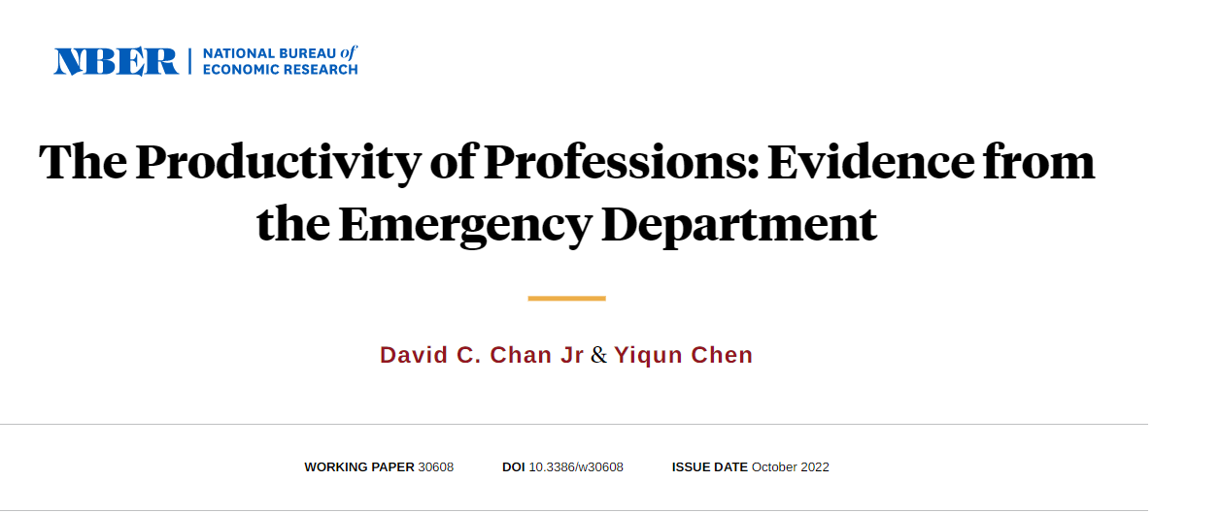
1.1 million visits to 44 ERs throughout the Veterans Health Administration
‘Counterfactual analysis suggests a net increase in medical costs with NPs, even when accounting for NPs’ wages that are half as much as physicians’
7% increase in cost of care
11% increase in ED LOS
Patients were 20% more likely to be readmitted to the hospital within 30d
Notes:
Professions play a key role in determining the division of labor and the returns to skilled work. This paper studies the productivity difference between physicians and nurse practitioners (NPs), two health care professions performing overlapping tasks but with stark differences in background, training, and pay. Using data from the Veterans Health Administration and quasi-experimental variation in the patient probability of being treated by physicians versus NPs in the emergency department, we find that, compared to physicians, NPs significantly increase resource utilization but achieve worse patient outcomes. We find evidence suggesting mechanisms relating to lower human capital among NPs relative to physicians and worker-task assignment responding to the lower skill of NPs. Counterfactual analysis suggests a net increase in medical costs with NPs, even when accounting for NPs’ wages that are half as much as physicians’. Despite large productivity differences between professions, we find even larger productivity differences within professions and substantial productivity overlap between professions. Yet there is little overlap in wages between NPs and physicians and, within professions, no significant correlation between productivity and wages.
A working paper, published in October by the National Bureau of Economic Research, analyzed roughly 1.1 million visits to 44 ERs throughout the Veterans Health Administration, where nurse practitioners can treat patients without oversight from doctors.
Researchers found that treatment by a nurse practitioner resulted on average in a 7% increase in cost of care and an 11% increase in length of stay, extending patients’ time in the ER by minutes for minor visits and hours for longer ones. These gaps widened among patients with more severe diagnoses, the study said, but could be somewhat mitigated by nurse practitioners with more experience.
The study also found that ER patients treated by a nurse practitioner were 20% more likely to be readmitted to the hospital for a preventable reason within 30 days, although the overall risk of readmission remained very small.

Slide 14
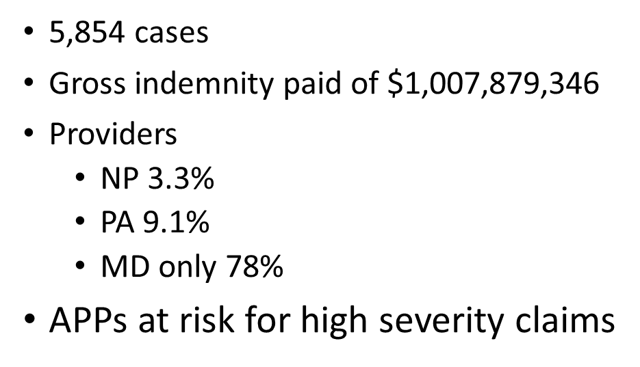
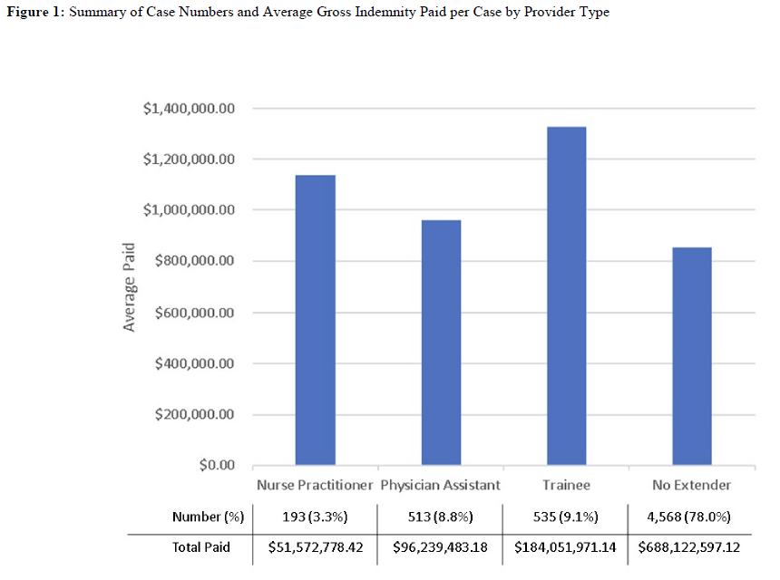
Malpractice and APPs
CRICO/Candello National Malpractice Data

Slide 15
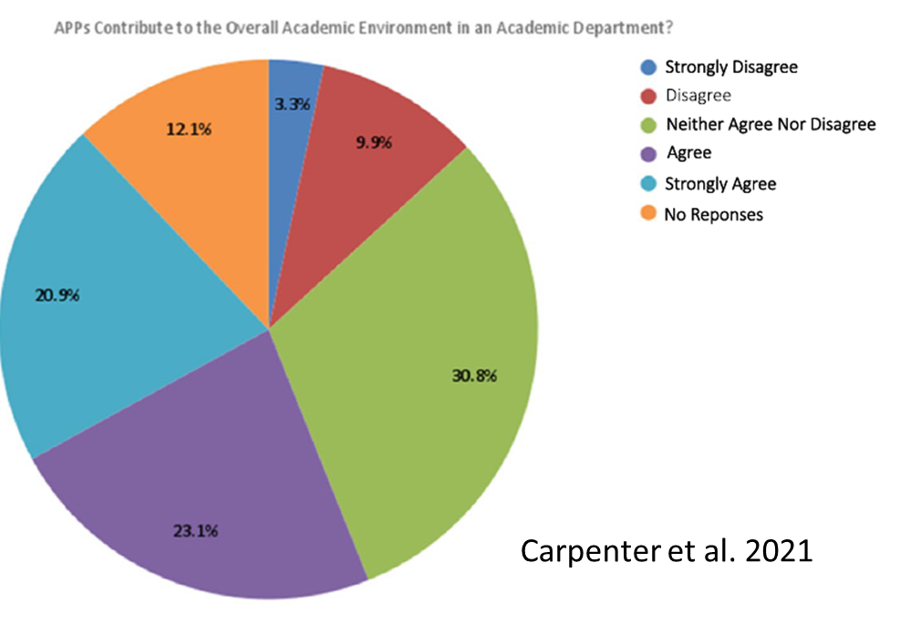
APPs and Academics
Notes:
44% think APPs contribute to the academic mission
13% believe they do not

Slide 16
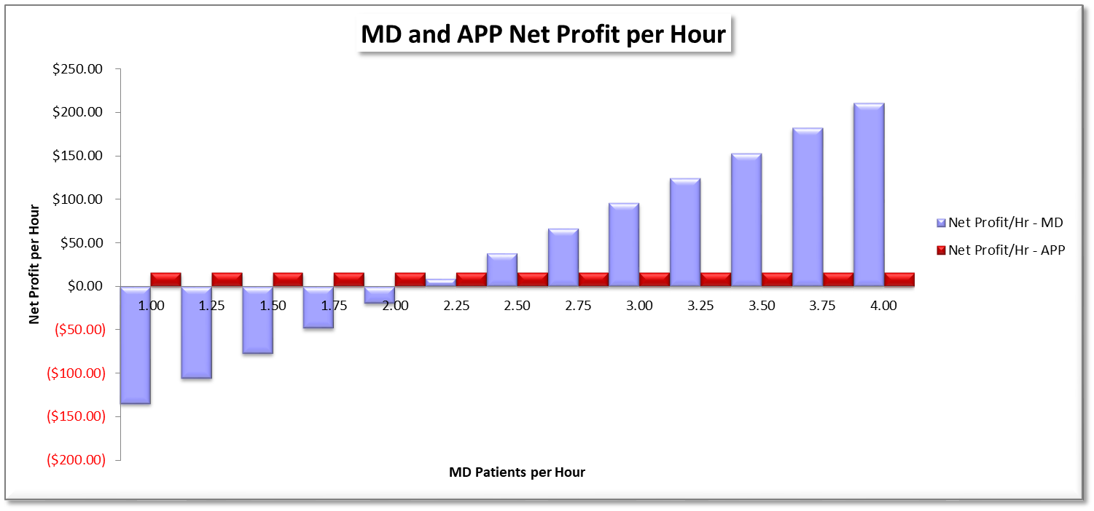
Fiscal Considerations – When is an MD more cost-effective than APP?
Potential margin analysis per provider type on an array of MD overall productivity
Assumptions
Average APP productivity stable at 1.0 pph
Like acuity patients for MD & APP
All-in Physician hourly cost $250
All-in APP hourly cost $100
Notes:
Revenues per hour based on BILH community hospital affiliates actual average wRVUs / pt for APP level of acuity of 3.40 at per pt, then multiplied by number of pts per hour
MD costs = $250 per hour ($200/h +25% fringe; APP cost = $100 per hour ($80/h +25% fringe)

