Slide 1
Hot Topics

Slide 2
The problem

Slide 3
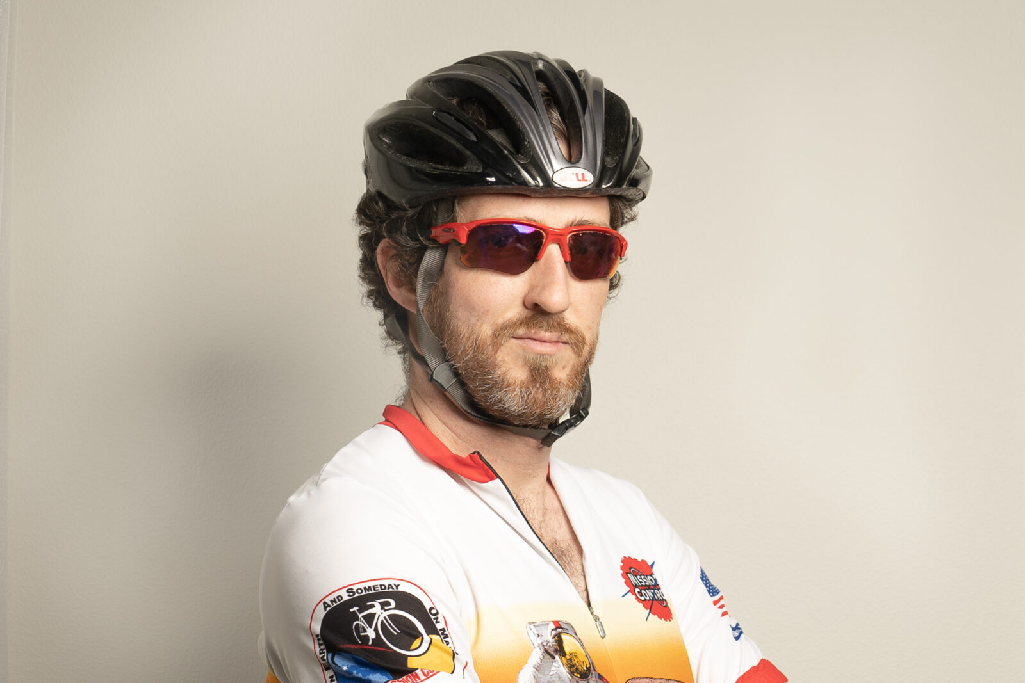
What do the experts say?
Notes:
Barrier to entry – increase in Mountain Bike Prices

Slide 4
Asking the right questions
The Workforce study killed us!
It’s a regional problem caused by weak programs!
Is EM no longer an attractive specialty?
Lifestyle – is it still a draw?
Too many slots!
CMGs, APPs, & HCA – oh my!
It’s the virtual match process.
Burnout – who me?
It’s everything!

Slide 5
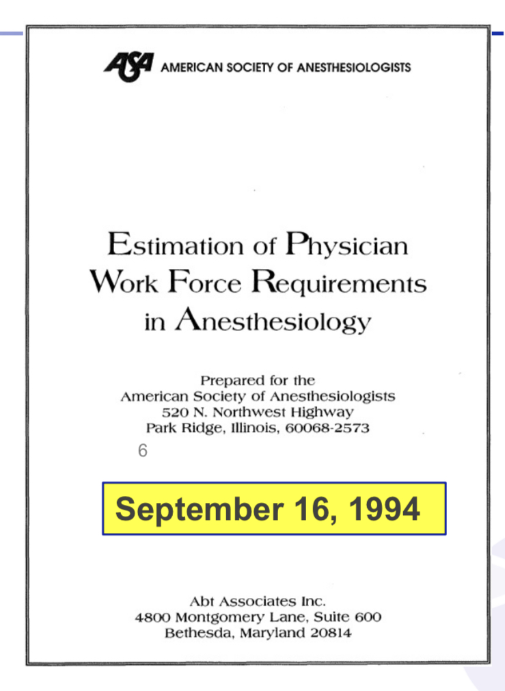
Anesthesia story
Notes:
CMS broadcast reductions in reimbursements for common surgeries (tympanostomy tubes)
Anesthesia Societies openly debated issues with regard to workforce and impending oversupply
CRNAs provided alternative source of anesthetists
Anesthesia Society commission workforce studies which predicted decrease salary and potential oversupply
Medical Students decided against being anesthesiologists!

Slide 6
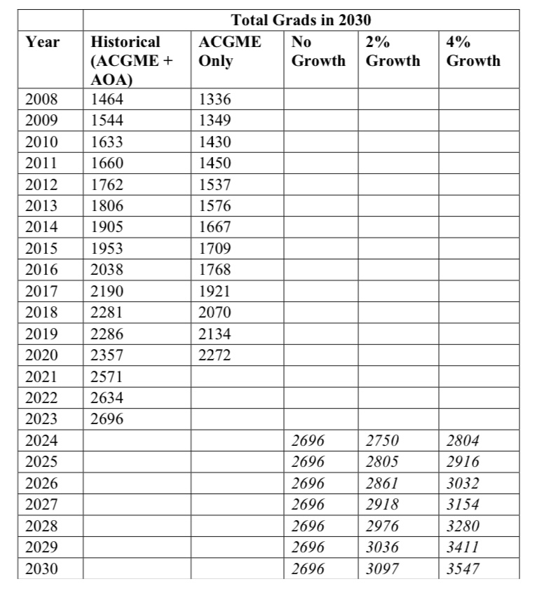
Workforce study
2023 Match will be the class of 2026
2961 filled positions (Main + SOAP)
Class of 2026 = 2961
2-4% growth
Maybe the workforce study got this part right
Notes:
The pause in hiring around Covid seems to have ended…

Slide 7
Is it a regional supply/demand problem?
 | Slots | Unfilled | Percentage
Total | 3011 | 555 | 18.43%
… SOAP may have filled 500 positions …
Is that a good thing??????
Are we ready for the needs of students with lower exam scores and grades!!!???

Slide 8
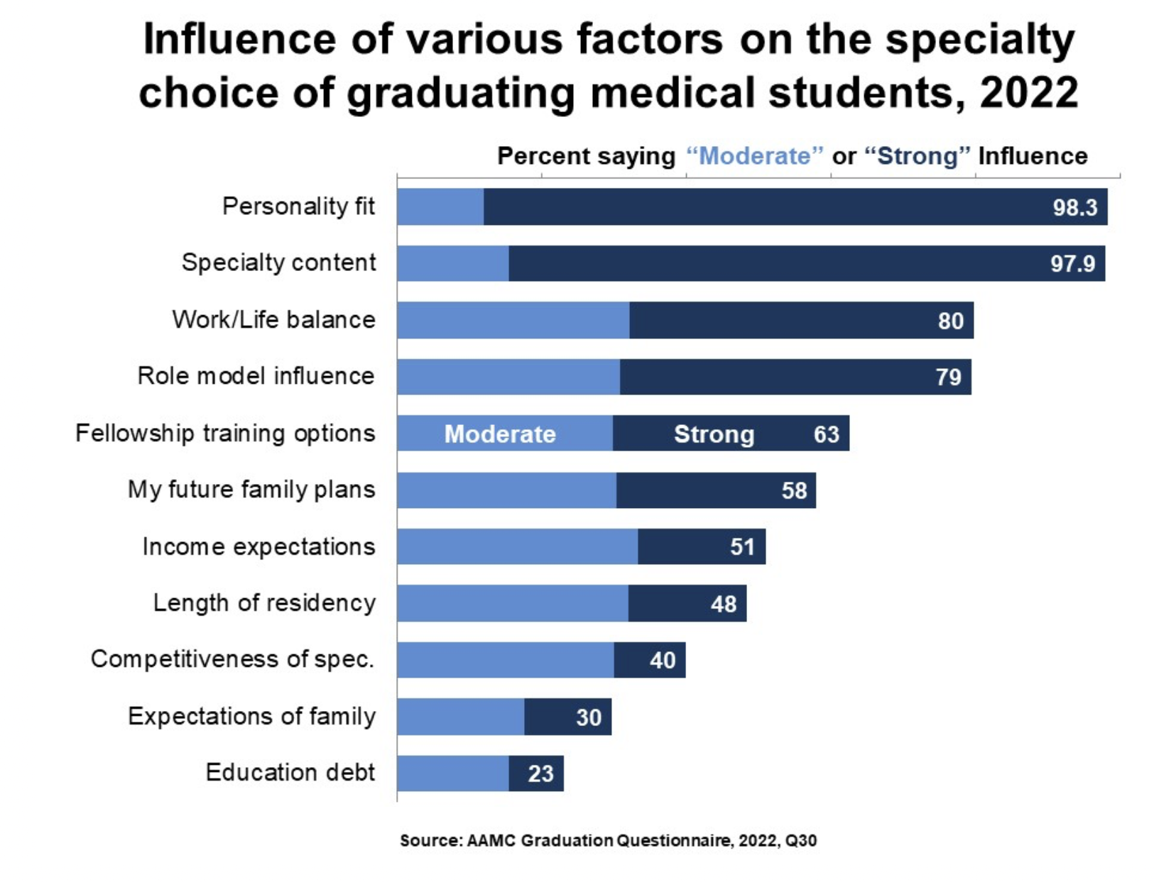
Is EM no longer attracting medical students?
Notes:
How does a med student choose a specialty?
Or MAYBE
How does a medical student SAY they choose a specialty?

Slide 9
Are you a personality fit to work in the ED?
Is our caricature our own worst enemy?
Notes:
Our DEI issue may be manifesting itself here

Slide 10
Med school composition v EM by gender (+ unmatched slots)
Notes:
And so in case you need to frame our keynote into actionable objectives, here is one way to look at our match results. Now, I am not saying this is the issue in its entirety – far from up – but it does appear that our DEI vision and our DEI outcomes are not in alignment. Our plan is to have a Keynote Workshop… it will be interactive and will require you to break up into small groups and interact and problem solve.

Slide 11
What do students think about EM Residencies?

Slide 12
Would we be willing to…
Reduce shift length?
Reduce the number of shifts?
How about a hybrid?
Add a few shifts on elective
Reduce the number of shifts while on EM

Slide 13
Work life balance?
Opportunity Highlights
Locally owned and operated health system with strong and supportive administration
No weekend call responsibilities
Excellent compensation package with a great benefits package
Salary guarantee of $400k
$50,000 sign-on
Student loan repayment available
Visa sponsorship available
Community Information
Picture yourself in this well-loved community. Surrounded by rolling hills and pristine lakes, it’s considered a top place to live and raise a family in the South.Family-oriented lake and country club community, ideal for raising a family or a retreat from city living
Low cost of living and top-rated school systems in the state
Enjoy eclectic, boutique local dining, a local brewery, and nationally-recognized arts and crafts and music festivals
Notes:
Advertisement featuring work life balance – except it’s not for an EM position. It’s OB GYN!

Slide 14
EM work life balance reconsidered
Notes:
Autonomy, mastery and purpose
Move to the positive
EM as a calling, a vocation
Programs to develop skills
A dream job?

Slide 15
Moratorium on increase in slots?
We had this discussion last year…
… and yet the number of positions still increased!!

Slide 16
Interview issues - did the signaling help?
Random sampling of chairs and PDs
Helped find a small number unexpectedly interested students
Overall, PDs knew who was interested in the program
Notes:
1/3 known
1/3 unexpected with a small +
1/3 from IMGs

Slide 17
Is it us?
Do we look miserable?
When did it stop being fun?

Slide 18
Now discuss and recommend solutions
It’s a regional problem with weak programs!
Is EM no longer an attractive specialty?
Lifestyle – is it still a draw?
Too many slots!
CMGs, APPs, & HCA – oh my!
The Workforce study killed us!
It’s the virtual match process.
Burnout – who me?
It’s everything!

Slide 19
Let’s leave with at least one action item…
Everything we do to make the specialty better will make the match better

