Slide 1

Academy of Administrators in Academic Emergency Medicine
Salary and Staffing Survey
Fiscal Year 2022
James Scheulen, PA, MBA
On behalf of the
AAAEM Benchmark Committee
March, 2023

Slide 2

Academic Faculty Life
Faculty Salary
Compensation Plans
Provider Coverage Hours
Professional Billing
APP Salary Survey
Fellow Salary Survey
James Scheulen
On behalf of the AAAEM Benchmark Committee
March, 2023

Slide 3

Faculty Level Benchmarks
RVU Productivity
  Per hour
  Total
Publications
  First vs any author
  Journal quality
  Type of publication
Grants submitted/Awarded
  Submission or award
  NIH or all
  PI or other
Needed? Wanted? Useful?
Notes:
2016 =160356 total median COLLECTION $44.44, PER MD HOUR 6.54; PER PATIENT BILLED 2.88; RVU PER CLINICAL fte 10613
2017= 173902 total median; Collection $45.76; PER MD HOUR 6.73; PER PATIENT BILL 2.86, PER FTE 10127
Work RVU per MD hour up slightly from last yeas as is collection per RVU.
RVU collection range 93.63-9.92
25th percentile = 39.08
75th percentile 51.77

Slide 4
Physician Staffing
Arrivals per
faculty hour:
2.4
Arrivals per
faculty hour:
2.1
Arrivals per
faculty hour:
2.1
Notes:
The mean increase was 2075 hours across the board, but hard to make year to year comparisons because of the varying participation among sites and data entry. But it does appear that we have been adding more clinical hours over the past few years

Slide 5
Clinical Hours: Rank & Site
Do you require a minimum number
of clinical hours?
70% = Yes
Median = 384
25th to 75th = 373 to 425
Do shifts recognize sign in & out?
42% = Yes
Assumed work week hours?
40 hours

Slide 6
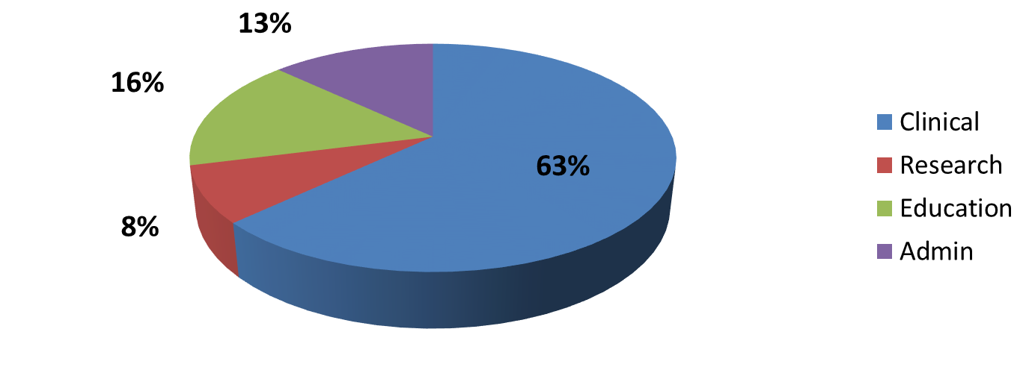
Faculty Effort
Percent Faculty Effort: Multiple Missions
Increasing clinical effort
FY 2015
FY 2022
Academic Centers

Slide 7
Daily Provider Coverage
Hours per Day
56%
52%
52%
Attending
Hours
34%
54%
Attending
Hours
33%
Resident
Hours
42%
Resident
Hours
55%
APP
Hours
11%
APP
Hours
25%
Notes:
Medians :184 hours in main ED 2016 ; 2017 186 hours as was 186 in 2012, essentially resident coverage has remained flat we have added attending hours to compensate for increase volume On average 50 %f the daily ED coverage hours are provided by residents for EDs> 40 K
From 2012 through 2017 the percent resident coverage 55%, 55%,56%,54%, 52%, 52%

Slide 8
Daily Provider Coverage
Hours per Day
56%
52%
52%
Attending
Hours
34%
54%
APP
Hours
33%
Resident
Hours
54%
APP
Hours
11%
Attending
Hours
67%
Common for APP coverage in fast track areas in community
Notes:
Medians :184 hours in main ED 2016 ; 2017 186 hours as was 186 in 2012, essentially resident coverage has remained flat we have added attending hours to compensate for increase volume On average 50 %f the daily ED coverage hours are provided by residents for EDs> 40 K
From 2012 through 2017 the percent resident coverage 55%, 55%,56%,54%, 52%, 52%

Slide 9
Physician Hour Coverage
1 added patient = 22 additional provider minutes
+ 1000 patients = 366 additional provider hours
+10000 patients = 3667 additional provider hours
Notes:
Medians :184 hours in main ED 2016 ; 2017 186 hours as was 186 in 2012, essentially resident coverage has remained flat we have added attending hours to compensate for increase volume On average 50 %f the daily ED coverage hours are provided by residents for EDs> 40 K
From 2012 through 2017 the percent resident coverage 55%, 55%,56%,54%, 52%, 52%

Slide 10
Charge Data
 | FY 18 Median | FY 19 Median | FY 20 Median | FY 21 Median | FY 22 Median
Collection/Work RVU | $46.11 | $47.19 | $47.05 | $46.95 | $46.35
Work RVU/Hour | 6.8 | 7.2 | 6.8 | 6.0 | 6.1
Work RVU/Patient | 2.9 | 3.0 | 3.0 | 3.2 | 3.2
Collections ($) | $8,18,2346 | $8,480,310 | $8,174,995 | $7,737,646 | $8,473,792
Collections/Visit | $128.50 | $128.27 | $136.30 | $140.61 | $138.83

Slide 11
Professional Fee Billing
Percent
Academic & Affiliate:
95% of RVUs Attributed to faculty

Slide 12
Professional Fee Billing
E & M Codes
Percent
82.8% Levels 4, 5 and CC
91% of charges from E&M Codes

Slide 13
Payer Mix
Mean Payer Mix Distribution

Slide 14
Payer Mix
Mean Payer Mix Distribution

Slide 15
Academic Faculty Life
Faculty Salary
APP Salary
Fellow Salary

Slide 16
Faculty Salary Survey
Faculty Demographics

Slide 17
Faculty Demographics
2021 Salary Survey Demographics
 | FY 18 | FY 19 | FY 20 | FY 21 | FY 22
# Faculty | 2571 | 2468 | 2530 | 2560 | 2454
Experience
Years at Current EM | 9.1 | 8.2 | 8.8 | 8.5 | 8.9
Years post Residency | 11.3 | 11.5 | 11.6 | 10.8 | 11.0
Degree
MD/Master/PhD | 95% | 98% | 96% | 95% | 95%
DO | 5% | 2% | 4% | 5% | 5%
Notes:
Slide 3

Slide 18
Faculty Demographics
Years as EM Faculty
24.9% < 5 years
54.8% < 10 years
29.7% = 10 to 20 years
16.7% > 20 years

Slide 19
Faculty Demographics
Faculty Rank

Slide 20
Faculty Demographics

Slide 21
Salary Trends: All Faculty
Mean Total Salary = $336,133 (+4.5%)
$330,282
No Chairs and Chiefs
Chairs and Chiefs included

Slide 22
Salary Trends: All Faculty
2022 Base = 83% of total
29% increase in Total Salary over 9 years
Chairs and Chiefs included

Slide 23
Salary Trends: All Faculty
Total salary increase 4.5%
Base salary increase 2.7%
2022 Base = 83% of total
Chairs and Chiefs included

Slide 24
Salary Trends: No Chair & Chief
Mean Total Salary = $330,826 (+4.4%)
Chairs and Chiefs and Pure Pediatrics excluded

Slide 25
Salary Trends
Mean Total Salary = $330,282 (+4.4%)
Mean Base Salary = $274,243 (+2.8%)
2013 Base = 87% of total
2019 Base = 85% of total
2021 Base = 84% of total
2022 Base = 83% of total
Chairs and Chiefs and Pure Pediatrics excluded

Slide 26
Salary Trends
First Year Faculty
Mean Total Salary = $296,600 (+2.7%)

Slide 27
Salary by Rank
Flat
4.6%
4.4%
2.7%
84% Base
83% Base
82% Base
82% Base
Chairs, Chiefs, pure Peds EM excluded
Notes:
Cathi’s Note: for 2018 instructors, I excluded affiliate sites since those are the main outliers in that group. All others include all sites.

Slide 28
Salary Trends: Regions

Slide 29
Salary Trends: Regions

Slide 30
Salary Trends: Regions

Slide 31
Salary Trends: Regions
5%

Slide 32
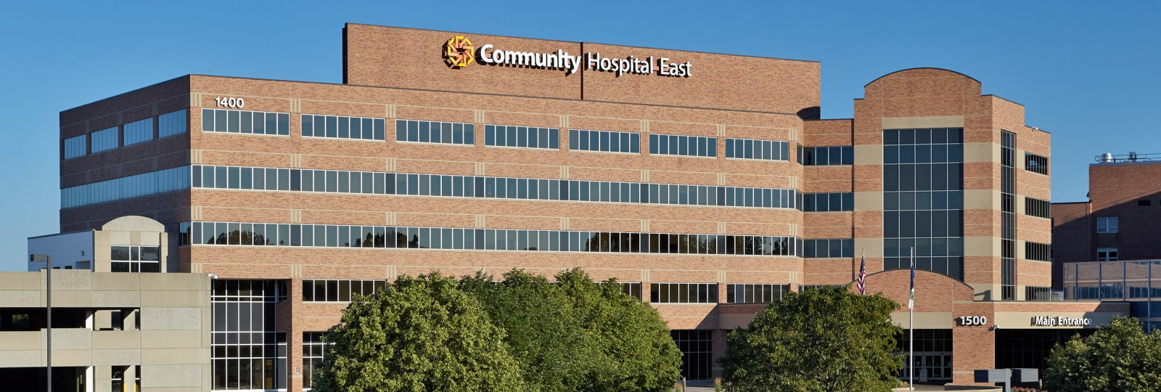
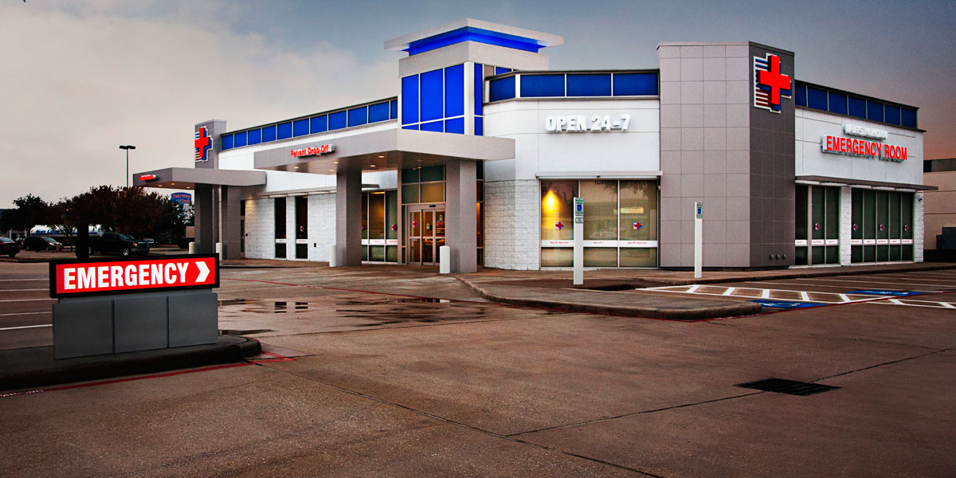
Faculty Salary
Practice setting
 | Clinical Hours | Total Salary
Academic | 969 | $330,650
Academic Affiliate | 1,144 | $339,409
Community | 1,314 | $332,667
Freestanding | 1,484 | $337,597

Slide 33
Compensation Plans

Slide 34

How do we pay our faculty?
Faculty Compensation Plans
Single component: 2.2%
Salary only
Three component: 54.2%
Base + Extra + Stipend
Base + Extra + Bonus = 83%
Base + Stipend + Bonus
Two component: 25.4%
Base + Extra hours
Base + Stipend
Base + Bonus = 73%
Four component: 18.2%
Base + Extra+ Stipend + Bonus

Slide 35
Salary Components
100%
Base
89%
Base
83%
Base
76%
Base
Chairs, Chiefs, pure Peds EM faculty excluded

Slide 36
Salary Components

Slide 37
APP Salary Survey
Fiscal Year 2022 Data

Slide 38


PA and NP Demographics
689 Advanced Practice Providers
  9.1 years post training
  65% Physician Assistant
  35% Nurse Practitioner
  70% Female
  30% Male

Slide 39

PA and NP Demographics
ED area worked
More than one area | 68%
Main ED only | 18%
Observation only | 7%
FT/Arrival/Triage | 7%
1,740 Total hours
$135,692 Total salary
68% PA and 32% NP
Minimal difference PA/NP
365 hour reduction for lead or administration
$22,000 difference between administrative role and none

Slide 40
PA and NP Salary
9.1%
7.5%

Slide 41
PA and NP Salary
No significant change in total hours worked
Pay rate changes with years of service

Slide 42
PA and NP Salary
Salary by Region
 | Total Salary | Total Hours | % PA
Midwest | $140,903 | 1718 | 71%
Northeast | $138,524 | 1822 | 82%
South | $129,954 | 1799 | 47%
West | $144,429 | 1714 | 57%
Same distribution with a very slight shift towards NP

Slide 43
Fellowship Survey
Fiscal Year 2022 Data
ED Benchmark Questionnaire
Fellow Salary Survey

Slide 44

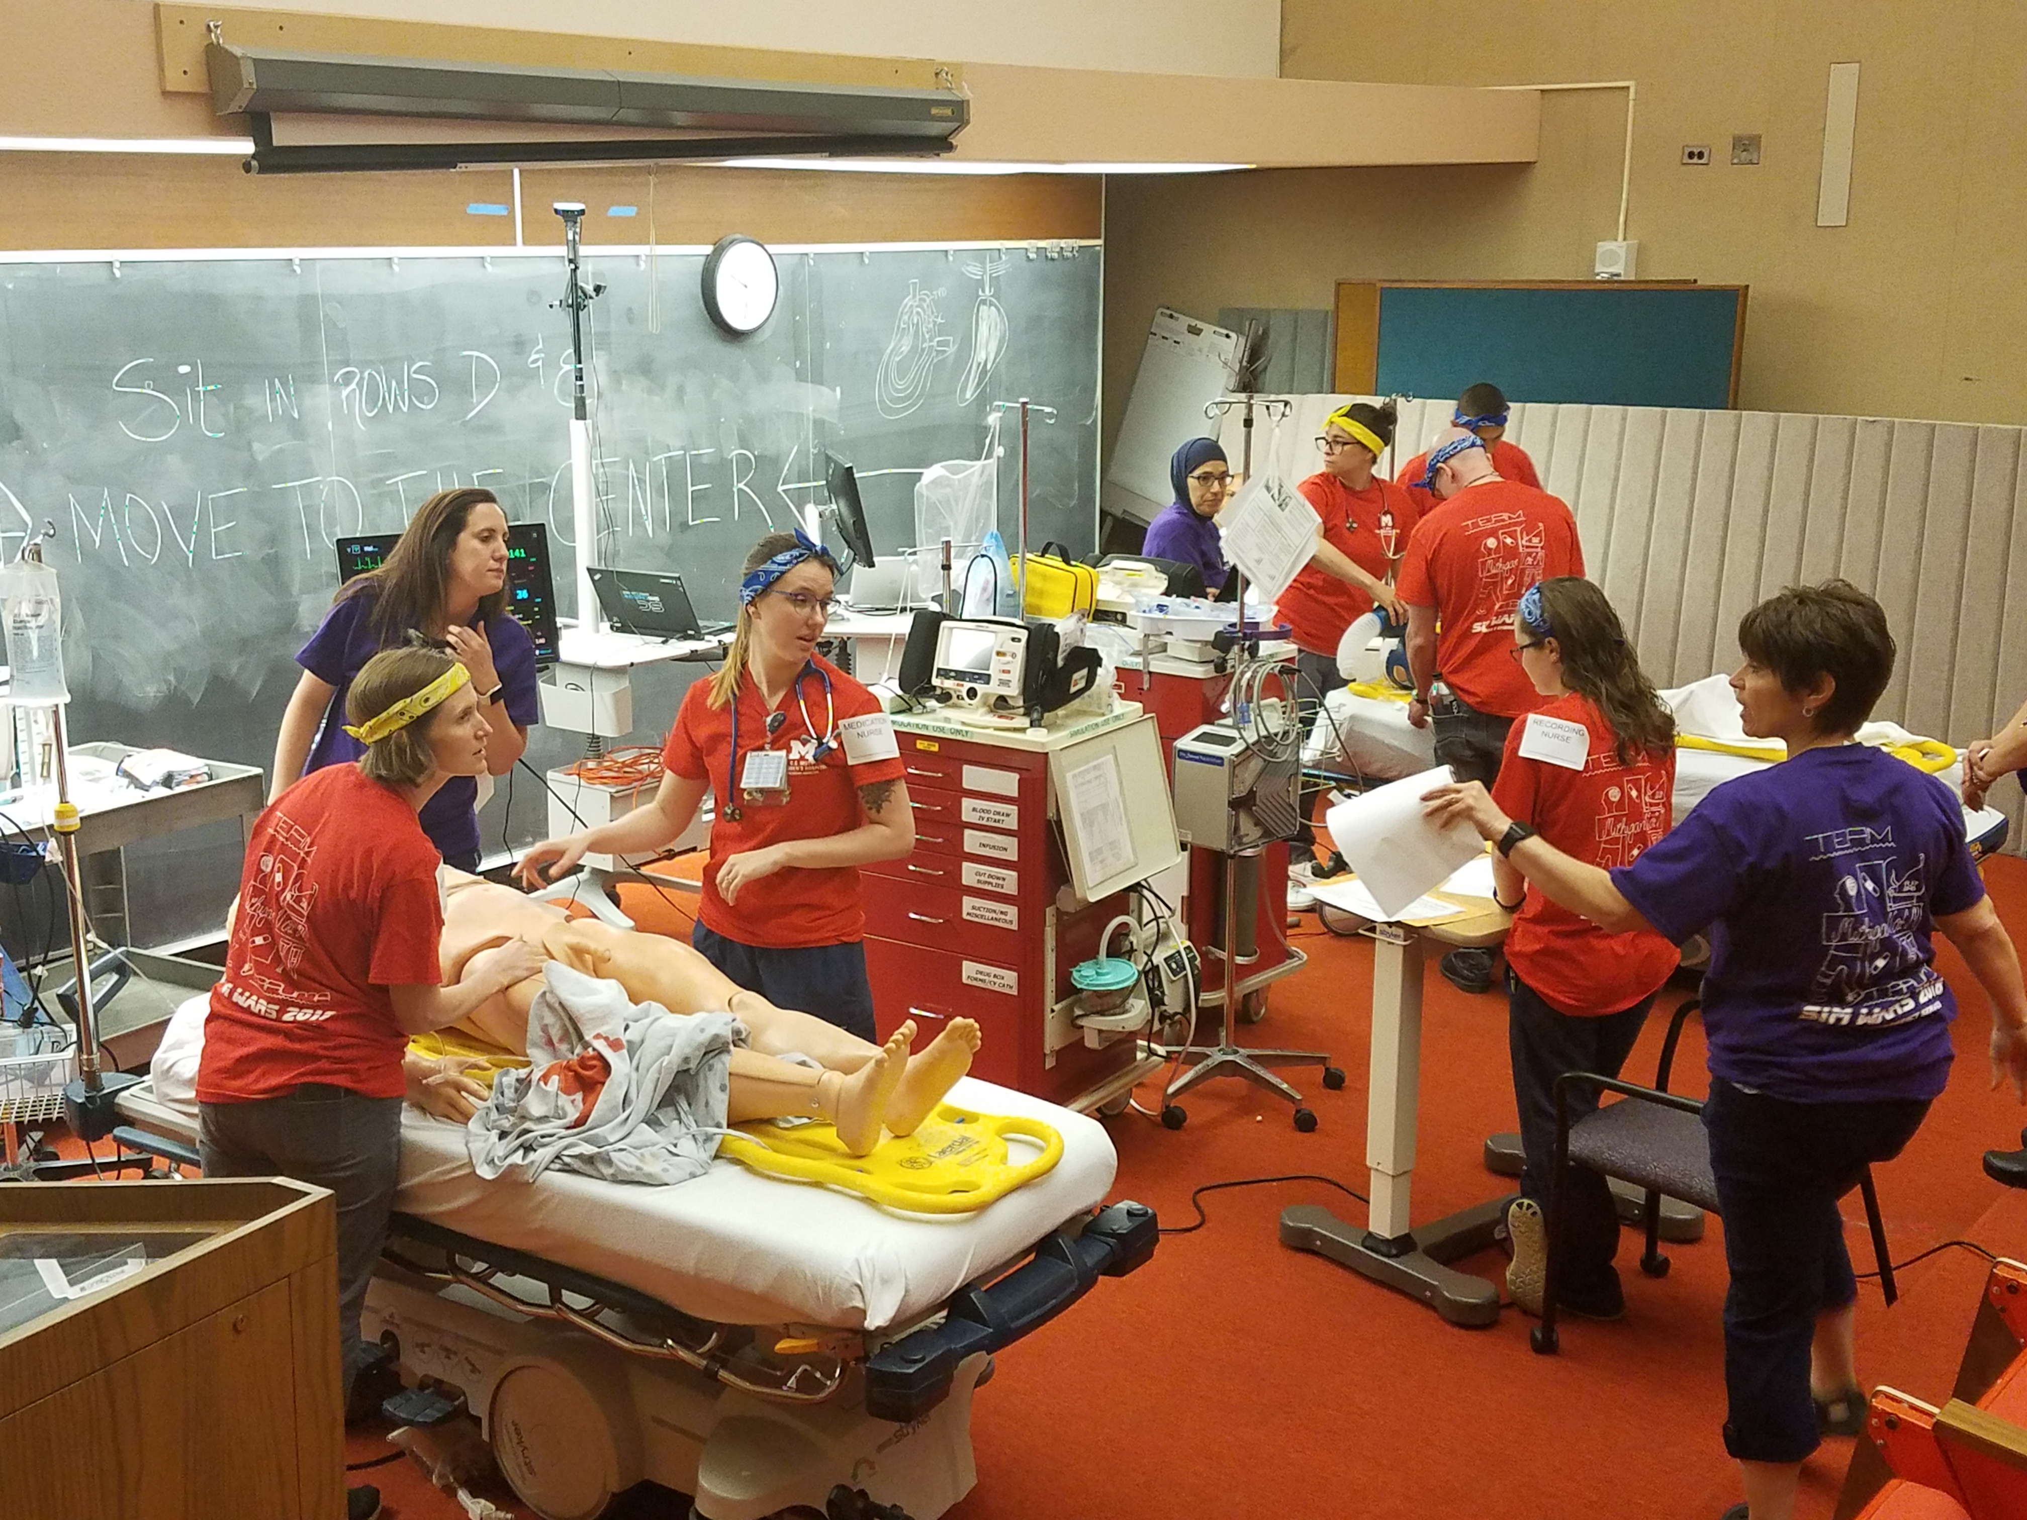
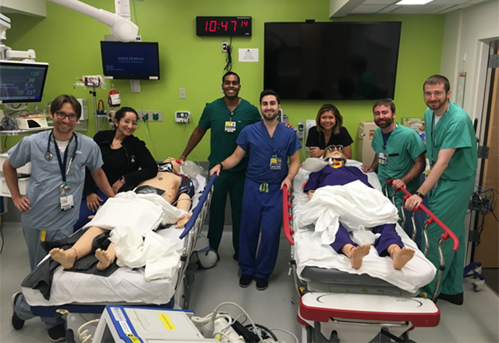
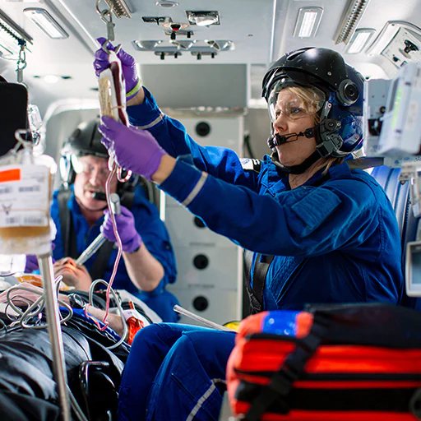
EM Fellowship Programs
Do you offer “this” fellowship program
If “yes” how many spots
If “yes” how many spots filled
41 Institutions responded
29 Fellowship programs
229 Available positions
76% Overall Fill Rate

Slide 45
EM Fellowship Programs
Fellowship | Filled | Spots | Fill Rate
Ultrasound | 40 | 46 | 87%
Emergency Medical Services | 23 | 27 | 85%
Medical Education | 17 | 23 | 74%
Administration | 10 | 18 | 56%
Toxicology | 14 | 18 | 78%
Global International | 10 | 15 | 67%
Pediatric Emergency Medicine | 13 | 14 | 93%
Research | 10 | 14 | 71%
Disaster Medicine | 4 | 7 | 57%
Simulation | 5 | 7 | 71%
Wilderness Medicine | 6 | 7 | 86%
Fellowship | Filled | Spots | Fill Rate
Clinical Research | 2 | 4 | 50%
Critical Care and Emergency Medicine | 2 | 4 | 50%
Medical Informatics | 3 | 4 | 75%
Sports Medicine | 3 | 3 | 100%
Faculty Development | 2 | 2 | 100%
Hyperbaric Medicine | 2 | 2 | 100%
Motorsports | 1 | 2 | 50%
Health Equity | 1 | 2 | 50%
Geriatric Emergency Medicine | 0 | 1
Health Policy | 0 | 1
Palliative Care | 1 | 1 | 100%
Fellowship | Filled | Spots | Fill Rate
Telemedicine | 1 | 1 | 100%
Pediatric Emergency Ultrasound | 1 | 1 | 100%
Tactical Emergency Medicine | 0 | 1
Oncology | 0 | 1
POCUS in in Resource Limited Settings | 0 | 1
Social Emergency Medicine | 1 | 1 | 100%
Population Health | 1 | 1 | 100%

Slide 46
EM Fellow Demographics
Salary Survey Data
218 Fellows
  65% 3 year residency
  35% 4 year residency
  48% Female
  52% Male
  73% Non-ACGME
  27% ACGME
  72% Instructor
  28% Non-faculty
  56% = 1 year program
  43% = 2 year program
  1% = 3 year program

Slide 47
EM Fellow Demographics
Non-ACGME (73%)
  Ultrasound 51
  Education 24
  Global/Int’l 21
  Administration 19
  Research 10
  Simulation 8
  Wilderness 6
  Other 20
ACGME (27%)
  EMS 28
  Toxicology 10
  Critical Care 7
  Sports Medicine 6
  Pediatrics 4
  Addiction 2
  Hyperbaric 1
  Informatics 1
159
59

Slide 48

EM Fellow Advanced Degrees
16 Fellows in programs that REQUIRE a degree
7% of all fellows reported
No reported ACGME programs REQUIRE a degree
10 Departments REQUIRE a degree (24%)
5 pay full cost of degree
4 pay partial cost of degree
1 does not pay for degree
1 Department provides a fixed amount of support
($25,000/year) for 2 years for a degree

Slide 49
EM Fellow Advanced Degrees
Non-ACGME
ACGME
Fellowship | Required | Optional | Sub-total | Optional | Total
Administration | 11 | 2 | 13 | -- | 13
Education | 2 | 12 | 14 | -- | 14
Emergency Medical Services | -- | -- | -- | 2 | 2
Global/International EM | 2 | 6 | 8 | 6 | 14
Research/Clinical Research | -- | 7 | 7 | 1 | 8
Simulation | -- | -- | -- | 1 | 1
Ultrasound | -- | 5 | 5 | -- | 5
Other | 1 | 4 | 5 | 1 | 6
Total | 16 | 36 | 52 | 11 | 63

Slide 50
EM Fellow Advanced Degrees
63 (29%) pursuing advanced degree
  Required: 16 Fellows ( 7.3%)
  Optional: 47 Fellows (21.6%)
  NA/None: 155 Fellows (71.1%)
Advanced Degree Type
  MPH $27,000
  MBA $45,000
  MEd $26,000
Department Support
  $31,000 Mean for all degrees overall
  $24,000 Mean for partial support
  $36,000 Mean for full support
  $24,000 Mean for optional degree
  $44,500 Mean for required degree
  $50,000 Grant program

Slide 51
EM Fellow Program Length
ACGME Fellowship Length
Non-ACGME Fellowship Length
 | One | Two | Three
EMS | 26 | 2 | 0
Sports Medicine | 6 | 0 | 0
Peds EM | 1 | 0 | 3
Hyperbaric | 1 | 0 | 0
Toxicology | 0 | 10 | 0
Informatics | 0 | 1 | 0
 | One | Two | Three
Ultrasound | 45 | 6 | 0
Education | 8 | 16 | 0
Global/Int’l | 5 | 16 | 0
Administration | 2 | 17 | 0
Research | 4 | 6 | 0
Simulation | 0 | 4 | 0
Wilderness | 6 | 0 | 0
Other* | 12 | 7 | 0
*Disaster, Sports, Faculty Development, Informatics, EMS, Neurology, CC

Slide 52
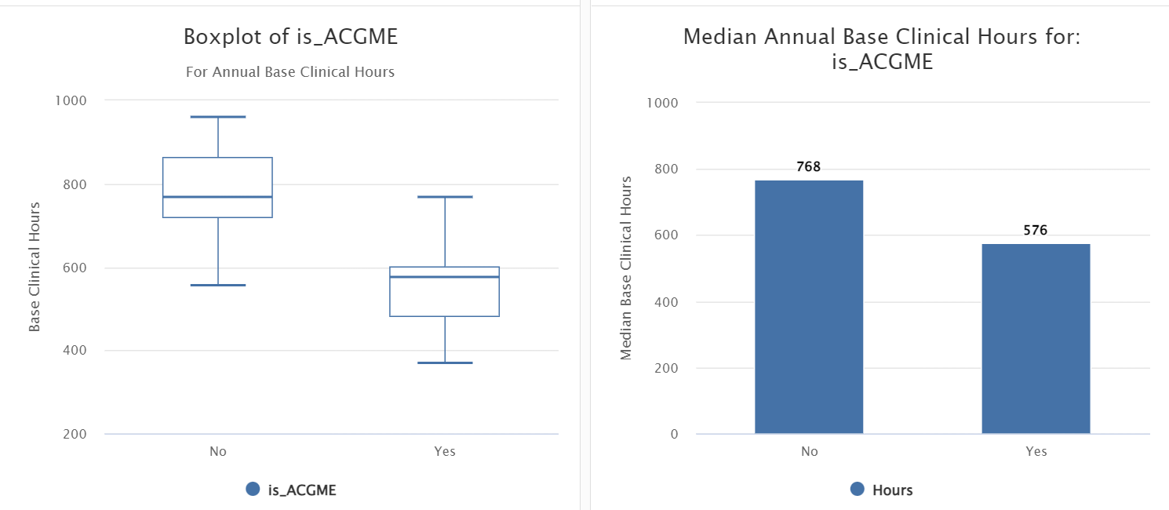
EM Fellow Clinical Hours
Relatively tight distribution of base clinical hours

Slide 53
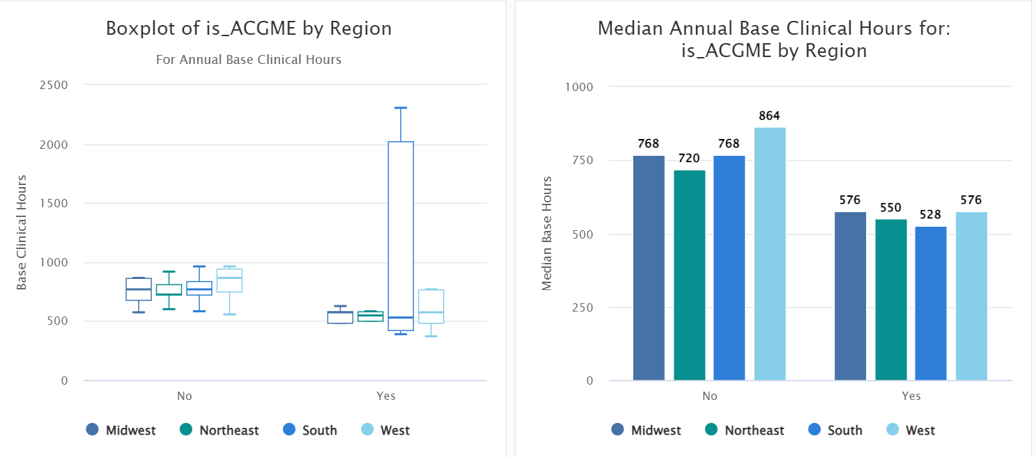
EM Fellow Clinical Hours
Consistency across regions

Slide 54
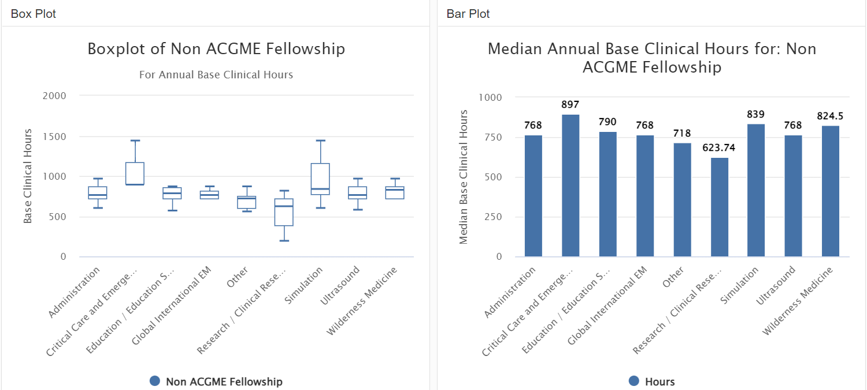
EM Fellow Clinical Hours
Consistency across NON-ACGME fellowship programs

Slide 55
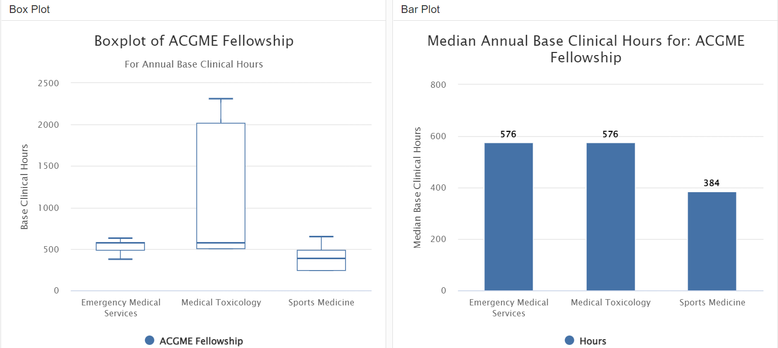
EM Fellow Clinical Hours
Consistency across ACGME fellowship programs

Slide 56
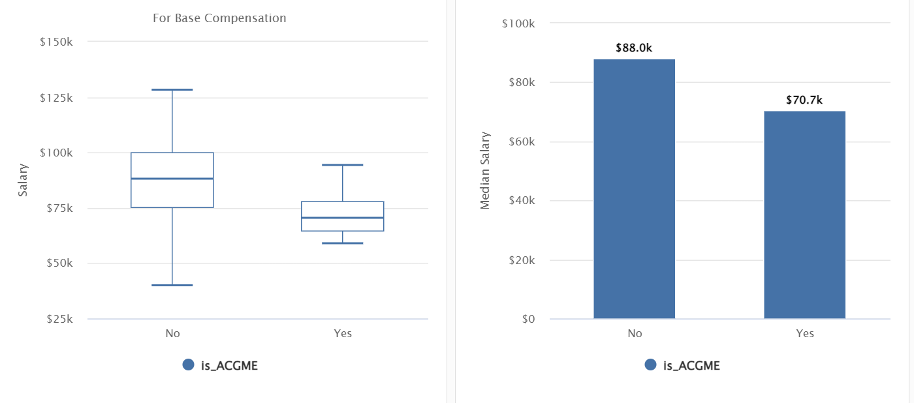
EM Fellow Compensation
Median Base Salary
Mean Base Salary ACGME: $77,418
Mean Base Salary Non-ACGME: $90,515

Slide 57
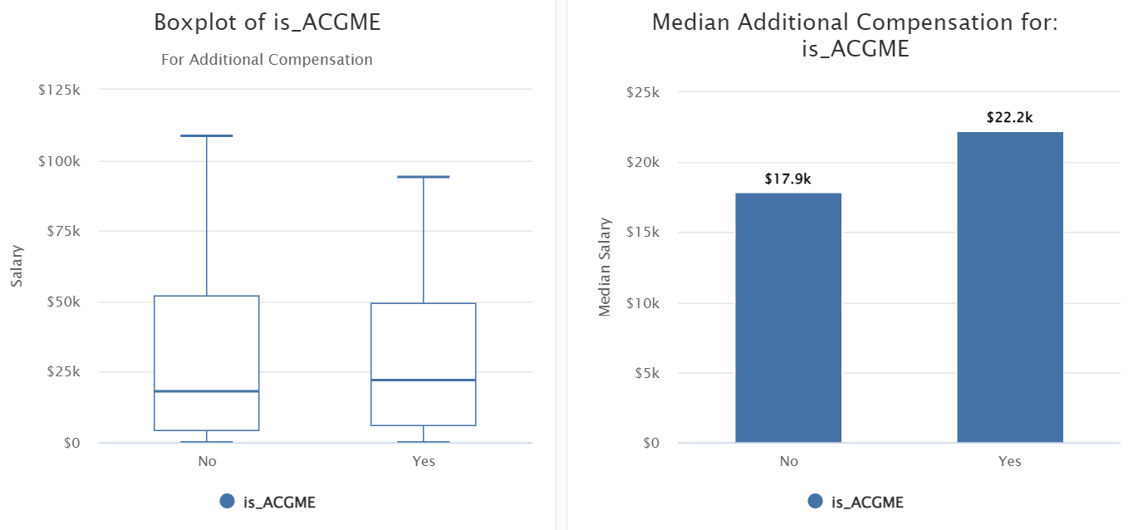
EM Fellow Compensation
Mean Additional ACGME: $30,135
Mean Additional Non-ACGME: $28,567

Slide 58
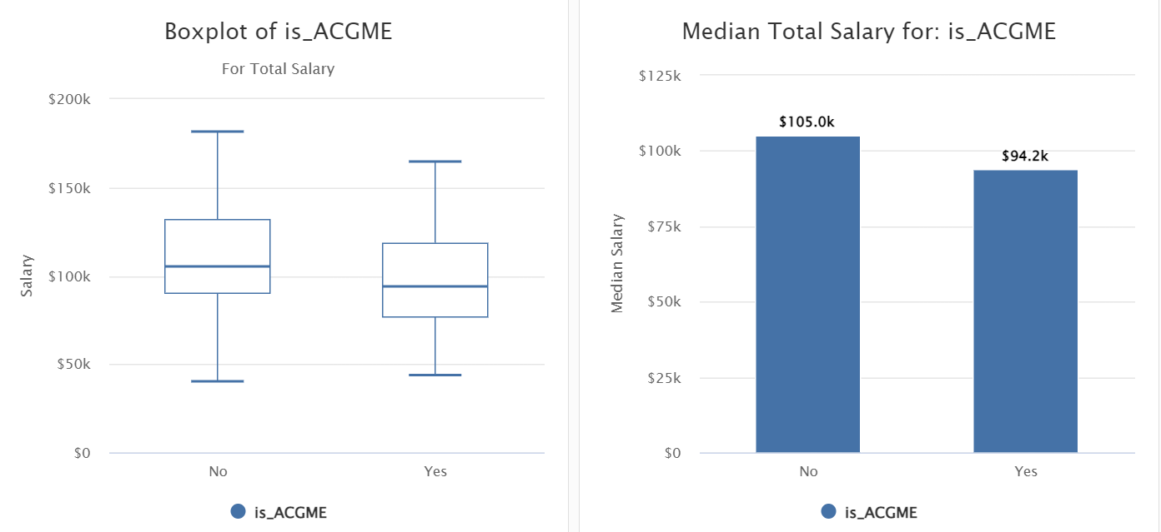
EM Fellow Compensation
Mean Total Salary ACGME: $102,767
Mean Total Salary Non-ACGME: $112,889

Slide 59
EM Fellow Compensation
 | ACGME PROGRAMS | NON-ACGME PROGRAMS
COSTS
Base Salary | $77,000 | $90,000
Base Salary + Benefits | $102,400 | $119,700
Degree Cost (Optional) | $36,000 | $36,000
Total cost WITH degree | $138,400 | $155,700
REVENUE
Total WRVU @ 6.1/hr | 3,514 | 4,685
Collections @ $46.35/RVU | $162,900 | $217,100
MARGIN
NO Degree | $60,400 | $97,400
WITH Degree | $24,400 | $61,400
May be additional
ancillary costs to
consider

Slide 60
Thanks
Let’s talk…

