Slide 1

Academy of Administrators in Academic Emergency Medicine
Operations and Research
Fiscal Year 2022
James Scheulen
Steve Maxwell
On behalf of the
AAAEM Benchmark Committee
March, 2023

Slide 2

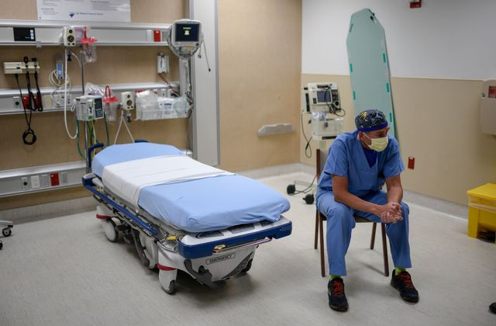

Survey Timeline
July
Aug
Sept
Oct
Nov
Dec
Jan
Feb
Mar
Apr
May
June
FY 2019
Normal
FY 2020
COVID
July
Aug
Sept
Oct
Nov
Dec
Jan
Feb
Mar
Apr
May
June
July
Aug
Sept
Oct
Nov
Dec
Jan
Feb
Mar
Apr
May
June
FY 2021
Recovery
July
Aug
Sept
Oct
Nov
Dec
Jan
Feb
Mar
Apr
May
June
FY 2022
New Normal

Slide 3
This year…
Benchmark & Salary:
  COVID survey update
  Complexity index next steps
  Research section development
  Fellow salary data
Data Insights Portal:
Research
Teaching
Patient Care
https://saem.roundtableanalytics.com/insights/

Slide 4


Benchmark Committee
Steve Maxwell
Becky McGowan
Ashlee Miller Melendez
Jennifer Muir
Steven Petrovic
Kain Robbins
Travis Schmitz
Jim Scheulen
Benjamin Sun
Gregory Volturo
Robert Eisenstein
Theodore Corbin
Gregory Archual (Chair)
Kathleen Acevedo
Antoinette Brooke
Louis Burton
David Calder
David Christiansen
Gai Cole
Jay Schuur
Amy Jameson
Kenny Lopiano
Alyssa Tyransky

Slide 5
Data Set: Demographics
Fiscal Year | 2018 | 2019 | 2020 | 2021 | 2022
Academic Hospital | 79 | 74 | 72 | 70 | 73
Academic Affiliated | 17 | 17 | 18 | 18 | 20
Academic/Affiliated | 96 | 91 | 90 | 88 | 93
Community | 33 | 34 | 28 | 34 | 40
Freestanding ED | 6 | 5 | 7 | 6 | 8
Adult Departments | 135 | 130 | 125 | 127 | 141
Pediatric ED | 25 | 24 | 18 | 20 | 20
Total ED Reports | 160 | 154 | 143 | 127 | 161

Slide 6
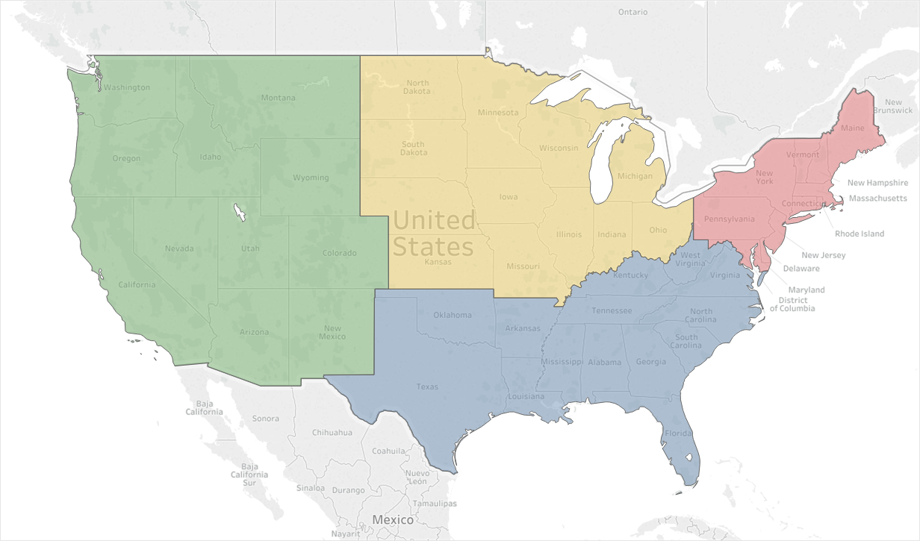
Data Set
Adult Academic and Affiliate Responses: 93
18
18
37
20
5,627,797 Emergency Visits
1,525,288 Hospitalizations
$639,438,518 Collected Revenue

Slide 7

Data Set: Demographics
55% Private
45% State
79% Level 1 Trauma
6% Level 2 or 3
Hospitals are operating 97%
of licensed beds
Turnover = 51 patients/bed
Last year = 52 patients/bed
45% Pediatric ED is physically separate
40% of departments staff the Peds ED

Slide 8

The Academic ED
Fiscal Year 2022 | Median
Hospital Beds | 655
Licensed ED Beds | 58
Total Bed Hours | 525,600
% Bed Hours to MAIN | 70%
ED Treat & D/C | 35,842
ED Admissions | 15,118
Hospital Observation | 2,867
Total Visits | 62,483
Hospitalized Rate (Calc) | 28.8
Unique visits | 66.8%
62,483 Visits
Range: 22,085 – 126,467
41,739 Unique visits

Slide 9
The Academic ED
 | 2019 Median | 2020 Median | 2021 Median | 2022 Median
Hospital Beds | 632 | 664 | 656 | 655
Licensed ED Beds | 52 | 59 | 58 | 58
Total Bed Hours | 495,670 | 520,689 | 534,360 | 525,600
% Bed Hours to MAIN | 70% | 67% | 68% | 70%
ED Treat & D/C | 42,244 | 38,875 | 35,748 | 35,842
ED Admissions | 14,702 | 14,258 | 14,831 | 15,118
Hospital Observation | 3,262 | 3,215 | 2,868 | 2,867
Hospitalized Patients | 17,964 | 17,473 | 17,699 | 17,985
Total Visits | 64,326 | 59,417 | 56,235 | 62,483
Hospitalized Rate (Calc) | 27.9% | 29.4% | 31.5% | 28.8%
Unique Visits (65%) | 65% | 65% | 66.4% | 66.8%

Slide 10
The Academic ED
 | 2019 Median | 2020 Median | 2021 Median | 2022 Median
Hospital Beds | 632 | 664 | 656 | 655
Licensed ED Beds | 52 | 59 | 58 | 58
Total Bed Hours | 495,670 | 520,689 | 534,360 | 525,600
% Bed Hours to MAIN | 70% | 67% | 68% | 70%
ED Treat & D/C | 42,244 | 38,875 | 35,235 | 35,842
ED Admissions | 14,702 | 14,258 | 14,831 | 15,118
Hospital Observation | 3,262 | 3,215 | 2,868 | 2,867
Hospitalized Patients | 17,964 | 17,473 | 17,699 | 17,985
Total Visits | 64,326 | 59,417 | 56,235 | 62,483
Hospitalized Rate (Calc) | 27.9% | 29.4% | 31.4% | 28.8%
Unique Visits (65%) | 65% | 65% | 66.4% | 66.8%

Slide 11
Patient Populations
 | 2019 Median | 2020 Median | 2021 Median | 2022 Median
Total | 64,326 | 59,417 | 56,235 | 62.483
EMS Arrivals | 18,005 | 15,876 | 16,515 | 18,333
EMS Percent | 26.2% | 25.9% | 28.1% | 27.6%
EMS Admit Rate | 42.9% | 42.6% | 45% | 41.3%
Behavioral Health | 5.5% | 4.9% | 5.0% | 5.0%
Patients > 65 Years | 20.7% | 21.0% | 21.5% | 21.6%
Pediatric Visits | 2.1% | 1.7% | 0.8% | 1.2%
Dedicated Pediatrics | 24,921 | 22,160 | 19,766 | 26,929

Slide 12
Patient Volume Trend: Median
Patient Volume Trend—All Responders FY 21

Slide 13
Left Before Treatment Complete
Where are the missing patients?
Hours
Mean

Slide 14
Left Before Treatment Complete
Where are the missing patients?
Hours
Mean

Slide 15
Left Before Treatment Complete
Where are the missing patients?
Hours
Mean

Slide 16
Left Before Treatment Complete
Where are the missing patients?
50% > 8.5%
As high as 21%
5,311
Patients
Hours
Mean

Slide 17
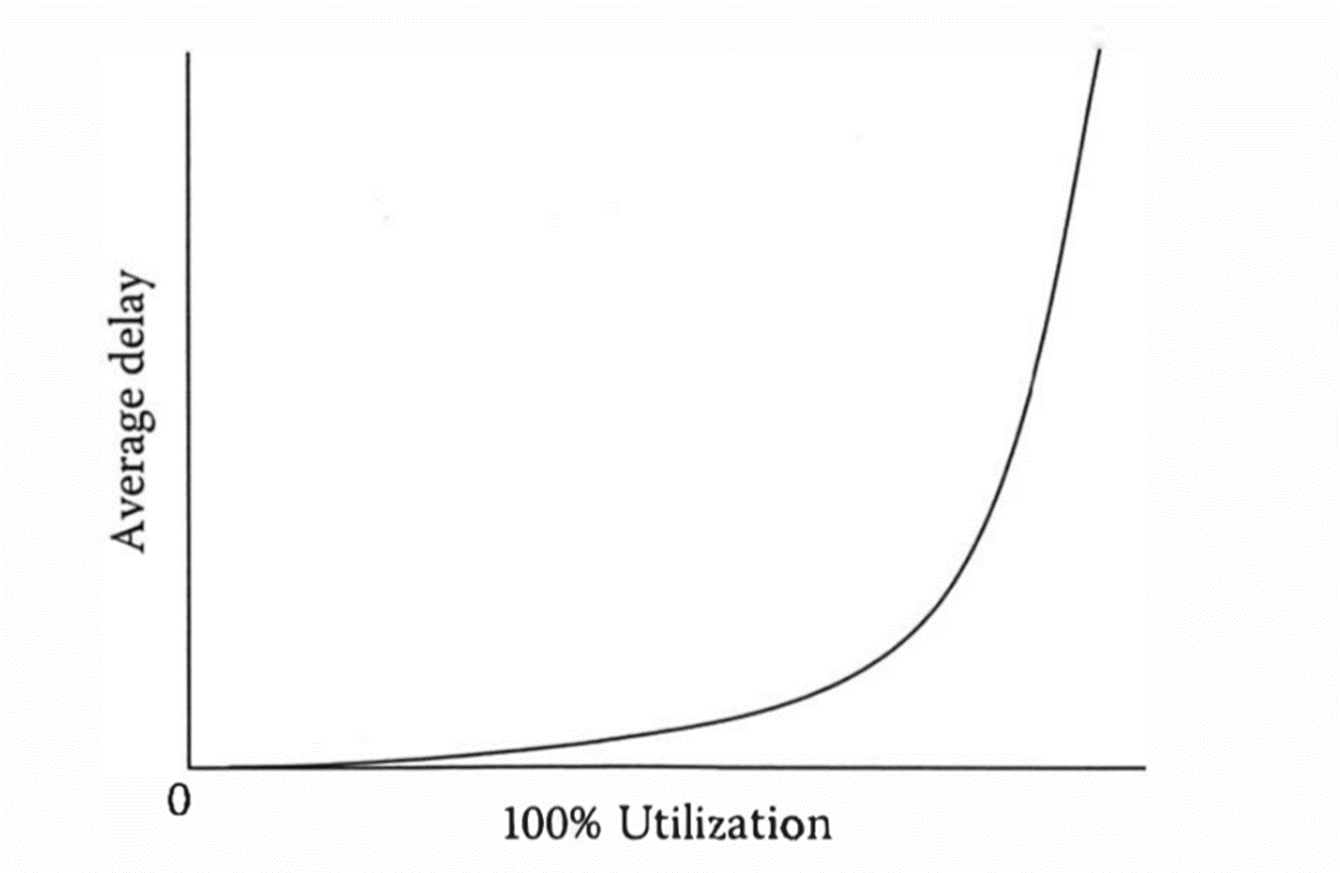

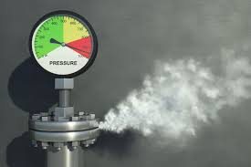

Slide 18
Drivers of Operations
Volume
Time
Increase
Increase
Space
Minimal inpatient change
18

Slide 19
Hospitalization Data

Slide 20
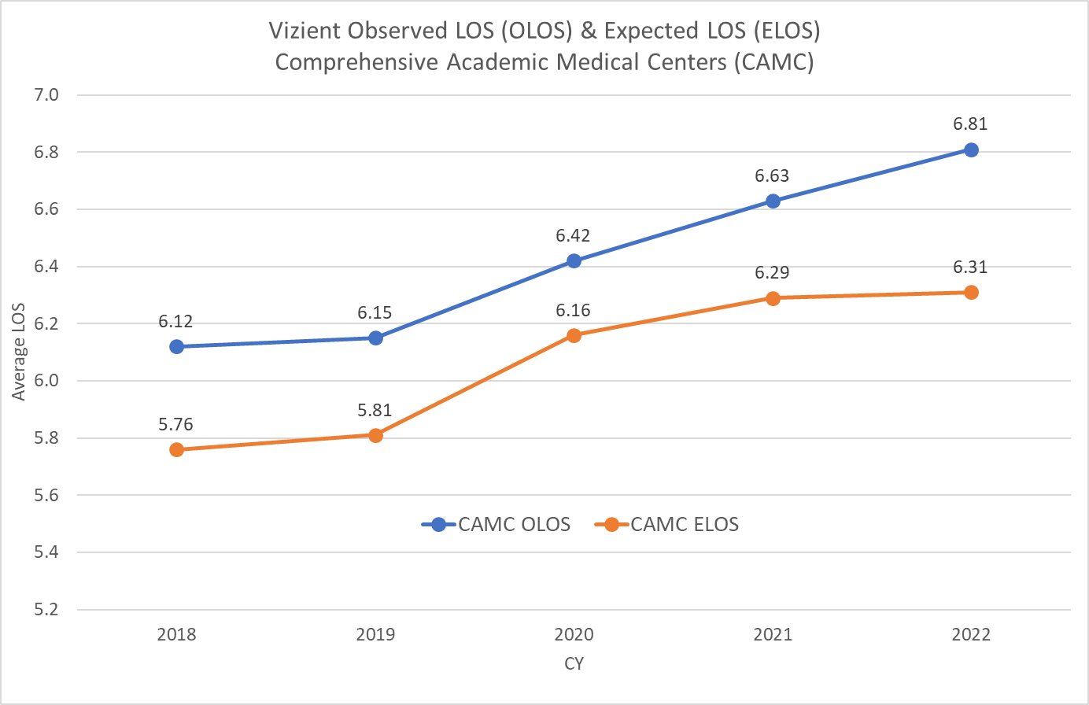
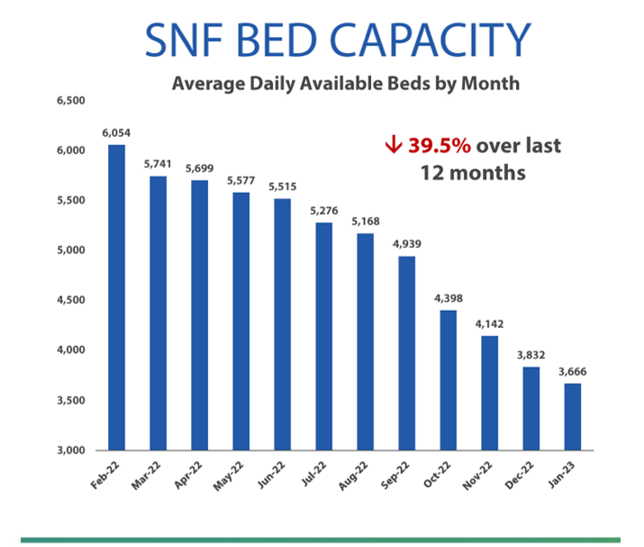
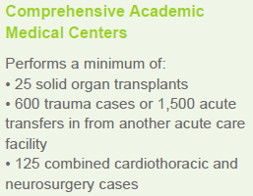
Hospitalization Data
Source: Vizient Clinical Database (CDB)
Notes: Outliers included; Normal newborns excluded; ‘CAMC’ cohort is pre-defined each year by Vizient and comprises 109 CAMCs

Slide 21
Hospitalization Data
Increased Inpatient Volume + Increased LOS = Increased Occupancy
Increased Boarding

Slide 22
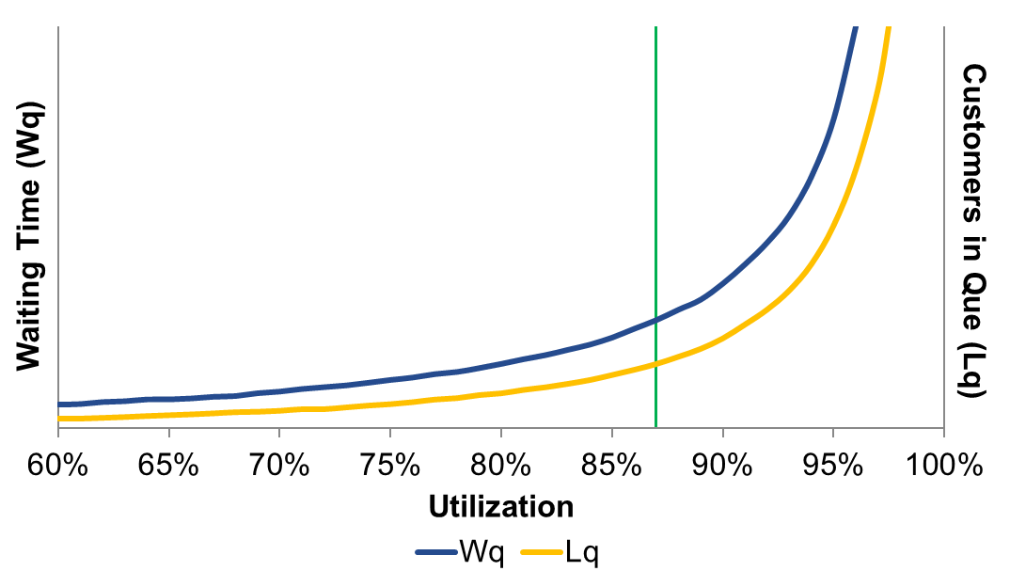
Drivers of Operations
Volume
Time
+1049
patients
+.66
days
Space
Additional .66 patient days applied to 31,906
Hospitalized patients = 58 additional inpatient beds
22

Slide 23
LOS Trend: Median LOS
Median Emergency Department Length of Stay
Hours
Median times represented here
Mean times are longer
Distribution with a long right tail

Slide 24
LOS Trend: Bed to Decision Time
Median “Main” Bed to Decision Time: Admit vs D/C
Hours

Slide 25


Value Added Time
Discharged Patients
Admitted Patients
Total LOS | Bed to Decision | Other | Value Time % |  | Total LOS | Bed to Decision | Other | Value Time %
4.6 | 3.1 | 1.5 | 67% | Academic | 10.4 | 3.7 | 6.7 | 36%
3.2 | 2.6 | 0.7 | 81% | Community | 6.3 | 3.1 | 3.2 | 49%
2.8 | 2.3 | 0.5 | 82% | Freestanding | 9.0 | 2.3 | 6.7 | 26%
3.0 | 2.1 | 0.9 | 70% | Pediatrics | 6.4 | 3.0 | 3.4 | 47%

Slide 26
Value Added Time
Arrival to Provider same
Similar decision time
Increased Boarding

Slide 27
Boarding Time
Mean and Median Boarding Time
Hours
The Boarding “Tail” continues to grow

Slide 28
Boarding Time
Total Boarding Hours
14.4 beds fully
dedicated to
Inpatient care
13 beds fully
dedicated to
Inpatient care
Hours
10 beds fully
dedicated to
Inpatient care
9 beds fully
dedicated to
Inpatient care

Slide 29
Boarding Distribution
FY 2015 vs FY 2022
Percent of Patients
Boarding Hours

Slide 30
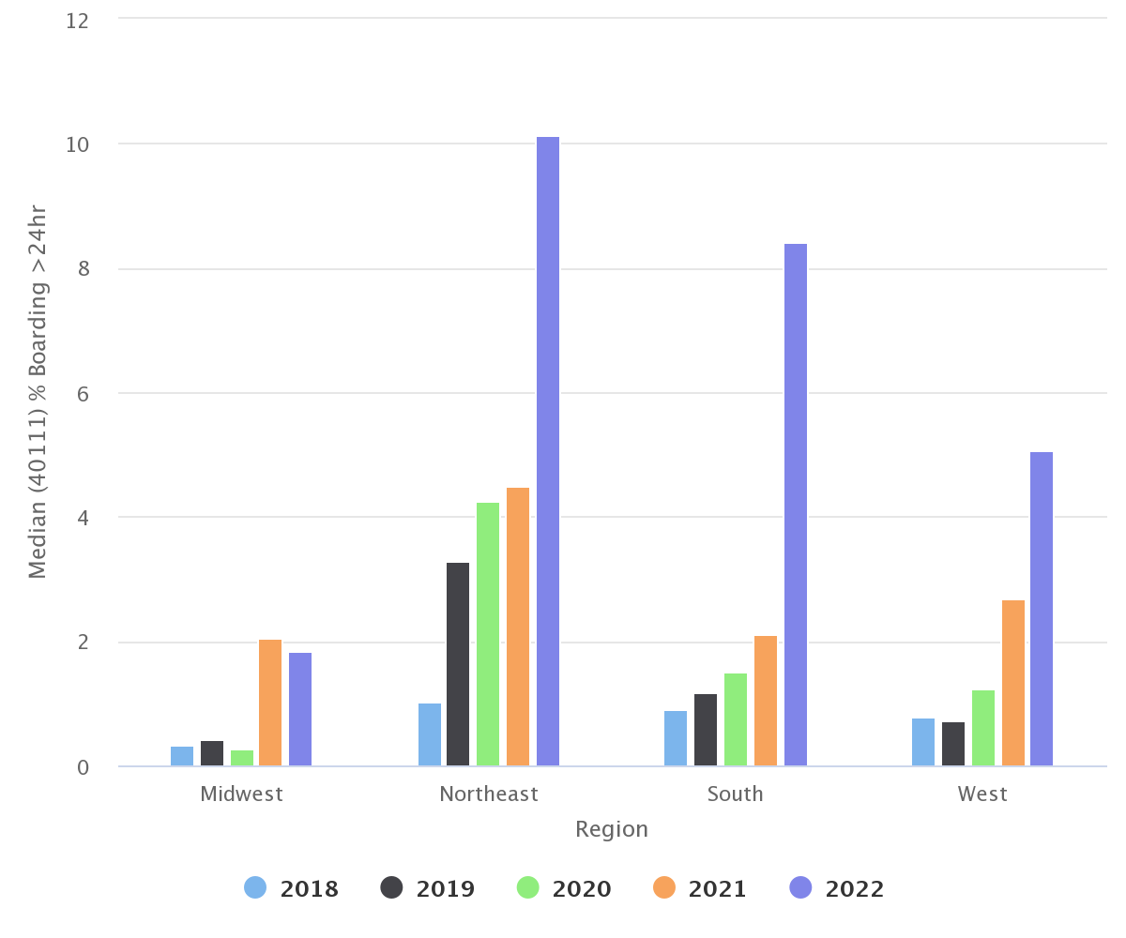
Boarding Distribution
MEDIAN % of patients boarding MORE THAN 24 HOURS
Percent of Patients
Boarding Hours

Slide 31
Ancillary Resource Utilization
Resource | FY 18 | FY 19 | FY 20 | FY 21 | FY 22
CT Utilization | 23.3% | 25.5% | 28.3% | 31.3% | 30%
MRI Utilization | 2.1% | 2.7% | 2.8% | 2.8% | 2.9%
Plain Film (% visits) | 40.3% | 40.2% | 43.0% | 44% | 42%
Laboratory (% visits) | 68.3% | 69.6% | 70.5% | 72.2% | 72%
EKG (% visits) |  | 33% | 36% | 40% | 38%
U/S (Radiology) | 6.3% | 7.9% | 6.9% | 7.6% | 7.8%
Consult & D/C | 6.8% | 7.0% | 7.5% | 8.5% | 9.4%
MRI Turnaround | 4.0 Hr | 4.0 hr | 4.3 hr | 5.1 hr | 5.3 hr
MEAN MRI Turnaround = 9.5 hours (Increased by 1 hour)

Slide 32
Academic vs Others
 | Arrivals | Unique Visits | ED Beds | Pts Per Bed | Hospitalized Rate | ED Index
Academic | 62,483 | 67.1% | 58 | 1056 | 28.8% | .697
Community | 29,239 | 69.5% | 20 | 1422 | 16.1% | .378
Freestanding | 28,578 | 69.6% | 18 | 1573 | 10.2% | .193
Pediatrics | 26,929 | 70.2% | 20 | 1346 | 13.9% | .192

Slide 33
Complexity Metrics: Sicker patients?

Slide 34
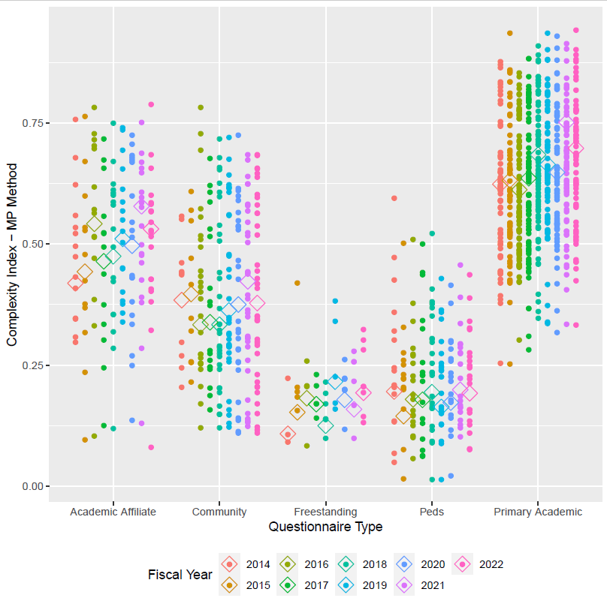
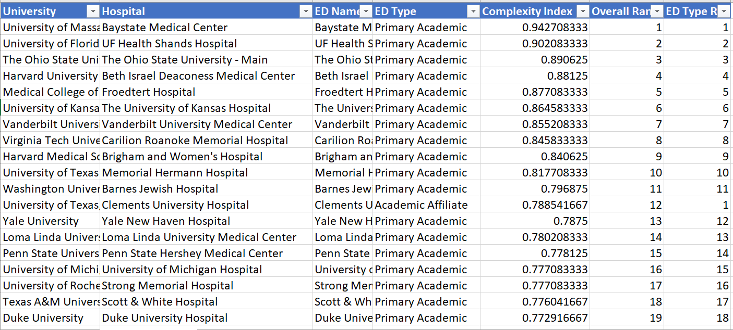
Operations Based Complexity Index
Hospitalization rate
EMS Arrivals
EMS Admissions
High Acuity Codes
Acuity 1&2
.697
.531
.378
.193
.192
Notes:
There are 2 options we can pursue.
Looking at acuity as a stand-alone concept for our patient population where we seek to quantify and contrast how sick our patients are. High acuity patients are more likely than low acuity patients to die, require surgery, or be medically admitted. Question: is your average behavioral health patient high or low acuity?
The other option is to expand this concept and incorporate additional factors that serve as indicators of how complex it is to clinically and operationally manage these patients. This option isn’t just about how sick the patients are but how resource intensive they are and how much pressure the place on the internal system of the ED.

Slide 35



Patient Based Complexity Index
Collaboration with Vizient
  Membership PI Organization
  Most AMCs
  Clinical Data Base from members
Patient Based Complexity Index
  Patient level data
  Encounter specific metrics
    Demographics (Age)
    Presentations
    Diagnoses
    Co-morbidities
    Social Determinants of Health
  Impact on Throughput
Heather Blonsky
Jaie
Lavoie
Notes:
There are 2 options we can pursue.
Looking at acuity as a stand-alone concept for our patient population where we seek to quantify and contrast how sick our patients are. High acuity patients are more likely than low acuity patients to die, require surgery, or be medically admitted. Question: is your average behavioral health patient high or low acuity?
The other option is to expand this concept and incorporate additional factors that serve as indicators of how complex it is to clinically and operationally manage these patients. This option isn’t just about how sick the patients are but how resource intensive they are and how much pressure the place on the internal system of the ED.

Slide 36


Patient Based Complexity Index
Quantify differences in the complexity of cases seen in different EDs or one ED over time
  Provide context to understanding variables impacting throughput
    Patient Clinical Complexity
    Social Needs
    Variability (Operations)
Hypothesis:
  An emergency department that sees patients with more clinical needs and patients with more social needs will have longer throughput times,
Notes:
There are 2 options we can pursue.
Looking at acuity as a stand-alone concept for our patient population where we seek to quantify and contrast how sick our patients are. High acuity patients are more likely than low acuity patients to die, require surgery, or be medically admitted. Question: is your average behavioral health patient high or low acuity?
The other option is to expand this concept and incorporate additional factors that serve as indicators of how complex it is to clinically and operationally manage these patients. This option isn’t just about how sick the patients are but how resource intensive they are and how much pressure the place on the internal system of the ED.

Slide 37
Initial data set:
Vizient Clinical Data Base
280 patient level variables
Patient Based Complexity Index
Principal Component Analysis
Streamlined variables
On this day in this ED….
Encounter Types
Hospital Cohort
Patient Age
Admission/Transfer
Diagnoses and procedures
Current and past comorbidities
Past ED utilization
Procedures done in the ED
Neighborhood factors
  Vizient Vulnerability Index
Over 65 or with 4 co-morbidities
Current diagnoses
  Psychosis
  Alcohol and/or drugs/depression
  Trauma
Transfers into or out of ED
7 day returns
COVID (impacts variability)
High Volume and Variability
Patients from neighborhoods with high social needs (transportation domain)
Notes:
There are 2 options we can pursue.

Slide 38
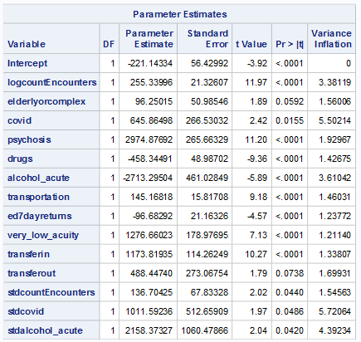
Patient Based Complexity Index
Monthly averages of core measures outcomes
provide a good fit (r² = 0.37)
    More patients
    More patients with psychosis
    More elderly or complex patients
    More patients transferred from another hospital
    More patients with covid
    More patients transferred to another acute care hospital
    Patients from neighborhoods with high social needs (transportation domain)
    Reduced time: more patients with drugs or alcohol diagnoses, more patients with a history of 7-day returns to the ED
Note: Initial results using a small number of data points. Fit significantly higher with larger data set
Notes:
There are 2 options we can pursue.
Looking at acuity as a stand-alone concept for our patient population where we seek to quantify and contrast how sick our patients are. High acuity patients are more likely than low acuity patients to die, require surgery, or be medically admitted. Question: is your average behavioral health patient high or low acuity?
The other option is to expand this concept and incorporate additional factors that serve as indicators of how complex it is to clinically and operationally manage these patients. This option isn’t just about how sick the patients are but how resource intensive they are and how much pressure the place on the internal system of the ED.

Slide 39
Patient Based Complexity Index
Hospitals with any core measures data in 2019, 2020, or 2021 shows:
  Higher complexity for AMCs than for any other cohort
  Highest complexity within any one cohort tends to match complexity that serve highly vulnerable neighborhoods (rural south, safety net hospitals, large urban hospitals)
Academic Affiliate Community Community
Notes:
There are 2 options we can pursue.
Looking at acuity as a stand-alone concept for our patient population where we seek to quantify and contrast how sick our patients are. High acuity patients are more likely than low acuity patients to die, require surgery, or be medically admitted. Question: is your average behavioral health patient high or low acuity?
The other option is to expand this concept and incorporate additional factors that serve as indicators of how complex it is to clinically and operationally manage these patients. This option isn’t just about how sick the patients are but how resource intensive they are and how much pressure the place on the internal system of the ED.

Slide 40
Patient Based Complexity Index
Hospital A
(LSMC)
Hospital B
(AMC)
AMCs have high variability/volume
Hospital C
(Community)
Hospital D
(Community)
Notes:
There are 2 options we can pursue.
Looking at acuity as a stand-alone concept for our patient population where we seek to quantify and contrast how sick our patients are. High acuity patients are more likely than low acuity patients to die, require surgery, or be medically admitted. Question: is your average behavioral health patient high or low acuity?
The other option is to expand this concept and incorporate additional factors that serve as indicators of how complex it is to clinically and operationally manage these patients. This option isn’t just about how sick the patients are but how resource intensive they are and how much pressure the place on the internal system of the ED.

Slide 41
Summary of overall ED Complexity:
Patient Based Complexity Index
Higher complexity EDs are those that serve:
    A large number of patients
    A high proportion of patients with psychiatric issues (Psychosis)
    A high proportion of elderly and complex patients (more than 4 comorbidities)
    Patients transferred to or from other hospitals
    Patients from neighborhoods with high social needs (transportation domain: marker of high poverty areas)
    COVID rates add to the month-by-month variation
Notes:
There are 2 options we can pursue.
Looking at acuity as a stand-alone concept for our patient population where we seek to quantify and contrast how sick our patients are. High acuity patients are more likely than low acuity patients to die, require surgery, or be medically admitted. Question: is your average behavioral health patient high or low acuity?
The other option is to expand this concept and incorporate additional factors that serve as indicators of how complex it is to clinically and operationally manage these patients. This option isn’t just about how sick the patients are but how resource intensive they are and how much pressure the place on the internal system of the ED.

Slide 42
Next Steps:
Patient Based Complexity Index
Consider other outcome variables
  Length of stay with more precision
  Other outcomes
Identify sources for outcome variable data
  Vizient member database vs Other
Further quantify the value: Develop “the number”
Notes:
There are 2 options we can pursue.
Looking at acuity as a stand-alone concept for our patient population where we seek to quantify and contrast how sick our patients are. High acuity patients are more likely than low acuity patients to die, require surgery, or be medically admitted. Question: is your average behavioral health patient high or low acuity?
The other option is to expand this concept and incorporate additional factors that serve as indicators of how complex it is to clinically and operationally manage these patients. This option isn’t just about how sick the patients are but how resource intensive they are and how much pressure the place on the internal system of the ED.

Slide 43
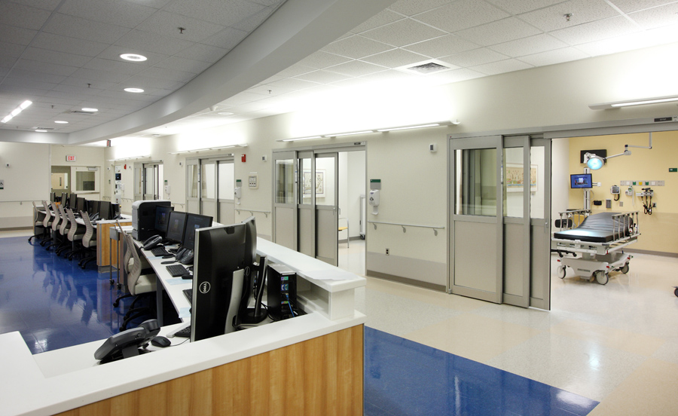




Nursing and Support Hours
 | Median Budgeted Hours | Median Worked Hours | Percent Worked Hours
Nursing | 200,949 | 175,342 | 87.1%
Support | 94,443 | 76,485 | 80.8%
 | % Yes | Weekday | Weekend
Case Management | 90% | 16 | 12
Social Work | 91% | 24 | 24
Pharmacist | 96% | 16 | 16

Slide 44
Academic Emergency Medicine
Tripartite Mission
Research
Teaching
Patient Care

Slide 45


Research – Where have we been
Emergency Medicine Grant Activity FY 22
  Institutions reporting Active Grants: 40
  Institutions reporting Active NIH Grants: 37
Notes:
Number of institutions have trend in decline over five years from 55 to 49 to 42 to 48 to 45 to 40
NIH decline follows similar 44 to 43 to 37 to 41 to 37 stayed at 37

Slide 46
Submissions and Awards
Reported Grant Submissions and Awards
 | FY 14 | FY 15 | FY 16 | FY 17 | FY 18 | FY18 | FY20 | FY21 | FY22
Number Submitted | 784 | 733 | 1,026 | 915 | 782 | 938 | 1,158 | 892 | 758
Awarded from Submissions | 336 | 342 | 507 | 373 | 334 | 350 | 356 | 283 | 296
Conversion Rate | 42.9% | 46.7% | 49.4% | 40.7% | 47.6% | 37.4% | 44.3% | 38.4% | 39.1%
Awarded from submissions is a calculation based upon a subset of institutions that reported conversion rate and
number of the grants submitted.
Notes:
Awarded from submissions is calculation based on submitted grants and the conversion rate for those that reported conversions

Slide 47
Grant Spending
Notes:
NIH other down $18M
Additional $3M decline in industry
Those declines offset by
NIH K and R down
Foundations and industry are down relative to FY20 but more consistent with prior year spending / awards
NIH awards as a percentage of total awards runs between 30% and 33% - FY21 is 32.8%
NIH spend as a percentage of total spend ran around 46% until covid and increased to 50% last year and 52% this year

Slide 48
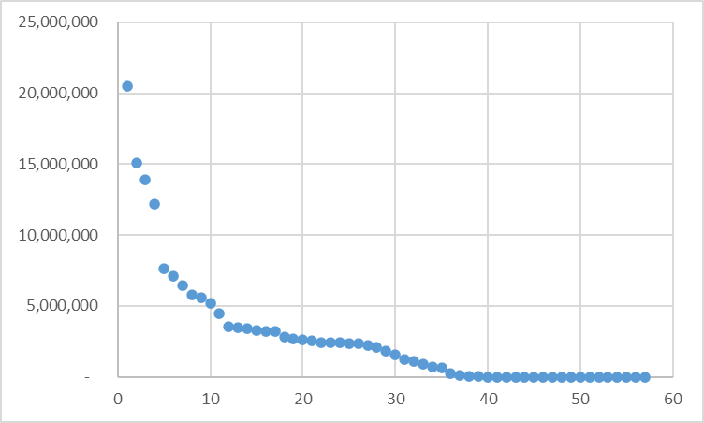
Total spending by institution
Total Grant Spending
Reporting Institutions
Notes:
Number of institutions >$5M consistent year over year, but those institutions with higher spending increased spending at higher rate than overall survey
Increase in spend for institutions 35 to 40. also 10 to 20 and 20 to 30 higher spend year over year

Slide 49
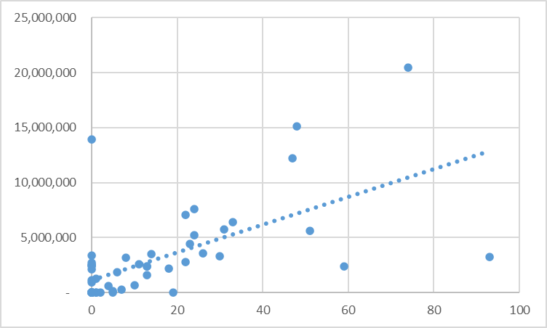
Grants submitted to total spending
Total Grant Spending
Number of Grants Submitted
Notes:
Correlation between the number of grants submitted and the total spending. Could be more spending leads to submitting more grants or submitting more grants leads to more research spending.
Number of submissions going up – increase from 4 to 6 instutitutions with >40 grants submitted.

Slide 50
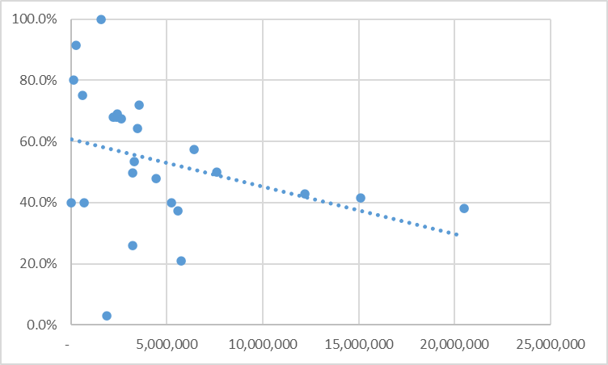
Grant success rate to total spending
Grant Success Rate
Total Grant Spending
Notes:
We looked at grant success rate by rank, by size of spending, number of grants submitted, all the data seems to indicate an approximate success rate of about 40% and does not appear to be dependent on any variable, ie the institutions with high submisssions and by rank all seem to have approximately the same success rate, this is consistent over a couple years.

Slide 51
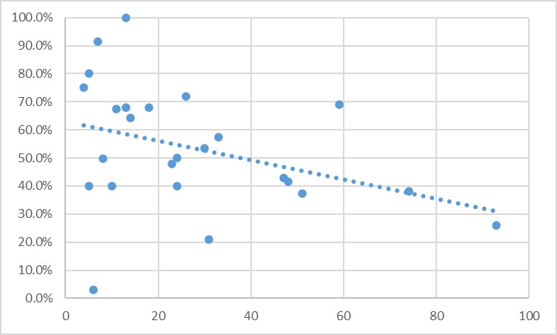
Grant success rate to grants submitted
Grant Success Rate
Number of Grants Submitted
Notes:
Success rate was typically around 40% for all, will be interesting to see if the two higher sites go back up

Slide 52
Grants compared to PI’s
Number of faculty doing research
Number of Active Grants
Notes:
Same sloped line when doing tenured faculty vs any faculty but smaller sample size

Slide 53
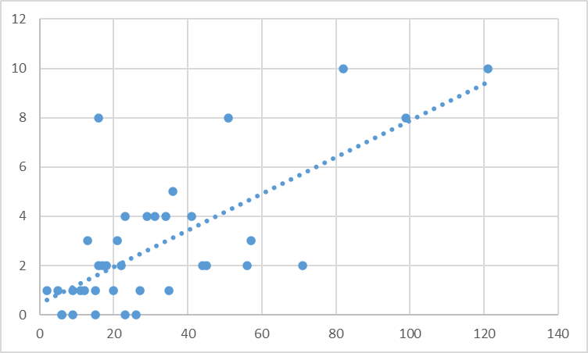
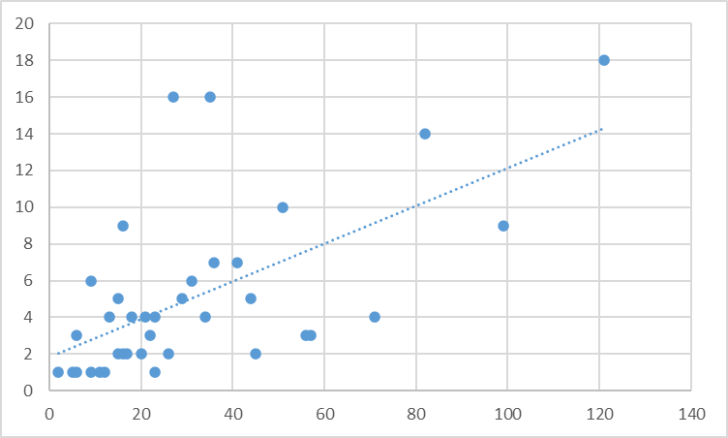
Number of Active Grants compared to MD/PhD’s and PhD’s in department
Number of MD/PhD’s & PhD’s
Number of PhD’s
Number of Active Grants
Number of Active Grants
Notes:
There does seem to be some correlation between number of active grants and the number of PhD’s. Slope of the line same as last year but some movement from 0 phd to 1 and 2
Md/phd is steeper slope – 1 additional >60 same 40 to 60

Slide 54
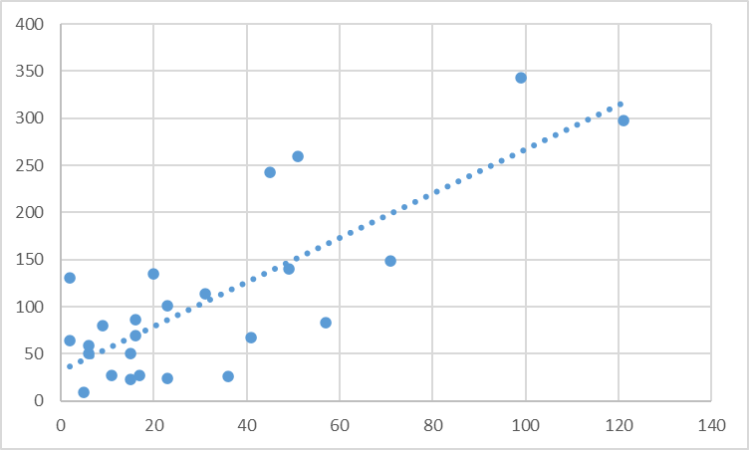
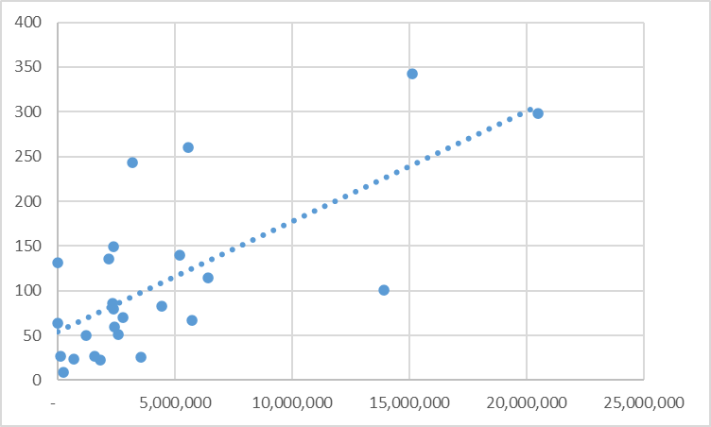
Peer Reviewed publications and annual research grants and spending
Total Publications
Total Publications
Number of Active Grants
Total Grant Spending
Notes:
Amount of the grants does not seem to impact the number of publications – more grants is same slope as funding

Slide 55
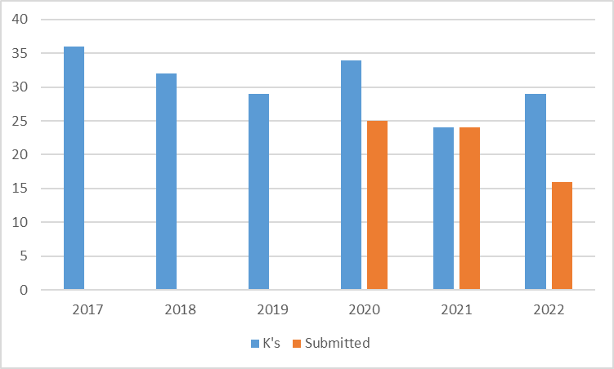
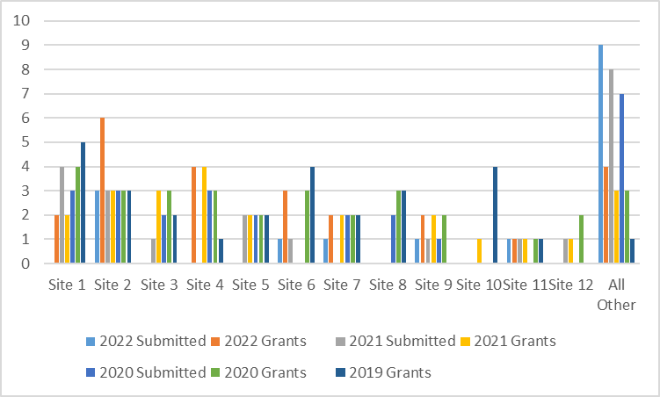
Use of Funds to support K awards
Institutions reporting K’s consistent over past three years. (16,14,15)
Institutions submitting new K’s consistent over past three years.
Only 3 institutions without active K’s submitted new K which is less than prior year (7)
Number of K awards
Other sites have three year trend of increasing K award applications.
Number of K awards
Notes:
The graphs show institutions that had active K awards or submitted K awards this year. There are 7 institutions that currently do not have K awards and of those 16 institutions that do have K’s, 10 submitted new awards.

Slide 56
Thank You

