Slide 1
AAAEM Guidelines to Listserv Usage and File Management

Slide 2
AAAEM Listserv Guidelines
1. Include a descriptive subject line to prevent erroneous email filtration.
2. If the response to the discussion question will be of interest to the entire group, reply to the listserv address.
3. Personal replies should be directed to specific individual not the entire listserv.
Cut and paste the sender’s e-mail address when replying for personal response. Do not simply hit the “Reply” button. Examples of personal replies: Thanks.’, 'Yes.' or ‘No’, 'I would also.’, 'I would like more information. Could you e-mail me directly?’, 'Welcome!’ and ‘Best of luck with your retirement.’
4. If you receive a notice that your original e-mail was 'rejected' or you received a 'delivery error', find out the reason for the rejection before resending the message so people do not receive a duplicate. Often, the error is in response to a problem with a single recipient's email and the message was indeed sent and received by many other list subscribers.
5. The AAAEM listserv may not be used for any commercial use.
6. AAAEM listserv may not be used to promote or engage in political activities.

Slide 3
AAAEM Listserv Guidelines
7. AAAEM listserv should not be used for any kind of job posting announcements or position descriptions. For this purpose, the SAEM- AAAEM community website can be used. The only exception, is the
posting of an academic emergency medicine administrator position, indicating the school and contact person.
8. If a particular question does not apply to your institution, you do not need to reply.
9. If you don’t have a unique response, that hasn’t already been expressed, you do not need to reply.
Avoid the “same here,” “us too,” “ditto” type responses.
10. Before sending an email to ask a specific question, check the AAAEM listserv archives. In some
cases, your subject may be already discussed. However, if you have searched the archives and the
question is more than two years ago consider asking the question again on the same thread or
start a new one. Things may have changed in that timeframe and warrant a new discussion/feedback.
11. If you are the originator of an email asking a specific question, it is the expectation that upon
completion of all responses that you provide a summation email or document within two weeks.
12 . Before sending an email to the listserv, check if the answer is in our Benchmark Survey (located in the Library in the Meetings folder in the AAAEM Community).

Slide 4
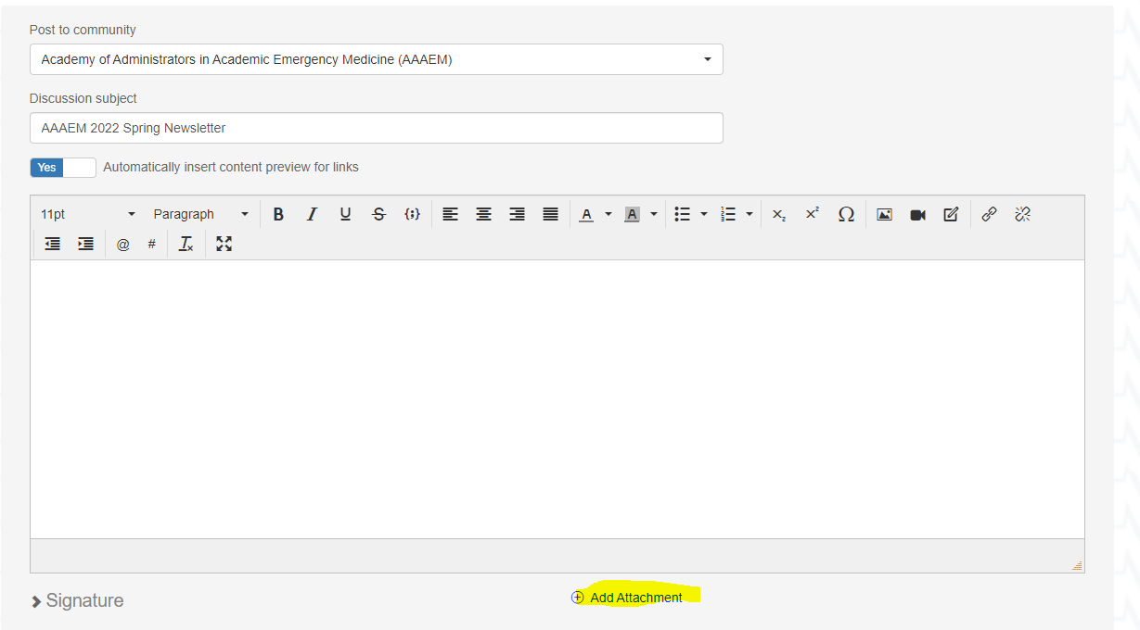
File Management
When uploading a document to our listserv you will first click the ‘Add Attachment’ button

Slide 5
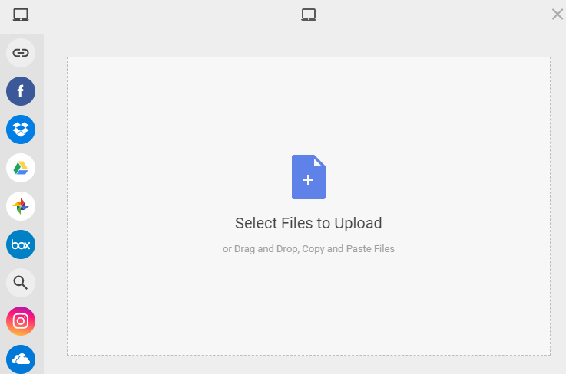
File Management
After select what file to upload then you will click on ‘Edit Details’

Slide 6
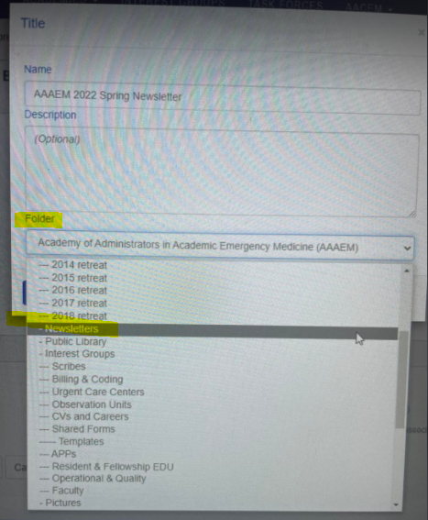
File Management
After selecting ‘Edit Details’ you will click on the folder drop down listing to find the appropriate placement for your attachment

